Slide 1

Master’s Of Computer APPLICATION
Final Project
Presentation
SILVER OAK UNIVERSITY
402 New S G Road, Ahmedabad, Gujarat 382481

Slide 2
AIAAMS-AI Assisted Academic Management System
TEAM G42
(2404070100003) Parihar Lakshya
(2404070100021) Vishvakarma Suraj
(2404070100042) Acharya Arjun

Slide 3

INTRODUCTION
Introduction
Overview: AIAAMS is a next-generation academic platform designed to bridge the gap between traditional administration and modern AI capabilities.
Goal: To centralize academic processes (attendance, grading, communication) into a single, cohesive interface powered by predictive analytics.
Impact: Empowers institutions with data-driven insights to improve student outcomes and operational efficiency.
3

Slide 4


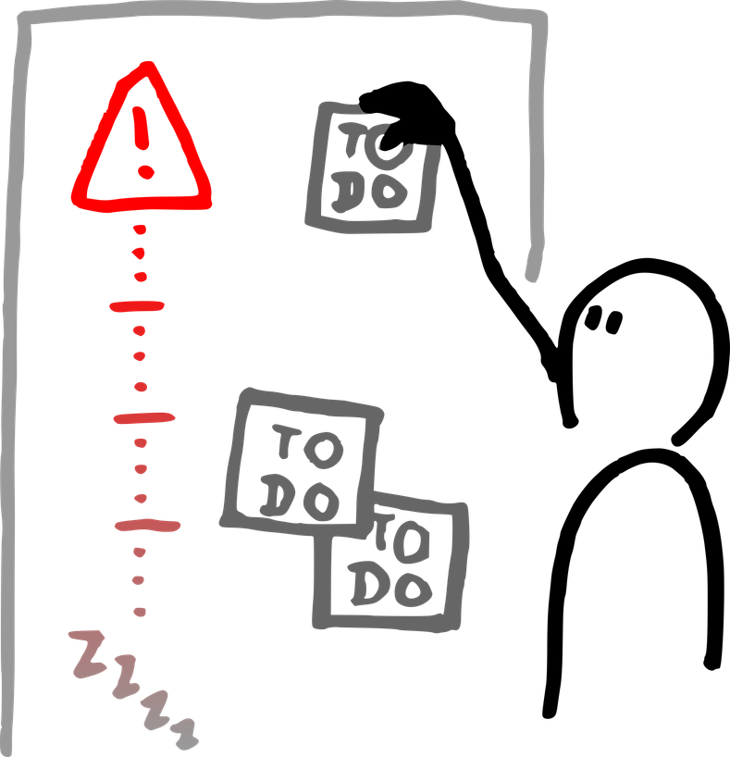
Introduction
Team A
Project Overview
Problem
Solution
Why It Matters
Traditional academic management often relies on disconnected, manual processes that lead to administrative bottlenecks and scheduling errors.
Integrates machine learning to analyze student performance data and provide faculty with actionable, data-driven insights.
Providing students with intuitive organization and proactive tracking tools directly improves academic performance and well-being.
4

Slide 5

Introduction
Project Objective
Main Goal
To create an intelligent, data-driven management platform that utilizes AI to optimize academic administration, personalize student tracking, and enhance overall institutional efficiency.
Supporting Objectives
Develop a backend using Node.js to handle automated scheduling and real-time data processing.
Integrate Machine Learning models to analyze student performance trends and provide actionable alerts for faculty.
Design a modern, responsive UI with React and Tailwind CSS that ensures accessibility for students and administrators on any device.
5

Slide 6

Problem DEFINITION
Problem Defination
Most academic management systems only store data like attendance and marks and do not provide meaningful insights.
Academic processes are often manual, time-consuming, and unable to identify students who need early support.
There is no intelligent system to analyze academic data, predict student performance, or assist faculty in decision-making.
The AI-Assisted Academic Management System (AIAAMS) is designed to overcome these issues by automating academic tasks and using AI to analyze data, predict outcomes, and improve overall academic management.
6

Slide 7
Existing System
What We Found
1
2
3
Faculty rely heavily on spreadsheets and paper records, creating data silos where attendance and grades are never analyzed together
Current systems are merely 'record-keepers.' They notice a student is failing only after the exams, rather than predicting risks early
Critical updates are scattered across WhatsApp groups, emails, and physical notice boards, leading to students missing important deadlines
Key Insight
Students don’t lack tools — they lack tools that work the way they think.
7

Slide 8
FUNCTIonal REQUIREMENTS
Functional Requirements
Core Automation
Predictive Intelligence
Unified Access
Smart Connectivity
Replaces manual paperwork by automatically handling attendance tracking, grading, and timetable scheduling.
Moves beyond simple data storage by using AI to analyze patterns and predict student performance risks early.
Removes confusion by providing a single, clean dashboard where Admins, Faculty, and Students see only what they need.
Keeps everyone in the loop with instant, real-time alerts for exam schedules, fee reminders, and syllabus updates.
8

Slide 9
Non-functional REQUIREMENTS
Non-Functional Requirenments
Scalability
Reliability
Final Build
Built to grow with the college—it can easily handle thousands of new students and records without slowing down.
Ensures the system is always available 24/7, so students can check results or pay fees anytime, day or night.
Maintainability
Written with clean, organized code, making it easy for future developers to fix bugs or add new features like online exams.
Feedback & Revisions
We gathered peer feedback and refined the layout to improve clarity and usability.
9

Slide 10
System RequiremenT
Team A
System Requirement (HWrequirement)
Component | Minimum Specifications | Recommended Specification
Processor | Intel Core i3 (10th Gen) or AMD Ryzen 3 | Intel Core i5 (11th Gen) or higher
RAM | 4 GB | 8 GB or 16 GB (for smooth AI processing)
Storage | 256 GB SSD/HDD | 512 GB SSD (Faster boot & compile times)
Internet Internet | Basic Broadband (2 Mbps) | High-Speed Fiber (for Cloud Database access)
10

Slide 11
System RequiremenT
System Requirement (SWrequirement)
Category | Technologies | Tool Purpose
FrontEnd | React.js, Tailwind CSS | Building the user interface (UI)
Backend | Node.js, Express.js | Handling server logic and API requests
DataBase | MySQL | Storing student data and attendance records
AI/ML | Python (Scikit-learn) | Running the predictive analysis models
IDE | VS-Code | Writing and debugging code
Testing | Thunder Client | Testing API endpoints
11

Slide 12
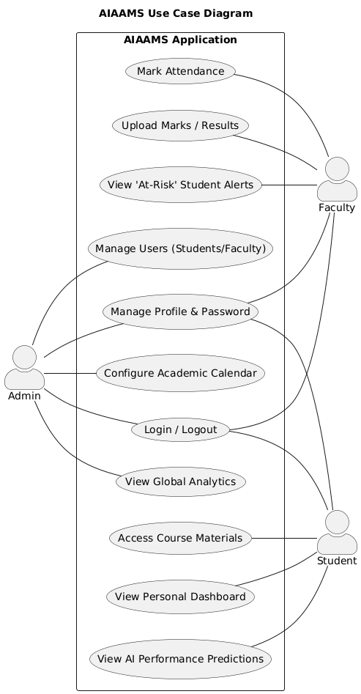
USEcase
12

Slide 13
METHODOLOGY
Team A
Software Requirements
Requirement Specification
User Role Definition
Defines the functional and non-functional requirements of the system.
Establishes system scope, constraints, and expected outcomes.
Identifies system users: Admin, Faculty, and Students.
Defines access levels and role-based permissions.
AI Feature Integration
Institutional Alignment
Specifies AI-based functionalities such as performance prediction and academic analytics.
Supports data-driven decision-making through intelligent insights.
Ensures the system fulfills academic and administrative requirements of institutions.
Enhances operational efficiency and academic performance monitoring.
13

Slide 14
METHODOLOGY
Team A
Hardware Requirements
Developnment Server
Processor
RAM
Intel i5 / i7 (8th Gen or above)
OR AMD Ryzen 5 / Ryzen 7
Minimum: 8 GB
Recommended: 16 GB (for AI model training & backend processing)
Storage
GPU
Minimum: 256 GB SSD
Recommended: 512 GB SSD
NVIDIA GPU with CUDA support (if advanced ML models are used)
14

Slide 15
METHODOLOGY
Team A
Hardware Requirements
Production Server
(Deployment Environment)
Processor
RAM
2 vCPU (minimum)
4 vCPU (recommended for large institutions)
Minimum: 2 GB
Recommended: 4–8 GB (for AI processing & concurrent users)
Storage
Hosting Environment
20–50 GB SSD (depending on student data size)
Runs on institutional/local machine
Backend hosted using Node.js + Express locally
15

Slide 16
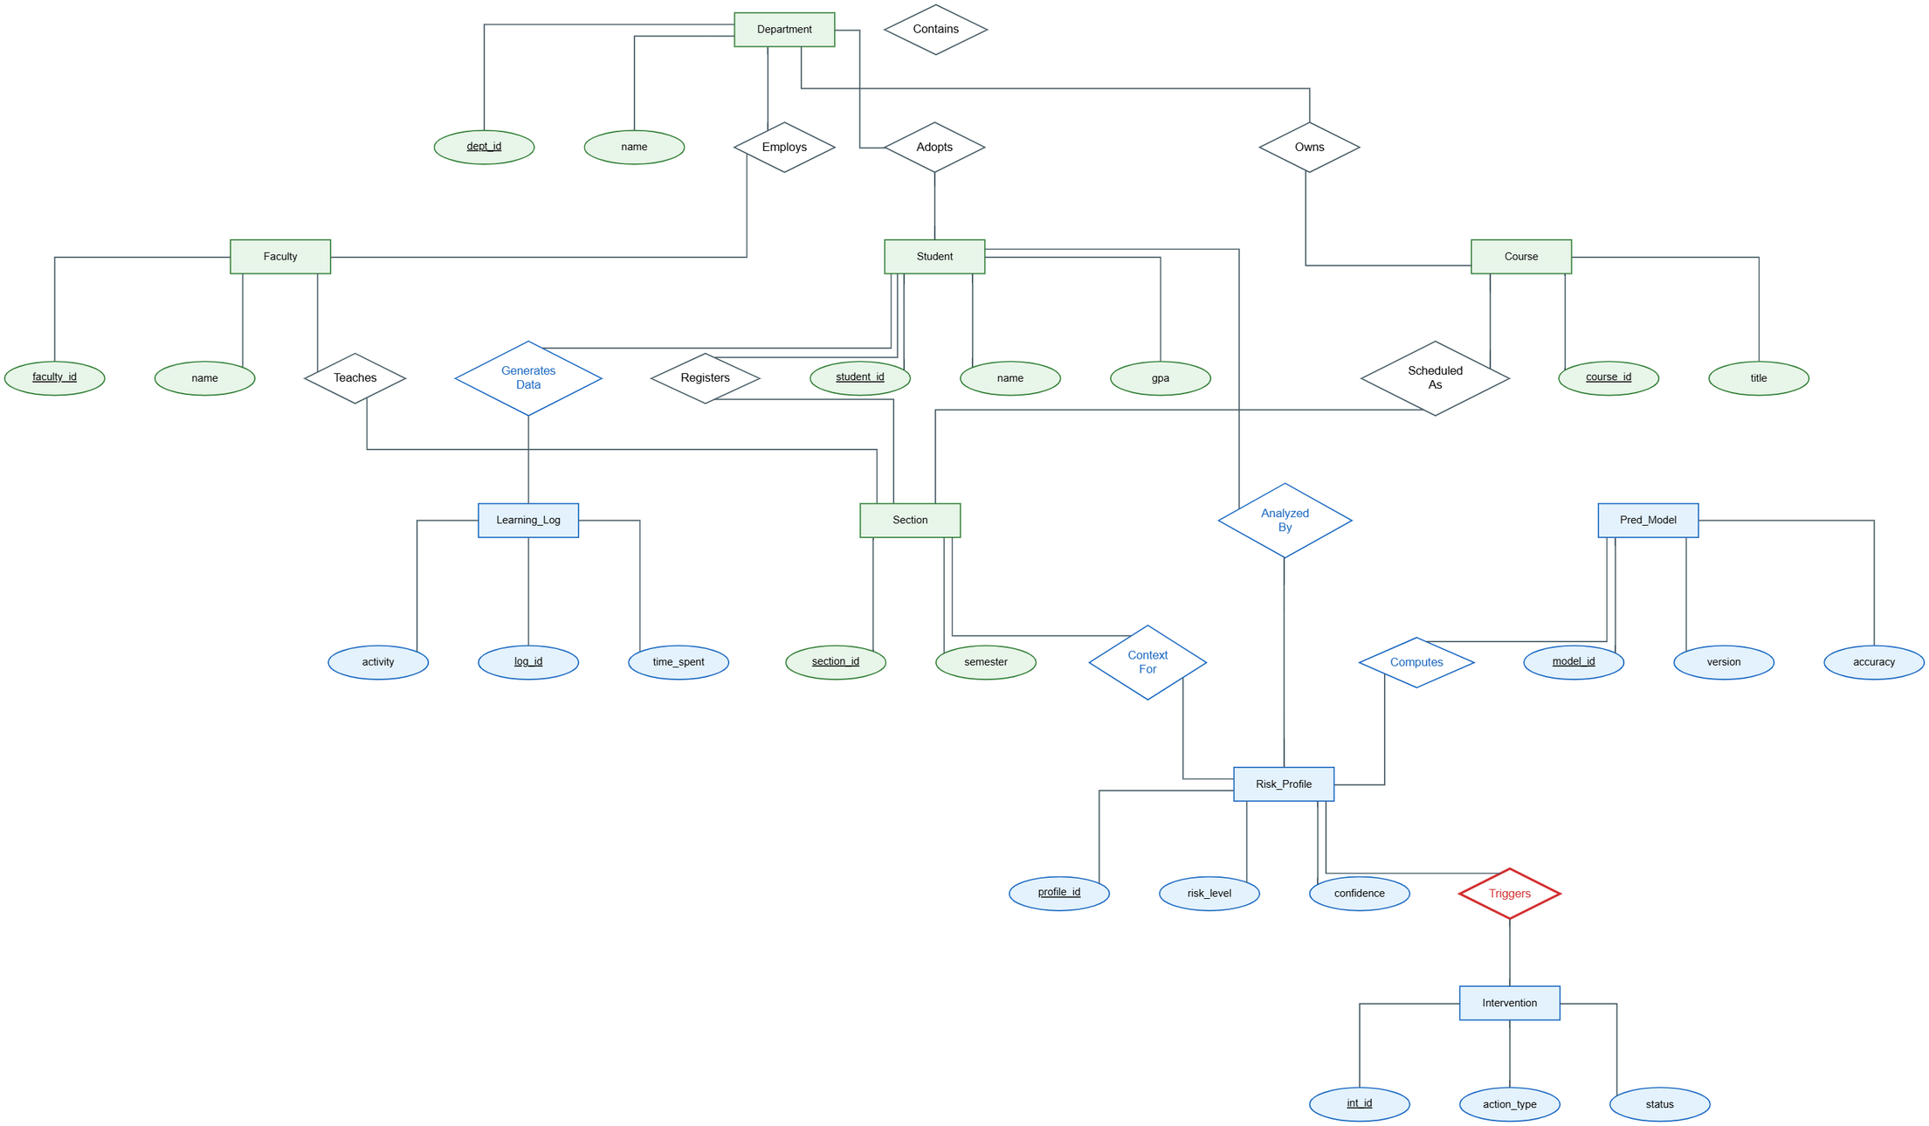
ER Diagram
16

Slide 17
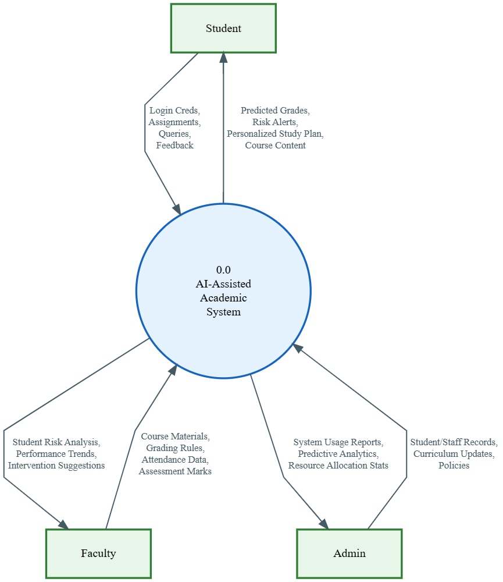
DFD DATA FLOW DIAGRAM
17

Slide 18
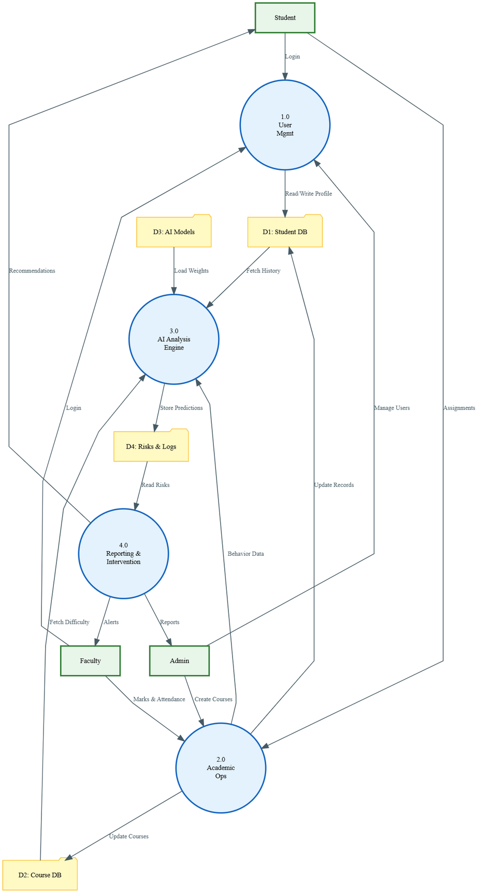
DFD DATA FLOW DIAGRAM
LEVEL 1
18

Slide 19
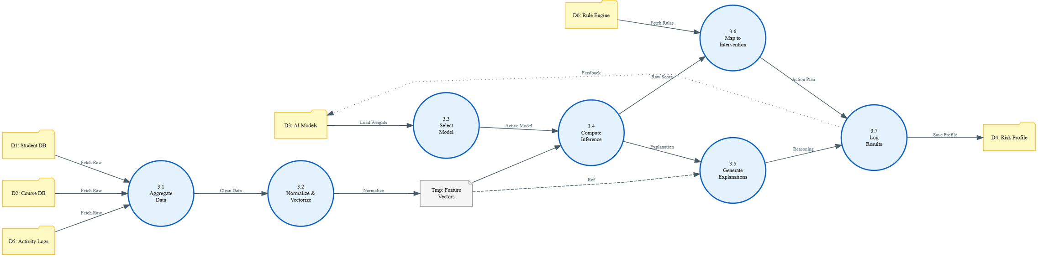
DFD DATA FLOW DIAGRAM
LEVEL 2
19

Slide 20
References
Team A
What We Got
REACT/JS
NODE/JS
Used for understanding Component Lifecycle and Hooks (useState, useEffect).
Referenced for backend routing, middleware integration, and server-side logic.
MySQL Reference Manual
Tailwind CSS
Used for designing the Relational Database Schema and writing SQL queries.
Used for responsive UI design and utility-based styling.
https://tailwindcss.com/docs/
20

Slide 21
An AI prediction module analyzes academic data to predict student performance and identify at-risk students.
Implementations
Developed using Node.js and Express.js to handle RESTful APIs, routing, authentication, and server-side logic.
Implementations Details
Frontend
Backend &API
DataBase
Architecture
AI Integration
Built using React (Vite) and Tailwind CSS to create a responsive and interactive user interface for academic dashboards and system modules.
Developed using Node.js and Express.js to handle RESTful APIs, routing, authentication, and server-side logic.
Keeps everyone in the loop with instant, real-time alerts for exam schedules, fee reminders, and syllabus updates.
21

Slide 22
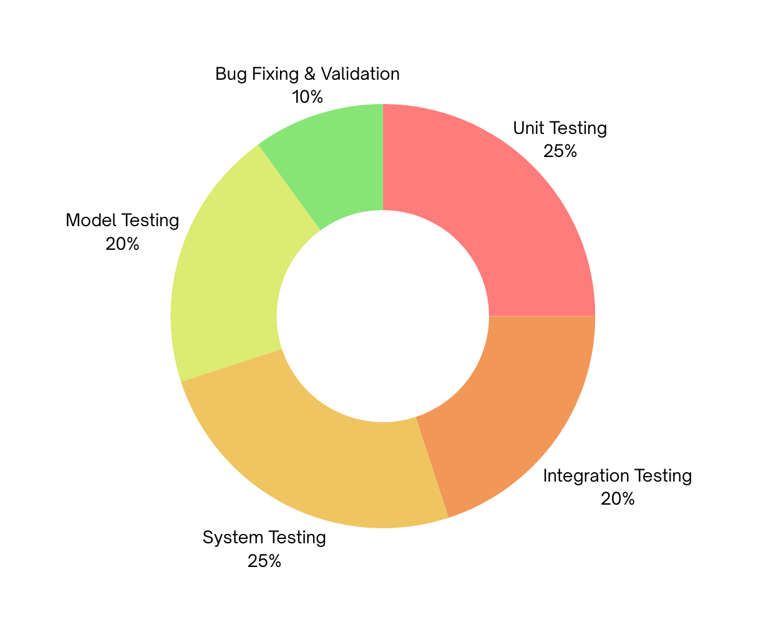
TESTING APPROACH
Testing Approach
Unit Testing:
Tested individual backend APIs and frontend components such as login validation, attendance entry, and student data handling.
Integration Testing:
Verified smooth communication between React frontend, Node.js backend, and MySQL database through REST APIs.
System Testing:
Tested the complete workflow including login → student management → attendance → results → AI prediction.
Model Testing:
Validated the prediction module using sample academic datasets to ensure accurate performance insights.
22

Slide 23
MODULES
Team G42
Module
Explanations
Student Module
Profile Management
Academic Performance
Students can view and update personal academic information
Displays department, semester, and enrolled courses
View internal marks, exam results, and grades
Track academic progress across semesters
Attendance Tracking
AI Performance Insights
Students can monitor subject-wise attendance
System provides alerts for low attendance
AI analyzes attendance and marks
Provides performance prediction and improvement suggestions
23

Slide 24
MODULES
Team G42
Module
Explanations
Faculty Module
Course Management
Attendance Management
View and manage assigned courses
Access student enrollment details
Record daily student attendance
Update or correct attendance records
Marks & Evaluation
Student Monitoring
Enter internal marks and assessment scores
Calculate grades and academic results
Track student progress and attendance trends
Use AI insights to identify struggling students
24

Slide 25
MODULES
Team G42
Module
Explanations
Admin Module
User Management
Course & Department Setup
Add, update, or remove student and faculty accounts
Manage system login credentials and roles
Create courses, departments, and academic structures
Assign faculty members to courses
Data Management
Reports & Analytics
Maintain centralized academic records
Ensure data accuracy and integrity
Generate institutional reports and statistics
Monitor overall academic performance
25

Slide 26
MODULES
Team G42
Module
Explanations
Prediction Module
Data Collection
Insights & Recommendations
Collect academic data such as attendance and marks
Process historical academic records
Provide actionable insights to faculty and admin
Support data-driven academic decision-making
Data Analysis
Performance Prediction
Apply machine learning techniques to analyze patterns
Detect performance trends and risk indicators
Predict student academic outcomes
Identify students who may require academic support
25

Slide 30

Solution Overview
Team A
Project Summary
What We Created
We designed a lightweight digital planner made for students who want to stay organized without feeling overwhelmed.
What It Does
Allows users to create and manage tasks effortlessly
Offers a distraction-free “focus mode” for study or work
Provides customizable reminders and alerts
Syncs data across multiple devices
Supports offline access for uninterrupted use
8

Slide 31
Key Features
Team A
Key Features
Our final design includes a set of focused features aimed at enhancing usability and effectiveness. These include a clean visual layout for easy navigation, a drag-and-drop task scheduler, gentle reminders to reduce stress, and an offline mode for uninterrupted access. Each component was chosen to support the user’s productivity while keeping the interface simple and distraction-free.
9

Slide 32

Prototype
Team A
Simple layout with today’s tasks and quick notes
Drag-and-drop interface to organize your week
Minimal screen with timer and soft reminders
10

Slide 33
Studio ShodwE
The End
TEAM A
Drew Feig
Eleanor Fitzgerald
Estelle Darcy
Donna Stroupe

Slide 34



Target Audience
Team A
Who We Designed For
Target User
Their Challenges
College students between 18–24 years old, balancing academics, part-time jobs, and personal life.
Struggle with managing time and deadlines
Easily distracted by phones or unstructured routines
Feel overwhelmed by traditional productivity apps
5

