Slide 1

A PROJECT PRESENTATION
ON
BUS TICKET BOOKING SYSTEM
Submitted By
Tirth Prajapati | En. No. - 2104030100785
Lakshya Parihar | En. No. - 2104030100551
Uday Sathvara | En. No. - 2104030100885
B.C.A. - V
Internal Guide
Prof. Vandana Patel

Slide 2
TABLE OF CONTENTS
01
INTRODUCTION
02
03
Project category
04
Tools/platform hardware and software
Proposed system description
OBJECTIVES
05
06
07
MODULE DESCRIPTION
ER-DIAGRAM / DFD
08
SCOPE OF THE PROJECT
09
screenshots
~

Slide 3
INTRODUCTION
A bus ticket booking system is a digital platform designed to streamline the process of reserving seats or tickets for bus journeys.
This system allows users to conveniently plan their travels, choose specific routes, select preferred seats, and make secure online payments.
It offers a user-friendly interface that enables individuals to browse through available bus schedules, compare prices, and make informed decisions based on their preferences and requirements.
By leveraging technology, this system enhances efficiency and accessibility, ensuring a smoother and more organized bus ticket booking experience for both passengers and bus operators.

Slide 4
OBJECTIVES
USER CONVENIENCe
CHEAPER TRANSPORT
EFFICIENT MANAGEMENT
CASHLESS BOOKING
Book Bus Tickets online and avoid
Long Queues at Ticket Counters.
The System aims to provide affordable
travel for all types of passengers with
its reasonable ticket prices
The System ensures Efficient
Management of Bus Schedules ,
including Seat Availability and Route
Convenience.
The System has a Secure Payment
Gateway that uses various Payment
options to make Online Bookings
Cashless.

Slide 5
Project category
The bus ticket management system falls under the category of "Transportation and Ticketing Solutions.“
This category encompasses various software and digital platforms that facilitate ticketing, reservations, and management processes for transportation services, including buses, trains, flights, and more.
These solutions aim to streamline ticket purchasing, seat selection, scheduling, payment processing, and passenger management for a seamless and efficient travel experience.

Slide 6
TOOLS/PLATFORM HARDWARE & SOFFTWARE
HARDWARE
platform
Processor : Core2duo Or Above
Ram : 2048MB or Above
Cache Memory : 128kb or Above
Word-Editors : Notepad++
Scripting Language : JS , HTML , CSS , PHP
Backend : SQL Server
Operating System: Windows 7 or Higher
RAM: 2048MB or Higher
Processor: Core2duo Or Higher
Printer: Compatible
Screen Resolution: 1024x768

Slide 7
Proposed System Description
Backend Development
Frontend Development
Testing & Launching
1
The proposed bus ticket booking system
involves the development of a robust platform
built on the back-end to ensure server-side
support.
2
The front-end
development is focused on
the user interface and
design of the platform to
ensure optimal user
experience and easy
navigation.
3
After thorough testing, the platform
is launched and monitored for optimal
functionality.

Slide 8
SCOPE OF THE PROJECT
GOOD INTERFACE
SATISFIES USER REQUIREMENTS
EXPANDABLE
SCALABILITY AND PERFORMANCE
CUSTOMER SUPPORT
SECURITY AND DATA PRIVACY

Slide 9
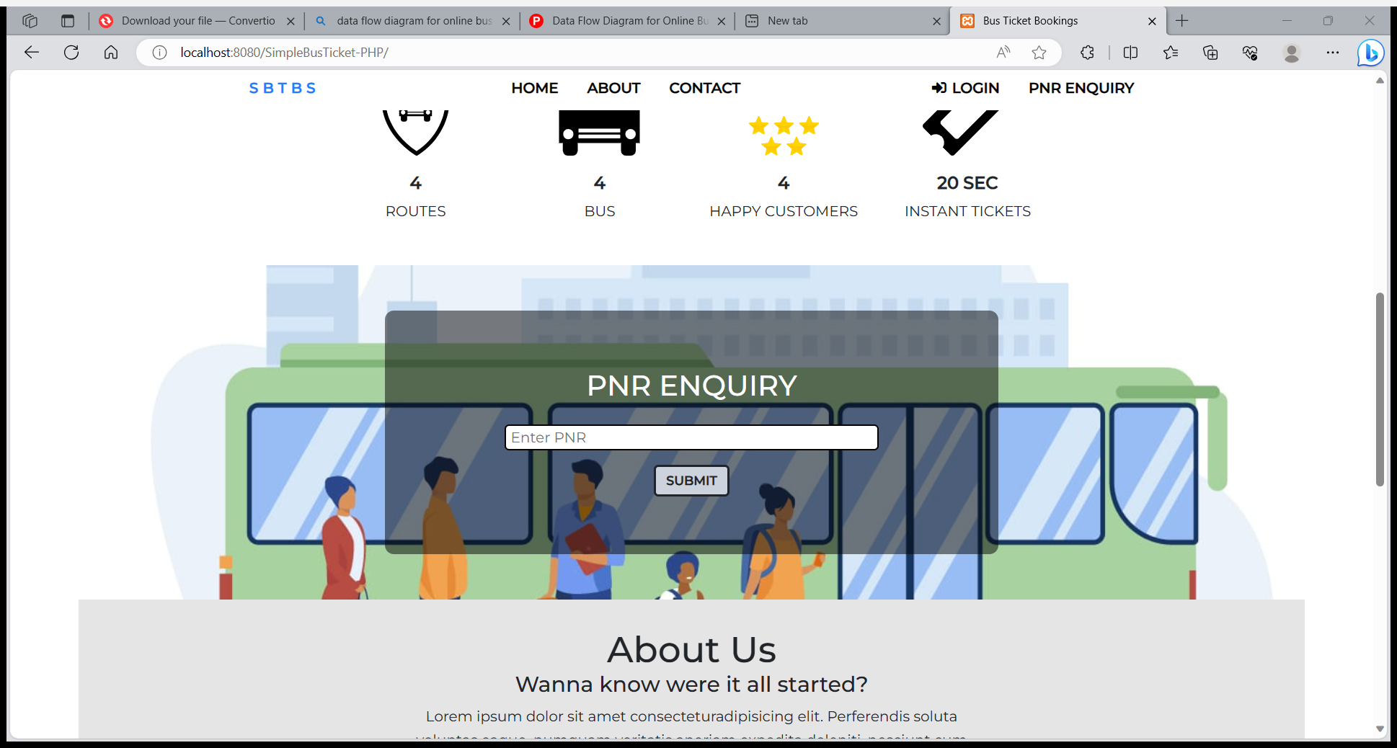
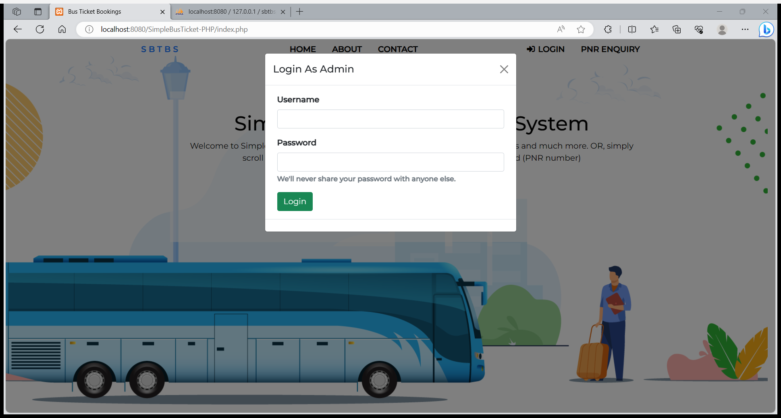
screenshots
HOME PAGE
ADMIN LOGIN
NOTE : THESE IMAGES ARE JUST FOR EXAMPLE PURPOSE. PROJECT IS YET IN WORKING PROGRESS, SO IMAGES MAY DIFFER AFTER IMPLEMENTATION OF FINAL PROJECT.

Slide 10
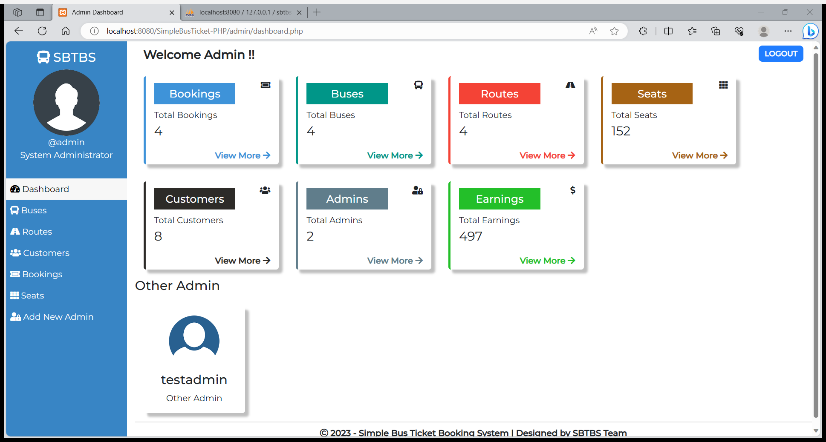
screenshots
ADMIN DASHBOARD
NOTE : THESE IMAGES ARE JUST FOR EXAMPLE PURPOSE. PROJECT IS YET IN WORKING PROGRESS, SO IMAGES MAY DIFFER AFTER IMPLEMENTATION OF FINAL PROJECT.

Slide 11
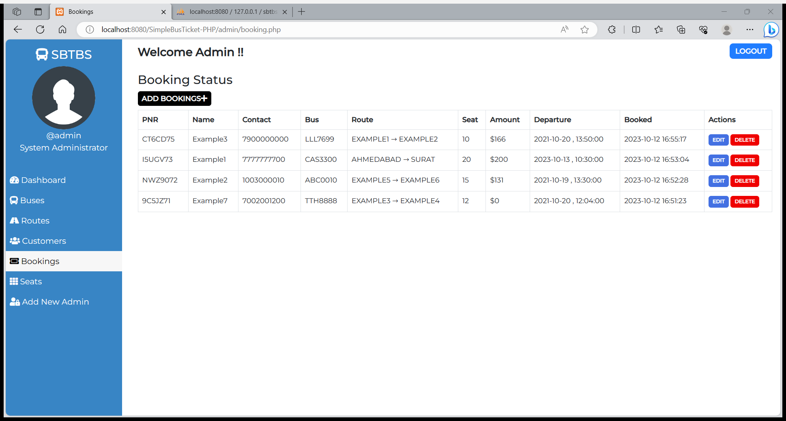
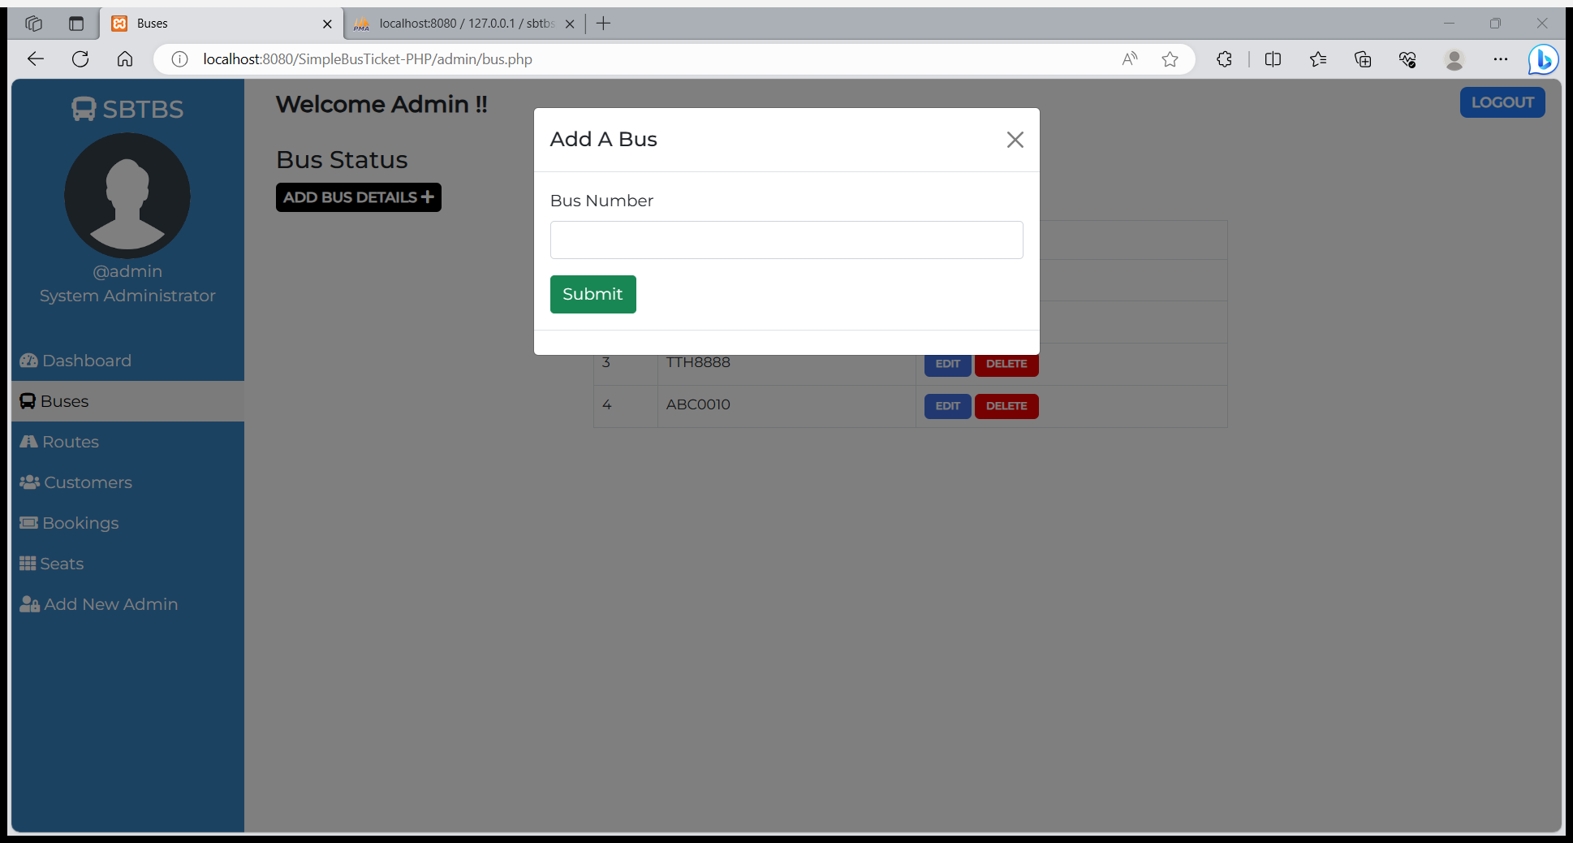
screenshots
BOOKED-LIST
ADD NEW BUS
NOTE : THESE IMAGES ARE JUST FOR EXAMPLE PURPOSE. PROJECT IS YET IN WORKING PROGRESS, SO IMAGES MAY DIFFER AFTER IMPLEMENTATION OF FINAL PROJECT.

Slide 12

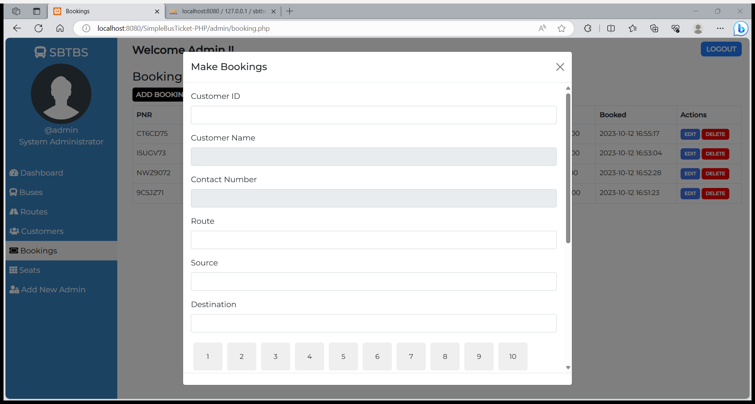
screenshots
USER LOGIN
BOOK BUS
NOTE : THESE IMAGES ARE JUST FOR EXAMPLE PURPOSE. PROJECT IS YET IN WORKING PROGRESS, SO IMAGES MAY DIFFER AFTER IMPLEMENTATION OF FINAL PROJECT.

Slide 13
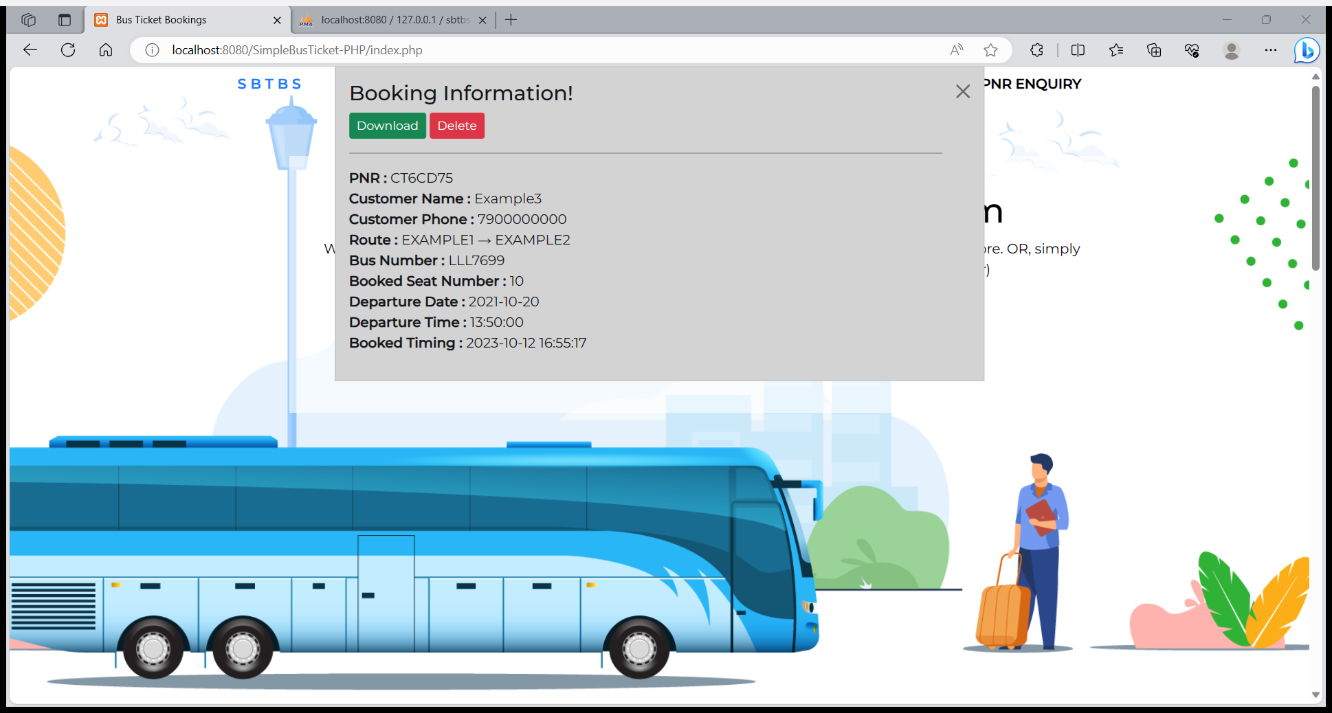
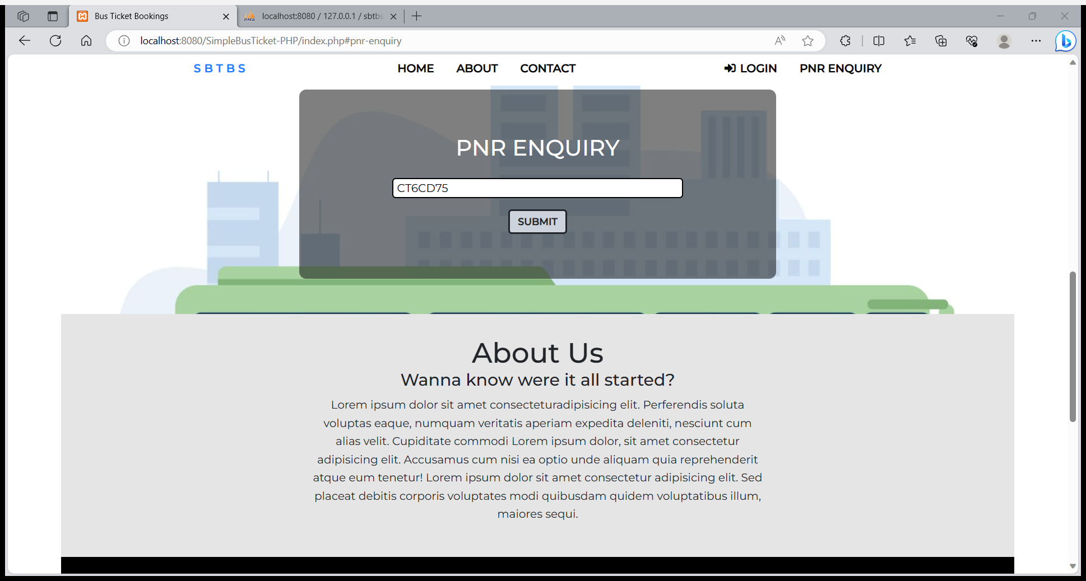
screenshots
BOOKING DETAILS
PNR ENQUIRY
NOTE : THESE IMAGES ARE JUST FOR EXAMPLE PURPOSE. PROJECT IS YET IN WORKING PROGRESS, SO IMAGES MAY DIFFER AFTER IMPLEMENTATION OF FINAL PROJECT.

Slide 14
THANK YOU
FOR WATCHING
~

