Slide 1



SMART INDIA HACKATHON 2026
Problem Statement ID – SIH26050
Problem Statement Title – High Altitude Performance Optimization and Robust Design of Anti-Drone System
Theme – Smart Automation / Security & Surveillance
PS Category – Hardware
Team ID – 165054
Team Name – WeAreDoomed
ACHAL a self-calibrating pointing head for high-altitude anti-drone systems

Slide 2
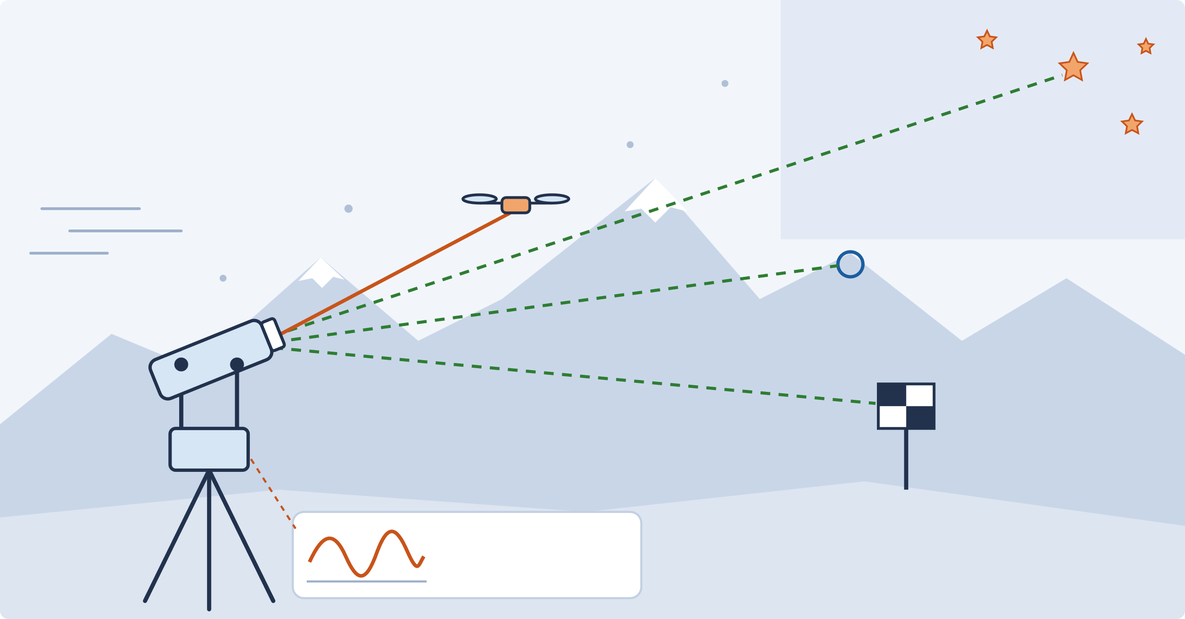





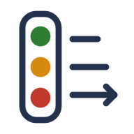

WeAreDoomed
Team ID 165054
PROPOSED SOLUTION
At 4,500 m an anti-drone tracker doesn't fail loudly. It quietly misses.
ACHAL measures what the cold did to the machine and re-aims itself.
THE PROBLEM
ACHAL IN 3 IDEAS
Stars
Cold stiffens the machine
Drone (tracked)
Torque fingerprint
Cables, bearings & batteries derate
Motor current split into friction, cable, imbalance, wind
ACHAL head
Ridge
Sun & wind bend the aim
Thermal gradients + gusts at µrad scale
Reference revisits
Marker
Markers, ridges & stars re-fit tilt, flexure, gyro bias, boresight
motor current = torque sensor
Calibration is frozen
Factory tables can't see what changed
Fixed references the cold cannot move → the head re-fits its own aim
Capability gate
WHERE IT SITS IN THE KILL CHAIN
Declares live accuracy; engages only when GREEN
The failure is silent
Detect
Track
Identify
Neutralize
It keeps tracking while accuracy drops
wide camera
2-axis gimbal
rotor signal + AI
effector handoff
GREEN
AMBER
RED
ACHAL keeps every stage accurate in the cold

Slide 3







WeAreDoomed
Team ID 165054
TECHNICAL APPROACH
1
2
3
SENSE THE EFFECTS
BUILD THE SELF-MODEL
CORRECT · JUDGE · DECLARE
Motor & motion
FAST · every cycle
Torque fingerprint
Correct
current · encoders · IMU
ADRC + feedforward from the measured plant
friction
cable
imbalance
wind
Reference camera
θ(t) ± σ
live self-model
markers · ridges · stars
every estimate carries its uncertainty
Judge
RLS + Kalman + WLS
inside cold-normal band → OK; outside → real fault
Target sensing
wide camera · rotor photodiode
SLOW · every few min
Reference revisit
Declare
Environment
tilt
flexure
gyro bias
boresight
live jitter, ID range, confidence
temp · pressure · humidity (priors)
VERIFY LOOP every revisit compares predicted accuracy with measured accuracy, then updates θ(t)
ACTUATION
COMPUTE
SENSING
ESTIMATION
VISION & AI
POWER
BLDC direct drive · magnetic encoders · FOC
Raspberry Pi 5 + real-time MCU
IMU · 2 cameras · current · temp · photodiode
ADRC · RLS · Kalman · TPOINT model
sub-pixel tracking · ONNX drone classifier
low-temp Li-ion · 3 heaters · health check

Slide 4

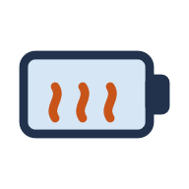





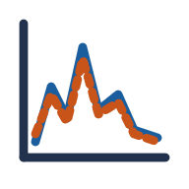


WeAreDoomed
Team ID 165054
FEASIBILITY AND VIABILITY
PROTOTYPE BUILD COST
WHY IT IS BUILDABLE
₹1.33 lakh
100% off-the-shelf
Heat only 3 parts
BLDC, encoders, Pi 5, MCU
battery · IMU · optical window
one complete prototype, including the −40 °C test bench
Pointing head ₹97k
Bench ₹29k
−40 °C campus bench
Proven maths
+5% contingency · itemised BOM in Budget Report
dry-ice box, fan, IR lamp, shaker
ADRC, RLS, Kalman, vision
No radar · no FOG gyro · no GPU needed
BUILD ROADMAP
1
2
3
4
5
6
7
8
Physics proof
Gimbal head
Embedded sensing
Control stack
Cold & wind tests
Prediction check
Integration
Live A/B demo
TOP RISKS → HANDLED
Snow hides references
→ markers + ridges + stars; capability drops honestly
Frost / dust on optics
→ heated window + image-quality check
Cold battery
→ insulated heated pack, cold-charge lockout
Estimator drift
→ excitation gating, fallback to bench values

Slide 5






WeAreDoomed
Team ID 165054
IMPACT AND BENEFITS
0
3
₹1.33 L
manual field recalibrations
heated parts only
full prototype cost
references do the calibrating (design goal)
not the whole head, so power stays low
incl. −40 °C bench, itemised BOM
WHAT CHANGES AT 4,500 M
WHO COULD USE IT
TODAY · frozen calibration
WITH ACHAL
DRDO labs laser & EO trackers
✕ Aim drifts in cold & wind
Aim held steady: identification range holds
BEL D4 / IDD&IS
✕ Technician must re-boresight
Boresight, tilt, gyro drift fixed in the field
Army Air Defence Ladakh, east
IAF high-altitude bases
✕ Cold looks like damage
Real faults (ice, slip, harness) flagged
ITBP / CAPF LAC posts
✕ Fires blind on a bad aim
Operator sees live ID range; no blind engagement
Critical infra Himalayan sites
potential users; no endorsement implied
Planet: low-power selective heating · People: safer, self-diagnosing operation · Profit: COTS, modular, scalable to DEW/EO trackers

Slide 6






WeAreDoomed
Team ID 165054
RESEARCH AND REFERENCES
India already fields precision counter-drone systems (D4, IDD&IS, Mk-II(A) laser) [1–3]. Holding micro-radian aim at altitude is the open gap.
PUBLISHED TECHNIQUE → HOW ACHAL USES IT
SCAN TO SEE MORE
Telescope pointing models
Disturbance observers
Live Simulation ↗
→ re-fit from markers, ridges, stars
→ ADRC on the measured plant gain
TPOINT [4]
Springer 2020 [5]
achal-simulation.vercel.app
Gimbal torque calibration
Auto-boresight
→ done live in the field, not once in a lab
→ checked by co-observing references
Technical Report ↗
US 7,437,222 [6]
WO2000016152 [7]
full ACHAL documentation
Jitter prediction
Propeller signatures
→ run live to declare capability
→ rotor photodiode for ID & kill check
NASA survey [8]
EventRadar 2026 [9]
Budget Report ↗
Our novelty: each piece is published; the closed self-reference loop with live verification is ours.
itemised BOM + cost charts
1. BEL / DRDO. D4 Anti-Drone System.
2. Integrated Drone Detection & Interdiction System.
3. Business Standard. DRDO Mk-II(A) laser trial, Apr 2025.
4. P. Wallace. Telescope Pointing (TPOINT).
5. LOS stabilisation using a disturbance observer. Springer, 2020.
6. US 7,437,222. Gimbal disturbance calibration.
7. WO2000016152A1. Auto-alignment of EO elements.
8. NASA. Spacecraft line-of-sight jitter survey, 2020.
9. EventRadar: long-range UAV discovery. arXiv, 2026.
10. Adaptive servo control with LuGre friction. ASME JDSMC.
11. JSS 55555. Environmental tests for defence equipment.
12. Asian Military Review. MoD RFI, high-altitude C-UAS, 2026.

