Slide 1




SMART INDIA HACKATHON 2026
  Problem Statement ID – SIH26050
  Problem Statement Title- High Altitude Performance Optimization and Robust Design of Anti-Drone System
  Theme- Smart Automation / Security & Surveillance
  PS Category- Hardware
  Team ID- 165054
  Team Name - WeAreDoomed

Slide 2
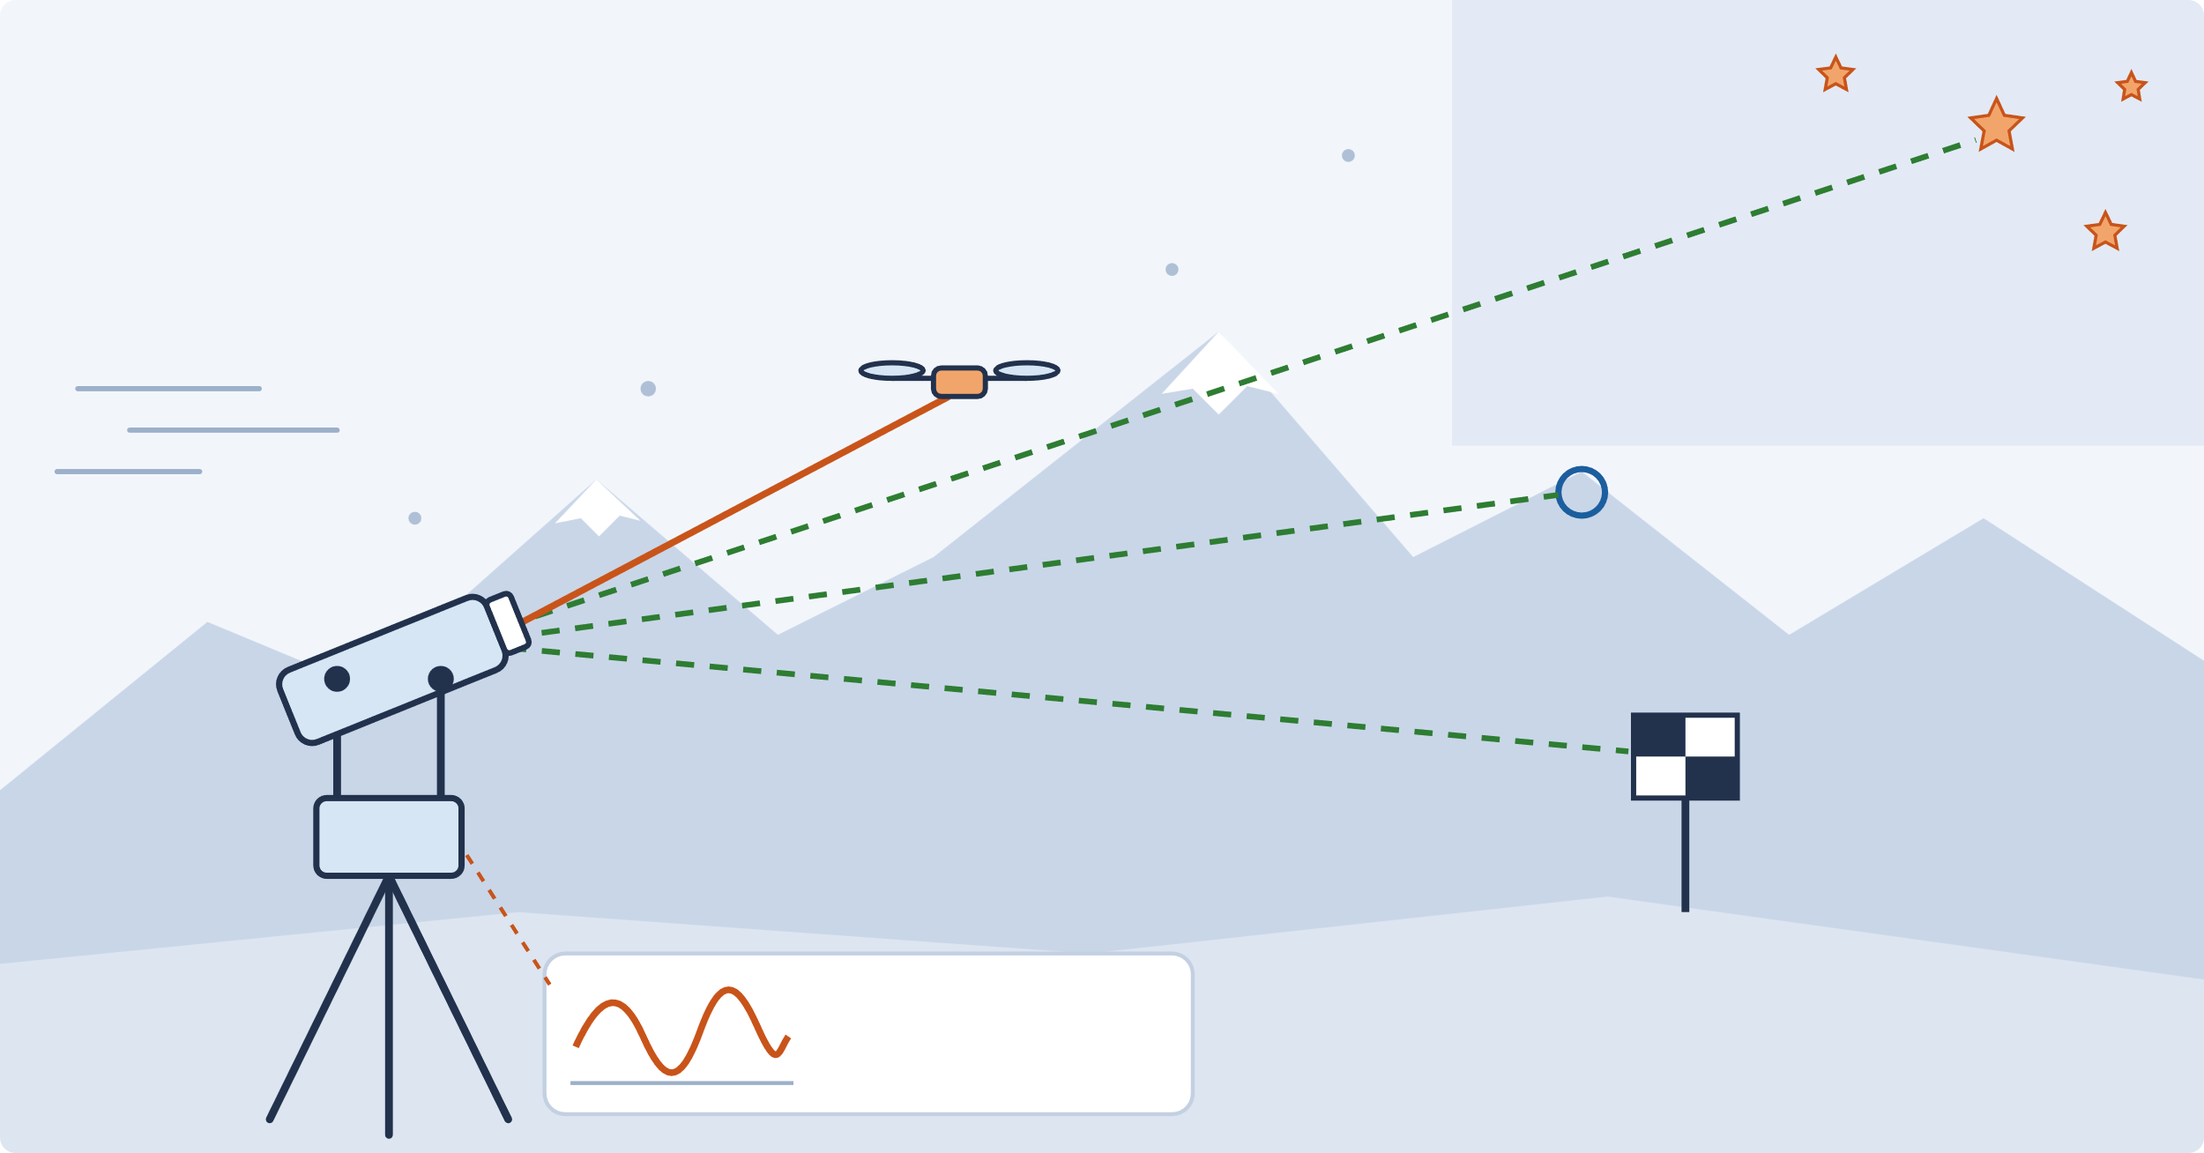









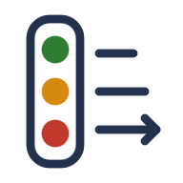
WeAreDoomed
Team ID 165054
PROPOSED SOLUTION
Problem at Hand
Our Solution ACHAL a self-referencing pointing head
Key Features
The cold changes the machine
Cables stiffen, bearings drag and sensors drift; motors, batteries and electronics derate.
Calibrate against what the cold cannot move
Torque fingerprint
Instead of compensating for the weather, ACHAL measures what the weather did to the machine.
Motor current reveals friction, cable stiffness, imbalance and wind
Drone: tracked
Stars (night)
high angles
Reference revisits
ACHAL head
Ridge (far)
fixes azimuth
Re-fit encoder offset, tilt, flexure, gyro bias and boresight
Sun and wind bend and shake it
Thermal gradients and wind deform the structure and push the aim off target.
Marker (near)
fixes elevation
Live self-model θ(t)
Updated continuously, with its own uncertainty
motor current
= torque sensor
sight line to a fixed reference
target track
Adaptive control
Calibration is frozen
Factory calibration and temperature-based compensation cannot see what actually changed.
1
2
3
4
5
6
7
Sense
effects
Torque
fingerprint
Aim
revisit
Model
θ(t) ± σ
Correct
ADRC
Judge
health
Declare
capability
ADRC + feedforward from the measured plant
Why We Stand Out
Cold vs broken
Measures the machine, not the weather
Calibrates against fixed references
Knows when it can't trust itself
Health judged against cold-normal bands
The failure is silent
The system keeps tracking while its true pointing accuracy quietly degrades.
motor current is split into named torques
markers
ridges
stars
fault
cold-normal band
Capability check
friction
cable
re-fits the aim: encoder zero · tilt · flexure · gyro bias · boresight
GREEN
AMBER
RED
Predicts jitter, range and handoff; engages only when confident
imbalance
wind
engages only when confident

Slide 3





WeAreDoomed
Team ID 165054
TECHNICAL APPROACH
1 SENSE THE EFFECTS
2 BUILD THE SELF-MODEL
3 CORRECT · JUDGE · DECLARE
Motor & motion
FAST
Torque fingerprint every control cycle
Correct
motor current · encoders · IMU gyro
ADRC + feedforward
FOC motor drives
direct-drive gimbal
motor current
disturbance torque
RLS split
Reference imaging
pointing model, gyro bias and boresight applied to every command
narrow camera on markers, ridges, stars
friction
cable
imbalance
plant gain
wind
Judge θ vs the cold-normal band at this temperature
θ(t)
SLOW
Reference revisit every few minutes
inside band → cold, normal
outside band → fault
Target sensing
a fault is e.g. ice load, joint slip or harness damage
wide camera (search) · rotor photodiode
re-image references
sub-pixel offsets
WLS aim fit
Declare jitter · handoff · ID range · confidence
Environment (priors only)
encoder zero
tilt
flexure
gyro bias
boresight
temperature · pressure · humidity
GREEN
AMBER
RED
engagement gate → EO / laser payload interface
one live self-model θ(t) ± σ via RLS + Kalman + WLS
VERIFY every reference revisit compares the predicted accuracy with the measured one, then updates θ(t)
Environment
cold · wind · dust · snow
Sensing
cameras · IMU · encoders
Self-model
θ(t) + health
Adaptive control
ADRC + motor drives
Pointing
2-axis gimbal
Track & identify
camera + rotor signal
Stable aim output
EO / laser payload
Technology Stack
ACTUATION
COMPUTE
SENSING
CONTROL & ESTIMATION
VISION & AI
POWER & HEALTH
• BLDC direct drive
• Magnetic encoders
• MCU + FOC
• Aluminium frame
• Raspberry Pi 5
• MCU real-time loops
• Local display + logs
• 4G / Wi-Fi link
• IMU + cameras
• Current + temperature
• Pressure + humidity
• Rotor photodiode
• ADRC control
• RLS torque ID
• Kalman + WLS
• TPOINT aim model
• Sub-pixel tracking
• ONNX drone classifier
• Low-temp Li-ion pack
• 3 selective heaters
• DC-DC power mgmt
• Health + capability check

Slide 4



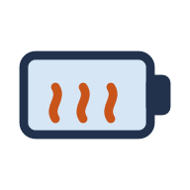




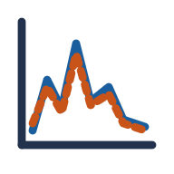


WeAreDoomed
Team ID 165054
FEASIBILITY AND VIABILITY
Why It Is Feasible
Prototype Build Cost
Off-the-shelf parts
No radar, laser or GPU
Pi 5 + MCU
≈ ₹1.33 lakh one prototype incl. test bench
BLDC motors, encoders, Pi 5 and MCU are all COTS
the method proves itself without them
vision on the Pi, real-time loops on the MCU
Pointing head
Bench
Heat only 3 parts
−40 °C campus bench
Proven methods
≈ ₹97k
≈ ₹29k
battery, IMU and optical window
dry-ice box, fan, IR lamp and shaker
ADRC, RLS, Kalman and vision
Avoided by design
FOG gyro
heated head
event camera
GPU
How We Actually Build It
itemised BOM + 5% contingency · see Budget Report
1
2
3
4
5
6
7
8
Physics proof
Mechanical head
Embedded sensing
Control stack
Cold & wind tests
Prediction check
Integration
Final demo
cold-box curves: cable, friction, drift
2-axis direct-drive gimbal
FOC, current sense, timestamps
ADRC, RLS, revisit fit
−40 °C, wind, vibration
predicted vs measured
cue → track → ID → gate
live A/B in the cold box
Key Risks and How We Handle Them
RISK
WHAT IT WOULD CAUSE
HOW WE HANDLE IT
µrad accuracy is hard
a small angle error is a big miss at range
sub-pixel tracking and optical-lever checks; validated at −40 °C, wind, vibration
Snow or cloud hides references
aim drift goes unmeasured
markers + terrain + stars; uncertainty grows, so the declared capability drops
Estimator drift
wrong compensation at low excitation
excitation gating and bounded estimates; fall back to bench values
Frost or dust on optics
blurred view, shorter ID range
heated window; image-quality check on reference textures
Cold battery
brownouts, short endurance
insulated heated pack; cold-charge lockout
Revisit leaves the sector
brief gap in watch
revisits are interruptible and run when idle

Slide 5









WeAreDoomed
Team ID 165054
IMPACT AND BENEFITS
0
Manual field recalibrations
3
Heated parts only
₹1.33 L
Prototype build cost
markers, ridges and stars do the calibrating (design goal)
battery · IMU · window, not the whole head, so power stays low
including the −40 °C test bench (itemised BOM estimate)
Who Could Use It
Immediate Impact
DRDO labs laser DEW and EO trackers
CAPABILITY
WHAT CHANGES ON THE GROUND
WHY IT MATTERS
Torque fingerprint + ADRC
Aim stays steady in cold and wind
so identification range holds
OPERATIONAL
BEL D4 / IDD&IS production
range preserved
Army Air Defence Ladakh and eastern sector
Reference revisits
Boresight, tilt, gyro drift fixed in the field
with no technician visit
LOGISTICS
fewer field visits
IAF high-altitude airfields
Cold-normal health
Cold no longer looks like damage
real faults (ice, slip, harness) flagged
RELIABILITY
ITBP / CAPF posts on the LAC
the right alarms
Capability gate
Operator sees the live ID range
no engagement while aim is uncertain
SAFETY
Critical infrastructure Himalayan sites
no blind engagement
potential users, no endorsement implied
Long-Term Value
PLANET
PEOPLE
PROFIT
Low-power thermal design · selective heating · reusable hardware · reduced energy use
Reliable tracking · minimal manual calibration · safer operation · self-diagnostics
Low-cost prototype · COTS components · modular maintenance · scalable defence integration

Slide 6




WeAreDoomed
Team ID 165054
RESEARCH AND REFERENCES
Research what is already published, what it proves, and where it lives in ACHAL
Precision counter-drone systems already exist in India: D4 (DRDO + BEL), IDD&IS and the Mk-II(A) laser weapon [1–3]. Laser engagement needs micro-radian pointing; holding it at altitude is the open gap.
Telescope pointing models
Disturbance observers
Gimbal torque calibration
Auto-boresight
Jitter prediction
Propeller signatures
Star sightings fit a pointing model with thermal and flexure terms.
Estimating disturbance torque stabilises the line of sight.
Harness stiffness and friction can be measured and compensated.
Laser-to-sensor alignment drifts with temperature.
Disturbance spectrum × system response predicts jitter.
Drones identified by blade periodicity at 0.7–1.5 km.
In ACHAL: the same model, re-fit from markers, ridges and stars
In ACHAL: ADRC rate loop using the plant gain we measure
In ACHAL: done continuously in the field, not once in a lab
In ACHAL: boresight checked by co-observing the references
In ACHAL: run live to declare capability
In ACHAL: rotor photodiode for ID and kill check
TPOINT, Wallace [4]
Springer, 2020 [5]
US 7,437,222 [6]
WO2000016152 [7]
NASA jitter survey [8]
EventRadar, 2026 [9]
Our integration, ACHAL
Sense
Torque
Revisit
θ(t)
Correct
Judge
Declare
Verify
Each technique is published; the self-reference loop and its verification are ours.
References
Links
1. BEL / DRDO. D4 Anti-Drone System.
2. Integrated Drone Detection & Interdiction System (IDD&IS).
3. Business Standard. DRDO Mk-II(A) laser weapon trial, Kurnool, Apr 2025.
4. P. Wallace. Telescope Pointing (TPOINT).
5. Line-of-sight stabilisation using a disturbance observer. Springer, 2020.
6. US 7,437,222. Gimbal disturbance calibration and compensation.
7. WO2000016152A1. Automatic alignment and stabilisation of electro-optical elements.
8. NASA. A survey of the spacecraft line-of-sight jitter problem, 2020.
9. EventRadar: long-range UAV discovery through event sensing. arXiv, 2026.
10. Adaptive control of servo systems with LuGre friction. ASME JDSMC.
11. JSS 55555. Environmental test methods for defence equipment.
12. Asian Military Review. MoD RFI for high-altitude counter-drone systems, 2026.
1
Documentation
Complete ACHAL technical report
↗
2
Budget Report
Detailed BOM + cost analysis + charts
↗
3
Prototype Simulation
Interactive ACHAL web demo
↗
4
Simulation Demo
Recorded walkthrough video
↗

