Slide 1



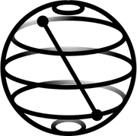

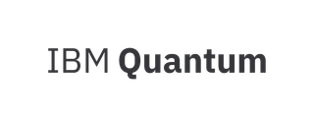

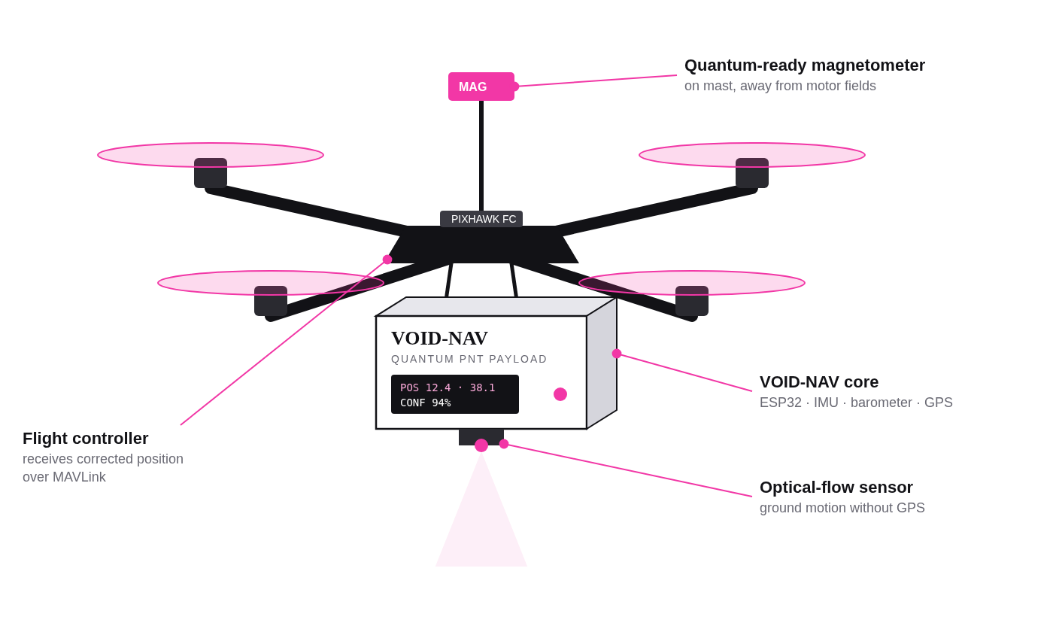
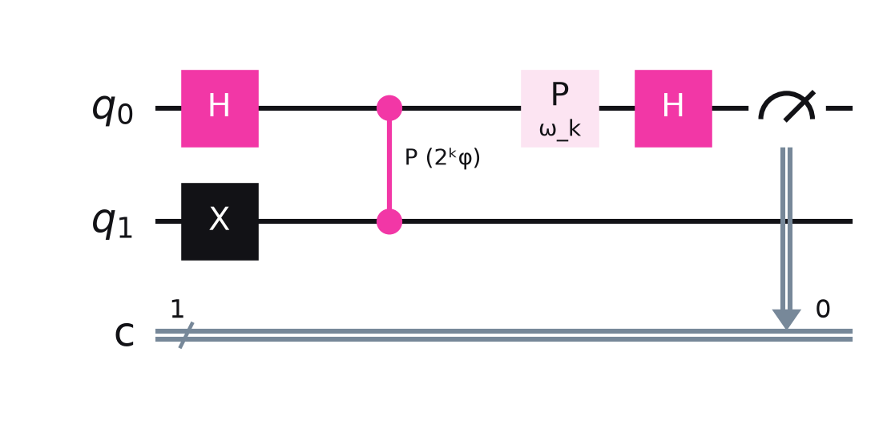
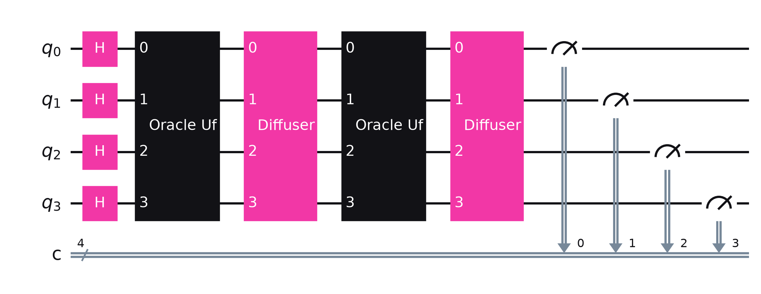
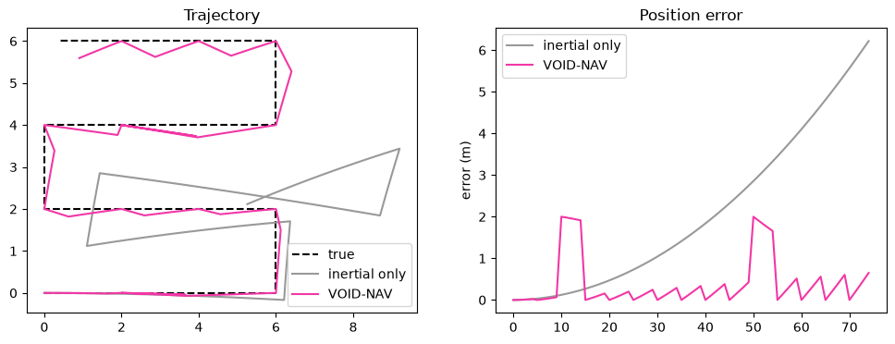
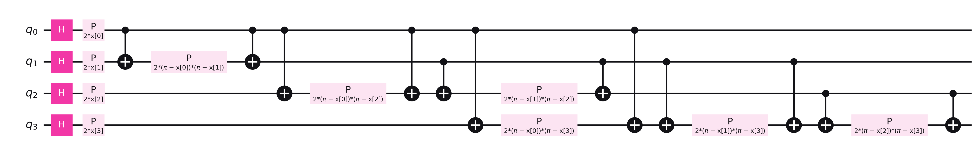
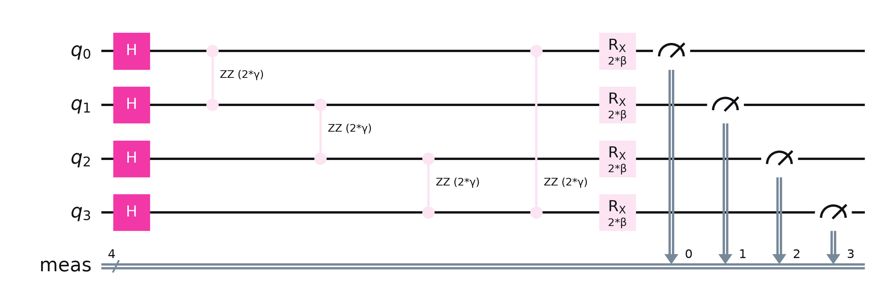
Rajiv Gandhi University of Knowledge Technologies
Nuzvid, Andhra Pradesh
VOID-NAV: Quantum-Assisted Navigation for GPS-Denied Drones
PROPOSED SOLUTION
PROBLEM STATEMENT
When GPS is jammed, blocked by terrain or simply unavailable, a drone falls back on its inertial sensors (IMU). Their small errors add up, and the position drifts without bound. Nothing on board can tell by how much.
Who is affected: defence UAVs, loitering systems, border and coastal patrol, and any drone flying in tunnels, forests or contested airspace.
Why current approaches fall short: low-cost MEMS IMUs drift hundreds of metres within minutes; navigation-grade INS and cold-atom sensors cost lakhs to crores; radar or camera fixes emit signals or fail in darkness and smoke.
VOID-NAV is a small, passive navigation payload that mounts on a drone. It reads the Earth's magnetic fingerprint, matches it to a pre-built magnetic map with quantum algorithms, and corrects inertial drift. No satellites, no emissions.
1 · Map
Survey once with GPS on: fingerprint [Bx, By, Bz, |B|, ∇B] per 2 m cell
2 · Sense
10⁻¹⁶ W
t²
UC-085
GPS off: magnetometer, IMU, optical flow, barometer
3 · Match
GPS power at the receiver: easy to lose
inertial error grows with time squared
quantum sensing for GPS-denied navigation
Quantum engine finds the matching map cell
4 · Correct
Particle filter resets drift, sends position to autopilot
KEY FEATURES
HOW IT WORKS
Full quantum pipeline
5-D magnetic fingerprint
sensing, search, learning and planning, each with a distinct job
matches field pattern and gradient, not a single value
SENSE
PRE-PROCESS
QUANTUM
FUSE
ACT
Grover + QSVM cross-check
Quantum-sensor ready
50 Hz sensors
calibrate + fingerprint
IPE · Grover · QSVM · QAOA
particle filter
autopilot + dashboard
a correction is accepted only when both agree
drop-in slot for an NV-diamond magnetometer
Sensor data streams in at 50 Hz. Every second the quantum engine takes a window of readings and returns candidate map cells; the particle filter accepts a correction only when Grover and the QSVM agree, then sends position + confidence to the autopilot. Quantum runs alongside flight control, never blocking it.
Passive and retrofittable
Low cost
emits nothing; talks MAVLink to ArduPilot/PX4
prototype under ₹4,000 in parts
QUANTUM SIMULATION
QUANTUM CIRCUIT / ALGORITHM
The full quantum pipeline runs in a Qiskit notebook on the Qiskit Aer simulator, on a 4×4 magnetic map. The simulation is part of the navigation loop: its outputs directly correct the drone's position.
Q1 · Quantum sensing: Ramsey + Iterative Phase Estimation
Simulated block | What it computes | Verified result
Ramsey + IPE | field phase from an NV-diamond qubit | 16/16 map cells recovered exactly (6-bit)
Grover (4 qubits) | matching map cell | 96.1% of shots on correct cell 1011
QSVM (ZZ kernel) | zone: corridor / stairwell / lab | 99.0% test accuracy
QAOA (p = 1) | best waypoint pair | matches brute-force optimum
Navigation loop | drift with vs without quantum fixes | mean error 2.10 m → 0.40 m (5.3×)
H creates superposition; the field imprints phase φ = 2πγBτ; phase kickback + IPE reads φ bit by bit.
Q2 · Grover's search: oracle + diffuser, 4 qubits
Oracle U_f flips matching cells; diffuser 2|s⟩⟨s|−I amplifies them; ~√N queries.
Q3 · Quantum-kernel SVM: ZZ feature map
K(x,x′) = |⟨φ(x)|φ(x′)⟩|² from statevectors, fed to a classical SVM.
Q4 · QAOA route planning, p = 1
Cost Hamiltonian from a QUBO; mixer ΣXᵢ; (γ, β) optimised on Aer.
Navigation loop output from the notebook: inertial-only drift (grey) vs VOID-NAV with Grover + QSVM fixes (pink).
IBM QUANTUM PLATFORM / TOOL
EXPECTED IMPACT
FUTURE SCOPE
• Qiskit 2.x SDK (circuits, primitives)
• Qiskit Aer (AerSimulator)
• Qiskit quantum_info (Statevector kernels)
• Qiskit circuit library (zz_feature_map, DiagonalGate)
• IBM Quantum Platform via qiskit-ibm-runtime (hardware run planned)
• Also: scikit-learn, NumPy, Matplotlib, ArduPilot SITL
• GPS-independent, jam-proof positioning for defence drones
• Bounded error instead of unbounded drift (5.3× lower in simulation)
• Passive: no emissions to detect
• Low-cost payload that retrofits existing drones
• Dual use: disaster response, mining, tunnels, maritime
• Run Grover and IPE on IBM Quantum hardware
• Replace the synthetic map with our real magnetometer survey
• Larger maps: more qubits, outdoor anomaly data
• Swap in a real NV-diamond quantum magnetometer
• Field trials with defence partners (DRDO / iDEX)
Video: https://youtu.be/BV2KYV-yhL0 Notebook: VOID-NAV_Quantum_Simulation.ipynb
TEAM VOID
Notes:
1

