Slide 1

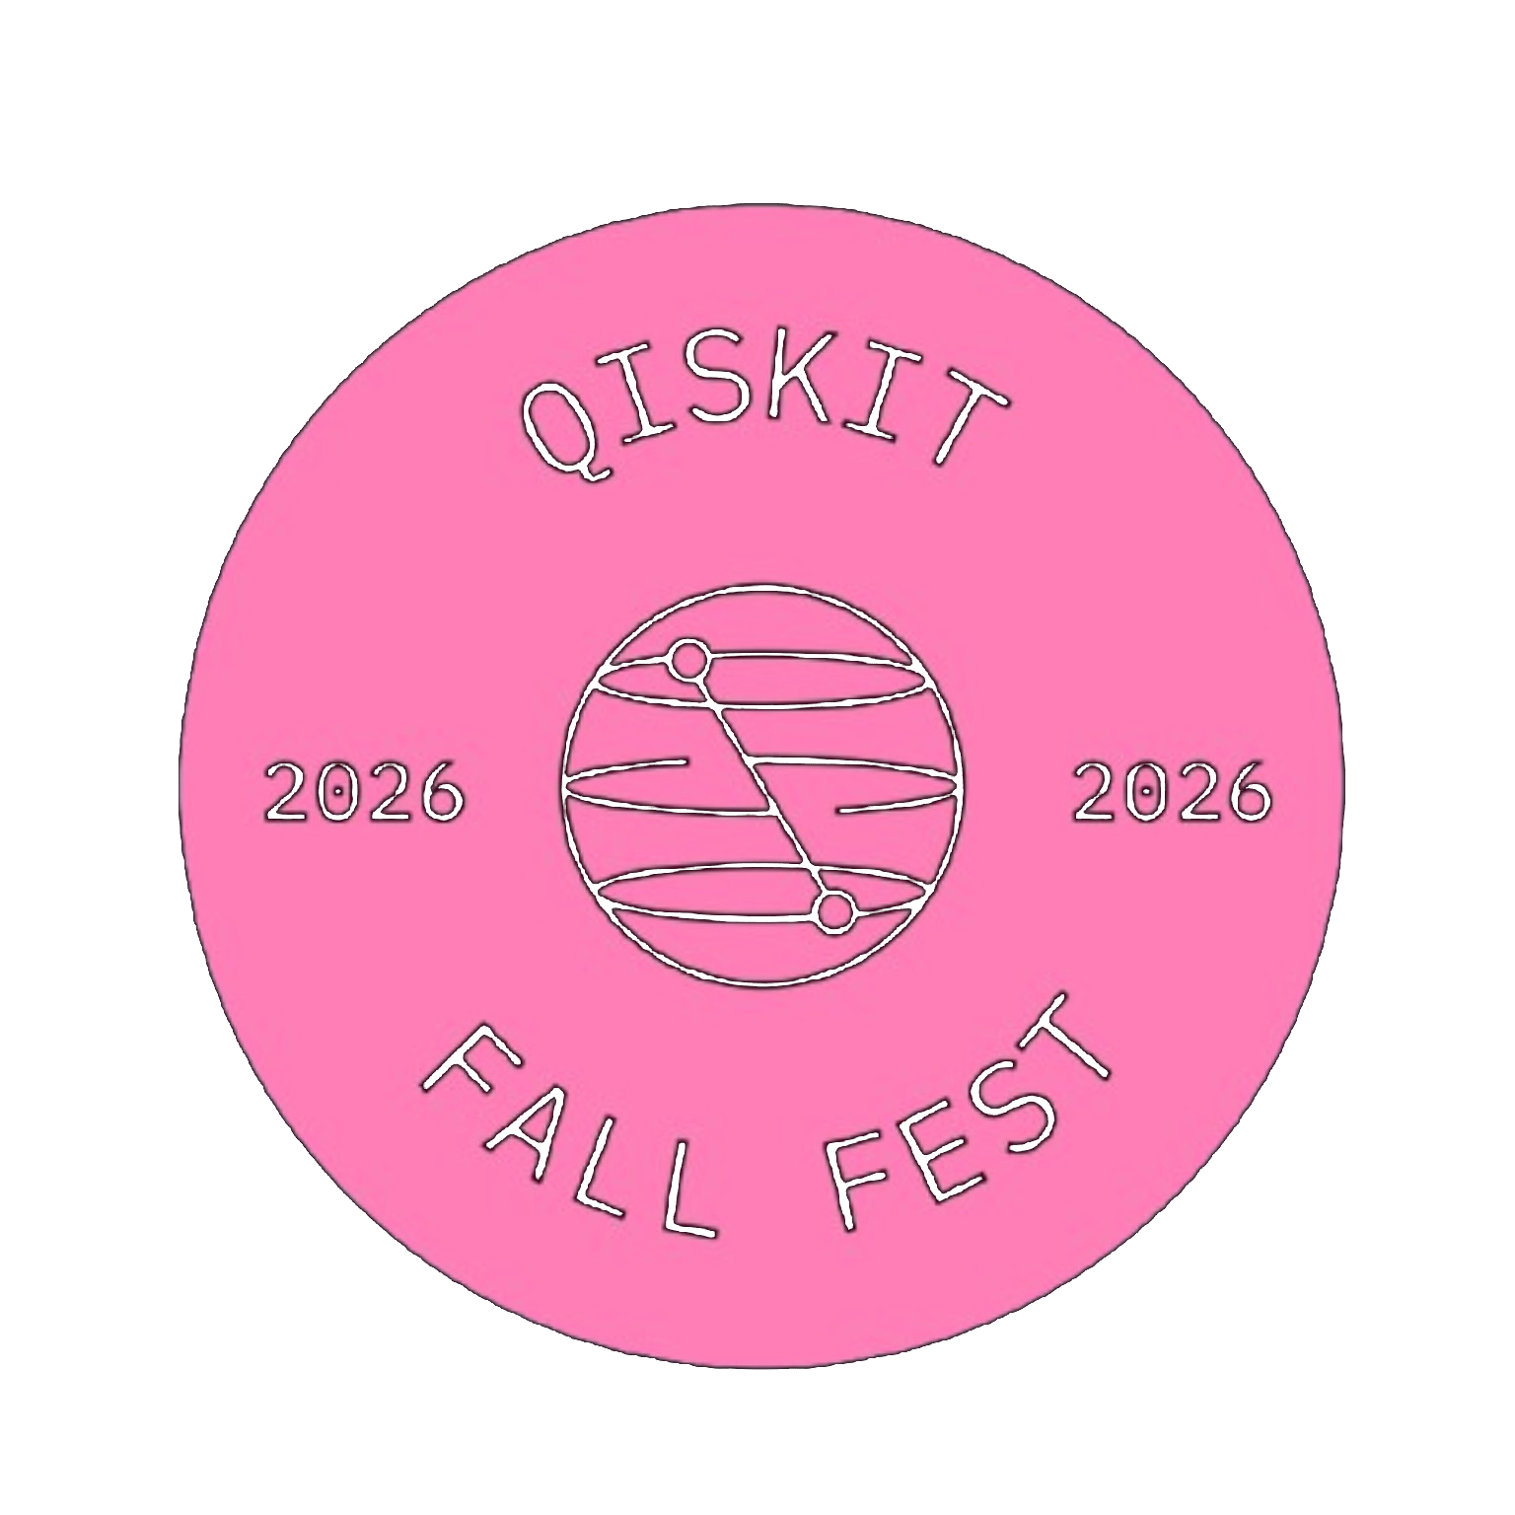
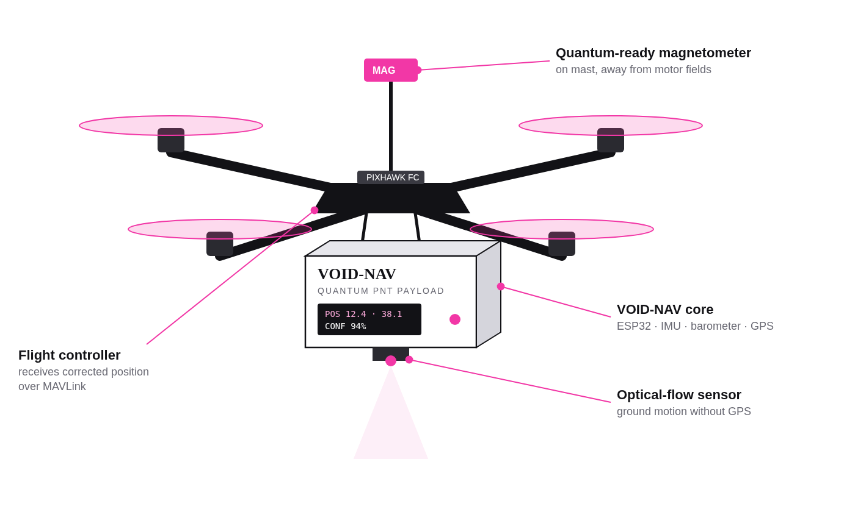
QUANTUM PNT FOR DRONES
UC-085 · DEFENCE & STRATEGIC APPLICATIONS
VOID-NAV
Navigating without the sky: a quantum-assisted positioning payload that reads the Earth's magnetic fingerprint when GNSS is jammed, spoofed or unavailable.
Quantum sensing
Grover search
Quantum kernel ML
QAOA planning
TEAM
DELIVERABLE
Team VOID
Working payload prototype + Qiskit pipeline + live dashboard
VIDEO PITCH
https://youtu.be/BV2KYV-yhL0
PLUS QISKIT FALL FEST 2026
01

Slide 2
PROBLEM STATEMENT
Without GNSS, a drone's inertial position drifts without bound.
10⁻¹⁶ W
GNSS power at the receiver: weaker than background noise, easily denied by jamming, terrain, tunnels or foliage.
~260 m
Mean error after 3 min of MEMS-only dead reckoning in our drift model: error grows with t², not t.
₹10L+
Cost of navigation-grade INS or cold-atom units: too expensive to fit on every tactical drone.
Problem: give a defence UAV a position it can trust within metres when GNSS disappears, with a passive (non-emitting), low-cost payload that is ready to take a quantum magnetometer, as UC-085 and the iDEX passive quantum positioning challenge call for.
PLUS QISKIT FALL FEST 2026
02

Slide 3
PROPOSED SOLUTION
VOID-NAV: a passive quantum PNT payload. The drone carries it; the payload does the navigation.
1
Map
GPS on: fly or walk the area once and log a 5-D magnetic fingerprint [Bx, By, Bz, |B|, ∇B] per 2 m cell.
2
Sense
GPS off: the magnetometer, IMU, optical flow and barometer track motion; the magnetic field is read as a short window.
3
Match
Quantum engine: Grover's search finds candidate cells, the quantum kernel SVM confirms the zone.
4
Correct
A particle filter fuses the match with dead reckoning, resets IMU drift and sends position + confidence to the autopilot.
PLUS QISKIT FALL FEST 2026
03

Slide 4
INNOVATION & UNIQUENESS
Most entries show one quantum algorithm. VOID-NAV runs a complete quantum PNT pipeline.
01 · FULL STACK
02 · RICHER FINGERPRINT
03 · QUANTUM CROSS-CHECK
Sense, search, learn, plan
5-D magnetic gradient map
Grover proposes, QSVM decides
Quantum sensing, Grover's search, quantum-kernel ML and QAOA each do a distinct job in one navigation loop.
We match the spatial pattern [Bx, By, Bz, |B|, ∇B], not a single field value, which cuts false matches sharply.
In our run Grover returned two look-alike cells (0110, 1011); the QSVM zone label resolved the tie.
04 · QUANTUM-SENSOR READY
05 · MAGNETICALLY AWARE ROUTES
06 · DEPLOYABLE
Drop-in NV-diamond slot
QAOA path planning
Passive, retrofit, low cost
Same data interface as an NV magnetometer; we simulate its Ramsey readout today to quantify the upgrade.
Chooses waypoints through magnetically rich cells so the drone gets more position fixes per minute.
Emits nothing, speaks MAVLink to any ArduPilot/PX4 drone, prototype under ₹8,000 in parts.
SENSE
SEARCH
LEARN
PLAN
FUSE
Ramsey + IPE
Grover
QSVM
QAOA
Particle filter
PLUS QISKIT FALL FEST 2026
04

Slide 5
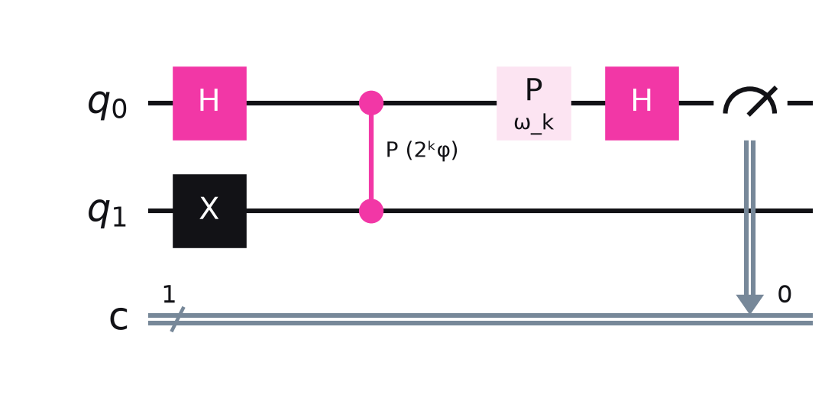
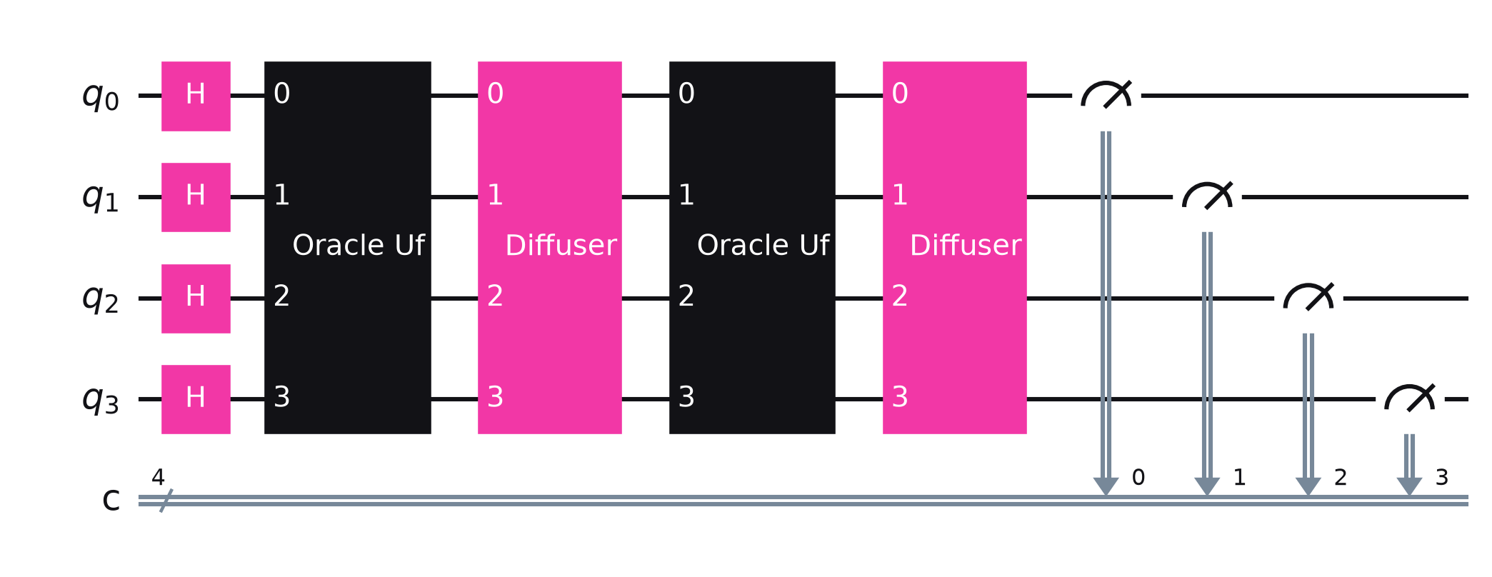
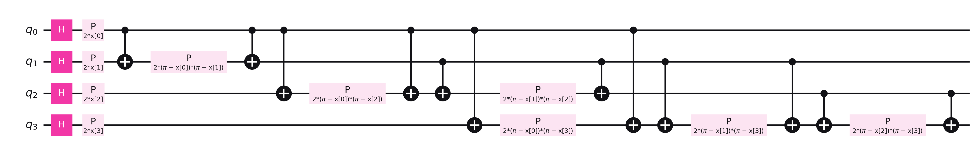
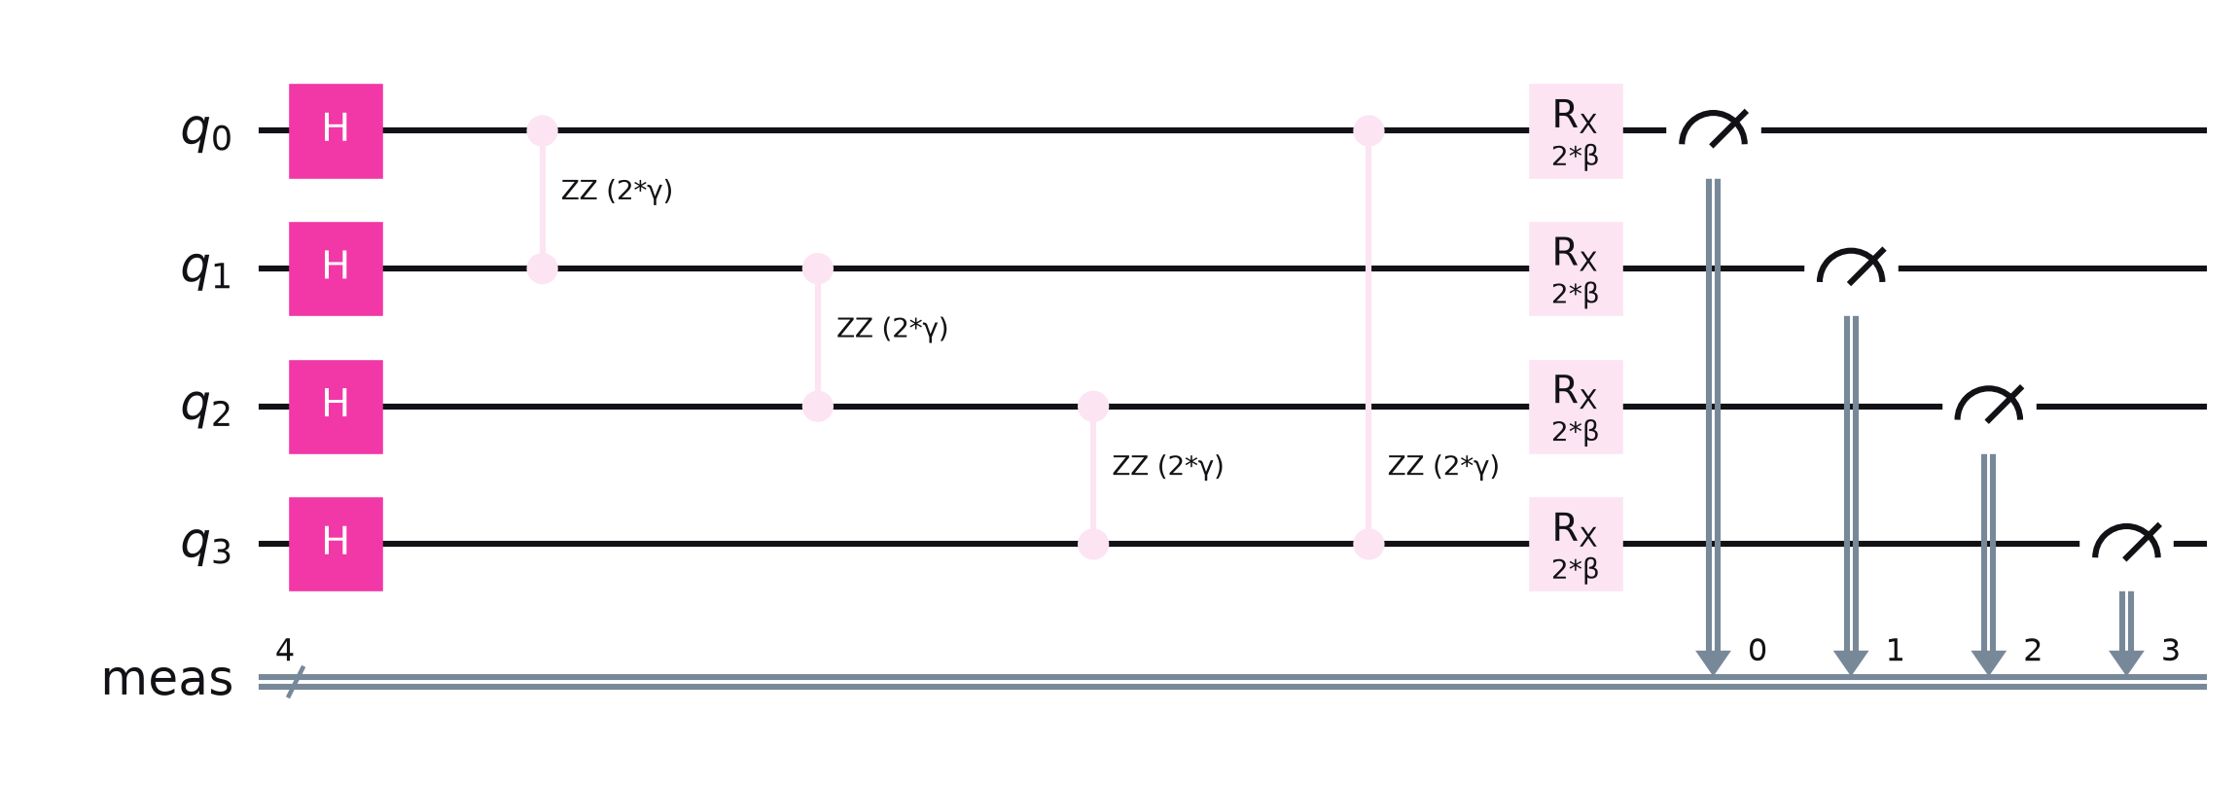
QUANTUM COMPUTING APPROACH
Four quantum building blocks, each mapped to one navigation job.
Q1 · QUANTUM SENSING
Q2 · SEARCH
Ramsey interferometry + iterative phase estimation
Grover's algorithm · 4 qubits, 16 map cells
Qubit in superposition via H; field B imprints phase φ = γBτ (γ ≈ 28 GHz/T); phase kickback + IPE reads φ bit by bit. Models an NV-diamond readout.
Oracle U_f phase-flips cells whose fingerprint matches; diffuser 2|s⟩⟨s|−I amplifies them. ~√N queries; 2 iterations here.
Q3 · LEARNING
Q4 · PLANNING
Quantum-kernel SVM · ZZ feature map
QAOA · p = 1, route graph
x ↦ |φ(x)⟩ in a 16-dim Hilbert space; kernel K(x,x′)=|⟨φ(x)|φ(x′)⟩|² feeds a classical SVM (QSVC) to label the zone.
Cost Hamiltonian H_C = Σ wᵢⱼZᵢZⱼ rewards magnetically rich waypoints; mixer H_M = ΣXᵢ; γ, β tuned by COBYLA.
PLUS QISKIT FALL FEST 2026
05

Slide 6
QISKIT & TECHNOLOGY STACK
Open-source software on borrowed hardware: built for a student budget.
QUANTUM
Qiskit 2.x SDK · Qiskit Aer · IBM Runtime SamplerV2 · qiskit-machine-learning (FidelityQuantumKernel, QSVC) · QAOA + COBYLA
Part | Role | Source | ₹
QMC5883L magnetometer | Main field sensor (mast) | Buy | 300
MPU-9250 IMU | Accel + gyro | Borrow | 600
BMP280 barometer | Altitude | Borrow | 150
NEO-6M GPS | Mapping + ground truth | Borrow | 450
PMW3901 optical flow | Ground motion | Buy (opt.) | 2,000
ESP32 DevKit | Sensor hub | Borrow | 450
Quadcopter frame / drone | Platform | Borrow | 0
Total if bought |  |  | ≈ 3,950
NAVIGATION
Python · NumPy / SciPy · FilterPy particle filter + EKF · hard/soft-iron calibration
FLIGHT
ArduPilot SITL · pymavlink · MAVLink VISION_POSITION_ESTIMATE / GPS_INPUT
FIRMWARE
ESP32 · Arduino C++ · I²C sensor drivers · 50 Hz UDP stream
INTERFACE
Streamlit + Plotly live map · circuit + histogram panels · CSV / Parquet logs
PLUS QISKIT FALL FEST 2026
06

Slide 7
SYSTEM ARCHITECTURE / WORKFLOW
Sensors in, trusted position out: quantum where it adds value, classical where speed matters.
SENSE · 50 HZ
PRE-PROCESS
QUANTUM ENGINE · QISKIT
FUSE & ACT
Magnetometer
Calibrate
hard/soft iron, tilt
Fingerprint
[Bx,By,Bz,|B|,∇B]
Dead reckoning
IMU + flow → Δx, Δy
Particle filter
500 particles; re-weighted only when Grover and QSVM agree
quantum-ready
Q1 Ramsey / IPE
read field (NV sim)
IMU
accel · gyro
Q2 Grover
Optical flow
candidate cells
ground motion
Q3 QSVM
Autopilot
MAVLink position + covariance
Dashboard
map, error, circuits
Barometer
zone label
altitude
Q4 QAOA
GPS
next waypoints
mapping only
Loop: classical fusion runs every 20 ms; quantum matching runs every 1 s on a window of readings, so quantum latency never blocks flight control.
PLUS QISKIT FALL FEST 2026
07

Slide 8
IMPLEMENTATION & FEASIBILITY
Built in 24 hours, with a working fallback at every level.
24-HOUR BUILD PLAN
H0
H4
H8
H12
H16
H20
H24
Hardware
Wire sensors + ESP32 firmware
Calibrate + mapping run
Mount on drone, test
Rehearse
record backup video
Quantum
Grover + IPE circuits (Aer)
QSVM on map data
QAOA + IBM run
Nav + UI
Dead reckoning + particle filter
Integrate quantum → filter
Dashboard
Level 1 · guaranteed
Level 2 · main demo
Level 3 · bonus
Payload carried along the mapped corridor; live dashboard shows drift vs correction.
Payload mounted on a borrowed drone, carried or tethered; full flight replayed in ArduPilot SITL on our real map.
Short real flight with GPS disabled in software, only if a flight-ready drone and venue permission exist.
PLUS QISKIT FALL FEST 2026
08

Slide 9
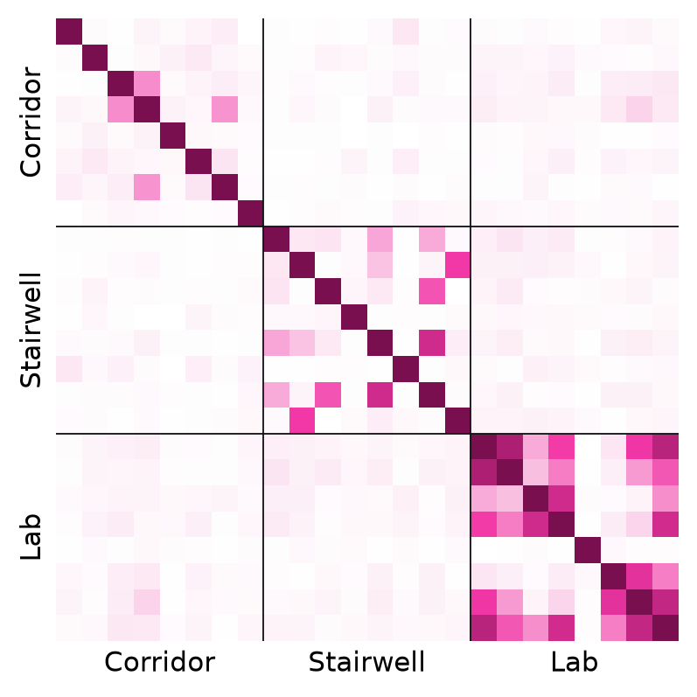
EXPECTED RESULTS & IMPACT
Early results from our own Qiskit runs and navigation simulation.
Quantum kernel matrix. Same-zone fingerprints overlap ~2.8× more than cross-zone ones (0.24 vs 0.09).
0110 + 1011 = 94% of shots. Grover returns 2 look-alike cells; QSVM breaks the tie.
~50×
lower drift vs inertial-only (MEMS model)
~6×
further gain with a quantum (NV) magnetometer
0 W
radio emission: fully passive
PLUS QISKIT FALL FEST 2026
09

Slide 10
FUTURE SCOPE & CONCLUSION
From a hackathon payload to a field-ready quantum PNT module.
NOW · TRL 3
6 MONTHS · TRL 4
18 MONTHS · TRL 5
36 MONTHS · TRL 6
Hackathon
Scale the map
Quantum sensor
Defence trials
Payload prototype, 16-cell map, 4 quantum blocks on Aer + one IBM hardware run, live dashboard.
Campus and outdoor anomaly maps (NGRI / EMAG2), larger Grover circuits, tethered drone trials.
Swap in an NV-diamond magnetometer with an NQM sensing-hub partner; quantum IMU fusion.
Ruggedised module with DRDO / iDEX partners on UAVs, loitering systems and vehicles.
"When GPS goes dark, the ground still knows where you are."
Team VOID
THANK YOU · QUESTIONS WELCOME
VOID-NAV: quantum sensing, quantum search, quantum learning and quantum planning, flying on one passive payload.
Video: https://youtu.be/BV2KYV-yhL0
PLUS QISKIT FALL FEST 2026
10

