Slide 1

Connecticut Real Estate Sales and Forecast (2001-2034)
by Lakshya Patel

Slide 2

INDEX
1 | INTRODUCTION
2 | Dataset overview
3 | Power BI Dashboard Highlights
4 | Dataset insights
5 | conclusion

Slide 3

INTRODUCTION
Real estate is a vital indicator of economic activity, regional growth, and investment trends. The Connecticut real estate market has undergone significant changes over the years, reflecting broader economic shifts and local developments.
This presentation leverages data from 2001 to 2022 to analyze these trends and provides a forecast extending to 2034 using Power BI's analytical tools. The interactive dashboard highlights key metrics, visualizes historical data, and predicts future trends, enabling better decision-making for stakeholders and investors.

Slide 4
Dataset Overview
Description: The dataset contains a listing of all real estate sales in the state of Connecticut with a sales price of $2,000 or greater between October 1 and September 30 of each year.
Data Compliance: The data adheres to Connecticut General Statutes sections 10-261a and 10-261b, with data missing for some years due to revaluation schedules.

Slide 5
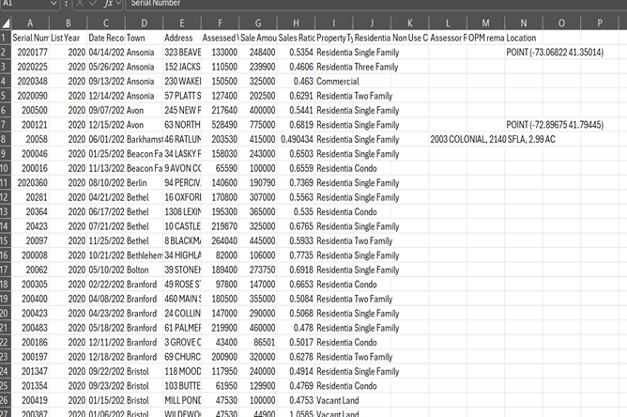
Raw Data

Slide 6
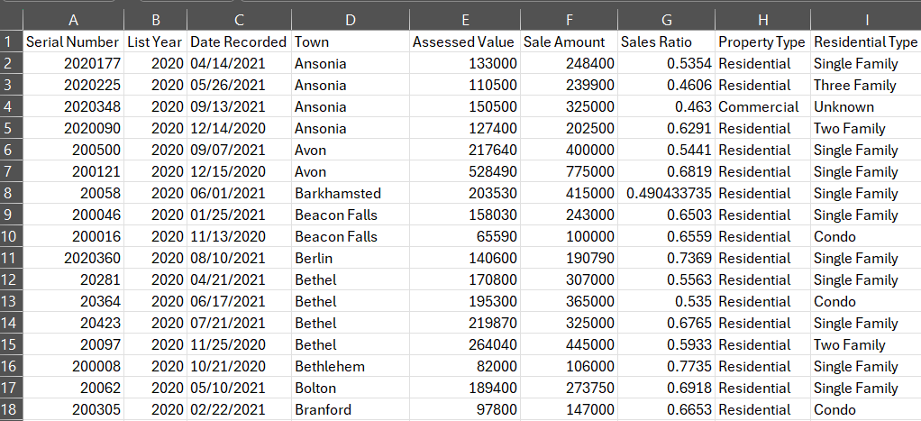
Cleaned Data
Key Data Fields:
List Year: The year of the sales record.
Town: The town where the property is located.
Property Type: The type of property (Residential, Apartment, Commercial, Industrial, Vacant Land).
Sale Amount: The transaction price of the property.
Assessed Value: The official assessed value of the property.
Residential Type: Further classification of residential properties (e.g., Single Family, Condo).

Slide 7
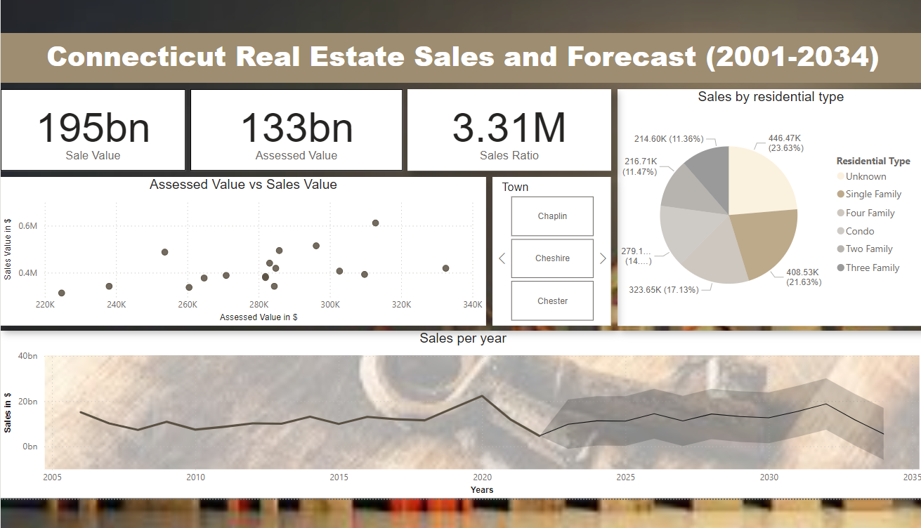
Dashboard

Slide 8
Dashboard Features
Key Features:
Card Metrics:
Total Sale Value: 417bn
Assessed Value: 294bn
Sales Ratio: 10.49M
Visuals:
Scatter Plot: Assessed Value vs. Sale Amount, highlighting the correlation between these metrics.
Pie Chart: Sales by Residential Type (e.g., Single Family, Condo) with proportionate breakdowns.
Line Chart: Yearly sales trends (2001-2034), including future forecasts until 2034.
Forecast Component:
A forecasted line chart predicts sales trends until 2034, providing insight into potential market growth.

Slide 9
Dashboard insights
Trends Observed:
The Connecticut real estate market saw steady growth from 2001 to 2020, reflecting stable economic conditions.
A sharp decline in 2021 is attributed to the economic impact of the COVID-19 pandemic, which disrupted real estate activity.
Forecast predicts recovery and consistent growth from 2025 onward as markets stabilize.
Property Distribution:
Single-family properties dominate the market, followed by condos and two-family homes.
Correlation Analysis:
Strong correlation exists between assessed property values and sales prices, indicating reliable valuations.

Slide 10
conclusion
The Power BI dashboard highlights Connecticut's real estate trends from 2001 to 2022 and forecasts up to 2034. Single-family homes dominate the market, accounting for 21.63% of sales due to their appeal for families and stable investment potential.
Despite a dip in 2021 caused by the COVID-19 pandemic, the market is projected to recover and grow steadily from 2025 onward.
This dashboard provides valuable insights for investors and stakeholders, supported by strong data correlations and comprehensive forecasts.

Slide 11
References
U.S. General Services Administration. (n.d.). Real estate sales 2001-2018. Data.gov. Retrieved January 20, 2025, from https://catalog.data.gov/dataset/real-estate-sales-2001-2018
Callan, I., & D'Mello, C. (2024, November 14). Single-family home starts hit 69-year low in new Ontario housing data. Global News. https://globalnews.ca/news/10869767/ontario-housing-starts-fao-report-2024/

Slide 12
Video Link
https://youtu.be/XyvJ_k16Xjw

Slide 13
Thank you

