Slide 1
Bus Schedule Optimizer
Team 5: TecRidge

Slide 2
The Problem - Introduction
Bus services in Bangalore is one of the most used public transportation services. These buses move up and about everyday through decided stops and harsh deadlines.

Slide 3
The Problem - Overview
As the crowd distribution is pretty dynamic, it is hard to predict what is the optimal timing for a bus to run through its route, so as to keep the bus filled (and at a profit) and facilitate crowd at the time of need.

Slide 4
The Problem - Detailed
How to optimize a dynamic system of schedules of bus services to maximize profit and minimize rate of customers missing the buses?

Slide 5
The Solution - Introduction
The solution comes from analysis of crowd distribution over different routes at different timestamps.
We can use it to perform a simulation for each bus following a specific route at different times

Slide 6
The Solution - Technicalities
We used a Reinforcement Learning Model to treat buses as agents which are rewarded or punished based on the number of passengers picked and rate of passengers missing the bus, when they start at a given timestamp.

Slide 7
The Solution – Tech Stack
React.JS
Mapbox Maps
Jupyter Notebook
Flask
CSS
Material UI

Slide 8
The Approach
Crowd Distribution, Bus Route and Timestamps are obtained.
The Bus is kept as an agent running on the route, which is the Environment
The Bus goes through several episodes of the same route at different timestamps
The most profitable time is chosen as final run.

Slide 9
The Approach - Drawbacks
The crowd distribution data is not available or documented, thus it is a randomly simulated version through which we were able to obtain results

Slide 10
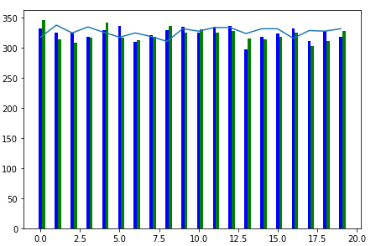
Results
An average increase of 4% in passengers was achieved for a bus ‘1’ through our model, with 65% profitable runs:

Slide 11
Future Work(s)
Crowd distribution data can be obtained through analysis of tickets, just like in Bangalore Metro.
The Model can also be made to accommodate traffic patterns and journey durations for optimal results.

Slide 12
The Impact
This small change can lead to:
Smaller waiting queues
Profit for bus services
Customer Satisfaction
Service appreciation
Thus it benefits both Passenger and the Provider

Slide 13
The Scope
This model can be used by BMTC, or other mass transportation services (something like UberBus).
It is also versatile enough to be used for Namma Metro.

Slide 14
The Conclusion
We obtained positive results from this model and represented it on a map, which makes it a good selling point for transportation start-ups or existing public transport companies.

Slide 15
THANK YOU!
Made By Team TecRidge:
K. Sidhartha Nambiar
Lakshya Sharma

Slide 16
THANK YOU!

