Slide 1
dExpParam exploration

Slide 2
First round of exploration
Varied dExpParam -> 0.1, 0.01, 0.001
Most populations with 0.01 and 0.001 went extinct, probably cause the distance a fair bit between them and thus all stealing were unsuccessful.
Varied dExpParam -> 0.1, 0.3333, 0.02

Slide 3
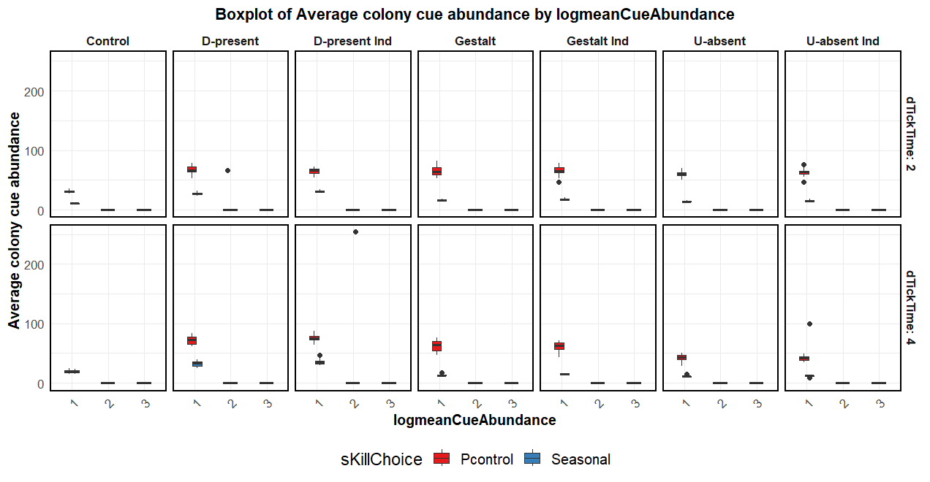

Slide 4
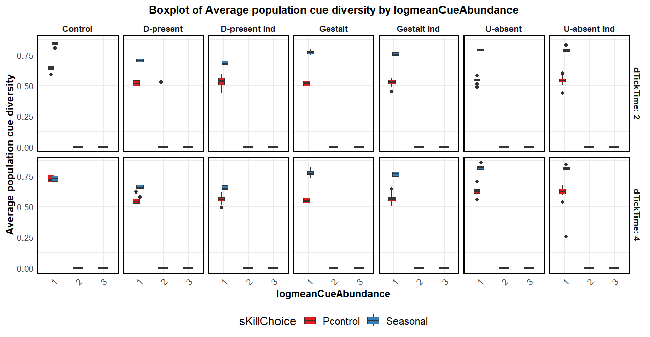

Slide 5
