Slide 1


Preliminary meeting: 09th April 2024
Behind Enemy Lines: Investigating Crozier’s Paradox and Recognition of Nestmates through an Individual Based Model
Lakshya Chauhan MEME 2022 – 2024
Supervisor: Margaux Brigitte, Florian Menzel, Hanna Kokko

Slide 2
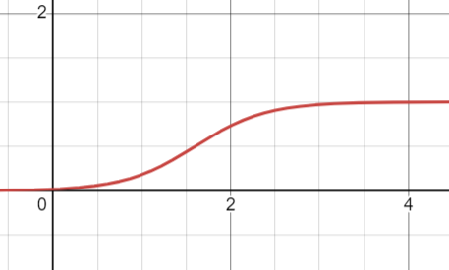

Proposed extensions to the project
Introduction
Revision of ticks
Threshold co-evolution
For future
Co-evolution of threshold
!!!!
Mating and sexuality (presence of a queen)
Gillespie algorithm
Rejection propensity
!!!!
Maybe non-constant worker population?
Profile distance
Notes:
Gillespie: implemented inherently in code design

Slide 3
Revising ticks under Gillespie
Introduction
Revision of ticks
Threshold co-evolution
For future
Randomised order of ants (1 chance each)
Getting rid of ticks altogether
Reproduction: When a colony dies, a colony reproduces, with their relative stocks defining chance [Reset food here??]
Mortality: Define a famine period where s fraction of colonies die, like ticks [Could reset food here too] OR let colonies dying by starvation be only form of mortality
Regeneration of food: Super tricky. Either it is a self-generating stock, continuously updating OR a constant food source such that ants always have a chance to forage/steal
Regeneration of food
Resetting stock Mortality Reproduction
1 tick
With each ant taking their own time to forage/steal, not every single ant will have exactly one chance per tick
Rather ants from various colonies can now act simultaneously with slight heterochrony, so MANY actions can exist within a tick.
Regeneration of food is tricky now
So is mortality and reproduction
Redefining ticks to a lower value
Retains a large fraction of properties from earlier model
Would require fine tuning the period of action (or tick) such that most colonies don’t die of starvation versus most colonies choosing to forage
Notes:
Gillespie: implemented inherently in code design

Slide 4
Time taken to forage/steal
Introduction
Revision of ticks
Threshold co-evolution
For future
Time taken to reach food source
Largely inconsequential as probability of stealing/foraging is not genetically inherited but depends on food source instead. More about realism of model
Need to define time taken for actions under Gillespie as well
Time taken to reach colony
Time taken to steal
Time taken to return (food or colony)
Notes:
Gillespie: implemented inherently in code design

Slide 5
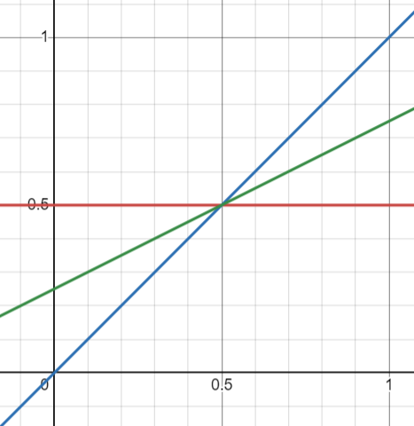



Co-evolution of tolerance
Introduction
Revision of ticks
Threshold co-evolution
For future
Heterogeneity
Tolerance is inherited
Individuals have a mutated profile around the colony tolerance, providing heterogeneity
All colonies start with an initial state (coin toss) close to each other but slightly mutated
Bernoulli sampling of propensity at distance will provide stochasticity
$$T_{colony}=random\left(0, 0.8\right)+0.6$$
$$T_{resident}=T_{colony}=T$$
Stochasticity
$$If random\left(0, 1\right)<Dist_{model}∗T$$
No inheritance just yet
Ants have thresholds similar to their colonies, no heterogeneity on the individual level
Can’t have tolerance that “kicks in”
Notes:
Gillespie: implemented inherently in code design

Slide 6
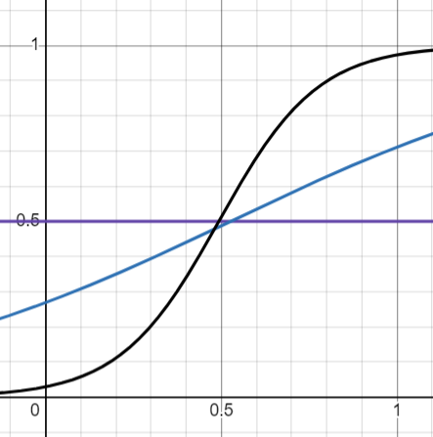


If linear tolerance is observed
Introduction
Revision of ticks
Threshold co-evolution
For future
$$propensity\left(x\right)=\frac{1}{1+exp⁡(a+bx)}$$
Mutation rate needs to be different or really small. Alternatively, maybe the results are so robust differential rates are not required.
Mutation rates need to be much smaller than 5 anyway. Given we can run this system for ages and we start with significant heterogeneity (lambda param 0.1), should be alright.
Neet to figure out system of co-evolution “kicking in” at certain timepoint, as we need a defined system for tolerance before.
Non-inherited current system
Evolvable system (redefine existing colonies’ tolerance)
Notes:
Gillespie: implemented inherently in code design

Slide 7
Future directions to look in
Introduction
Revision of ticks
Threshold co-evolution
For future
Mating and reproduction
Queen??
Central male population
Additions
Haplodiploid architecture
Non-constant worker population
Notes:
Gillespie: implemented inherently in code design

Slide 8
To discuss
Crozier’s Paradox
Earlier work
Status
Next steps
Mating (haplodiploid structure?)
If haplodiploid, additive vs Non additive expression, recombination present vs absent
And reproduction
Queen initialization
Male population structure
Colony and net food resources
Nest removal (ie timestop)
Should we have dispersal along with nest removal?
Providing raiding/foraging times / or travel times
Cost correction due to reproduction?
Rejection propensity
Profile distance
Notes:
-> Switch the co-evolution at a timepoint

