Slide 1


Coding and progress update: 05th June 2024
Behind Enemy Lines: Investigating Crozier’s Paradox and Recognition of Nestmates through an Individual Based Model
Lakshya Chauhan MEME 2022 – 2024
Supervisor: Margaux Brigitte, Florian Menzel, Hanna Kokko

Slide 2
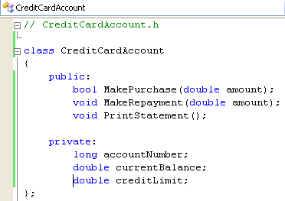
Coding basics (header files)
Coding basics
Code architecture
Changes to previous model
Timeline
Name of header: Parameters, Individual, Nest, Population etc for us
Public functions/variables: To manipulate the data structure
Start of class definition: Basically a data structure defining a level of complexity
private functions/variables: To manipulate the data structure

Slide 3
Code architecture (C++)
Coding basics
Code architecture
Changes to previous model
Timeline
Random
Parameter
Individual
Nest
Population
Main
Defines stochastic and statistical functions -> distribution samplings
- > troubleshooting functions
-> mean, SD and covariance functions
Defines parameter class -> time and parameter conditions
- > read parameters from file
-> mean, SD and covariance functions
Defines individual class -> chemical profile and other genes
- > distance calculation
-> creating new individuals -> Individual identifiers
Defines nest class -> list of individuals in nest
- > food stock
-> nest profile and other genes
-> foraging functions
-> creating new nests
Defines population class AND time struct -> tracking Gillespie time
-> global food stock
-> nest killing, reproduction and mortality
-> Initialising and simulating pop
-> Outputting
Creates executable to run everything

Slide 4
Code architecture (R and SLURM)
Coding basics
Code architecture
Changes to previous model
Timeline
create_ini.R
explore_range.R
analysis.R
SLURM
Defines function to output parameter text file
Uses said function to create multiple text files based on desired parameter exploration
Plots and analyses output results
Runs simulation on cluster
-> Creates individual output folders for parallel runs
-> Stores summary files that tell success of run

Slide 5










Changes to previous model (time series)
Coding basics
Code architecture
Changes to previous model
Timeline
*
*
* : possible simulation parameter
*
1 tick / global and local stock renewal and metabolic cost
*
*
*
*
*
*
*
*
*
*
*
*
*
*
*
*
*
1 generation = 100 ticks
Removal time
Mortality and reproduction after 300 generations
*
Metabolism and global (maybe even local) food renewal done at every step
Mass killing, mass reproduction, individual reproduction and local stock renewal optional

Slide 6
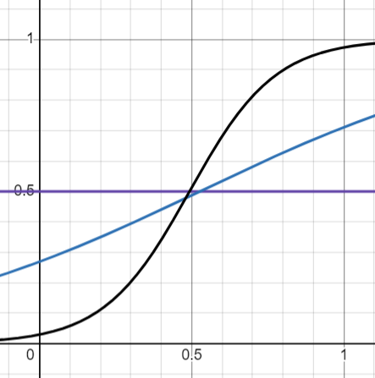



Changes to previous model (coevolution threshold)
Coding basics
Code architecture
Changes to previous model
Timeline
Heterogeneity
$$T_{colony}=random\left(0, 0.8\right)+0.6$$
$$T_{resident}=T_{colony}=T$$
Stochasticity
$$If random\left(0, 1\right)<Dist_{model}∗T$$
Control (distance and tolerance both sampled from [0,1]
Linear
Logistic
Non co-evolving

Slide 7
Timeline
Coding basics
Code architecture
Changes to previous model
Timeline
Start major simulations, start intro and other sections
Writing manuscript and prepping for defense
Debugged working model
Report submission
Mid/end of June
Early/mid July
Early August latest
End of August
End June/early July
mid/end July
14th August
Graphing of initial base results
Analyse simulations and discussion
Thesis defense
September
Extra simulations / manuscript editing

