Slide 1


Thesis defense: 14th August 2024
Behind Enemy Lines: Investigating Crozier’s Paradox and Recognition of Nestmates through an Individual Based Model
Lakshya Chauhan MEME 2022 – 2024
Supervisors: Dr. Bieuville, Dr. Menzel, Prof. Kokko

Slide 2
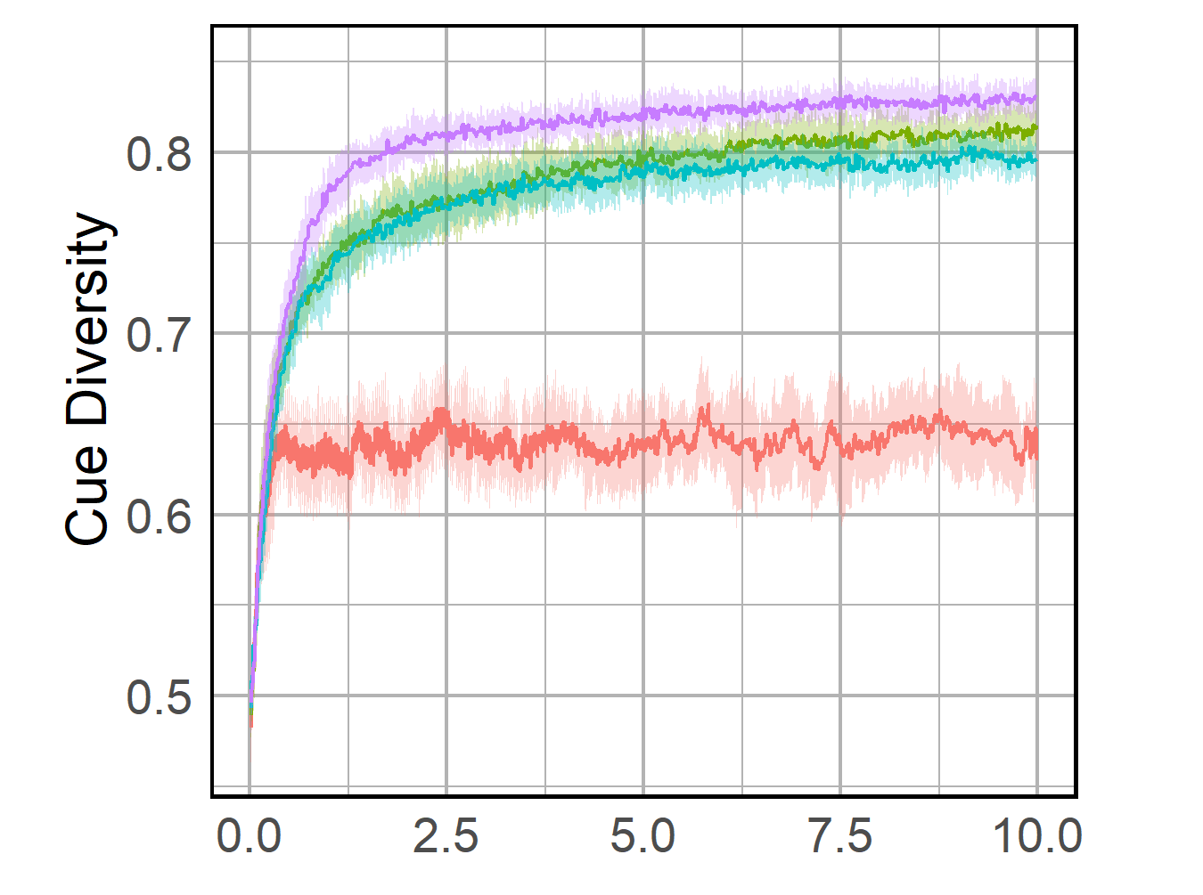
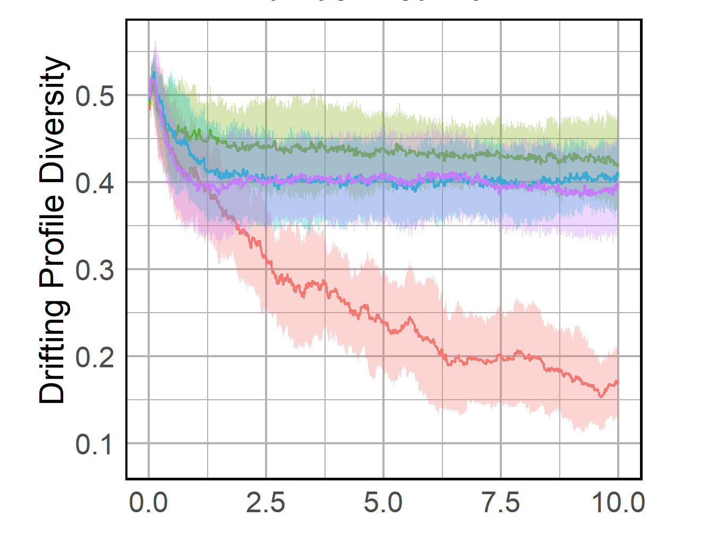
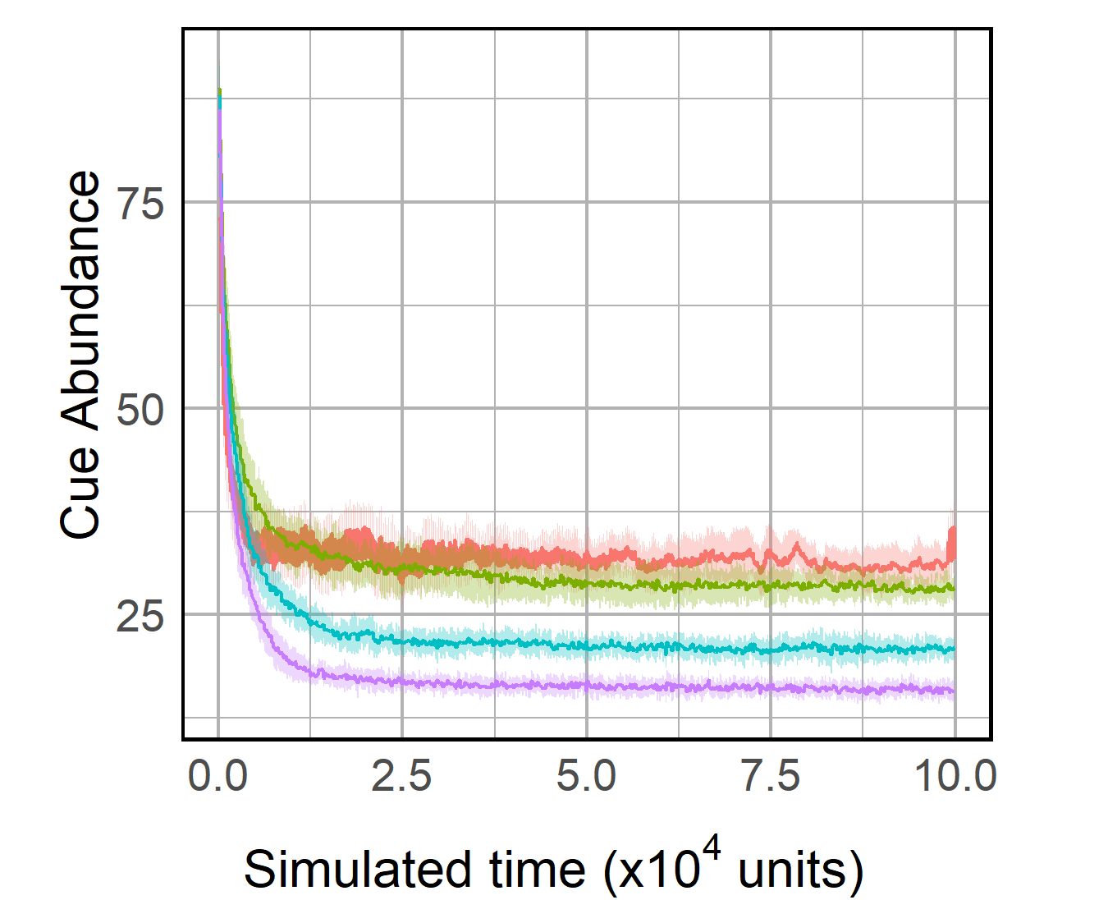
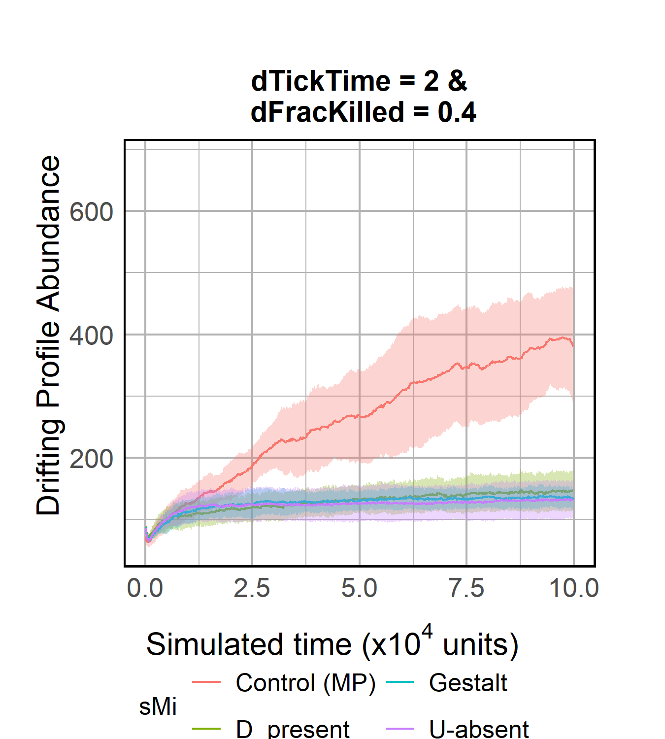
A)
B)
C)
D)
Notes:
Fig 1

Slide 3
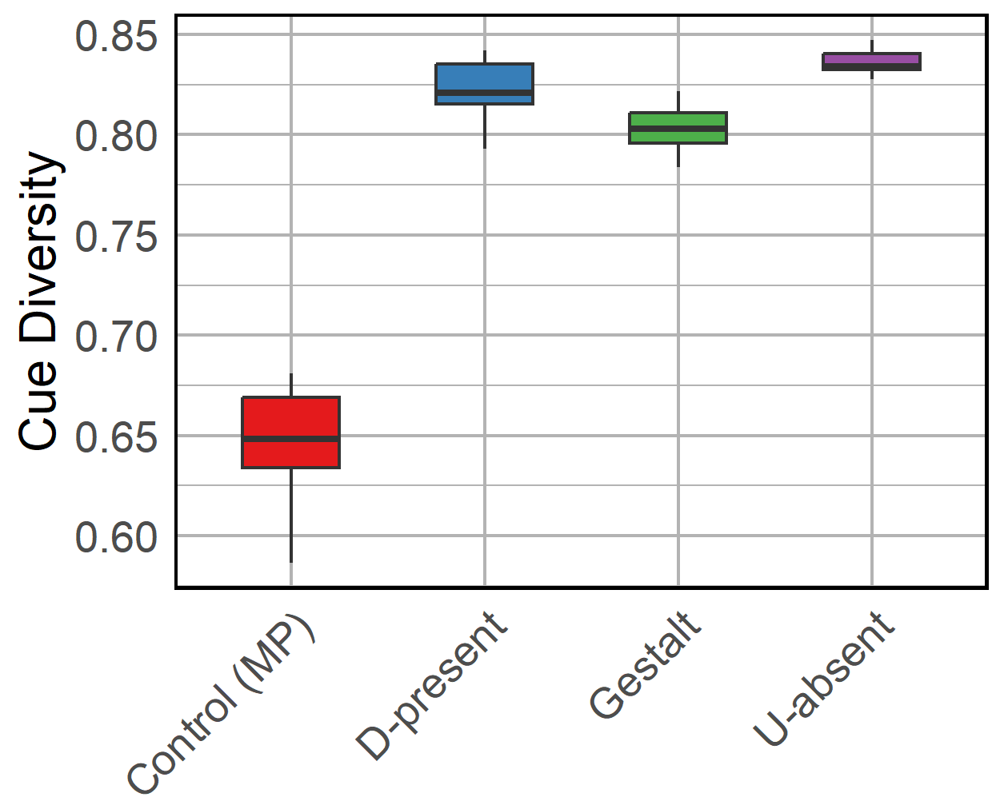
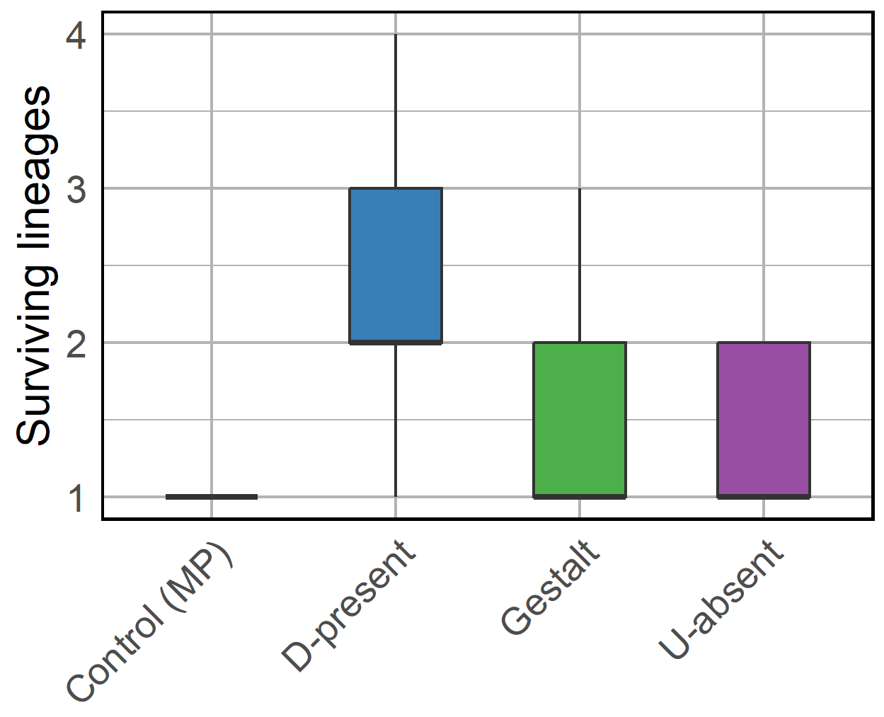
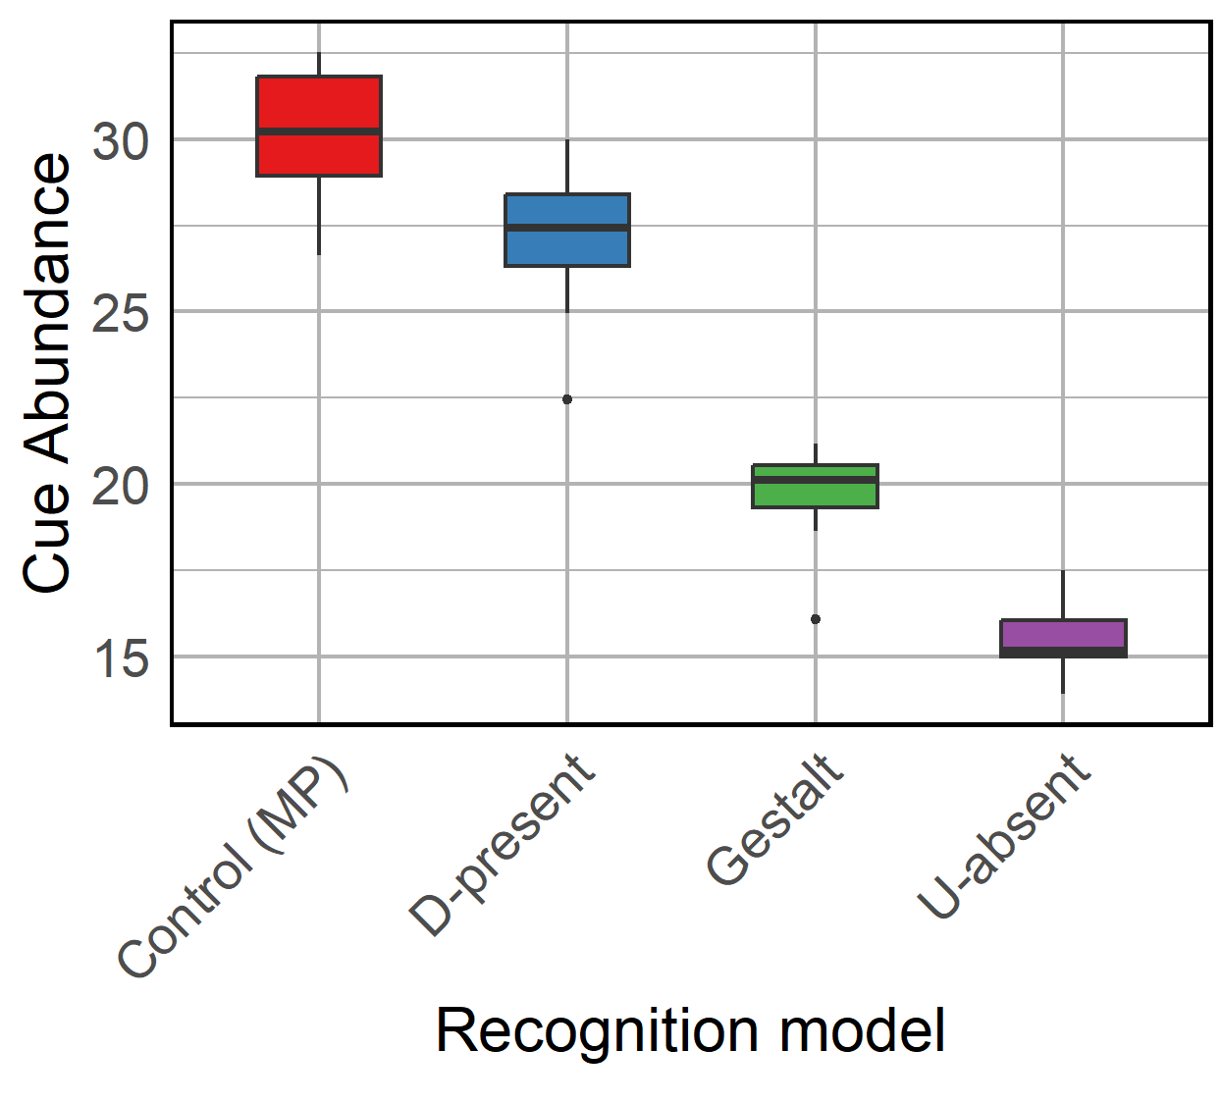
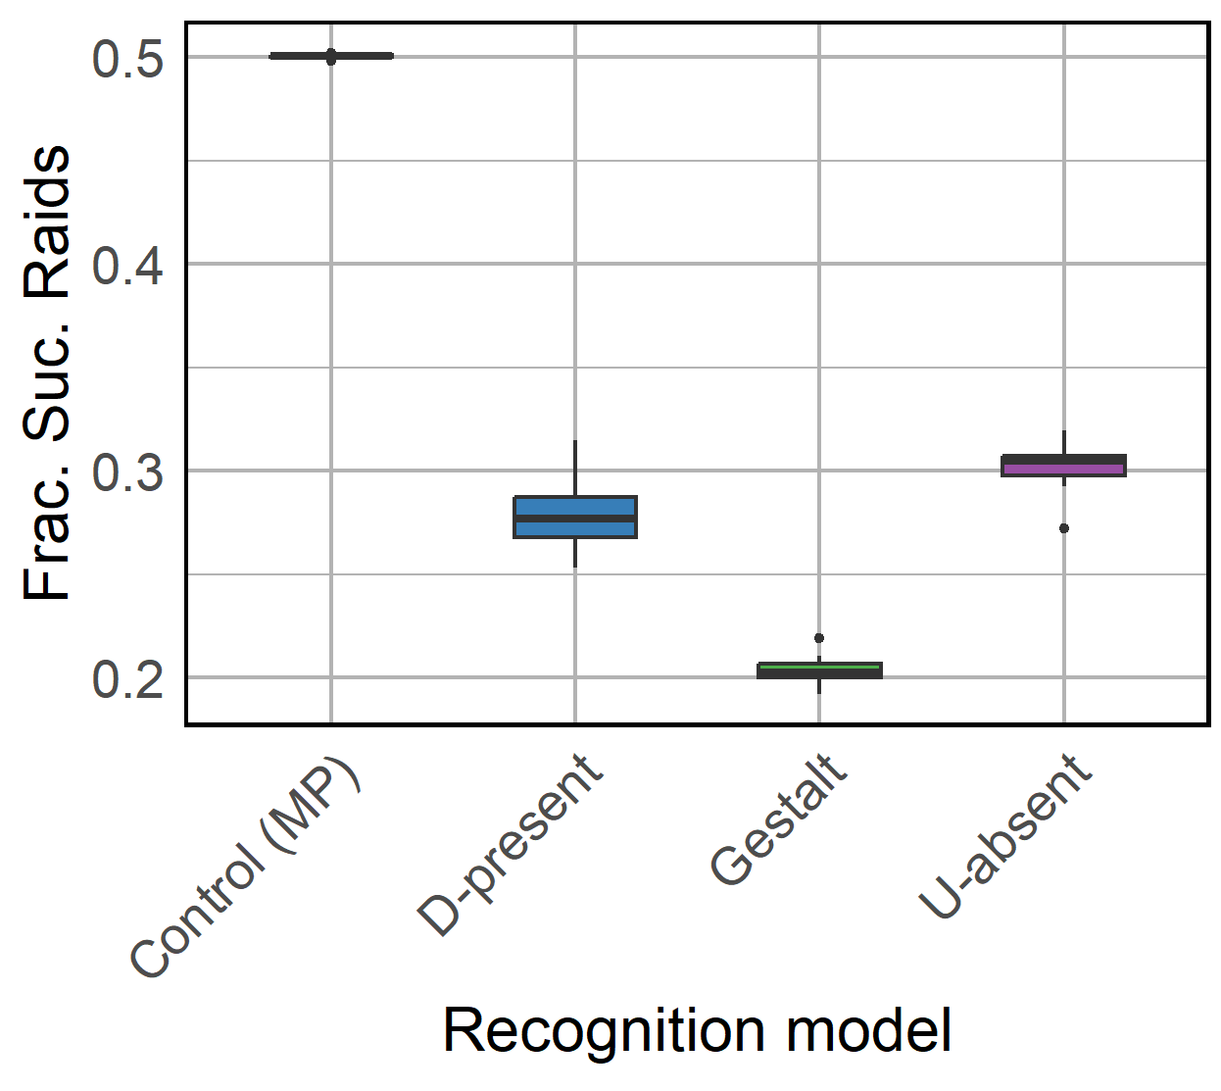
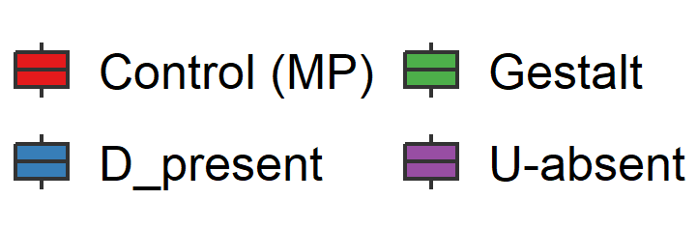
A)
B)
***
***
n.s
C)
D)
Notes:
Fig S1

Slide 4
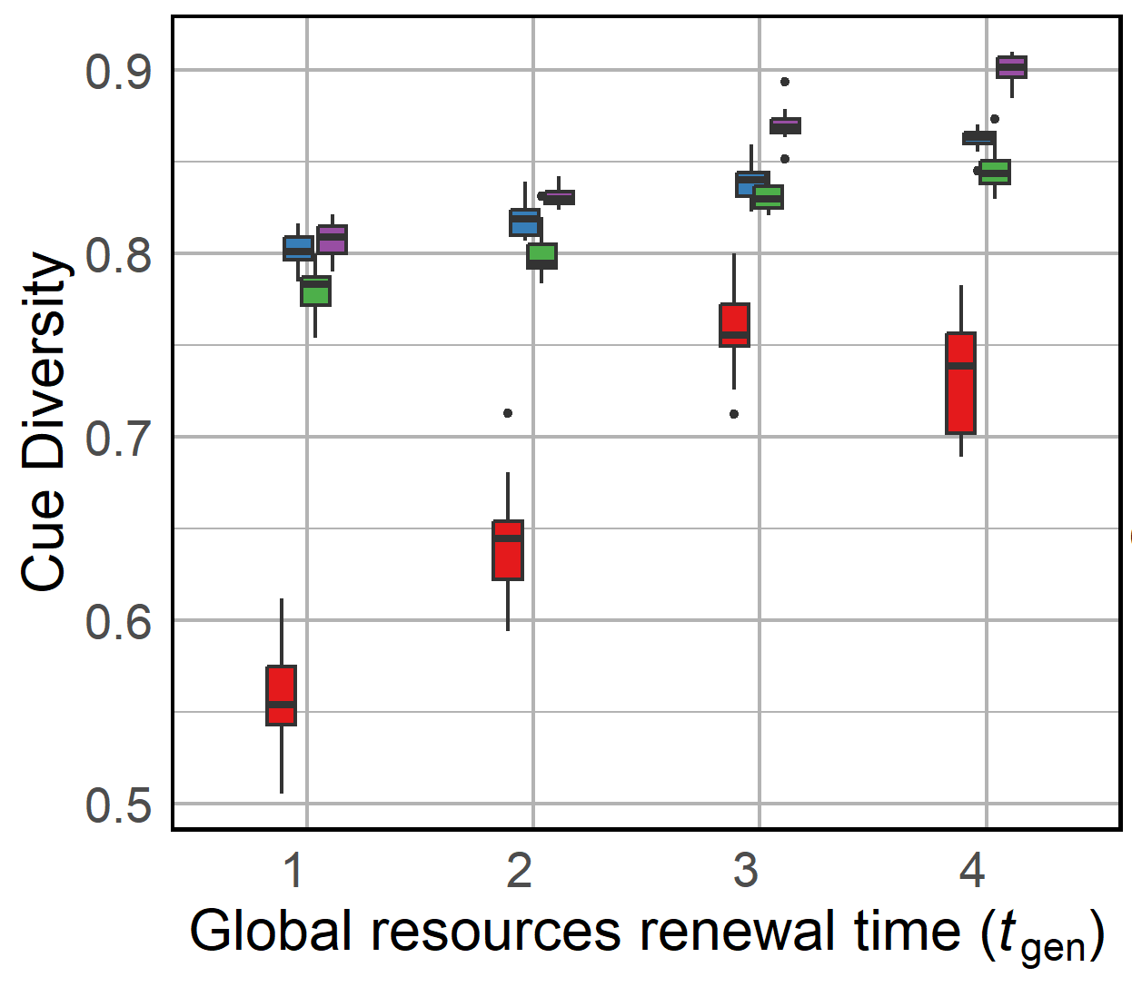
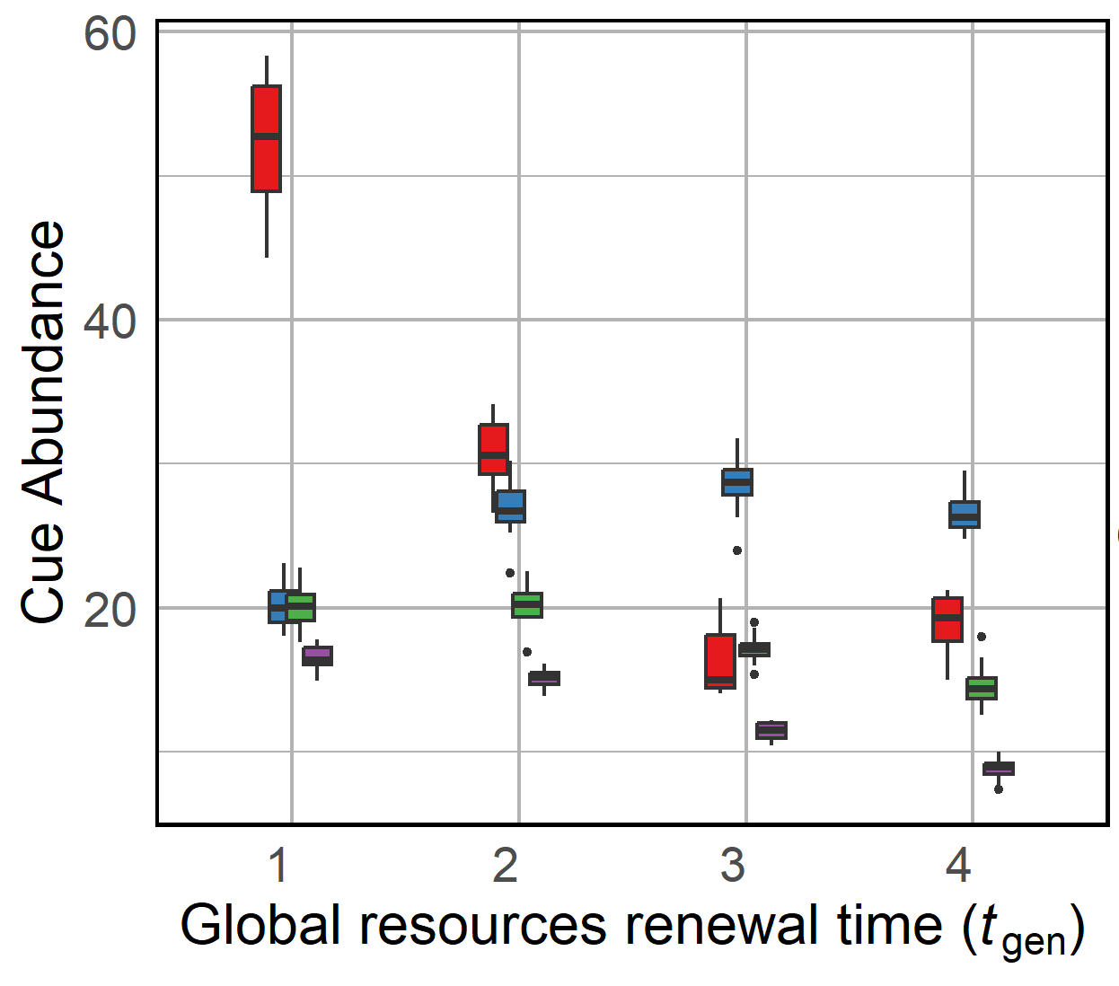
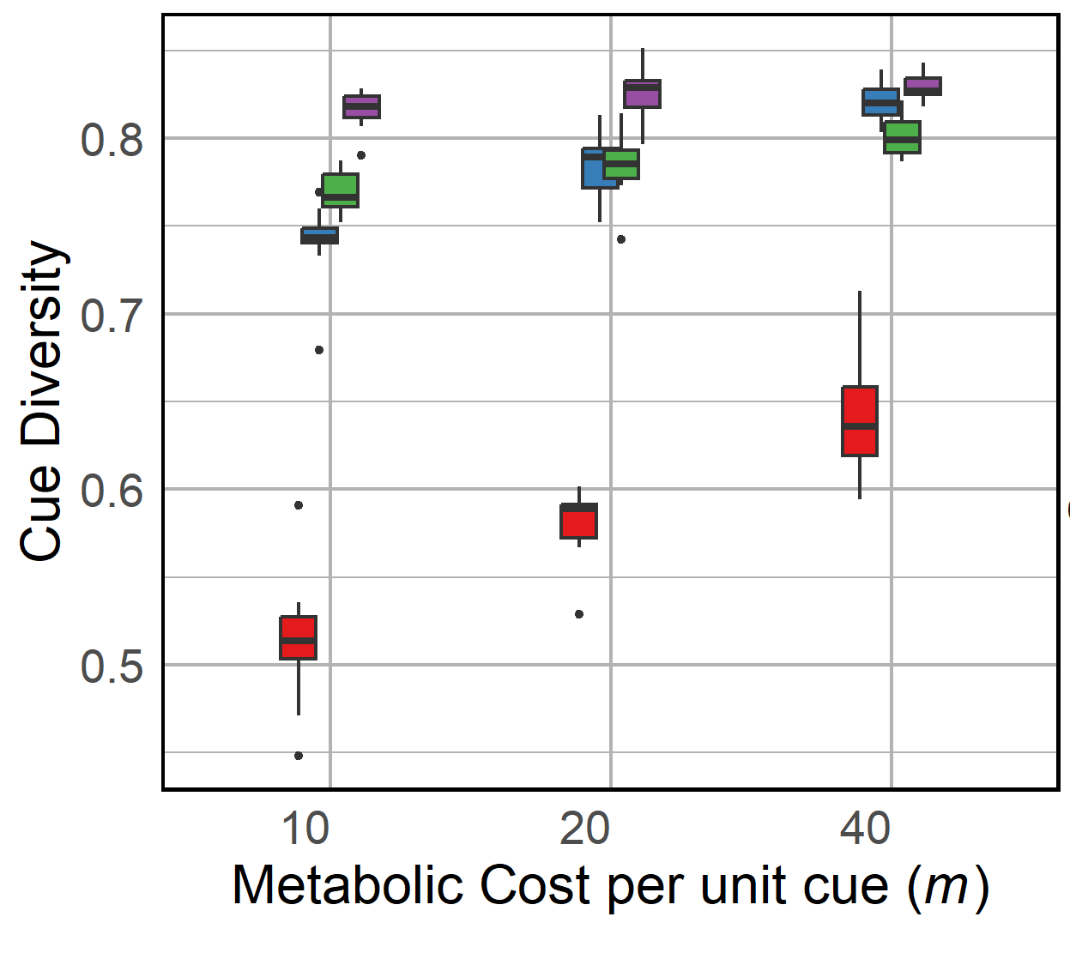
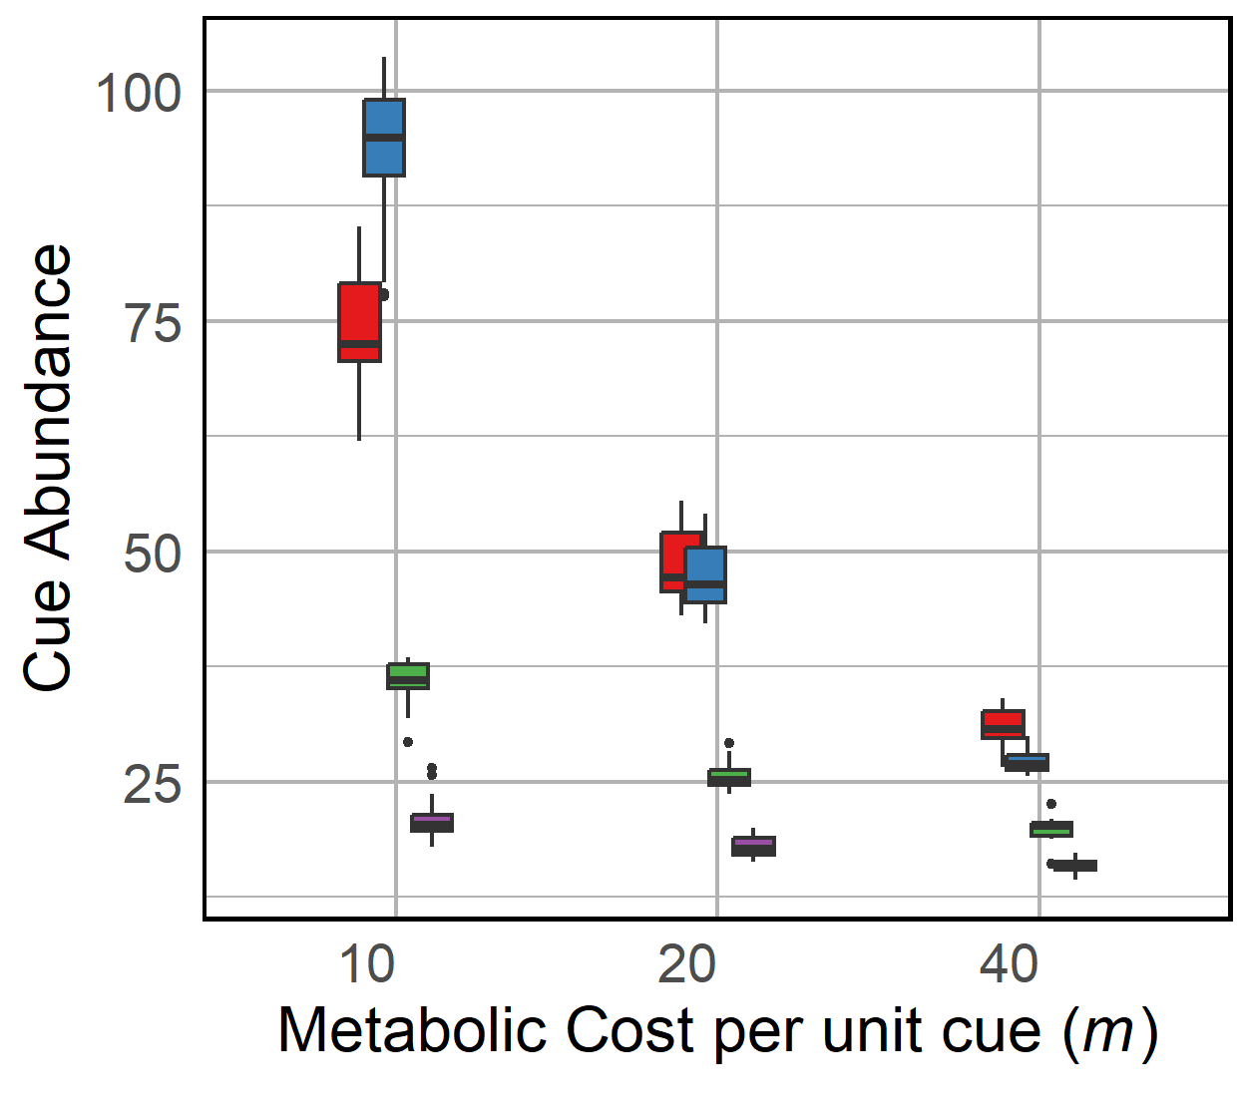
A)
B)
C)
D)
Notes:
Fig 2

Slide 5
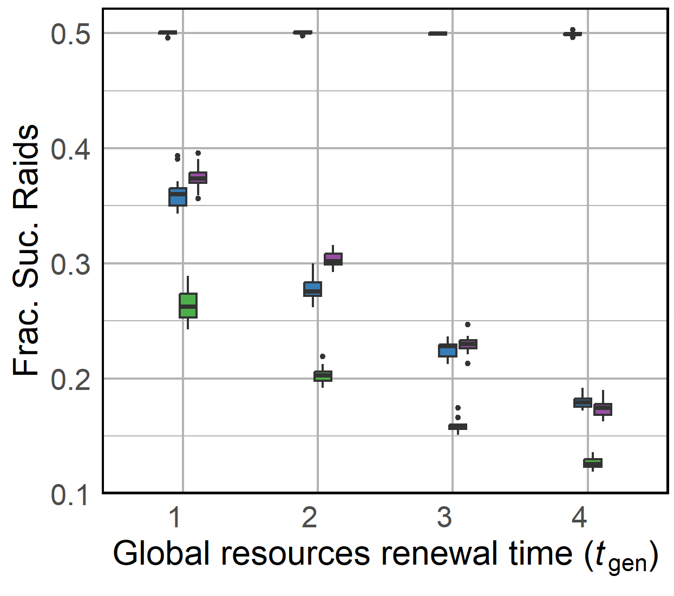
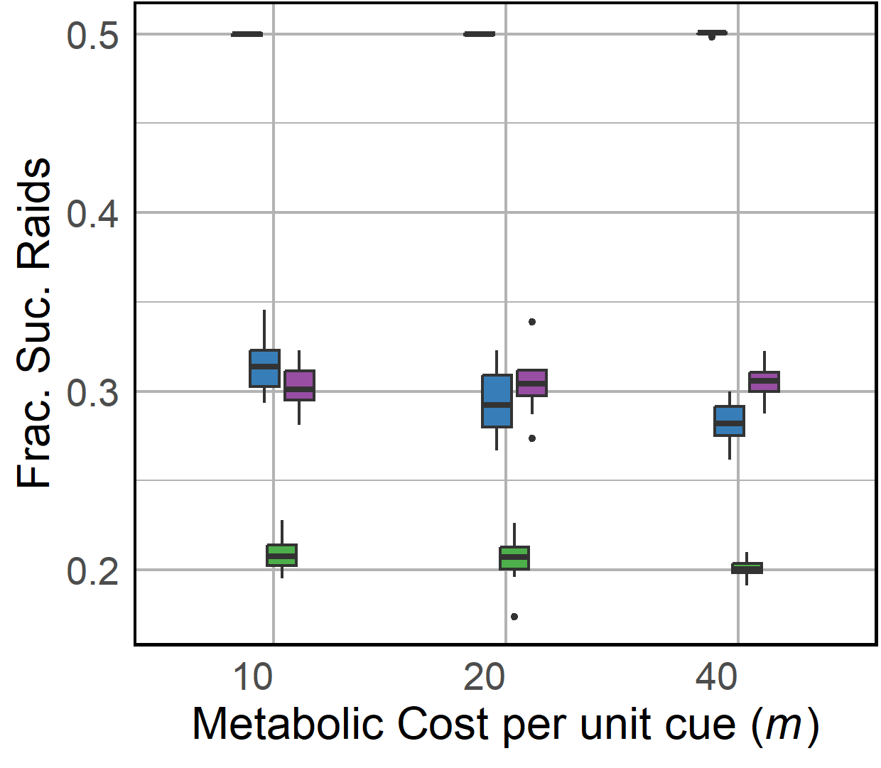
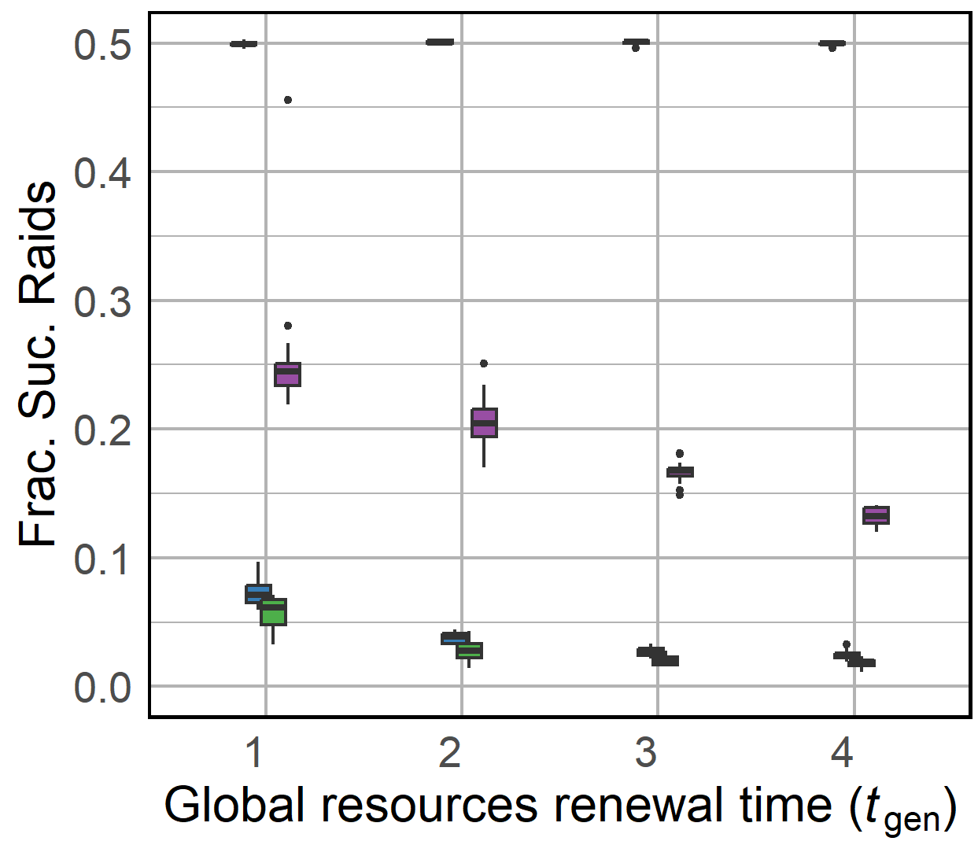
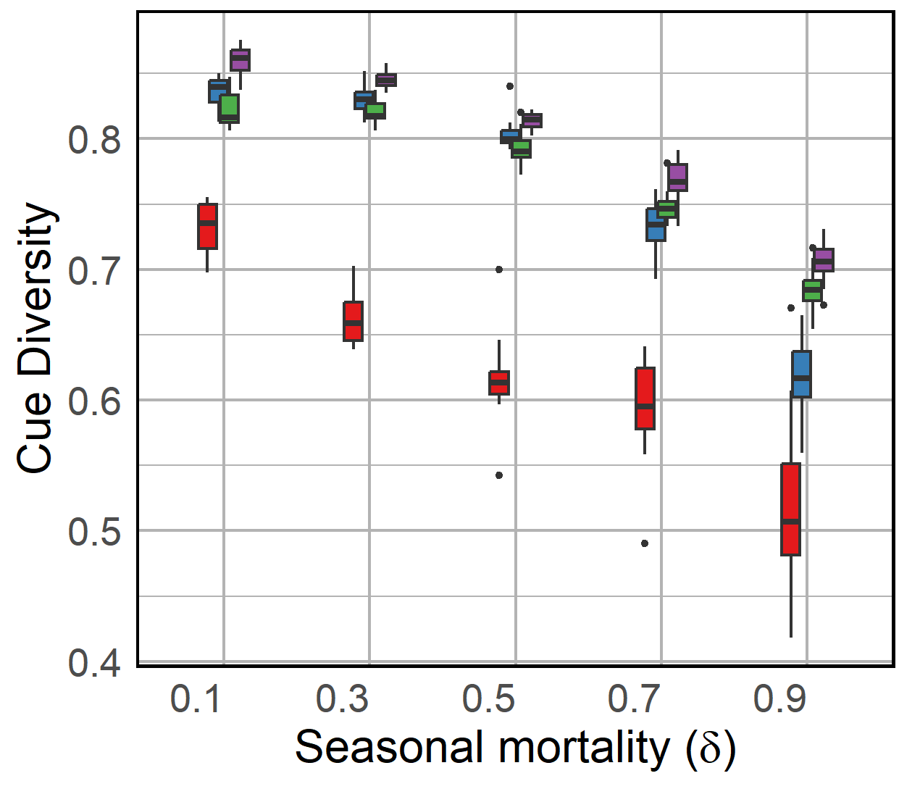
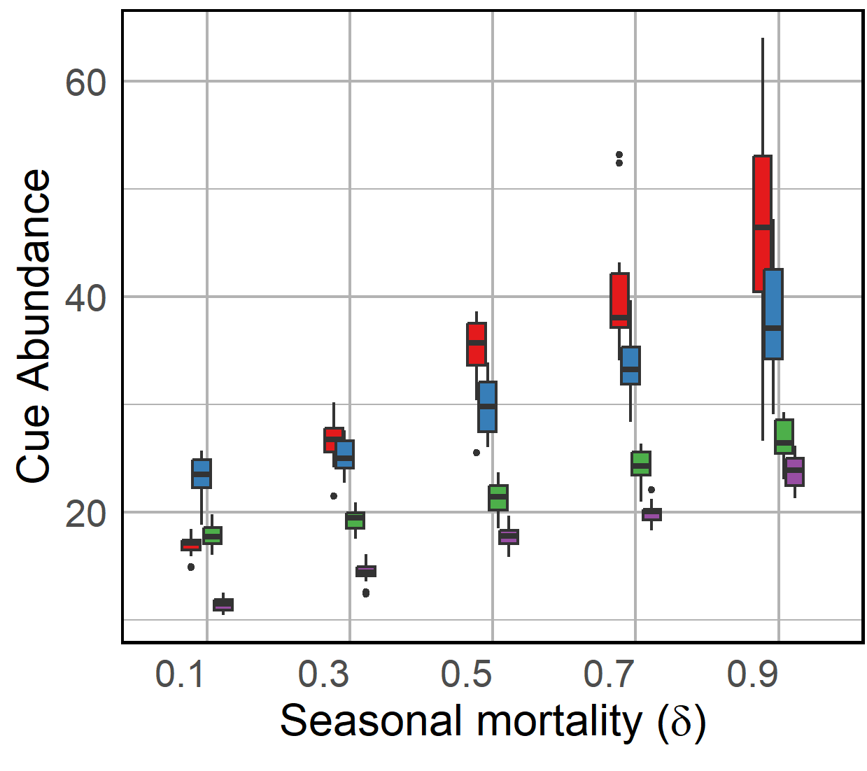
A)
B)
C)
D)
E)
Notes:
FigS2

Slide 6
A)
B)
Notes:
FigS2*

Slide 7
A)
B)
Notes:
FigS3*

Slide 8
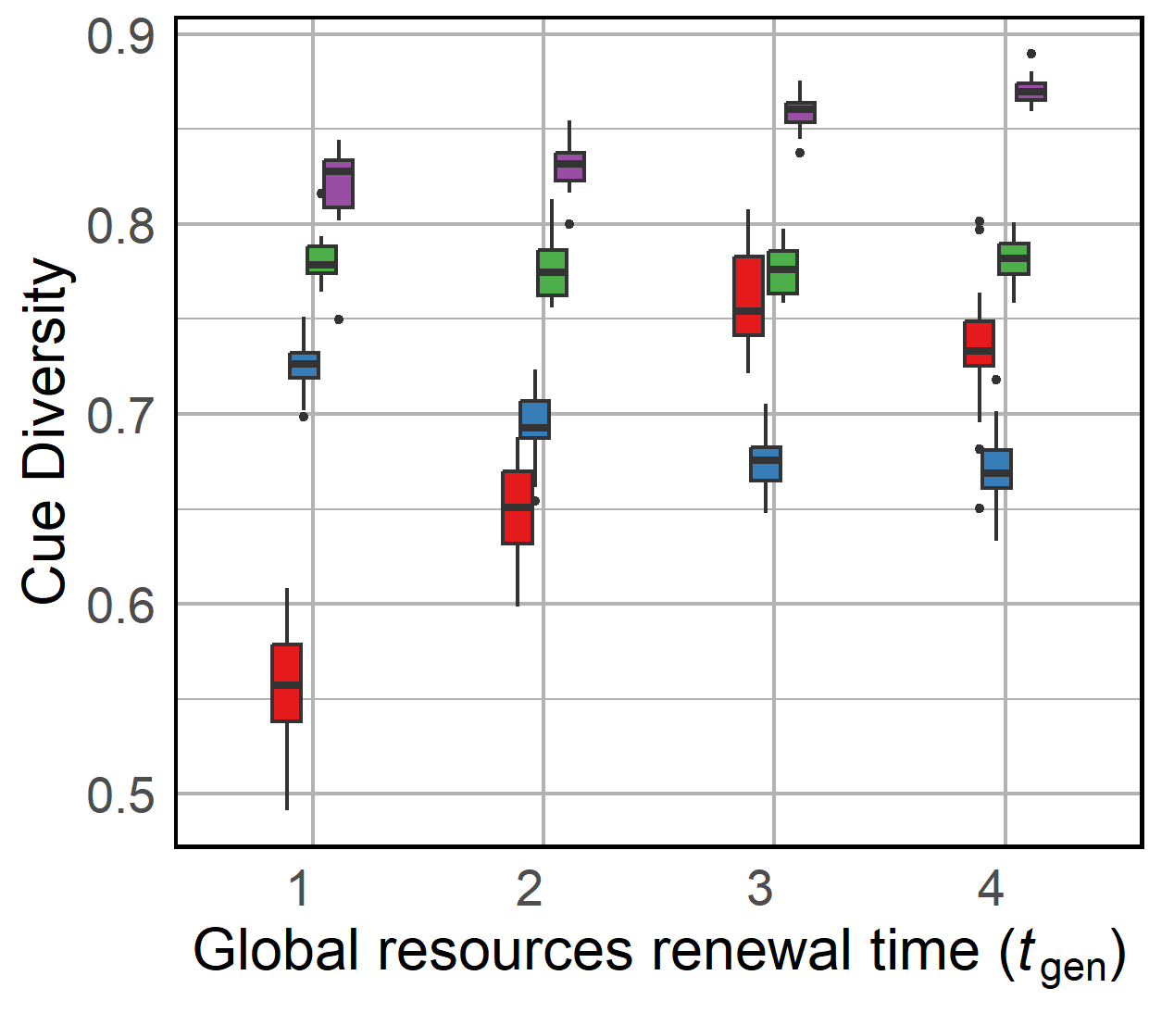
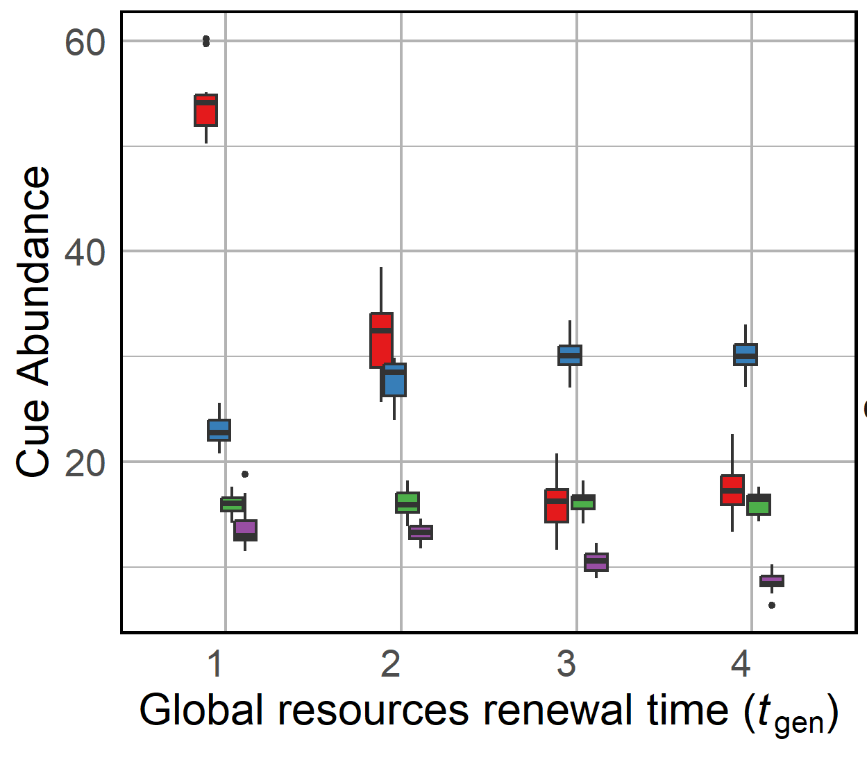
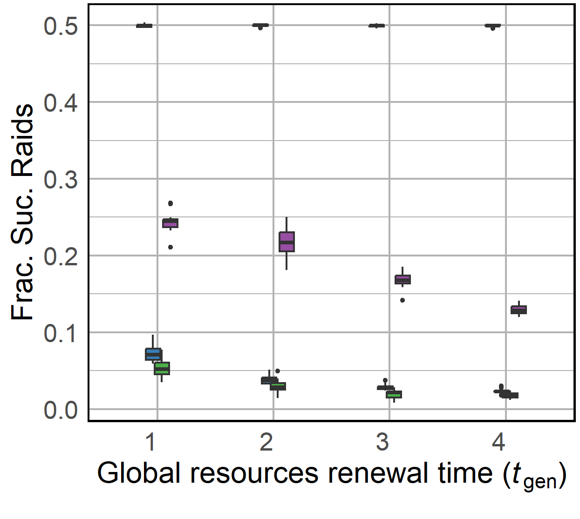
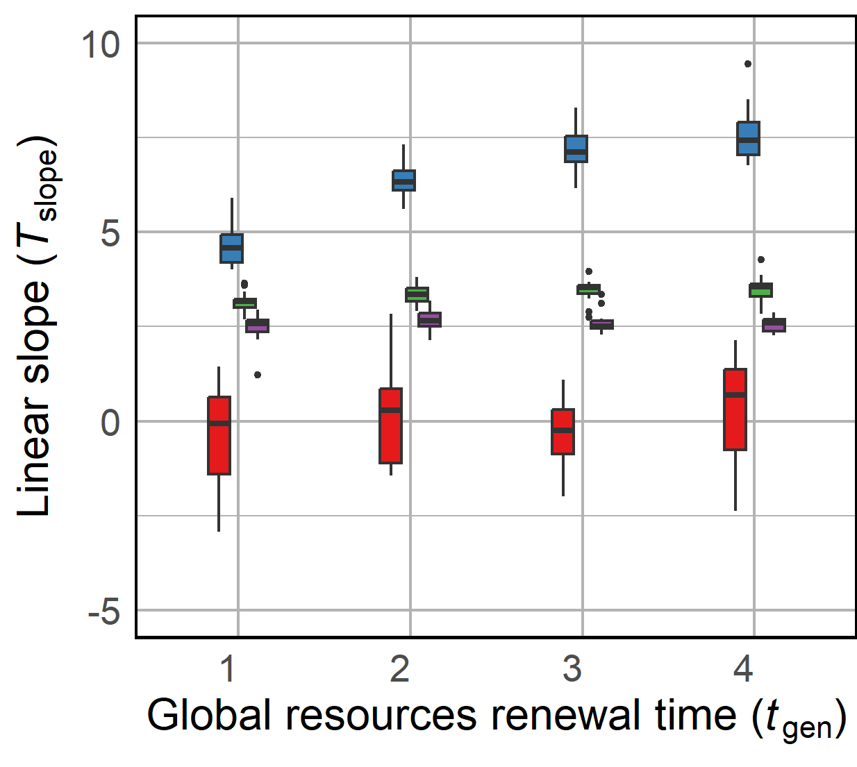
A)
B)
C)
D)
Notes:
Fig3

Slide 9
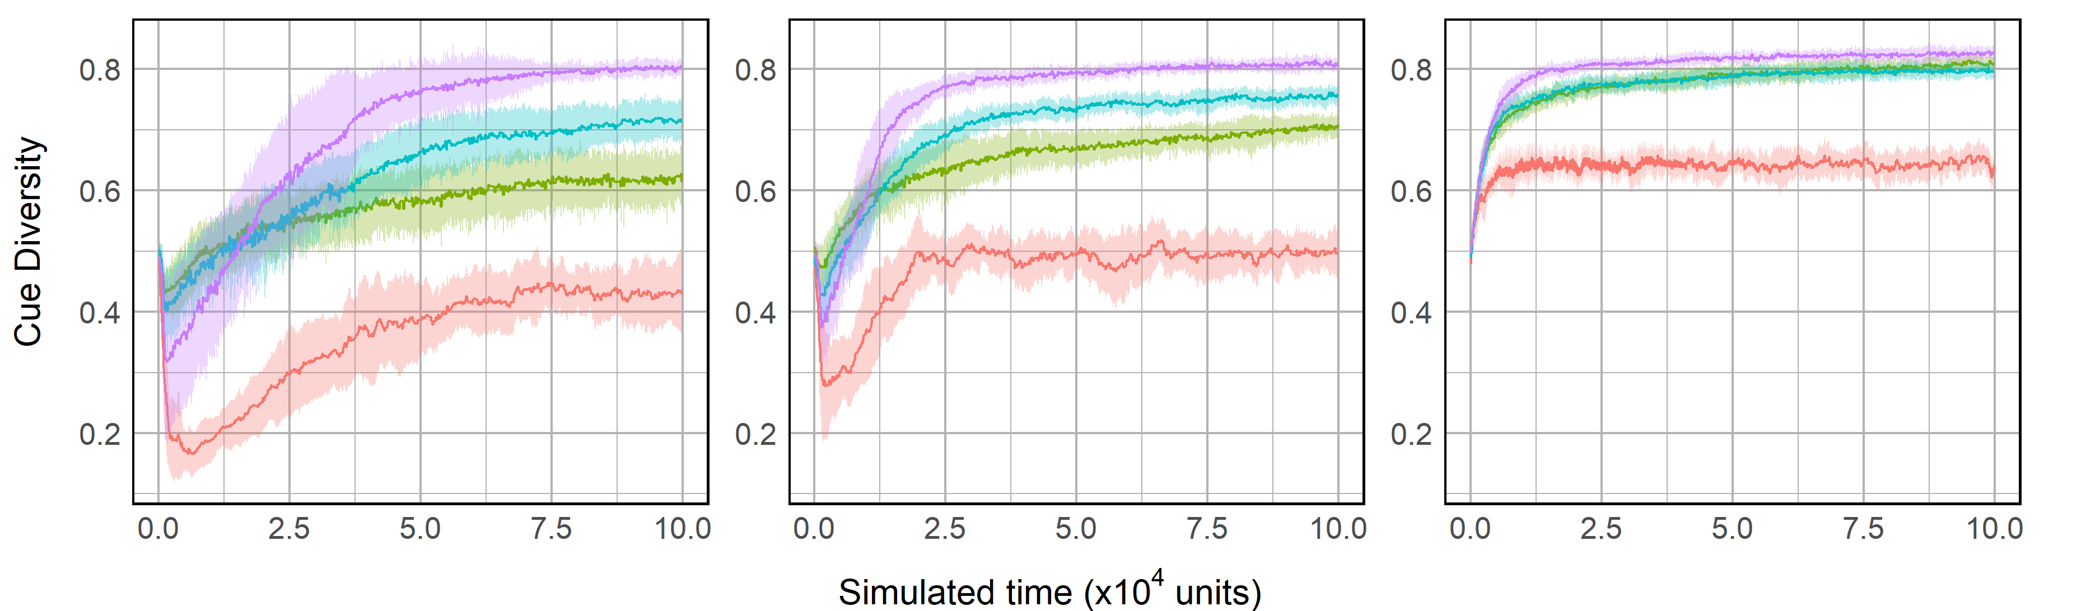
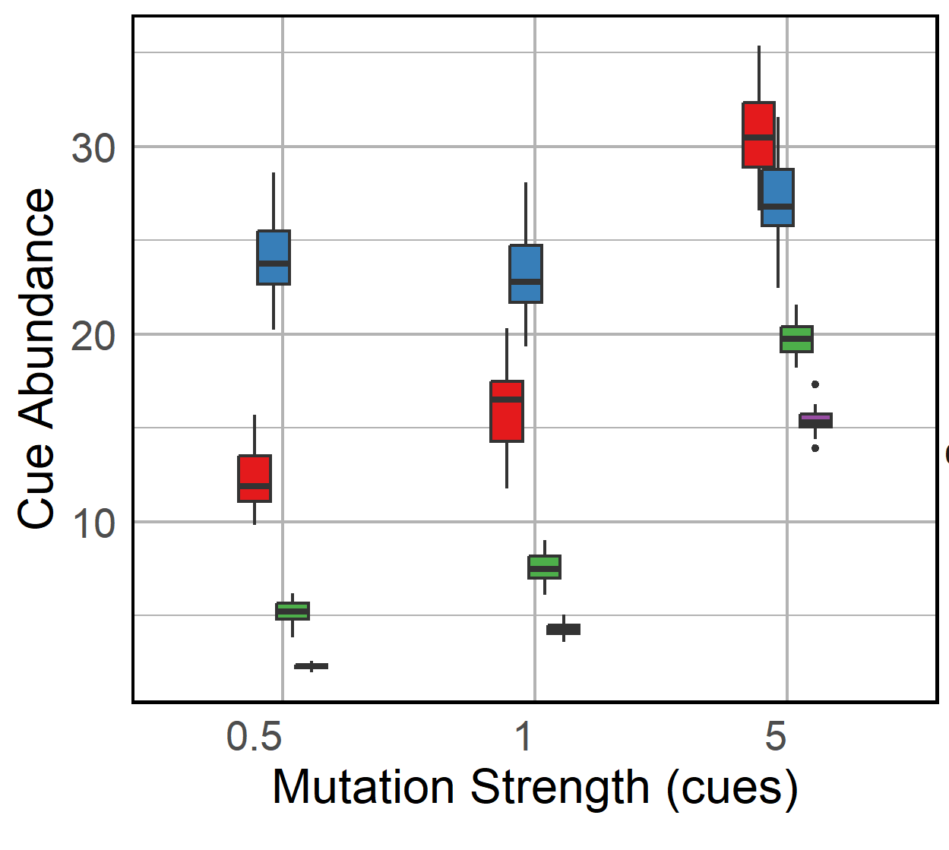
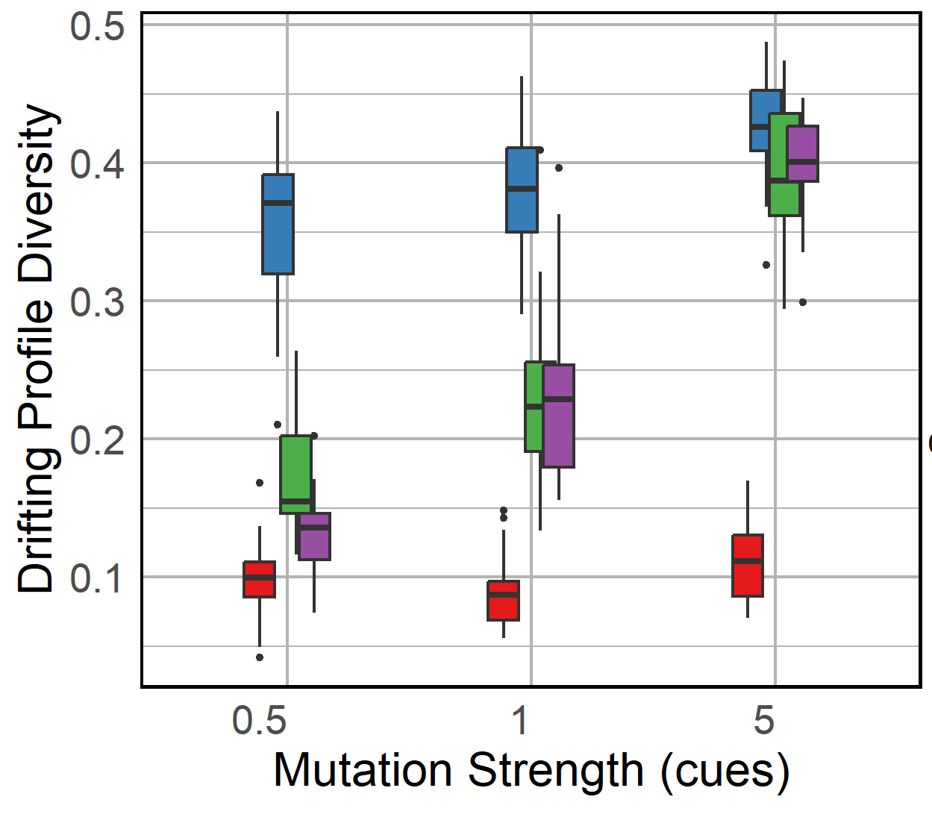
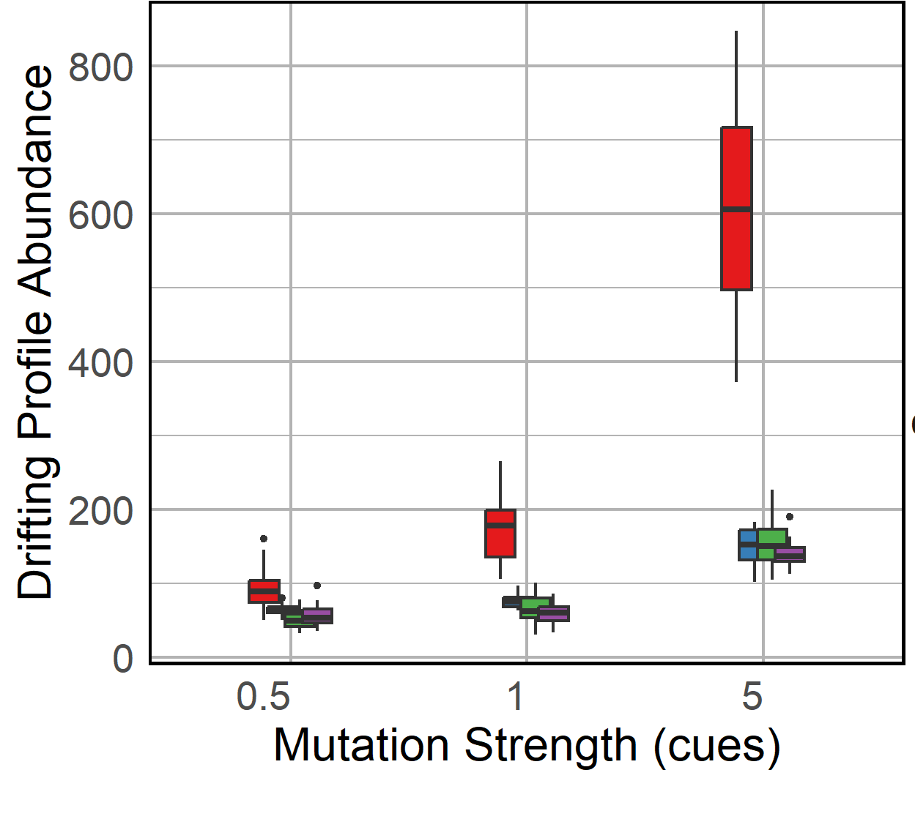



$$μ_{cues}=0.5$$
$$μ_{cues}=1$$
$$μ_{cues}=5$$
A)
B)
C)
D)
Notes:
Fig S4*

Slide 10
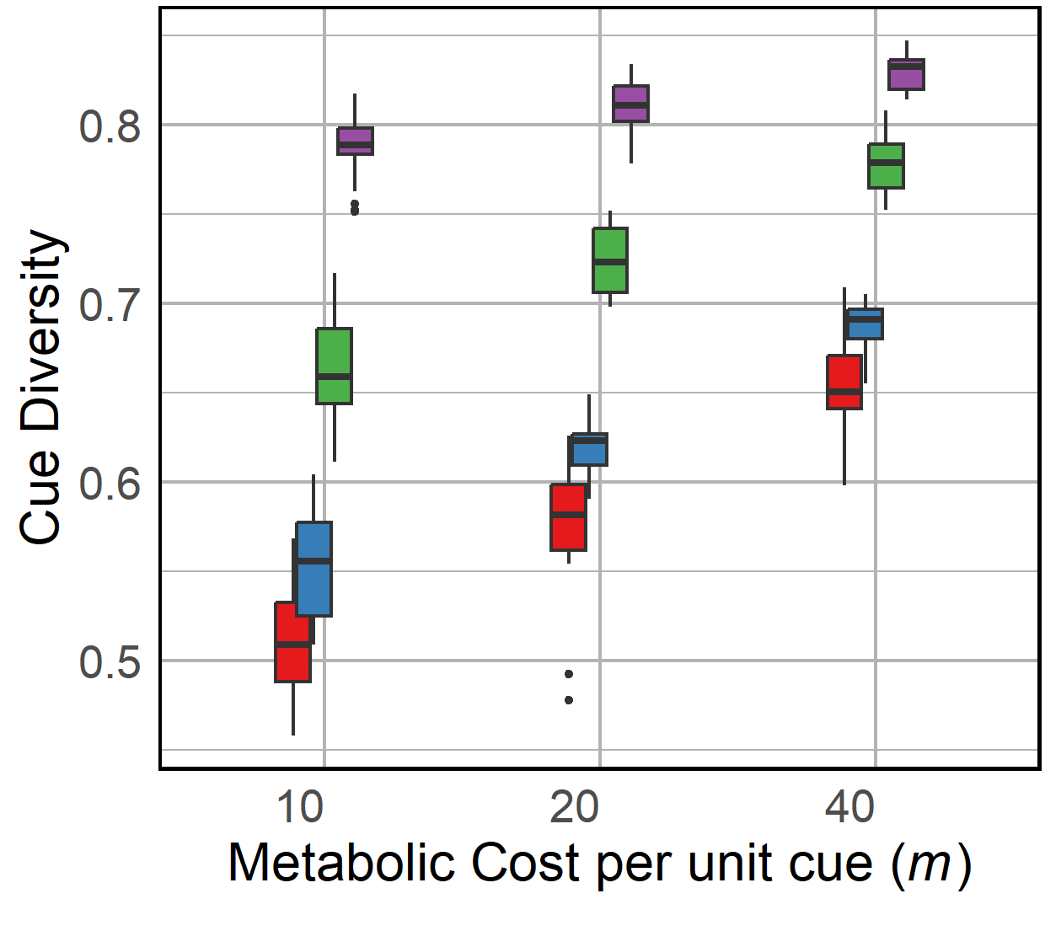
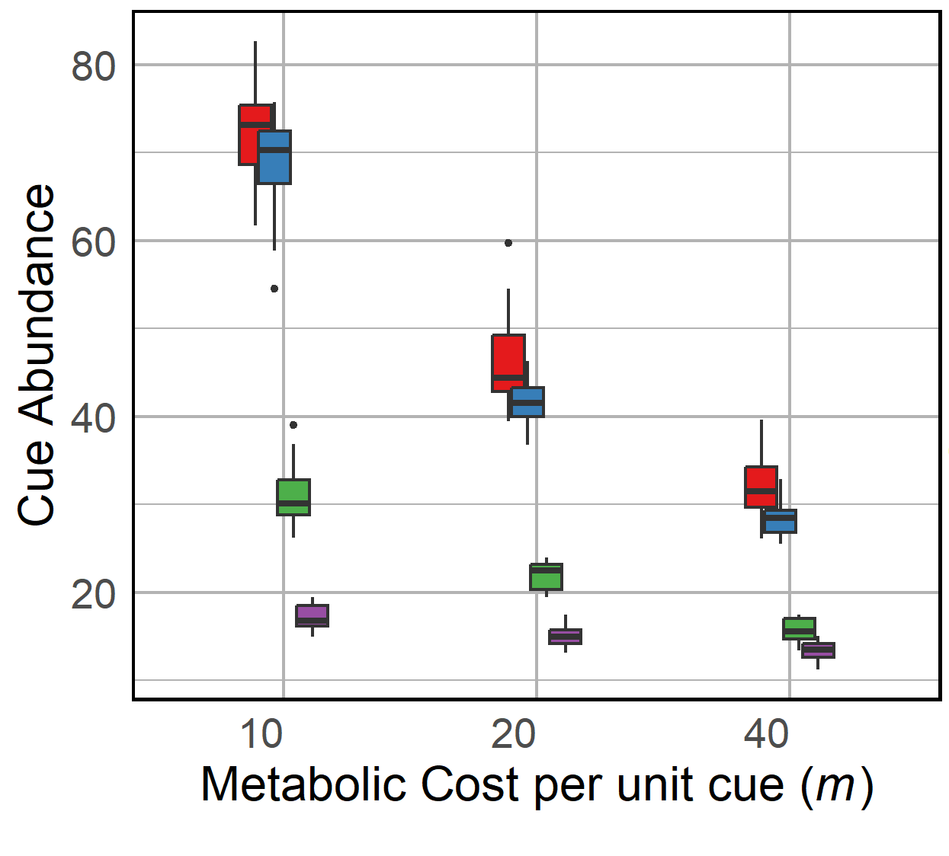
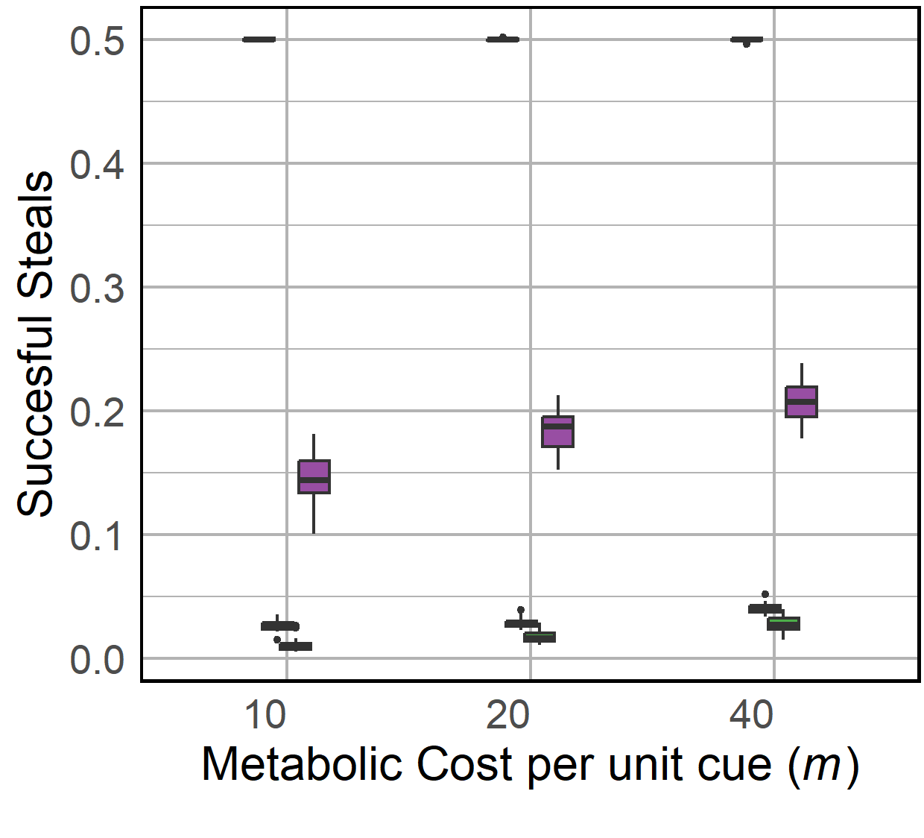
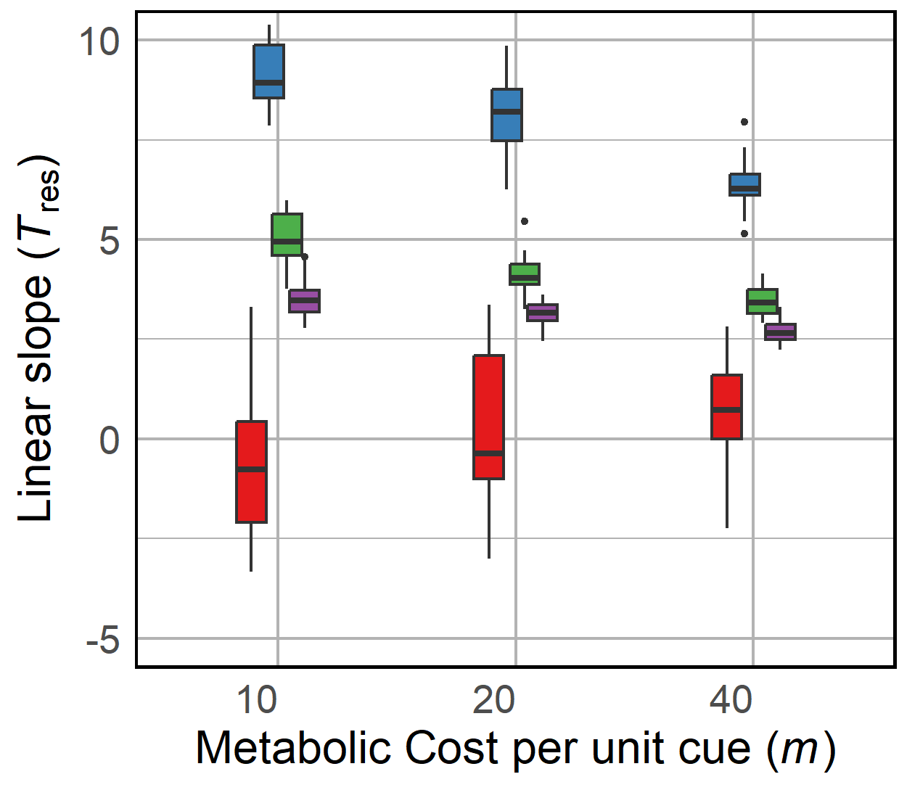
A)
B)
C)
D)
Notes:
S5

Slide 11
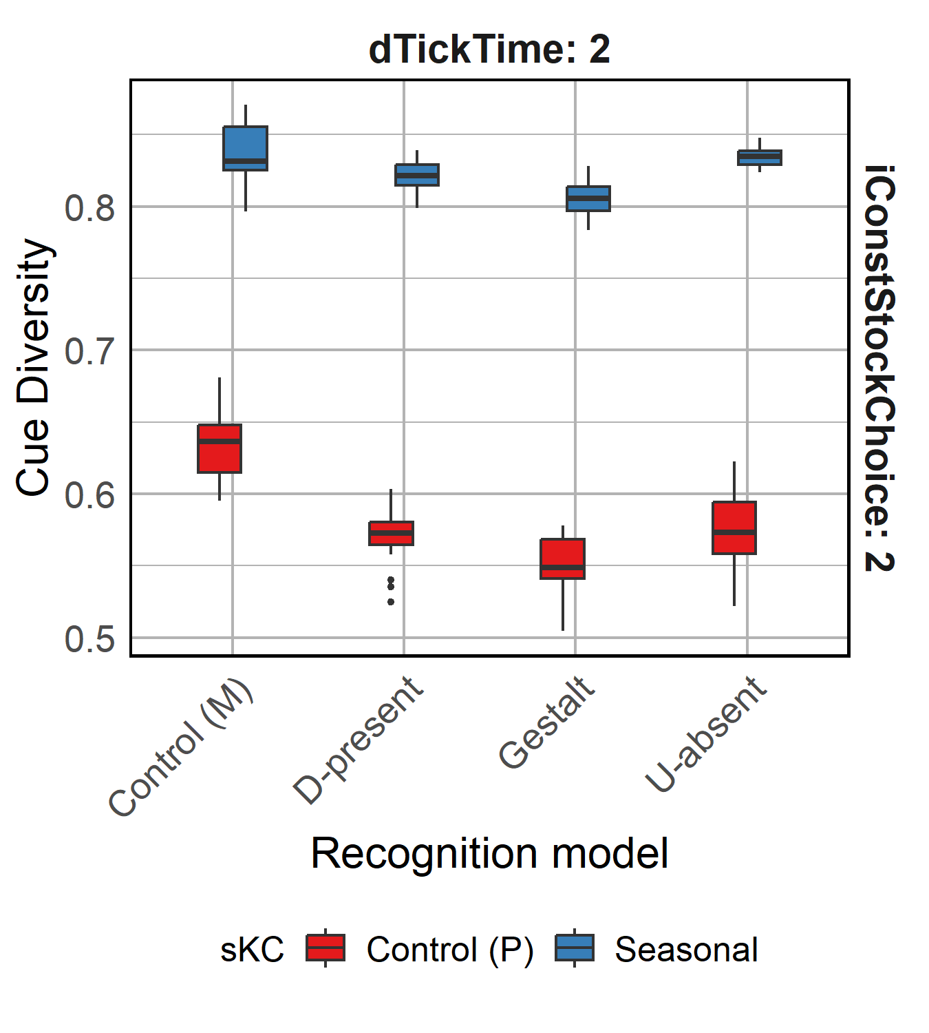
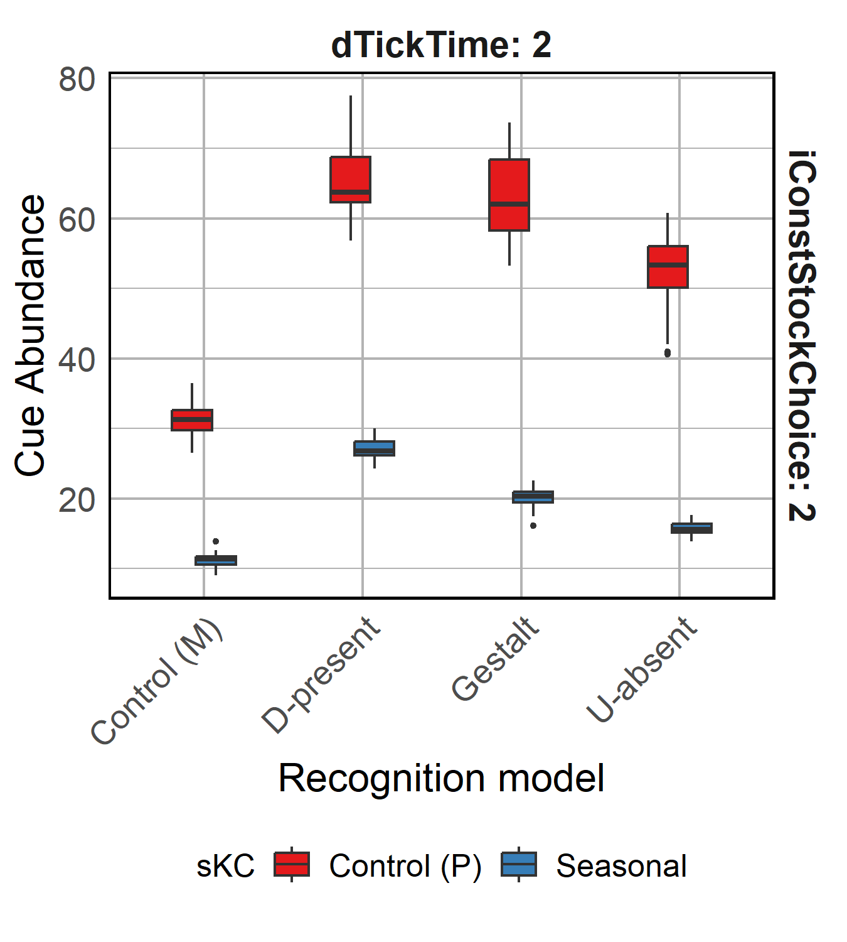
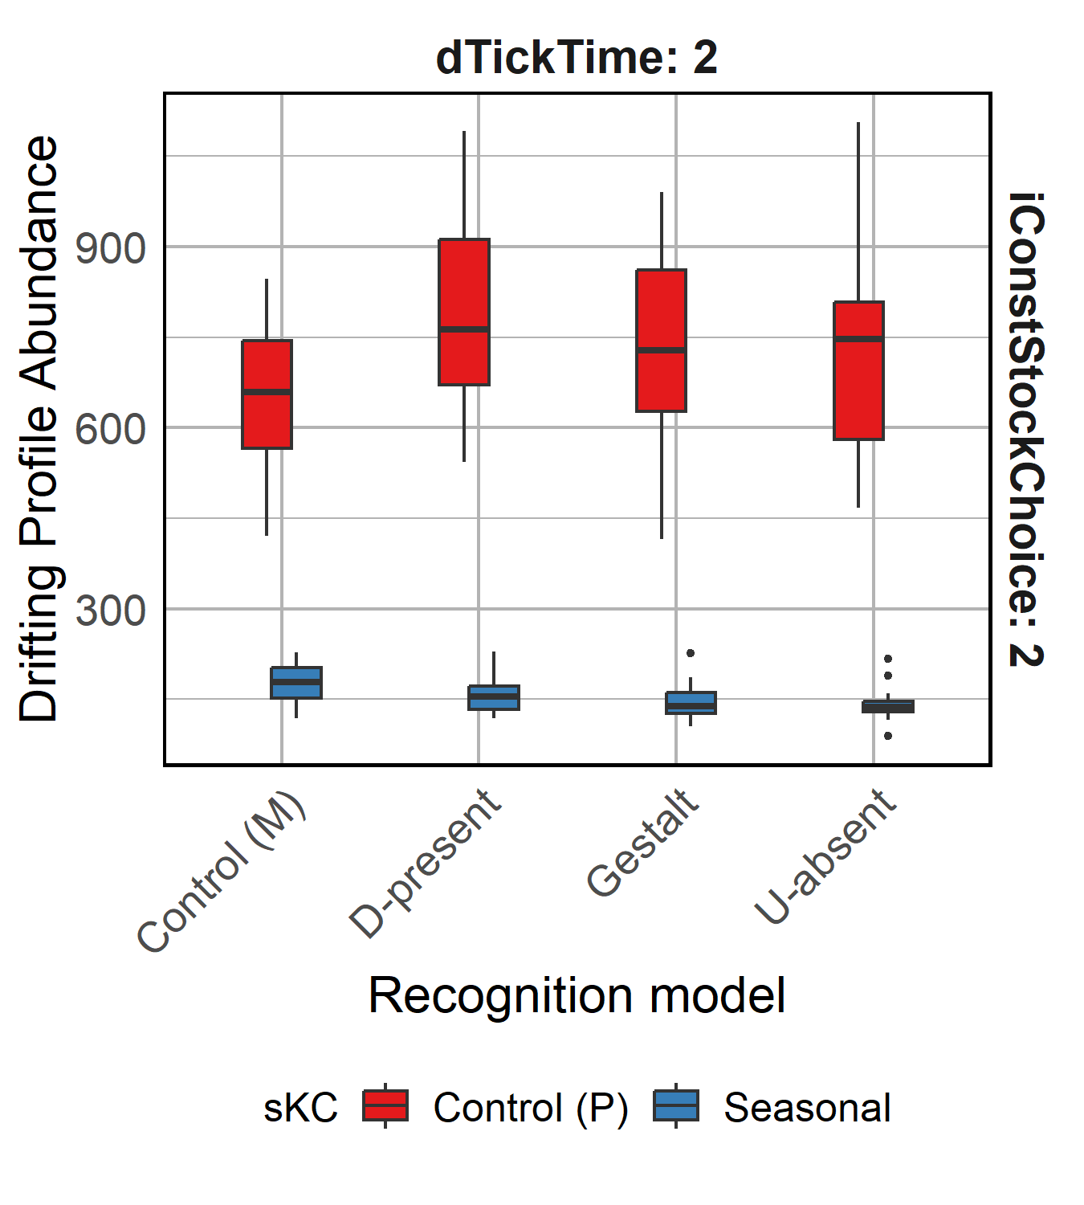
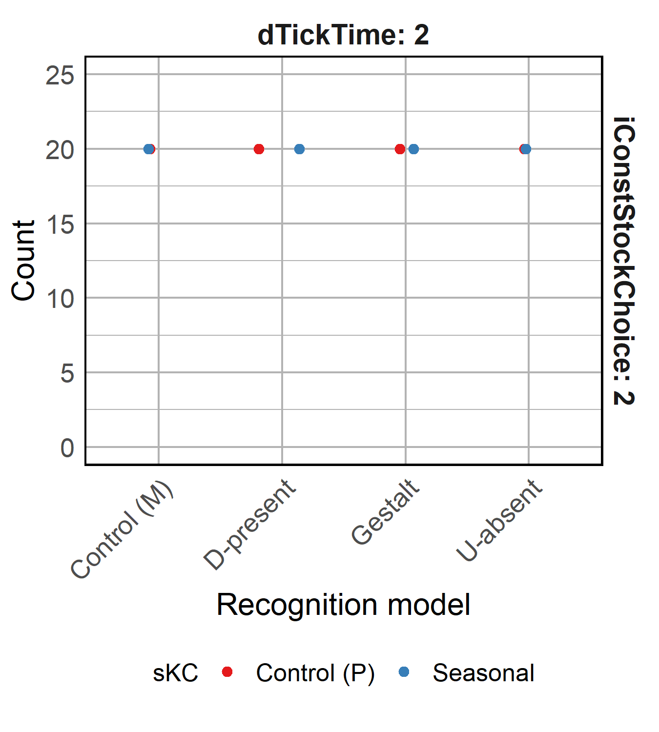
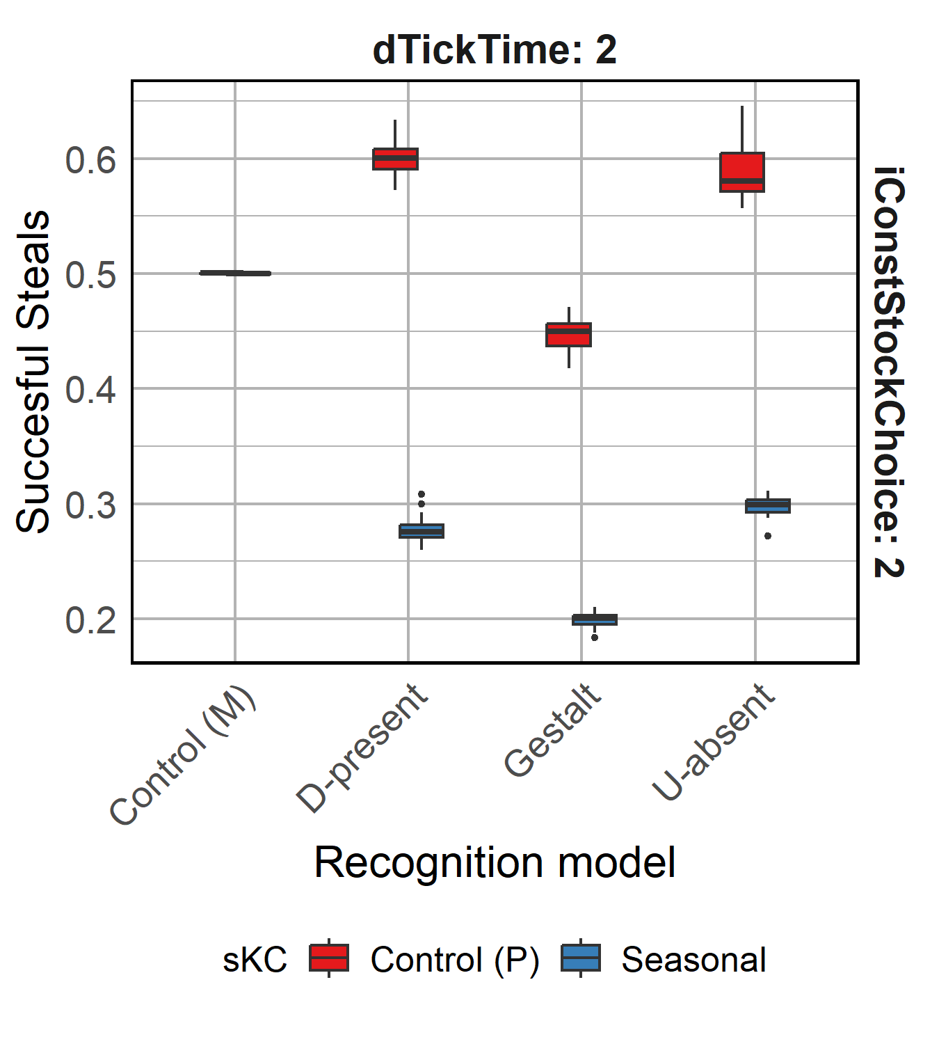
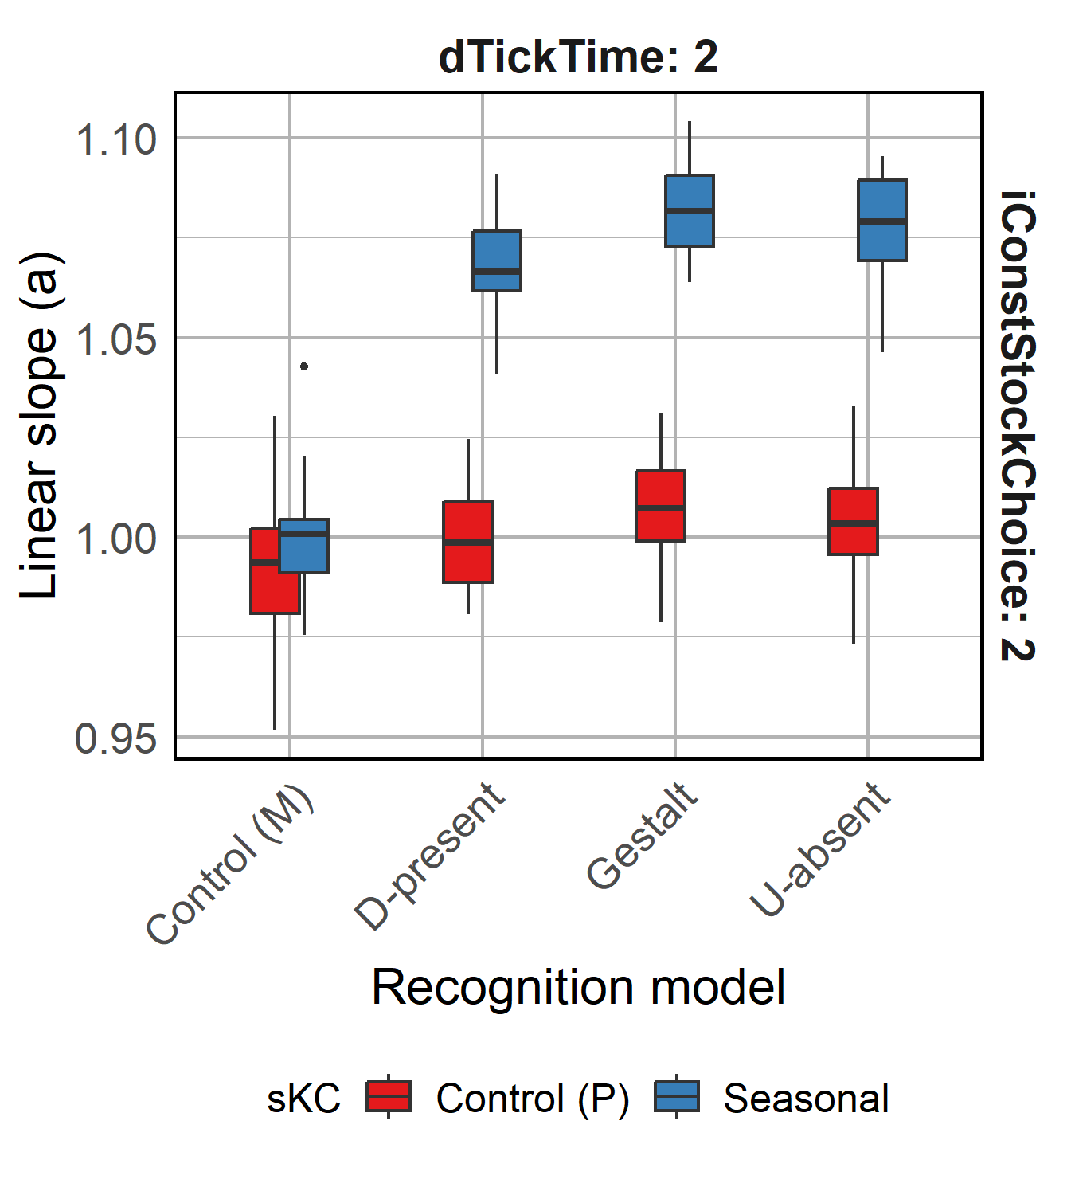
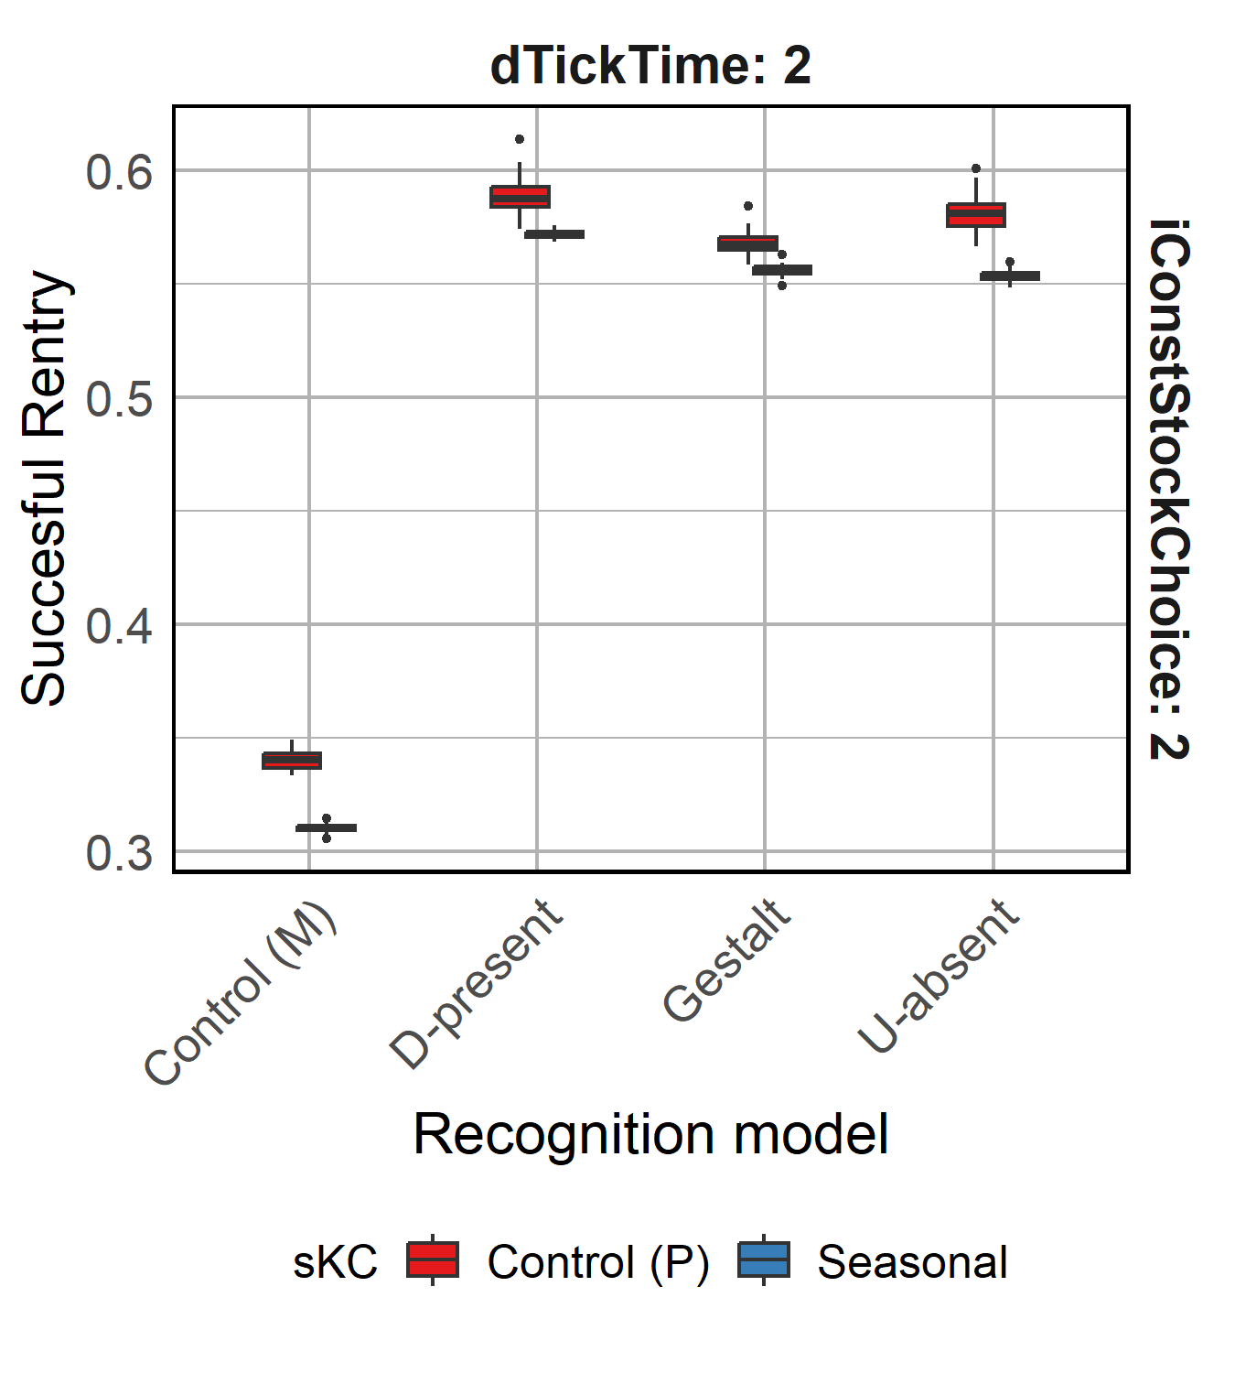
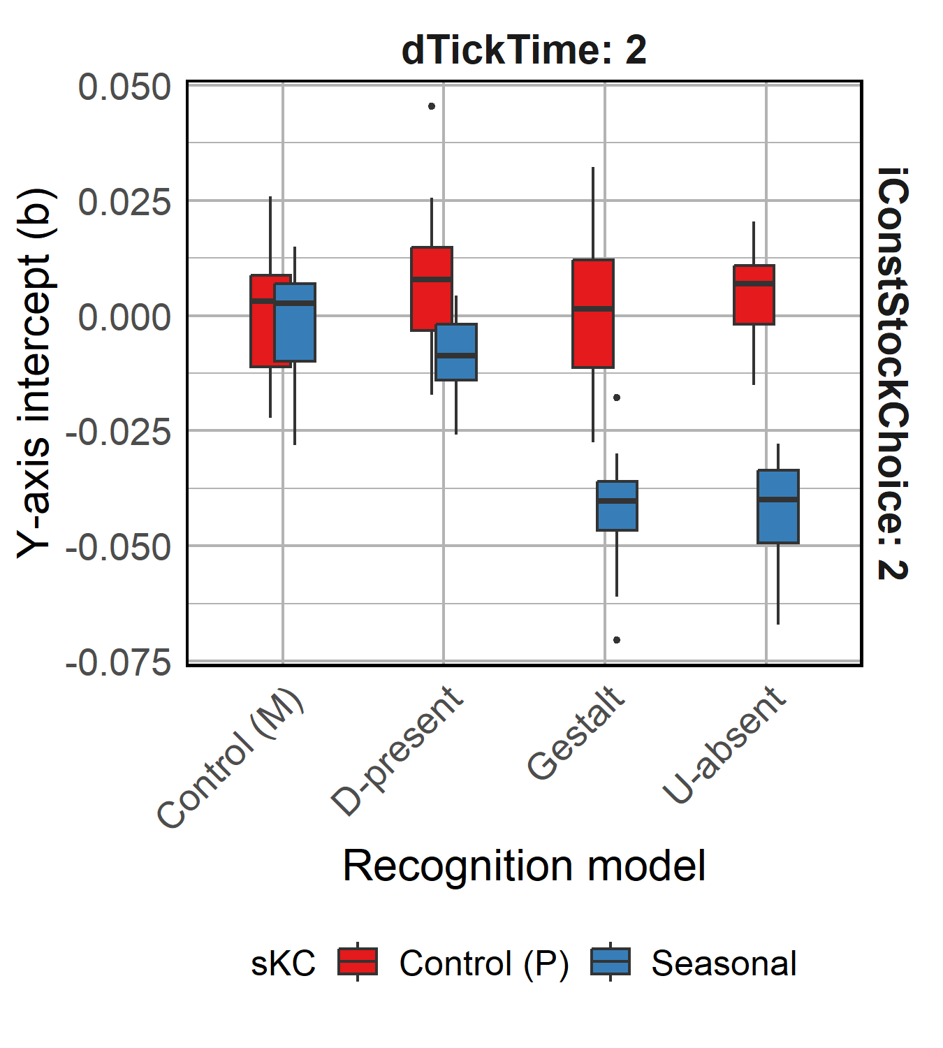
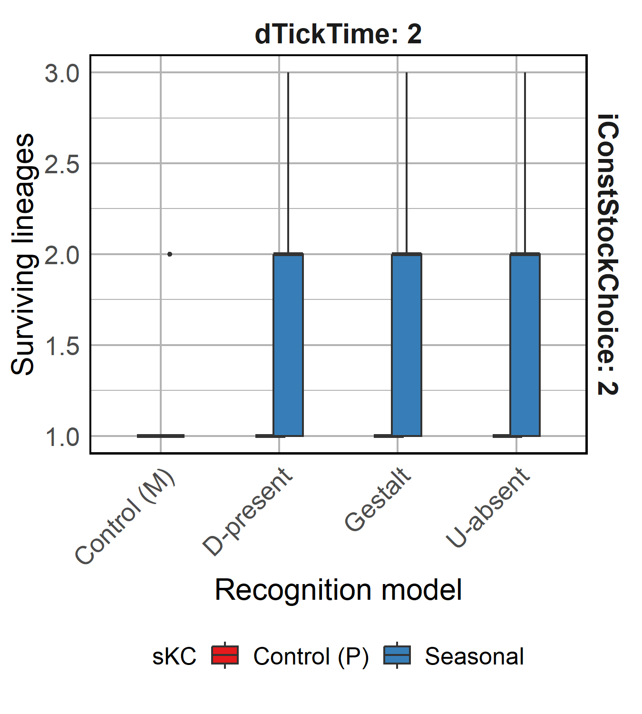
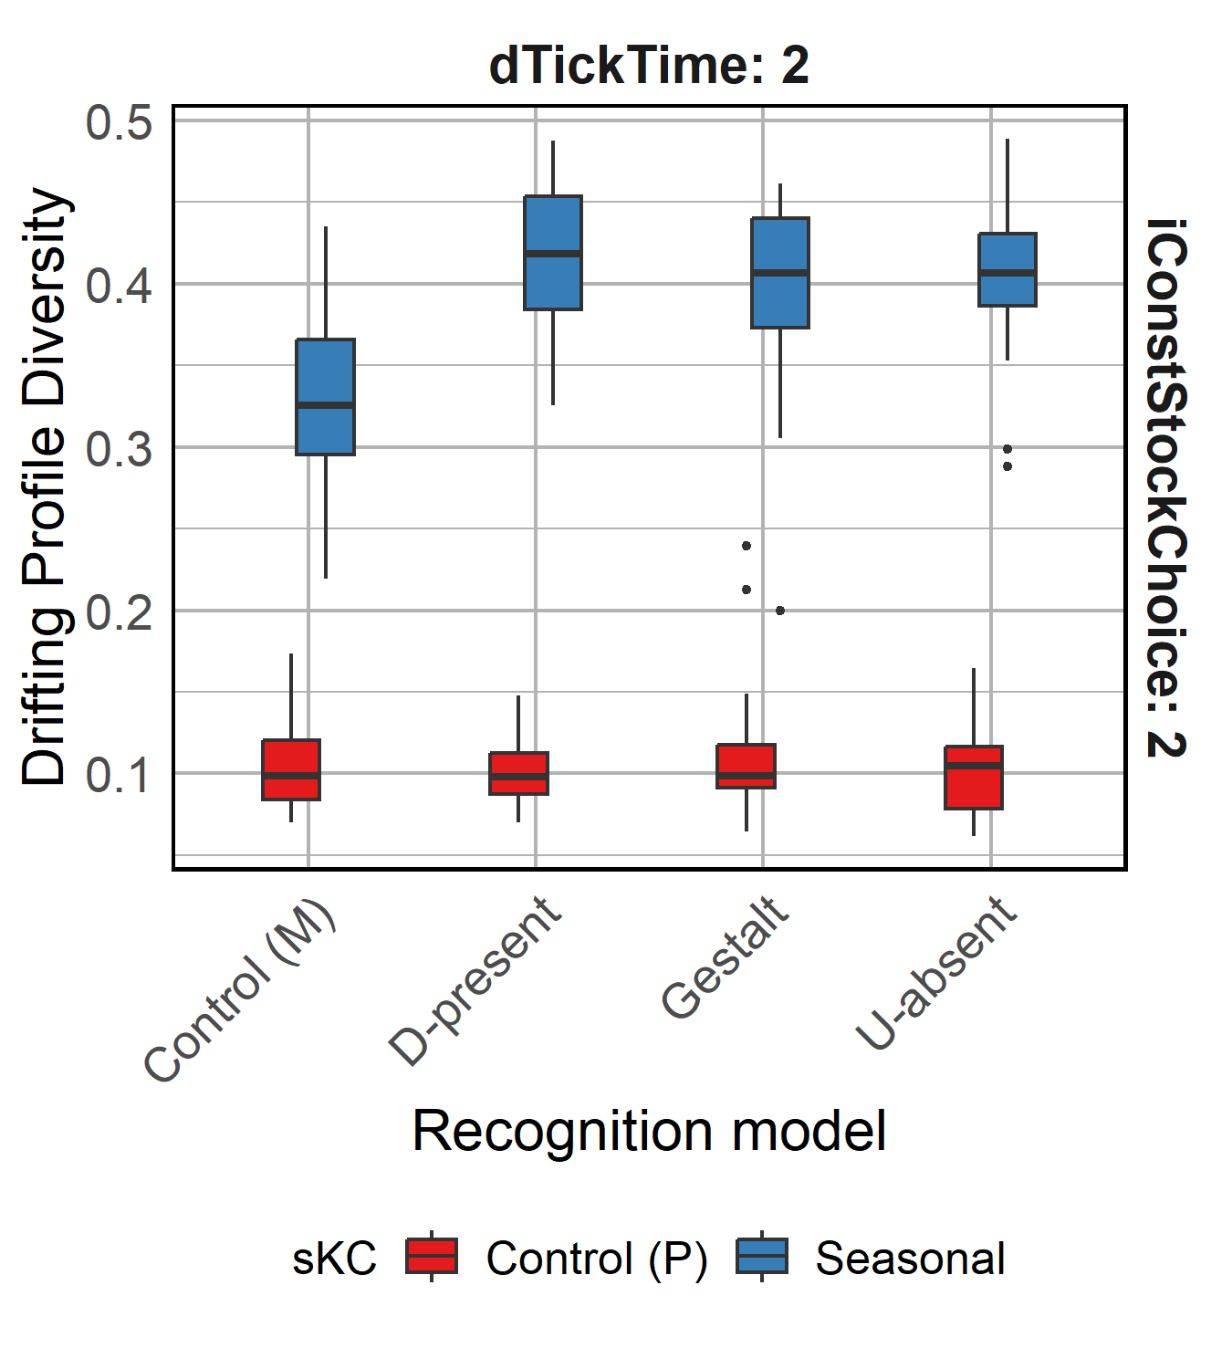
Notes:
Base

Slide 12
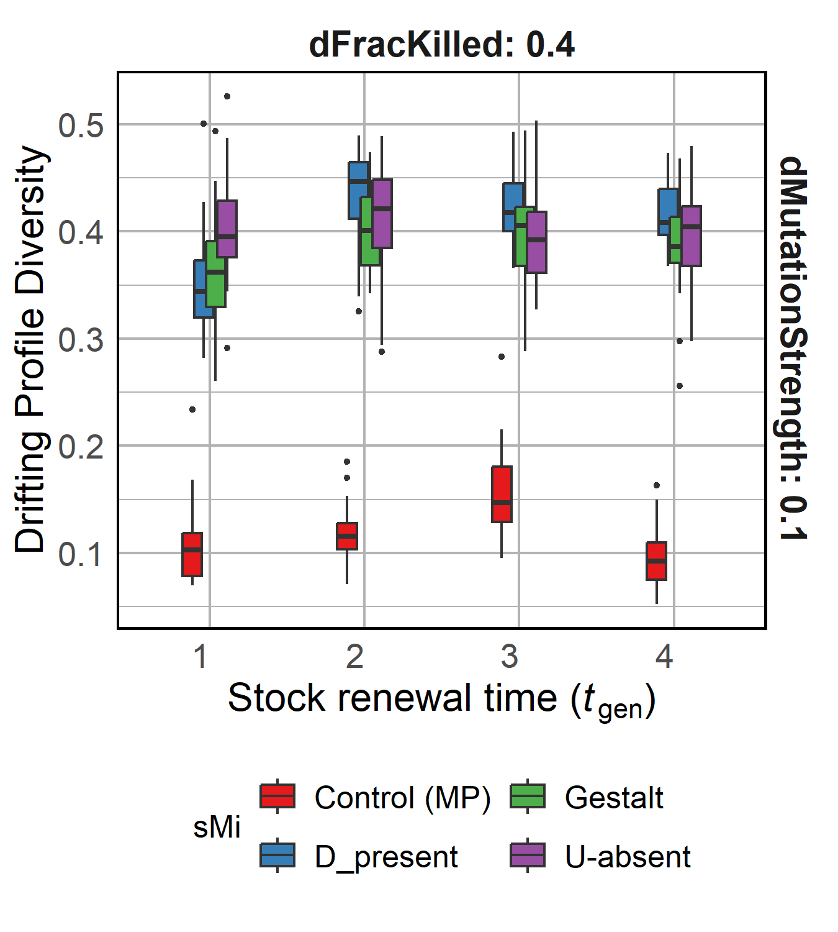
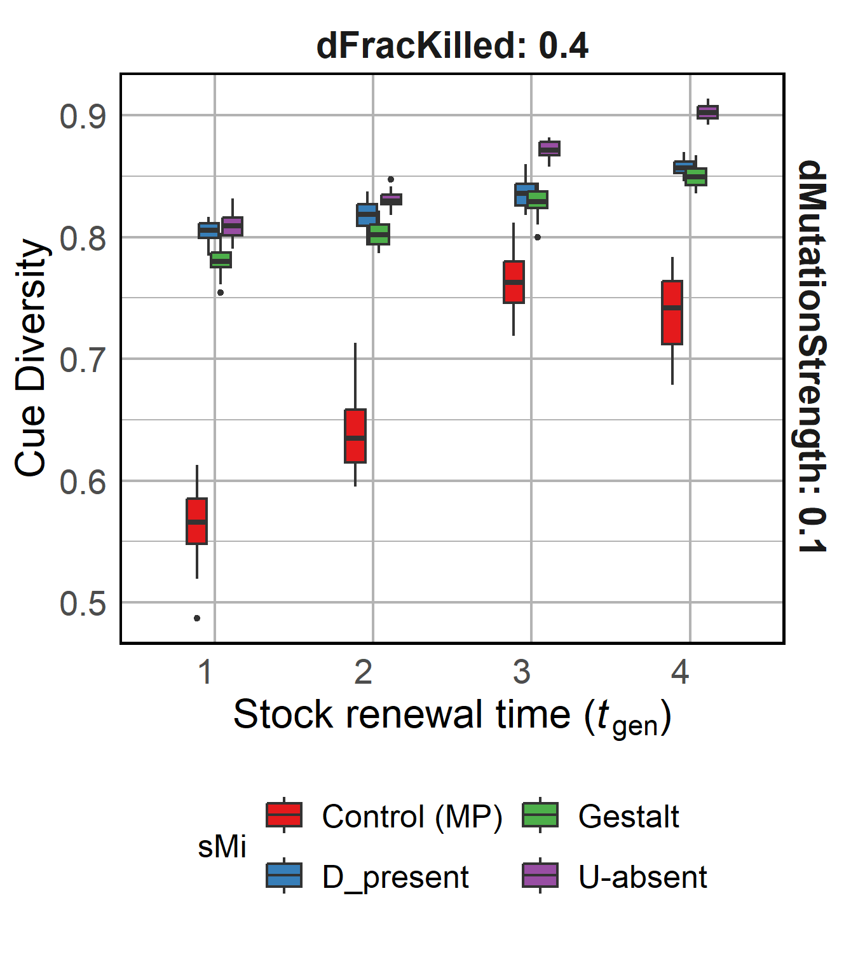
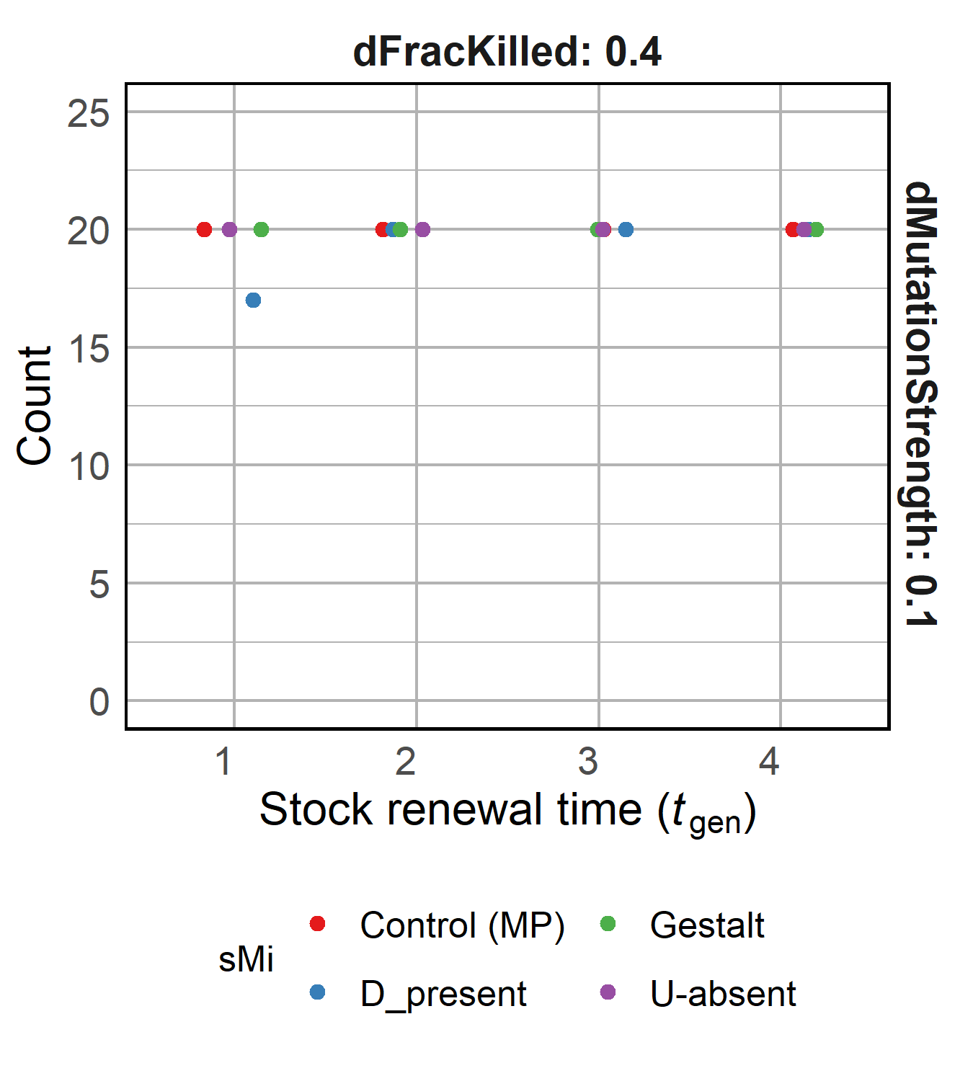
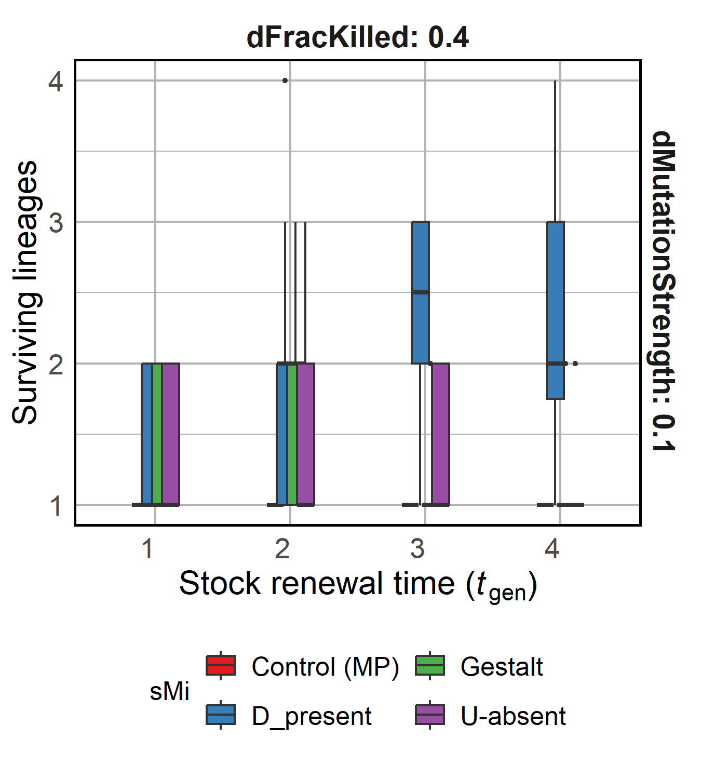
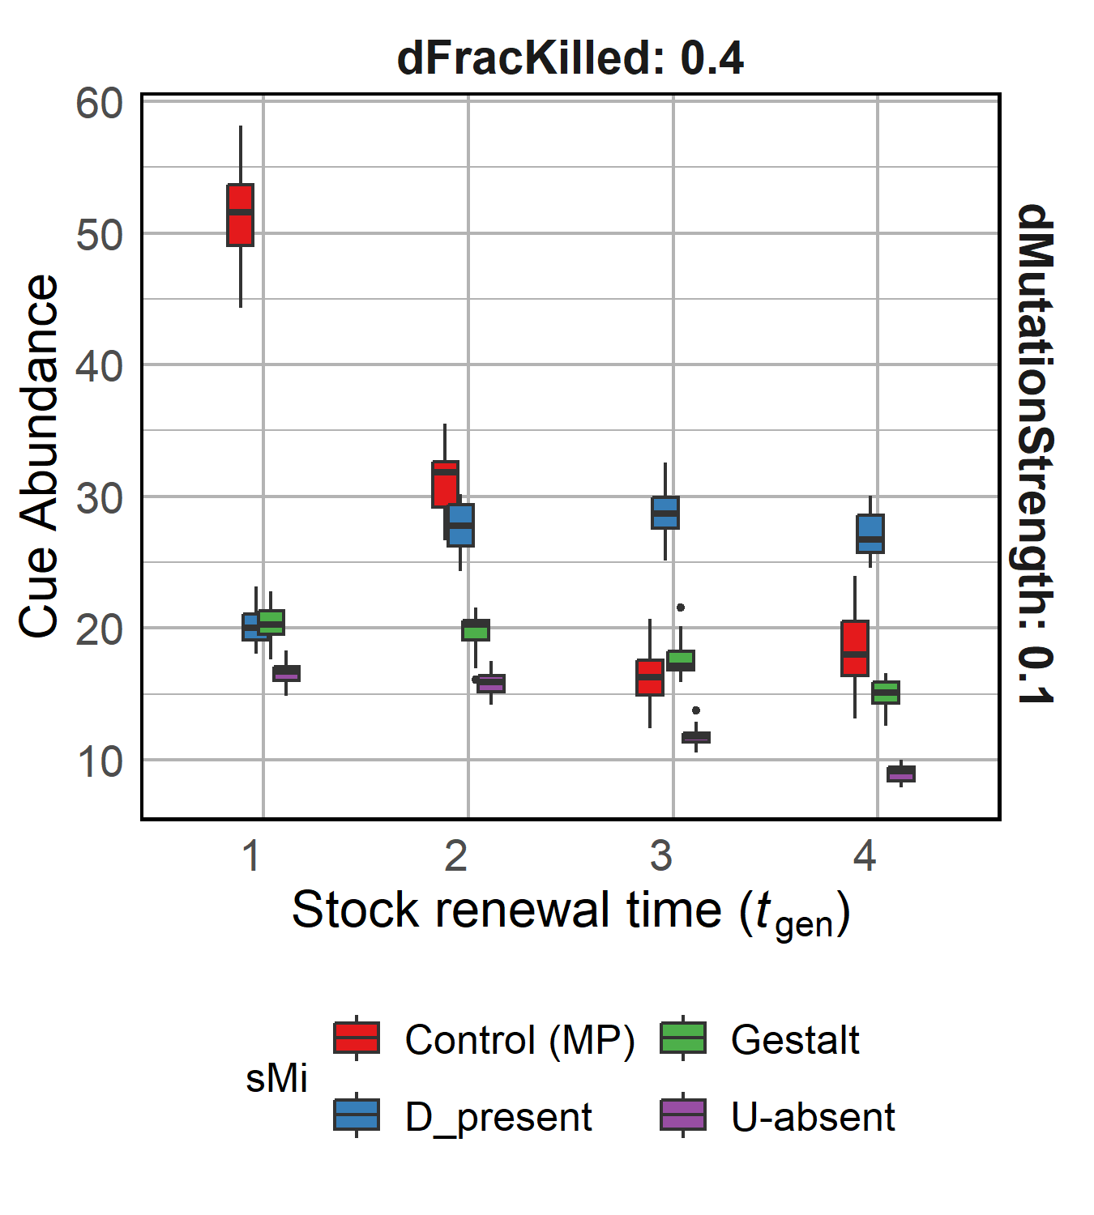
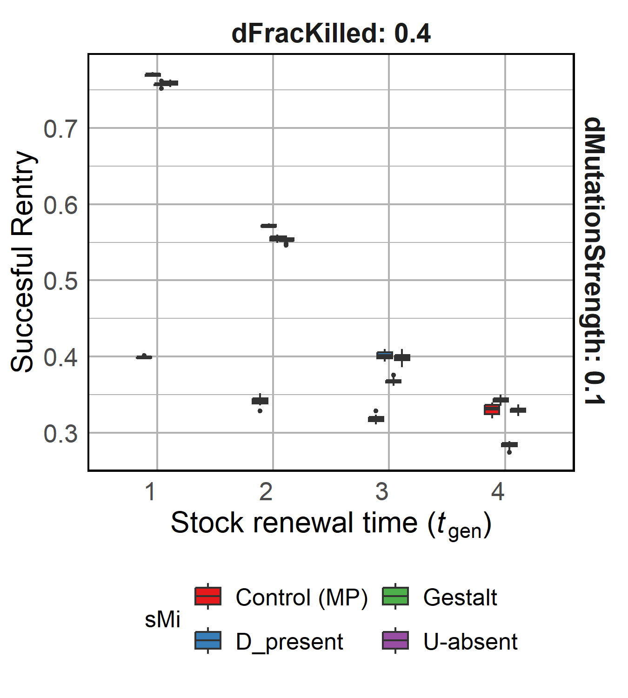
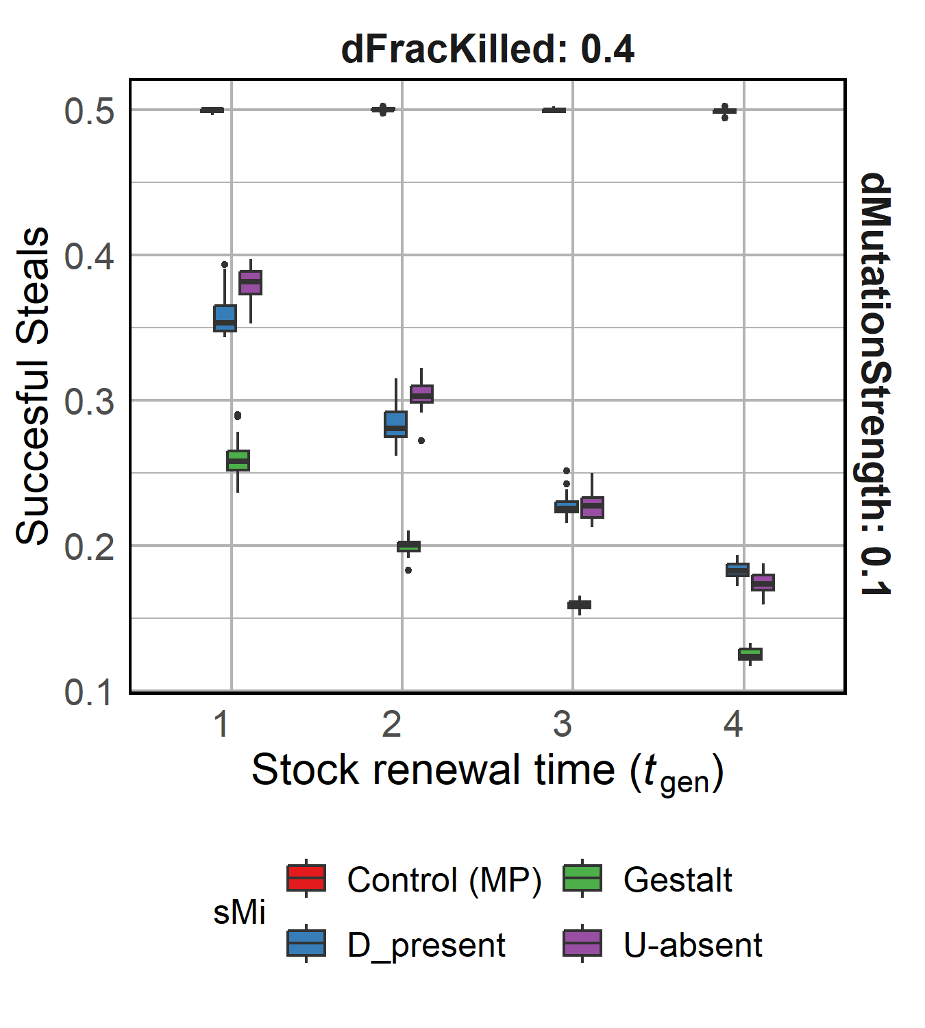
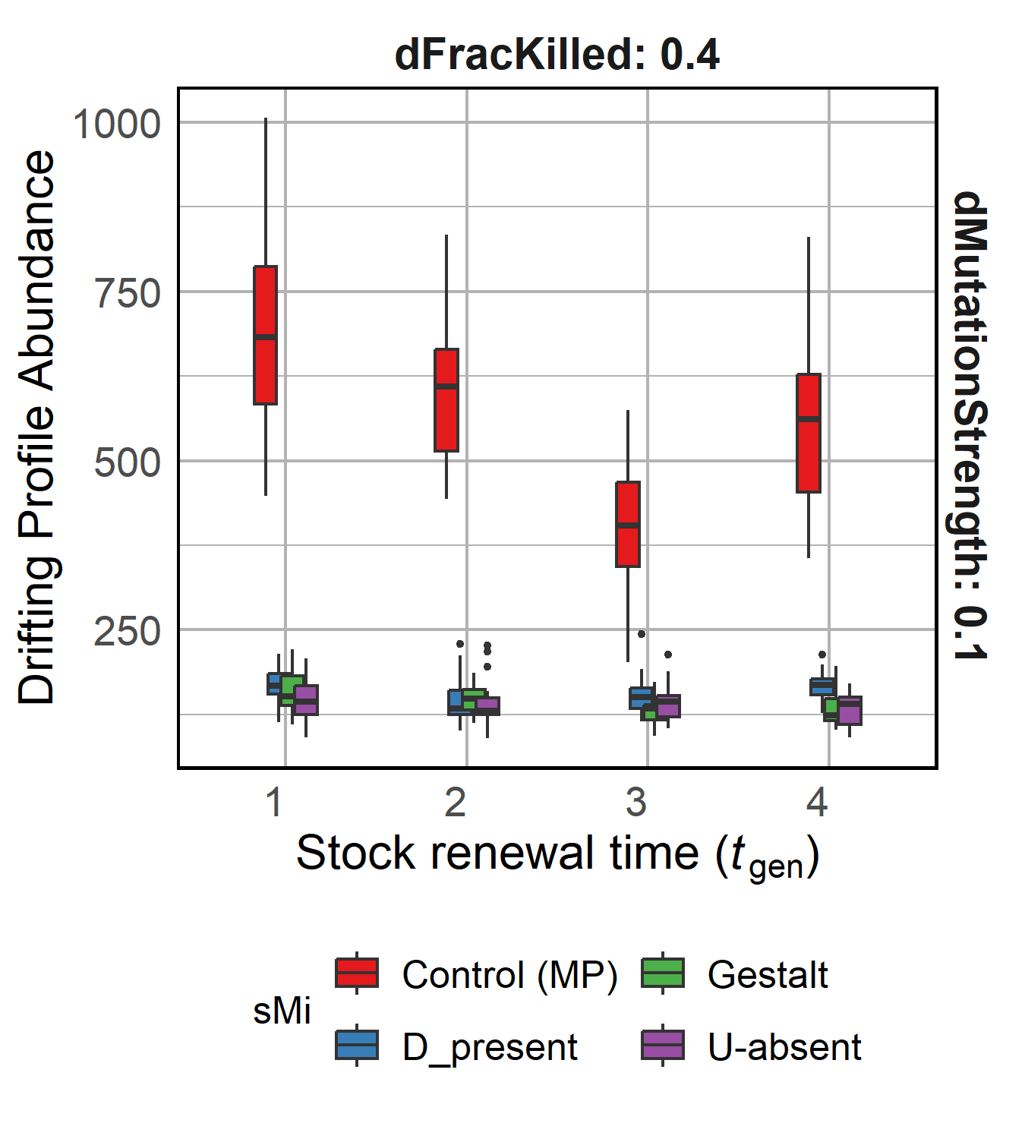

Slide 13
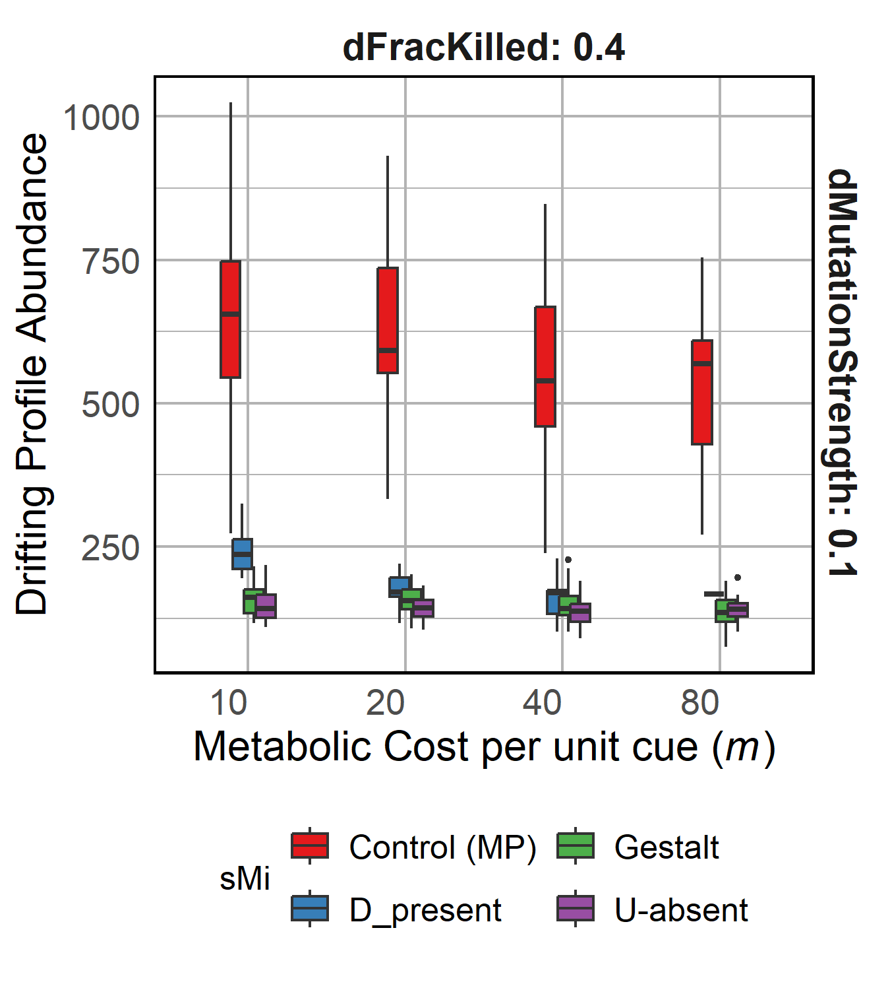
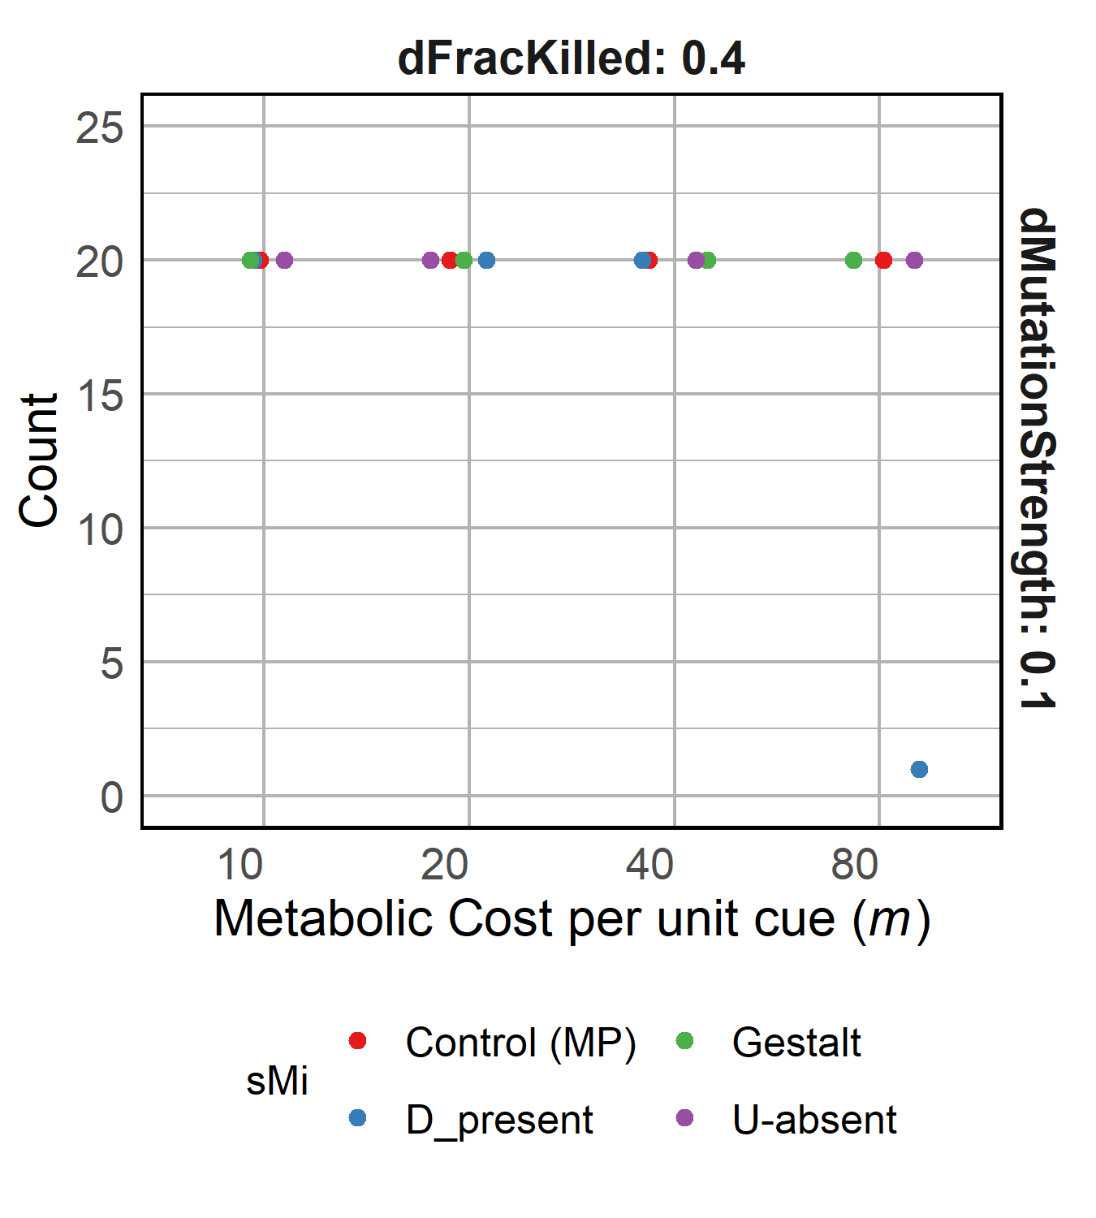







Slide 14









Slide 15









Slide 16
Co-evo

Slide 17











Slide 18
R1.1.1 Cue diversity is maintained
Higher Cue-diversity and lower Cue-abundance evolved
Cue-diversity can persist even if a single lineage survives
Selection still acting on Control (P)
Notes:
NUMBER OF CUES
Generalist vs Specialist

Slide 19




R1.1.2 Drift control
Compared to Drift control, our system evolves much higher cue diversity and cue abundance

Slide 20
R1.2 Reducing food availability to the population
Decreasing food availability
Decreasing food availability
Increased raiding due to low population food stock necessitates more stringent checks, observed via increased diversity, reduced success of raids and more lineages surviving
Notes:
Cue diversity increases as availability of food decreases.
Cue abundance decreases with decreasing resources, except in D-present recognition model.
Metabolic constraints to D-present

Slide 21
R1.2 Reducing food availability to the population

Slide 22
R1.3 Varying Selection Strength
Increasing selection strength
Increasing selection strength
Increasing selection reduces diversity, presumably through a “bottleneck” effect. Increasing stealing success and reducing surviving lineages further suggest reduced diversity.

Slide 23
R1.3 Varying Selection Strength

Slide 24
R1.4 Varying Metabolic Costs
Increasing metabolic costs
Increasing metabolic costs
Increasing metabolic costs affect D-present model the most and U-absent the least.
It does not affect the stealing success for any model system.
Notes:
Stealing success of Gestalt??

Slide 25
R1.4 Varying Metabolic Costs

Slide 26
R1.5 Varying mutation strength of cues
Increasing mutation strength
Increasing mutation strength
Varying mutation strength does not affect diversity or stealing success majorly except for D-present model

Slide 27
R1.5 Varying mutation strength of cues
Notes:
Cue diversity increases as availability of food decreases.
Cue abundance decreases with decreasing resources, except in D-present recognition model.
Metabolic constraints to D-present

Slide 28


R1.6 Constant population food stock
Increasing food availability
Increasing food availability
Even with high diversity and low food availability (blue box), the constant food availability results low reliance on stealing resources from other nests
Notes:
< Mention low stealing value >

Slide 29



R1.6 Constant population food stock

Slide 30
Results 2: Co-evolving Cues and Perception
Yes, cue diversity can persist in the presence of an evolved recognition system!!
Can cue diversity and a corresponding recognition system co-evolve?

Slide 31

R2.1 Expected recognition curve evolves
Decreasing food availability
Decreasing food availability
Rejection probability
Chemical distance
A stringent cue recognition system evolves, where availability of food does not affect slope and intercept values except for D-present.
Notes:
< Mention low stealing value >

Slide 32
R2.2 Cue diversity increases in a co-evolving system
Yes, cue diversity and a corresponding recognition system can co-evolve!!
Decreasing food availability
Decreasing food availability
Cue diversity shows decreasing trend with decreasing food availability for D-present model, even though success of stealing decreases??
Notes:
< Mention low stealing value > < Non significant >

Slide 33
R2.2 D-present behaves weird (as always)
Notes:
< Mention low stealing value >

