Slide 1


Reproducing initial results: 18th July 2024
Behind Enemy Lines: Investigating Crozier’s Paradox and Recognition of Nestmates through an Individual Based Model
Lakshya Chauhan MEME 2022 – 2024
Supervisor: Margaux Brigitte, Florian Menzel, Hanna Kokko

Slide 2
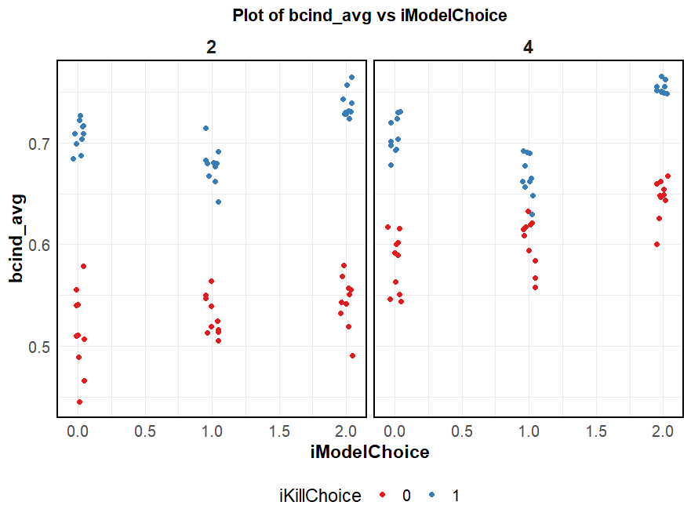
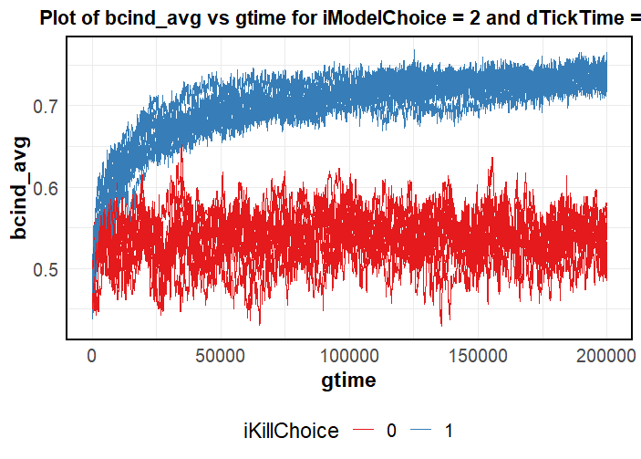
F1: Effect of model choice on cue diversity (individual)
iModelChoice
0 | Gestalt
1 | Dpresent
2 | Uabsent
iKillChoice
0 | Random
1 | Sorted
dTickTime
2 | Low
4 | High

Slide 3
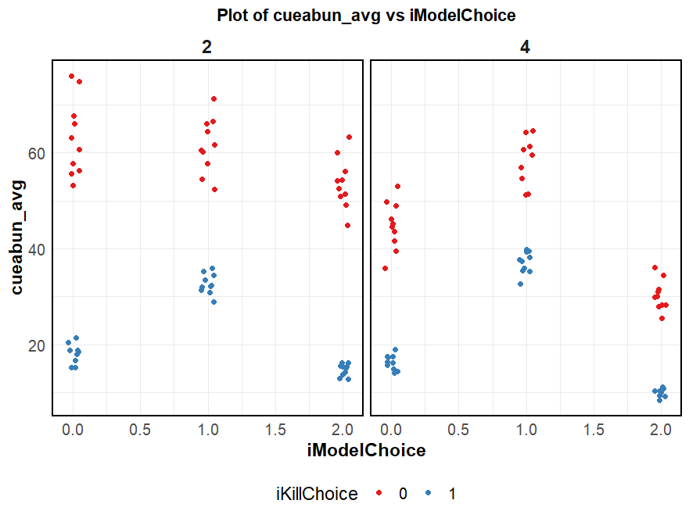
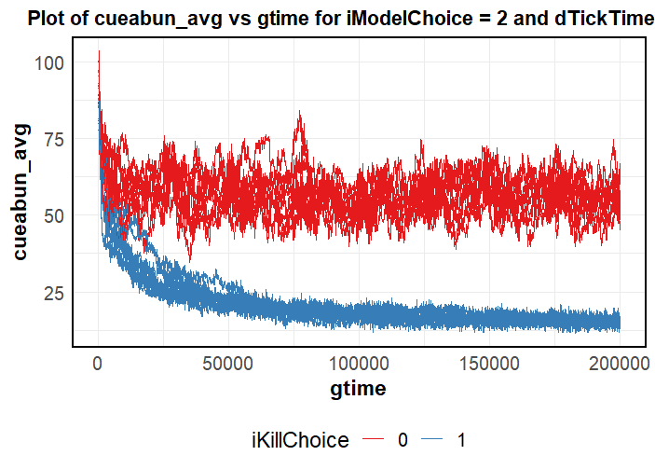
F1: Effect of model choice on cue abundance
iModelChoice
0 | Gestalt
1 | Dpresent
2 | Uabsent
iKillChoice
0 | Random
1 | Sorted
dTickTime
2 | Low
4 | High

Slide 4
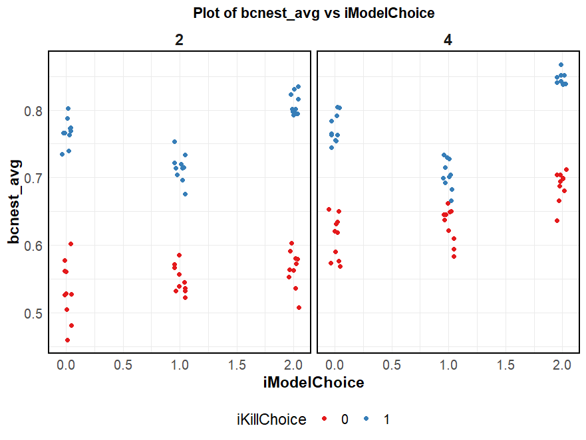
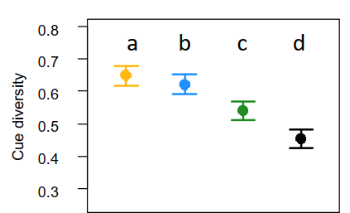
Effect of model choice on cue diversity (nest)
iModelChoice
0 | Gestalt
1 | Dpresent
2 | Uabsent
iKillChoice
0 | Random
1 | Sorted
dTickTime
2 | Low
4 | High

Slide 5
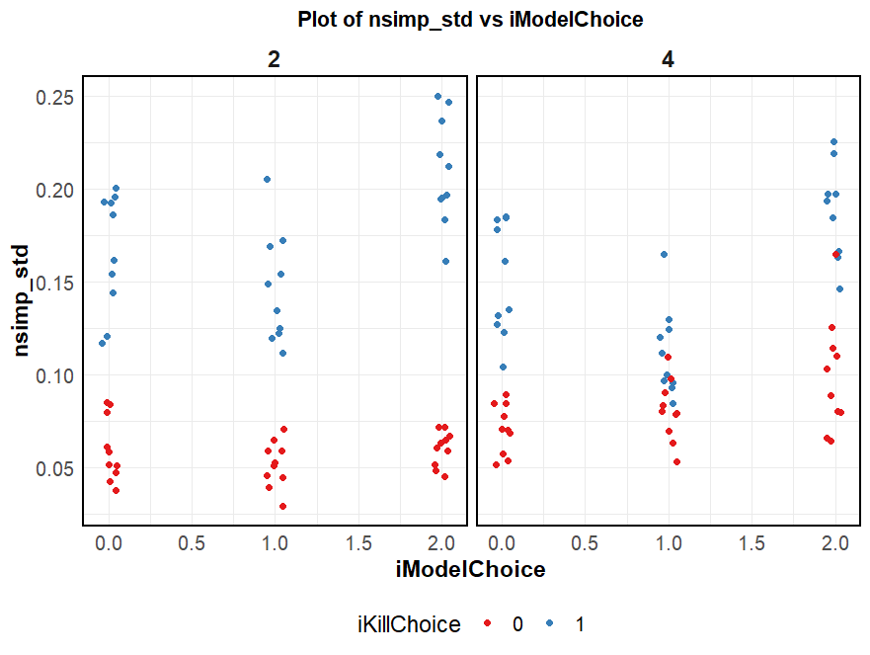
Effect of model choice on cue diversity (simpson spread)
iModelChoice
0 | Gestalt
1 | Dpresent
2 | Uabsent
iKillChoice
0 | Random
1 | Sorted
dTickTime
2 | Low
4 | High

Slide 6
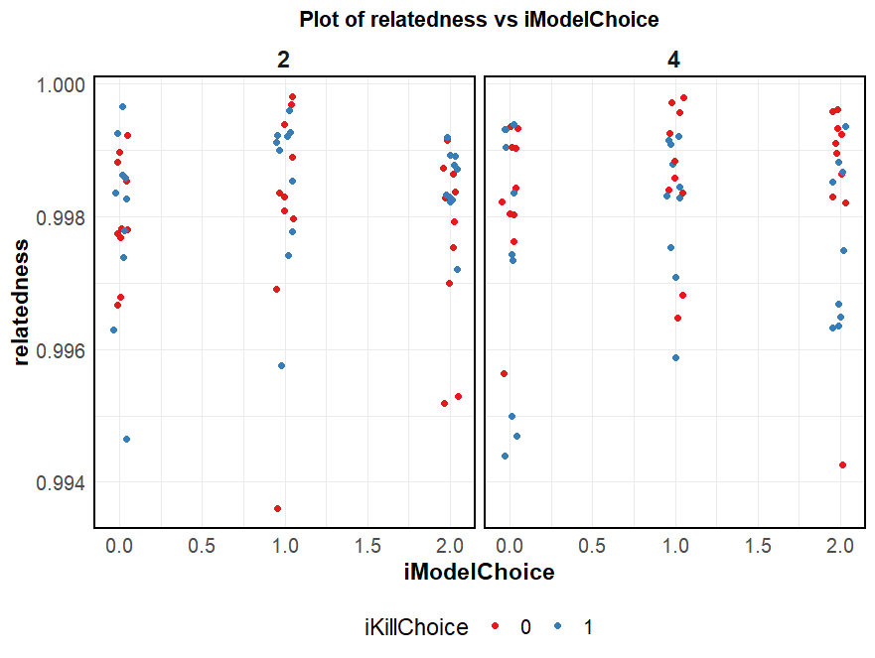
Varying model choice for other outputs

Slide 7
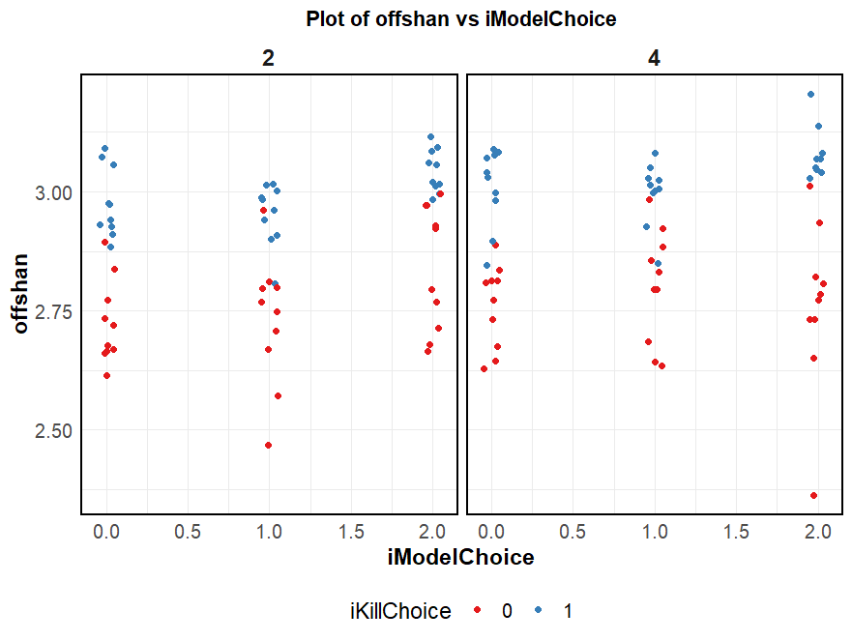
Varying model choice for other outputs
iModelChoice
0 | Gestalt
1 | Dpresent
2 | Uabsent
iKillChoice
0 | Random
1 | Sorted
dTickTime
2 | Low
4 | High

Slide 8
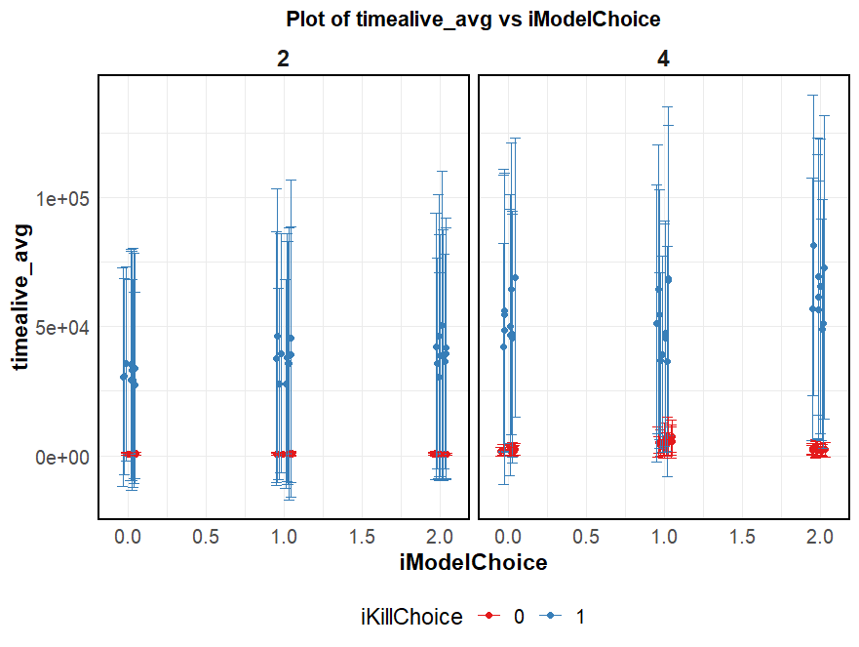
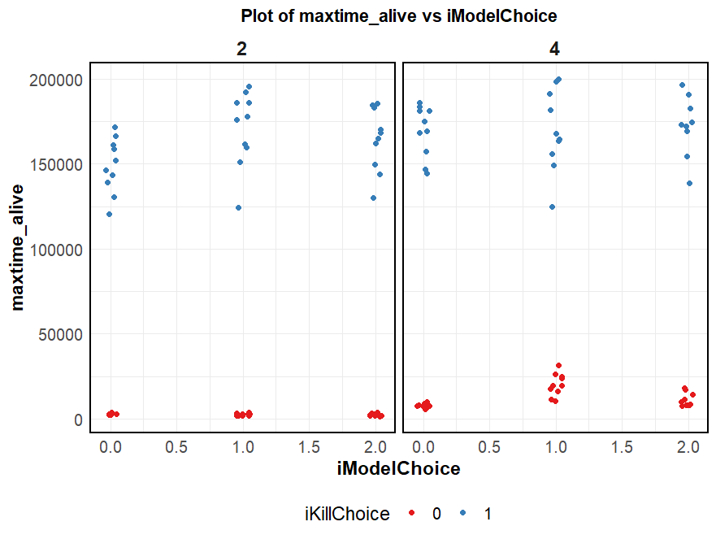
Varying model choice for other outputs

Slide 9
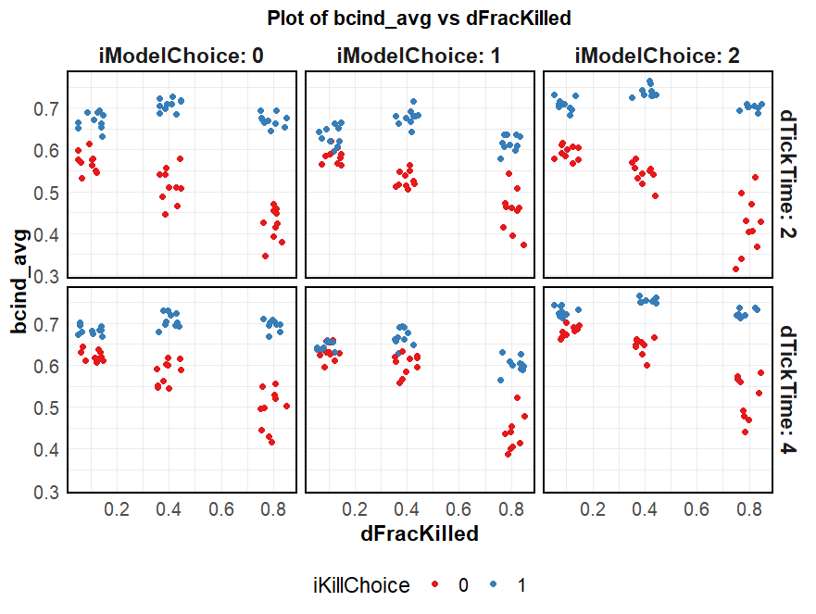
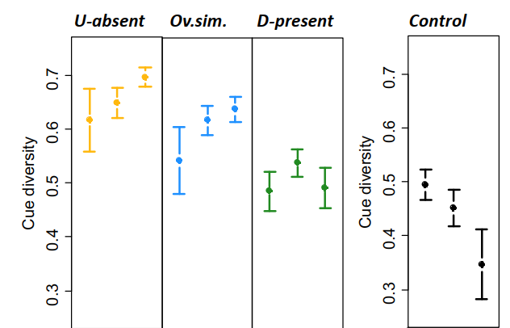
Varying selection strength for cue diversity
iModelChoice
0 | Gestalt
1 | Dpresent
2 | Uabsent
iKillChoice
0 | Random
1 | Sorted
dTickTime
2 | Low
4 | High

Slide 10
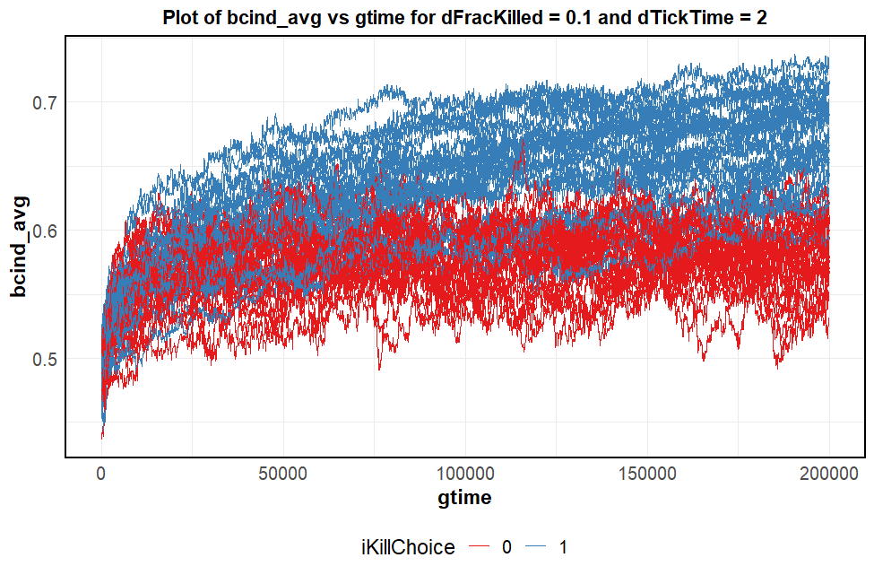
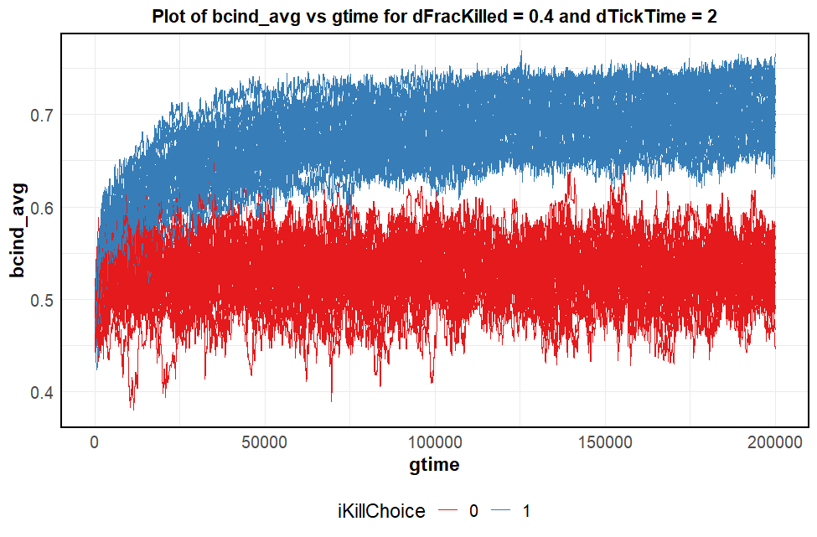
Varying selection strength for cue diversity

Slide 11
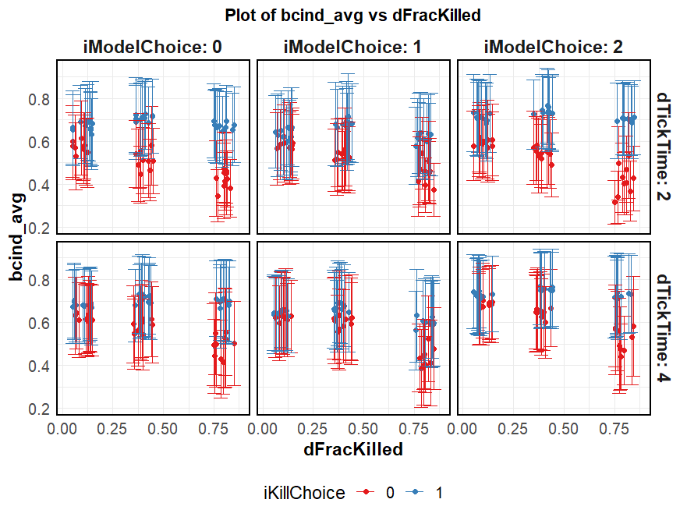
Varying selection strength for cue diversity
iModelChoice
0 | Gestalt
1 | Dpresent
2 | Uabsent
iKillChoice
0 | Random
1 | Sorted
dTickTime
2 | Low
4 | High

Slide 12
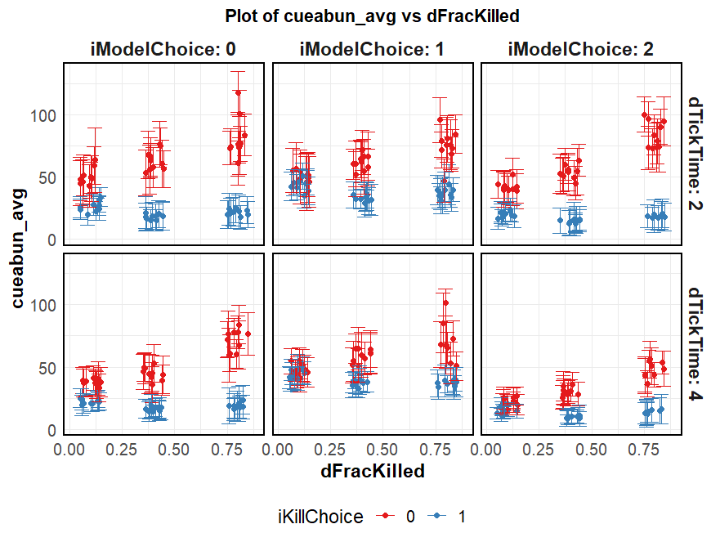
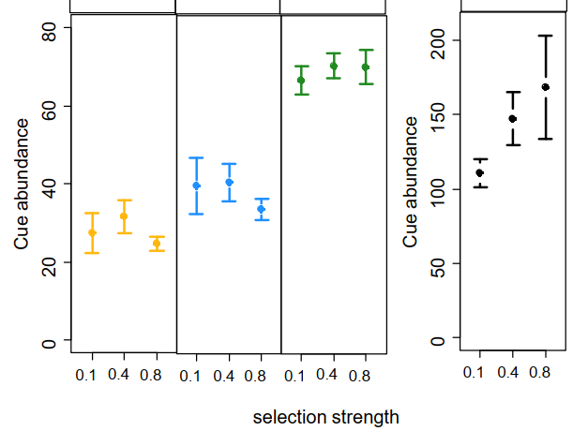
Varying selection strength for cue abundance
iModelChoice
0 | Gestalt
1 | Dpresent
2 | Uabsent
iKillChoice
0 | Random
1 | Sorted
dTickTime
2 | Low
4 | High

Slide 13
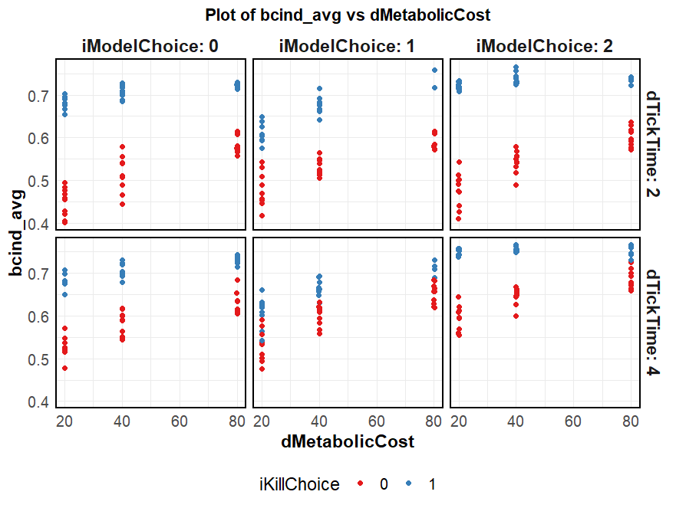
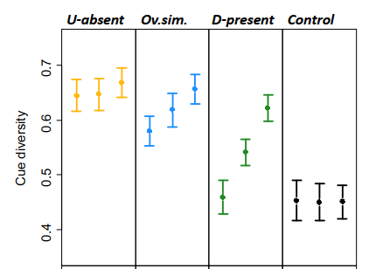
Varying metabolic cost for cue diversity
iModelChoice
0 | Gestalt
1 | Dpresent
2 | Uabsent
iKillChoice
0 | Random
1 | Sorted
dTickTime
2 | Low
4 | High

Slide 14
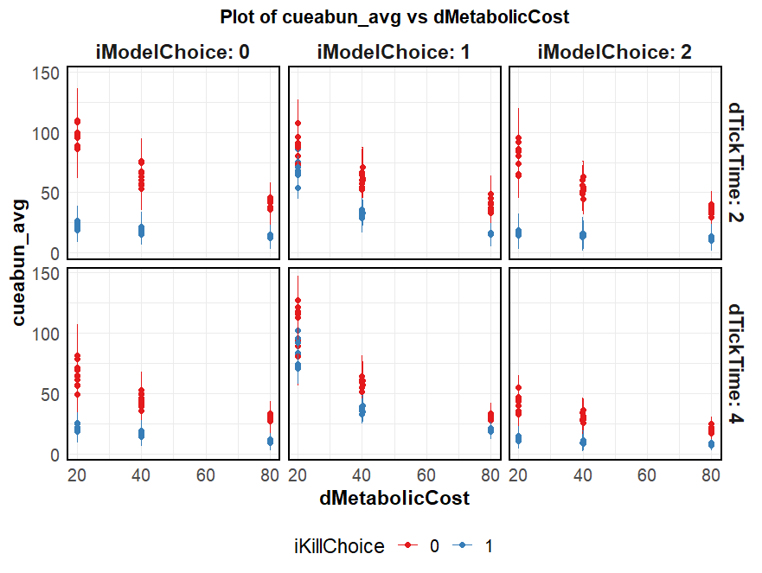
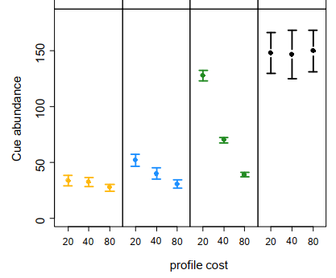
Varying metabolic cost for cue abundance
iModelChoice
0 | Gestalt
1 | Dpresent
2 | Uabsent
iKillChoice
0 | Random
1 | Sorted
dTickTime
2 | Low
4 | High
Notes:
Explore with a larger ExpParam value

Slide 15
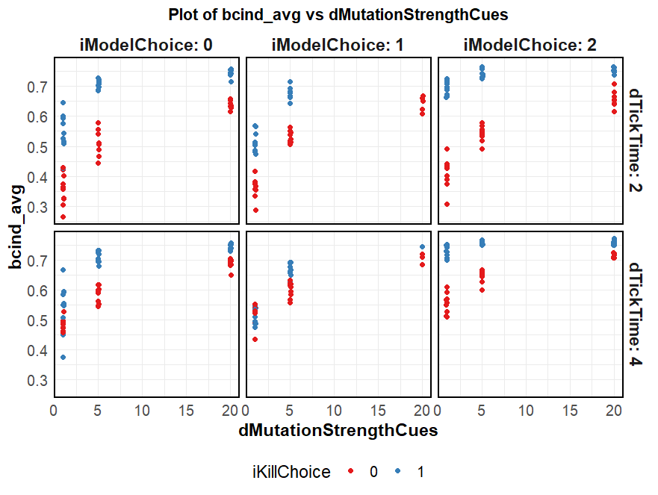
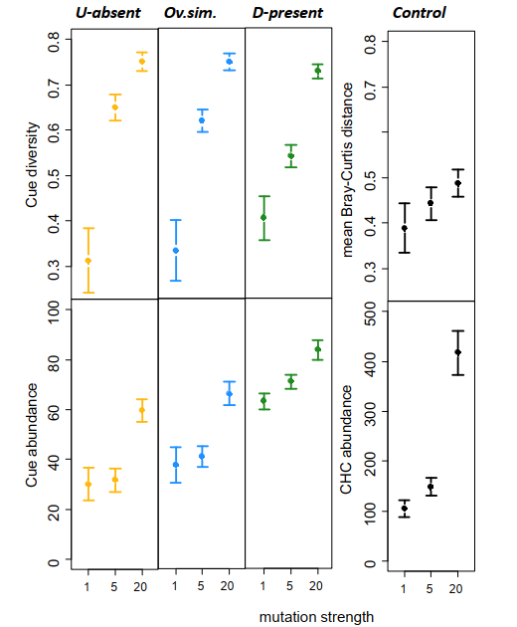
Varying mutation rate for cue diversity
iModelChoice
0 | Gestalt
1 | Dpresent
2 | Uabsent
iKillChoice
0 | Random
1 | Sorted
dTickTime
2 | Low
4 | High

Slide 16
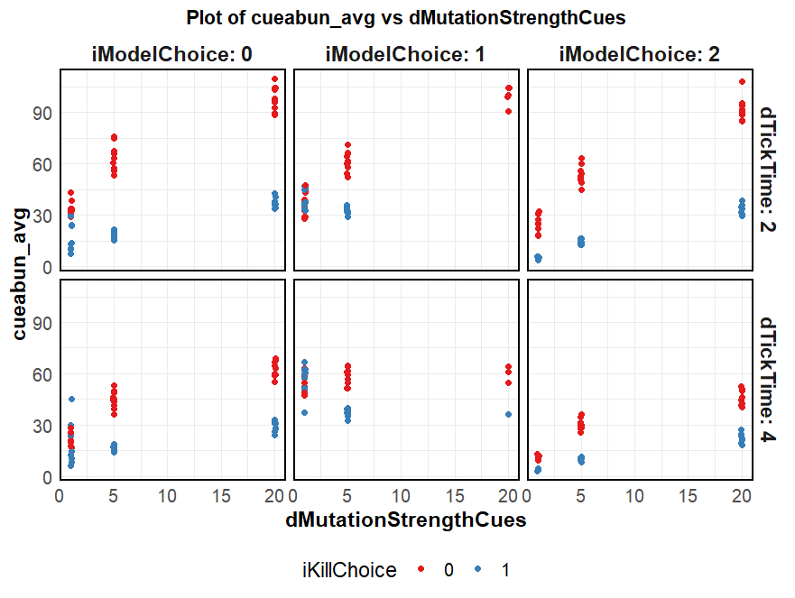
Varying mutation rate for cue abundance
iModelChoice
0 | Gestalt
1 | Dpresent
2 | Uabsent
iKillChoice
0 | Random
1 | Sorted
dTickTime
2 | Low
4 | High

Slide 17
Parameters to explore
Coevolve??
Constant pop stock
Generational death
Num colonies
- Linear vs Logistic - Effect of mutation rates? - What other explorations
- Various conditions of food availability
-
- Biological implications
- Effect of drift
September
Extra simulations / manuscript editing

Slide 18
Timeline
mid/end July
end July/early August
14th August
End of August
- Analyse initial results - Plan analyses - Plan exploration - Start writing methodology
- Obtain all results - Start collating results - Start defense prep - Finish major chunks of report
Thesis defense
Report submission
September
Extra simulations / manuscript editing

