Slide 1


Behind Enemy Lines: Investigating Crozier’s Paradox and Recognition of Nestmates through an Individual Based Model
Lakshya Chauhan MEME 2022 – 2024
Supervisor: Margaux Marie-France Brigitte, Hanna Kokko

Slide 2
Role of Cuticular Hydrocarbons
Introduction
Earlier work
Status
Next steps
CHCs proven to be recognition cues in ants
CHCs in nestmates are similar through sharing, Trophallaxis and grooming
Genetically mixed colonies, queen transplants and slave making ants also exist
CHCs and Nestmates (a minefield of confusion)
Callow workers more plastic than adult workers
CHCs differ among species, castes, task groups and change with diet, over time and environmental conditions
Aggression is context dependent

Slide 3

Crozier’s paradox
Introduction
Earlier work
Status
Next steps
Genetic kin recognition in ants will not be evolutionarily stable
1987
1 locus – 2 allele model
Inspired from Sea Anemones that show aggression towards non-clones.
Selection for such a system leads to loss of polymorphism
Suggested other forms of selection present
Crozier considered a completely genetic basis to kin recognition
Considered random mating
Rossiter H. Crozier

Slide 4

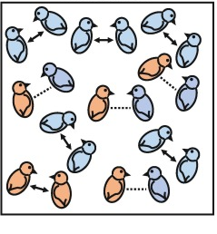
Attempts at solving Crozier’s paradox
Crozier’s Paradox
Earlier work
Status
Next steps
Disassortative mating
Pleiotropy
Multiple social encounters before interaction
Mating with genetically distant males
Beard chromodynamics
Maintains genetic diversity but little evidence of disassortative mating in social insects
Restrictive assumptions!
??

Slide 5

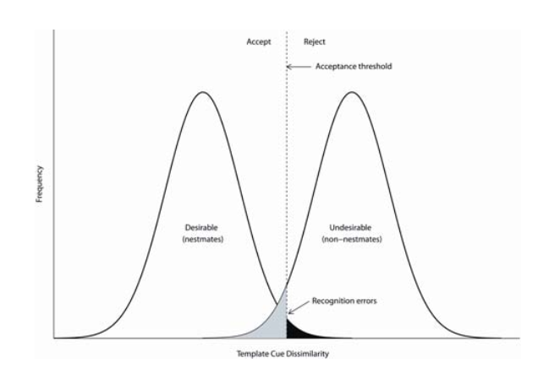
Work from the group till date
Crozier’s Paradox
Earlier work
Status
Next steps
Selection pressure based on resources
ACCEPT
REJECT
Individuals can forage food externally
Can also sneak into another colony and steal food
A returning member may be rejected
Chemical profile can evolve
Each colony has a specific profile, worker profiles sampled from this with variation
Recognition depends on chemical profile distance based on 3 models:
Gestalt model
U-absent model
D-present model
Threshold
Frequency
Nestmates (Desirable)
Non-nestmates (Undesirable)
ERROR!
Template Cue Dissimilarity

Slide 6
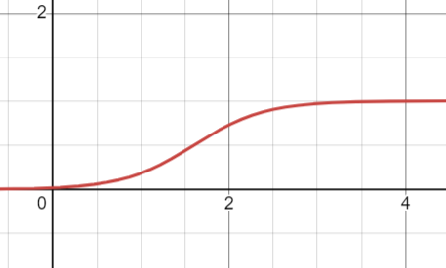

My job
Crozier’s Paradox
Earlier work
Status
Next steps
Co-evolution of threshold
Mating and sexuality (presence of a queen)
Gillespie algorithm
Rejection propensity
Maybe non-constant worker population?
Profile distance
Notes:
Gillespie: implemented inherently in code design

Slide 7
To discuss
Crozier’s Paradox
Earlier work
Status
Next steps
Mating (haplodiploid structure?)
If haplodiploid, additive vs Non additive expression, recombination present vs absent
And reproduction
Queen initialization
Male population structure
Colony and net food resources
Nest removal (ie timestop)
Should we have dispersal along with nest removal?
Providing raiding/foraging times / or travel times
Cost correction due to reproduction?
Rejection propensity
Profile distance
Notes:
-> Switch the co-evolution at a timepoint

