Slide 1
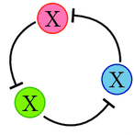
Generation of modified repressilator network(s) to model effect of light on Circadian Rhythm (OR) Generation of dynamic repressilator networks in silico to aid in vivo construction
Term project done for the requirement of Molecular Systems Biology (CH248)
Lakshya Chauhan, 3rd year UG Cancer Systems Biology Lab, BSSE, IISc

Slide 2

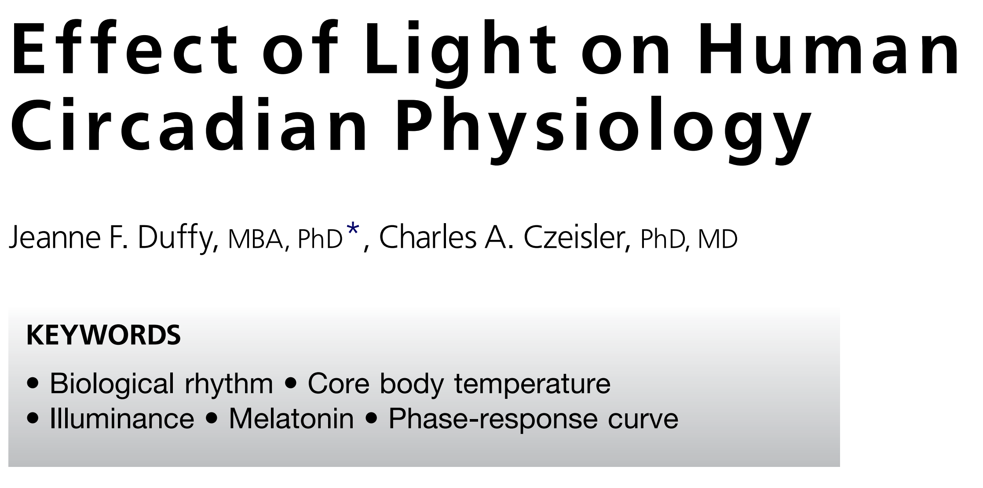
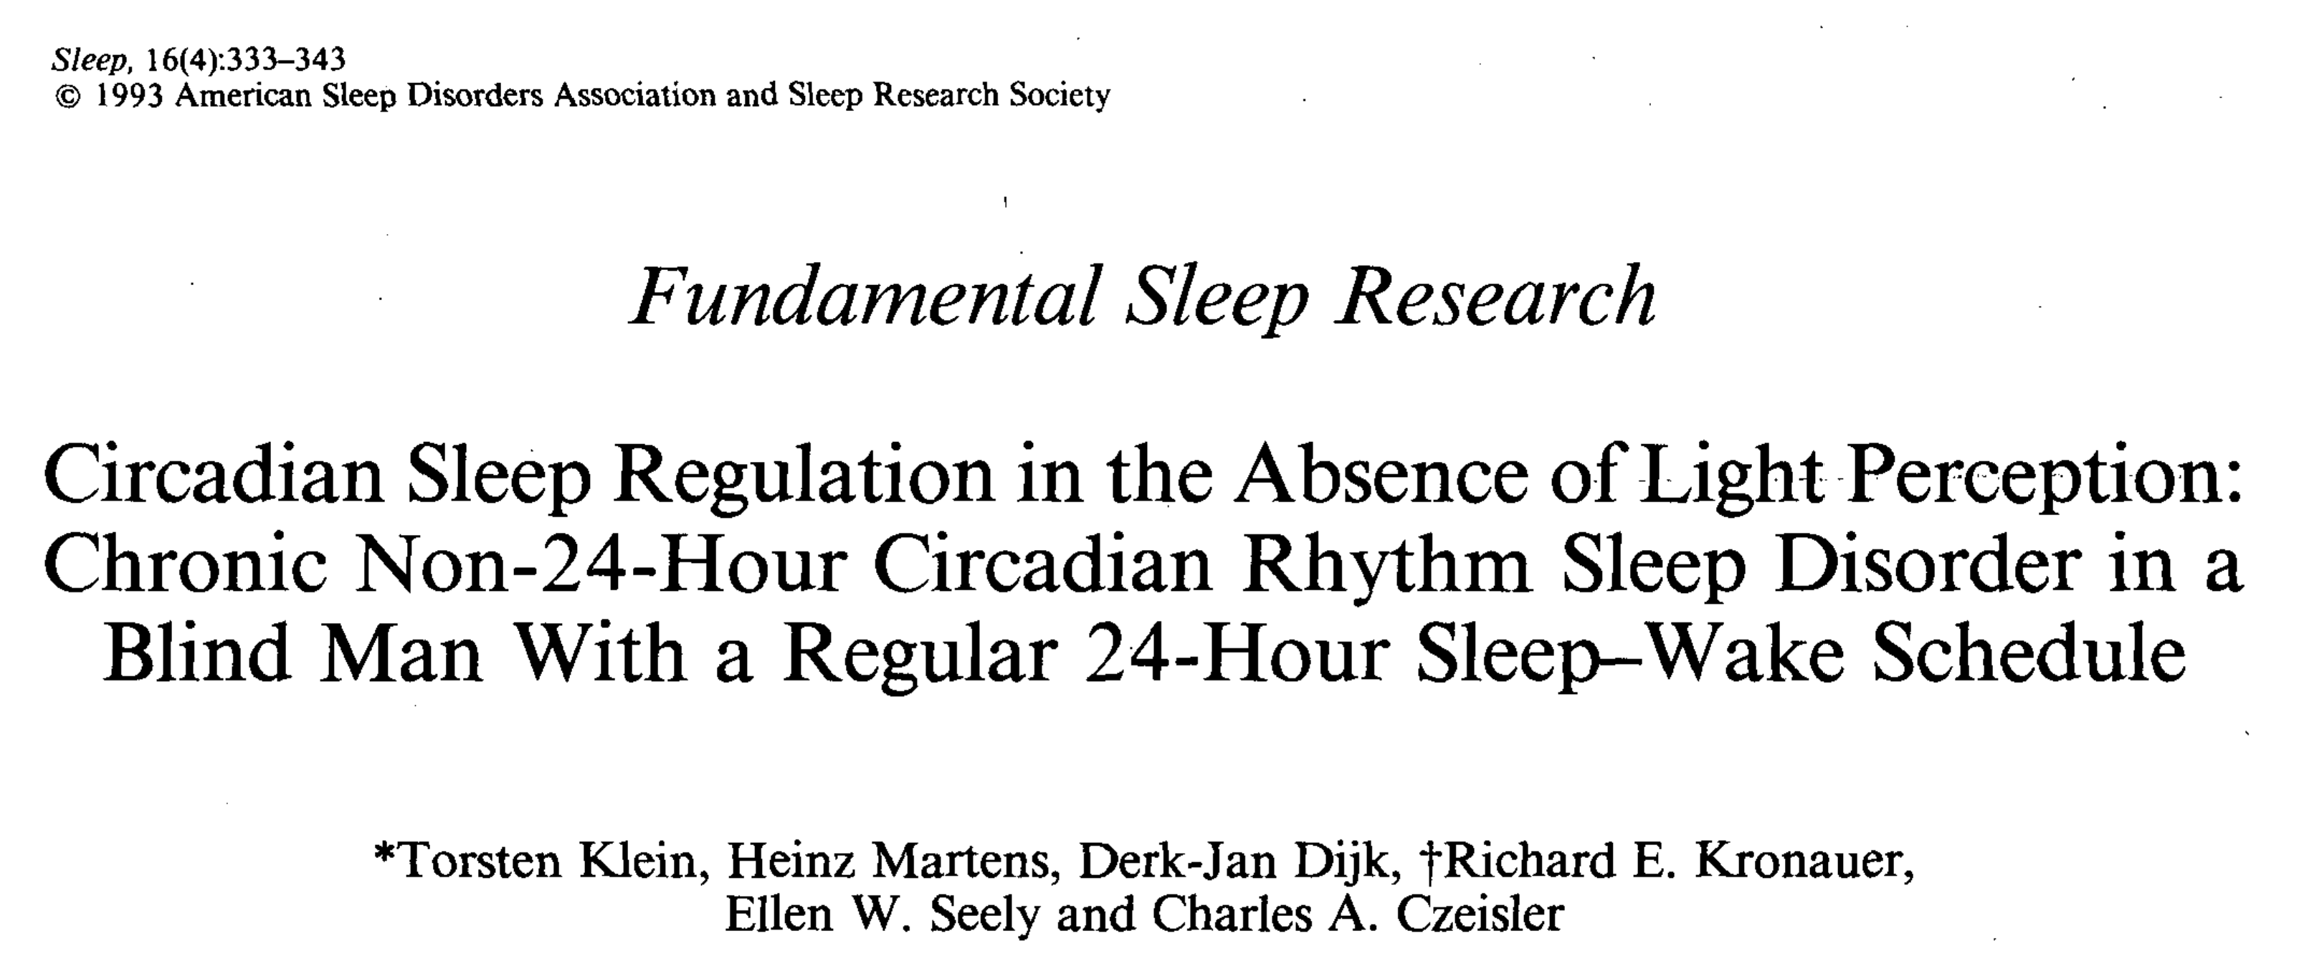

Motivation and Introduction
Repressilator at the center of Circadian Rhythm
Variance in physiological processes depending on time of day
Staggered sleep cycle in blind/perturbed individuals

Slide 3
Motivation and Introduction
Hypothesis: The central repressilator at the core of MCR might be under direct effects of a signal, which changes the expression profile by altering frequency or amplitude. This is then seen as varied physiological response, or as staggered sleep cycle

Slide 4
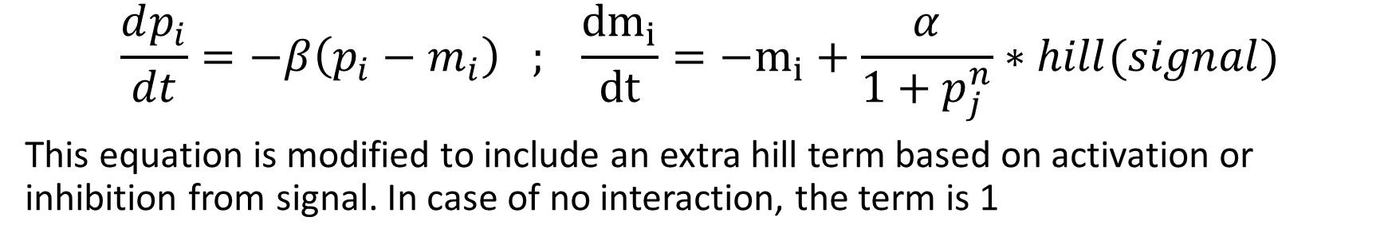
ODE for simulating Repressilator
$$\frac{dp_{i}}{dt}=−β\left(p_{i}−m_{i}\right) ; \frac{{dm}_{i}}{dt}=−m_{i}+\frac{α}{1+p_{j}^{n}}∗hill(signal)$$
This equation is modified to include an extra hill term based on activation or inhibition from signal. In case of no interaction, the term is 1
This is based on the same model as Elowitz’s initial studies. However, it should be noted it’s rife with assumptions and simplifications, that might result in erroneous conclusions.

Slide 5
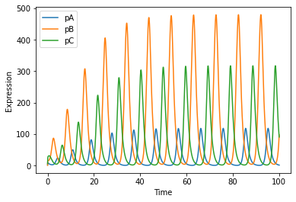
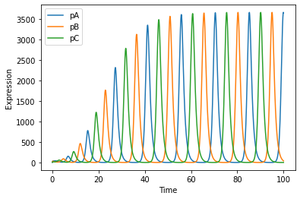
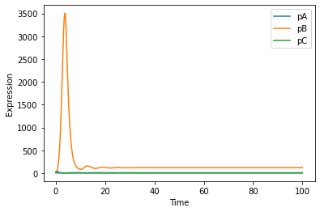
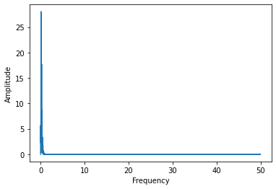
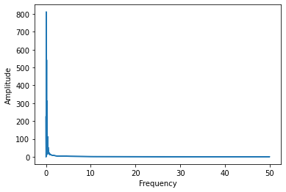
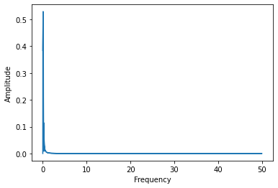
Basic Repressilator Simulation
Fourier transform is not the way to go for non-sinusoidal waves, and parameter values along with repressilator symmetry plays a huge role in expression profile (duh)

Slide 6
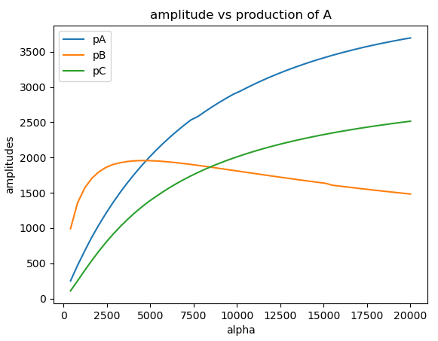
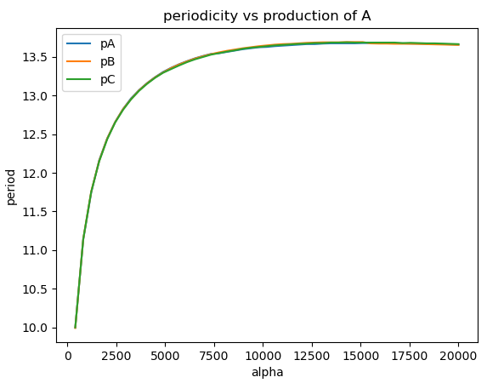
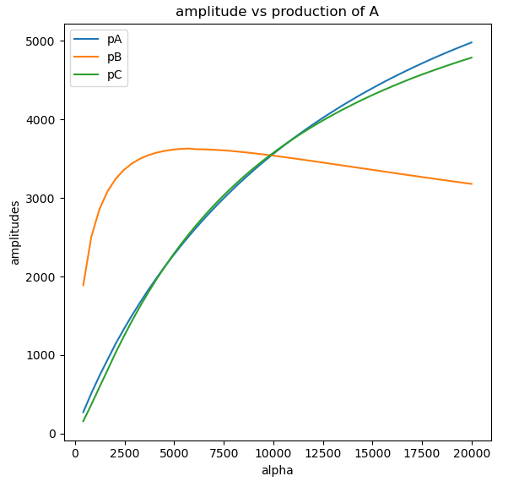
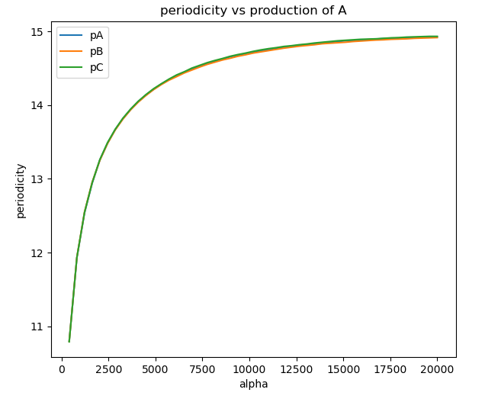
Frequency/Amplitude variance wrt production parameter
We see coherence in period of all the proteins expressions; A and C have coherence with amplitude that might be due IFFL properties of Repressilator
The trend remains somewhat similar for asymmetric repressilators as well

Slide 7
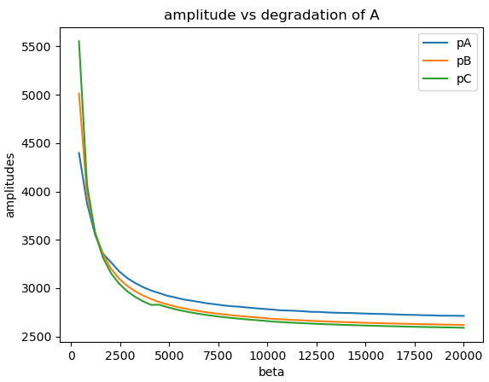
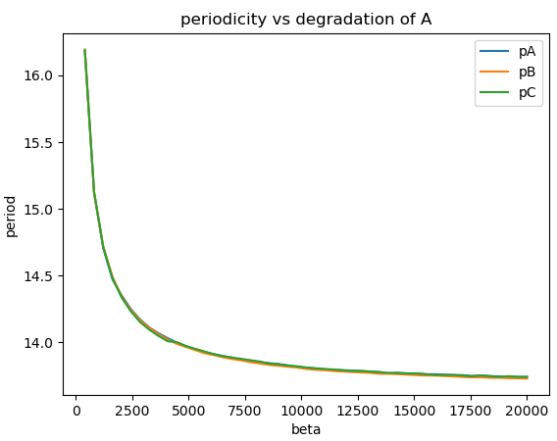
Frequency/Amplitude variance wrt degradation parameter
Perturbing degradation rated is a better way to go, as the amplitude does not achieve values of 0 over large ranges (thus suggesting robust oscillations)
Hence an external signal that affects production or degradation parameters could potentially achieve dynamic control over frequency and/or amplitude. However, it should be noted that so far, amplitude and frequency are displaying correlation with each other

Slide 8
All possible networks?
The external signal can interact with a node in 3 ways; inhibition, activation and no interaction
Hence, we have 27 networks possible, where “Sig” Node has only outgoing nodes.
Subsequently, each network would be tested with variable values of signal presence.
Sig

Slide 9
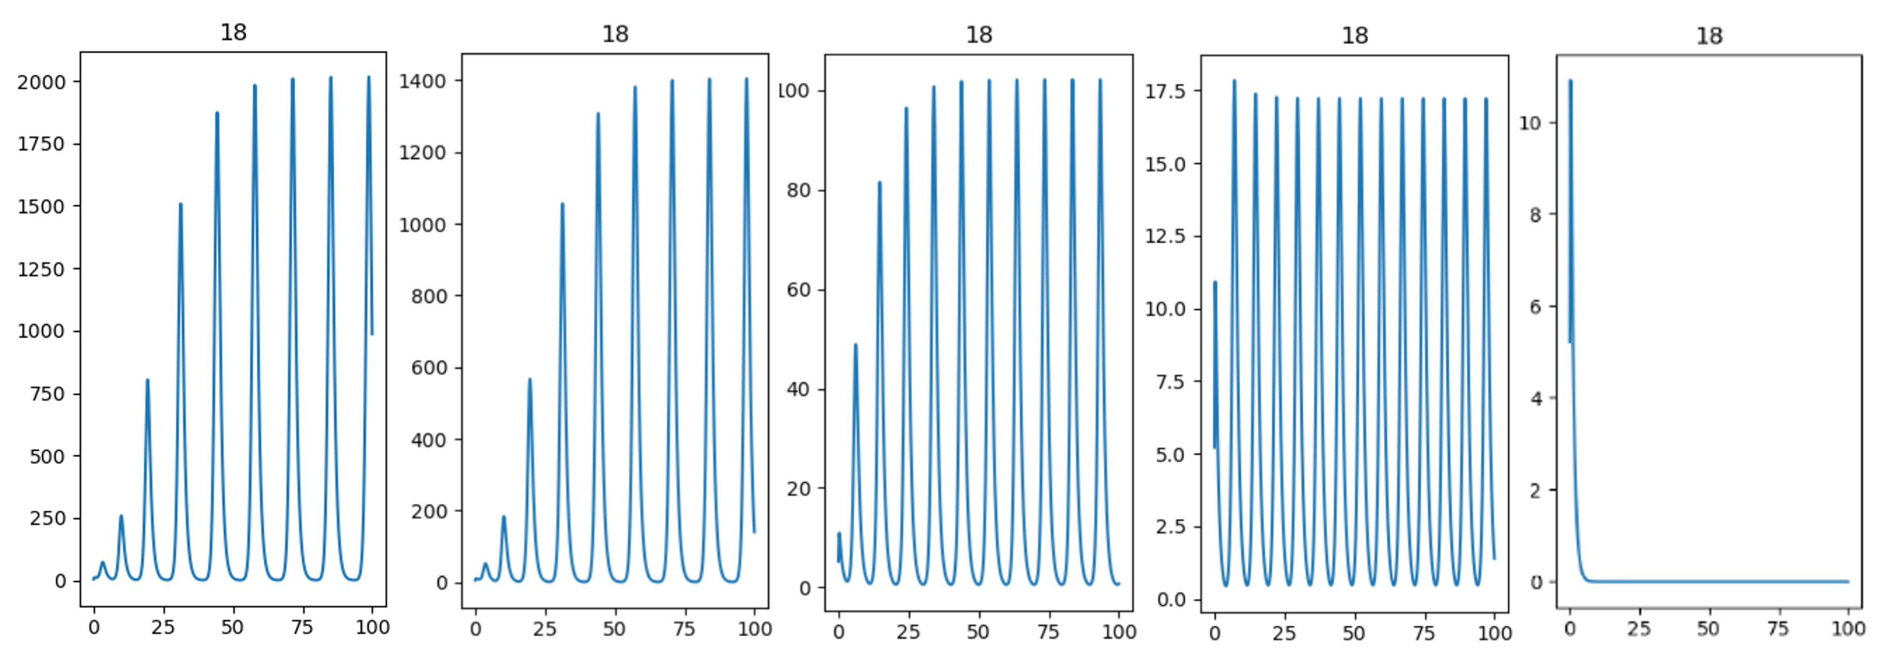
Does varying signal level change expression profile?
Left to Right, Signal increases from 0.1 (left) to 100 (right) for network 18

Slide 10
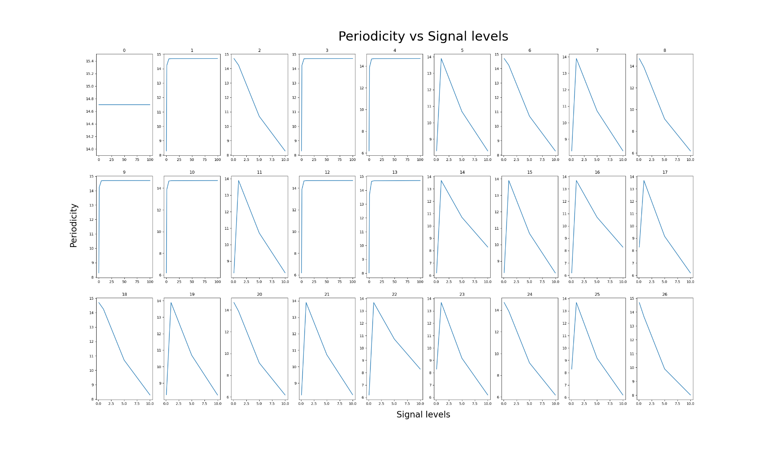
Subtle period decrease to select viable networks
Networks {2,6,8,18,24,26} are viable candidates as the period (amplitude too) decreases predictably.

Slide 11
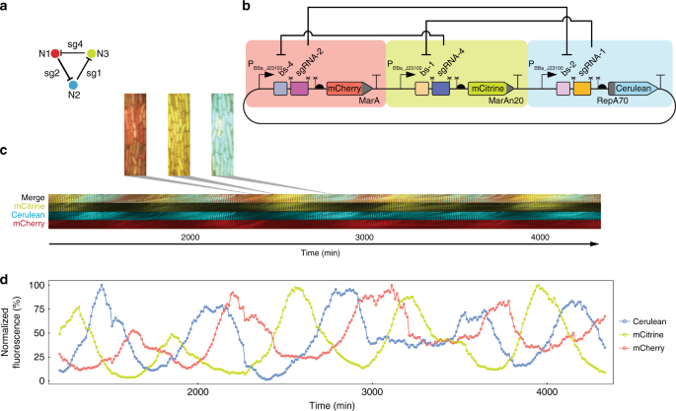
Where does CRISPR come in?
Traditionally, synthetic circuits would be designed using Transcription Factors, which have low modularity, orthogonality and specificity.
The advent of CRISPR-i and CRISPR-a have drastically changed the notion of circuit design. Circuits like CRISPRlator offer much better control.
Thus essentially, the viable circuits discussed above can be created with relative ease! Having the guide RNAs for CRISPR under control of inducible promotors would provide the necessary external signal!
This study provides candidates for creating such circuits
Moreno et al, 2020

Slide 12
Future Directions
Expanding the ODEs to include many more parameters that could have a major effect on the expression profile, such as activating concentration of proteins
Testing whether the same principle can be extended to other oscillating networks
Finding a robust way to measure frequency that is not fallible to noise experimental data
Actually constructing such modifications of CRISPRlator and validating in silico observations
Moreno et al, 2020

Slide 13

Thank you and questions please?

