Slide 1
NAT Gateway

Slide 2
A NAT gateway is a Network Address Translation (NAT) service. You can use a NAT gateway so that instances in a private subnet can connect to services outside your VPC but external services cannot initiate a connection with those instances.
But NAT Gateway is heavily charged.
To avoid billing, we can use NAT Instance instead of NAT Gateway, provided we have less number of servers in private subnet and their need to access Internet is also less.
When you create a NAT gateway, you specify one of the following connectivity types:
Public -
-Instances in private subnets can connect to the internet through a public NAT gateway, but cannot receive unsolicited inbound connections from the internet.
-You create a public NAT gateway in a public subnet and must associate an elastic IP address with the NAT gateway at creation.
-You can use a public NAT gateway to connect to other VPCs or your on-premises network.

Slide 3
Private –
-Instances in private subnets can connect to other VPCs or your on-premises network through a private NAT gateway.
-You can route traffic from the NAT gateway through a transit gateway or a virtual private gateway.
-You cannot associate an elastic IP address with a private NAT gateway.
-You can attach an internet gateway to a VPC with a private NAT gateway, but if you route traffic from the private NAT gateway to the internet gateway, the internet gateway drops the traffic.
While configuring NAT gateway , NAT gateway are placed at public subnet only and rules are written in private subnet route table.
NAT gateway is costly as compare to igw because NAT gateway provide high security by allowing one way communication.
An elastic ip gets assign to the NAT gateways.

Slide 4
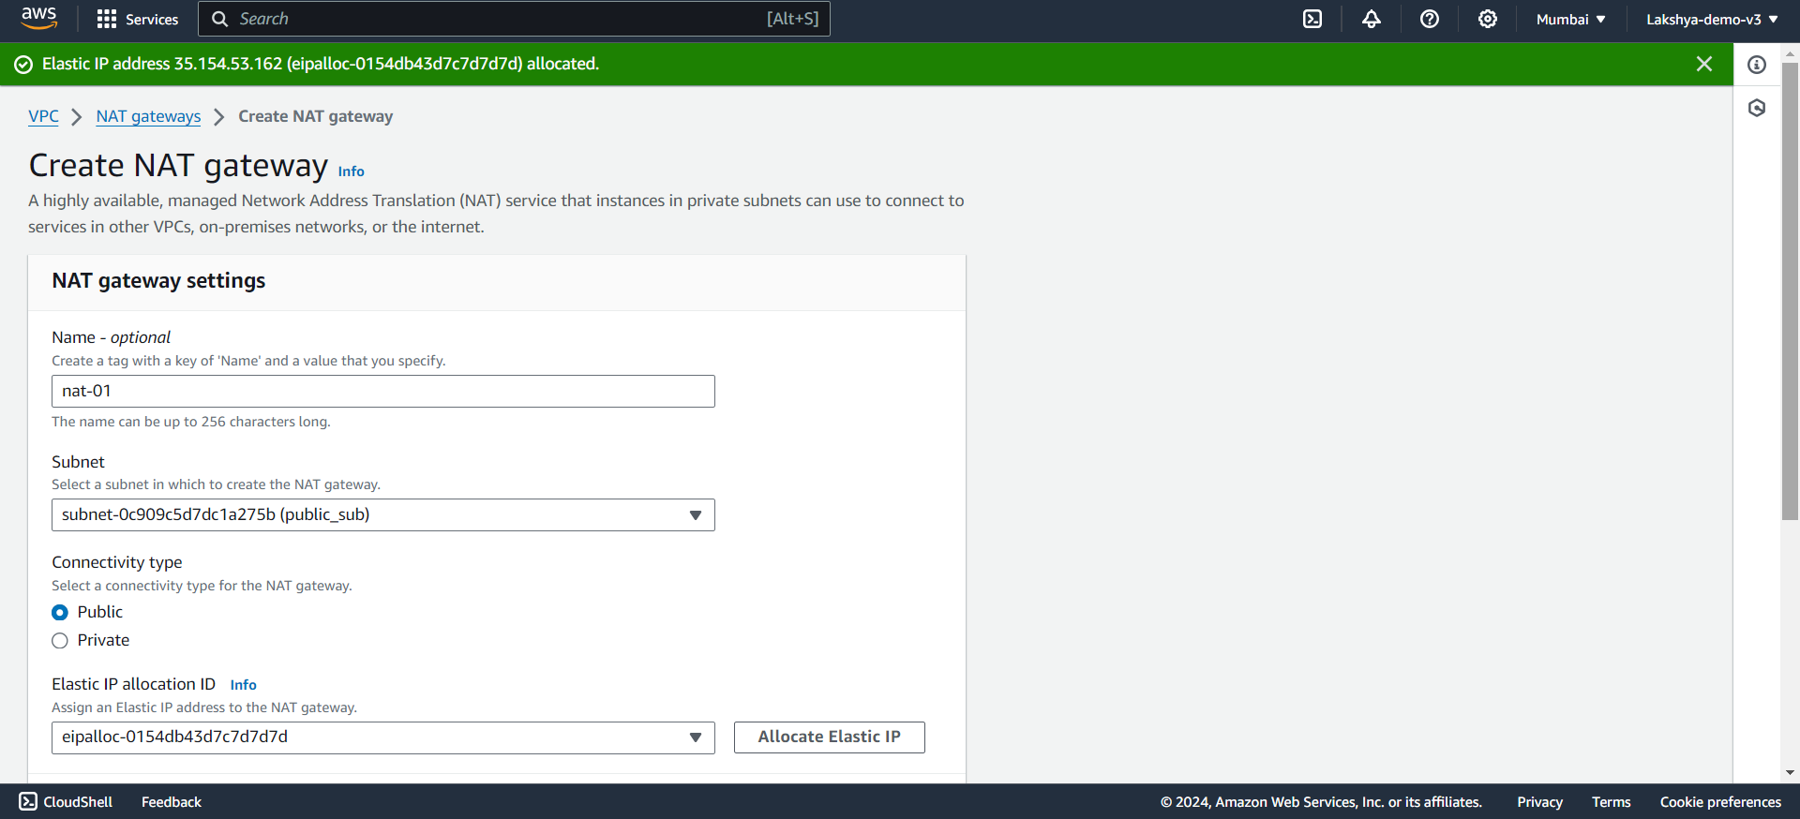
Creating NAT Gateway
Create NAT Gateway

Slide 5
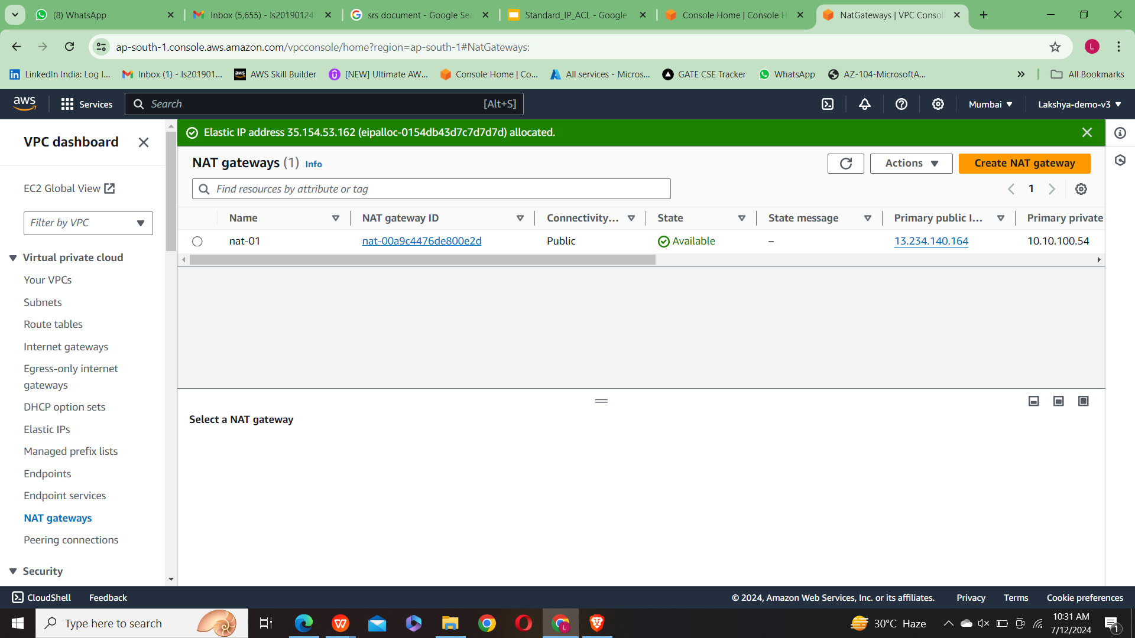

Slide 6
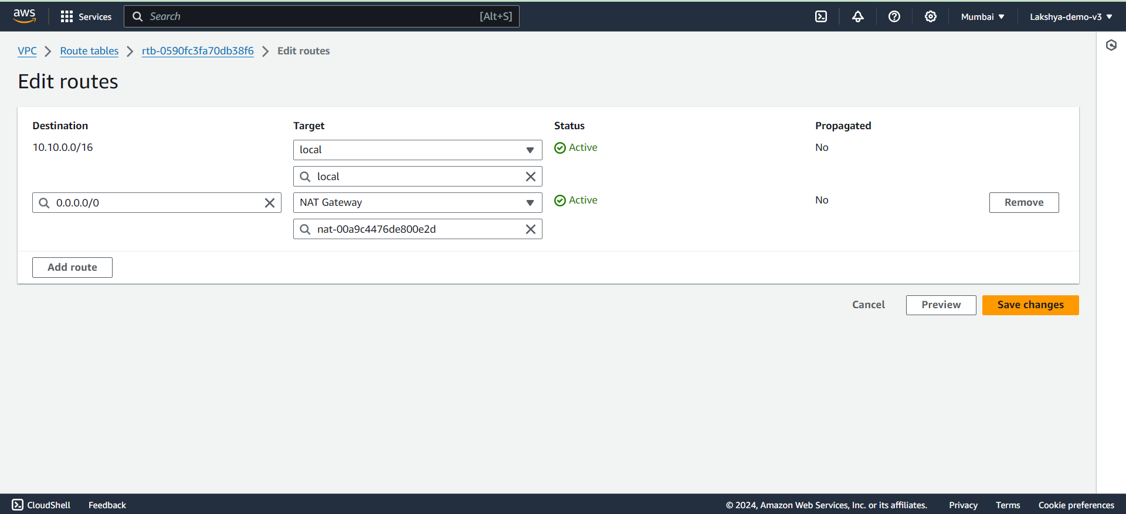
2. Adding routes to the route table of the private subnet

Slide 7
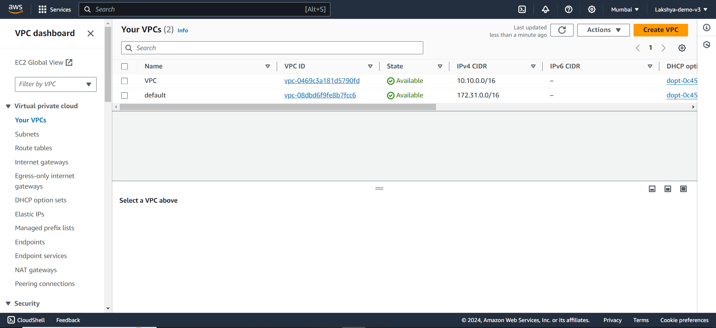
3. VPC Configuration - VPC , Subnet , Route tables , Internet gateway

Slide 8
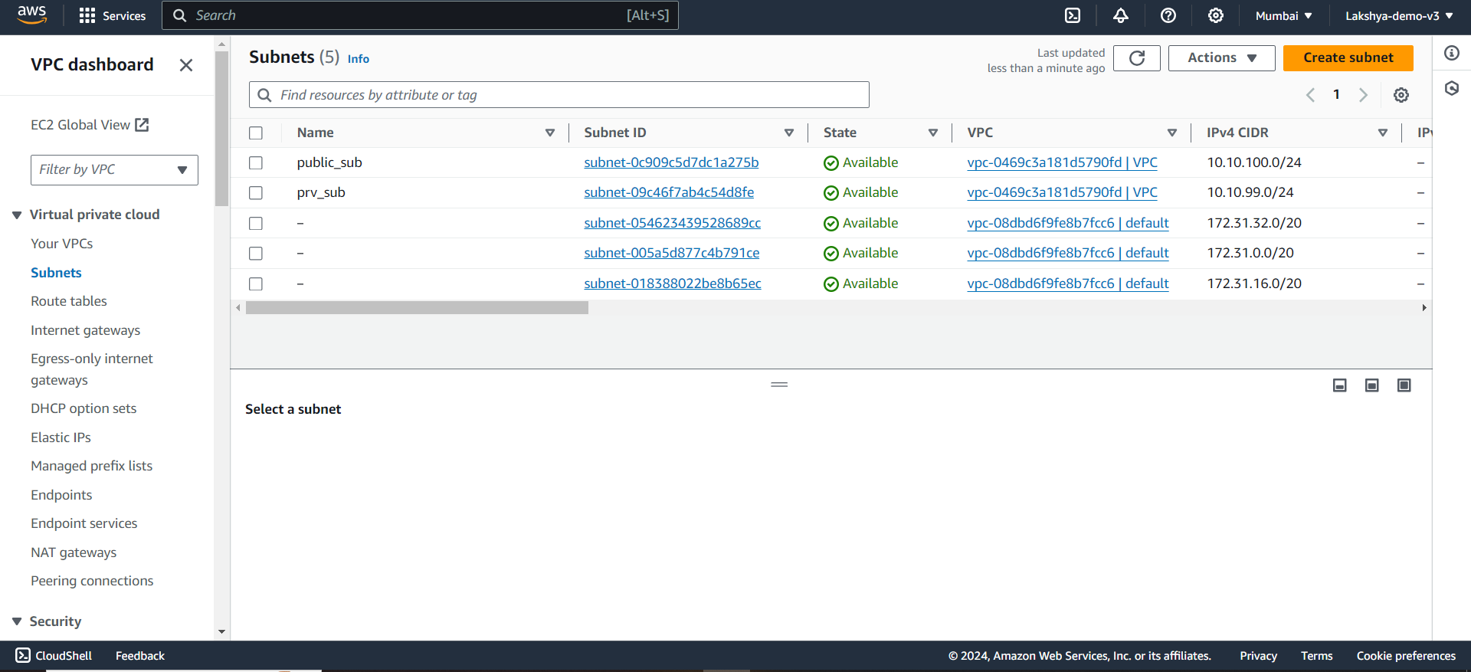

Slide 9
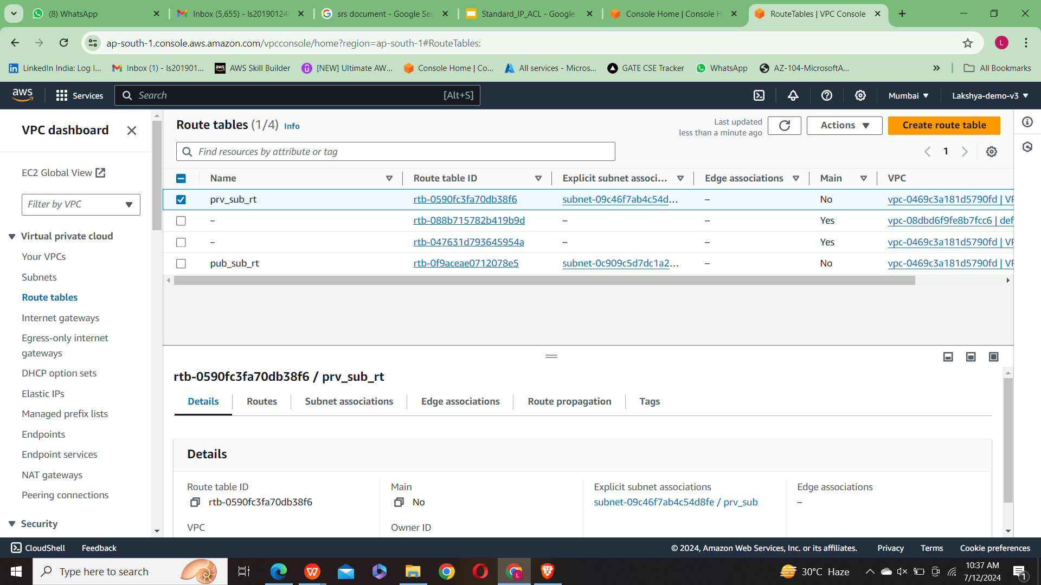

Slide 10
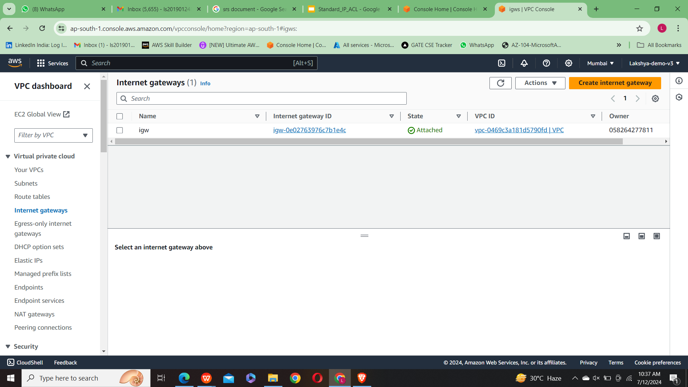

Slide 11
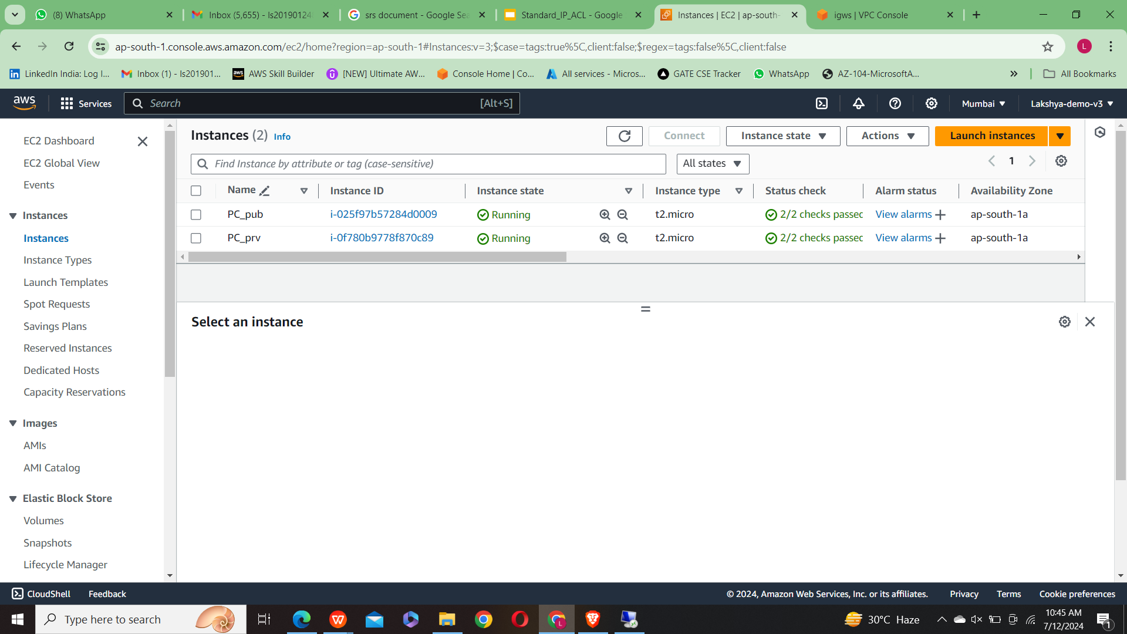
Testing of NAT Gateway configuration
Creating two instances

Slide 12
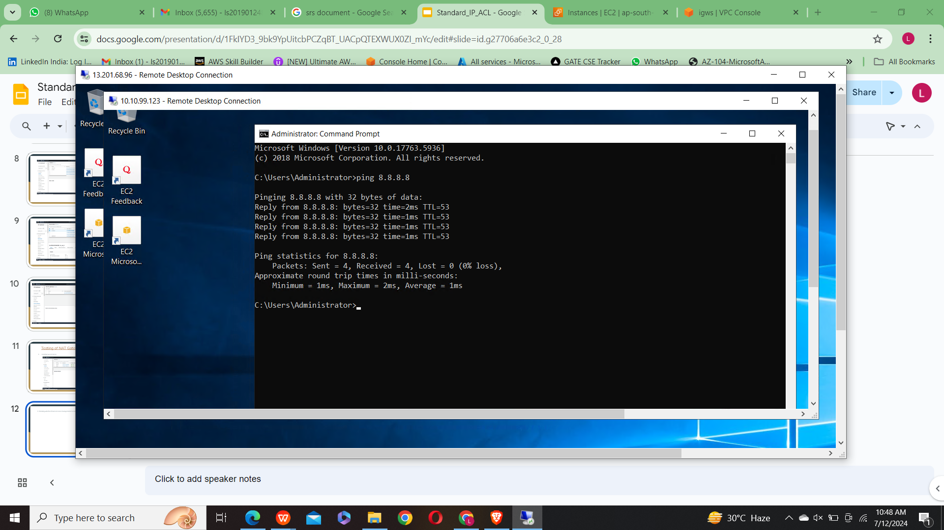
2. Checking whether Private instance having internet access .

Slide 13
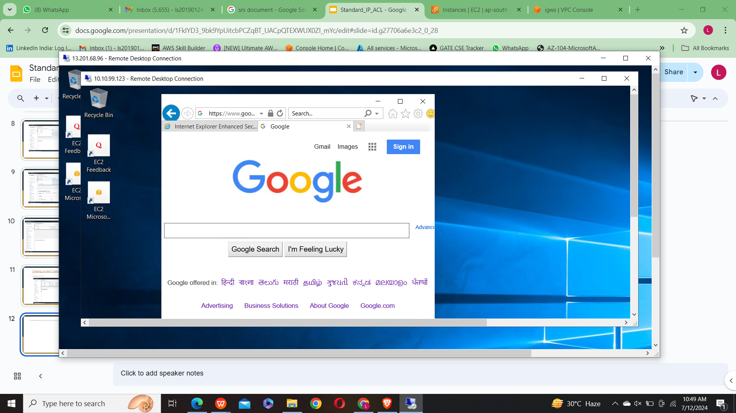
3. As we can see google can accessed through private subnet.

Slide 14
THANK YOU

