Slide 1
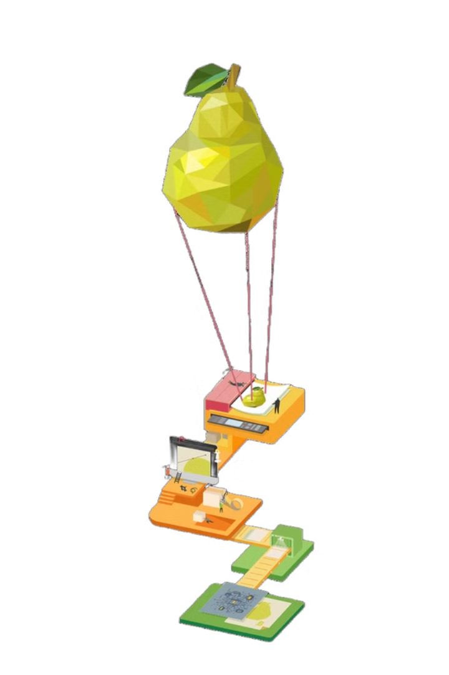
NUTRI-SNAP
SNAP TO KNOW, EAT TO GROW
Camera-Based Nutrients Recognition System
This system leverages computer vision and machine learning to identify and categorize food items from images captured by a camera, enabling personalized nutrition tracking and dietary recommendations.

Slide 2

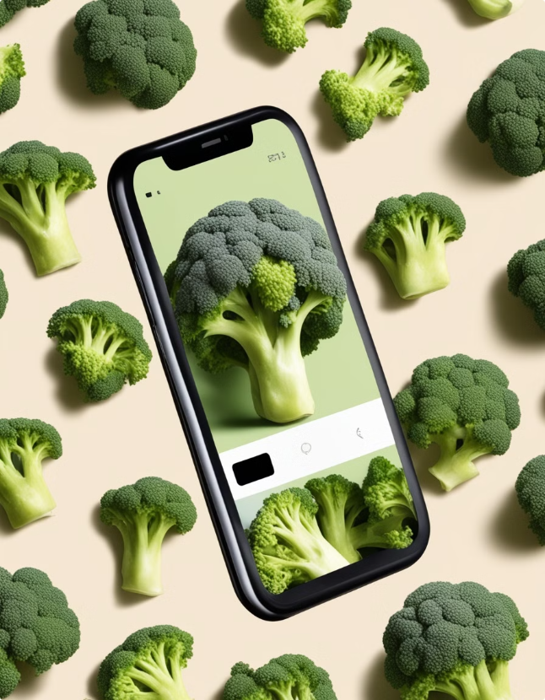
Problem Statement
Current methods for food tracking often require manual input, which can be time-consuming and prone to errors. This system offers a convenient and accurate solution for real-time nutrition analysis.
1
Time-Consuming
2
Error-Prone
Manually tracking food intake can be tedious and require significant effort.
Manual logging often leads to inaccurate estimations of portion sizes and nutrient content.
3
Limited Real-Time Data
Traditional methods lack real-time feedback and insights into dietary choices.

Slide 3






Flowchart of the Process
The system utilizes a series of steps to process food images and provide personalized nutrition information.
Image Capture
A camera captures an image of the food item.
Image Preprocessing
The image is cleaned and prepared for analysis, such as resizing and noise reduction.
Food Recognition
Machine learning models identify the food type based on image features.
Portion Size Estimation
The system estimates the size of the food item using object detection techniques.
Nutrient Analysis
The system calculates the nutrient content of the food based on its type and size.
Dietary Recommendations
Personalized recommendations are generated based on the analyzed food data.

Slide 4
Importing the Dataset
A comprehensive dataset of food images is required to train the machine learning models. The dataset should include a wide variety of food items, with multiple images per item and variations in lighting and presentation.
Data Collection
Data Annotation
Data Splitting
Images can be collected from online sources, food databases, or through user-generated content.
Each image in the dataset must be annotated with the corresponding food type and portion size information.
The dataset is split into training, validation, and testing sets for model development and evaluation.

Slide 5

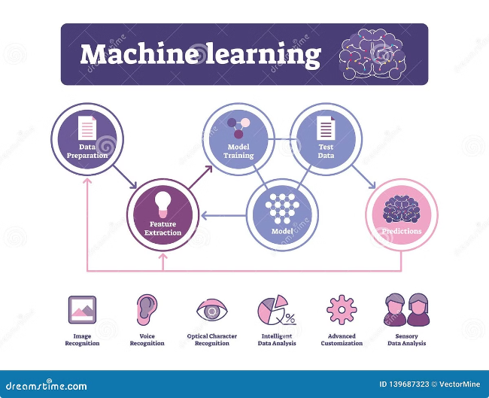
Classifying Food Types Using Machine Learning Models
Machine learning algorithms are trained on the dataset to learn patterns and features that distinguish different food types.
Model Type
Description
Convolutional Neural Networks (CNNs)
Effective for image recognition tasks, extracting features from images.
Support Vector Machines (SVMs)
Powerful for classifying data into distinct categories, based on labeled examples.
Random Forests
Ensemble learning approach, combining multiple decision trees to improve accuracy.

Slide 6

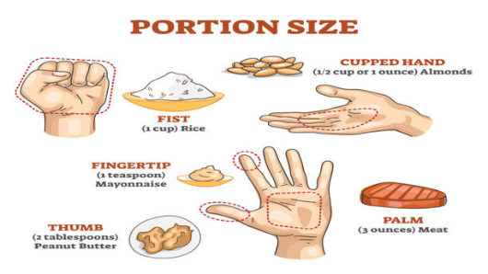



Estimating Food Portion Sizes from Images
Object detection algorithms can be used to estimate the portion size of food items in images. The system can analyze the size and shape of food items relative to known objects in the image, such as plates or utensils.
Object Detection
Size Estimation
Reference Objects
Algorithms identify and locate objects in the image, including food items.
The system measures the dimensions of the food item based on its pixels.
Known objects, such as plates, provide context for size estimation.

Slide 7

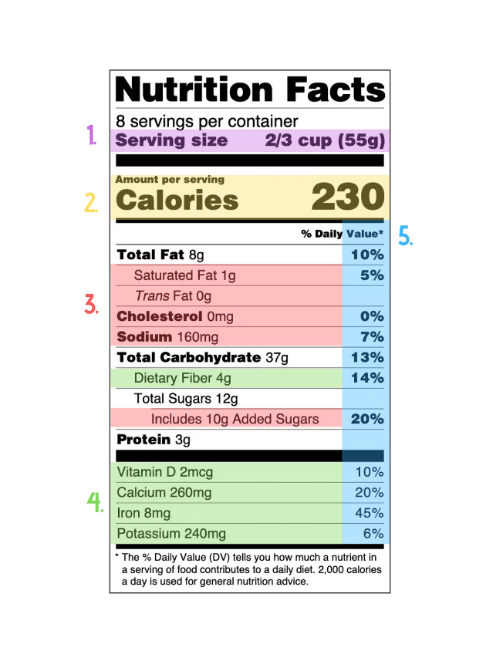
Analysis of the Nutrients Content in the Food
Once the food type and portion size are identified, the system can analyze the nutrient content using pre-existing nutritional databases.
Carbohydrates
Proteins
The system estimates the amount of carbohydrates based on the food type and portion size.
The system calculates the protein content using a similar approach, considering the type and amount of food.
Fat
Sugar
The system estimates the fat content of the food item, based on its composition and serving size.
The system analyzes the sugar content of the food, taking into account the food type and serving size.

Slide 8


Conclusion and Future Developments
This camera-based food recognition system offers a convenient and accurate way for consumers to track their nutrition in real-time.
1
Improved Image Analysis
Enhancements to the image processing algorithms can improve the accuracy and efficiency of food recognition.
2
Personalized Recommendations
The system can be tailored to individual dietary needs and goals, providing customized advice.
3
Integration with Health Apps
Integration with existing health and fitness apps can provide a comprehensive view of dietary data.

