Slide 1

SMART INDIA HACKATHON 2026
SETU · INTELLIGENT DEAD RECKONING
Problem Statement ID – ____________
Problem Statement Title- AI-ML based Intelligent Dead Reckoning system for seamless navigation
Theme- ____________
PS Category- Software
Team ID- ____________
Team Name (Registered on portal)- Sanskari<CODERS>
Seamless Egomotion Tracking under Unavailable-GNSS
Lane-level position through tunnels, underpasses, basement parking and urban canyons — from a smartphone IMU alone.
≈1%
drift per km, against
a 10 % ceiling
TEAM Sanskari<CODERS> Lakshya Jain (Team Leader) · Akshit Jain · Veneya Kharkhodi · Garv Goel · Lavish Kumar · Aashi Jain

Slide 2
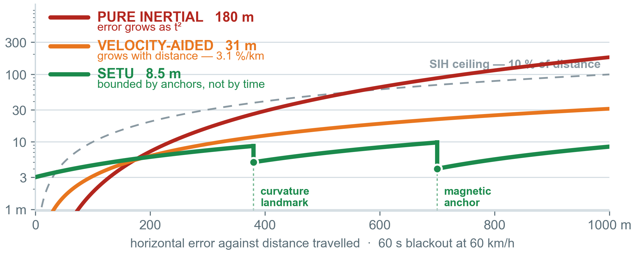
SETU — NAVIGATION WITHOUT GNSS
Sanskari
<CODERS>
Everyone integrates acceleration twice, so error grows as t². SETU asks how far along this road am I — and answers with measurements that never accumulate.
Detailed explanation of the proposed solution
How it addresses the problem
ACE
solves the phone→vehicle mount, online
MSVR
classifies motion, mount and road shock
SVO
ground speed from axle harmonics
CTS
absolute speed out of every turn
CSA
arc length from the map's own shape
EFA
magnetic, baro and radio anchors
IAF
invariant EKF in a road-graph filter
GQM
per-satellite GNSS trust, not a switch
3.6 MB models 2.7 ms per tick 10 Hz phone 200 Hz edge
Integration is demoted to interpolating between fixes. Every anchor crossed resets the error, so drift is bounded by anchor spacing, not by elapsed time.
Innovation and uniqueness of the solution
N1 Speed from frequency
not integration — nothing accumulates
N2 Two-wheeler lean physics
v = g·sinφ / ωz; omitting cosφ costs 4 %
N3 Scale-free map registration
prior shape-matching needs an odometer
N4 CAN wheel speeds as teacher
training-only; far better than GPS labels
N5 Learned σ and Q in one filter
multi-hypothesis over the road graph

Slide 3
TECHNICAL APPROACH
Sanskari
<CODERS>
Methodology and process for implementation
CLIENT
RUNTIME
offline
zero network calls
SENSE
CONDITION
OBSERVE
FUSE
DELIVER
IMU 200–400 Hz
STFT harmonic ridge
SVO
spectral speed
CTS
turn speed
RI-EKF SE₂(3)
10 Hz phone pose
GNSS raw NavIC L5
Notch engine order
CSA
map arc length
EFA
field anchors
learned σ per measurement
200 Hz edge pose
Baro Magnetometer
Shock pothole reject
learned Q transformer
Lane-level + tube
NHC
zero side-slip
GQM
sat trust
External IMU MEMS / FOG
ACE mount solve
RB-PF road graph
API gRPC · NMEA
SYNC
PLANE
out-of-band
async, never blocking
DISTRIBUTION signed, immutable, versioned bundles — installed offline
CONTRIBUTION opt-in · ~1 KB per edge · signatures only, never trajectories
Model registry
Map / tile CDN
Config & flags
API gateway
Stream queue
k-anon aggregator
CLOUD
PLANE
batch
region-sharded
MAP BUILD per region, independently
LEARNING nightly retrain, gated on the benchmark
OSM extract
Graph + κ(s) LUT
DEM · PMTiles
Data lake
Training cluster
Eval gate
Telemetry & KPI
SCALES BY SHARDING, NOT BY CAPACITY zero runtime API calls, so device count adds no serving load · ≤250 MB per region · immutable CDN bundles · contribution ~1 KB per edge
Technologies to be used
Training
PyTorch · Lightning · Hydra · MLflow · masked-IMU pretraining
On-device
LiteRT + XNNPACK · ExecuTorch · int8 QAT · 3.6 MB total
Engine
C++20 · Eigen · SE₂(3) Lie · FlatBuffers · GTest replay
Mobile
Kotlin · Compose · MapLibre + PMTiles · SensorDirectChannel
Edge & maps
aarch64 · gRPC / NMEA / ROS 2 · osmium · CartoDEM

Slide 4
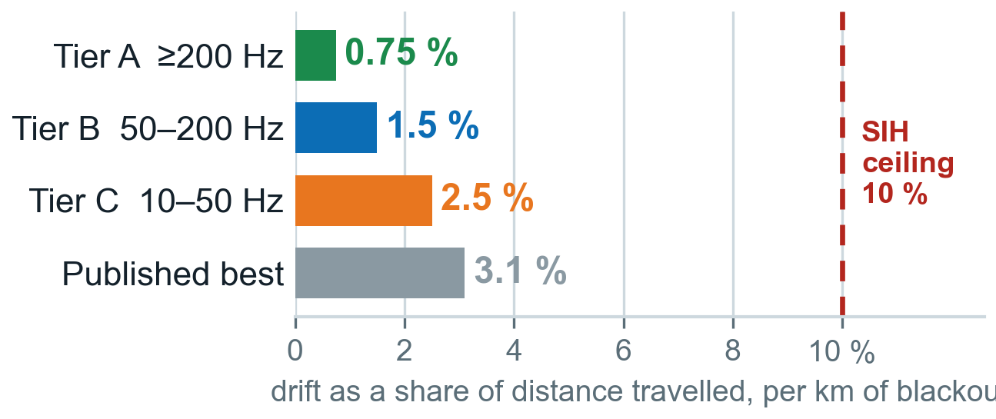
FEASIBILITY AND VIABILITY
Sanskari
<CODERS>
Analysis of the feasibility of the idea
Potential challenges and risks | Severity | Strategies for overcoming these challenges
CSA ambiguous on featureless or badly-mapped roads | High | Landmark saliency scoring · top-k hypotheses in the particle filter · honest σ. Falls back to classical HMM map matching.
Axle harmonics weak — smooth road, quiet EV, soft mount | Medium | Mount-quality gate · summation over 8+ orders · learned σ down-weights it. Falls back to Tier B.
IO-VNBD phone stream is 10 Hz, so cannot validate SVO | Known | Declared as capability tiers. SVO validated on self-collected 400 Hz logs.
No two-wheeler data in IO-VNBD — four cars, no Indian roads | Known | Lean relation imposed as a physics loss, so few samples suffice. Dedicated collection.
Sensor rate throttled below 200 Hz on some devices | Medium | Tier detected at runtime · SensorDirectChannel · verified on three device classes.
Uneven OpenStreetMap geometry on Indian roads | Medium | Covariance scaled by OSM confidence · explicit off-road particle · provider adapter.
Data already in hand
IO-VNBD: 5,700 km, phone IMU and CAN bus recorded together
Core physics is closed-form
v = a_lat/Ω and f = v/2πR are algebra; only residuals learn
Fits today's phones
3.6 MB int8, 2.7 ms per tick, CPU only — no NPU needed
Sensors already present
IMU, magnetometer, barometer, raw GNSS with NavIC L5
Maps fit offline
≤250 MB per metro region, no connectivity at runtime
Nothing to buy or fit
no dongle, no encoder, no roadside infrastructure
Every device class clears the ceiling. IO-VNBD's 10 Hz stream is Tier C — so that is how we report it.
Fallback ladder lose CSA → HMM map matching · lose SVO → Tier B · lose both → INS + NHC + ZUPT, which already sits inside the 10 % gate. No single failure leaves us with nothing to demonstrate.

Slide 5
IMPACT AND BENEFITS
Sanskari
<CODERS>
Potential impact on the target audience
Benefits of the solution (social, economic, environmental, etc.)
Delivery and quick-commerce riders
the next turn is announced before the exit, not after it
Social
A correct instruction on time means fewer glances at the screen when a rider can least afford one. Emergency crews stay locatable underground. Accurate navigation stops being a feature of expensive cars.
Economic
Zero marginal hardware — it runs on phones riders already own. No dongle per vehicle, no factory INS, no leaky-feeder per tunnel. Fewer missed exits and failed deliveries on the same fleet.
Logistics and fleet operators
mileage, ETA and proof of delivery survive the gap — no dongle
Ride-hailing drivers and riders
no frozen or teleporting car; pickups on the correct side
Emergency responders
a live position underground, where dispatch loses them today
Environmental
A missed exit is wasted kilometres, fuel and emissions; removing the cause removes all three. Entirely on-device, so no roadside infrastructure is built, powered or maintained.
Strategic
Jamming- and spoofing-resilient by construction, since every channel is self-contained. Uses NavIC L5 where Indian devices expose it, runs fully offline, keeps data on the phone.
Two-wheeler riders
India's largest vehicle class, finally with lean-aware physics
Defence and critical logistics
self-contained; degrades gracefully under jamming or spoofing
Pure inertial
180 m
½·b·t² — a block away after one minute
Best published
31 m
3.1 % per km, INS + NHC in a real tunnel
SETU target
8–15 m
0.8–1.5 % per km, anchored to map and field
Where it matters most
Long tunnels and metro underpasses the road is one-dimensional, so the map carries it
Multi-level parking helical ramps are unique signatures; the barometer gives the floor
Dense urban canyons position unusable, but Doppler velocity survives on 3–4 satellites
Forested and valley highways partial GNSS, absorbed by the trust ramp with no mode switch
Horizontal drift over a 1 km blackout at 60 km/h. The SIH ceiling is 10 % — 100 m.
Reach any Android phone already on the dashboard — no purchase, no fitting, no connectivity. The same engine serves a FOG-grade edge unit at 200 Hz.

Slide 6
RESEARCH AND REFERENCES
Sanskari
<CODERS>
Details / Links of the reference and research work
DATASET AND BENCHMARK
IO-VNBD: Inertial & Odometry Benchmark Dataset
Data in Brief 35:106885, 2021 · github.com/onyekpeu/IO-VNBD · arXiv:2005.01701
WhONet: Wheel Odometry Neural Network
Eng. Appl. of AI, 2021 · arXiv:2104.02581 — our privileged upper bound
R-WhONet: recalibration by transfer learning
arXiv:2209.05877 — evidence of cross-vehicle domain shift
LEARNED INERTIAL ODOMETRY
Deep Learning for Inertial Positioning: A Survey
Chen & Pan · IEEE T-ITS, 2024 · arXiv:2303.03757
Inertial Navigation Meets Deep Learning
Cohen & Klein · 2024 · arXiv:2307.00014
AI-IMU Dead-Reckoning — invariant EKF
Brossard, Barrau & Bonnabel · IEEE T-IV, 2020 · arXiv:1904.06064
TLIO: Tight Learned Inertial Odometry
Liu et al. · IEEE RA-L, 2020 · arXiv:2007.01867 — learned covariance
OdoNet: untethered speed aiding
arXiv:2109.03091 · 68 % error reduction over NHC alone
CarSpeedNet: accelerometer-only speed
arXiv:2401.07468 · <0.72 m/s ≈ 4.3 % — the accuracy to beat
LEARNED AND ADAPTIVE FUSION
KalmanNet: NN-aided Kalman filtering
Revach, Shlezinger, van Sloun & Eldar · IEEE TSP, 2022
A-KIT: Adaptive Kalman-Informed Transformer
arXiv:2401.09987 · github.com/ansfl/A-KIT — learned process noise
PiDR: Physics-Informed Inertial Dead Reckoning
Sahoo & Klein · 2026 · arXiv:2601.03040
Differentiable particle filters, semi-supervised
arXiv:2011.05748 — end-to-end learning with algorithmic priors
MAP MATCHING AND CONSTRAINTS
Hidden Markov Map Matching
Newson & Krumm · ACM SIGSPATIAL, 2009 — the baseline
Heading–length sequence matching
arXiv:2005.13704 — nearest prior art to CSA; needs a known speed
Map-aided dead reckoning from OBD speed
arXiv:1611.07910
Lever-arm accuracy of the non-holonomic constraint
Zhang & Hu · IEEE TVT, 2020
NHC-assisted GNSS/SINS with motion-state CNN
GPS Solutions, 2023 · doi 10.1007/s10291-023-01483-9
SPECTRAL SPEED AND FIELD ANCHORS
Vehicle Speed Tracking Using Chassis Vibrations
Linköping University, 2016 — axle-order tracking, motivates tunnels
Accelerometer-based wheel odometer
Sensors, 2021 · PMC7918720
Magnetic positioning in a long tunnel
Applied Sciences 11(24):11641, 2021
Vehicle positioning in tunnels: a review
Complex & Intelligent Systems, 2025
Barometric floor detection on smartphones
Sensors, 2015 · PMC4431287 — basis for the parking-level anchor
GNSS INTEGRITY AND PLATFORM
Vehicle positioning underground using a smartphone
ISPRS Archives XLVI-3/W1, 2022 — the 3.1 %/km reference
GNSS multipath detection by machine learning
Hsu · IEEE ITSC, 2017
Android GnssMeasurement HAL — raw observables
source.android.com · pseudorange, Doppler, C/N₀, AGC
u-blox Untethered Dead Reckoning (UDR)
u-blox.com — the closest commercial analogue, on dedicated hardware
A 66-entry annotated bibliography, with a prior-art positioning table for each of the five mechanisms, is maintained alongside the implementation documentation.

