Slide 1

SMART INDIA HACKATHON 2026
SETU · INTELLIGENT DEAD RECKONING
Problem Statement ID – ____________
Problem Statement Title- AI-ML based Intelligent Dead Reckoning system for seamless navigation
Theme- ____________
PS Category- Software
Team ID- ____________
Team Name (Registered on portal)- ____________
SETU · Seamless Egomotion Tracking under Unavailable-GNSS lane-level position in GNSS-denied environments, from a smartphone IMU alone

Slide 2
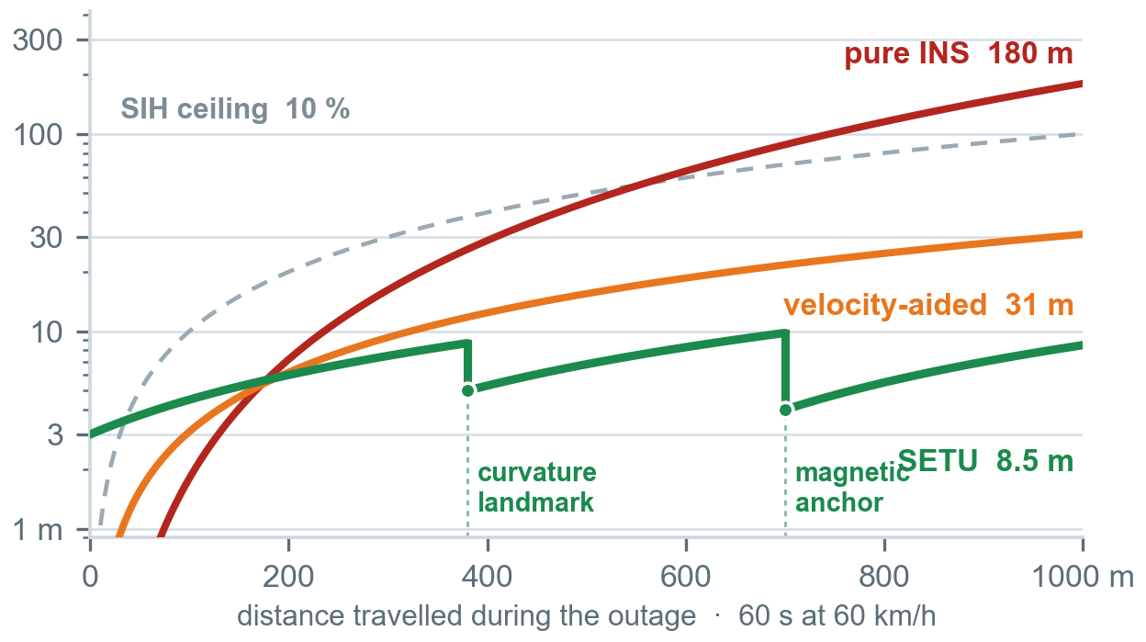
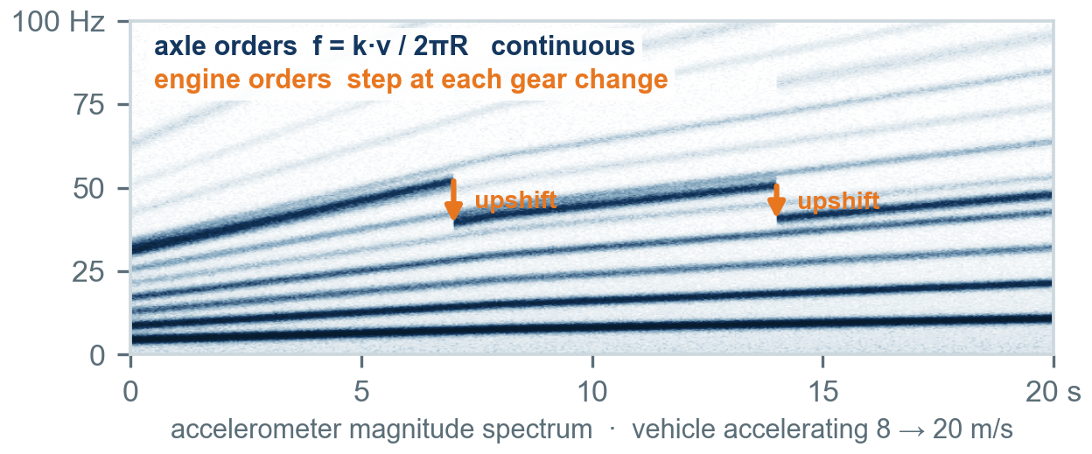
SETU — NAVIGATION WITHOUT GNSS
Your Team Name
Every phone-only system integrates acceleration twice, so its error grows as t². SETU asks a different question — how far along this road am I — and answers it with three measurements whose error does not accumulate with time.
Detailed explanation of the proposed solution
How it addresses the problem
Innovation and uniqueness of the solution
One C++ engine, two shells: Android app and edge daemon.
ACE solves phone→vehicle pitch, roll and yaw online. No user calibration; re-aligns in under 2 s after a knock.
MSVR classifies motion and mount quality, so potholes, idling and phone handling gate every other module.
SVO reads ground speed off the axle harmonics already present in the accelerometer spectrum.
CTS reads absolute speed from lateral force ÷ yaw rate in every turn — lean-corrected for two-wheelers.
CSA registers the gyro-derived path shape onto an offline OSM road manifold.
EFA magnetic, barometric and radio anchors, built by ordinary driving rather than by a survey fleet.
IAF invariant EKF on SE₂(3) with learned noise, inside a road-graph particle filter.
GQM per-satellite trust from raw GNSS — handover ramps, never switches.
N1 Speed from frequency, not integration. Chassis-vibration speed tracking exists in the DSP literature and has never been fused into a navigation filter.
N2 Two-wheeler physics done right: v = g·sinφ / ωz. Omitting cosφ is a silent 4 % scale error — 40 m per km.
N3 Scale-free map registration. Prior shape-matching work needs an odometer; we solve for the scale itself.
N4 IO-VNBD's synchronised CAN wheel speeds used as a training-only teacher instead of noisy GPS speed.
N5 Learned σ and learned Q inside one invariant filter, multi-hypothesis over the road graph.
Integrating a 0.1 m/s² bias gives ½·b·t² = 180 m in one minute. No network repairs a double integrator.
Aiding velocity makes the error linear in distance — 31 m per km at the 3.1 %/km published for a smartphone in a real tunnel.
Registering position makes it bounded: error resets at every curvature landmark and field anchor, so it stops growing with time.
3.6 MB int8 models 2.7 ms per tick 10 Hz phone 200 Hz edge · fully offline
N1 evidence — axle orders rise continuously with speed while engine orders step down at each upshift. That step is a free training label.

Slide 3
TECHNICAL APPROACH
Your Team Name
Methodology and process for implementation
SENSE
CONDITION
OBSERVE · measurement generators
FUSE
DELIVER
Accel + gyro 200–400 Hz
Magnetometer
Barometer
GNSS raw incl. NavIC L5
External IMU MEMS / FOG
STFT 2.56 s / 0.1 s hop
Harmonic ridge Viterbi
Adaptive notch engine order
Shock tagging potholes
MSVR motion + mount
SVO ground speed from axle harmonics
CTS absolute speed from lateral force ÷ yaw rate
CSA arc length from map shape, scale-free
EFA magnetic / barometric / radio anchors
NHC · ZUPT zero lateral, vertical, stopped velocity
GQM per-satellite GNSS trust + Doppler
RI-EKF on SE₂(3) × θ, 23 states
Learned σ per measurement
Learned Q transformer
RB-PF over the road graph
64 / 256 particles
10 Hz phone
200 Hz edge
Lane-level pose
Confidence tube
gRPC · NMEA · ROS 2
no OBD-II · no vehicle bus
ACE solves the mount online
each emits ⟨ value, covariance, validity, timestamp ⟩
χ² gating · stochastic cloning
no jump on re-acquire
TRAINED OFF-DEVICE masked-IMU pretraining → privileged distillation from CAN → BPTT through the filter → int8 export
OFFLINE MAP & ANCHOR BUNDLE OSM routing graph · ψ(s), κ(s) curvature LUT @ 1 m · DEM · magnetic and baro anchor DB · ≤250 MB per metro region
Technologies to be used
Models & training
PyTorch 2.5 · Lightning · Hydra · Polars · MLflow · masked-IMU pretraining · privileged distillation from the CAN bus · differentiable-filter BPTT
On-device ML
LiteRT + XNNPACK · ExecuTorch · int8 post-training quantisation, QAT on the velocity head · export parity asserted in m/s, not in tensor MSE
Engine core
C++20 · Eigen 3.4 · SE₂(3) Lie algebra · FlatBuffers + protobuf · GTest with golden-replay determinism · one core, two shells
Mobile
Kotlin 2.0 · Jetpack Compose · MapLibre GL + PMTiles offline basemap · SensorDirectChannel · GnssMeasurementsEvent · foreground service
Edge & maps
aarch64 static binary · gRPC / NMEA-0183 / ROS 2 · ADIS16505 and FOG at 200 Hz · osmium · CartoDEM · tippecanoe → PMTiles

Slide 4
FEASIBILITY AND VIABILITY
Your Team Name
Analysis of the feasibility of the idea
Potential challenges and risks | Severity | Strategies for overcoming these challenges
CSA is ambiguous on featureless or badly-mapped roads | High | Landmark saliency scoring, top-k path hypotheses in the particle filter, honest σ from the Gauss–Newton Hessian. Fallback: classical HMM map matching, still inside the gate.
Axle harmonics too weak — smooth road, quiet EV, soft mount | Medium | Mount-quality gate disables SVO when the mechanical path is decoupled; summation over 8+ orders; learned σ down-weights it automatically. Fallback: Tier B, gate still met.
IO-VNBD's phone stream is 10 Hz, so it cannot validate SVO | Known limit | Declared as capability tiers rather than hidden. IO-VNBD results are reported as Tier C with SVO off; SVO is validated on self-collected 400 Hz logs from week 2.
No two-wheeler data in IO-VNBD — four cars, no Indian roads | Known limit | The lean relation is imposed as a physics loss rather than learned, so few samples are needed; a dedicated two-wheeler collection covers both mount types.
Phone sensor rate throttled below 200 Hz on some devices | Medium | Tier detected at runtime from the achieved rate; SensorDirectChannel where available; verified across high, mid and low device classes.
Uneven OpenStreetMap geometry on Indian roads | Medium | Cross-track covariance scaled by an OSM confidence heuristic, an explicit off-road particle so a missing road cannot force a wrong match, and a provider adapter.
Data already in hand. IO-VNBD gives 5,700 km over 98 h with the phone IMU and the CAN bus recorded simultaneously — both the input and a clean label.
The load-bearing physics is closed-form. v = a_lat / Ω and f = v / 2πR are algebra, not training. Only the residuals are learned, so the core carries no research risk.
Compute fits today's phones. 3.6 MB of int8 models, 2.7 ms per 10 Hz tick, CPU only — no NPU or GPU delegate dependency across low-end SKUs.
The sensors are already there. Accelerometer, gyroscope, magnetometer, barometer and raw GNSS including NavIC L5 are exposed by standard Android APIs.
Maps are tractable offline. ≤250 MB per metro region for the routing graph, the precomputed curvature lookup and the DEM. No connectivity in the runtime path.
Nothing to buy or install. No OBD-II dongle, no wheel encoder, no UWB, leaky-feeder or 5G roadside build-out — it runs on the phone already on the dashboard.
Capability tiers — declared at runtime, never hidden
A ≥200 Hz IMU full spectral odometer 0.5–1 %/km
B 50–200 Hz axle orders 1–4 only 1–2 %/km
C 10–50 Hz no spectral odometer 2–3 %/km
IO-VNBD's smartphone stream is 10 Hz, so every result we report on it is Tier C with the spectral odometer switched off.

Slide 5
IMPACT AND BENEFITS
Your Team Name
Potential impact on the target audience
Benefits of the solution (social, economic, environmental, etc.)
Quick-commerce and delivery riders — the marker keeps moving through underpasses and basement parking, so the next turn is announced before the exit, not after it.
Logistics and fleet operators — mileage through tunnels and yards stops being guesswork; ETA and proof of delivery survive GNSS gaps, with no dongle to fit or maintain.
Ride-hailing drivers and riders — no frozen or teleporting car in an urban canyon, and pickup points that resolve to the right side of the road.
Emergency responders — ambulance and fire crews keep a live position inside tunnels, metro underpasses and multi-level structures, exactly where dispatch loses them today.
Two-wheeler riders — the largest vehicle class on Indian roads gets a lean-aware solution instead of one built for cars, and less time spent looking at a stalled screen.
Defence and critical logistics — a wholly self-contained position that degrades gracefully under jamming or spoofing instead of failing.
Social
Safer riding: a correct instruction on time means fewer glances at the screen at the moment a rider can least afford one. Emergency crews stay locatable underground. Accurate navigation stops being a feature of expensive cars and becomes a property of any phone on any dashboard.
Economic
Zero marginal hardware — it runs on phones riders already own. No OBD dongle per vehicle, no factory-fitted INS, no UWB or leaky-feeder installation per tunnel. Fewer missed exits, re-routes and failed delivery attempts per shift, on the same fleet.
Environmental
A missed exit is wasted kilometres, wasted fuel and avoidable emissions; removing the cause removes all three. And because the solution is entirely on-device, no roadside infrastructure has to be manufactured, powered or maintained.
Strategic
Resilient to jamming and spoofing by construction, since every SETU channel is self-contained. Uses NavIC L5 where Indian devices expose it, runs fully offline, and keeps trajectory data on the phone rather than in a cloud.
Where it matters most
Long tunnels and metro underpasses — GNSS is absent, and the road is topologically one-dimensional, so the map does most of the work.
Multi-level parking — the helical ramp is a uniquely-shaped signature and the barometer resolves the floor to within one level.
Dense urban canyons — position is unusable but Doppler velocity survives on three or four satellites, where others discard everything.
Forested and valley highways — partial, intermittent GNSS, which the trust ramp absorbs without ever switching mode.
Pure inertial, 60 s
180 m
½·b·t² with a 0.1 m/s² bias — the marker is a block away
Best published smartphone
31 m
3.1 % of distance per km, INS + NHC in a real tunnel
SETU design target
8–15 m
0.8–1.5 % per km, anchored to the map and to the field
Horizontal drift over a 1 km GNSS blackout at 60 km/h. The SIH ceiling is 10 % of distance travelled — 100 m.

Slide 6
RESEARCH AND REFERENCES
Your Team Name
Details / Links of the reference and research work
DATASET AND BENCHMARK
IO-VNBD: Inertial & Odometry Benchmark Dataset
Onyekpe, Palade, Kanarachos, Szkolnik · Data in Brief 35:106885, 2021 · github.com/onyekpeu/IO-VNBD · arXiv:2005.01701
WhONet: Wheel Odometry Neural Network
Eng. Applications of AI, 2021 · arXiv:2104.02581 — our privileged upper bound
R-WhONet: recalibration via transfer learning
arXiv:2209.05877 — evidence for cross-vehicle domain shift
LEARNED INERTIAL ODOMETRY
Deep Learning for Inertial Positioning: A Survey
Chen & Pan · IEEE T-ITS, 2024 · arXiv:2303.03757
Inertial Navigation Meets Deep Learning — a survey
Cohen & Klein · 2024 · arXiv:2307.00014
AI-IMU Dead-Reckoning — invariant EKF, learned noise
Brossard, Barrau & Bonnabel · IEEE T-IV, 2020 · arXiv:1904.06064
TLIO: Tight Learned Inertial Odometry
Liu et al. · IEEE RA-L, 2020 · arXiv:2007.01867 — learned covariance into a filter
OdoNet: untethered speed aiding, no odometer
arXiv:2109.03091 · 68 % error reduction over NHC alone
CarSpeedNet: accelerometer-only speed
arXiv:2401.07468 · <0.72 m/s ≈ 4.3 % — the accuracy to beat
PiDR: Physics-Informed Inertial Dead Reckoning
Sahoo & Klein · 2026 · arXiv:2601.03040
LEARNED AND ADAPTIVE FUSION
KalmanNet: neural-network-aided Kalman filtering
Revach, Shlezinger, van Sloun & Eldar · IEEE TSP, 2022
A-KIT: Adaptive Kalman-Informed Transformer
Cohen & Klein · arXiv:2401.09987 · github.com/ansfl/A-KIT — learned process noise
Differentiable particle filters, semi-supervised
arXiv:2011.05748
MAP MATCHING AND KINEMATIC CONSTRAINTS
Hidden Markov Map Matching Through Noise and Sparseness
Newson & Krumm · ACM SIGSPATIAL, 2009 — the map-matching baseline
Heading–length sequence matching for localisation
arXiv:2005.13704 — nearest prior art to CSA; assumes a known speed source
Map-aided dead reckoning from OBD speed
arXiv:1611.07910 — map-aided DR with a known odometer
Lever-arm accuracy of the non-holonomic constraint
Zhang & Hu · IEEE TVT, 2020
NHC-assisted GNSS/SINS with motion-state CNN
GPS Solutions, 2023 · doi 10.1007/s10291-023-01483-9
SPECTRAL SPEED AND FIELD ANCHORS
Vehicle Speed Tracking Using Chassis Vibrations
Linköping University, 2016 — axle-order tracking; motivates tunnel navigation
Accelerometer-based wheel odometer
Sensors, 2021 · PMC7918720
Magnetic field vehicle positioning in a long tunnel
Applied Sciences 11(24):11641, 2021 · doi 10.3390/app112411641
Vehicle positioning in tunnel environments: a review
Complex & Intelligent Systems, 2025 · doi 10.1007/s40747-024-01744-1
Barometric floor detection on smartphones
Sensors, 2015 · PMC4431287 — basis for the parking-level anchor
GNSS INTEGRITY AND PLATFORM
Vehicle positioning in underground space using a smartphone
ISPRS Archives XLVI-3/W1, 2022 — the 3.1 %/km INS+NHC tunnel reference
GNSS multipath detection using machine learning
Hsu · IEEE ITSC, 2017
Android GnssMeasurement HAL — raw GNSS observables
source.android.com/reference/hal/struct_gnss_measurement
u-blox Untethered Dead Reckoning (UDR)
u-blox.com/en/technologies/udr-untethered-dead-reckoning — commercial reference
A 66-entry annotated bibliography, with a prior-art positioning table for each of the five mechanisms, is maintained alongside the implementation documentation.

