Slide 1
Fail-Closed or Fail-Degraded? A Simulation Study of Forced Assurance Loss in Contested Multi-Hop QKD Networks
Lakshya Jain¹, Siddhi Arora²
¹Maharaja Agrasen Institute of Technology, Delhi | ²Noida Institute of Engineering and Technology, Greater Noida
167
Notes:
Good morning, everyone. I'm Lakshya Jain, and this is joint work with Siddhi Arora. Our question is a practical one. When a multi-hop quantum key distribution network runs out of key, should it refuse service, or quietly fall back to weaker cryptography? And if an attacker wants to push it into that fallback, what does it cost them?

Slide 2




Motivation: When Quantum Key Runs Out
Out of key, a network must refuse service or quietly weaken it
Rear base
Front post
Every relay re-encrypts the key with a one‑time pad, so an n‑hop path pays for key on every hop, and a free-space hop makes only about 10² bit/s.
Fail closed
Fail degraded
Refuse the request, as a layered PQC design does.
The commander sees an outage and can act.
Fall back to a weaker cipher, as ITU‑T Y.3803 allows.
Nobody notices until the audit.
Notes:
Picture a brigade up in the mountains, talking to its rear base through a chain of relay sites. In a trusted-relay network every relay decrypts and re-encrypts the key, so a path of n hops pays for key n times over, shown by the red keys on each link. Free-space links only make around a hundred bits a second, so what runs out first is key, not connectivity. At that point the network has two choices. It can fail closed and refuse the request: the commander sees an outage and can react. Or it can fail degraded and fall back to a weaker cipher, which ITU-T Y.3803 allows: nothing looks wrong until someone audits the logs. Which is worse, and what does it cost an attacker to force it?

Slide 3


Research Gap and Contributions
Prior work asks if a request was served, not what it got
Line of prior work
Served?
Grade?
What this paper adds
Routing
A threat-aware model where stored key outlives generation
which path a request takes
Quality of service
Forced assurance loss F and the downgrade-forcing cost k*
who gets key first
Exhaustion and fallback
A cut condition that predicts how long service lasts
switching to a KEM
Adversary models
Evidence on five graphs that forcing needs capability, a cut and time
depletion, attack radius
The missing column. No study we found reports how much traffic entitled to ITS key is served below ITS on a multi-hop network under attack.
An audit of a learned controller, and accounting checked against field data
Notes:
Here's the gap. Routing papers, quality-of-service papers, papers on key exhaustion and fallback, and papers that model an adversary all ask the same question: was the request served or blocked? That's the column of ticks. What nobody reports is the highlighted column: what grade of protection the traffic actually got. A post-quantum-only session simply counts as served. That's what we add: a model that keeps stored key and failure surfaces apart, two metrics for exactly this loss, a cut condition, evidence on five graphs, and an audit of our own method.

Slide 4
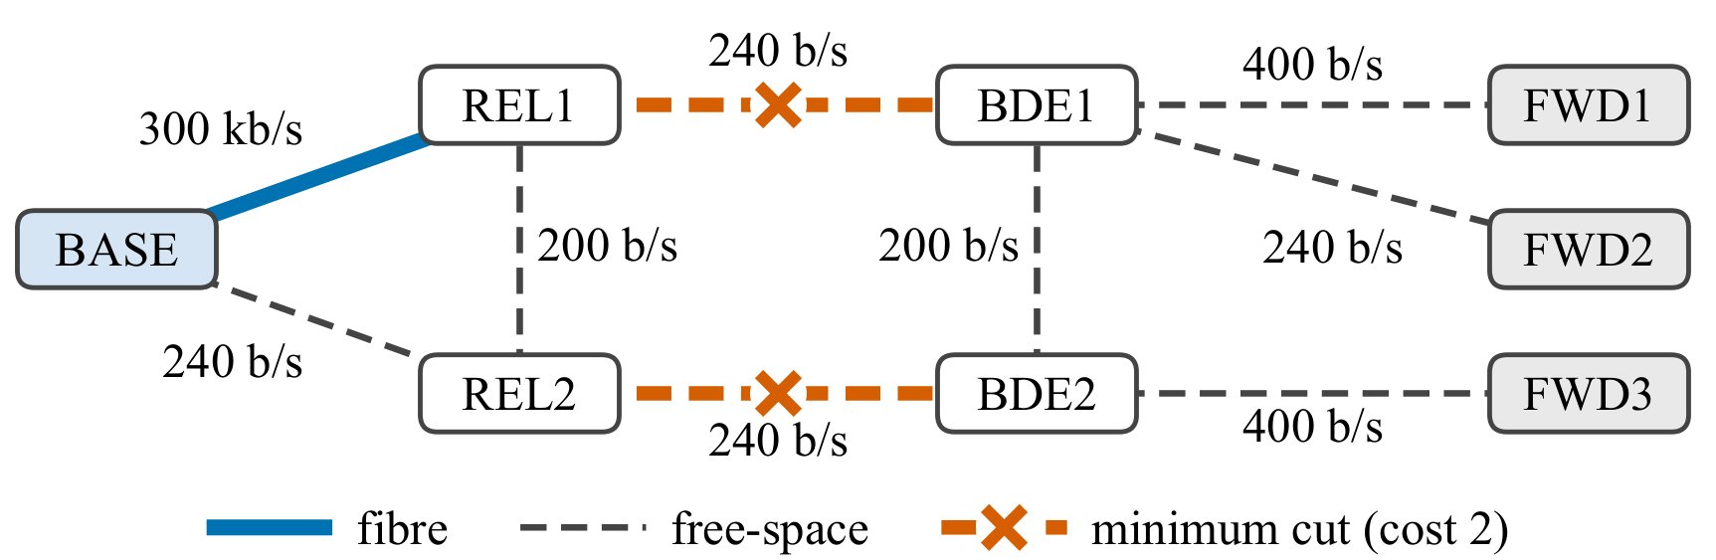

System Model: Formation, Key Grades and Adversary
Every session to the front crosses one of two 240 bit/s links
The assurance ladder
G₁
One-time pad
ITS
G₂
QKD-keyed cipher
ITS key
G₃
QKD ⊕ ML-KEM
below ITS
Paper Fig. 1(a). Orange crosses mark the two-link minimum cut.
G₄
ML-KEM only
post-quantum
Three failure surfaces, kept separate
Floors C2 → G₂ ISR → G₁ LOG → G₃
Quantum channel
QBER past 0.075 stops fresh key
Classical transport
no relaying, no fallback
Key service
no KEM fallback setup
The attacker raises the QBER on links it buys until they abort.
Stored key survives, so it must outlast the stock.
Notes:
This is our main network, an eight-node tactical formation. Look at the orange crosses: every session from the rear base to the forward posts has to cross one of those two 240 bit-per-second links, and the fat fibre behind them can't help. We keep three failure surfaces apart: noise on the quantum channel stops fresh key, denial of classical transport stops everything, and denial of the key service blocks a KEM fallback. On the right is the assurance ladder, from one-time pad down to ML-KEM on its own; each traffic class has a floor it's entitled to. The attacker raises the error rate until links abort, but stored key can still be spent, so the attack has to last long enough to drain it.

Slide 5
Metrics and Experimental Setup
Availability hides the damage, so we measure the grade served
Fail-degraded, two-link cut held for 24 h
6.6% at grade
2.5% blocked
90.9% served below floor
97.5% counted as available
A = Q + L
F forced assurance loss
T* = ΣU_{e}(0) / D̄
Availability splits into service at its authorised grade (Q) and below it (L).
Requests entitled to ITS key that are served without it. Blocked ones stay in the count.
How long stock behind a held cut lasts: 1.44 h at 2% fill.
Tested with 24 h attacks, 12 paired seeds and 95% bootstrap intervals, behind a 43-check gate and 127 regression tests.
Notes:
Why new metrics? Because availability on its own hides the problem. This bar is fail-degraded under the held cut. 97.5 percent of requests count as available, but only the navy sliver, 6.6 percent, is at the grade it was entitled to; the red 90.9 percent is served below its floor. So we split availability into Q and L. Our headline metric F counts requests entitled to ITS key that end up without it, keeping blocked requests in the count so both modes are compared fairly. And the cut condition gives a clock: stock behind the cut divided by demand, 1.44 hours at two percent fill. Everything is tested over 24-hour attacks with twelve paired seeds and bootstrap intervals, behind a validation gate.

Slide 6
Key Result: The Fail-Mode Exchange Rate
Same attack: refuse nearly everything, or serve it below grade
Fail closed
Fail degraded
90.1%
of requests entitled to ITS key are served without it (95% CI 89.2–91.0, 12 seeds)
6.7%
97.5%
93.2%
served
served
of served sessions run on ML‑KEM‑768 alone
87.6–92.9%
Refuses 93.3%: a visible outage
Only 6.6% at its grade
forced loss on each of the five graphs (paper Fig. 2)
at authorised grade
below floor (all classes)
refused
Notes:
This is the result to take home. Same attack, same graph, two fail modes. On the left, fail closed: the network refuses almost everything and serves 6.7 percent, a clear and visible outage. In the middle, fail degraded: it serves 97.5 percent, so availability looks fine, but look at the ring. Only 6.6 percent is at its proper grade; the red is service below the floor. That's 90.1 percent of entitled requests losing ITS protection, and 93 percent of served sessions running on ML-KEM alone. The fallback doesn't buy assurance back; it hides the loss. And it's not one graph: on all five, a held cut forces 88 to 93 percent.

Slide 7



What Forcing Requires: Capability, Cut and Endurance
Forcing needs capability, a cut and time. Remove one, it fails
k*: links an attacker must buy to force F ≥ 50% in 24 h (fail-degraded, 2% fill, 8 seeds)
Capability
A link aborts only once Δe ≥ 0.045; below that, under 0.1% is forced.
A cut
A smart attacker needs only the 2‑link cut, however deep the chain.
Time
First forcing after about 1.5 h; from full stores, nothing in 24 h.
Routing adds 0.12 points; reservation floors cut F to 63.6%; a learned controller gains little.
Notes:
So what does it take to force a downgrade? Three things, and the attacker needs all of them. Capability: a link only aborts once the injected error passes 0.045; below that, almost nothing is forced. A cut: look at the chart. A naive static ranking, the navy line, makes a longer chain look safer, needing d plus two links. A smart attacker who recomputes after each removal, the red line, needs only the two-link cut at every depth. Depth buys no protection. And time: the attack has to outlast the stored key. First forcing comes after about an hour and a half, and from full stores nothing is forced all day. Routing, reservation floors and a learned controller shift the numbers, but none removes one of these three requirements.

Slide 8


Conclusions and Recommendations for Operators
Report the grade of what you serve, not only that you served it
Three rules for operators
Report Q and F next to availability A.
Thank you
Keep stock behind the minimum cut for T* hours of the attacks you fear.
Questions are welcome
Set fail modes per traffic class, and put a price on every exception.
10jainlakshya@gmail.com
Sid.arora1701@gmail.com
github.com/LakshyaJ1/Quantum_ResearchPaper
Limits and next steps. Key rates are parameterised and the graphs synthetic; cross‑validation with QKDNetSim comes next.
Notes:
Let me wrap up. Refusing service costs availability; degrading quietly costs assurance, and under a held cut that's ninety percent of entitled traffic. An attacker can only force it with capability, a cut and enough time, so stock behind the cut is a real defence. If you remember one thing: report the grade of what you serve, not only that you served it. For operators that means three rules: report Q and F next to availability, keep stock behind the minimum cut for the attacks you fear, and set fail modes per traffic class. Our rates are parameterised and the graphs synthetic, so cross-validation with QKDNetSim is next. Thank you, and I'm happy to take questions.

