Slide 1
EXPLAINABLE ML · CONSUMER PROTECTION
DarkShield AI
Explainable Machine Learning for Detecting Dark Patterns in E-Commerce Interfaces
Rayavarapu Rohan Krishna
Satvik Jindal
Lakshya Jain
23BAI1102
23BPS1123
23BPS1059
Guide: Dr. Sridevi S, Associate Professor, SCOPE
Digital Assessment 3 · October 2026
Notes:
Title slide. DarkShield AI — explainable ML to detect dark patterns in e-commerce UIs. Team of 3, guided by Dr. Sridevi S.

Slide 2
OVERVIEW
Presentation Agenda
01
02
03
Objectives
Literature Review
Proposed Methodology
Goals & project scope
Prior work & research gaps
Architecture, pipeline & models
04
05
06
Novel Aspects
Results & Discussion
Conclusion & Future Scope
What sets DarkShield apart
Benchmarks & live audits
Contributions & next steps
DarkShield AI · Machine Learning (BCSE209L) · VIT Chennai
2
Notes:
Roadmap follows the required report structure: objectives, literature, methodology, novelty, results, conclusion.

Slide 3
SECTION 01
Objectives & Project Scope
Design, evaluate and deploy a robust, explainable, production-ready ML framework for autonomous dark-pattern detection on live web interfaces.
1
Curate corpus
2
MLOps pipeline
Validate a clean training set from the ec-darkpattern dataset with strict schema constraints.
Automate ingestion, validation, transformation, 5-fold tuning, evaluation & deployment.
3
Comparative benchmark
4
Explainable AI
Evaluate 4 ML architectures: Logistic Regression, Linear SVM, LSTM and GRU.
Apply game-theoretic SHAP to highlight exact deceptive tokens in real time.
5
Granular auditing
6
Full-stack delivery
Dual-stage element-level engine + stealth Playwright scraper to audit live sites.
FastAPI backend, React/Vite dashboard and a Manifest V3 Chrome extension.
DarkShield AI · Machine Learning (BCSE209L) · VIT Chennai
3
Notes:
Six concrete objectives spanning data, modelling, explainability, scraping and deployment.

Slide 4
THE PROBLEM
What Are Dark Patterns?
Deceptive UI/UX that manipulates users into actions against their intent — undermining autonomy and violating FTC, EU DSA and India CCPA/ASCI rules. Regex and heuristic matchers are brittle and false-positive prone.
Dark Pattern | UI Manifestation | Consumer Harm
False Urgency | Countdown timers, 'Sale ends in 02:14!' | Irrational time pressure → impulse buys
Manufactured Scarcity | 'Only 1 left!', '18 viewed now' | Exploits scarcity → rushed checkout
Confirmshaming | 'No thanks, I hate saving money' | Emotional guilt for declining offers
Sneak into Basket | Pre-ticked warranties, hidden fees | Unauthorized charges at checkout
Obstruction / Roach Motel | 1-click signup vs 7-step cancel | Inflated exit friction, locked billing
DarkShield AI · Machine Learning (BCSE209L) · VIT Chennai
4
Notes:
Five canonical dark-pattern categories with their UI form and the harm they cause. India outlawed 13 archetypes in 2023.

Slide 5
SECTION 02
Literature Review & Related Work
Deceptive UI foundations
ML for web text security
Brignull (2010) coined 'dark patterns'. Mathur et al. (2019) crawled 11K shopping sites; Gray et al. (2018) built the UX taxonomy.
Classical TF-IDF classifiers (LR, SVM) and recurrent nets — LSTM (1997), GRU (2014) — capture token dependencies for subtle manipulative phrasing.
Explainable AI & trust
Anti-scraping evasion
Lundberg & Lee (2017) SHAP gives axiomatic, game-theoretic token attribution — grounding each detection in observable evidence.
Modern bot walls (Cloudflare, Akamai, Amazon WAF) block vanilla Selenium; stealth fingerprinting is required to audit live product pages.
DarkShield AI · Machine Learning (BCSE209L) · VIT Chennai
5
Notes:
Four pillars of related work: deceptive-UI studies, ML text classification, XAI, and anti-bot evasion.

Slide 6
MOTIVATION
Identified Research Gaps
GAP 1
GAP 2
GAP 3
No End-to-End MLOps
Whole-Page Aggregation Fallacy
Missing Integrated Explainability
Prior work stops at offline notebooks — no reproducible validation, model pusher, or production serving.
Concatenating all page text spikes false positives when innocent pages contain words like 'free' or 'deal'.
Existing extensions give binary flags with no token attribution — users & auditors can't see the rationale.
DarkShield AI · Machine Learning (BCSE209L) · VIT Chennai
6
Notes:
These three gaps directly motivate DarkShield's pipeline, granular scoring, and SHAP integration.

Slide 7
SECTION 03 · PROPOSED METHODOLOGY
End-to-End System Architecture
Client
(React / Extension)
›
FastAPI
Gateway
›
Stealth Playwright
Scraper
›
DOM Element
Extractor
›
Multi-Model
Inference
›
Calibrated
Auditor
›
SHAP
Explainer
1
2
3
5 decoupled tiers
Request flow
MLOps components
Client · API gateway · scraping engine · inference & auditing · explainability + registry.
Audit request → Playwright hydrates URL → discrete DOM elements → 4-model inference → SHAP attribution → structured JSON.
6 modular src/ stages: ingestion, validation, transformation, trainer, evaluation, model pusher → auto-deploy to backend.
DarkShield AI · Machine Learning (BCSE209L) · VIT Chennai
7
Notes:
Decoupled microservice architecture; the top band is the live execution pipeline from client to SHAP explainer.

Slide 8
SECTION 03 · METHODOLOGY
Models, Data & Training
DATASET — ec-darkpattern
FOUR-WAY MODEL BENCHMARK
2,356
Model | Type | Key Config
Logistic Regression | Linear | C=10, lbfgs, L2
Linear SVM | Hyperplane | C=1, linear, Platt scaling
LSTM | Recurrent DL | hidden=128, 15 epochs
GRU | Recurrent DL | hidden=32, 3.2× faster
Total UI snippets
1,884
Train (80%) · 5-fold CV
472
Held-out test (20%)
50 / 50
Balanced classes
Train-only vectorization prevents leakage · stop-words pruned but urgency tokens ('only','left','hurry') preserved · SHAP (LinearExplainer + DeepExplainer) attributes every token.
5,000
TF-IDF n-grams (1–2)
DarkShield AI · Machine Learning (BCSE209L) · VIT Chennai
8
Notes:
Balanced 2,356-sample corpus, 80/20 stratified split, TF-IDF features. Four models from linear to recurrent, all SHAP-explained.

Slide 9
SECTION 04
Novel Aspects
★
Granular element-level auditing
★
Stealth Playwright scraper
Dual-stage engine scores discrete 5–30 word UI elements instead of concatenating 50K-char pages — kills false positives, ~100% specificity.
Fingerprint randomization, webdriver scrubbing & CAPTCHA detection audit live Amazon India pages that block vanilla Selenium.
★
SHAP across linear + deep
★
Enterprise MLOps + full-stack
Unified token attribution over both TF-IDF and recurrent models — amber = deceptive, emerald = benign in the live UI.
Reproducible 6-stage pipeline with auto model-pusher, FastAPI gateway, React dashboard & Manifest V3 extension.
DarkShield AI · Machine Learning (BCSE209L) · VIT Chennai
9
Notes:
Four contributions: granular scoring, stealth scraping, dual SHAP, and a full MLOps/full-stack delivery.

Slide 10
SECTION 05 · RESULTS & DISCUSSION
Comparative Model Performance
94.92%
96.40%
0.9750
GRU accuracy
SVM precision
LR ROC-AUC
best overall
lowest false alarms
best separation
Model | Accuracy | Precision | Recall | F1-Score | ROC-AUC
Logistic Regression | 92.80% | 94.69% | 90.68% | 92.64% | 0.9750
SVM (Linear) | 93.64% | 96.40% | 90.68% | 93.45% | 0.9709
LSTM | 94.70% | 95.28% | 94.07% | 94.67% | 0.9735
GRU | 94.92% | 95.69% | 94.07% | 94.87% | 0.9708
Green cells mark the winning model for each metric · all four models exceed 92% accuracy on 472 unseen samples
DarkShield AI · Machine Learning (BCSE209L) · VIT Chennai
10
Notes:
GRU wins accuracy & F1, SVM wins precision, LR wins ROC-AUC. All >92% accuracy.

Slide 11
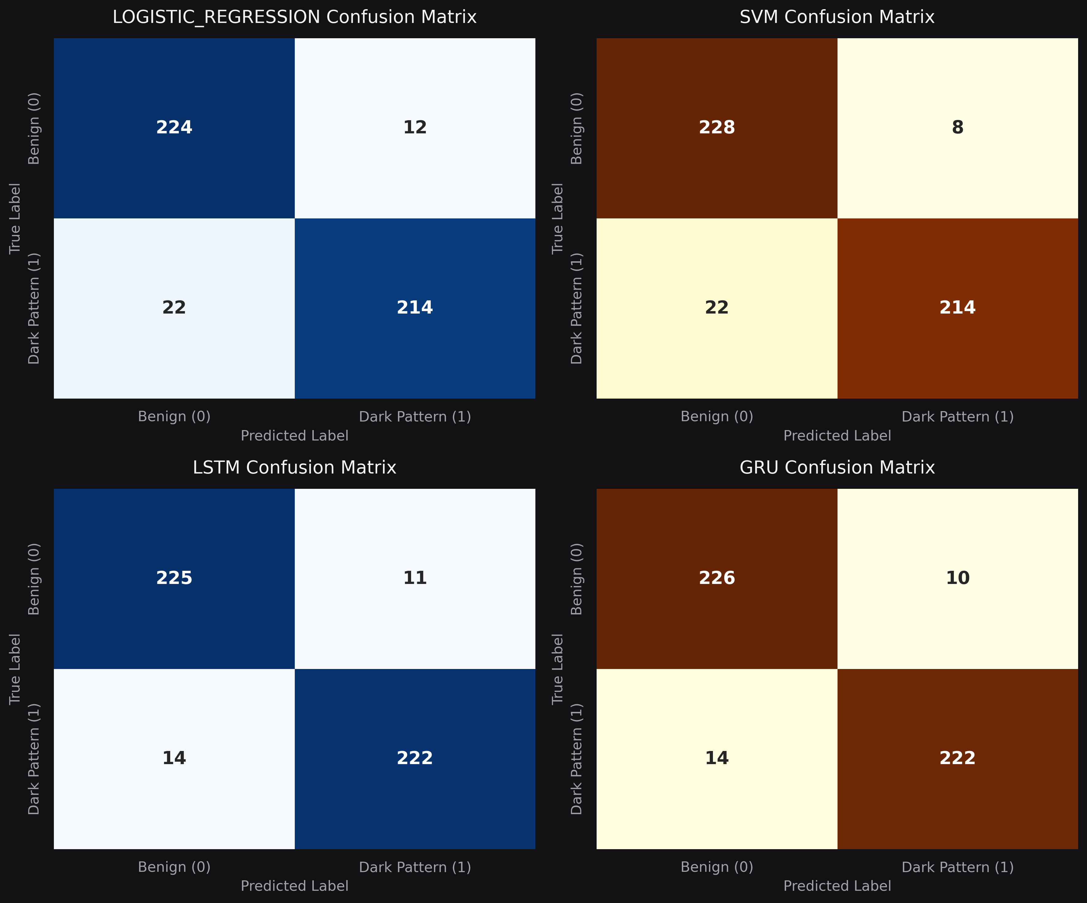
SECTION 05 · RESULTS
Confusion Matrices — All Models
READING THE MATRICES
SVM
Only 8 false positives — 228/236 benign correct.
GRU & LSTM
222/236 dark patterns caught (14 misses each).
Diagonal dominance
Strong true-positive & true-negative mass across all four.
Fig 6.1 — Normalized confusion matrices (472 test samples)
DarkShield AI · Machine Learning (BCSE209L) · VIT Chennai
11
Notes:
Confusion matrices confirm SVM's low false-positive rate and the recurrent models' high recall.

Slide 12
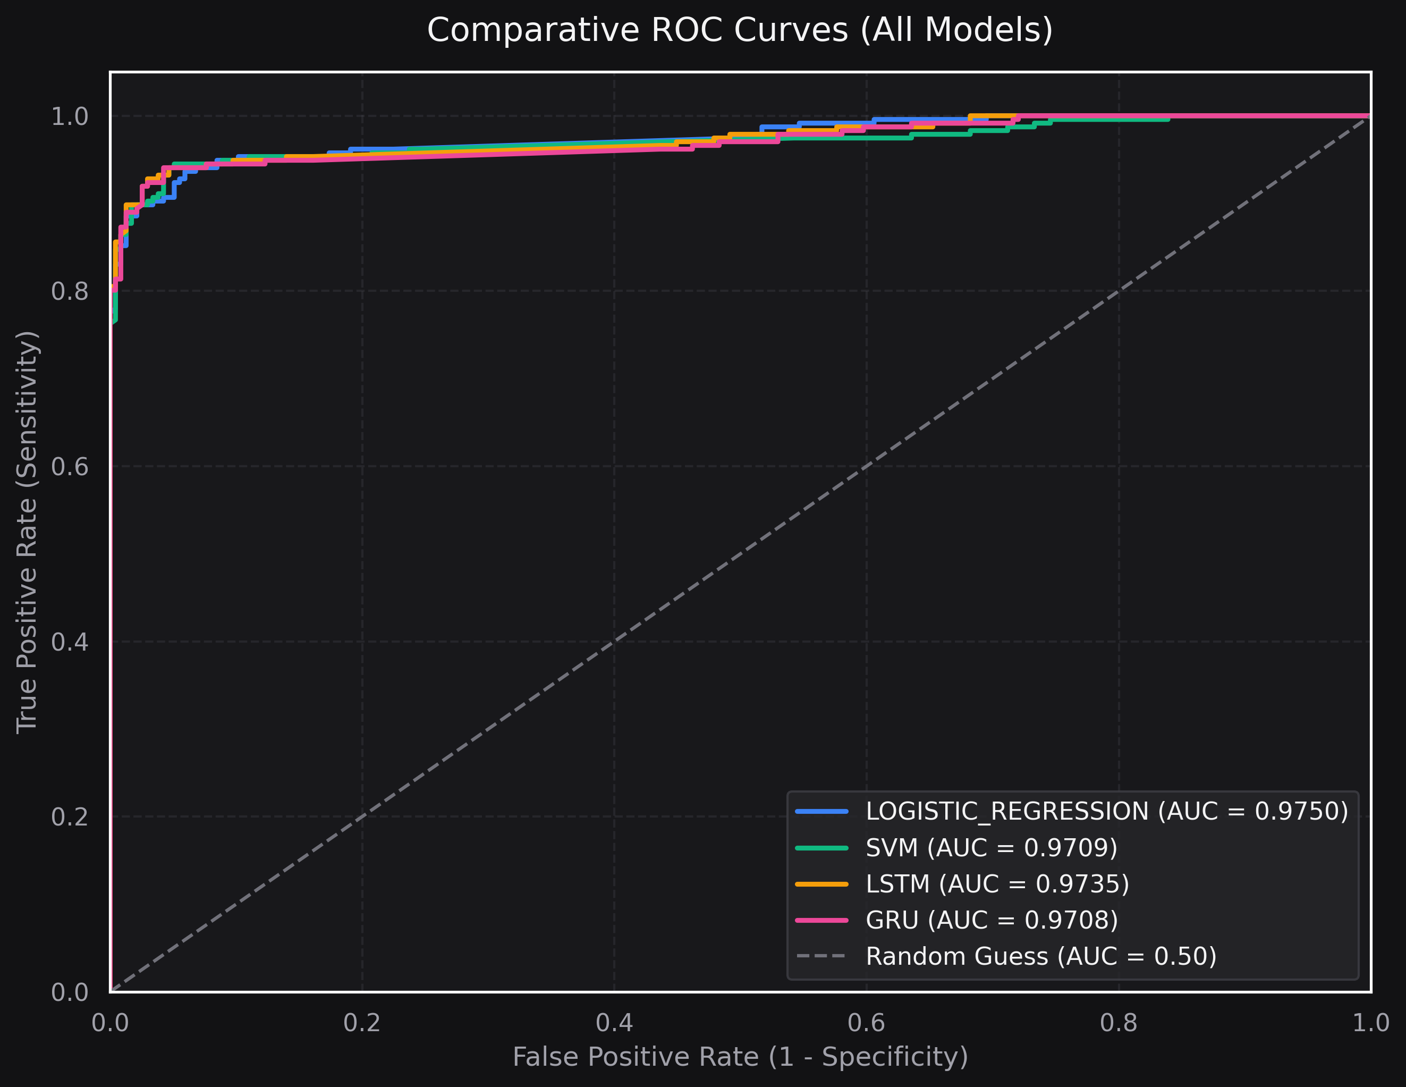
SECTION 05 · RESULTS
ROC Curves & Discrimination Power
WHY IT MATTERS
AUC ≈ 0.97
All models cluster far above the 0.50 random-guess diagonal.
Threshold-robust
High sensitivity sustained across operating points.
LR leads AUC
0.9750 — strongest class separation overall.
Fig 6.2 — Comparative ROC curves across all four classifiers
DarkShield AI · Machine Learning (BCSE209L) · VIT Chennai
12
Notes:
ROC curves hug the top-left corner; AUC near 0.97 for every model.

Slide 13
SECTION 05 · LIVE VALIDATION
Real-World E-Commerce Audits
Website / Product | Elements | Dark Score | Outcome
python.org (docs) | 42 | 0.2% | Verified clean — 0 FP
example.com | 4 | 0.1% | Verified clean — 0 FP
wikipedia.org | 58 | 0.4% | Verified clean — 0 FP
Amazon IN — Tata Sampann | 34 | 68.4% | Flagged: 'Only 1 left'
Amazon IN — Lego Icons | 41 | 74.2% | Flagged: 'Deal of day'
< 0.5% risk on informational sites (zero false positives) while precisely flagging genuine deceptive cues on live Amazon India listings.
DarkShield AI · Machine Learning (BCSE209L) · VIT Chennai
13
Notes:
Calibrated granular scoring: clean sites score near zero, real Amazon dark patterns score 68–74%.

Slide 14
DEPLOYMENT
Software Implementation
FastAPI Backend
Sentinel Amber Dashboard
Async microservice, 4 REST endpoints (/analyze, /scrape, /explain/shap), Swagger docs.
React 18 + Vite: live multi-model charts, deceptive-cue inspector, SHAP token heatmaps.
Chrome Extension (MV3)
Docker + CI/CD
Service worker captures active-tab DOM, injects on-page overlays highlighting dark patterns.
Containerized Python 3.10 + Playwright; GitHub Actions runs schema checks & pytest on every push.
DarkShield AI · Machine Learning (BCSE209L) · VIT Chennai
14
Notes:
Production stack: FastAPI, React/Vite dashboard, MV3 extension, Docker + GitHub Actions CI.

Slide 15
SEE IT IN ACTION
Live Demo & Source Code
▶
Hardware / Software Demo Video
1.5–2 min walkthrough: live Amazon audit, SHAP token highlighting & the Chrome extension overlay
loom.com/share/9640b1b56c824ac6a79cc2505f2b6b3e
{ }
GitHub Repository
Full source: MLOps pipeline, backend, React dashboard, Chrome extension & trained models
github.com/LakshyaJain08/DarkShield-AI
DarkShield AI · Machine Learning (BCSE209L) · VIT Chennai
15
Notes:
Demo video (Loom) and GitHub repository links. Click to open during presentation.

Slide 16
SECTION 06
Conclusion
Reproducible MLOps
Full pipeline: validation → training → evaluation → auto model registry.
✓
Empirical rigor
4-paradigm benchmark: GRU 94.92% accuracy, SVM 96.40% precision.
✓
False-positive fix
Calibrated granular element-level auditing + stealth crawler.
✓
Explainable AI
SHAP across all models exposes exact deceptive tokens.
✓
Full-stack delivery
FastAPI + React/Vite dashboard + Manifest V3 extension.
✓
DarkShield AI · Machine Learning (BCSE209L) · VIT Chennai
16
Notes:
Five contributions summarise the project: MLOps, benchmark, FP fix, XAI, full-stack.

Slide 17
SECTION 06
Future Scope & Key References
FUTURE RESEARCH
SELECTED REFERENCES
1
Multimodal VLMs
Brignull, H. — Dark Patterns: Deception vs Honesty in UI (2010).
Mathur et al. — Dark Patterns at Scale: 11K Shopping Sites, ACM CSCW (2019).
Gray et al. — The Dark (Patterns) Side of UX Design, CHI (2018).
Lundberg & Lee — A Unified Approach to Interpreting Model Predictions (SHAP), NeurIPS (2017).
Hochreiter & Schmidhuber — Long Short-Term Memory, Neural Comp. (1997).
Cho et al. — GRU: Encoder-Decoder Approaches, SSST-8 (2014).
FTC — Bringing Dark Patterns to Light, Staff Report (2022).
CCPA India — Guidelines for Prevention of Dark Patterns (2023).
LayoutLM + CLIP to fuse text, bounding boxes & colour-contrast for visual-interference patterns.
2
Real-time DOM mutation
MutationObserver to catch ephemeral popups & JS countdown animations.
3
Regulatory reporting
Auto-generate compliance audit reports for FTC / CCPA submission.
Full 22-reference list in the project report (IEEE format)
DarkShield AI · Machine Learning (BCSE209L) · VIT Chennai
17
Notes:
Future work: multimodal VLMs, real-time DOM tracking, automated regulatory reporting. Key references listed.

Slide 18
★
THANK YOU
DarkShield AI — making deceptive design visible, explainable and accountable.
github.com/LakshyaJain08/DarkShield-AI · Watch the demo
Questions & Discussion welcome
Notes:
Closing slide with repo and demo links. Invite questions.

