Slide 1
IBM University Engagement Project Submission
“Exploring the Power of Agentic AI with IBM Granite and IBM Bob”

Slide 2

Project Title – [ PS: 5 - Travel Planner Agent]
Domain of Project – [Travel and Tourism ]
Student Name | Recent Passport Photo | Email ID | Mobile number [WhatsApp]
Lakshya Jain |  | AICTE Registered Email ID – Lakshyajain688@gmail.com | +91 9321440294

Slide 3
Problem Statement – 5 : Travel Planner Agent
Problem Statement : Travel Planner Agent
The Challenge
Planning a trip can be time-consuming due to destination selection, budgeting, transportation, accommodation, and itinerary planning. Travelers often need to search multiple platforms to create a suitable plan based on their preferences and budget.
The Objective
Build an AI-powered Travel Planner Agent that provides personalized travel recommendations and itineraries based on the user's destination, budget, duration, and interests.
The solution should:
• Destination Recommendations – Suggest destinations and attractions based on user preferences.
• Itinerary Generation – Create a day-by-day travel plan based on trip duration and interests.
• Budget Planning – Estimate expenses for accommodation, food, transportation, and activities.
• Activity Recommendations – Suggest sightseeing, restaurants, and activities.
• Travel Guidance – Provide transportation options, travel tips, and useful suggestions.
• Personalized Adjustments – Modify the itinerary according to budget, duration, interests, and travel style.
• Multi-Agent System
Destination Agent – Recommends destinations and attractions.
Itinerary Agent – Creates the daily travel plan.
Budget Agent – Estimates and organizes trip expenses.
Travel Guidance Agent – Provides transportation and travel tips.
• Travel Dashboard – Display the itinerary, budget, activities, and recommendations in an easy-to-use interface.

Slide 4
Proposed Solution -
Proposed Solution: AI-Powered Travel Planner Agent
The proposed solution is an AI-powered Travel Planner Agent built using IBM BOB, IBM watsonx.ai, and Granite Models to provide personalized travel recommendations and itinerary planning based on the user's preferences, budget, and trip requirements.
At its core, the solution uses Granite models to understand user requirements and generate customized travel plans. The system considers factors such as destination, duration, budget, interests, travel style, and transportation preferences to create practical and personalized itineraries.
The system consists of four key components:
Destination Recommendation Agent suggests suitable destinations, attractions, and activities based on the user's interests and preferences.
Itinerary Planning Agent creates a structured day-by-day itinerary based on the trip duration, selected activities, and available time.
Budget Planning Agent estimates expenses for accommodation, transportation, food, and activities while keeping the user's budget in consideration.
Travel Guidance Agent provides transportation suggestions, travel tips, activity recommendations, and other useful information for the trip.
The solution includes a user-friendly dashboard where users can enter their travel requirements and view personalized destinations, itineraries, budget estimates, activities, and travel suggestions.
IBM BOB is used to assist in building and orchestrating the application, while Granite models provide the AI capabilities for understanding preferences, generating itineraries, and personalizing recommendations.
Overall, the solution delivers an intelligent travel planning assistant that simplifies trip planning and helps users create personalized, practical, and budget-conscious travel experiences.

Slide 5
Technology Used
• IBM BOB Platform – Used to build and integrate the Travel Planner Agent through natural-language prompting.
• IBM Granite Model – Used for understanding travel preferences, generating personalized itineraries, recommendations, and travel guidance.
• IBM Cloud – Used to provide the cloud infrastructure and services required for the application.
• AI-Based Personalization – Used to tailor travel plans according to the user's destination, budget, duration, interests, and travel style.

Slide 6
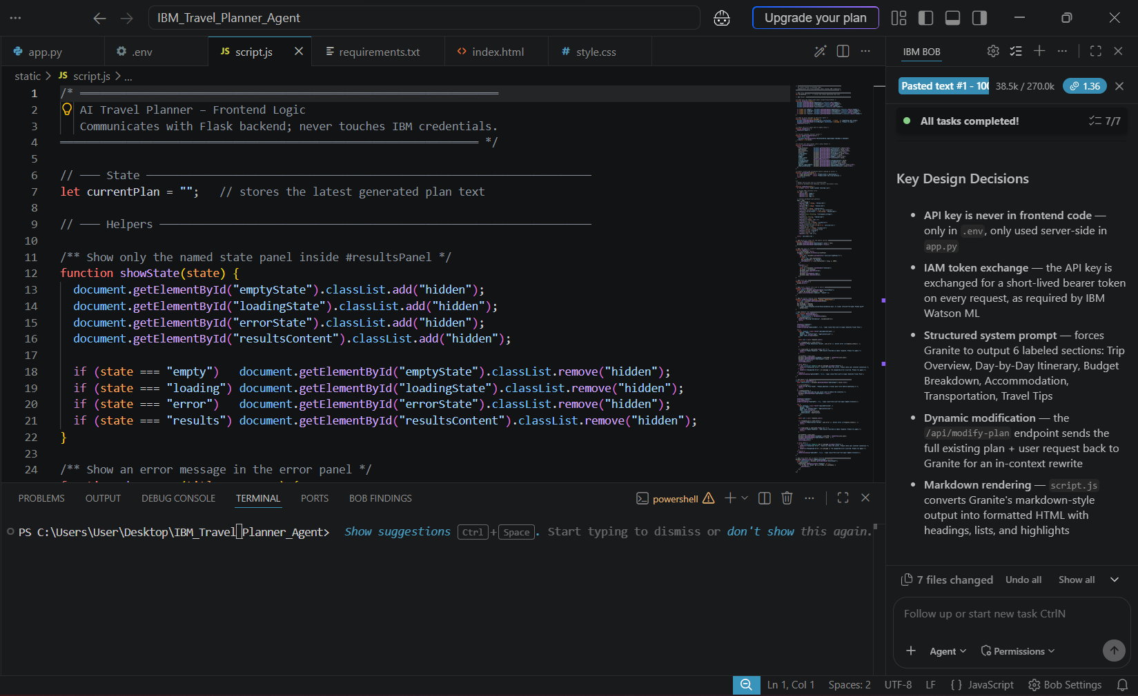
Required Files created using IBM bob -
App.py
Requirements.txt
Style.css
.env
Index.html
Scripts.js

Slide 7
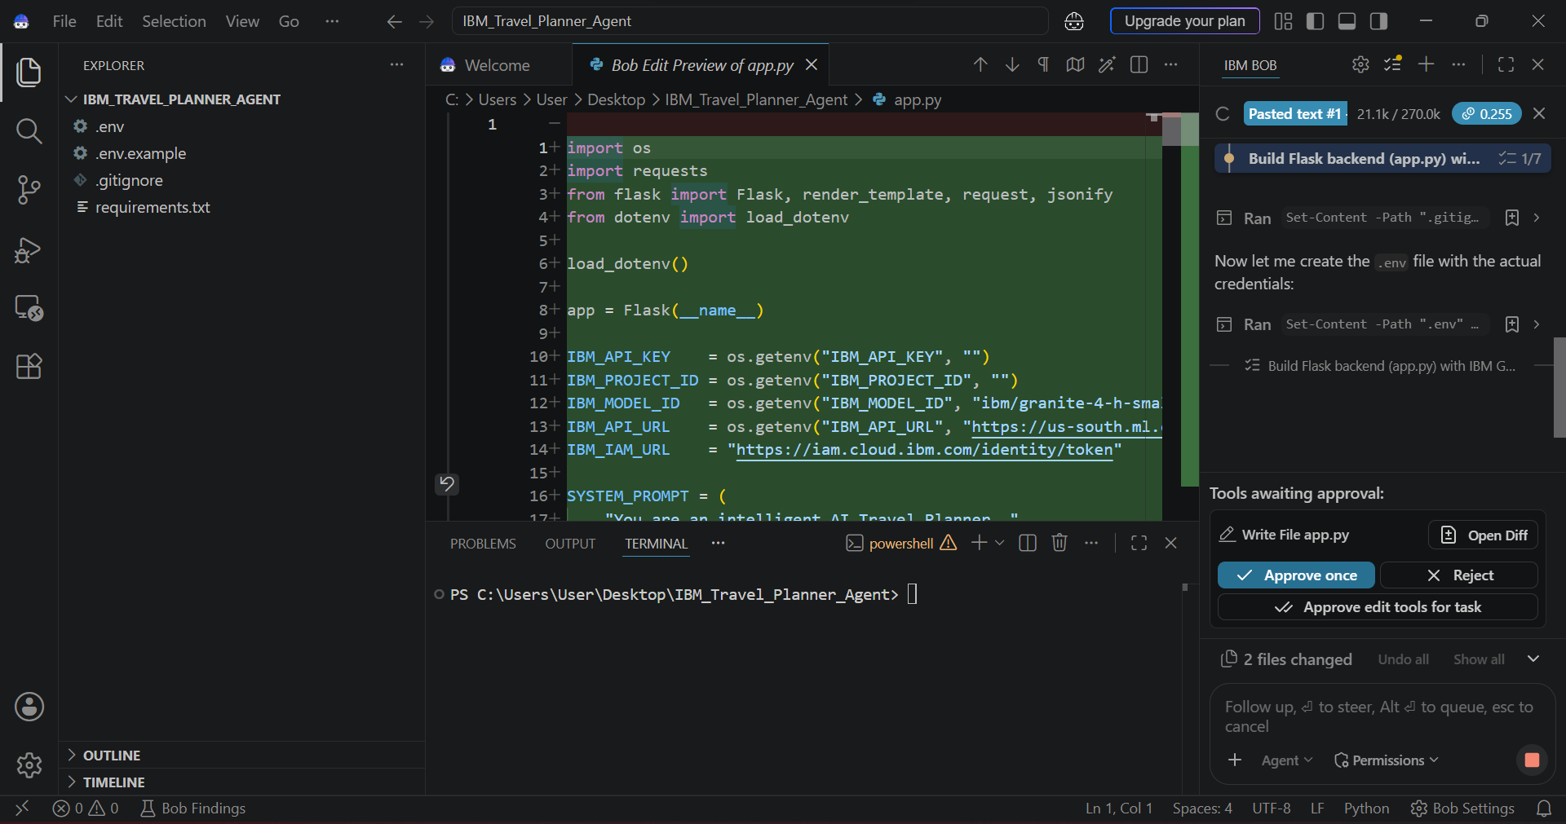
IBM Bob Screenshots:

Slide 8
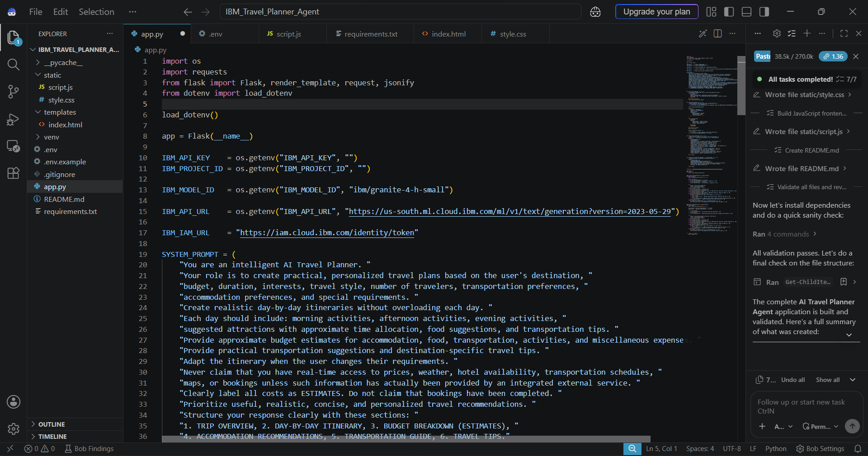

Slide 9
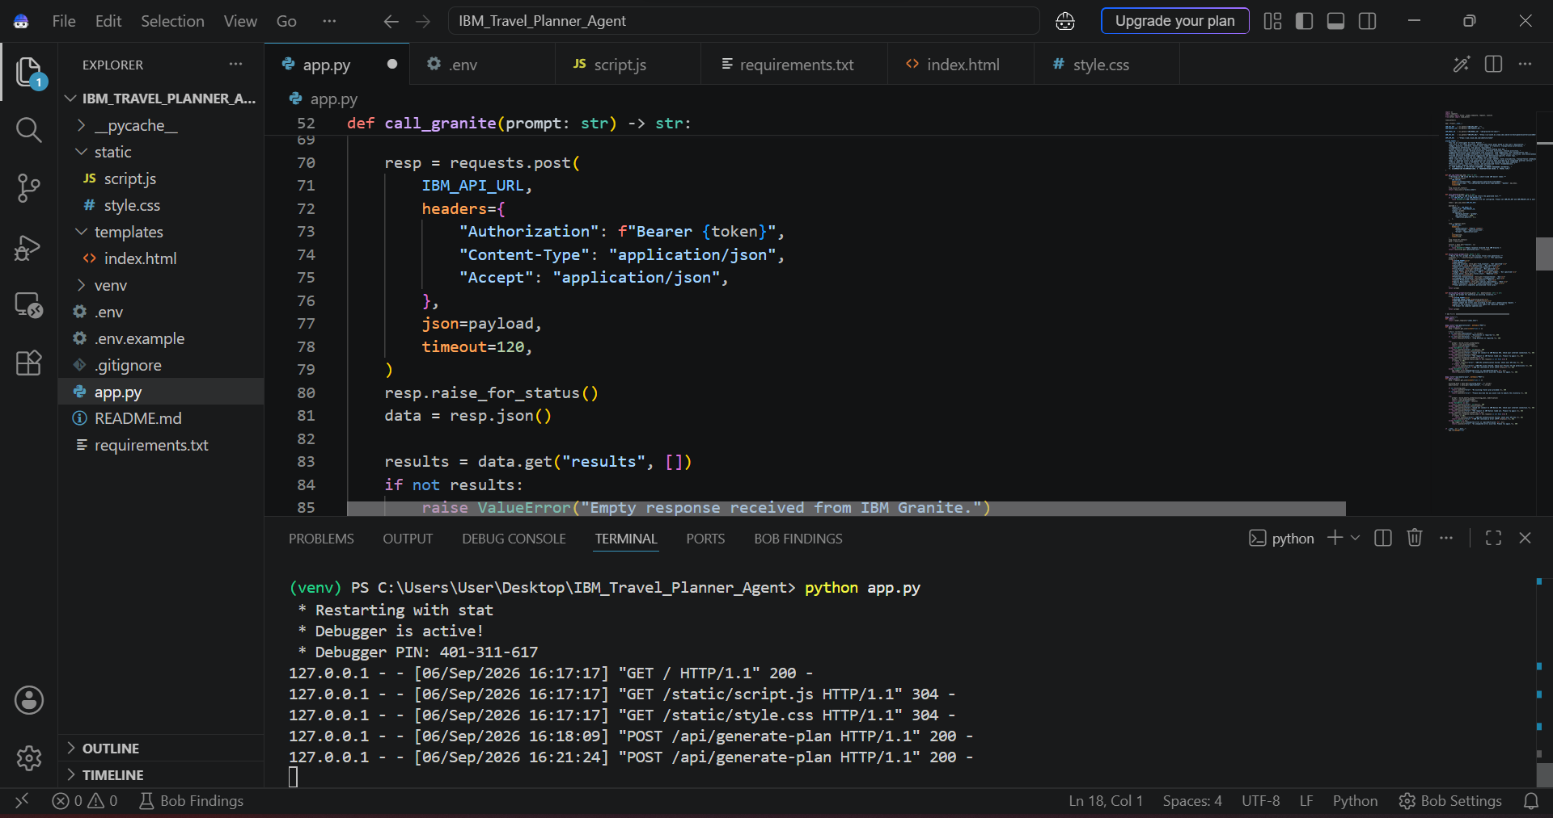

Slide 10
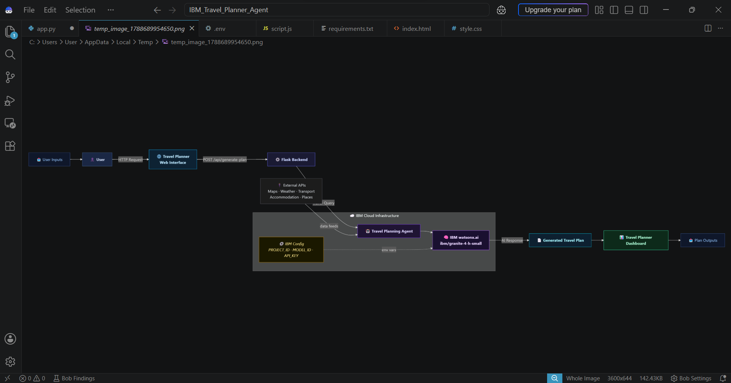
Architecture blueprint for IBM bob:

Slide 11

Role of Agentic AI in the solution
Role of Agentic AI in Travel Planner Agent
Agentic AI enables the Travel Planner Agent to function as an intelligent, autonomous system rather than a simple chatbot. Using IBM watsonx.ai and IBM Granite models, it coordinates multiple specialized agents to create personalized travel plans.
Each agent performs a specific role—such as recommending destinations, creating itineraries, planning budgets, and providing travel guidance—while working collaboratively. This multi-agent approach enables efficient task execution and personalized travel planning.
Agentic AI also provides context awareness, understanding user preferences such as budget, trip duration, interests, travel style, and transportation requirements to generate suitable recommendations. It supports dynamic adaptation, allowing travel plans to be modified based on changes in user requirements.
Additionally, agents communicate with each other, enabling better coordination between destination selection, itinerary planning, budget management, and travel guidance.
Overall, Agentic AI makes the system personalized, adaptive, and goal-driven, acting as a smart digital travel planner that helps users create practical and enjoyable travel experiences.

Slide 12
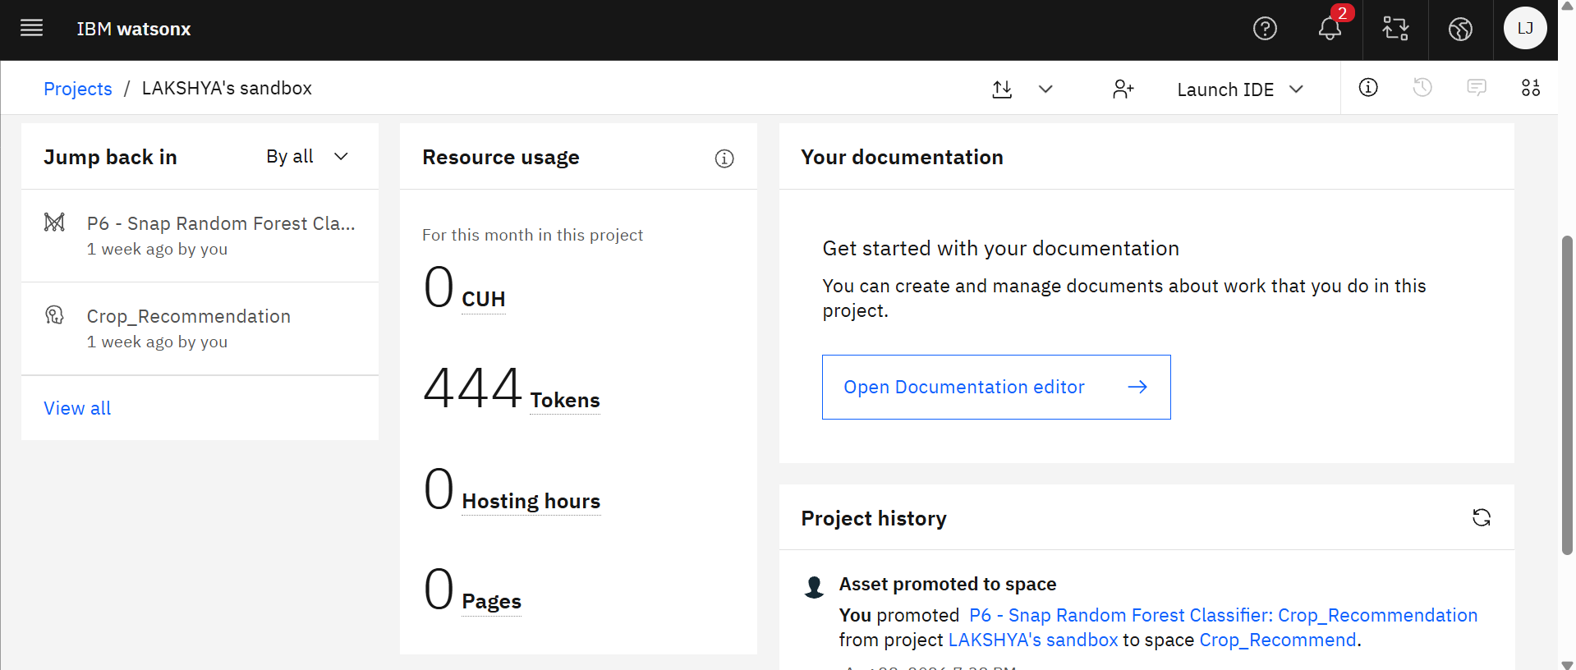
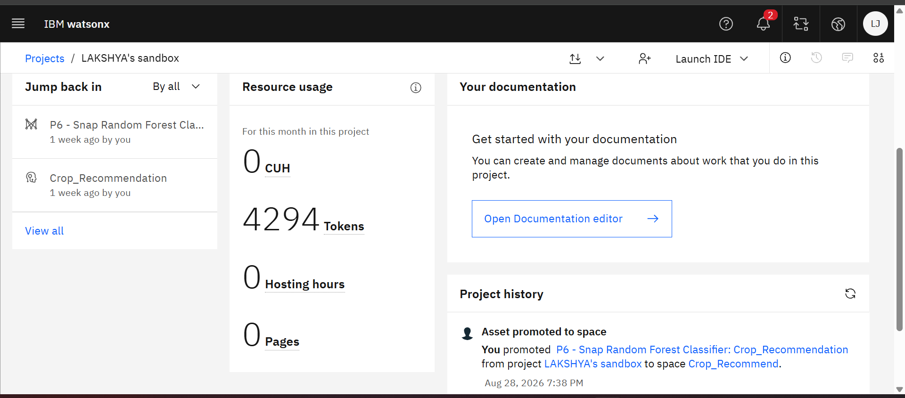
Token Usage
3,850 token are used
Before Prompt
After the Prompt
·

Slide 13
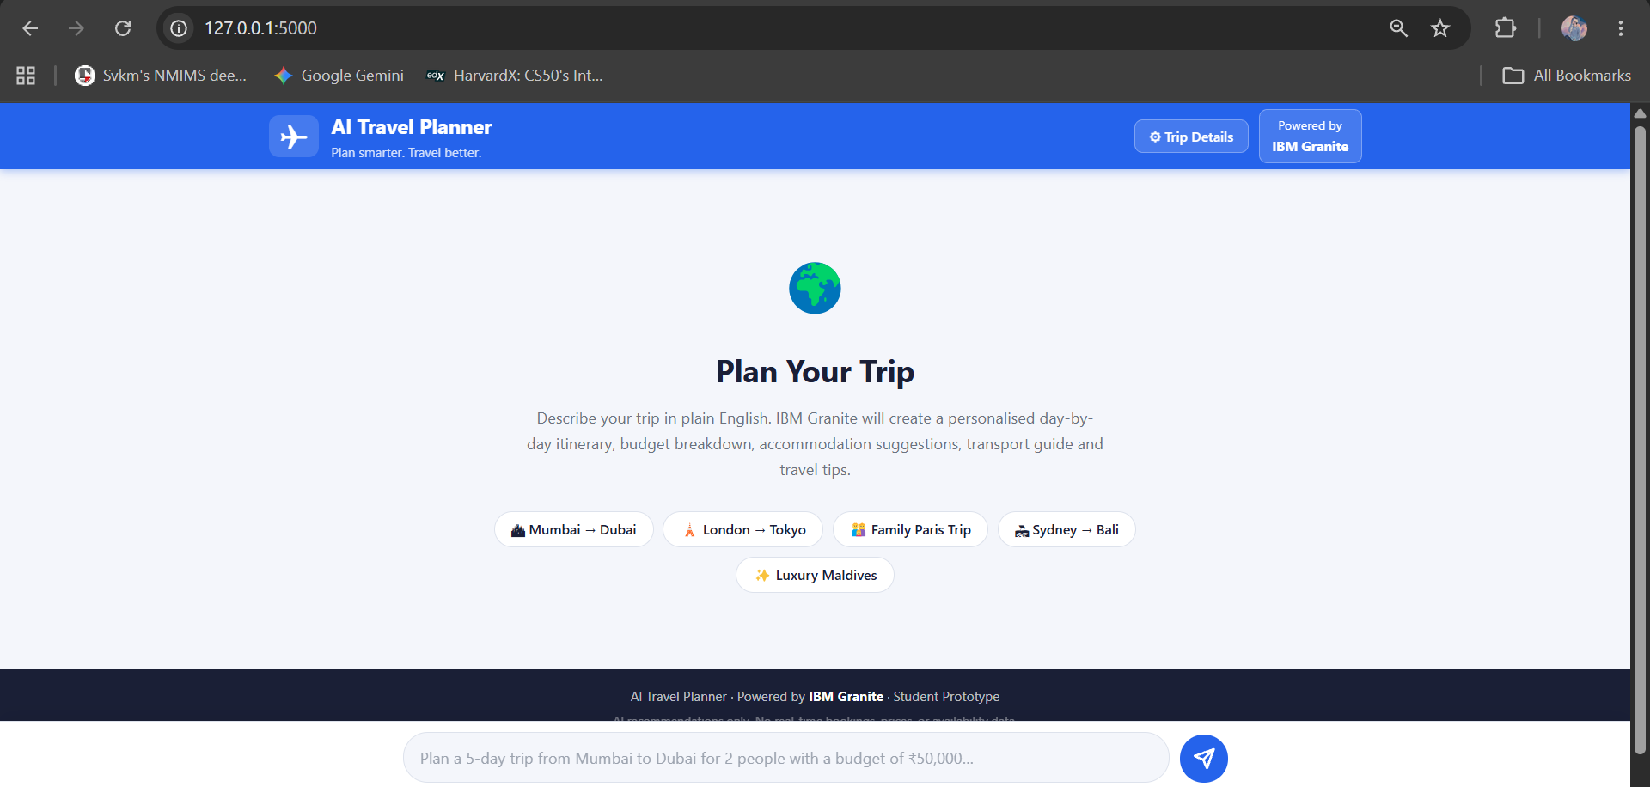
Project Output Screenshot
·
·
·

Slide 14
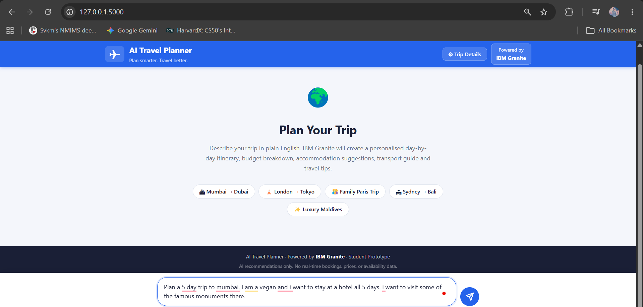
Project Output Screenshot
Please put IBM Bob output screenshots with 2-3 prompts.
You can take 2-3 more slides for each screenshot
·
·
·

Slide 15
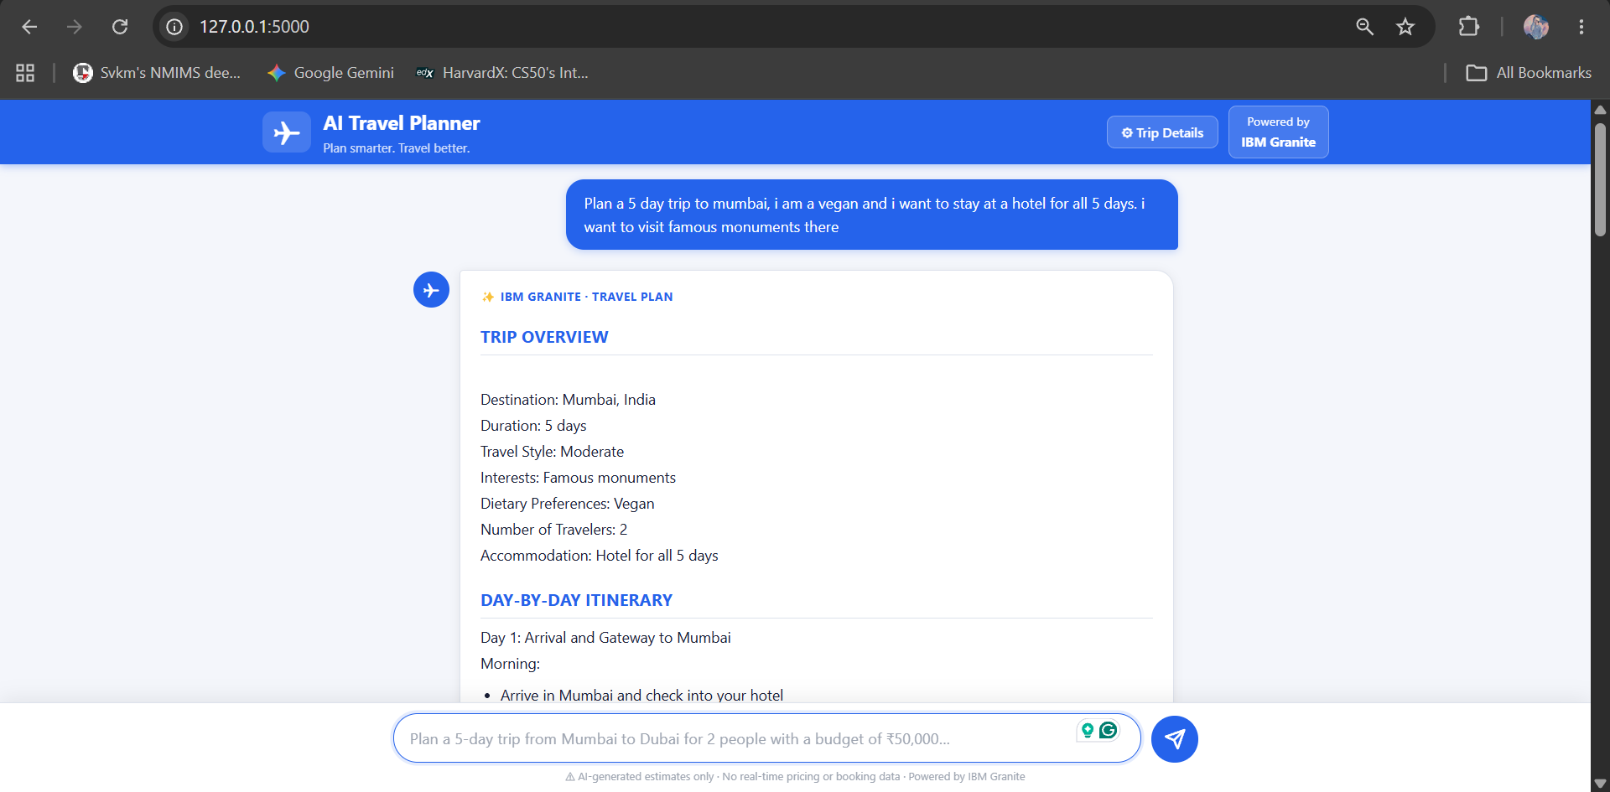
Project Output Screenshot
Please put IBM Bob output screenshots with 2-3 prompts.
You can take 2-3 more slides for each screenshot
·
·
·

Slide 16
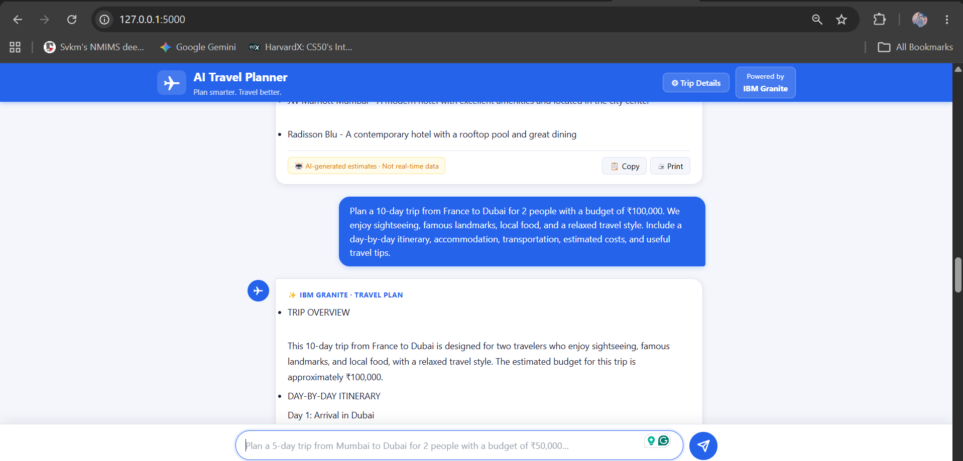
Project Output Screenshot
Please put IBM Bob output screenshots with 2-3 prompts.
You can take 2-3 more slides for each screenshot
·
·
·

Slide 17
Novelty and Uniqueness
The proposed Travel Planner Agent stands out by combining Agentic AI, personalization, and intelligent planning into a single travel assistance system.
Multi-Agent Intelligence – Multiple specialized agents collaborate to handle destination selection, itinerary planning, budgeting, and travel guidance.
Hyper-Personalization – Creates travel plans based on the user's budget, interests, duration, travel style, and preferences.
Dynamic Itinerary Planning – Automatically adjusts the itinerary when users change their requirements, activities, or available time.
Budget-Aware Planning – Considers the user's budget while recommending activities, accommodation options, transportation, and other expenses.
Context-Aware Recommendations – Understands user requirements and provides relevant destinations, activities, and travel suggestions.
Interactive Travel Assistance – Allows users to refine their itinerary through follow-up requests and receive updated recommendations.
IBM-Powered AI – Built using IBM BOB, IBM watsonx.ai, and IBM Granite models, providing a scalable foundation for intelligent travel planning.
This makes the solution a smart, adaptive, and personalized digital travel planner, rather than just a static itinerary generator.

Slide 18
Git Hub Link
· Please create public github repository (Enable Add README button while creating repository) with format –
Please test and Paste the working Github URL –
https://github.com/LakshyaJain779/IBM_SkillBuild_AICTE_Edunet_Foundation
Make sure you have Uploaded following three files into your github repository 1) All Agent relevant files of IBM Cloud , 2) yourproblemstatement.pdf file 3) your projectpresntation.pptx file 4)any other files
·
·

Slide 19
Future Scope
1. Real-Time Travel Data Integration –
The system can be integrated with real-time APIs for flight prices, hotel availability, weather, and local transportation. This will enable the Travel Planner Agent to provide more accurate and up-to-date travel recommendations and dynamically adjust itineraries.
2. AI-Powered Voice Assistant & Multilingual Support –
Enhancing the system with a voice-enabled assistant and multilingual support will improve accessibility. Users will be able to interact naturally in their preferred language, making the solution more inclusive for travelers from diverse backgrounds.
3. Smart Booking & Reservation Integration –
The system can be extended to connect with flight, hotel, restaurant, and activity booking platforms, allowing users to move from itinerary planning to actual reservations through a single platform.
·
·
·

Slide 20
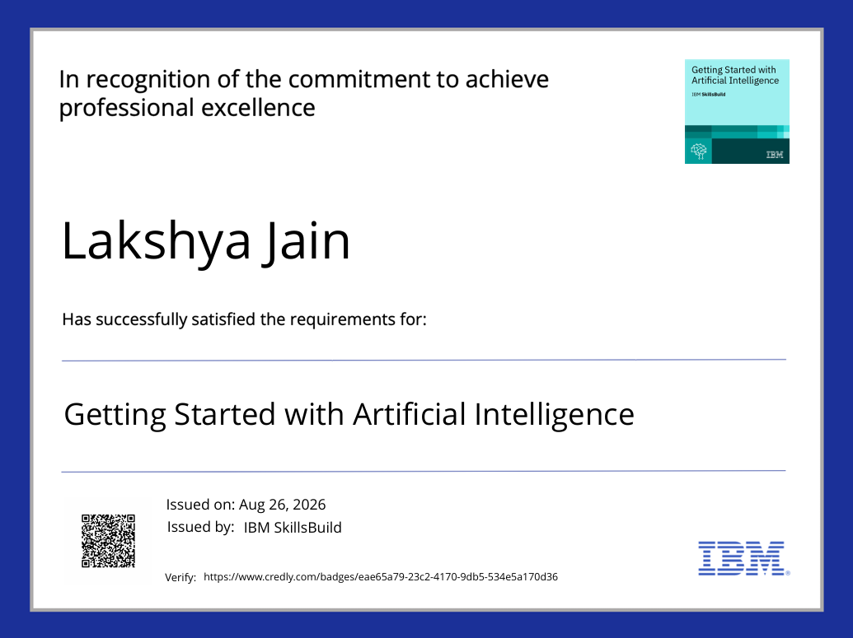
Certificates Earned:
Please add your credly certificate(Getting Started with Artificial Intelligence)

Slide 21

Certificates Earned:
Please add your credly certificate(Getting Started with Cybersecurity)

Slide 22
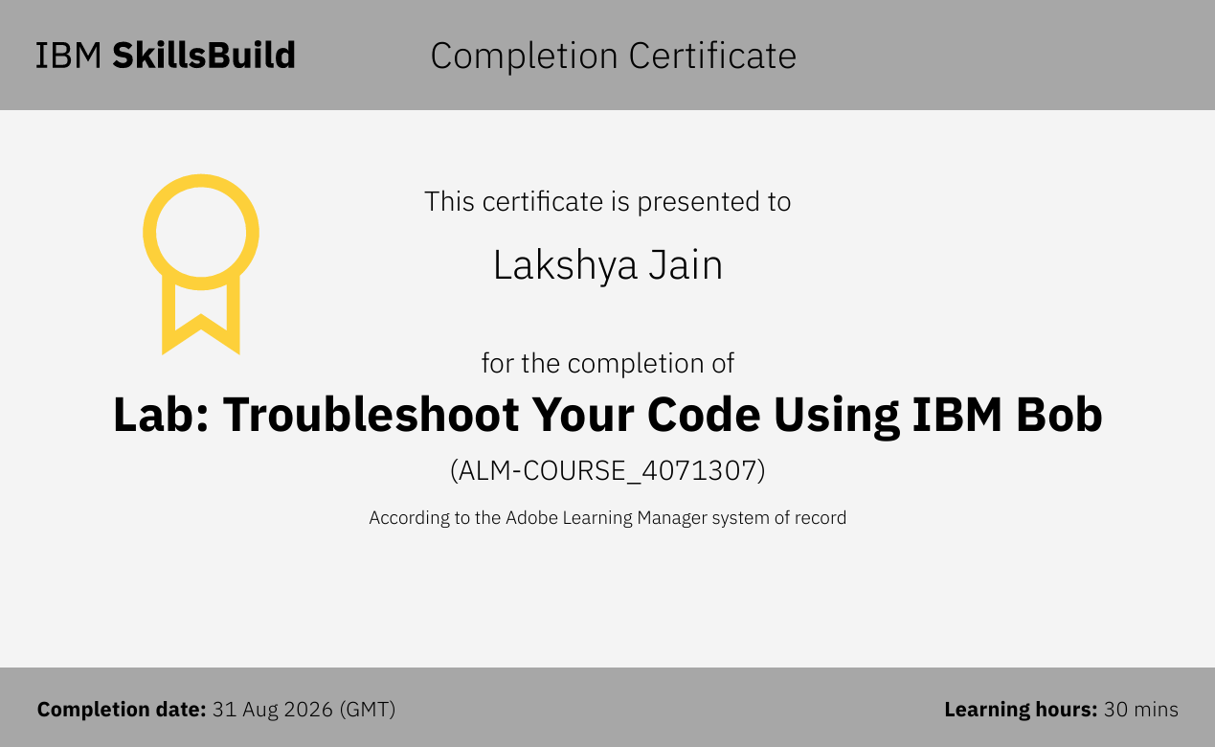
Certificates Earned:​
Add your IBM BOB Certificate

Slide 23


