Slide 1
AI for Social Good
Hackathon, Sept 21 and 22nd

Slide 2
Acknowledgements
We want to thank IEEE computer society for sponsoring this hackathon

Slide 3
AI Club
We want to thank the AI club @UBCO for advertising and help us organizing this hackathon

Slide 4
Schedule
Sep 21
9: 00 AM -- Welcome and introductions
9.05 AM -- Research explanation
9: 15 AM – Hackathon logistics
10:00 AM – Signing forms and consent.
10:30 AM – Hackathon starts
12:00 PM – Lunch Time
7:00 PM – Dinner Time

Slide 5
Schedule
Sep 22
10 AM light snacks and coffee
3 PM – Project submissions
3 .05 PM – Project presentations starts
5.30 PM – Judges discussion
6 PM – Prices Announcement

Slide 6
Welcome and introductions
Who we are
For your safety:
If you feel unwell, please refrain from coming to the classroom.
Please, wear a mask if necessary.
Notes:
Here’s an improved version of the text:
---
- **Who We Are**
- **Code of Conduct**
- **For Your Safety**:
- If you feel unwell, please refrain from coming to the classroom. Contact us, and we will arrange for you to participate online.
- Please wear a mask if necessary.
---
This revision improves clarity and corrects small grammatical errors. Let me know if you’d like any further adjustments!

Slide 7
Hackathon logistics
Hackathon topic: AI for Social Good
Goal: Use AI to create software for helping communities
Participation in Teams
One English as second language person
Code of conduct (CoC)
Contact gema.rodriguezperez@ubc.ca to report any violations of the CoC
To participate:
sign up the consent form and answer a short demographic survey
Submit you GitHub repo before 3 PM tomorrow.

Slide 8
AI4 Social Good
Utilize the power of AI to create impactful software solutions that can address societal challenges and improve the quality of life for individuals and communities
Examples:
https://globalgoals.withgoogle.com/globalgoals/
https://github.com/TechforgoodCAST/awesome-techforgood?tab=readme-ov-file

Slide 9
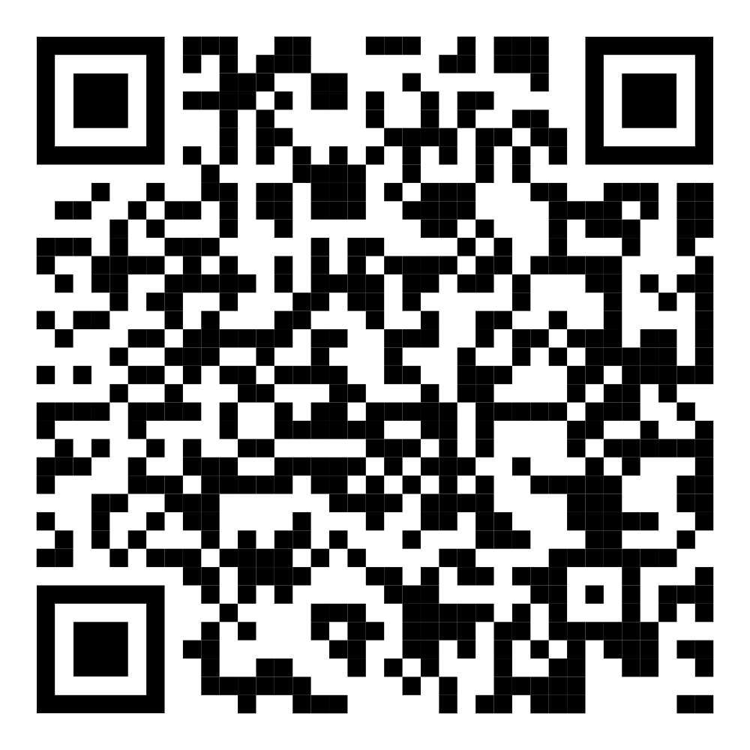
Hackathon software requirements
Software required:
VSCode
GitHub Copilot/ Amazon CodeWhisperer
(CodeWatcher) → VSCode extension
Submissions will be done through DevPost

Slide 10
Hackathon logistics
To start, clone this repo https://github.com/STASER-Lab/AI4SG-Hackathon
Submissions requirements
Should contain all the code in the GitHub repo
Add all the required info to the README.md and documentation.md
Make sure you describe with high detail the use of AI in the documentation.md
Submit everything before 3PM on Sep 22

Slide 11
Project Presentations
Sunday 3.05 PM
At least three judges will be there
Each project needs to do a presentation (10 min each)
Presentation should cover (in any order)
Demo of the project
Problem statement
Solution
Technical implementation
Use of AI

Slide 12
Evaluation Criteria
Each project will be evaluated based on the following criteria:
Innovation and creativity (0-20)
Importance and relevance (0-20)
Technical implementation/ completion (0-30)
Team collaboration (0-15)
Documentation (0-15)
Inclusive Bonus

Slide 13
Winners
The 3 projects that score the highest after the evaluation will obtained the following prices:
1st: CAD$1000
2nd CAD$700
3rd CAD$400

Slide 14
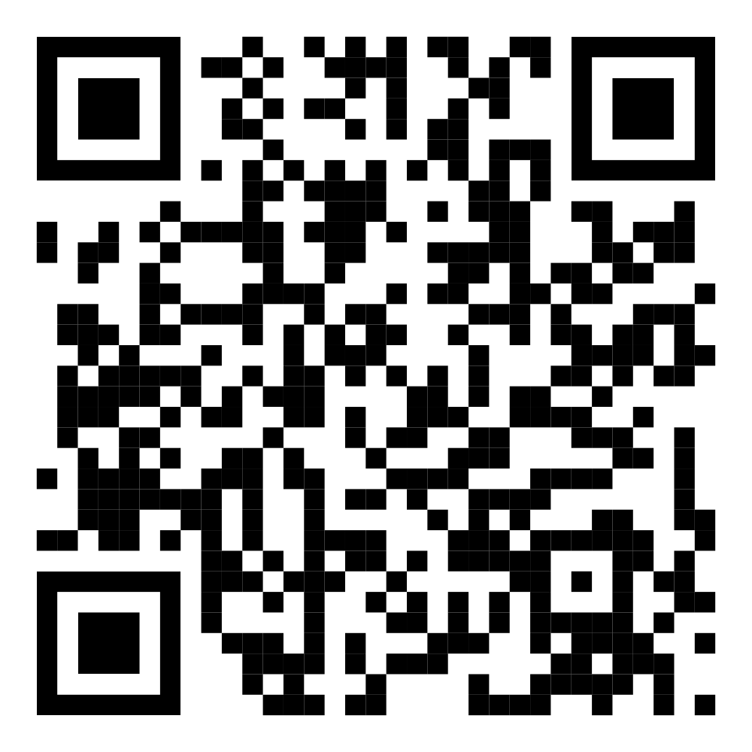
Discord Channel
Please join us in the discord channel.
https://discord.gg/Cn4Xtqy4
Feel free to reach out and ask questions
We will be monitoring the discord, be respectful.
We have a CoC for the hackathon
https://github.com/STASER-Lab/AI4SG-Hackathon/blob/main/CODE_OF_CONDUCT.md

