Slide 1
Om snamo COIMBATORE INSTITUTE OF TECHNOLOGY COIMBATORE
GRAPH MODELLING FOR COVID-19 PANDEMIC
19 34 021 – Lakshya Karwa
I Year M.Sc. AIML
DEPARTMENT OF
Artificial intelligence & Machine learning
10th July, 2020
Notes:
1
*

Slide 2
DOMAIN AND MOTIVATION
Covid-19’s impact on INDIA
Parameters taken under observation:
- Active Cases
-States and Union Territories
- Cured Cases
- No. of Tests being done per Day
- Total Cases
- Deaths/Deceased
This work will help us to analyse the impact of Covid-19 on India and will also give measures on how to recover from the losses we have suffered economically, even a non-programmer.
2

Slide 3
PROBLEM DESCRIPTION
On the analysis of the given data, one will be able to find out :
How much each state can sustain?
Predicting the number of cases for the future.
How much the curve should flatten so that healthcare infrastructure can manage the peak number of patients?
Effect on each state.
Recovery rate over time.
Predicting the Inflexion Point for the cases.
3

Slide 4
INITIAL WORK
Picking up a Domain.
Selecting a Dataset
Understanding the different attributes/parameters used in the dataset.
Gathering a set of questions for the database.
Understanding the matplotlib library in Python.
Learning different methods of Case Study.
Understanding Seaborn and particular functions in the SciPy library.
4

Slide 5
PROPOSED WORK
Work Breakdown Structure (WBS):
Selecting the domain - 07/07/2020
Selecting a Data-Set - 07/07/2020
Analyzing the attributes - 07/07/2020
Gathering Questions for the data set - 08/07/2020
Learning the techniques to be applied - 08/07/2020
Analyzing and Visualizing the data - 09/07/2020
Applying different visualization techniques - 10/07/2020
Getting insights from the data - 10/07/2020
Answers for the questions from the insights that have been gathered - 14/07/2020
5

Slide 6
TECHNIQUES
Plotting – To visualize the data and analyze the trend of growth and dips in the number of Covid positive cases and Recovery Rates respectively.
Bar Graphs to check the number of deaths in each case
Data Cleaning.
Scatter Plots to check the recovery rates gradually over time.
Sigmoidal Function to predict the number of cases and the inflexion point.
Correlation Matrix to fin features with positive and negative Correlation in all types of cases.
6

Slide 7
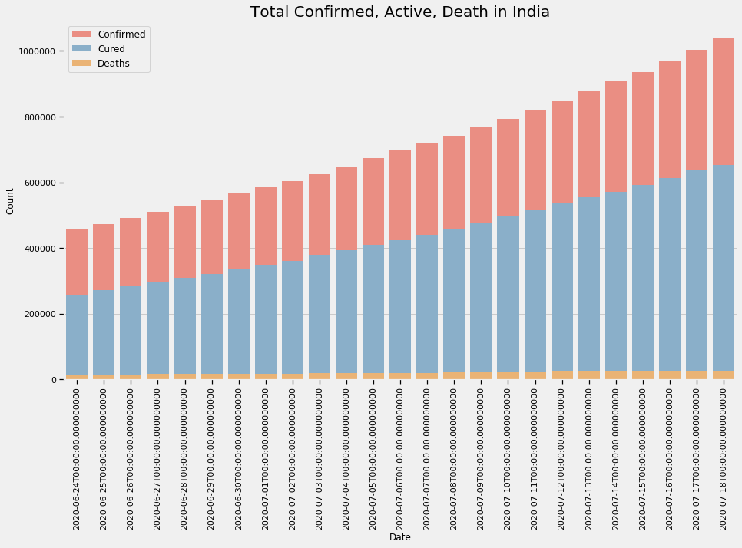
GRAPHS

Slide 8
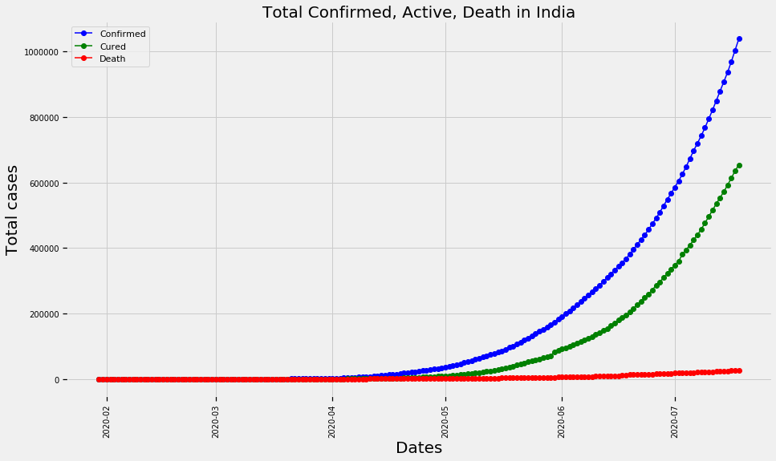
GRAPHS

Slide 9
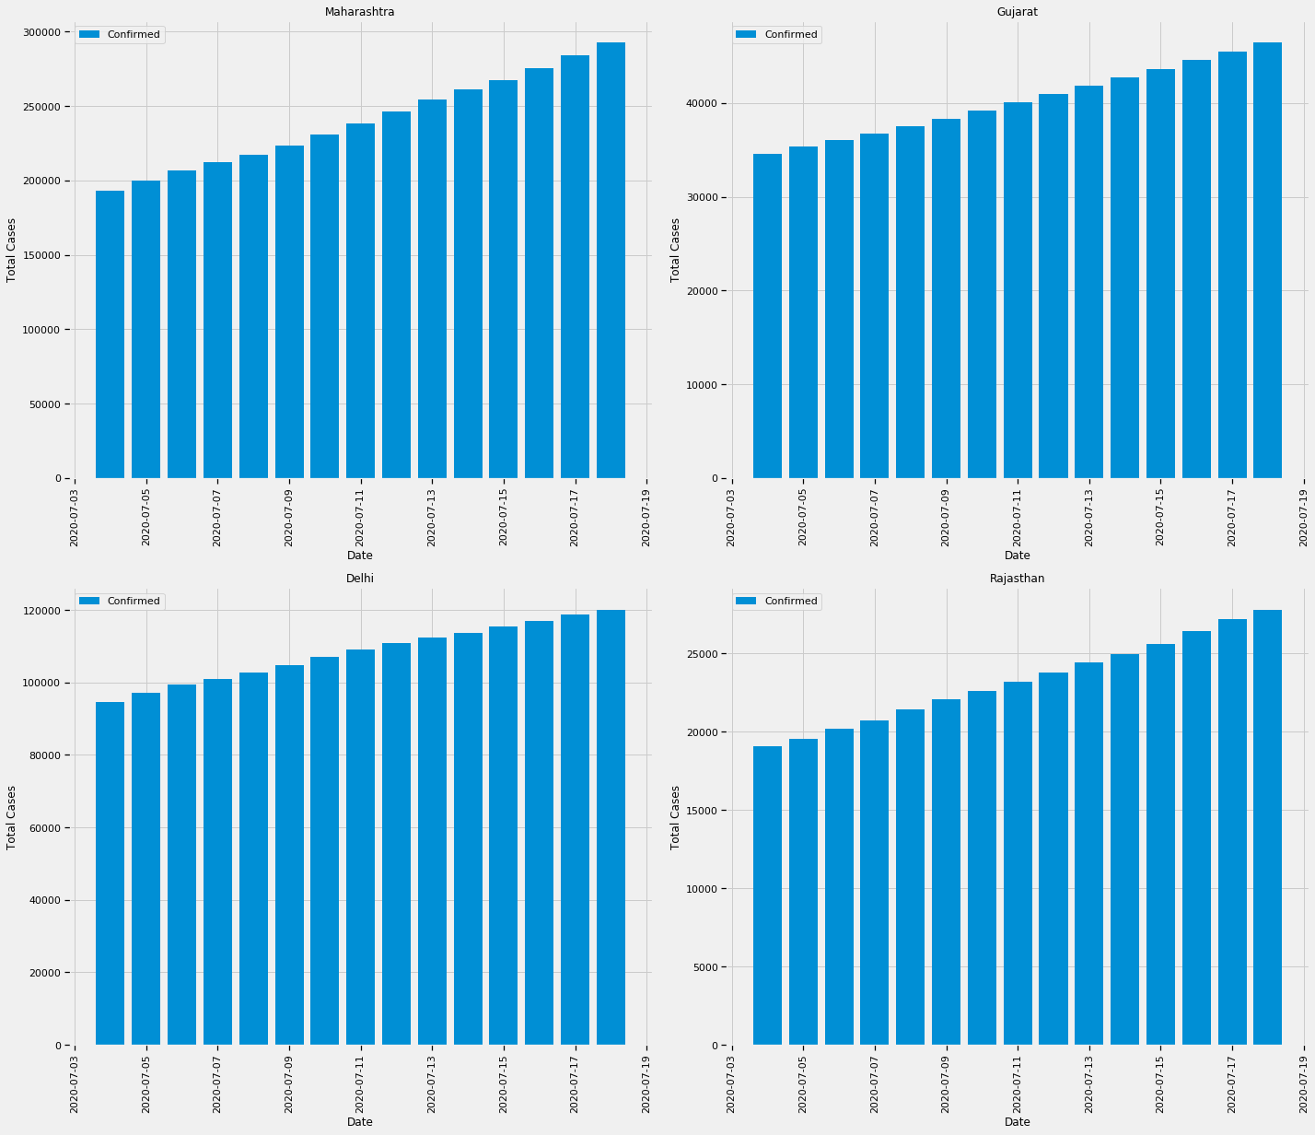
CASES IN EACH STATE

Slide 10
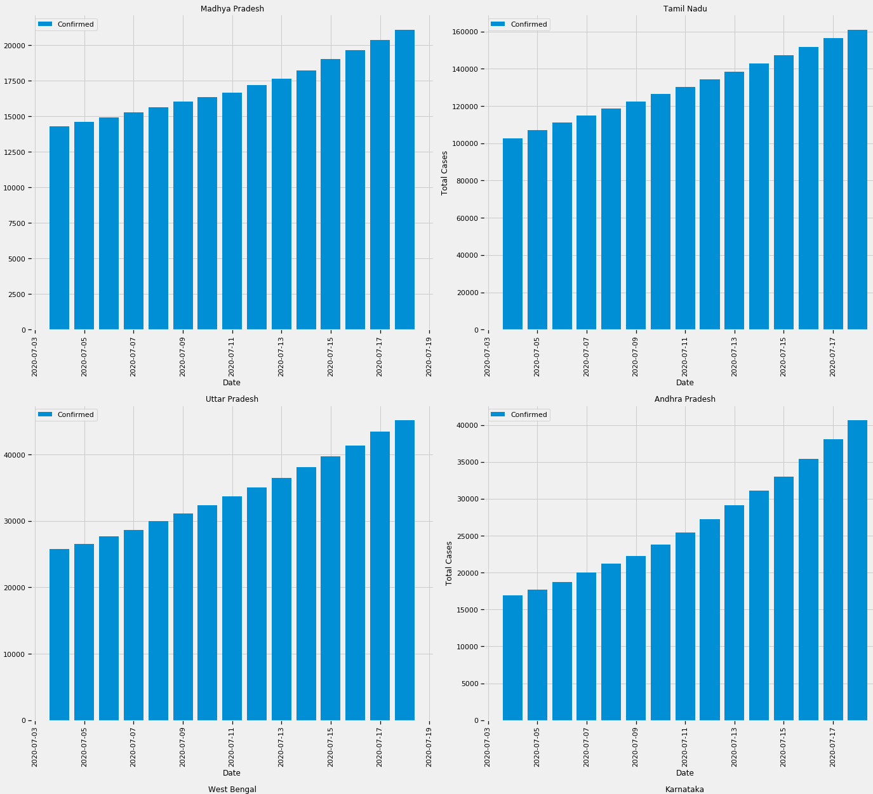
CASES IN EACH STATE

Slide 11
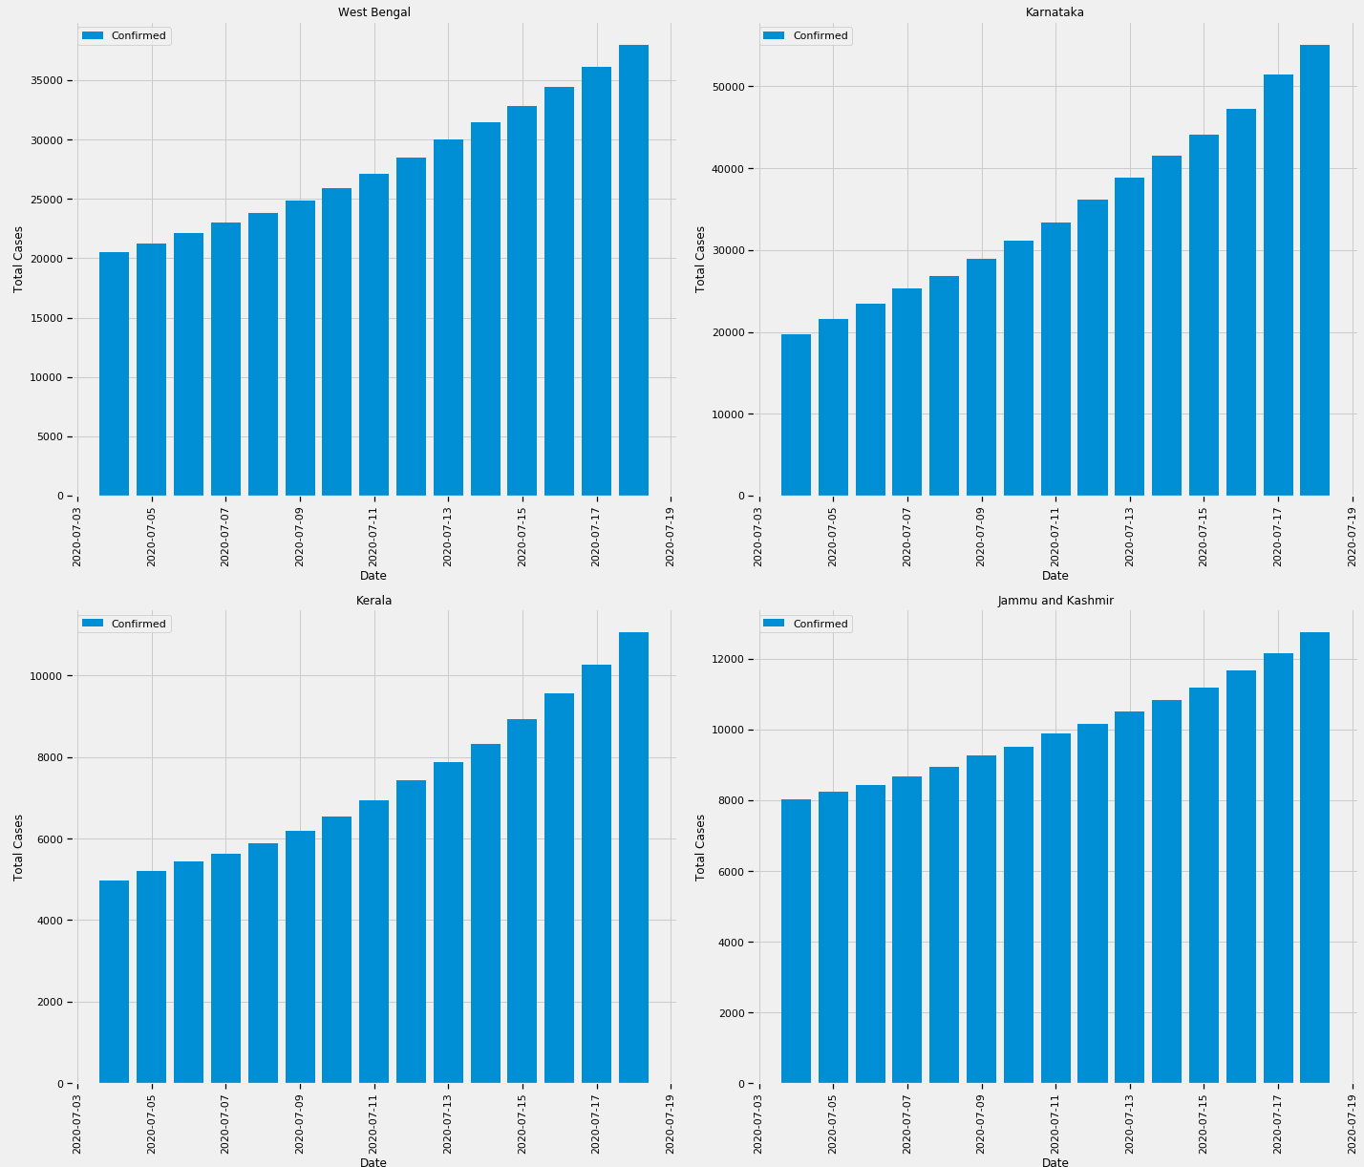
CASES IN EACH STATE

Slide 12
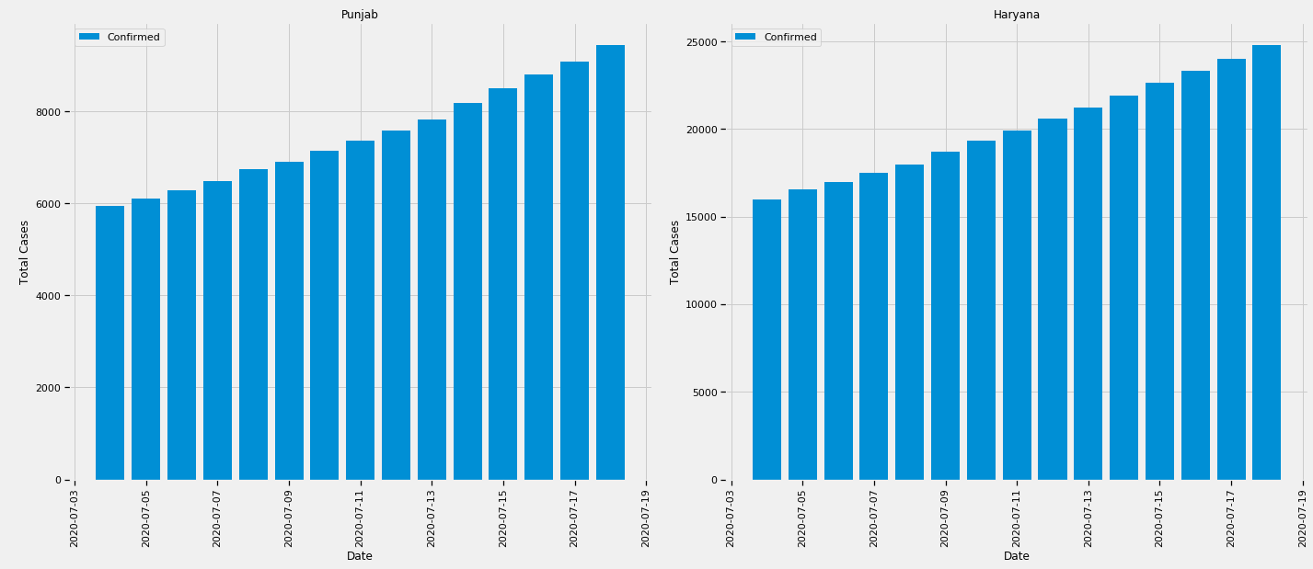
CASES IN EACH STATE

Slide 13
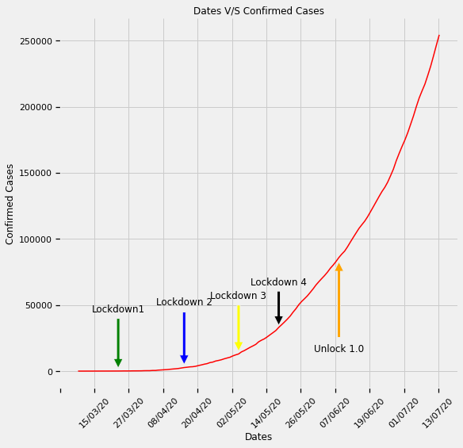
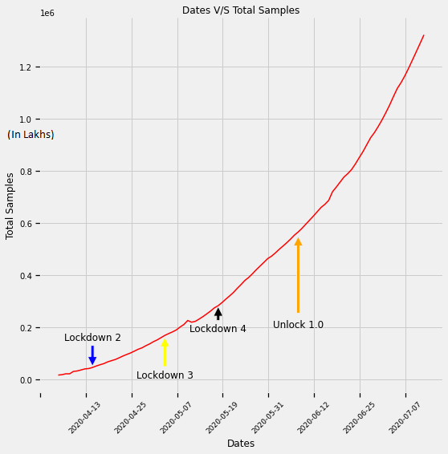
EFFECT OF LOCKDOWN IN MAHRASHTRA

Slide 14
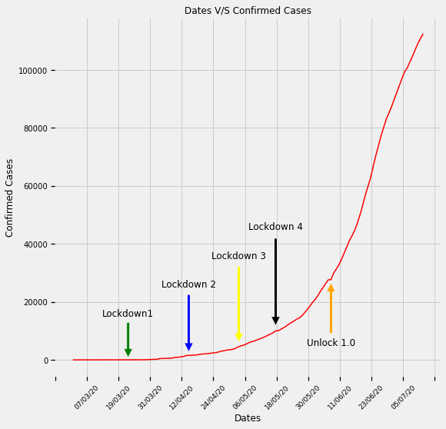
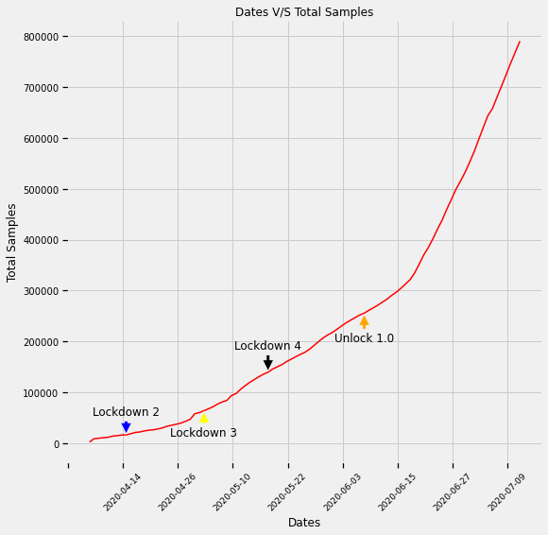
EFFECT OF LOCKDOWN IN DELHI

Slide 15
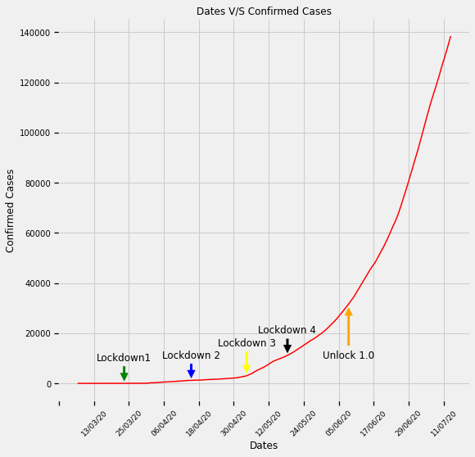
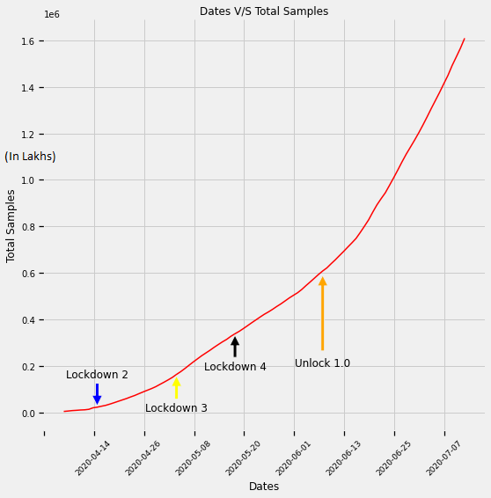
EFFECT OF LOCKDOWN IN TAMIL NADU

Slide 16
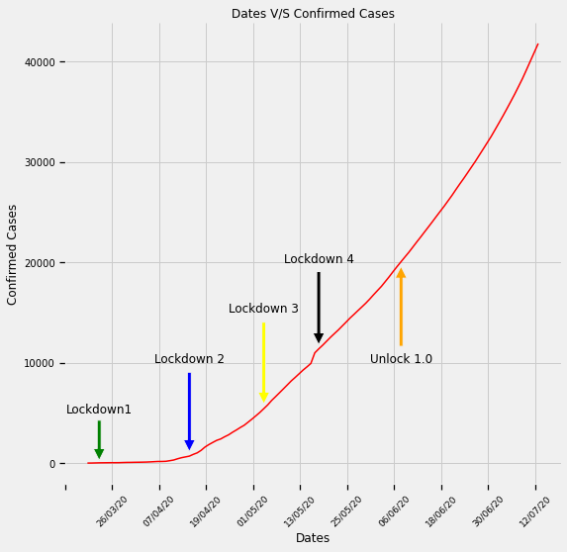
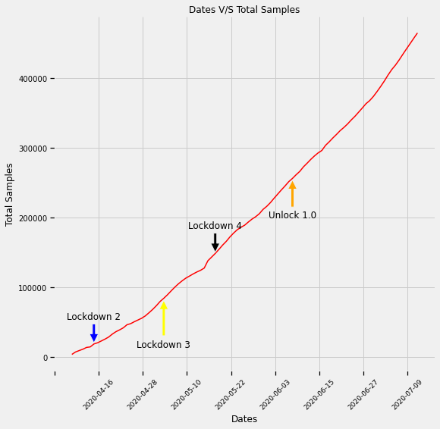
EFFECT OF LOCKDOWN IN GUJARAT

Slide 17
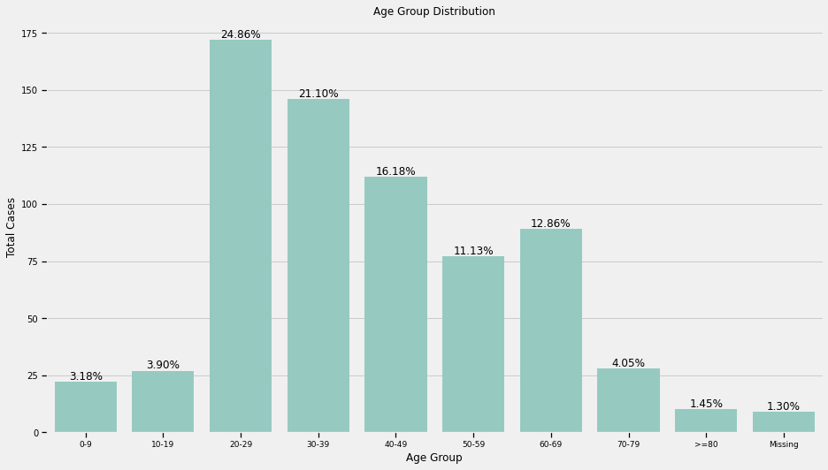
AGE GROUP ANALYSIS

Slide 18
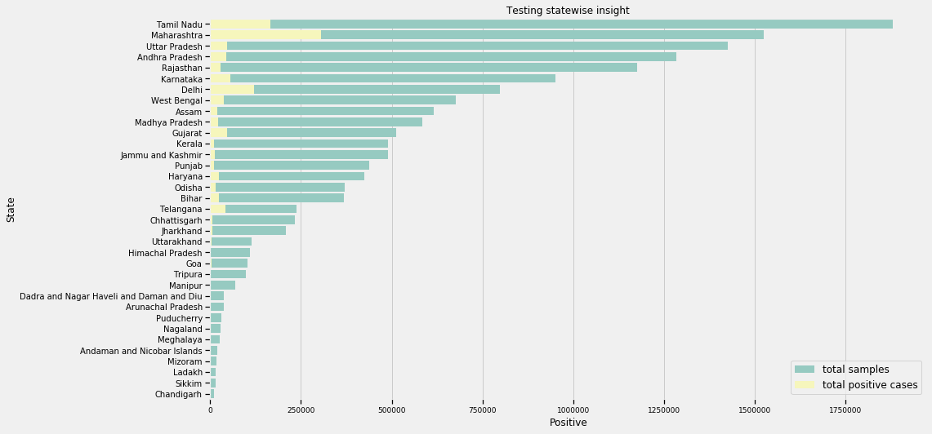
STATEWISE TESTING

Slide 19
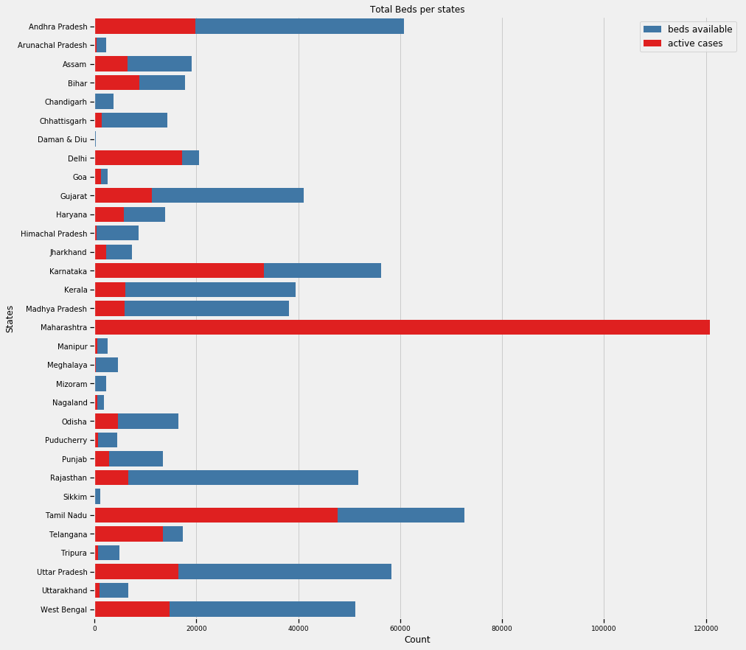
NUMBER OF BEDS AVAILABLE PER STATE

Slide 20
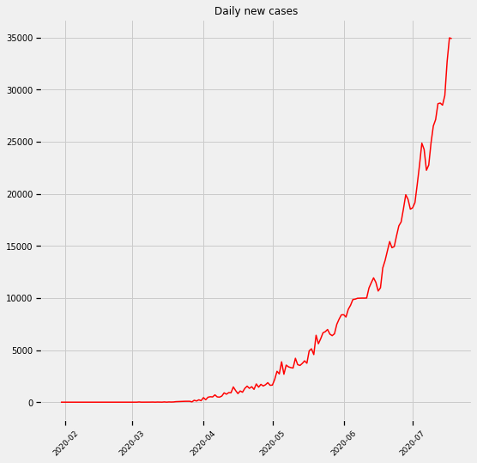
CASES PER DAY

Slide 21
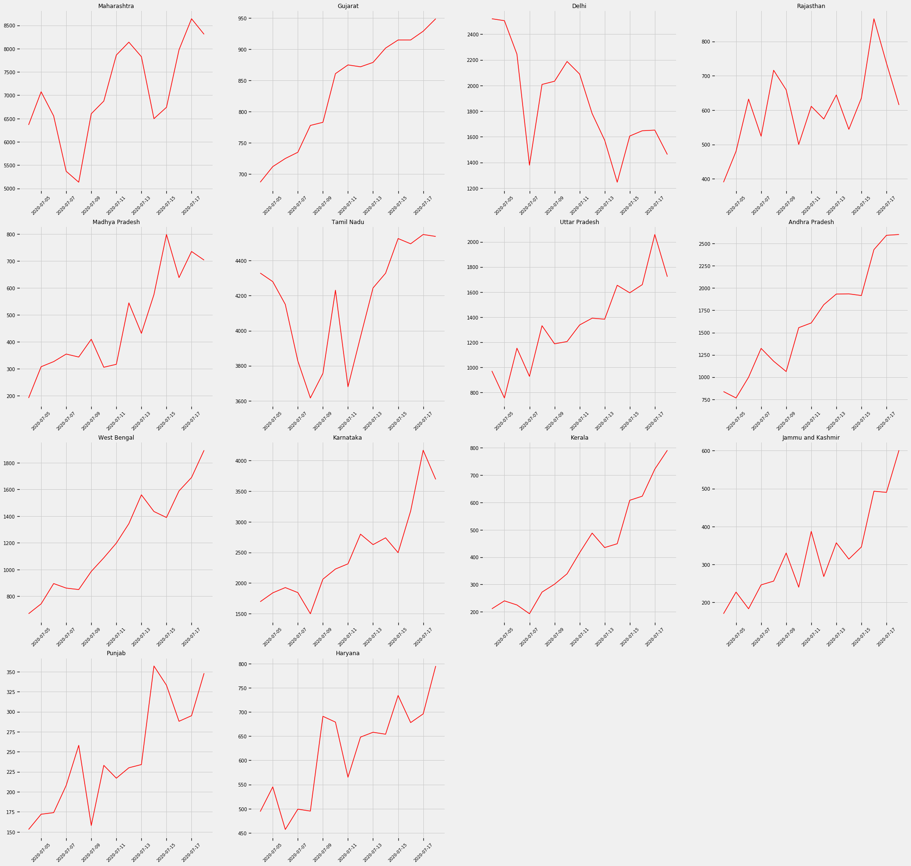
PER STATE ANALYSIS

Slide 22
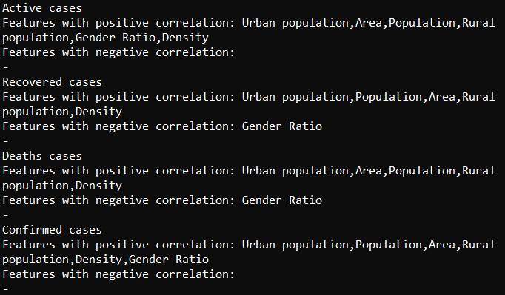
CORRELATION MATRIX
To find the positive and negative correlation features by generating a correlation matrix.

Slide 23
CURVE FLATTENING
To find a pattern on the Covid situation in India, and how it can reach the end state, i.e., flattening of the curve, we need to look at the country, where it has already flattened, i.e., China.

Slide 24

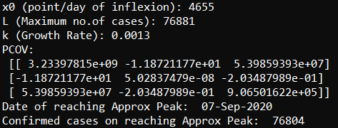
CONCLUSION
We found the projected number of Cases in India over time using the Logistic Curve, or commonly known as the Sigmoid Equation which is :
and the results we got were as follows,

Slide 25
REFERENCES
https://matplotlib.org/
https://www.covid19india.org/
https://api.covid19india.org/
https://github.com/covid19india/covid19india-react
https://kaggle.com/sudalairajkumar/covid19-in-india/
https://seaborn.pydata.org/
https://stackoverflow.com/
https://www.geeksforgeeks.org/
https://www.ncbi.nlm.nih.gov/pmc/articles/PMC7128942/
25

Slide 26
Thank You
26

