Slide 1
Article Recommender System
Guided by-
Dr. J. Shana
Done by-
Lakshya Karwa
Tarun Kumar I. S.

Slide 2
Problem Description
On the Internet, where the number of options is overwhelming, there is a need to filter prioritize and efficiently deliver relevant information in order to alleviate the problem of information overload, which has created a potential problem to many internet users.

Slide 3
DataSet Description
The dataset which we are using was available on DeskDrop which is an Internal Communications Platform developed by CI & T.
It has data from 2016 to 2017 There are 2 different Datasets namely :
Shared_Articles
User_Interactions

Slide 4
Shared_Articles
timestamp
eventType
contentId
authorPersonId
authorSessionId
authorUserAgent
authorRegion
authorCountry
contentType
url
title
Text
Lang

Slide 5
Shared_Articles
Contains information about the articles shared in the platform. Each article has a sharing date (timestamp), the original URL, title, content, the article lang and information about the user who shared the article (author).
Two possible event types at a given timestamp:
CONTENT SHARED: The article was shared in the platform and is available for users.
CONTENT REMOVED: The article was removed from the platform and not available for further recommendation.
For the sake of simplicity, we only consider here the "CONTENT SHARED" event type, assuming (naively) that all articles were available during the whole one year period. For a more precise evaluation (and higher accuracy), only articles that were available at a given time should be recommended.

Slide 6
User_Interactions
timestamp
eventType
contentId
personId
sessionId
userAgent
userRegion
userCountry

Slide 7
User_Interactions
Contains logs of user interactions on shared articles. It can be joined to articles_shared.csv by contentId column.
The eventType values are:
VIEW: The user has opened the article.
LIKE: The user has liked the article.
COMMENT CREATED: The user created a comment in the article.
FOLLOW: The user chose to be notified on any new comment in the article.
BOOKMARK: The user has bookmarked the article for easy return in the future.

Slide 8
Data Pre-Processing and Preparation
No filling up of data was required as there were no missing info in the dataset
A new rating column was created based on the user’s actions on a particular article.
1 - VIEW: The user has opened the article.
2 - LIKE: The user has liked the article.
3 - COMMENT CREATED: The user created a comment in the article.
4 - FOLLOW: The user chose to be notified on any new comment in the article.
5 - BOOKMARK: The user has bookmarked the article for easy return in the future.
The two datasets were merged using “INNER Join” using the “contentID” attribute present in both the datasets

Slide 9
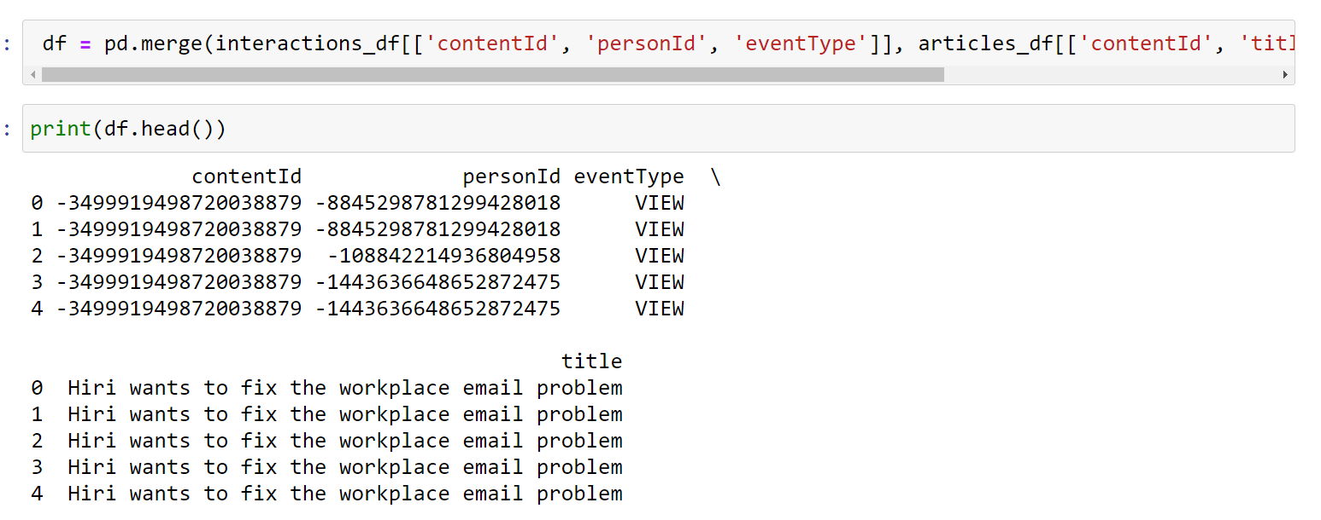
MERGING OF TABLES

Slide 10
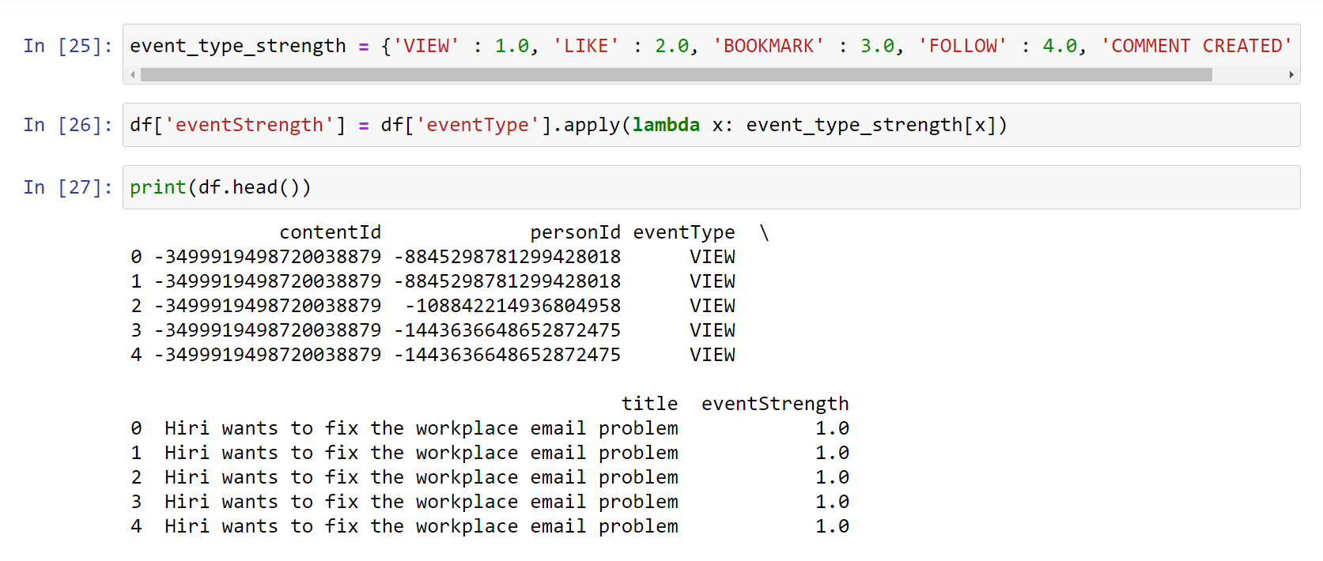
IMPLICITLY ADDING VALUES TO PREVIOUS VIEWS

Slide 11
EXPLORATORY DATA ANALYSIS

Slide 12
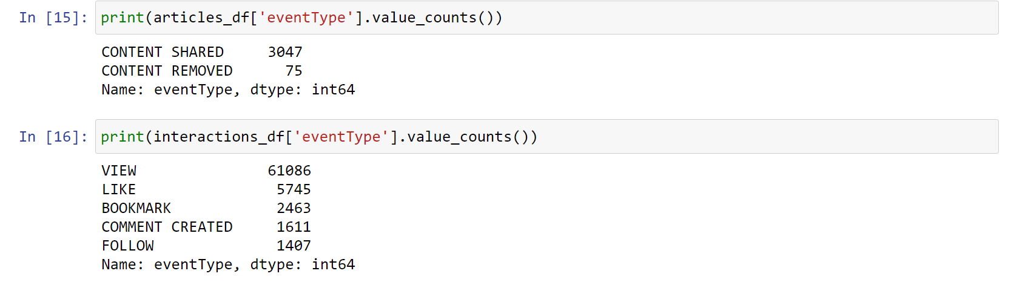
COUNT OF ITEMS IN EVENT TYPE

Slide 13
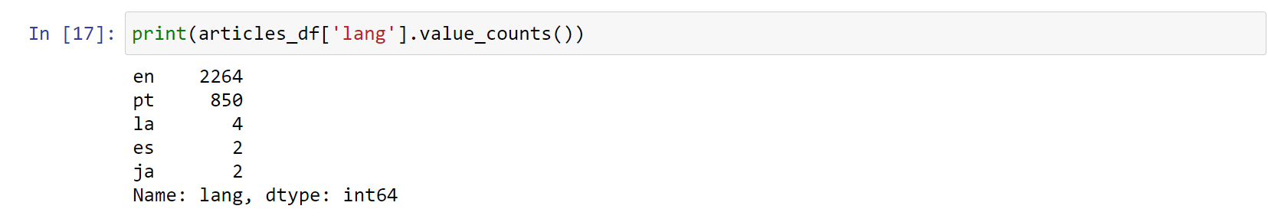
NO OF ARTICLES IN DIFFFENT LANGUAGES

Slide 14
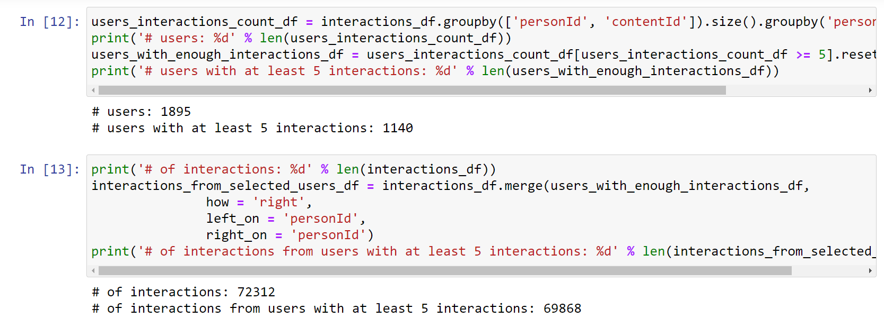
CHECKING INTERACTIONS WITH USERS

Slide 15
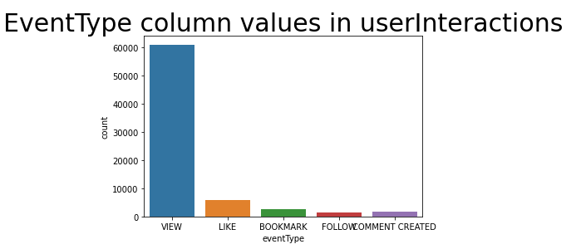

Slide 16
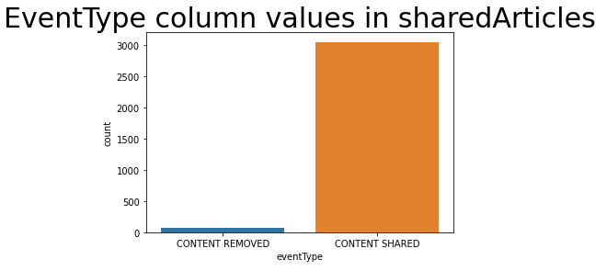

Slide 17
MODEL SELECTION
Alternating Least Squares (ALS) - Performed by Lakshya Karwa
Bayesian Personalized Ranking (BPR) - Performed by Tarun Kumar I.S.
Logistic Matrix Factorization (LMF) - Performed by both

Slide 18
MODEL BUILDING PHASES
Model Selection :
Was selected on the basis of collaborative filtering.
ALS minimizes two loss functions alternatively.
Scalability
BPR works on Concept of Bayes concept, where it tries to find probability of item to occur when certain thing occur.
LMF works on same concept using ALS but using log function in confidence matrix to improve accuracy.
Model Fitting :
Done using the implicit library available in python
Model Validation:
Checked using train-test split

Slide 19
Performance Analysis
Accuracy for Bayesian Personalized Ranking (BPR): 82.6 %
Accuracy for Alternating Least Squares (ALS): 98.1%
Accuracy for Logistic Matrix Factorization (LMF): 97.89 %

Slide 20
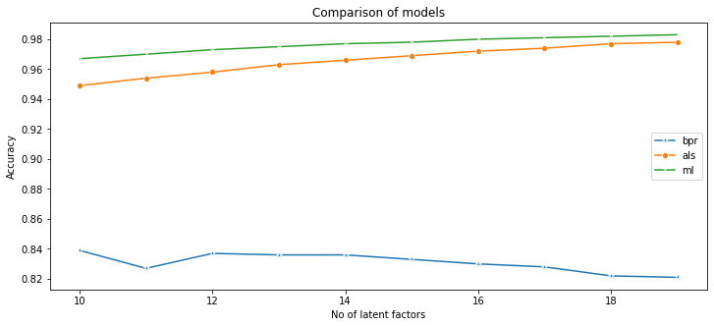
COMPARISON OF MODELS

Slide 21
Inference For ALS
Collaborative Filtering can be improved using Matrix Factorization
The method is pretty robust.
The time complexity is O(n).

Slide 22
Inference for BPR
The method is does depend more on previous interactions than latent factors.
The time complexity is O(n).

Slide 23
Inference For LMF
THIS method is almost similar as ALS, here we use log function in confidence matrix which improves accuracy than ALS
The time complexity is O(n).

Slide 24
Time Taken by each of the models to train
Total Time taken in building the BPR model: 0.25283193588256836
Total Time taken in building the ALS model: 0.4497077465057373
Total Time taken in building the LMF model: 0.3670186996459961

Slide 25
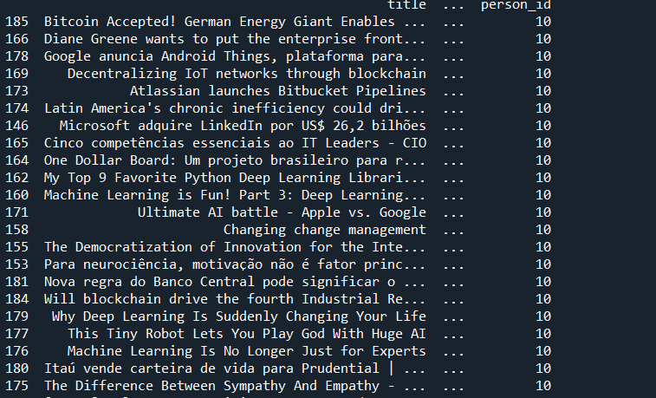
RECOMENDATION

Slide 26
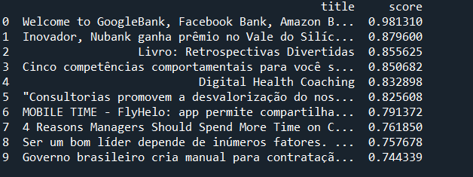
Recommendation by als

Slide 27
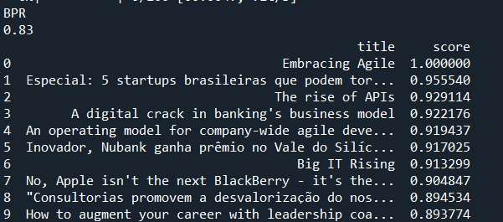
Recommendation by BPR

Slide 28
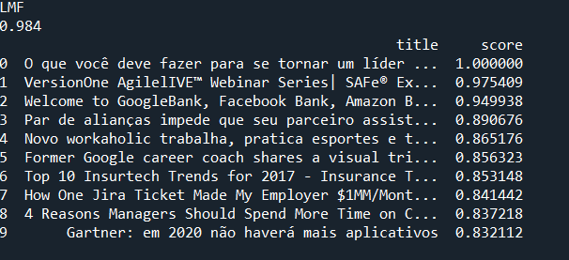
Recommendation by LMF

Slide 29
Challenges
The implicit library available for implementation of the algorithms wasn’t readily available for the Windows 10 Operating System. It had to be run on Linux (ubuntu) and to run on Windows 10 it needed a C/C++ compiler.
On Ubuntu, the system took a lot of time computing the results for ALS, i.e., 17.xx seconds, every time the model was built.

Slide 30
Learning
The usage of the implicit Library available in python.
How different-different ‘Recommender Systems’ work.
Implementation of ALS, BPR and LMF models using the implicit library and how collaborative filtering can be improved.
Matrix Factorization for sparse data problem.

Slide 31
References
DataSet - https://www.kaggle.com/gspmoreira/articles-sharing-reading-from-cit-deskdrop
https://implicit.readthedocs.io/en/latest/quickstart.html
https://implicit.readthedocs.io/en/latest/
https://readthedocs.org/projects/implicit/downloads/pdf/latest/

Slide 32
THANK YOU

