Slide 1
BIO-7057X DISSERTATION PRESENTATION
Does anticholinergic burden
predict cognition beyond
polypharmacy?
Jigneshbhai Siddhapura | Student 100537203
Supervisor: Dr Saber Sami
NHANES 2013-14 • adults aged 60+
Notes:
Timing: 0:00-0:20. Good morning. My dissertation asked a simple but clinically important question: does anticholinergic burden predict cognitive performance beyond what we already learn from counting how many medicines a person takes? I used nationally representative NHANES data from US adults aged sixty and over.
[Sources]
- Siddhapura, Dissertation BIO-7057X draft, title page and abstract.

Slide 2
CONTEXT
Anticholinergic medicines may impair cognition with age
Acetylcholine supports
Why older adults may be more vulnerable
attention
More exposure
More medicines and more opportunities for anticholinergic activity
processing speed
memory
Reduced reserve
Age-related changes in clearance, blood-brain barrier and cholinergic function
Potentially modifiable
Medication exposure can be reviewed, unlike age or genotype
The key problem: people with greater burden also tend to take more medicines overall.
2
Notes:
Timing: 0:20-1:05. Acetylcholine contributes to attention, processing speed and memory. Many medicines block cholinergic activity as a secondary effect. Older adults may be more vulnerable because they take more medicines, clear them more slowly and already have reduced cholinergic reserve. This makes anticholinergic exposure potentially important, and in principle modifiable. But there is a major interpretive problem: people with a higher anticholinergic burden usually take more medicines overall.
[Sources]
- Siddhapura dissertation, pp. 5-6.
- Boustani et al. (2008).
- American Geriatrics Society Beers Criteria Update Expert Panel (2023).

Slide 3
QUESTION AND HYPOTHESIS
Medication count cannot describe pharmacological burden
Same medication count: 4
Participant A
Participant B
lisinopril
simvastatin
levothyroxine
omeprazole
lisinopril
metoprolol
ranitidine
amitriptyline
ACB 0
ACB 5
Research question
Hypothesis
Does higher burden predict lower DSST performance after accounting for medication count?
Yes — the association will persist after adjustment.
ACB = Anticholinergic Cognitive Burden score | DSST = Digit Symbol Substitution Test
3
Notes:
Timing: 1:05-2:00. Medication count and anticholinergic burden are related but not identical. These two hypothetical participants both take four medicines. The first has no scored anticholinergic exposure. The second accumulates a burden of five because the medicines have different weights. My primary question was therefore whether higher burden remained associated with lower Digit Symbol Substitution Test performance after accounting for the simple medication count. I hypothesised that it would.
[Sources]
- Siddhapura dissertation, pp. 6-10; worked example adapted from section 2.2.

Slide 4
METHODS
NHANES linked prescriptions with cognitive performance
10,175
1,841
1,785
1,592
NHANES
participants
aged 60
or older
received cognitive
module
valid DSST
primary sample
Exposure
Outcomes
Analysis
Boustani ACB (0–3)
Sensitivity: IACB (0–4)
Primary: DSST processing speed
Secondary: animal fluency
Survey-weighted linear regression
Burden and medication count together
Association, not causation: exposure and cognition were measured at the same visit.
4
Notes:
Timing: 2:00-3:05. I analysed the 2013-14 NHANES cycle. From 10,175 participants, 1,841 were aged sixty or older, 1,785 received the cognitive module and 1,592 had a valid DSST score. Prescription names were scored using the Boustani scale, and the analysis was repeated using IACB. The primary outcome was DSST processing speed, with animal fluency secondary. Survey-weighted linear regression accounted for NHANES sampling and entered burden and medication count together. Because exposure and cognition were measured at the same visit, the results describe association, not causation.
[Sources]
- Siddhapura dissertation, pp. 9-12.
- National Center for Health Statistics (2018), NHANES analytic guidelines.
- Jaeger (2018).

Slide 5
UNADJUSTED RESULTS
Processing speed declined as Boustani burden increased
8.8 points
lower DSST at ACB 3+
than at ACB 0
2.5 → 7.4
mean number of medicines
across the same categories
This gradient could still reflect medication count or health differences — adjustment is essential.
5
Notes:
Timing: 3:05-4:00. Before adjustment, weighted mean DSST fell from 54.4 with no burden, to 48.2 at low-to-moderate burden and 45.6 at high burden. That is an 8.8-point difference. But medication count also rose sharply, from 2.5 to 7.4 medicines. This graph establishes a gradient, but it does not yet show that anticholinergic burden adds information beyond polypharmacy or other health differences.
[Sources]
- Siddhapura dissertation, Table 2 and Figure 2, pp. 13-14.

Slide 6
PRIMARY RESULT
Boustani burden remained associated after adjustment
Model M4: survey-weighted, including medication count, demographics and socioeconomic factors.
−1.36
−5.58
−1.35
DSST points per
ACB unit
DSST points at
ACB 3+ vs 0
after adding
comorbidities (M4+)
95% CI −1.98 to −0.74
p<0.001
95% CI −8.00 to −3.17
p<0.001
Medication count: p=0.066
Burden: p<0.001
Sensitivity checks were similar: IPW (inverse-probability weighting) −1.31; prior-stroke exclusion −1.20.
Coefficient comparisons describe modelled associations — not biological ageing or treatment effects.
6
Notes:
Timing: 4:00-5:10. After adjustment for medication count, demographics and socioeconomic factors, each Boustani burden unit was associated with a 1.36-point lower DSST score. High burden, defined as three or more, was associated with a 5.58-point deficit. Adding comorbidities left the burden estimate almost unchanged at minus 1.35, while medication count weakened to non-significance. The estimate also remained similar after inverse-probability weighting and after excluding people with prior stroke. These are modelled associations, not treatment effects.
[Sources]
- Siddhapura dissertation, Table 4 and sections 3.4-3.5, pp. 16-18.

Slide 7
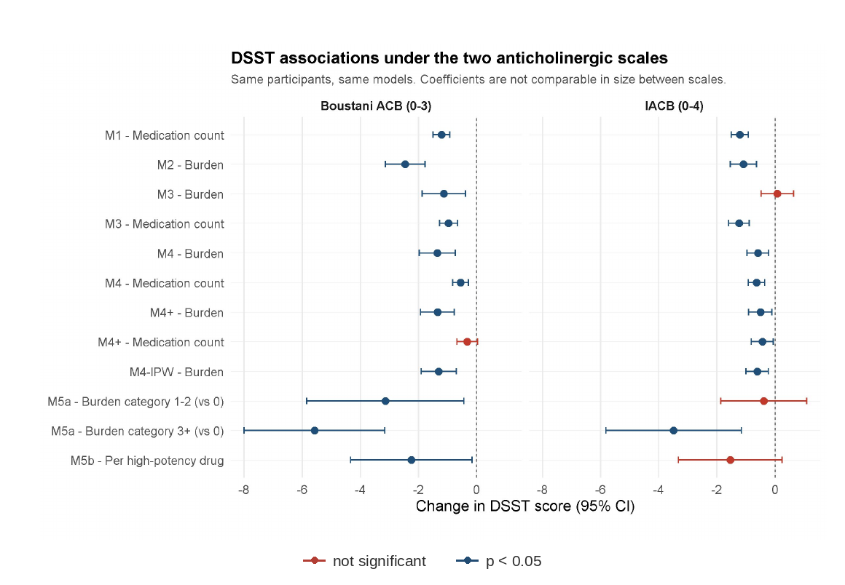
SCALE SENSITIVITY
Changing the burden scale changed the central answer
Boustani
Burden remained associated
beyond medication count
M3: −1.14; p=0.005
IACB
No burden association in
the head-to-head model
M3: +0.08; p=0.776
Same participants. Same models. Different scoring instrument.
M3 = burden and medication count entered together. Under full adjustment (M4) both scales show an association.
7
Notes:
Timing: 5:10-6:35. The most consequential result appeared when I rescored the same prescriptions using IACB. Both scales associated higher burden with poorer DSST after full adjustment. But they disagreed on the central head-to-head question. Under Boustani, burden remained associated after medication count was entered. Under IACB, the burden coefficient was essentially zero and medication count carried the signal. Because the participants, outcomes and models were unchanged, this difference must come from how the instruments classify and weight medicines.
[Sources]
- Siddhapura dissertation, Figure 3 and Table 6, pp. 20-22.
- Fleetwood et al. (2021), IACB scale, SSRN 3777231.

Slide 8
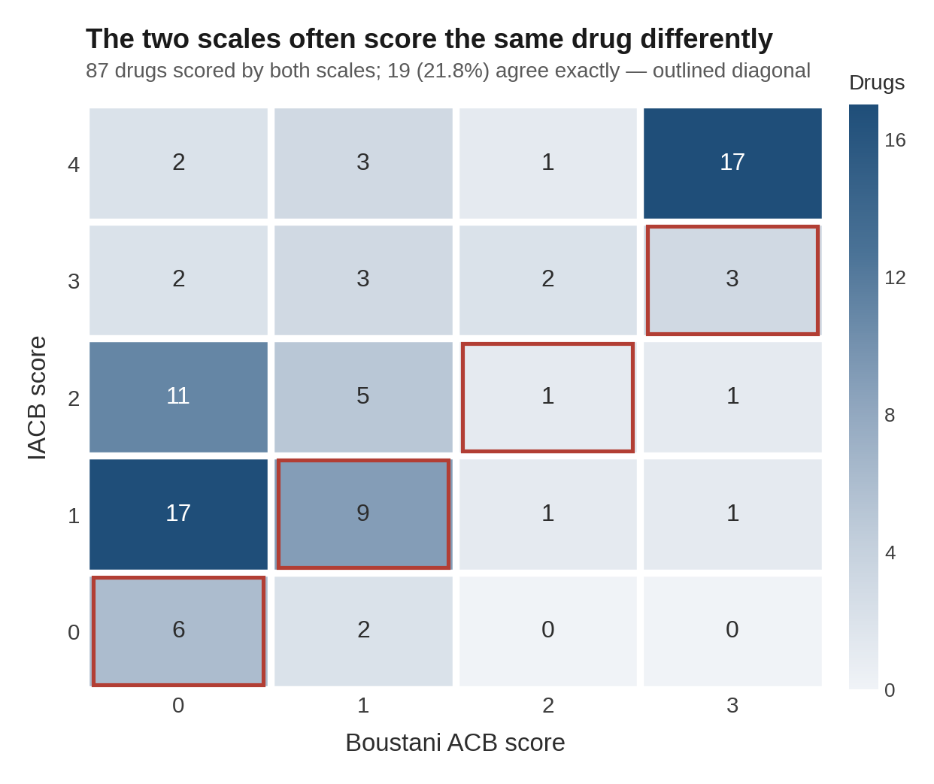
INTERPRETATION
The scales disagree about which drugs generate burden
21.8%
exact agreement among the
87 drugs scored by both scales
Common cardiovascular drugs
Metoprolol and furosemide:
Boustani = 1 | IACB = 0
They are common, occur on long medication lists and may also mark cardiovascular illness.
Scale disagreement is not a technical footnote — it changes the substantive conclusion.
8
Notes:
Timing: 6:35-7:30. The scales agreed exactly for only 19 of the 87 drugs that both scored. Much of the disagreement involved common cardiovascular medicines. Metoprolol and furosemide score one under Boustani but zero under IACB. Because these drugs are common on long medication lists and can also indicate cardiovascular illness, their classification can materially change the apparent burden signal. Scale disagreement is therefore not simply a measurement detail; it changes the conclusion.
[Sources]
- Siddhapura dissertation, Figure 4 and section 3.7, pp. 19-22.
- Boustani et al. (2008).
- Fleetwood et al. (2021).

Slide 9
CRITICAL EVALUATION
The association is informative, but it is not causal
Strengths
Limitations
• Nationally representative survey design
• Burden and medication count tested together
• IPW, stroke exclusion, comorbidity adjustment and second scale
• Cross-sectional: no temporal or causal inference
• Residual confounding by illness and indication
• Exact drug-name matching and no gold-standard burden scale
Clinical implication: review anticholinergic exposure cautiously; these results do not justify stopping medication.
9
Notes:
Timing: 7:30-8:25. The study's strengths are correct use of the complex survey design, direct comparison of burden with medication count, and several sensitivity analyses. The limitations are equally important. It is cross-sectional, so temporal order and causation cannot be established. The conditions prompting treatment may still confound the association. Exact name matching may miss combination products, and neither burden scale is a gold standard. Clinically, the result supports cautious medication review, not automatic deprescribing.
[Sources]
- Siddhapura dissertation, sections 4.5-4.7, pp. 26-27.

Slide 10
CONCLUSION
Higher anticholinergic burden
accompanied poorer processing speed.
But its value beyond medication count depended on the scale used.
Instrument-dependent association
Not evidence of causation or a direct reason to stop medicines
Questions
Jigneshbhai Siddhapura
Notes:
Timing: 8:25-9:10. In conclusion, higher anticholinergic burden consistently accompanied poorer processing speed in this population. However, whether burden added information beyond a simple medication count depended on the scoring scale. The defensible interpretation is therefore an instrument-dependent association, not evidence that anticholinergic medicines caused the difference or that treatment should be stopped. Thank you, and I welcome your questions.
[Sources]
- Siddhapura dissertation, conclusion and future directions, pp. 27-28.

Slide 11
BACKUP METHODS
Methods detail for questions
BACKUP
Covariates
Comorbidities
Sensitivity analyses
Age
Sex
Race/ethnicity
Education
Income-to-poverty ratio
Stroke
Cardiovascular disease
Diabetes
Depression
Self-rated health
Inverse-probability weighting
Prior-stroke exclusion
IACB rescoring
Burden categories
High-potency drug count
Primary outcome: DSST | Secondary outcome: animal fluency
11
Notes:
Backup slide. Use only if asked about adjustment or sensitivity analyses. The fully adjusted model included age, sex, race and ethnicity, education and income. A further model added stroke, cardiovascular disease, diabetes, depression and self-rated health. Sensitivity analyses addressed informative missingness, prior stroke, burden categorisation, high-potency medicines and the alternative IACB scale.
[Sources]
- Siddhapura dissertation, sections 2.4-2.5 and 3.5-3.7, pp. 11-12 and 18-22.

Slide 12
BACKUP FOLLOW-UP
Why the 2011-12 intervals were wider
BACKUP
Follow-up audit of the M4 sample
1,288
59.2% / 49.8%
17 df
2.11
participants
in M4
zero burden
Boustani / IACB
design degrees
of freedom
95% interval
t multiplier
Most participants contributed no signal for a continuous burden term, while the survey design required wider t-based intervals.
Use as replication context only; the dissertation's primary analysis is NHANES 2013-14.
12
Notes:
Backup slide. The later 2011-12 audit used 1,288 people in M4. Burden was concentrated at zero: 59.2 percent under Boustani and 49.8 percent under IACB. The survey design supplied 17 degrees of freedom, so the 95 percent intervals used a t multiplier of 2.11 rather than 1.96. These factors help explain the wider intervals. This is replication context and should not displace the 2013-14 primary analysis in the ten-minute talk.
[Sources]
- User-supplied follow-up email to Dr Saber Sami, 24 August 2026.

