Slide 1


Multimodal AI Framework for
Personalized & Context-Aware
Skin Disease Diagnosis, Monitoring,
and Treatment Support
Group 25-26J-222
Mihisandali W.K.M (IT22246400)
Wijesinghe H.W.M.O.P (IT22643322)
Devindi K.P.T (IT22249784)
Laksopan R (IT22277954)
SLIIT – Faculty of Computing, Dept. of Information Technology

Slide 2

Problem Statement
Rural Areas
Unimodal AI
Skin Bias
Lack specialist access
Image-only, misses symptoms
Models fail dark tones
Sri Lanka faces widespread skin disease burden — eczema, acne, dermatitis — affecting mental and physical health across all demographics.
Dermatology facilities are sparse in rural & semi-urban regions; patients rely on self-diagnosis or unverified online sources.
Current AI systems are unimodal — dependent only on images — and fail under varied lighting, skin tones, and visually similar conditions.
Clinical symptoms (pruritus, pain, recurrence) are non-visual and cannot be captured by image-only approaches, reducing diagnostic accuracy.
Multimodal AI Skin Disease Framework | Group 25-26J-222

Slide 3




Our Solution & Design Excellence
A unified 4-component multimodal AI dermatological decision-support system:
Multimodal Diagnosis
Explainable Severity
CNN + ASR + NLP symptom fusion for robust skin disease classification beyond image-only approaches
Rule-based scoring with CLAHE normalization — interpretable Mild / Moderate / Severe tracking over time
Domain Adaptation
Treatment Recommender
ConvNeXt + DANN adversarial training for fairness across skin tones, lighting, and camera variations
Knowledge-graph + LLM mapping disease predictions to 1200+ OTC treatment records with allergy awareness
Multimodal AI Skin Disease Framework | Group 25-26J-222

Slide 4
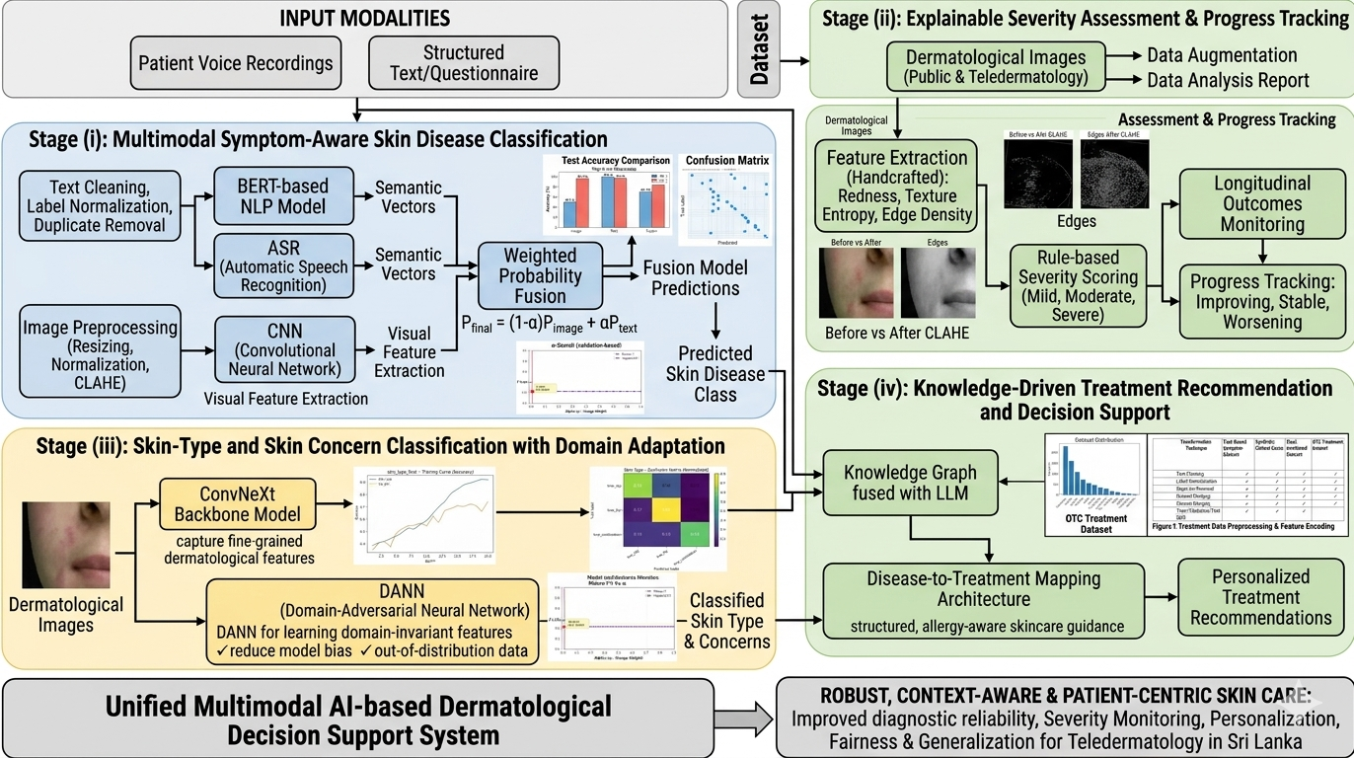
System Diagram
Multimodal AI Skin Disease Framework | Group 25-26J-222

Slide 5
Used Technologies & Techniques
Technologies
Algorithms
Techniques
Object Detection
Color Detection in HSV Space
Euclidean Distance Calculation
Frame Resizing
Dynamic Line Adjustment
Python
PyTorch / TensorFlow
BERT / DistilBERT
CNN (ResNet / ConvNeXt)
OpenCV
ASR (Speech Recognition)
Flask / FastAPI
SuperBase / MySQL
Convolutional Neural Network (CNN)
Transformer Model (BERT / DistilBERT)
Automatic Speech Recognition (ASR)
Domain-Adversarial Neural Network (DANN)
Rule-based Scoring Algorithm

Slide 6

Component 1: Multimodal Symptom-Aware Skin Disease Classification
IT22643322 | Wijesinghe H.W.M.O.P | 25-26J-222
Objective
Photo
Combine skin images with patient-reported voice symptoms to improve diagnostic reliability over single-modality systems.
Approach
CNN extracts visual texture, pigmentation & lesion structure features from skin images
ASR converts voice inputs → text, encoded by BERT into semantic symptom vectors
Weighted probability fusion: Pfinal = (1−α)·Pimage + α·Ptext, α optimized via Macro-F1
Fusion model reaches 69% accuracy vs 49% for image-only; text-only peaks at 99% on clean text
Multimodal AI Skin Disease Framework | Group 25-26J-222

Slide 7
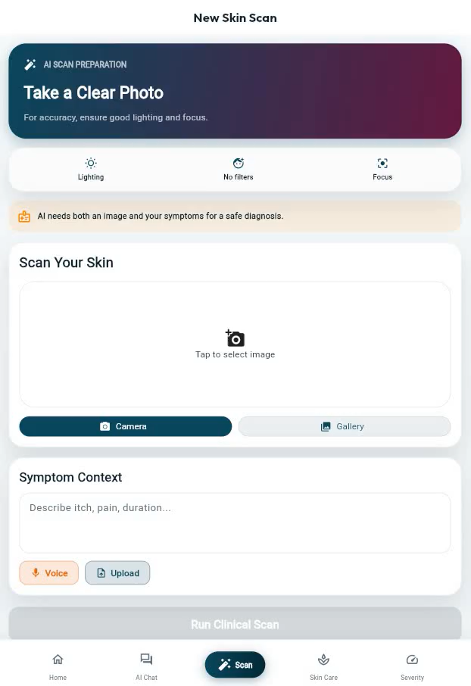
Proof of Work
Multimodal AI Skin Disease Framework | Group 25-26J-222

Slide 8
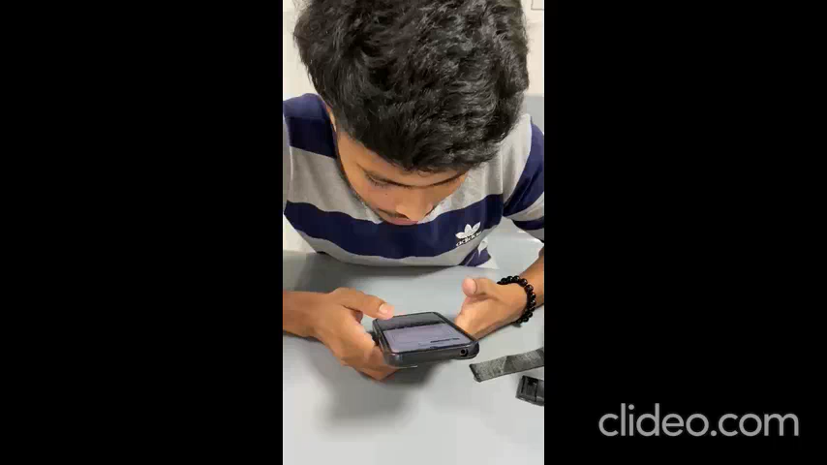
Proof of Work
Multimodal AI Skin Disease Framework | Group 25-26J-222

Slide 9

Component 4: Knowledge-Driven Treatment Recommendation
IT22246400 | Mihisandali W.K.M | 25-26J-222
Objective
Photo
Develop an interactive chat interface that enables users to identify skin diseases through text-based symptom descriptions and receive automated, condition-specific treatment recommendations.
Approach
Conversational Diagnostic Interface: Design a user-friendly chatbox that facilitates natural language interaction for collecting patient symptom data.
Systematic preprocessing: text cleaning, label normalization, duplicate removal, categorical encoding of therapeutic class
Disease-to-treatment mapping: each predicted label dynamically maps to clinically relevant OTC interventions
Modular architecture: treatment database updatable without retraining classification model — supports new pharmaceutical guidelines
Multimodal AI Skin Disease Framework | Group 25-26J-222

Slide 10
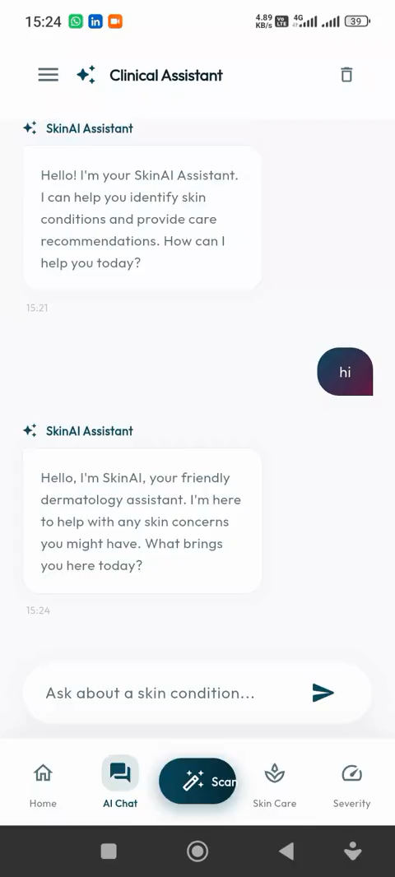
Proof of Work
Multimodal AI Skin Disease Framework | Group 25-26J-222

Slide 11

Component 3: Skin-Type Classification with Domain Adaptation
IT22249784 | Devindi K.P.T | 25-26J-222
Objective
Photo
Classify facial skin types and concerns under real-world imaging variations while ensuring fairness across diverse skin tones.
Approach
ConvNeXt backbone selected for fine-grained texture, pore structure, redness & pigmentation capture
Images resized, normalized & augmented for consistent training and improved generalization
Model comparison: ConvNeXt outperforms MobileNet and Swin Transformer on Macro-F1
Domain-Adversarial Neural Network (DANN) reduces sensitivity to lighting, camera & environment shifts
Strong diagonal confusion matrix — minor misclassification between visually similar oily/combination types
ConvNeXt
F1: 0.68
MobileNet
F1: 0.49
Macro-F1 Score Comparison
Swin-T
F1: 0.41
Multimodal AI Skin Disease Framework | Group 25-26J-222

Slide 12

Proof of Work
Multimodal AI Skin Disease Framework | Group 25-26J-222

Slide 13

Component 2: Explainable Severity Assessment & Progress Tracking
IT22277954 | Laksopan R | 25-26J-222
Objective
Photo
Provide interpretable skin condition severity grading (Mild / Moderate / Severe) from single-image inputs without labeled severity datasets.
Approach
Dataset: 6,768 facial skin images — resized, cropped, CLAHE illumination-normalized
Handcrafted features: redness intensity, brightness, texture entropy, edge density
Rule-based severity score → quantile thresholds → Mild / Moderate / Severe classes
Balanced distribution: 2,234 Mild | 2,233 Moderate | 2,301 Severe cases
Longitudinal tracking: Improving / Stable / Worsening by comparing visit scores
Mild
Moderate
Severe
Multimodal AI Skin Disease Framework | Group 25-26J-222

Slide 14
Proof of Work
Multimodal AI Skin Disease Framework | Group 25-26J-222

Slide 15

Limitations & Future Improvements
Current Limitations
Future Improvements
Data sourced from open repositories, not clinical settings — may not fully generalize
Validate with larger, heterogeneous clinical datasets from hospitals across Sri Lanka
Rule-based severity uses fixed thresholds that may miss nuanced clinical variations
Integrate clinically validated severity indices (e.g., EASI, PASI) for robust scoring
Text-only model's 99% accuracy is contingent on high-quality, clean symptom input
Explore advanced multimodal fusion: cross-attention transformers and late fusion
Treatment mapping relies on static thresholds; requires periodic clinical validation
Expand treatment recommender with LLM-powered generation and real-time drug updates
No real-world user acceptance testing conducted yet with patients or clinicians
Develop multilingual voice interface for local languages (Sinhala, Tamil)
Multimodal AI Skin Disease Framework | Group 25-26J-222

Slide 16
Commercialization Strategy
Product Deployment: The system can be deployed as a scalable mobile and web-based healthcare application, enabling easy access for users and healthcare providers.
Target Market: Designed for hospitals, dermatology clinics, telemedicine platforms, and individual users, especially in regions with limited access to specialists.
Business Model: Revenue can be generated through subscription-based services, premium diagnostic features, and API integration for healthcare providers.
Partnership Opportunities: Potential collaborations with hospitals, pharmaceutical companies, skincare brands, and insurance providers to expand service reach and credibility.
Market Scalability: The solution is highly scalable, with the ability to expand into international markets and adapt to different healthcare environments.
Value Proposition: Provides cost-effective, accessible, and AI-driven dermatological support, improving early diagnosis, personalized treatment, and patient engagement.
Multimodal AI Skin Disease Framework | Group 25-26J-222

Slide 17

Conclusion
A proof-of-concept unified multimodal AI system for robust, interpretable, and fair dermatological diagnosis
ConvNeXt + BERT fusion outperforms image-only approaches and handles visually ambiguous cases
Explainable severity scoring enables longitudinal disease tracking without labeled temporal datasets
DANN domain adaptation promotes fairness across skin tones and imaging environments
Knowledge-graph treatment recommender delivers actionable, allergy-aware OTC guidance
Designed for real-world deployment in Sri Lanka's underserved dermatological landscape

Slide 18
Thank you

