Slide 1
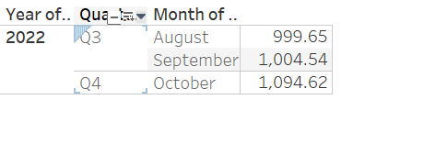
Call Center ABC The shared data contains record of 3 months, Aug, Sept, Oct . Dataset represents performance data for Call Center , where information such as, number of calls, sales units and call time is present. This dataset contains 146k+ records and 613 unique userid.
EventDate vs AHT

Slide 2
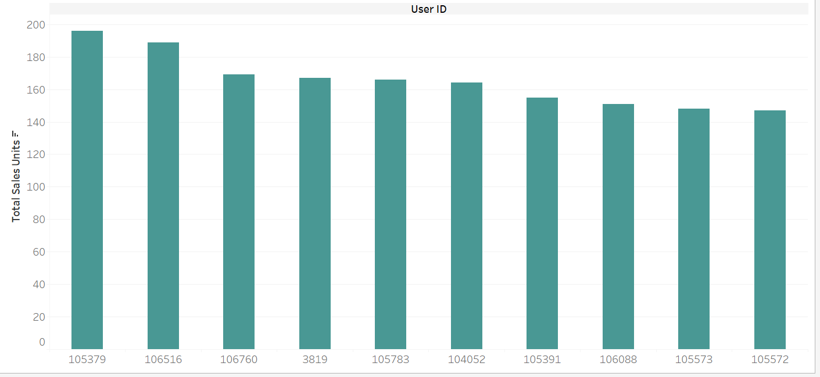
Users vs Total unit Sales
This is the list of top 10 userid and total units sold to them.
Bar graph is arranged in decreasing order.

Slide 3
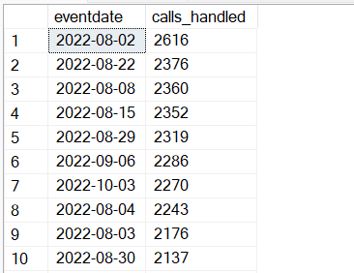
Eventdate vs Totalnumberofcallshandled
Top 10 total number of calls attended with respect to eventdate.

Slide 4
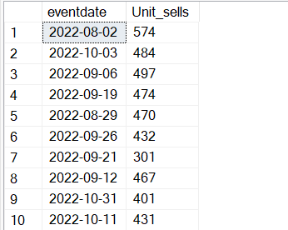
Eventdate vs Unit_sells
Top 10 unit sales.

Slide 5
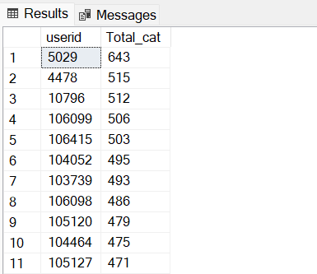
Userid vs categories count
Top 10 users with highest categories

Slide 6
