Slide 1
Course Title : Responsive Web Design and TypeScript
Course Code : 23PGCA101

Slide 2


Slide 3
Course Detail
Responsive Web Design
HTML
CSS
TypeScript

Slide 4


Slide 5
HTML
We move on for HTML?

Slide 6


Slide 7
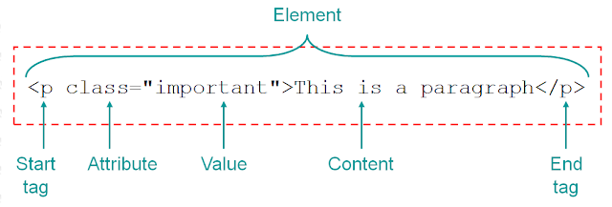
Tag

Slide 8


