Slide 1
Test Data Management
Lesson 1: Test Environment Management

Slide 2
Lesson Objectives
To understand the following topics:
Introduction
What is TEM ?
Need of TEM
Role of Environment Managers
Problems faced due to poor TEM
TEM’s Techniques
Delivery Activities & efforts in TEM service
TEM’s end-to-end Service
Benefits of TEM
Problems with TEM
Solution to overcome the TEM Problems
Two Case study Examples

Slide 3
Introduction
To successfully test business applications end-to-end, across multiple user channels and through the distributed systems landscape and proliferation of system interfaces, the organization must have the right environment, controlled change, and tailored support practices.
The Test Environment Management service fulfills all these demands.

Slide 4
What is TEM ?
You may hear things like “please don’t deploy to staging, some clients are load testing on it” or “can you refresh the user data so that our consumer can regression test on it?” These sorts of requests come through ad-hoc communications, like Slack and e-mail.
These communications and how we respond are our test environment management.
It is often ad-hoc and full of error-prone, manual processes.
Notes:
Testing is a very critical stage of the SDLC and can decide the ultimate fate of the quality of software being released into the live environments. Therefore, it is very important to ensure that the test environments used for testing the software are reliable and as close to production as possible.

Slide 5
Need of TEM
The emergence of more sophisticated application solutions, combined with cheaper storage and alternative infrastructure models such as virtualization and cloud technologies, have led to businesses’ IT landscapes becoming increasingly integrated and complex.
More than ever, managers are under pressure to maintain control of these application ecosystems whilst maximizing the availability and utilization of these investments, in order to speed up their overall product time-to-market.
Example:
Take payment systems, for example. Most are now settled in real-time, rather than at pre-defined time periods (overnight batch) as they were previously.

Slide 6
Need of TEM (Contd..)
Organizations typically need a number of test environments for every production application – they may require anywhere between one to 250 different environments for a single business application. With the growth in ‘agile’ development environments, the need for frequent software releases has also increased, sometimes to the level of hourly or on-demand.
The TEM approach enables clients to begin testing earlier (shifting left), at a higher quality and at a lower cost to the organization.

Slide 7
Role of Environment Managers
List of hotspots that environment managers should take care :
Managing test infrastructure such as hardware servers, application servers, networking, firewalls, software components required for testing, build software required for testing releases etc.,
Managing test environments such as database clusters, UAT, Pre-prod and the data required for testing.
Manage or monitor Service Level Agreements (SLA).
Planning and analysis of test environments.
Monitoring servers and infrastructure.
Environment Maintenance.
Effective Communication between the test team and other stakeholders.
Bug life cycle

Slide 8
Problems faced due to poor TEM
Poor TEM Management | Impact
Test environments differ from production environments in terms of the operating systems, configuration, software versions, patches, etc. The wider the gap between test and production, the greater the probability that the delivered product will have more bugs/defects. | This results in poor code quality and also product failures in production or live environments.
Poorly managed infrastructure assets | This results in budget spikes and may delay the testing process.
Poorly administered and poorly controlled environments/infrastructure assets | This results in unintended consequences. It may also result in poor configuration and change control.

Slide 9
Problems faced due to poor TEM (Contd..)
Poor TEM Management | Impact
Misalignment of test and production environments | Root Cause Analysis of incidents and defects becomes challenging
Assign the application developers as testers or for testers to directly test the code in production | This results in the lack of accountability and also poses a deep risk in the software development process.
It is very common for test teams to clone or extract the production data and use it for testing purposes. | This approach is time-consuming, error-prone and may not meet the data protection policies. Further, it isn’t change-controlled and cannot be audited.

Slide 10
Problems faced due to poor TEM (Contd..)
Poor TEM Management | Impact
Poor communication in any phase of SDLC | This results in misunderstanding of the testing/business requirements and may also result in failure to identify important defects.
You need to configure bug or defect tracking tools well and there should be a process in place to manage their lifecycle. It isn’t uncommon to assign defects to the wrong teams and miss important information. | This not only results in wasted time/money but may also infuse more defects at later stages.

Slide 11
TEM’s Techniques
Three techniques are used to deliver accurate test environments:
Constructing a new test environment – the most labor intensive and time-consuming of the three approaches.
Copying an existing test environment – less labor intensive, due to the use of cloning tool suites and potentially less configuration, integration and test data provisioning activity.
Re-using an existing test environment – the least labor intensive option as it uses existing baselines of application code, configuration, integration and test data.
Notes:
Re-using the existing environment is the optimal technique as it is the lowest cost-and-effort solution.

Slide 12
Delivery Activities & efforts in TEM service
The delivery activities and effort involved in the TEM service environment can vary depending on the technique chosen and may involve
Configuration (system, module, sub-module).
Integration (endpoints).
Service virtualization.
Test data provisioning (traceability, privatization, segregation, ETL – extract, transform, load).
Shake-down testing (automation).
Monitoring (automation).
Environment cloning (copying).
Infrastructure and platform (operating system) provisioning.
Application provisioning (code compilation and installation).
Workplace technology provisioning (lab environment).
End-user provisioning (mobile device environment).

Slide 13
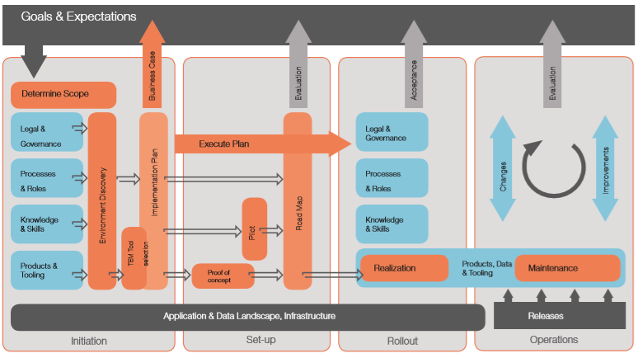
TEM’s end-to-end Service
Capgemini and Sogeti deliver TEM using a four-stage approach:
1. Initiation 2. Set-up. 3. Rollout. 4. Operations.
Notes:
INITIATION
1. One key service during this stage is the Quality Blueprint (QBP), an IT service management capability assessment that allows the customer insight into what problems need to be addressed, and the steps which need to be taken to solve them.
QBP :
Analyzes the client’s current test environment management situation, including: – The existing applications/data landscape, environments and infrastructure. – Which processes and roles are in place. – How often environments are shared/re-used. – The requirements of the test team & project teams.
Proposes what actions are needed to embed TEM into the organization and what TEM tools are needed to achieve this.
Identifies the benefits, if any, of introducing the TEM process and using the TEM tools
2. Another key service in the Initiation stage is the Implementation Plan including –
Project set-up.
Detailed business case for the improvement/introduction of the TEM process and corresponding TEM tooling.
Tools selection process.
Proof of concept.
Pilot.
Rollout/implementing the TEM process.
Operational after-care.

Slide 14
TEM’s end-to-end Service(Contd..)
Notes:
SET-UP
Sometimes clients want a demonstration that the proposed TEM process is workable and can deliver the expected benefits. This sincludes :
Defining the TEM Pilot – determining its goals, tool environment, scope, coverage and control measures used.
Preparing the TEM Pilot – installing and configuring the tooling, defining the TEM process outlines for the pilot organization, creating the TEM workspace on the client’s infrastructure, and determining and analyzing the general test data requirements.
Performing the TEM Pilot – executing all stages of the TEM model within a pilot environment, including performing the most high–risk activities in all stages of the model.
ROLL OUT
During this phase, Capgemini and Sogeti introduce the selected toolset, and the TEM service acts as an instrument for test environments. Services provided include Tools Implementation and full TEM Rollout.
OPERATIONS
Capgemini/Sogeti defines the required changes to keep alignment with live production environment baselines and continues to improve the test environment delivery and support process. Services offered include maintenance of set-up, ‘feeding and watering’ of environments, as well as training and support.

Slide 15
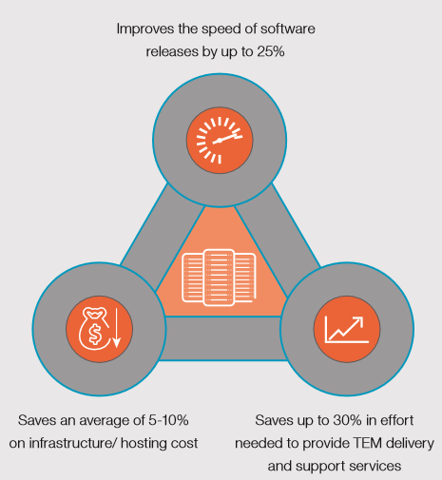
Benefits of TEM

Slide 16
Benefits of TEM(Contd..)
One of the key testing industry transformational initiatives undertaken by test environment consumers (predominately developers and testers) is to ‘shift quality to the left’ meaning the identification and removal of defects (code, data, configuration, build etc) within earlier phases of their software delivery life-cycles or in an effort to “do it right first time”.
Example :
PointZERO®, Capgemini and Sogeti’s quality business success solution, is used globally by organizations to achieve their shift left objectives.

Slide 17
Benefits of TEM(Contd..)
TEM is a professional services-led approach that:
Analyzes an organization’s current software testing and test environment management.
Proposes what actions (policies, standards, processes, guidelines) and toolsets are needed to improve testing within the organization.
Helps customers choose the right tools.
Offers a pilot or proof of concept to show the selected tools can deliver the test environment required within the client organization, and that the proposed process can deliver the expected benefits.
Provides a full TEM rollout.
Supports and trains customers all the way through the process and even after the rollout.

Slide 18
Problems with TEM
How do you ensure the test environment is broad and representative enough to test all possible scenarios?
How do you safely integrate those test environments into the preexisting landscape?
How do you effectively co-ordinate release priorities and control change in a shared services environment?
How do you ensure you can re-use the same environments time after time?
We know about our core systems. We know about the business processes, configuration and data in our systems. But we don’t know how to deliver and manage the test environments well enough to meet our time and cost expectations

Slide 19
Solution to overcome the TEM Problems
Capgemini and Sogeti TEM service addresses organizations’ key efficiency, quality and shift left objectives and challenges by:
Minimizing the cost of testing – by utilizing smaller asset footprints to support test projects.
Shortening the time to release – by simplifying and automating the environment delivery and support services, across development and testing.
Ensuring the quality of testing – the environments are representative of the ‘live’ production situation, making the test fully valid.
Improving test coverage – environments are integrated, incorporating all relevant risks and requirements.
Notes:
Capgemini and Sogeti recognize that it is unrealistic to expect development and test teams’ business processes optimization to deliver all the required shift left business objectives in today’s ever changing IT landscape.
Successful integration of development and Test Environment Management technologies and practices plays an integral role in assisting and driving many shift left outcomes that organizations are demanding. Successful industrialization of initiatives greatly improves the sustainability of organizational change and benefits realization.

Slide 20
Casestudy-1 :
CLIENT 1: Large international bank with 1,000-plus application environments
CHALLENGES :
Support in-flight pipeline of work comprising up to 100 concurrent projects.
Reduce build failures by an average of 75%.
Reduce release timelines by an average of 5%.
Increase service delivery efficiency by 25%. • Reduce infrastructure footprint by 2%.

Slide 21
Casestudy-1 : (Contd..)
PROJECT CHARACTERISTICS :
200 applications within over 1,000 environments, with platform upgrades, updates and migrations occurring continually.
Platforms range from mainframe to web applications, mobile solutions, cloud and lab technologies.
TEM APPROACH :
Identified business risks
Knowledge management practices.
Silo-based operating model.
Key resource points of failure.

Slide 22
Casestudy-1 : (Contd..)
2. Goals
Set up services-based operating model (best practice).
Set up centralized knowledge repository including integrated project, release, service and configuration management.
Reduce effort associated with support of environments once delivered by simplifying processes and introducing service/objective level agreements (SLAs/OLAs).
Reduce the need for so many test environments through better requirements capture, analysis and change control.

Slide 23
Casestudy-1 : (Contd..)
3. Results & Benefits
As a service operating model, delivery (including service breakdown) became aligned to industry best practice.
Integration with Capgemini/Sogeti standards, processes, guidelines.
Introduction of OLAs for environment delivery and support teams, including measurement and reporting automation.
Build failure reduced by 50% (ongoing initiative).
Release timeframes reduced by an average of 6%.
Service delivery productivity improved by 25%.
4.5% reduction in development and test environment infrastructure.

Slide 24
Casestudy-2 :
CLIENT 2: Insurance Institution
CHALLENGES :
Continual delay in pipeline project delivery due to environment delivery delays and change implementation failure.
PROJECT CHARACTERISTICS :
50 integrated applications including a shared, client-facing front-end and a core systems back-end.

Slide 25
Casestudy-2 : (Contd..)
TEM APPROACH :
Identified business risks
Shared systems management processes ill-defined and managed.
Poor requirements capture and utilization traceability.
Weak shared-systems change control processes.
Weak dependencies and impact assessment practices.
2. Goals
Streamline shared services management processes.
Establish dependent team’s service/objective level agreements (SLAs/OLAs).
Reduce change failure rate by 15%.
Improve environment provisioning lead-time by 25%.

Slide 26
Casestudy-2 : (Contd..)
3. Results & Benefits
Centralized engagement, requirements capture and estimation, including traceability.
Centralized shared service change advisory board (CAB) formalization, including change ownership, dependencies and impact assessments coupled with formalized approval processes.
Change failure rate reduced by 17%.
Environment provisioning lead-time reduced by 25% through OLA introduction and simplified request, measurement and control process, including tool integration.

Slide 27
Summary
In this lesson, you have learnt:
What is Test Data?
Test Data Challenges
Challenges of Test Data sourcing
Need for TDM
Essential Steps for a streamlined TDM
TDM Strategies
Corrupted Test Data
Preparing Ideal Test Data to ensure Maximum Test Coverage
TDM Tools

