Slide 1
Exam Preparation Planner
A Desktop Application using Python, Tkinter & SQLite
College Mini Project

Slide 2
Objective
• Help students organise subjects, exams and study plans in one place
• Track daily / weekly / monthly study progress with actual study hours
• Apply core CS concepts: GUI programming, database design, CRUD operations
• Provide a simple, fully offline desktop tool - no internet required

Slide 3
Technology Stack
Python 3
Tkinter
Core application logic
Desktop GUI (sidebar navigation, forms, tables)
SQLite3
VS Code
Local relational database, 5 linked tables
Development environment

Slide 4
Modules
Authentication (Login / Register)
Dashboard
Subject Management
Exam Management
Study Planner
Progress Tracker
Reports

Slide 5
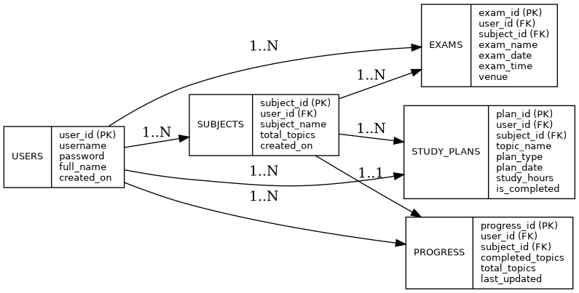
Database Design (ER Diagram)

Slide 6
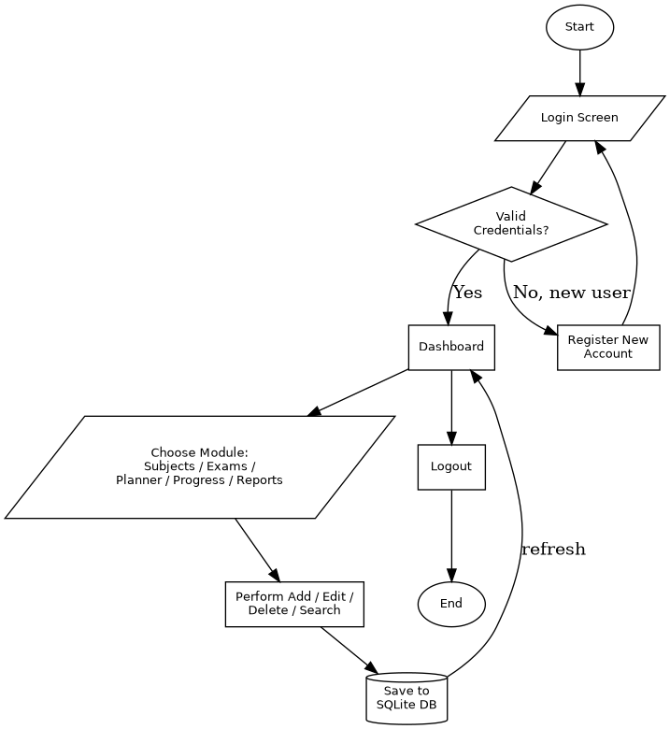
Application Flow

Slide 7
Key Screens
Dashboard
Total subjects, upcoming exams, today's plan, overall progress
Subject / Exam Management
Add, Edit, Delete, Search - full CRUD with validation
Study Planner
Daily / Weekly / Monthly topics with hours & completion status
Progress Tracker
Subject-wise and overall progress bars
Reports
Daily / Weekly / Monthly / Subject reports, export to .txt

Slide 8
Validation & Security
• Passwords stored using SHA-256 hashing, never in plain text
• No empty fields allowed - checked before every insert/update
• Duplicate subject names blocked per user
• Date fields validated in YYYY-MM-DD format
• Foreign keys with ON DELETE CASCADE keep data consistent
• All database calls wrapped in try/except for safe error handling

Slide 9
Testing Summary
24 manual test cases executed across all modules
24
24
0
Test Cases
Passed
Critical Bugs

Slide 10
Future Enhancements
• Exam countdown reminders / notifications
• PDF export for reports
• Progress charts using matplotlib (pie / bar)
• Cloud sync with a server-based database for multi-device access

Slide 11
Thank You
Exam Preparation Planner - Python | Tkinter | SQLite

