Slide 1



Statistical learning from simulation and observations with application to the protein ligand structures
Lala Ibadullayeva
MSERA, IMBB, Baku, Azerbaijan
lala.ibadullayeva@gmail.com
12-13 June, 2025, Baku, Azerbaijan
“Wheat Improvement through the Application of Digital and GWAS-Based Technologies” Conference

Slide 2
Plan :
Introduction
Aim of Research
Methods
Results
Conclusion

Slide 3
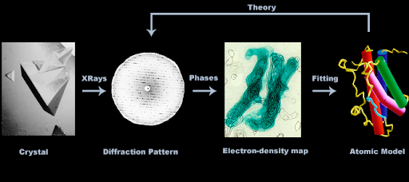
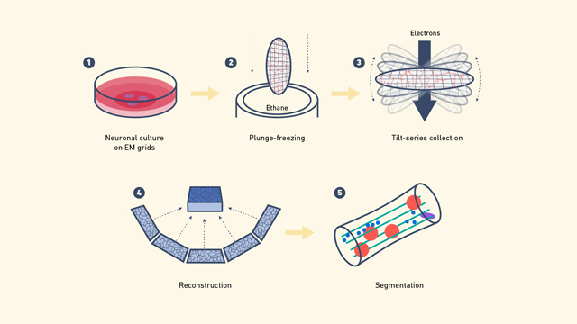
Derivation of Macromolecular atomic structure models
Macromolecular crystallography
Main Methods:
Crystallography & Cryo-Electron Microscopy: Can result in good models
Issues: Often produce sparse and noisy data, making data-only derived models unreliable
Solution - use Bayesian Statistics:
Combines likelihood (observation model) with prior probability (existing knowledge).
Enhances reliability of molecular models.
Stereochemical Parameters:
Bond lengths and angles: Well-established, widely used in structural biology software.
Conformational angles: Challenging due to multimodality and environmental dependence.
Cryo electron microscopy

Slide 4
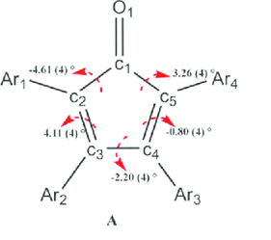
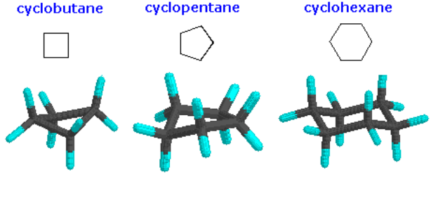
Challenges and Study Approach
Conformational Angle Challenges:
Torsion angles in small-ring systems: Complex due to ring closure constraints.
Constraints reduce independent variables leading to interdependencies.
Study Objective:
Develop a framework to organize and classify small-ring conformations.
Focus: Statistical models.
Methodology:
Combine computational simulations (RDKit, PySCF) with experimental data from Crystallography Open Database (COD).
Aim: Integrate knowledge to improve modelling of macromolecules

Slide 5
Aim of the Research
Overall Objective:
To calculate the possible conformations for each ring class with their respective energies.
To identify a relationship between simulations and observational data.
Details:
Use existing observational data build statistical models.
Use computational tools to augment observed data
Applications: (future)
Conformational analysis of ligands with small rings, e.g. carbohydrates.
More accurate analysis of RNA/DNA structures.
Improve atomic models in the PDB

Slide 6
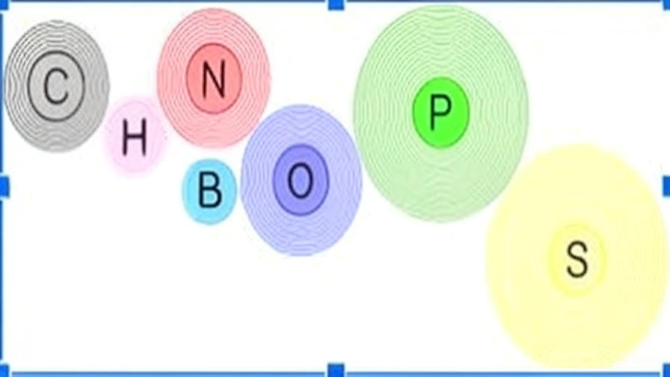
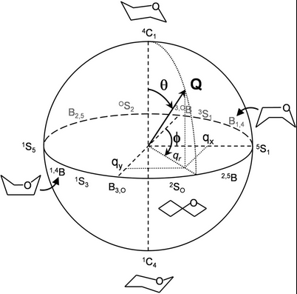
Methodology Overview
Workflow Summary:
Data acquisition from COD (≤1.0 Å)
Ring extraction & classification
Computation of Cremer–Pople parameters
SMILES conversion for simulations
Conformational sampling (RDKit)
Energy evaluation (DFT & HF using PySCF)
Cremer-Pople mapping rings to sphere

Slide 7
Methodology: Conformer Generation and Visualisation
Conformer Generation and Optimisation
RDKit: Generation of molecular structures from SMILES format.
MMFF and UFF Methods: Initial optimisation of molecular structures and calculation of their energies.
Energy Calculation Methods
Hartree-Fock Method: Precise calculation of molecular energies.
Density Functional Theory (DFT): Faster and accurate energy analysis.
Boltzmann Distribution
Identification of dominant conformers and calculation of relative probabilities.
Visualisation
Visualisation Tools: Conformers depicted in 3D using py3Dmol.
Conformer Generation from SMILES Format:
RDKit employed to generate conformers.
Geometry optimisation performed for each conformer.

Slide 8
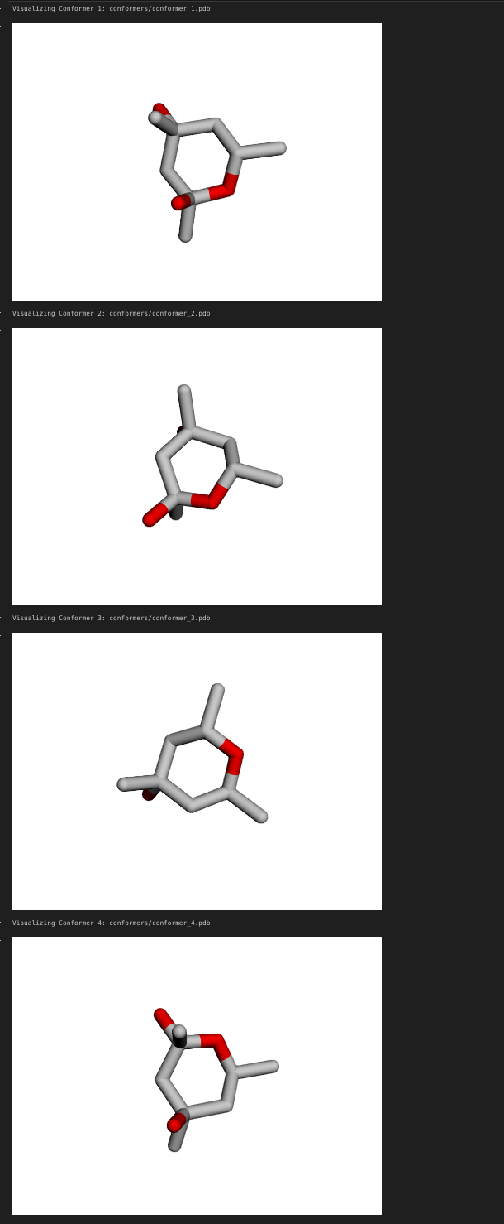
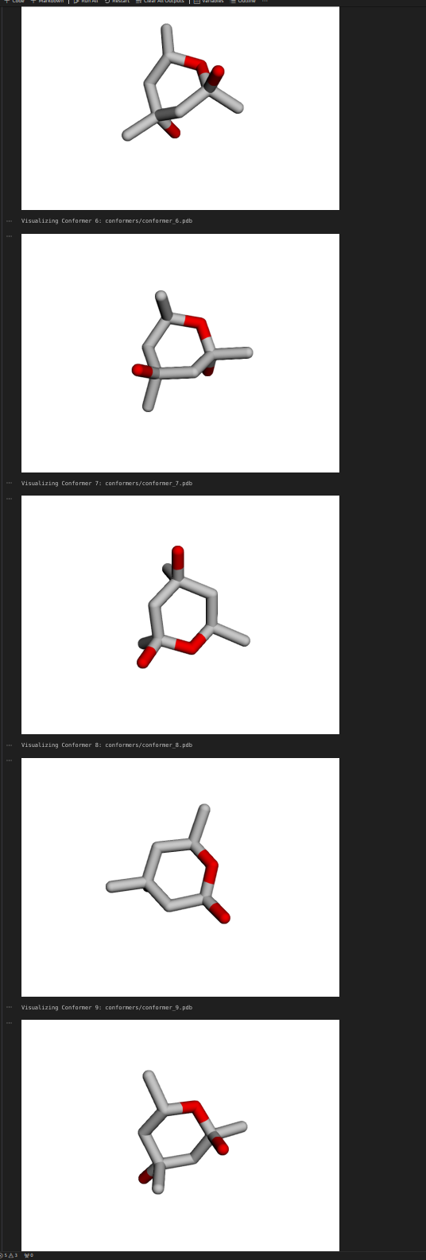
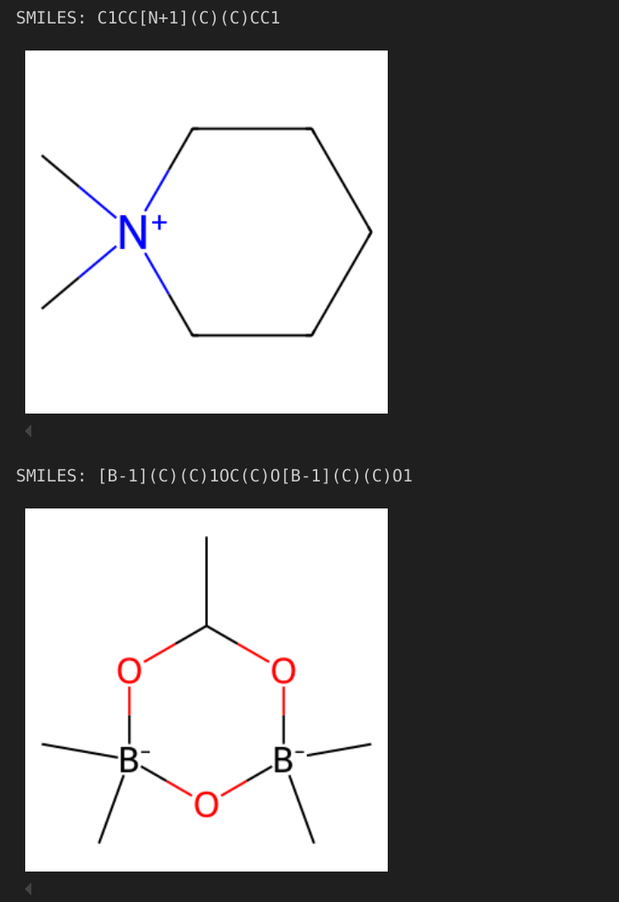
Molecular Structure Generation and Visualisation Using SMILES Format
Generation of Molecular Structures:
Utilisation of the RDKit tool to generate molecular structures from SMILES format.
Description and analysis of diverse chemical components corresponding to the molecules.
Significance of SMILES Format:
Critical for the representation and modelling of molecular structures in computational chemistry.
C(O)(C)1CC(C)(O)CC(C)O1 - Each conformer exhibits distinct torsion angles. The effects of these differences on energy stability and molecular processes have been analysed.
The following illustrations demonstrate how SMILES format represents molecular structures and reflects their chemical components: Molecule 1: SMILES notation "C1CC[N+1](C)CC1". Molecule 2: SMILES notation "[B-1](C)1OC(C)O[B-1](C)O1”.

Slide 9
Ring Selection Criteria
Filters Applied to COD Dataset:
High-resolution X-ray structures
Finite and well-defined molecules
Rings of 4–6 atoms, non-aromatic
Composed of C, N, O, P, S, B
Outcome:
523,000 initial crystal structures
235,000 passed the filters
157,000 contained non-aromatic rings
116,000 was the extracted number of 4-6 membered rings

Slide 10
Ring Classification
Classifying by Atomic Connectivity:
Total: 7,600 distinct classes
Only 20 classes had >500 observations
Cremer–Pople Parameters:
Quantify ring conformation parameters
Describe ring conformations independently of its size

Slide 11
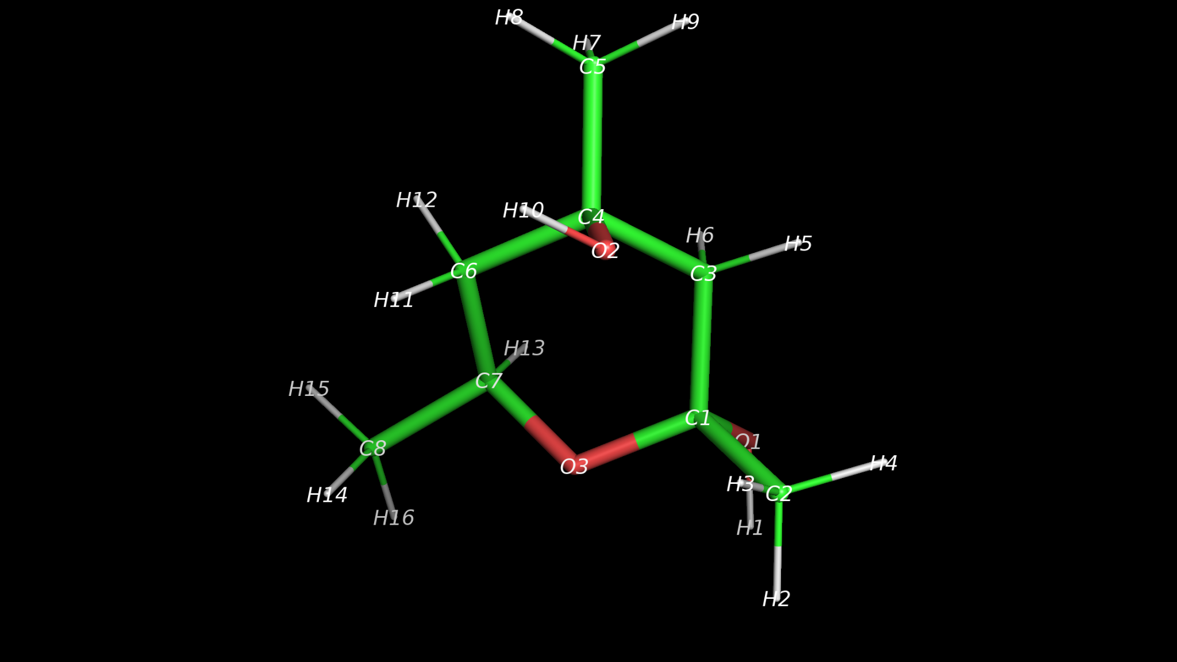
Atom types and ring classes: an example
Atom types (ring atoms only):
C1: C(2,2,0,0,0) - C with 2 C and 2 O nb
C3: C(2,0,0,2,0) - C with 2 C and 2 H nb
C4: C(3,1,0,1,0) - C with 3 C and 1 O nb
C6: C(2,0,0,2,0) - C with 2 C and 2 H nb
C7: C(2,1,0,1,0) - C with 2 C, 1 O and 1 H nb
O3: O(2,0,0,0,0) - O with 2 C neighbours
Ring class:
C(2,2,0,0,0):C(2,0,0,2,0):C(3,1,0,1,0):C(2,0,0,2,0):C(2,1,0,1,0):O(2,0,0,0,0)
If atom types are circularly sorted then these strings defines classes uniquely

Slide 12
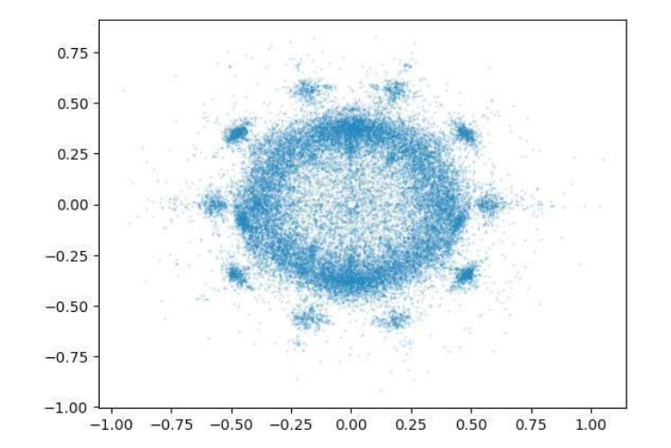
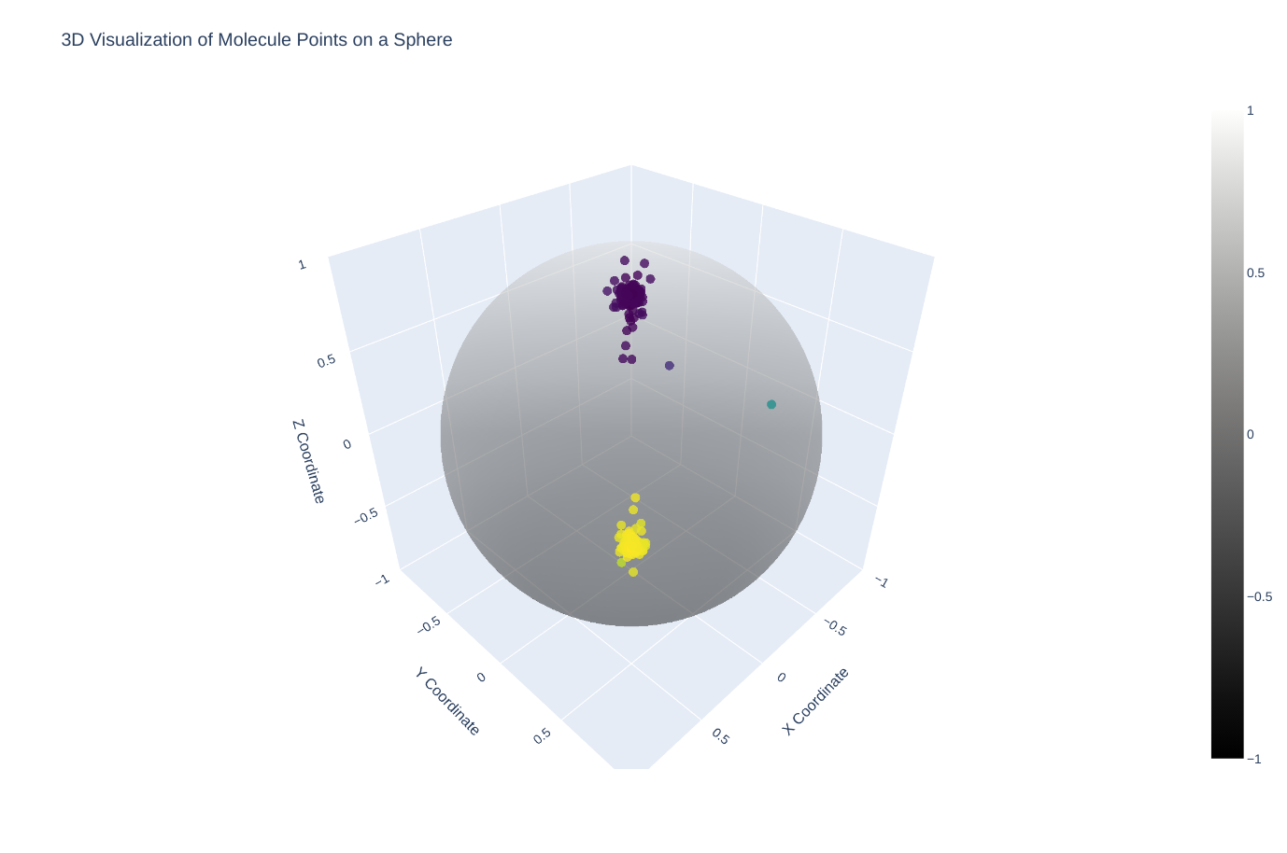
Statistical Description of Data: Conformational Analysis of 5- and 6-Membered Rings in 3D Representation
Graphical Representation :
Illustrates the spatial distribution of distinct conformations within molecules.
Analysis reveals circular and spherical structural patterns in observed conformations.
Distribution of conformations with similar energy stability is observed.
6-membered rings exhibit a broader circular distribution of conformations.
Each data point represents a specific conformational state.
Mapping of 6-membered rings to a sphere
Presents a 3D depiction of conformational distribution for 6-membered rings. Different colours highlight variations within molecular conformations..
Mapping of 5-membered rings to a circle.
Describes data obtained from molecular conformational analysis. Circular distribution indicates the presence of defined conformational classes. Each data point corresponds to a distinct conformational state of the molecule.

Slide 13
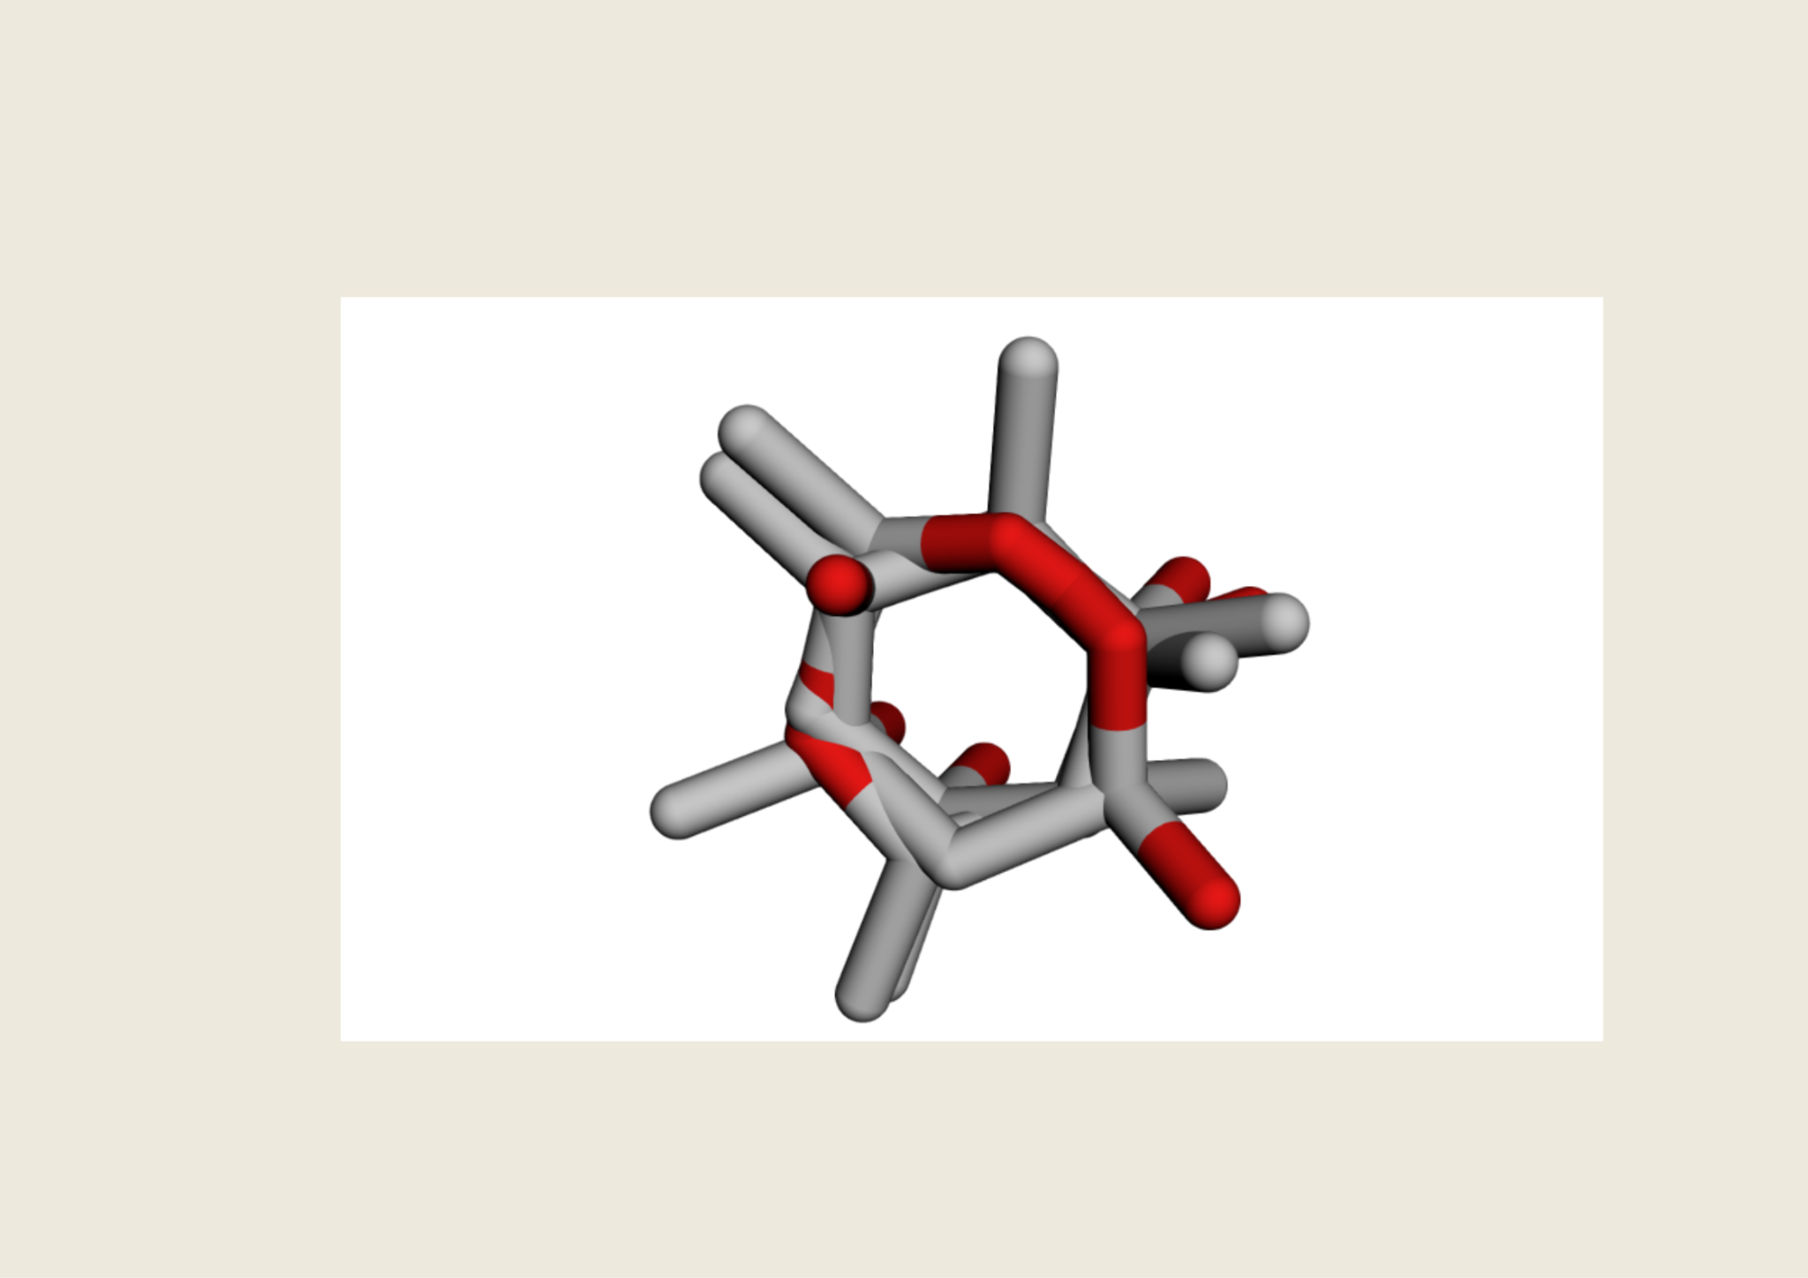


Computational Modelling
RDKit Ensemble Generation:
SMILES-based conformer generation
Superimposition and filtering of geometrically distinct conformers
Quantum Mechanical Calculations:
DFT & HF methods
Performed using PySCF

Slide 14
Results and Analysis
Energy Calculations
Energies of each conformer calculated using Hartree-Fock and Density Functional Theory (DFT) methods.
Energy differences expressed in kcal/mol units.
Analysis of Ring Structures
Conformational patterns identified for 5- and 6-membered rings.
Energy differences visualised in graphical representations.
Boltzmann Distribution Results
Identification of minimum-energy conformer(s).
Dominant conformers determined based on Boltzmann distribution.
The dominant conformers correspond to observed states

Slide 15
Conformational Distributions
Why Distributions Matter:
Not all conformers are equally probable
Populations are temperature-dependent
Next Steps:
Apply workflow to all 7,600 ring classes (to be done, we need computers)

Slide 16
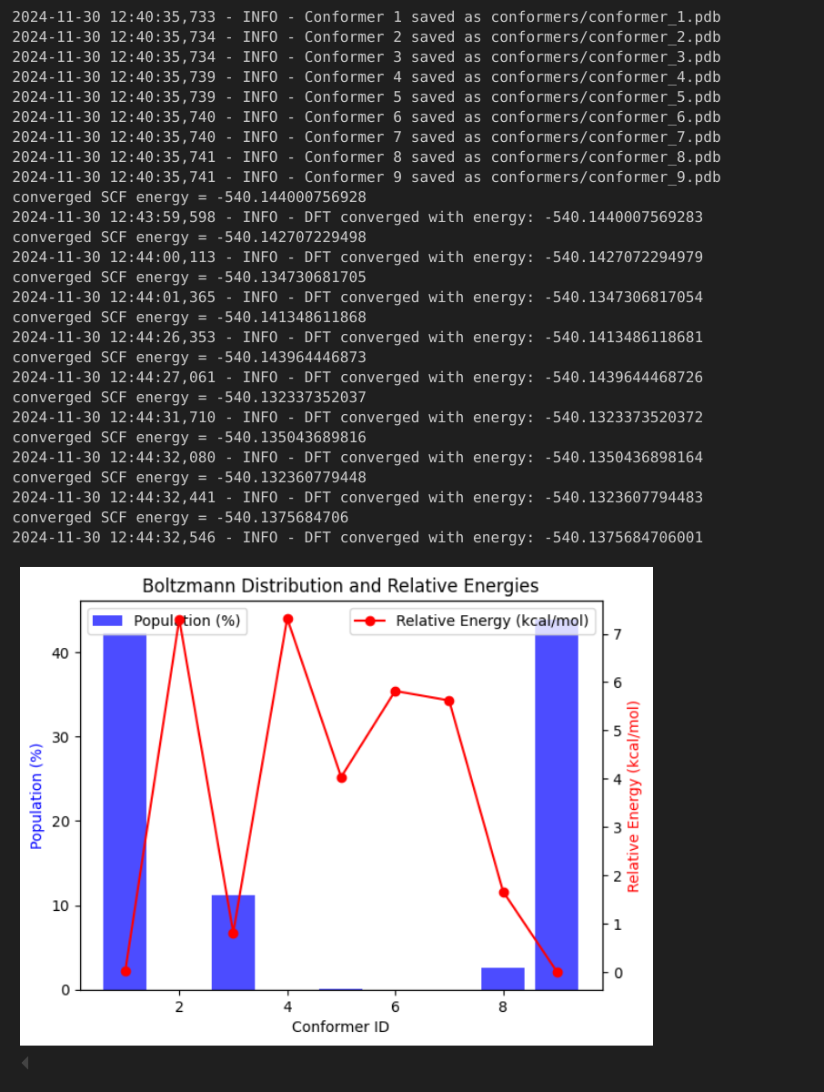


Boltzmann Distribution and Energy Analysis
Probability Calculation of Dominant Conformers
The probability of dominant conformers is calculated based on the Boltzmann factor.
Boltzmann probabilities are used to identify dominant conformer(s).
E_rel: relative energy of conformations
P_i: Probability of conformation. It should be proportional to the number of observed states
RT: Represents the effect of temperature on the system
Boltzmann Distribution and Energy Differences. The graph illustrates the results of energy analyses for conformers, plotted against conformer IDs. Blue bars represent the distribution percentages, while the red line indicates relative energies.

Slide 17
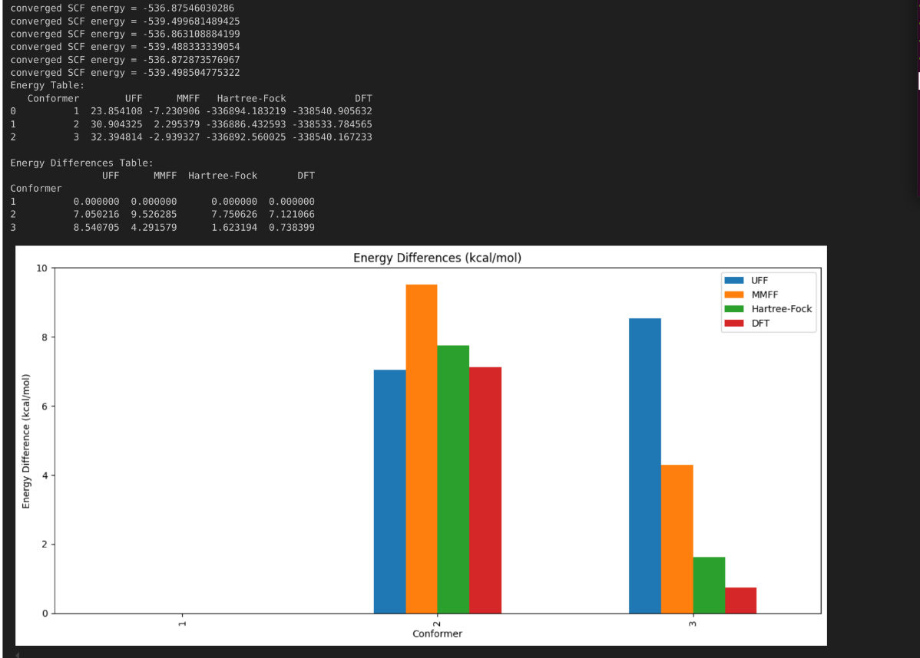
Conformer Generation and Energy Analysis
Molecular Generation:
Molecules generated from the provided SMILES format using the RDKit tool.
Energy Calculations:
Energy calculations performed for each conformer using UFF, MMFF, Hartree-Fock, and Density Functional Theory (DFT) methods.
Graphical Representation:
Energy differences presented alongside the methods used.
Graphical depiction of energy differences for the first three conformers shown on the right.
C(O)(C)1CC(C)(O)CC(C)O1

Slide 18
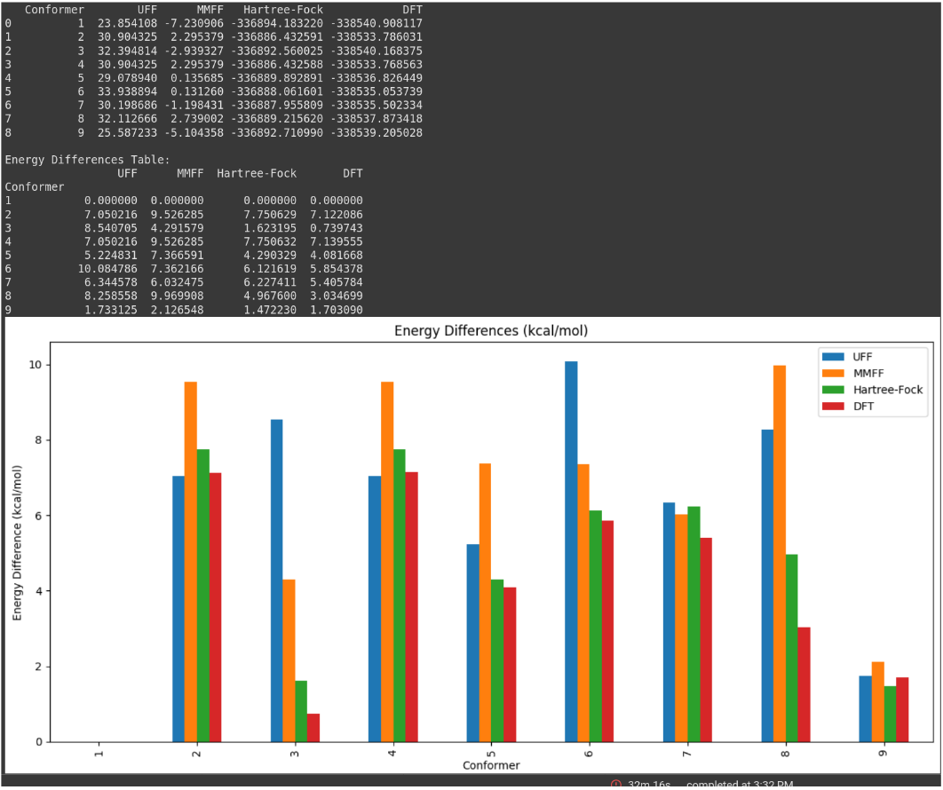
Energy Calculations and Method Comparison
C(O)(C)1CC(C)(O)CC(C)O1
The graph depicts the energy differences for nine conformers, calculated using various computational methods.
Method Characteristics :
UFF and MMFF Methods:
Deliver rapid computational results.
Exhibit lower accuracy when compared to Hartree-Fock and Density Functional Theory (DFT) methods.
Hartree-Fock and DFT Methods:
Provide more precise results.
Demand greater computational resources.

Slide 19

Conclusion and Future work
Experimental data alone are insufficient for full conformational coverage
Combining RDKit + PySCF provides a theoretically sound augmentation
Bayesian framework will allow for proper integration of uncertainty
Aim is to improve reliability the PDB entries containing small-rings
Future
Apply tools to all ring classes
Derive probability distributions for all classes
Apply derived models in macromolecular atomic model derivations

Slide 20
Acknowledgement
Garib Murshudov (IMBB, MRC-LMB)
Guman Garayev - PROXIMA, Azerbaijan
Fei Long - MRC-LMB, Cambridge
IMBB
Kave Babai
Sahib Babaliyev
Humay Mammadli
All colleagues from IMBB

Slide 21

Thank you for your attention :)

