Slide 1

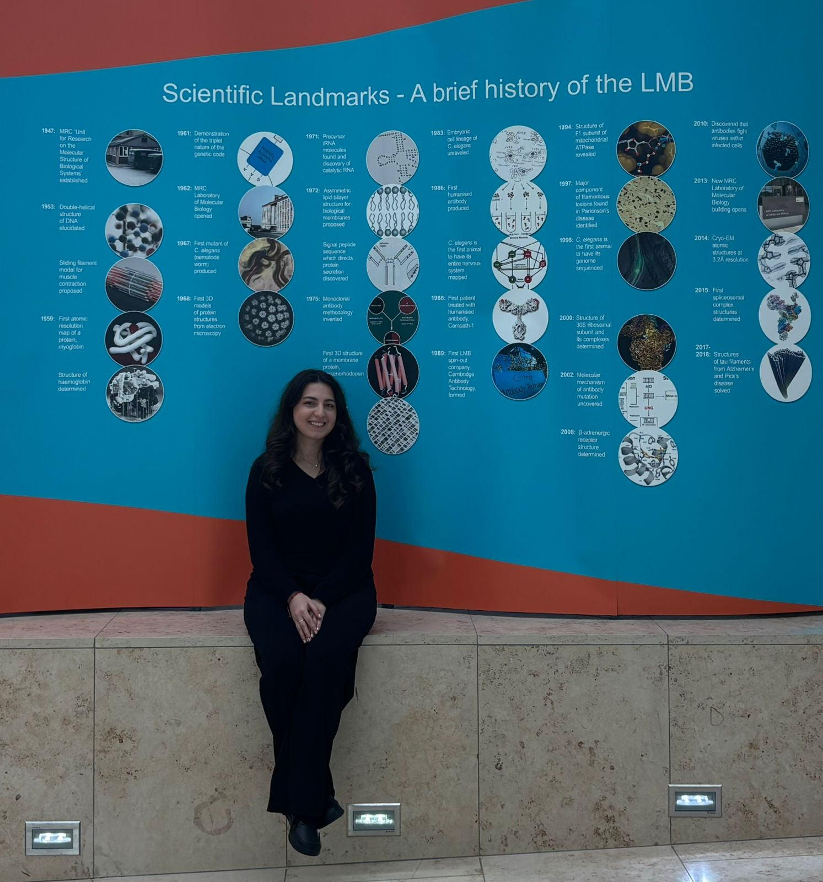
Computational Energy Analysis of Small-Ring Conformations
Lala Ibadullayeva
MSERA IMBB

Slide 2
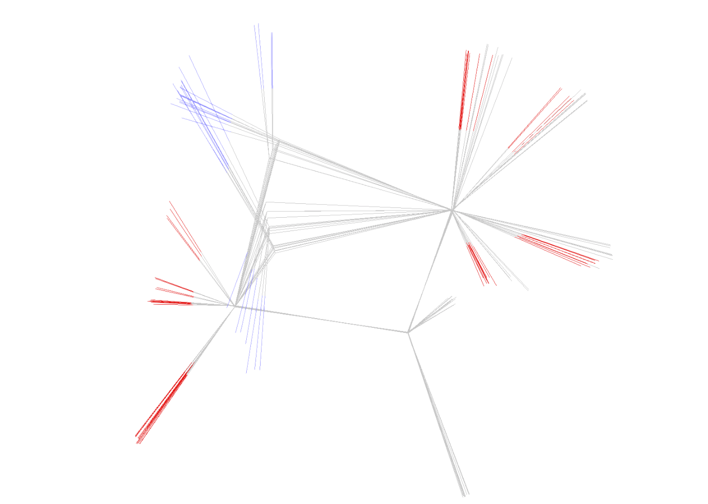
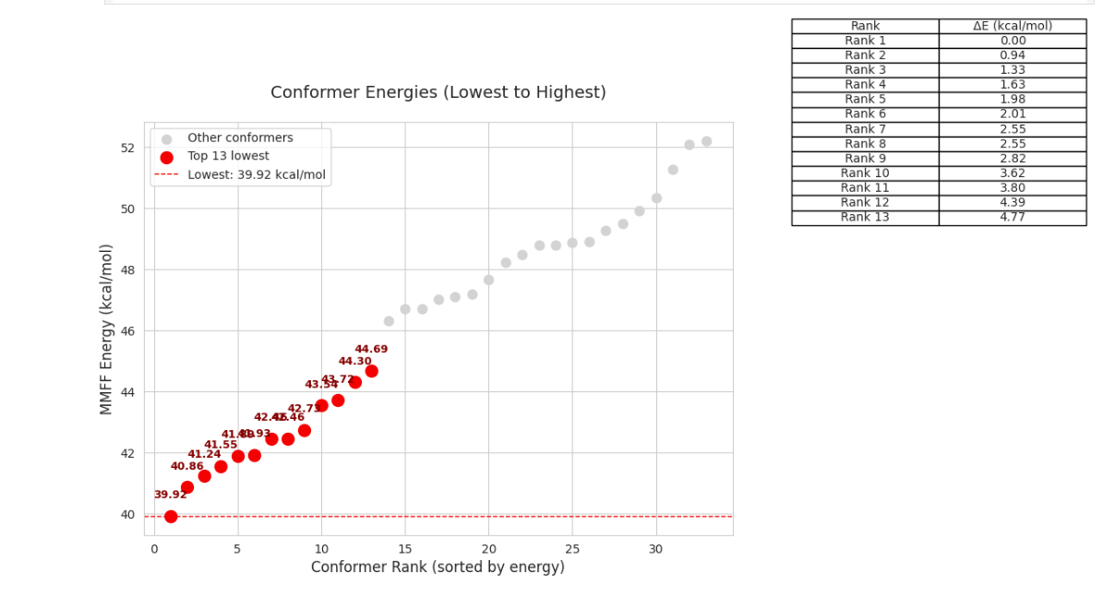


Computational Energy Analysis of Small-Ring Conformations
PROBLEM STATEMENT: Crystallography & Cryo-EM often produce sparse, noisy data, making data-only macromolecular models unreliable.
PROPOSED SOLUTION: Use Bayesian statistics to combine experimental data (likelihood) with existing knowledge (prior), enhancing model reliability. Our work builds the needed statistical priors for small rings.
OUR APPROACH: We developed a framework integrating observational data (COD) with computational simulations (RDKit, PySCF) to classify and analyze small (4-6 membered) ring conformations.
SYSTEM DESIGN:
Ring Selection Criteria: Filtered high-resolution COD structures (~116k rings).
Ring Classification: Categorized rings by atomic connectivity (7600 classes).
Conformer Generation: Created & optimized conformers from SMILES using RDKit.
Energy Evaluation: Computed energies via MMFF/UFF (RdKit) and accurate DFT/HF (PySCF).
Model Integration: Combined observational (COD) and theoretical (simulation) data.
KEY RESULT / WHAT WE FOUND:
Structural overlay of nearly iso-energetic low-energy conformers reveals significant differences in ring puckering and substituent orientation.
The energy ranking plot shows small differences among the lowest-energy conformers, showing multiple accessible states.
APPLICATION / WHO BENEFITS: Enables more accurate macromolecular modeling (PDB validation) containing ligands with small rings, ligand design (carbohydrates, small molecules), and analysis of RNA/DNA structures by providing robust statistical priors.
https://www.linkedin.com/in/lala-ibadullayeva/

