Slide 1
THE HIDDEN GEOMETRY
OF MOLECULES
How statistics reveals the language of structures
Lala Ibadullayeva
Computational Structural Biologist | PhD Candidate | ML & Bioinformatics Research
AI & Science Forum 2026 · Khazar University

Slide 2
My path did not start in technology or STEM
2015
2019–21
2021
2021
2022→
BSU
History / Anthropology
MSc Anthropology
GPA 98 / 100
Age 23 — decision
to switch fields
PhD Biology
highest entry score
Bioinformatics,
biostatistics, coding
Specialist @ BSU · PhD candidate @ Computational Structural Biology · Visiting Researcher, MRC LMB Cambridge

Slide 3
Understanding the conformation of small rings
PhD theme: statistical learning + conformational analysis
Goal — model the 3D behaviour of small-ring systems and build better geometric priors for protein–ligand structures.
Data
COD · PDB · CCD
Methods
Python · R · ML
Tools
RDKit · MDAnalysis · Gemmi · PyMOL · Coot

Slide 4
?
Do molecules arrange
at random - or do they
obey rules?
In this talk we expose the hidden order inside hundreds of real molecules — using statistics, live.

Slide 5
Why proline? The one ring in every protein
The only standard amino acid
whose side chain bonds back to its own
backbone nitrogen - forming a rigid
5-membered pyrrolidine ring.
This loop locks the backbone and makes
proline a structural "turn-inducer" - it dictates where chains bend.
N — Cα — Cβ
| |
Cδ ——— Cγ
The pyrrolidine ring of proline

Slide 6
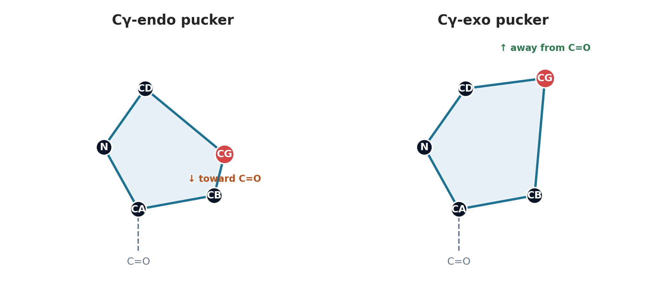
Even a small ring is not flat — it puckers
Proline settles into two envelope shapes - Cγ-endo and Cγ-exo - named by whether the γ-carbon points toward or away from the backbone carbonyl.

Slide 7
Why does ring shape matter?
🧬
Collagen
🛡️
Protein stability & design
Cγ-exo hydroxyproline is essential to the collagen triple helix — the most abundant protein in your body.
Ring pucker biases the backbone; fluoroprolines exploit this to stabilise proteins (e.g. ubiquitin) by pre-organisation.
💊
Drug discovery
📐
Better priors (my PhD work)
Pyrrolidine is a versatile scaffold — pseudorotation offers favourable 3D shapes for exploring pharmacophore space.
The statistical distribution of ring geometry becomes a prior for structure validation and modelling.

Slide 8
Turning a shape into a number
1
Take four consecutive ring atoms → measure the torsion angle
2
Collect all five endocyclic torsions: ν₀ … ν₄
3
Combine them into one pseudorotation phase P + amplitude
4
Altona–Sundaralingam (1972) : pure geometry, no AI
Phase P answers "which pucker" · amplitude answers "how puckered"

Slide 9
The data: Protein Data Bank
230 000+
Free
Global
experimental structures
open to everyone
from labs worldwide
A student in Baku has the same access as a professor at Harvard.

Slide 10
My open-source tool: gemmimol-notebook
An interactive macromolecular structure and electron-density viewer for Jupyter and Google Colab, powered by GemmiMol.
Open any PDB, COD, or CCD entry — or a local file — in a 3D viewer that shows the model together with its electron-density map, right inside a notebook cell.
No downloads, no Coot, no setup beyond a single import. Released under the MIT license on GitHub.
github.com/Lala2398/gemmimol-notebook

Slide 11
The pipeline — all open-source
Fetch
Pull structures from the PDB
Gemmi
Extract
Find every proline ring automatically
Gemmi / RDKit
Measure
Five torsions → phase P + amplitude
NumPy
Analyse
Distribution, clusters, anomalies
pandas · seaborn
Data sources: PDB · COD (Crystallography Open Database) · CCD

Slide 12
Live demo : what we'll do now
1
Pull several real protein structures from the PDB
2
Find every proline ring in each structure
3
Compute five torsion angles per ring
4
Reduce each to one pseudorotation phase (P)
5
Plot the distribution across hundreds of rings
6
Flag anomalies with a statistical z-score
Python · Gemmi · NumPy · Matplotlib

Slide 13
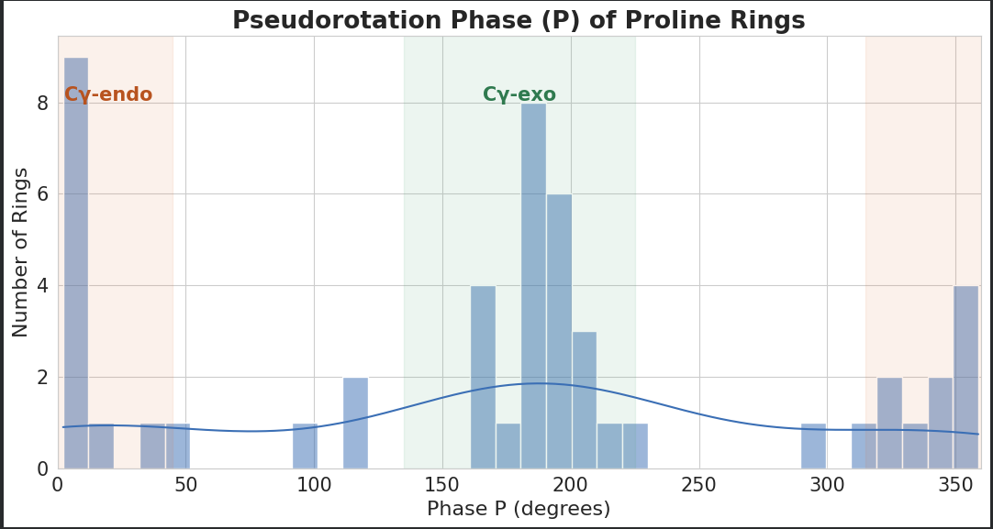
Result 1 — the distribution
What it shows
50 independent rings collapse onto two preferred conformations.
Why we plot it
To discover the preferred states directly from data - no assumptions. This bimodality IS the statistical law.
≈ 46% Cγ-exo · 46% Cγ-endo · 8% intermediate

Slide 14
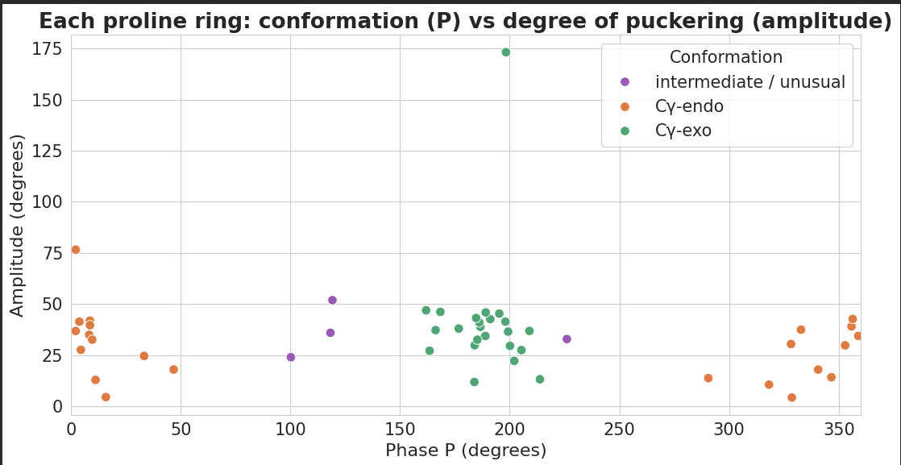
Result 2 — the conformational landscape
Two axes
Phase = which pucker. Amplitude = how puckered.
Why we plot it
Tight clusters are the normal states; scattered points are anomaly candidates. The 2D view separates shape from degree.
Each point is one real proline ring from a real structure.

Slide 15
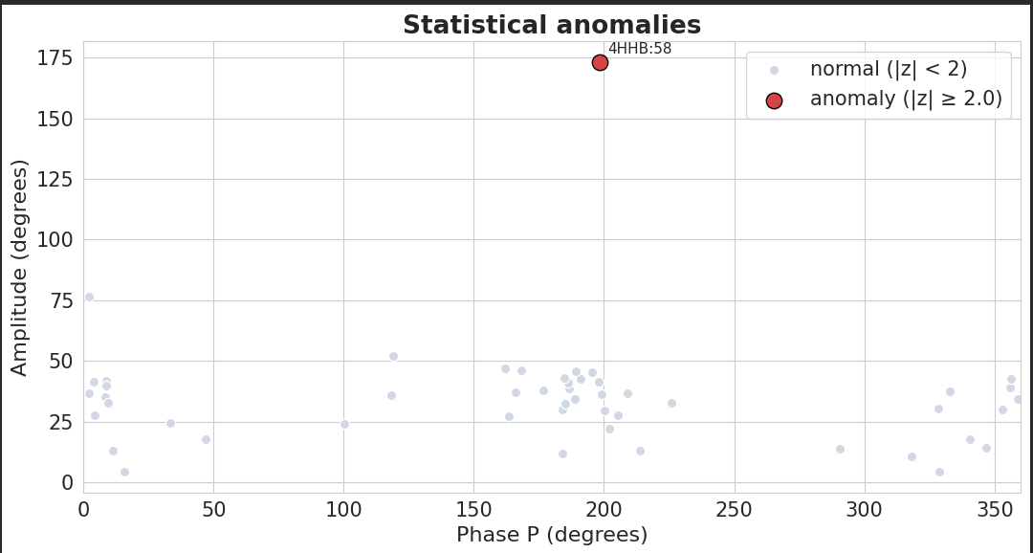
Result 3 — hunting anomalies
What it shows
z-score flags rings far from the mean - e.g. 4HHB:58, a ring with an impossibly high amplitude (a disordered ring).
Why it matters
Once statistics defines "normal," deviation becomes a measurable signal - the basis of validation.
The real scientific question begins here: biological strain · crystal artefact · refinement error?

Slide 16
What this means for you
Data
Tools
Curiosity
PDB, COD, CCD — all free
Python, Gemmi, NumPy — all free
the only thing you truly need
The best discoveries happen where fields meet — statistics is the language we all share.

Slide 17

Free data.
Free tools.
Curiosity.
Statistics does the rest.
Lala Ibadullayeva
github.com/Lala2398
Thank you — questions welcome.

