Slide 1

QUALITY OF PROTEIN MODELS
Lala Ibadullayeva
Azerbaijani
MSERA IMBB
AZERBAIJAN

Slide 2
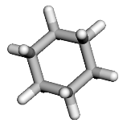
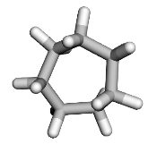
LALA IBADULLAYEVA
BREAKING THE WALL OF QUALITY OF PROTEIN MODELS
Main 3D structure methods (macromolecular crystallography, cryo-electron microscopy) yield sparse, noisy data.
Bayesian statistics produces reliable model by combining observation and prior knowledge.
Challenge: Create probability distributions for multimodal, environment-dependent conformation angles in small rings, considering ring closure constraints.
Now
COD
Data Processing
Ring classes
Simulations
Application to the PDB
Future

Slide 3
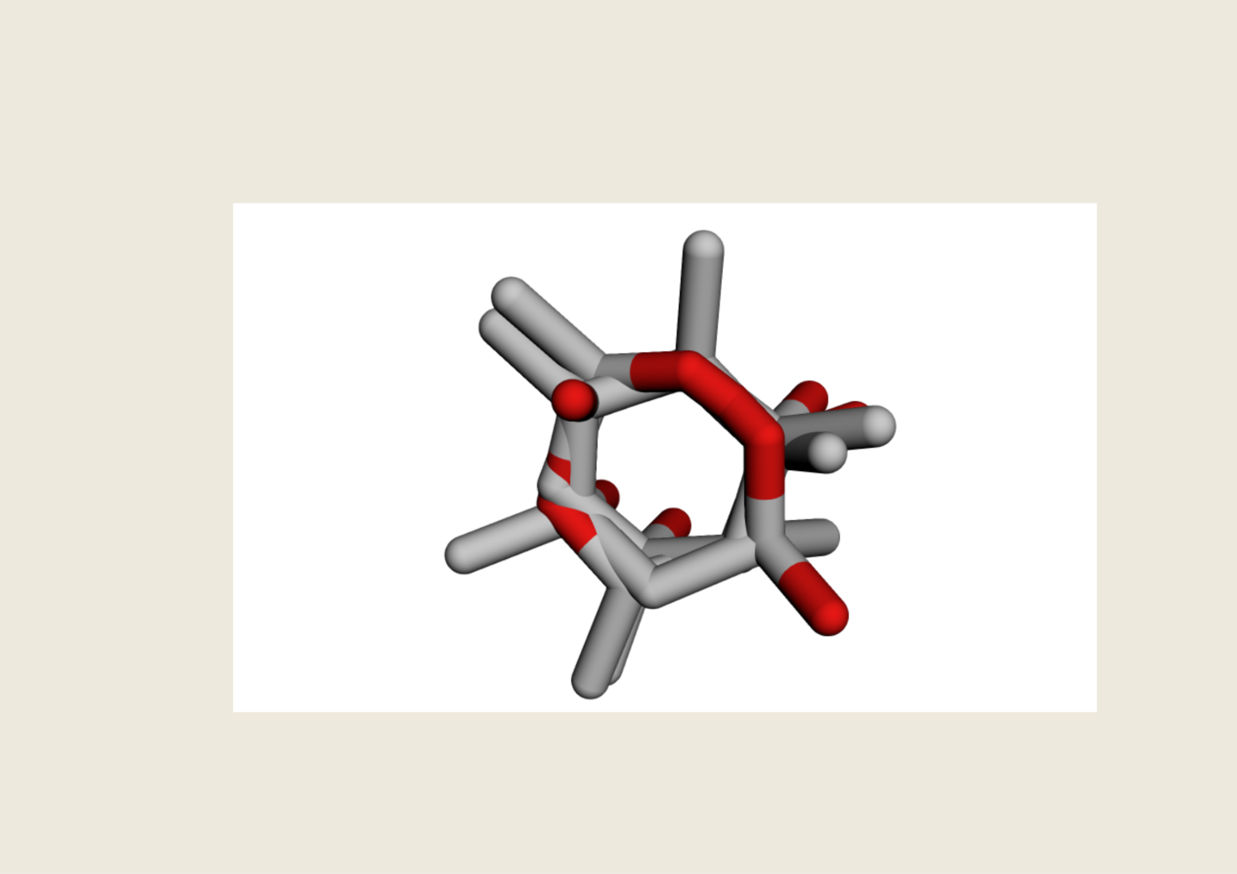
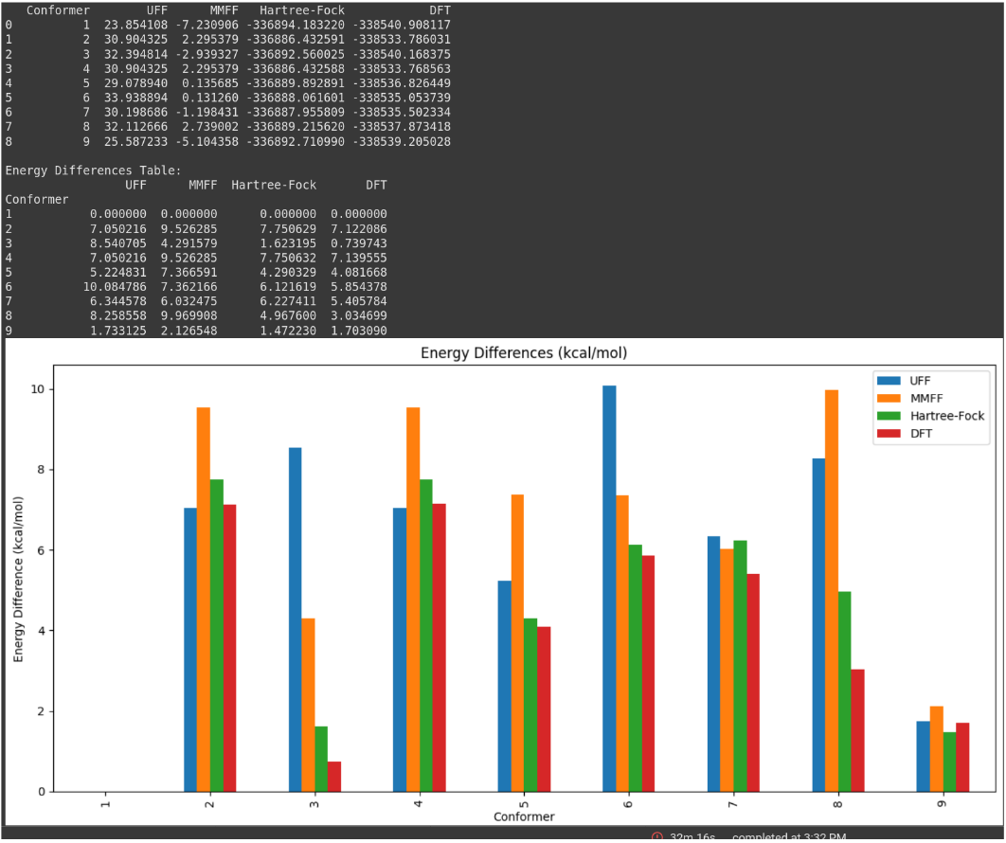
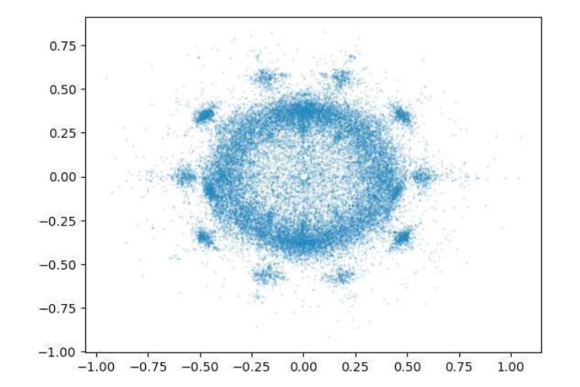
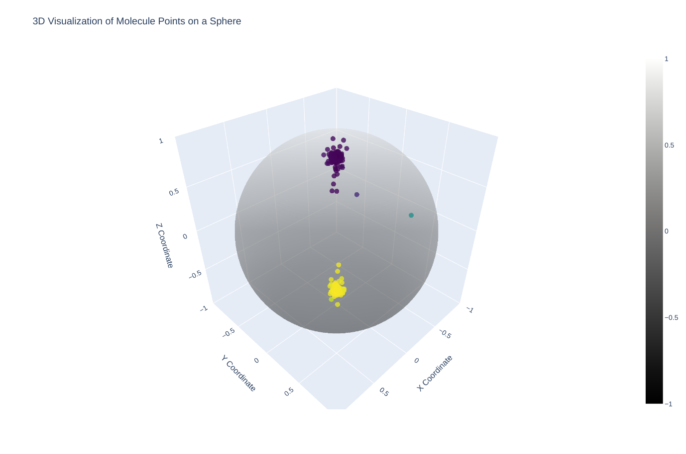
LALA IBADULLAYEVA
BREAKING THE WALL OF QUALITY OF PROTEIN MODELS
Methods: Extract, classify and organise all ring classes from the COD
Simulate conformations and calculate energies for all ring conformation using Computational Chemistry
Results: 523,000 COD structures yielded 126,000 reliable ring substructures, with 7,600 ring classes. Developing tools for simulations using RDKit and PySCF.
Conclusion: Combining experimental data with simulations aids in designing multimodal probability distributions, potentially enhancing Protein Data Bank entry reliability.

