Slide 1

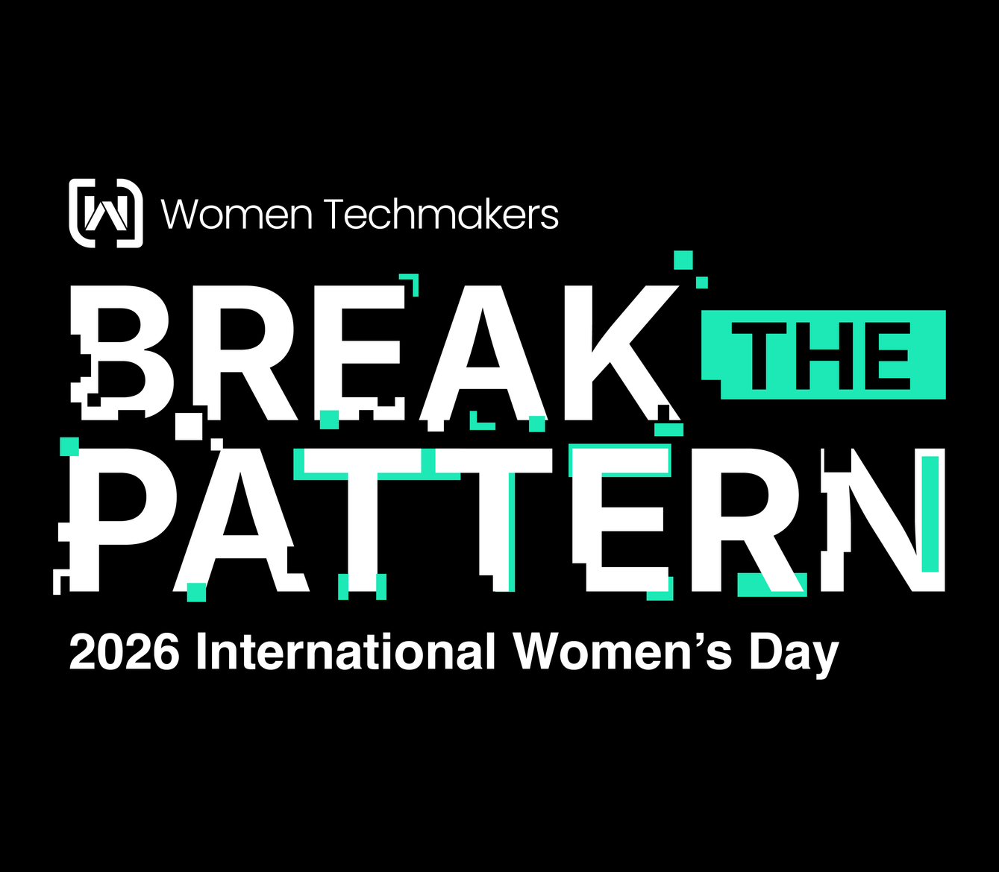

Slide 2
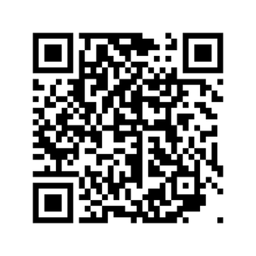
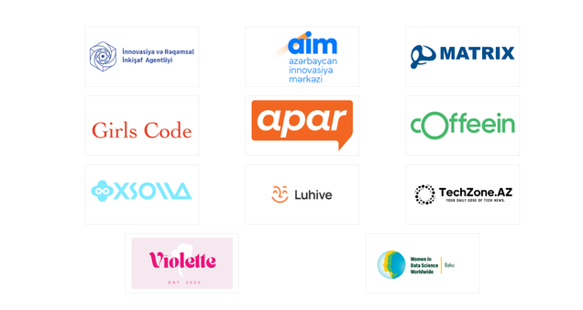

9:00 AM : Registration
10:00 AM : Opening Ceremony : Lala Ibadullayeva - WTM Ambassador | Nigar Humbatova - HR Project Coordinator (Xsolla) | Humay Mirzayeva - GirlsCode project Coordinator | Pari Abbasli - Content & Communications Strategist (Violette).
10:30 AM : Khanim Bahman : Break the Pattern with Open Data Turning open data from a showcase into practical power—real use cases, real impact
11:00 AM : Lala Mammadova : Why Good Analytics Fails Without Good Engineering
11:30 AM : Khayala Mammadova : AI Operating Models: A Framework for Structural Governance in Finance
11:45 AM : Nazrin Abbasli : AI and Automation in Aviation Sector
12:15 PM : Humay Almasova : Data Analytics and Vizualization: Making Data Speak
12:45 PM : Break : Lunch break and Networking
1:30 PM : Jamila Garayeva : From Numbers to Decisions: Role of Data in Business
2:00 PM : Khanim Pashayeva : Modern Frontend: Engineering Decisions with Real Impact
2:30 PM : Fidan Ahmadli : Intelligent Automation : From manual to AI autonomous
3:00 PM : Sitara Aghayeva : Model Performance Assesment from Ethics and Risk Perspective
Agenda
Linkedin Page :
Partners :

Slide 3
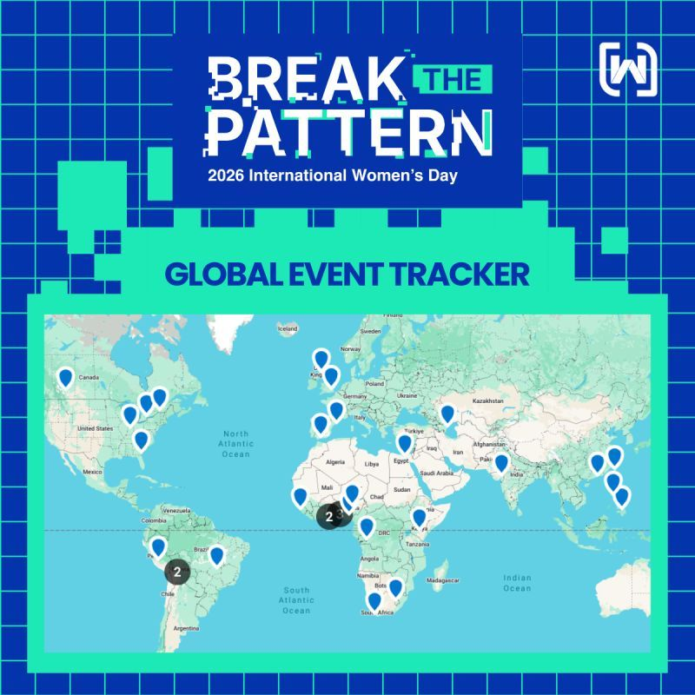
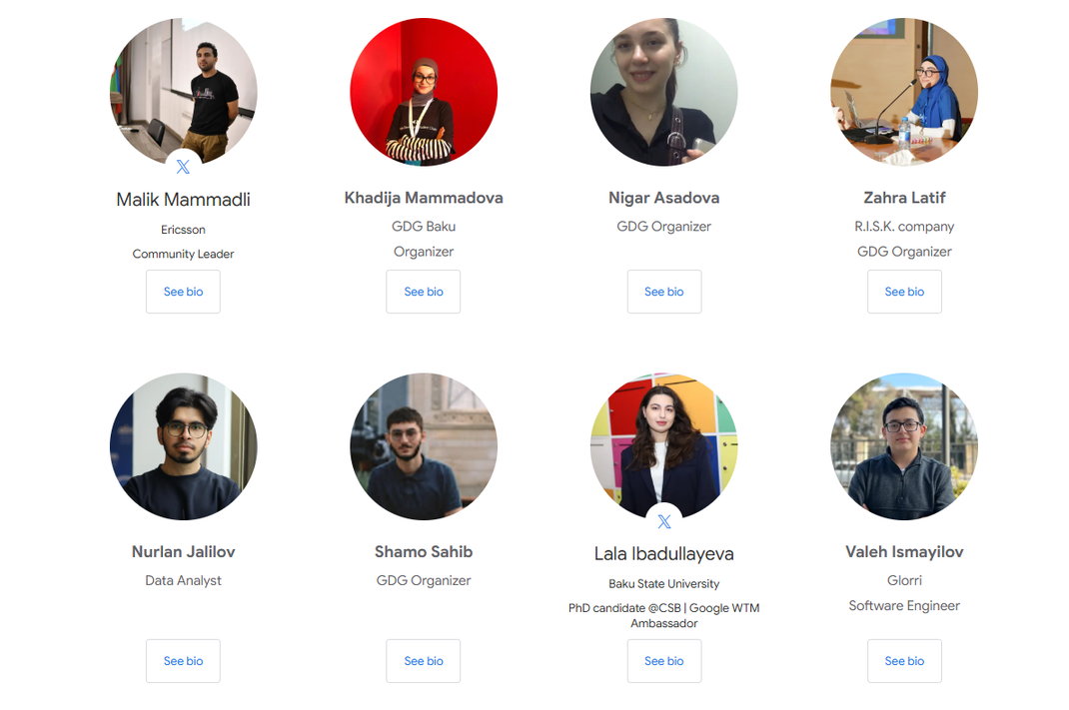
IWD 2026 Organizers

Slide 4
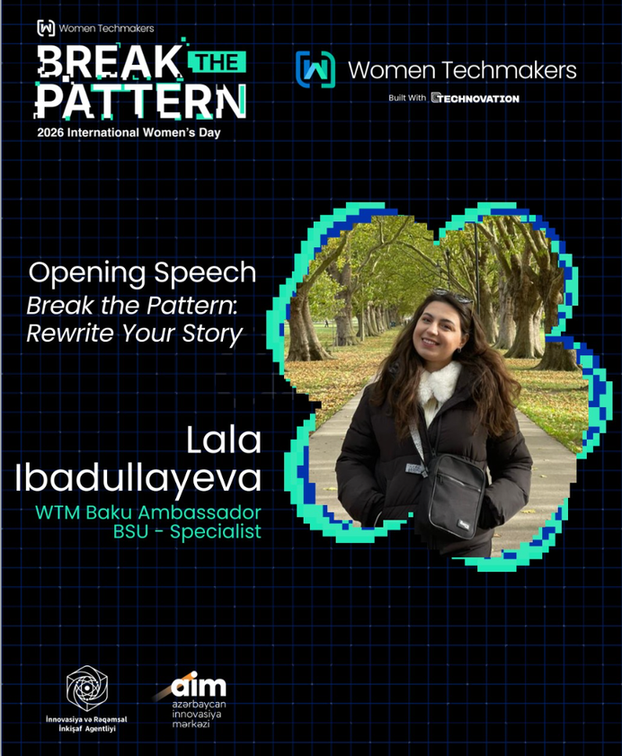
Why I became a Women Techmakers Ambassador
My journey started far from tech :
2015 – Started my education in Social Sciences (History faculty, even Anthropology)
2021 - Completed my Master's degree with higher GPA
At age 23, I made a life-changing decision : To leave my field
To start again in science and technology
2021 – Accepted to a PhD program in Biology with the highest admission score
The same year I started exploring programming
Began studying: Started taking structured notes from technical courses especially in Bioinformatics and Biostatistics

Slide 5


“This field is not for you”
Break the Pattern : Rewrite your story
Starting from zero
Learning everything from scratch
Proving myself again
“You will not succeed here”

Slide 6
The opportunity that changed my style
2022 - I discovered the WTM Ambassador Program
It felt different because:
I saw many women with stories similar to mine
Women who also changed careers
Women who refused to give up
I understood I could:
Share my story with more women
Support others going through similar struggles
Build something bigger than my own journey
Because sometimes your story is not just about you,
it becomes a path for others too.

Slide 7

Finding my second family in tech : GDG Baku
Late 2022 – I met what would become my second family
A community of people who believed in growth and support
Today, they are some of my closest friends
My first real Tech community experience
DevFest 2022 was approaching
A new organizing team was being formed
Malik brought everyone together and invited me as a WTM Ambassador
What I learned : The best feeling is realizing
You are not alone in your journey
You can create value even as a beginner
Community can change your confidence

Slide 8
International Women’s Day events journey
Event themes by years:
2024 – Impact the Future
2025 – Redefine Possible
2026 – Break the Patterns
Since 2024 International Women’s Day (IWD) events have been organized onsite in Baku
Each year, stronger voices
Each year, bigger impact

Slide 9

The most important lesson we learned in these years :
Never stop
Try to improve yourself a little every single day
Consistency is more powerful than talent
The reality many women face
Some people may say:
"You can't do it"
"This field is not for you"
Especially in environments dominated by:
Men
Senior authorities
Traditional mindsets

Slide 10
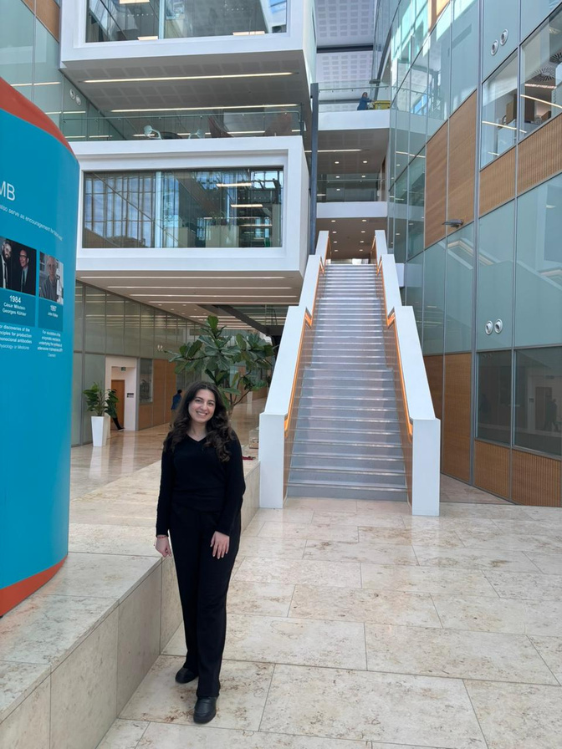
But what happens if you don't stop?
One day:
The same people who doubted you will respect you
They will shake your hand
They will say they are proud of you
So never stop, because your future success
might already be watching you work today.

Slide 11
Why WTM matters to me
I became a WTM Ambassador because I want to
Show women that career change is possible
Build supportive tech communities
Help women believe in their potential
Break the invisible barriers in tech
But the truth is :
The right people will find you
The people who truly see your value will say :
"You are capable"
Because sometimes one belief can change someone's entire life path

Slide 12
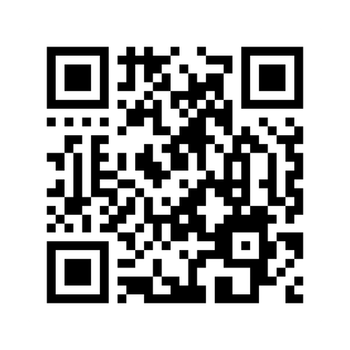
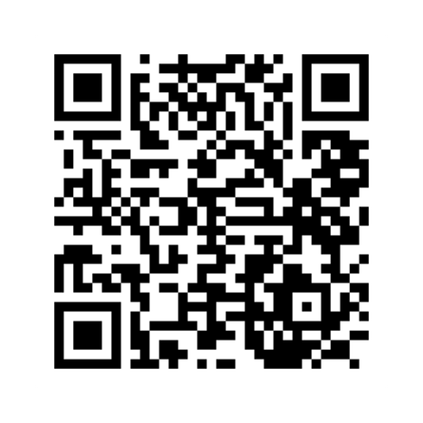
Instagram of WTM Baku :
About of me :
Thank you for joining us <3
We wait for your new stories, be brave :)

