Slide 1
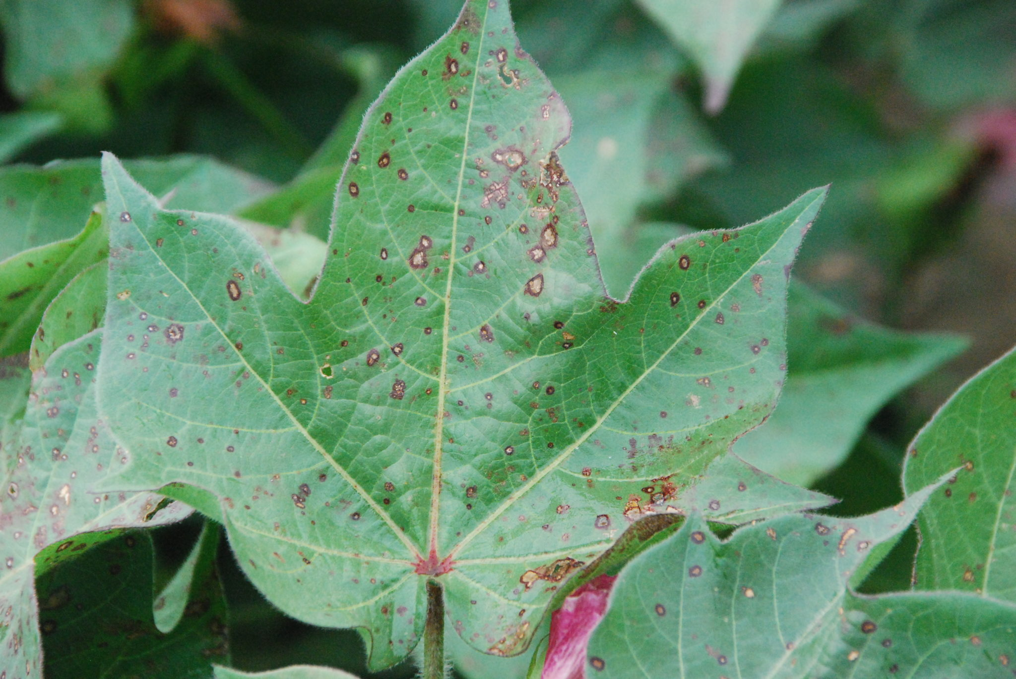
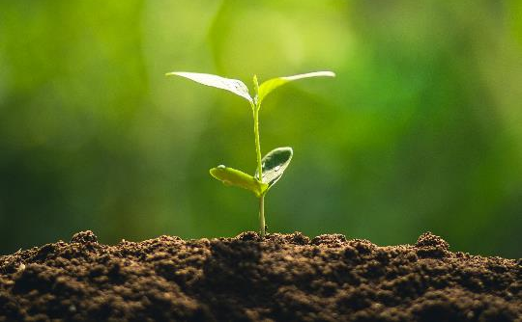
Project Plante

Slide 2
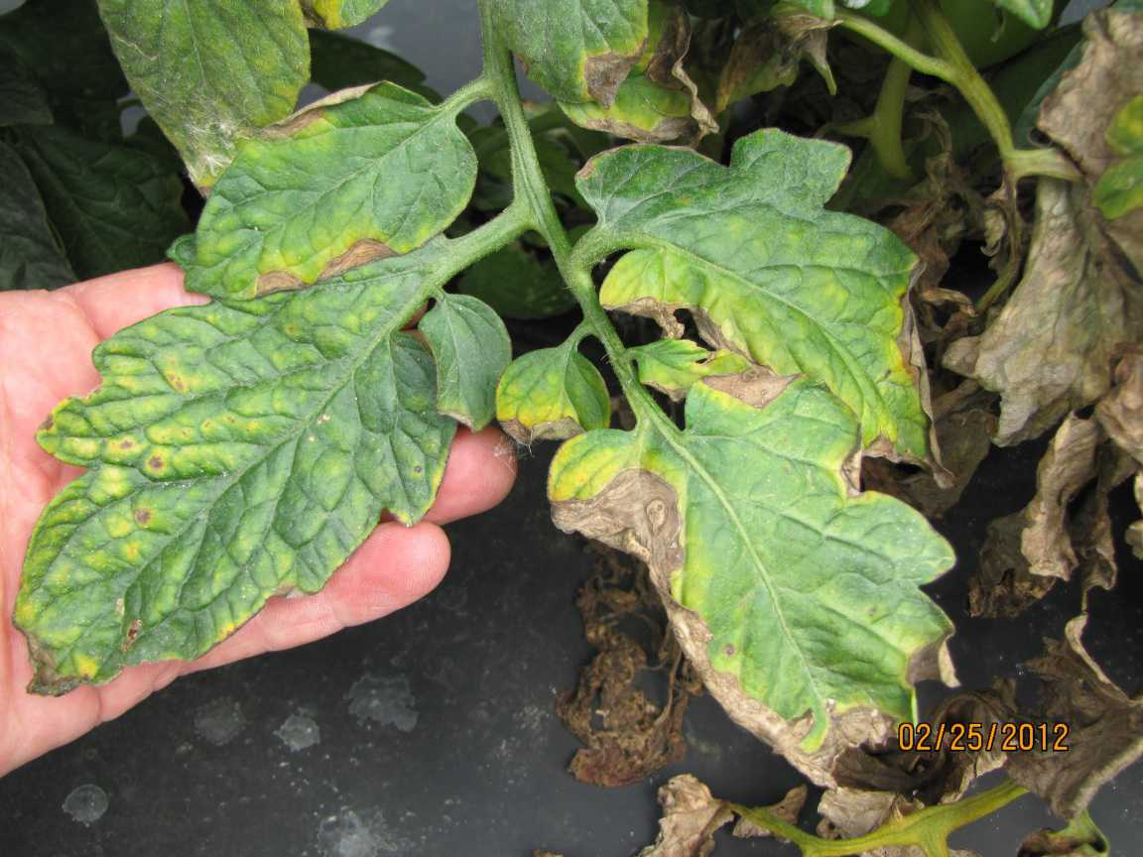
planting is something we should encourage our society to do.
Plant diseases are a common problem for anyone who loves to plant.
especially if they are not experienced in gardening they don't know how to identify or what to do when they are having plant diseases.

Slide 3
How to identify plant diseases using computer vision, and help inexperienced people to overcome plant diseases through mobile and web application development

Slide 4
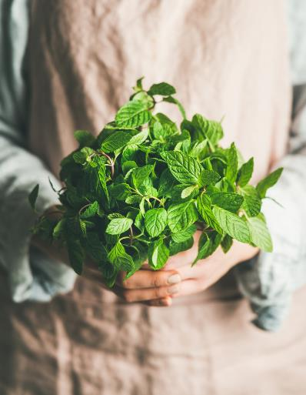
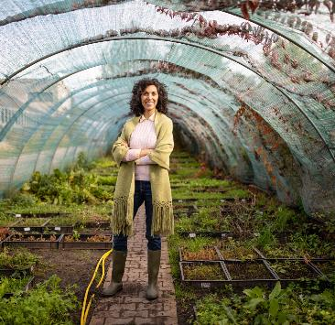
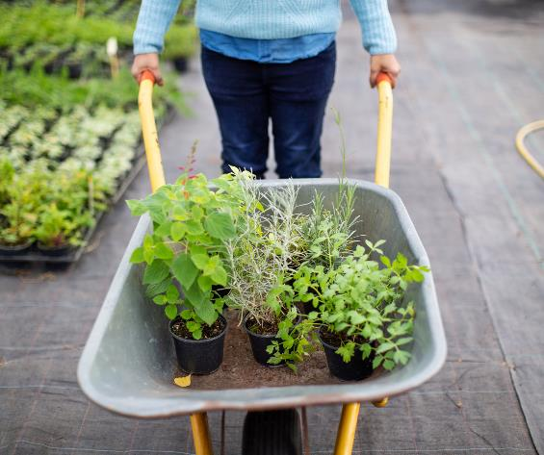
Project description
In this project, I am planning to make a mobile application. Which allow users to take pictures of the affected area of the plant (leaf) using the device camera or gallery. Deep neural networks will use to predict whether that particular plant has diseases or not. if it's having a disease we will use it to identify the disease.(using TensorFlow lite)
Once we identify the disease, we will recommend a solution for users such as treatments and products which they can use. if we could not identify the disease by using classification model, we will let the expert handle the problem using our web application.

Slide 5
Since collecting image Datasets can take years of the time period, in this project I am planning to use plant village Dataset but with time we can collect image data from users for further development of this project.

Slide 6



Web

Slide 7

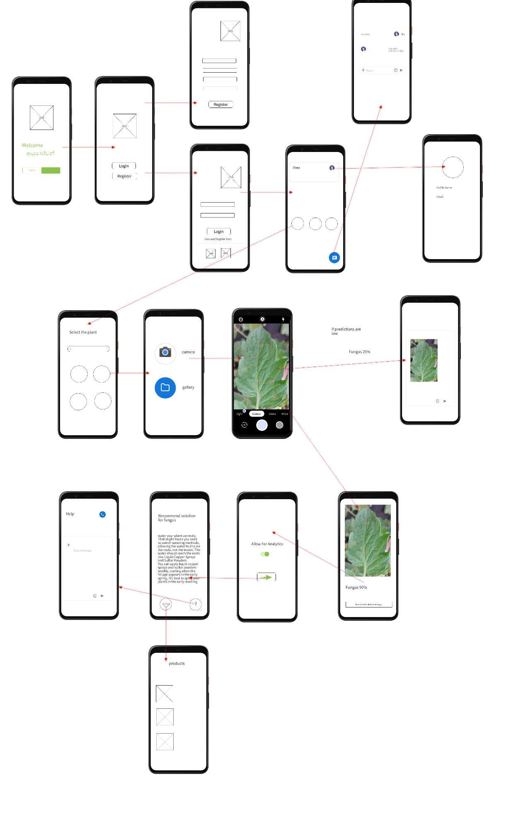

Slide 8

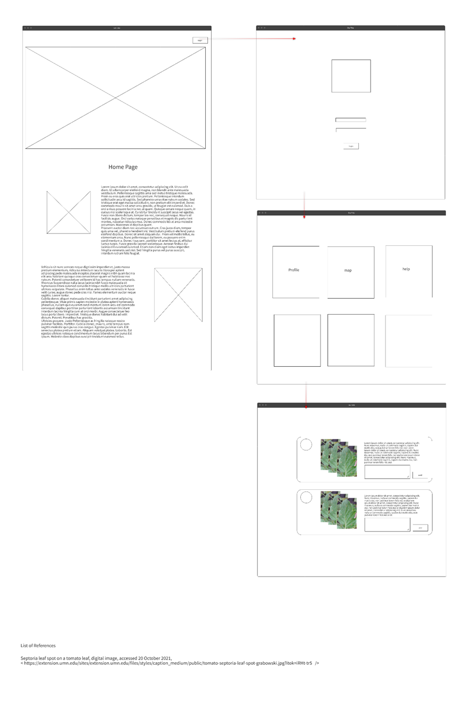

Slide 9
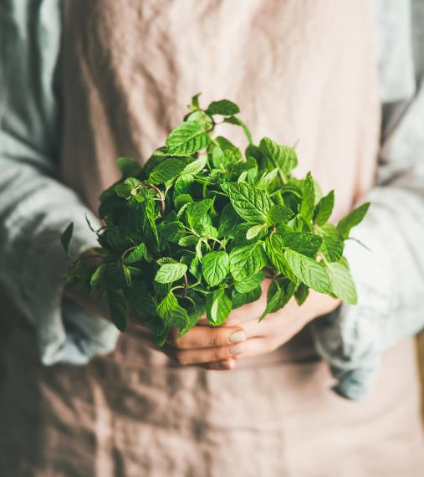
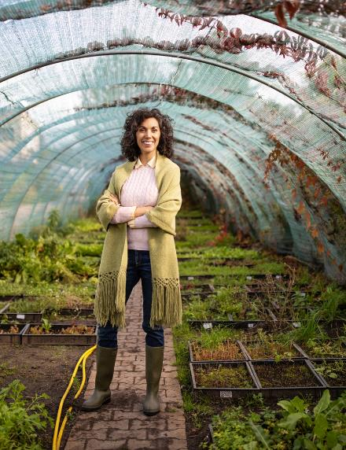
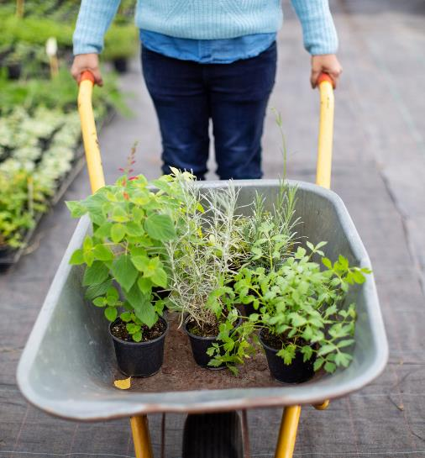
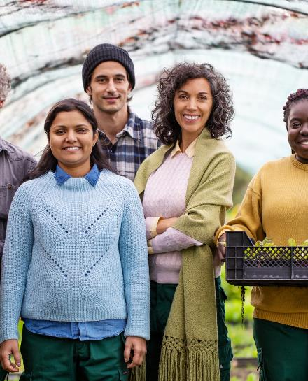
Thank You
-lalindu Wenasara Sudasingha-

