Slide 1

DEMOCRATIZING DANCE
Auto tune For Dancing - "Not Just Imagine, Create Your Own Dance Video Like A Professional".
Submitted By:
Abhinav Verma (9917103251)- F8
Neha Agarwal (9917103254)- F8
Lalit Garg (9917103126)- F4
Submitted To:
Mr. Raju Pal
Dr. Swati Gupta
Dr. Shilesh
JAYPEE INSTITUTE OF INFORMATION ND TECHNOLOGY SECTOR 128, NOIDA.
Department Of Computer Science And Engineering

Slide 2
Problem Statement
Our motive is to contribute a model to transfer the sequences of motion or poses from the source video to the target video. We no longer need to train an unprofessional person to perform highly skill required motion like Dance, Action scenes which is an expensive and time consuming process with no certainty of the expected result. Democratizing Dance is like auto tuning for dancing, we no longer need a crew of 100 professional dancers to create a dance video which can be really expensive. We can create our own background
dancers virtually with this model really cheaply.

Slide 3
State of the art and their limitations
Democratizing Dance is like auto tuning for dancing, we no longer need a crew of 100 professional dancers to create a dance video which can be really expensive. We can create our own background dancers virtually with this model really cheaply. Our motive is to contribute a model to transfer the sequences of motion or poses from the source video
We no longer need to train an unprofessional person to perform highly skill required motion like Dance, Action scenes which is an expensive and time consuming process with no certainty of the
expected result. We approach this problem as video to video translation using pose as an intermediate representation.

Slide 4
To transfer the motion, we extract poses from the source subject and apply the learned pose to appearance mapping to generate the target subject, using Pix2Pix GAN Deep Convolution Generative Adversarial Network, whose output would be transposed frame of the target video or the desired output. which will we converted into video's using continuous sequence of frames.

Slide 5
LIMITATIONS
We have achieved a level where pose of source person and objects in its surrounding is converted to target person's video clearly. Although we suffer at some points as well while focusing on great detailing we are not able rectify texture or crease on the clothes. Face of the target person is still not clear as desired not all materialistic things can be transposed like metal objects. However, our model is able to generalize to new motions fairly well from the training data. When filming a target sequence, we have no specific source motion in mind and do not require the target subject performing similar motions to any source, which means after training for one target only once, we can frame multiple video's of the target person irrespective of the source video. Also the video should acheive the equirement to create dataset.

Slide 6
OBJECTIVES AND WORK DISTRIBUTION
The main objective is to transfer motion between a variety of video subjects without the need for an
expensive 3D or motion capture data and to create a reasonable long videos of a target person enacting the
same sequence of movements as given in an input video of the source subject thus enabling our model to
perform an image to image translation between two subjects. And than this translated image is further used to produce target video enacting the source person.

Slide 7
Initially, we explored the Research papers, journals, blogs and studied the proposed strategies thoroughly. We also determined the software and hardware requirements needed for the entire project. Next, all the software requirements were installed to make our system compatible with our model used in the project.
We implemented a Pyopenpose library to obtain the pose coordinates and than to create pose stick figures of the corresponding frames of the source video.
Now the obtained pose stick figure and its respective frame is feeded into pix2pix GAN as an input and trains to map pose stick figure with respective frame inorder to obtain target person frame from source video pose stick figure .

Slide 8
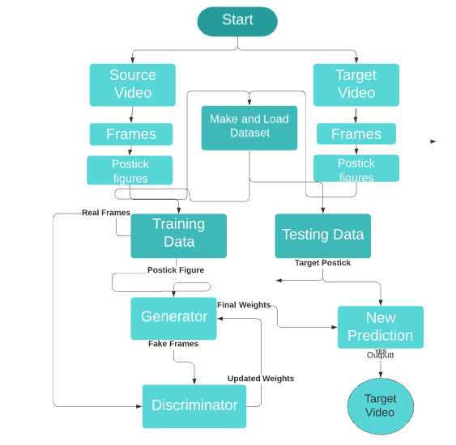
PROPOSED DESIGN AND IMPLEMENTATION

Slide 9
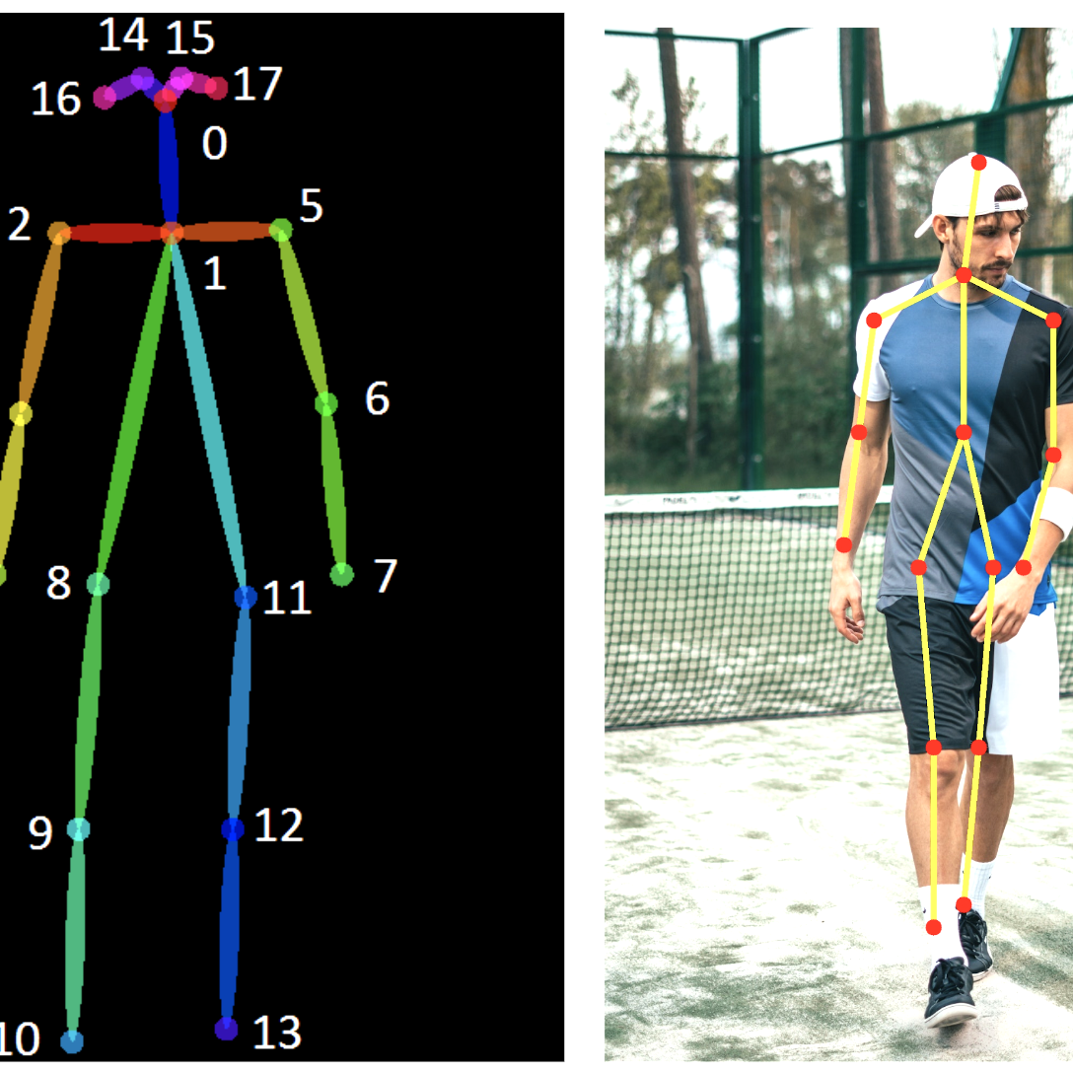
Pose Estimation
To encode the body pose of a subject image, we use a pre-trained pose detector P (OpenPose [6, 34, 43]) which accurately estimates 2D x, y joint coordinates. We then create a colored pose stick figure by plotting the keypoints and drawing lines between connected joints. Using tensorflow Posenet model, coordinate of pose matrix is obtained of dimension of [17,2] containing x,y coordinates of the 17 important keypoints.
0 nose, 1 leftEye, 2 rightEye, 3 leftEar, 4 rightEar, 5 leftShoulder,6 rightShoulder, 7 leftElbow, 8 rightElbow,9 letWrist, 10 rightWrist, 11 leftHip, 12 rightHip,13 leftKnee,14 rightKnee,15 leftAnkle,16 rightAnkle.

Slide 10
POSE NORMALIZATION
In different videos, subjects may have different limb proportions or stand closer or farther to the camera than one another. Therefore when retargeting motion between two subjects, it may be necessary to transform the pose key points of the source person
so that they appear in accordance with the target person’s
body shape and location as. We find this transformation by analyzing the heights and ankle positions for the poses of each subject and use a
linear mapping between the closest and farthest ankle positions in both videos. After gathering these positions, we
calculate the scale and translation for each frame based on
its corresponding pose detection

Slide 11
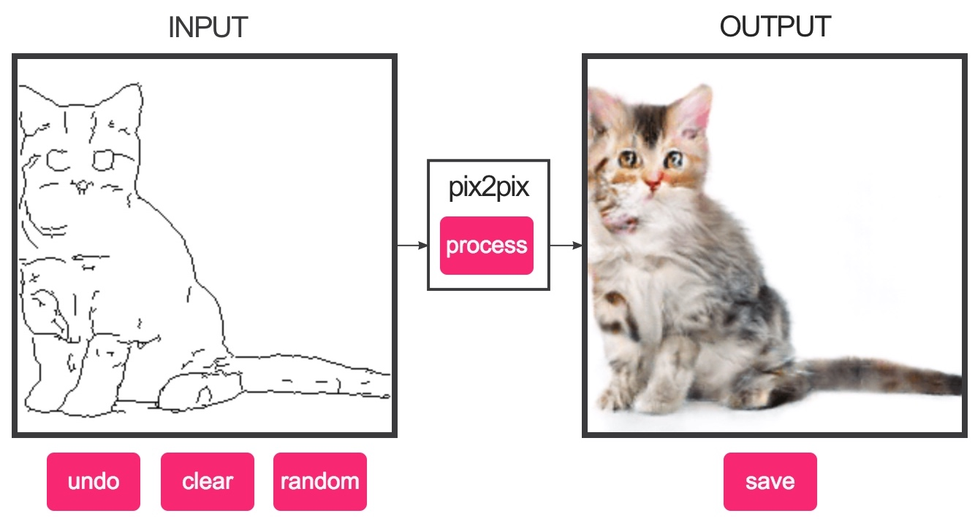
TRAINING PIX2PIX GAN MODEL

Slide 12
The discriminator model is trained directly on real and generated images, whereas the generator model is not.Instead, the generator model is trained via the discriminator model. It is updated to minimize the loss predicted by the discriminator for generated images marked as “real”. As such, it is encouraged to generate more real images. The generator is also updated to minimize the L1 loss or mean absolute error between the generated image and the target image
Each training step involves first selecting a batch of real examples, then using the generator to generate a batch of matching fake samples using the real source images. The discriminator is then updated with the batch of real images and then fake images Next, the generator model is updated providing the real source images as input and providing class labels of 1 (real) and the real target images as the expected outputs of the model required for calculating loss. The generator has two loss scores as well as the weighted sum score is returned. We are only interested in the weighted sum score (the first value returned) as it is used to update the model weights

Slide 13
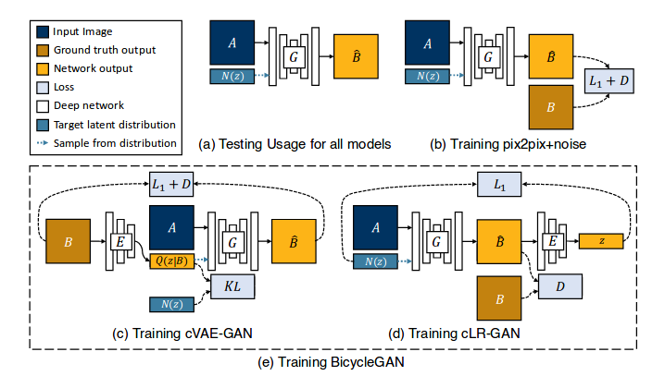

Slide 14
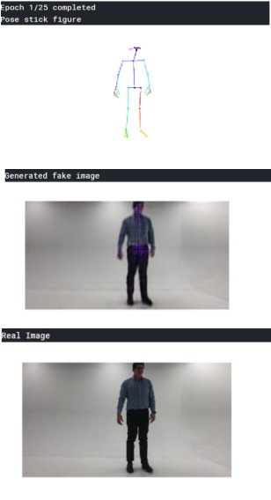
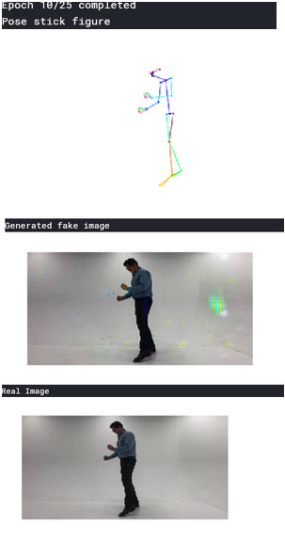
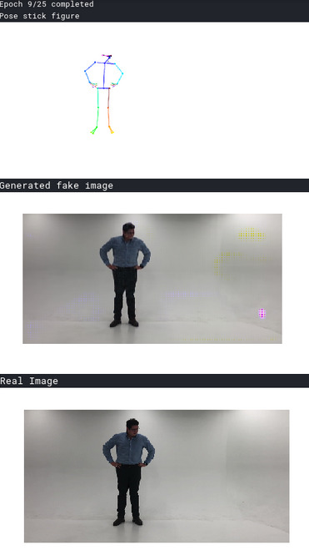
RESULT AND ANALYSIS

Slide 15
CONCLUSION
Overall we concluded that our relatively simple GAN model is able to create arbitrary long and good quality video of the target person as per the source dance pose movement. We have achieved a level where pose of source person and objects in its surrounding is converted to target person's video clearly. Although we suffer at some points as well while focusing on great detailing we are not able rectify texture or crease on the clothes. Face of the target person is still not clear as desired not all materialistic things can be transposed like metal objects. However, our model is able to generalize to new motions fairly well from the training data. When filming a target sequence, we have no specific source motion in mind and do not require the target subject performing similar motions to any source, which means after training for one target only once, we can frame multiple video's of the target person irrespective of the source video.

Slide 16
FUTURE SCOPE
Till now we can only synthesis video's containing only one source and one target person, but in future we can work on multiple person source and target video's, which can create an whole new tool to synthesis video for fun and media industry. Scope of this project cover’s media industry
Movie’s Studio.
Advertising Campaigns
Democratizing spin and twirl.
Music studios.
Snap chat Filters for Fun.
In Augmented Reality for creating 3D dancing model.

