Slide 1

Problem Statement – KPI’s Requirement
We need to analyze key indicators for our pizza sales data to gain insights into our business performance.
1. Total Revenue: The sum of the total price of all pizza orders.
2. Average Order Value: The average amount spent per order, calculated by dividing the total revenue by the total number of orders.
3. Total Pizzas Sold: The sum of the quantities of all pizzas sold
4. Total Orders: The total number of orders placed.
5. Average Pizzas Per Order: The average number of pizzas sold per order, calculated by dividing the total number of pizzas sold by the total number of orders.

Slide 2
Problem Statement – Charts Requirement (Part 1)
1. Daily Trend for Total Orders:
Create a bar chart that displays the daily trend of total orders over a specific time period. This chart will help us identify any patterns or fluctuations in order volumes on a daily basis.
2. Monthly Trend for Total Orders:
Create a line chart that illustrates the hourly trend of total orders throughout the day. This chart will allow us to identify peak hours or periods of high order activity.
3. Percentage of Sales by Pizza Category:
Create a pie chart that shows the distribution of sales across different pizza categories. This chart will provide insights into the popularity of various pizza categories and their contribution to overall sales.

Slide 3
Problem Statement – Charts Requirement (Part 2)
4. Percentage of Sales by Pizza Size:
Generate a pie chart that represents the percentage of sales attributed to different pizza sizes. This chart will help us understand customer preferences for pizza sizes and their impact on sales.
5. Total Pizzas Sold by Pizza Category:
Create a funnel chart that presents the total number of pizzas sold for each pizza category. This chart will allow us to compare the sales performance of different pizza categories.
6. Top 5 Best Sellers:
Create a bar chart highlighting the top 5 best-selling pizzas based on the Revenue, Total Quantity, Total Orders. This chart will help us identify the most popular pizza options.
7. Bottom 5 Worst Sellers:
Create a bar chart showcasing the bottom 5 worst-selling pizzas based on the Revenue, Total Quantity, Total Orders. This chart will enable us to identify underperforming or less popular pizza options.

Slide 4
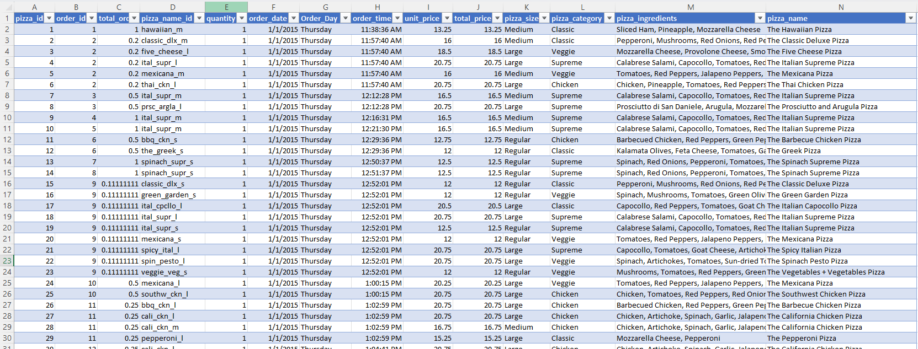
Dataset

Slide 5
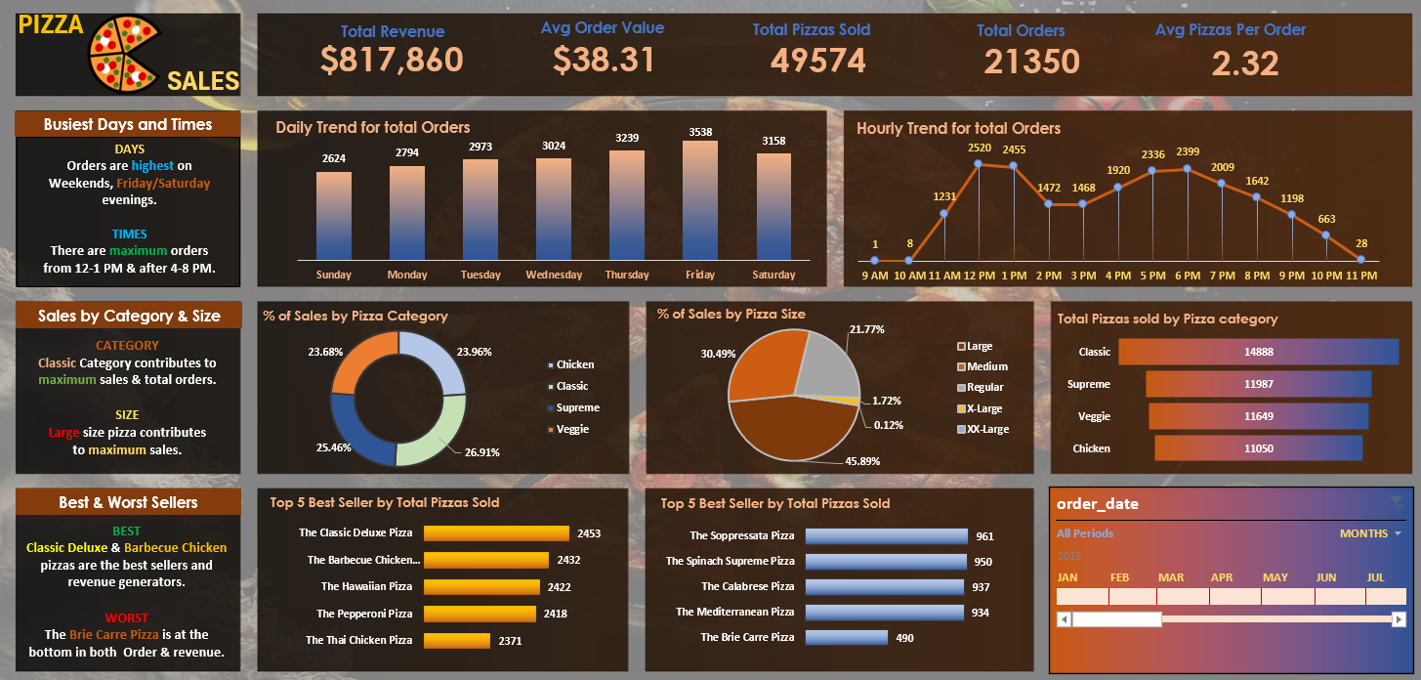
EXCEL Dashboard

Slide 6
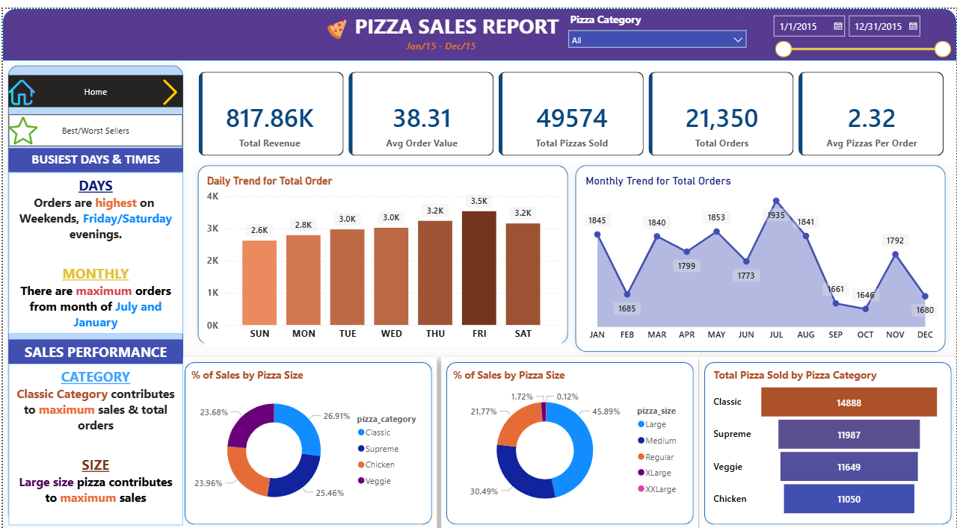
Power BI
1. Home Dashboard

Slide 7
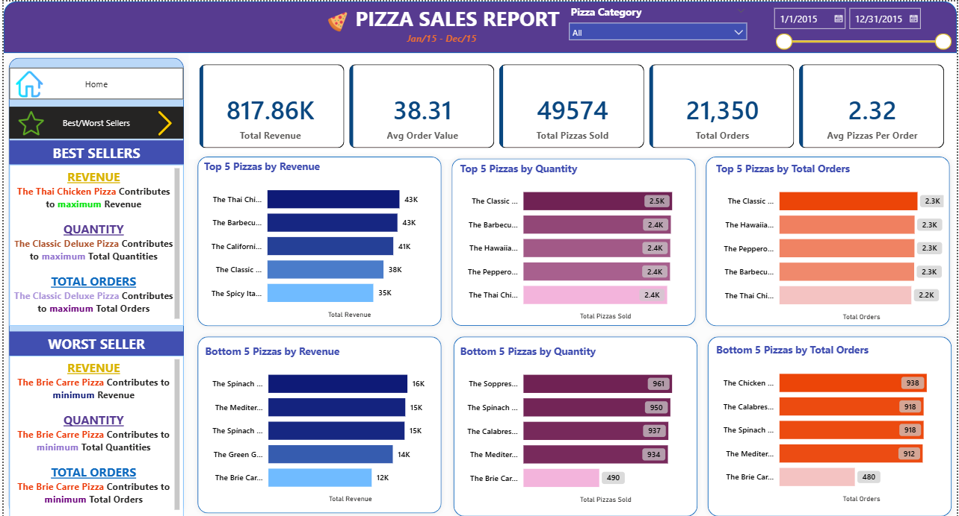
2.Best & Worst Seller

Slide 8
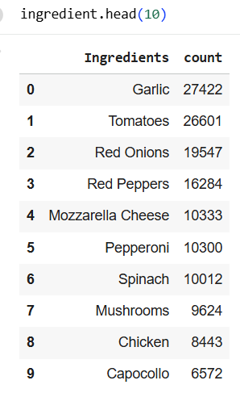
INGREDIENTS
TOP 10 Ingredients in Pizzas

Slide 9
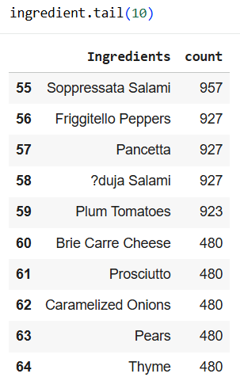
Bottom 10 Ingredients in Pizzas

