Slide 1
Marketing Channel Performance Summary
Key Insights & Recommendations

Slide 2
📊 Performance Highlights
• Channel 2 leads with over 100M Net Room Nights – primary revenue driver.
• Channels 5, 9, and 2 show top shopper engagement (>60%).
• Channel 1 has highest booking conversion (28%) despite low shopper quality.
• Channel 11 shows negative booking conversion – needs investigation.
• Traffic efficiency is highest in Channels 5 and 11.

Slide 3
🔑 Strategic Recommendations
• Prioritize investment in Channels 2 and 1 for volume and conversion strength.
• Investigate operational issues in Channel 11 (data anomalies, user behavior).
• Optimize targeting and UX for low shopper conversion channels (1, 10, 11).
• Scale high-efficiency channels (5, 9) to boost return on marketing spend.
• Explore qualitative factors behind low engagement on Channels 4, 7, 8.

Slide 4
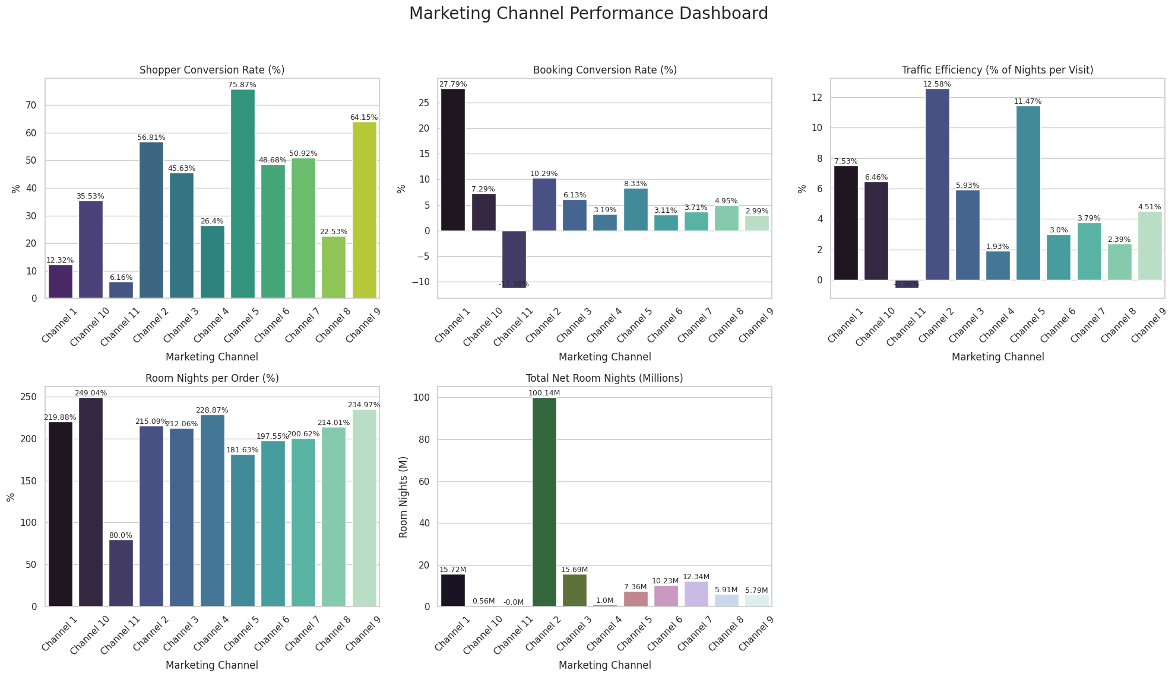
📈 Dashboard Visuals

