Slide 1
HCOM Analytics Insights Case Study
Drivers of Net Room Nights & Key Recommendations
Presented by: [Lalit Anand]

Slide 2
Objective
Analyze drivers of Net Room Nights
Identify marketing, platform, region, and seasonal trends
Recommend actions based on data insights

Slide 3
Data Overview
Simulated CSV dataset provided
Metrics: Visits, Qualified Shoppers, Net Orders, Net Room Nights
Dimensions: Date, Geographic Region, Platform, Marketing Channel

Slide 4
Key Metric Definitions
Metric | Definition
Visits | Total site visits
Qualified Shoppers | Visits with search or property detail viewed
Net Orders | Orders after cancellations
Net Room Nights | Room nights booked minus cancellations
Shopper Conversion Rate | Percentage of visitors who become qualified shoppers.
Booking Conversion Rate | Percentage of qualified shoppers who complete a booking.
Traffic Efficiency | Average number of Room nights booked in a single hotel visit on platform.
Room Nights per Order | Average number of Room nights booked in a single hotel booking.
Bounce Rate | Percentage of Visitors who bounced from platform.

Slide 5
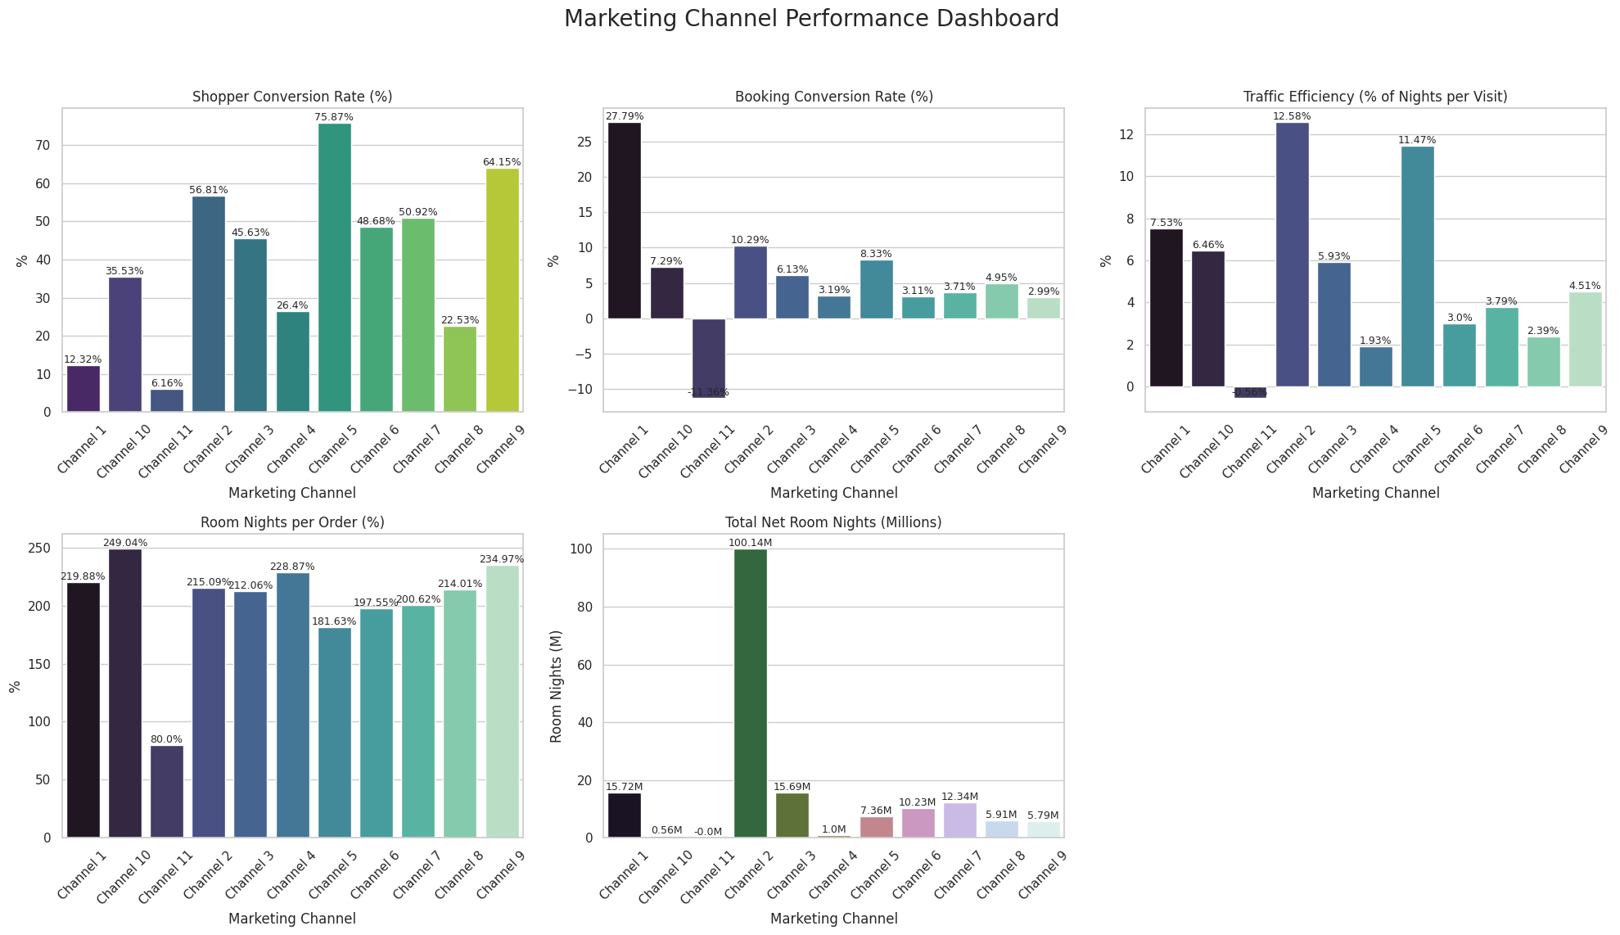
Charts

Slide 6
Marketing Channel Analysis
1. Channel Volume & Impact
Channel 2 leads by volume with 100M+ room nights, making it our core revenue driver.
Channels 1, 3, 6, and 7 contribute moderately with 6-15M room nights.
Channels 10 and 11 have minimal impact and warrant further investigation.
2. Shopper Quality & Engagement
Channels 5, 9, and 2 excel in attracting highly engaged visitors with shopper conversion rates above 60%.
Channels 1 and 11 lag significantly on shopper engagement, indicating low-quality traffic or UX challenges.
3. Conversion Effectiveness
Channel 1 converts shoppers to bookings most effectively with a 28% booking conversion rate, despite lower shopper quality.
Channels 5, 2, and 10 also show solid booking conversion in the 7-10% range.
Negative booking conversion in Channel 11 signals data or operational issues requiring urgent review.
4. Efficiency of Traffic
Channels 11 and 5 are most efficient, generating more room nights per visit (above 11%).
Channels with low efficiency, such as 4, 7, and 8, could benefit from improved targeting or UX enhancements.
5. Booking Value Insights
Most channels show room nights per order exceeding 180%, reflecting average stays longer than one night.
Channel 11’s notably low room nights per order (80%) suggests shorter stays or cancellations.

Slide 7
Recommendation on Marketing Channel
Prioritize marketing spend on Channels 2 and 1 for volume and conversion strength.
Investigate Channel 11’s data and operations to identify and resolve performance gaps.
Enhance user experience and targeting on low shopper conversion channels (1, 10, 11).
Leverage high-efficiency channels (5, 9) to maximize ROI by scaling successful tactics.
Conduct deeper qualitative analysis to understand visitor behavior differences across channels.

Slide 8
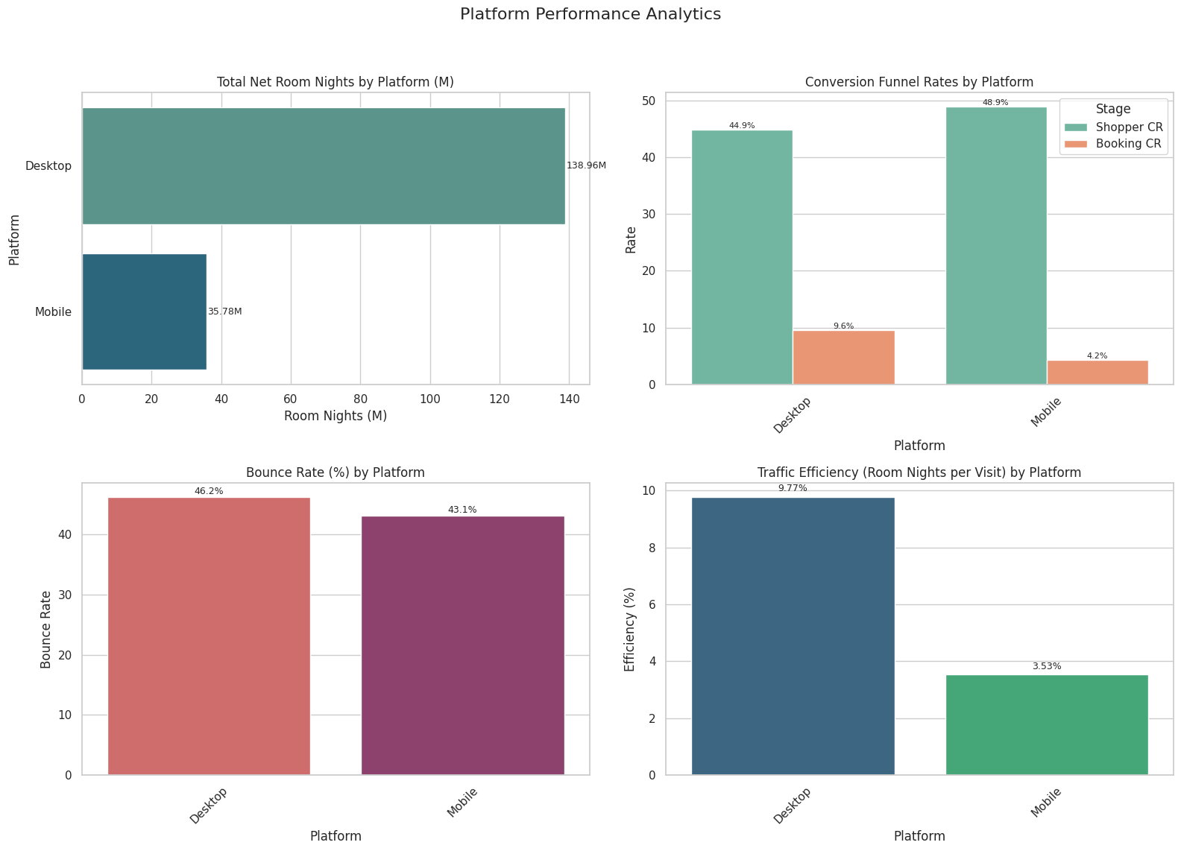
Charts

Slide 9
Platform Analysis
1. Net Room Nights Volume
Desktop generates ~139M room nights, dominating platform performance.
Mobile contributes significantly less (~36M), showing potential room for growth.
2. Conversion Funnel
Shopper Conversion Rate is slightly higher on Mobile (48.9%) than Desktop (44.9%) — mobile users are interested.
However, Booking Conversion Rate on Mobile is only 4.2%, less than half of Desktop’s 9.6% — strong intent but poor follow-through.
3. Bounce Rate
Both platforms have high bounce rates (43–46%), with Desktop slightly worse.
Indicates potential UX or content relevance issues across both.
4. Traffic Efficiency
Desktop traffic is nearly 3× more efficient (9.77%) than Mobile (3.53%) in converting visits to room nights.
Suggests better performance per visit and stronger completion behavior on Desktop.

Slide 10
Recommendation on Platform
UX & Technical Optimization
Improve mobile booking experience: Simplify checkout, reduce load times, and ensure payment reliability.
Investigate causes of high mobile drop-off: Look for friction in mobile funnel (especially between product view and checkout).
Mobile-Specific Initiatives
Retarget mobile shoppers with personalized incentives (e.g., app-exclusive discounts or abandoned cart emails).
Consider A/B testing for mobile-friendly layouts to reduce bounce and increase booking conversion.
Channel Strategy
Focus traffic investment toward Desktop for short-term efficiency and ROI.
Invest in longer-term mobile improvement to unlock shopper potential (given strong intent).

Slide 11
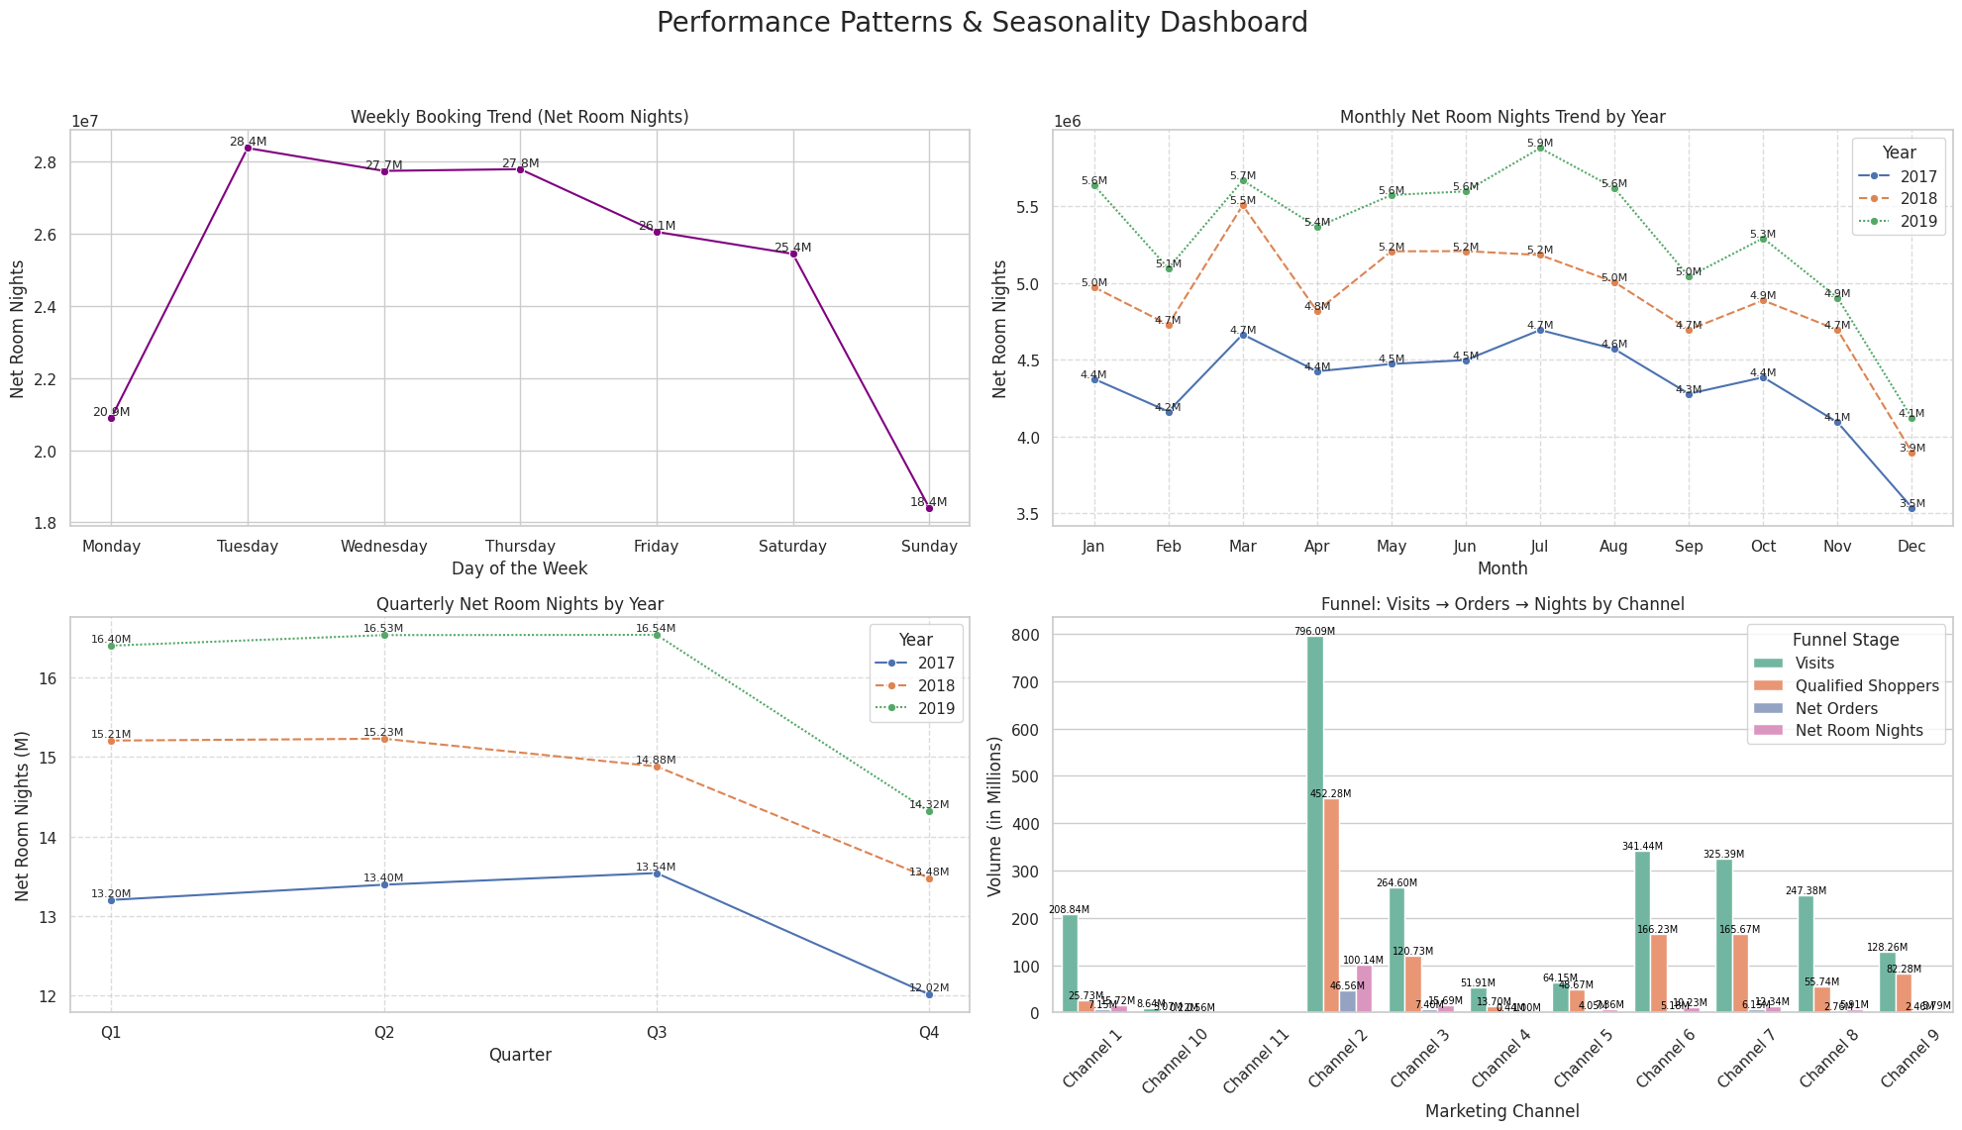
Charts

Slide 12
Patterns & Seasonality Analysis
1. Weekly Booking Trend
Peak booking days are Tuesday to Thursday, especially Tuesday (28.4M).
Lowest activity on Sunday (18.4M) and Monday, suggesting users plan mid-week.
2. Monthly Net Room Nights (2017–2019)
2019 consistently outperforms previous years.
Peaks in July (5.9M) and October (5.3M) hint at summer and Q4 seasonal demand.
December dips across all years, possibly due to holiday travel behaviour shifts.\
3. Quarterly Performance by Year
Q2 and Q3 are strongest quarters across years, particularly Q2 2019 (16.53M) and Q3 2019 (16.54M).
Noticeable decline in Q4 2019, aligning with monthly December drop.
4. Funnel Performance by Channel
Channel 2 is the top performer in both traffic and conversion:
796M visits → 462M shoppers → 100M room nights
Channels 1 and 3 show strong drop-offs between visits and room nights — possible leakage or UX friction.
Channel 10 and 11 underperform severely, with low values across all funnel stages.

Slide 13
Recommendation on Seasonality
Time-Based Strategy
Promotional campaigns should be concentrated mid-week (Tue–Thu) when booking activity is highest.
Align marketing budgets and discount strategies around Q2 and Q3, especially summer travel.
Funnel Optimization
Analyse Channel 1 & 3 funnel drop-offs: are users dropping during search, review, or booking?
Audit UX/UI for conversion friction — simplify checkout, load speed, personalization.
Experimentation
A/B test promotions in Q4 to reverse seasonal declines — consider bundling or early holiday deals.
Use behavioural insights to target Sunday & Monday with reminder nudges or mobile offers.
Channel Management
Invest more into Channel 2 — high-volume and efficient.
Consider retargeting Channel 1 users who browse but don’t book.
De-prioritize Channels 10 & 11 unless operational fixes or segment refinements are introduced.

Slide 14
Charts

Slide 15
Geography Region Analysis
1. Room Nights by Region
Geo Region 1 leads by a large margin (90.84M room nights), followed by Region 2 (48.53M).
Region 4 contributes the least (8.85M), indicating lower engagement or traffic volume.
2. Conversion Funnel (Shopper & Booking)
Region 1 has the strongest performance across both:
Shopper Conversion Rate: 51.6%
Booking Conversion Rate: 8.9%
Region 4 shows decent shopper CR (46.3%) but the lowest booking CR (4.4%), suggesting high drop-off post-engagement.
Region 3 has poor funnel metrics — low shopper (35.2%) and booking (6.1%) CRs.
3. Bounce Rate
Region 3 has the highest bounce rate (53%), indicating a mismatch between user expectations and site experience.
Region 1 performs best in minimizing bounce (41.1%).
4. Traffic Efficiency (Room Nights per Visit)
Efficiency follows volume:
Region 1: Highest efficiency at 8.91%
Region 4 and 3 underperform (5.39% and 4.95%)

Slide 16
Recommendation on Geography
Geo Region 1 – Optimize & Scale
Strongest region across all KPIs — continue scaling campaigns and investments.
Consider A/B testing premium offers or loyalty programs here due to high conversion and low bounce.
Geo Region 2 – Improve Booking Conversion
High shopper interest (47.9%) but only 6.0% bookings → optimize post-shopping funnel.
Investigate UX, pricing, or availability frictions preventing booking finalization.
Geo Region 3 – Fix Bounce & Engagement
High bounce (53%) and low conversion → needs major content and targeting revision.
Consider localizing landing pages or retargeting efforts for better relevance.
Geo Region 4 – Improve Booking Completion
Good shopper engagement (46.3%) but 4.4% booking conversion implies friction after interest.
Optimize checkout flows, especially mobile if that’s a factor; consider testing exit-intent offers.

Slide 17
Key Drivers Summary
Channel 2 is the top performer by volume, while Channel 1 delivers the highest booking conversion efficiency.
Peak bookings occur mid-week (Tues–Thurs) and during Q2–Q3, especially in July and October.
Desktop users drive the majority of bookings with nearly 4× higher efficiency than mobile.
Geo Region 1 leads across all KPIs, with the highest room nights, conversion rates, and efficiency.
Mobile platform and Regions 3 & 4 show engagement but low booking conversions — indicating opportunities to optimize UX and targeting.

Slide 18
Summary Recommendations
Scale investments in high-performing channels (esp. Channel 1) with strong ROI.
Audit low-performing channels: Consider refining messaging or pausing underperformers.
Use A/B testing for ads or landing pages tied to Channels 4, 6, and 9.
Optimize the mobile experience: Consider faster loading, better search UX, and streamlined checkout.
Consider device-targeted promotions or incentives for mobile to close the performance gap.
Investigate session duration and bounce rates by platform to identify drop-off points.
Encourage longer stays on mobile bookings with targeted upsells.
Schedule campaign pushes Tue–Thu to align with peak engagement.
Boost Q4 performance with holiday bundles or loyalty rewards.
Use slower periods (e.g., Sunday) for site maintenance or experiments.

Slide 19

Thank You / Q&A

