Slide 1
GNC Implementation for Waypoint Navigation with Gazebo Simulation Model
Adapted from Atilla Dogan & Ameya R. Godbole
XX {4,5}379 – Unmanned Vehicle System Development
Spring 2020

Slide 2
Simulation Model
Download “simModelUGV_ClosedLoop.zip” from Canvas
Simulink Model: trackVehicleNewVer6b_Encoders_DR_GNC.slx

Slide 3
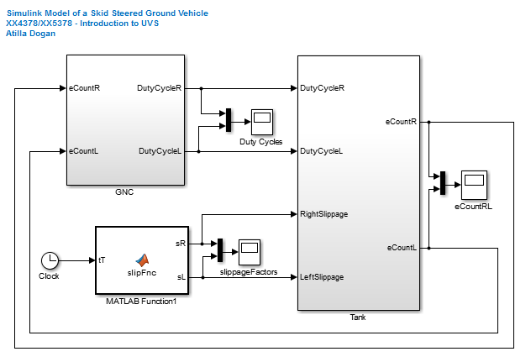
Simulation Model
For controlling the actual UGV,
we only need GNC
We will have the actual vehicle
instead of this block

Slide 4
Simulink Model for Simulation Platform
Need to build a new simulink model
“GNC” block
for Guidance, navigation, and Control
“Set Pace” block
to ensure simulink model runs at the speed of the Simulation
ROS Encoder position Subscriber block
to read in encoder counts coming from the Gazebo simulation
ROS Motor Velocity Publisher block
to send out %duty cycle commands to the Gazebo simulation

Slide 5
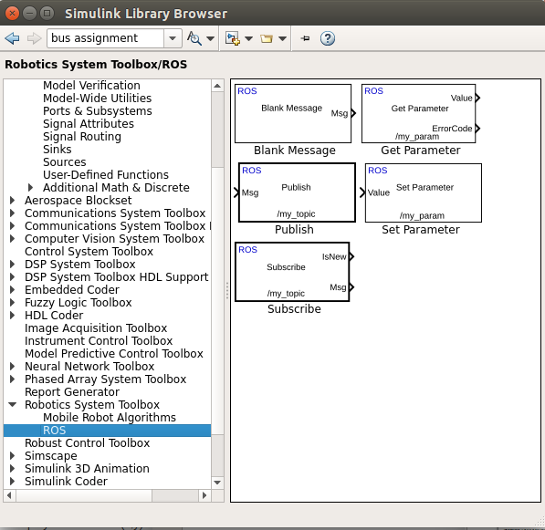
Connecting to ROS from Simulink
We will use Robotics System Toolbox - ROS blocks to read
encoder counts and control
motor speed through ROS.

Slide 6
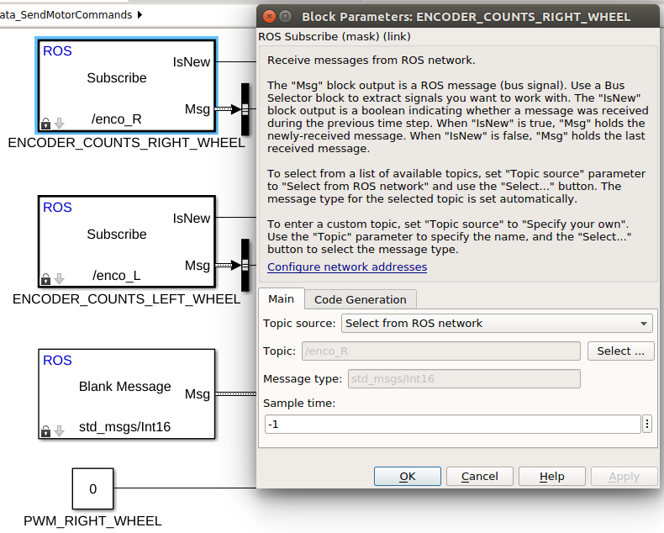
Simulink Model for NUC
We will use ROS Subscribe blocks to read encoder counts

Slide 7
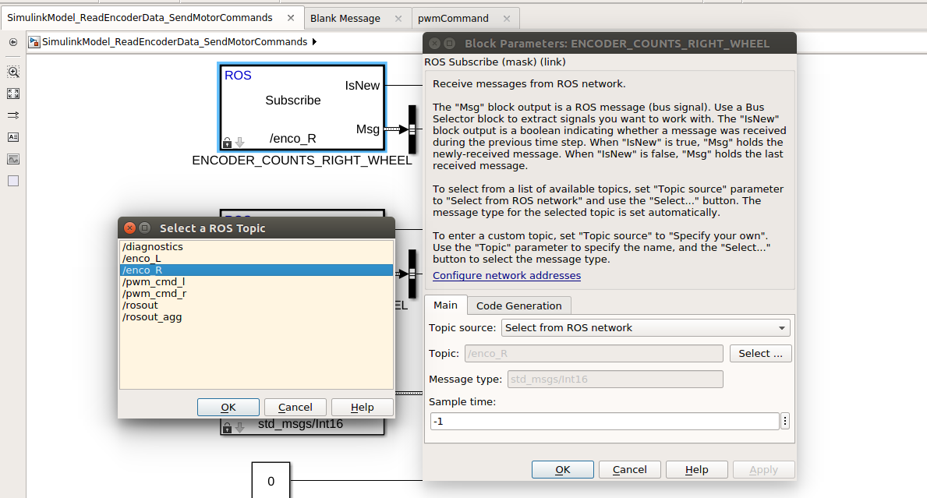
Connecting to ROS from Simulink
Creating Subscriber Block
If any topics are published,
you will see them here.
It will be /enco_R for the Right encoder ticks and /enco_L for the Left encoder ticks
Select topics from ROS Networks

Slide 8
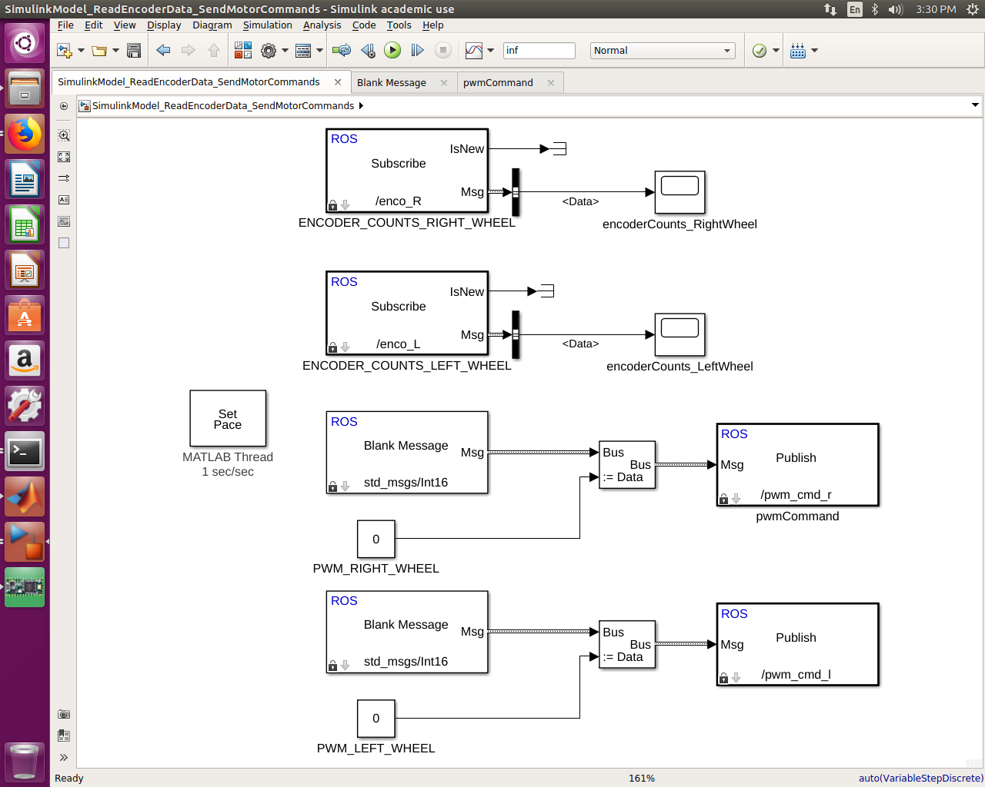
Connecting to ROS from Simulink
Creating Subscriber Block
Use Bus Selector block to reach messages published by previously selected topic.
Now, you can use the output as Encoder Count
in your model.

Slide 9
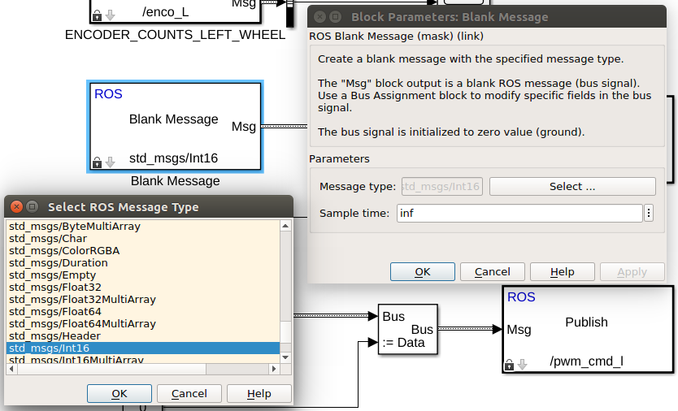
Connecting to ROS from Simulink
Creating Publisher Block
From wide range of standard ROS message types, you can select convenient one for your device or purpose. We are using std_msgs/Int16 message type to publish the PWM commands. Messages may carry more than multiple data sets. In order to publish data through them, we need to locate and relate them with Simulink blocks. For this reason, we will use Bus Assignment block.

Slide 10
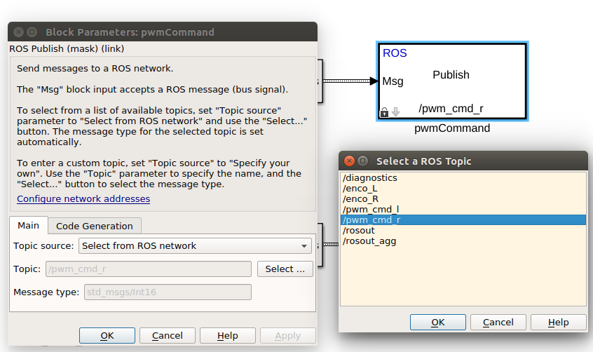
Connecting to ROS from Simulink
Creating Publisher Block
After assigning bus signals to created message, we will connect it to Publisher Block.
At this point, we can either publish this message under a user defined topic or publish it
under already existing topic name on ROS.

Slide 11
Example Simulink Model
Encoder position:
To read left and right encoder
counts into Simulink model
You should be able to run your vehicle with this Simulink model and show encoder counts incrementing
This is your assignment this week
To Simulate Real-Time
Motor PWM for left and right motors

