Slide 1
Autonomous Robots
Vision
© Manfred Huber 2019

Slide 2
Active vs. Passive Sensing
Active sensors (sensors that transmit a signal) provide a relatively easy way to extract data
  Looking only for the data they transmitted makes identifying the information simpler
    Laser scanners need to extract only one light frequency
    Sonar “listens” only for a specific frequency and modulation
    Structured light (e.g. Kinect) only looks for specific patterns
  But active sensors interfere with the environment (and with each other)
    Two identical sensors interfere with each other’s sensing
    Active transmission of sound or light can interfere with objects
© Manfred Huber 2019
Notes:
Active sensors transmit their own signal and can thus be engineered in such a way that it is easy to detect and extract the information (e.g. transmission in a frequency band or with a modulation that occurs rarely (or never) in nature).
Extracting the information is then independent of what is actually in the environment (objects, etc.). All that has to be done is looking for the special signal and compute either time of flight or to triangulate the (known) signal.
But there are drawbacks. Active transmission can interfere both with other sensors and with objects or entities in the environment. E.g. sonar and dogs sometimes do not go together that well.

Slide 3
Active vs. Passive Sensing
Passive sensors use only the signals present in the actual environment
  Passive sensors do not interfere with each other and the environment
  Extraction of information is substantially harder
    The signal that has to be found is less predictable
    Need to find a “common signature” or common traits that objects of interest have so we can look for them
  Passive sensors are usually less precise but can often be used in a wider range of environments
© Manfred Huber 2019
Notes:
Passive sensors require to extract naturally occurring patterns which are generally not as repeatable and as reliable.
Much higher computational effort but the signals do not get drowned out (e.g. active light-based sensors often don’t work in very bright or hot environments).

Slide 4
Vision
Vision is on of the sensor modalities that provides the most information if it can be extracted successfully
  Can provide remote information about existing objects
  Stereo vision can determine distances to objects
    Requires solution of the correspondence problem
  Requires to find patterns that indicate the presence and identity of objects
© Manfred Huber 2019
Notes:
Vision is one of the most important senses to us because it works at distance and it can provide a huge amount of information at once.
In exchange this means that a lot of processing has to be done to work with vision.

Slide 5
Spatial vs. Frequency Space
As with auditory signals, images can be processed either in a spatial or in the frequency domain
  In the spatial domain, images are 2 dimensional arrays of intensity values
  In the frequency domain images are represented in terms of frequencies and phases
    Strong brightness changes are high frequencies while uniform intensities are low frequencies
© Manfred Huber 2019
Notes:
As with audio, images can be represented in terms of spatial representations or in the frequency domain.

Slide 6
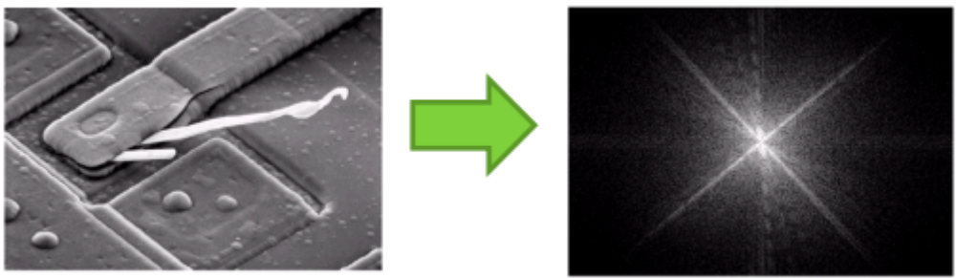
Spatial vs. Frequency Space
Frequency domain (e.g. Fourier space) makes extracting certain properties easier
  Here frequency domain shows that most high contrast lines (sharp edges) are oriented at 45°
© Manfred Huber 2019
Notes:
Frequency analysis can make certain properties easier to extract but is generally less intuitive.
While it is frequently used in computer vision we will in the robotics course concentrate on spatial analysis of images since it is more intuitive.

Slide 7
Low Level Vision
Image processing and computer vision deals with the automatic analysis of images
For many techniques, images have to be represented as 2D arrays of numbers
  Color images have 3 components
    Red Green Blue in RGB space – a color is a point in 3D space
    Hue Saturation Value in HSV space – color becomes a single number, the others represent color intensity and brightness
  For many vision techniques we have to extract patterns in only one of them at a time (often intensity)
© Manfred Huber 2019
Notes:
Image processing techniques often have to work on a single number per pixel. Most often this is intensity (basically treating the image as grey-scale).
But it could also be hue or anything else.

Slide 8
Early Vision and Visual Processing
Many models for visual processing in animals and humans have been devised
  A very common model sees vision and object recognition as a sequence of processing phases
  Different information is extracted in each stage
  The final goal is to recognize what objects are in the image and where they are
© Manfred Huber 2019

Slide 9
Early Vision and Visual Processing
Filtering
Feature Extraction
Grouping
Recognition
Box
Early Vision
Filtering: Used to clean and normalize images
Feature extraction: Finds locations where simple patterns are present in the image
Grouping: Puts together local features into object parts
Recognition: Identifies object identity
© Manfred Huber 2019
Notes:
A general vision model follows the filtering – feature extraction – grouping – recognition sequence.
Starting with an image,
* filtering normalizes and cleans image,
* feature extraction pulls out local patterns resulting in a set of feature maps (note that these are not really images but rather they are arrays with pattern strength values – they do not have to look like the features. E.g. a corner feature results not in something that looks like a corner but rather like a single point).
* grouping puts together local features into larger parts (either boundaries or surfaces
* recognition, finally, identifies objects
The first 2 steps are often called early vision and there is good evidence that they exist in the brain (e.g. there is evidence of edge detectors in the visual system.

Slide 10
Filtering
Filtering serves the purpose of making subsequent steps earlier
  Removing noise from the image
  Normalizing the images
    Adjusting for different brightness
    Adjusting for contrast differences
In nature some filtering is performed in hardware and some in “software”
  Iris adjustment to normalize global brightness
  Local brightness adjustment
© Manfred Huber 2019
Notes:
Filtering is a first step. It mainly cleans up images and is intended to provide a more uniform/normalized image to simplify processing.

Slide 11
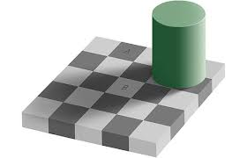
Filtering
Effect of local filtering can be profound
  Squares A and B are actually exactly the same brightness
© Manfred Huber 2019
Notes:
Filtering in the human visual system can be seen in certain visual illusions.
In order to be able to better judge colors the human system normalizes based on local neighborhoods (thus making it impossible to see the actual brightness but only what it would represent given the rest of the image).

Slide 12
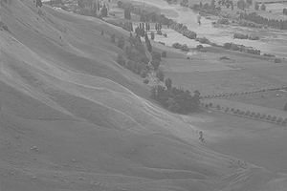
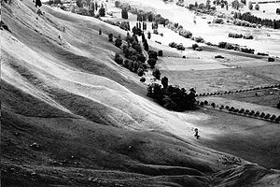
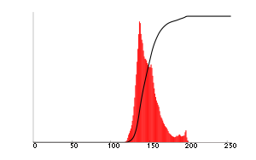
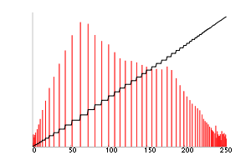
Filtering
Histogram equalization
  Adjusting brightness to be equally distributed
  While it doesn’t add information it can make it easier to find
Stretch and compress intensities to make each intensity interval equally likely
© Manfred Huber 2019
Notes:
Histogram equalization tries to make sure that each intensity occurs about equally often (i.e. that the cumulative frequency distribution over the intensity values is about a line).

Slide 13
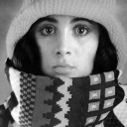

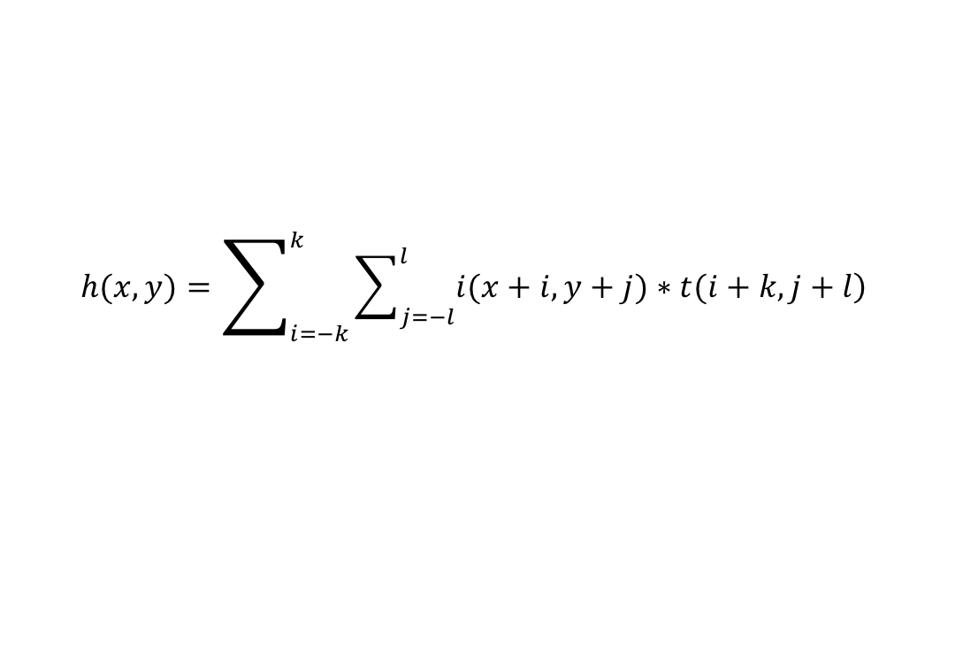
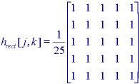
Filtering
Smoothing
  Removing noise to reduce effect of single pixels
    Replace each pixel with the average of the local neighborhood
  Convolution provides a mechanism for this
    Convolution computes cross-correlation value
© Manfred Huber 2019
Notes:
Smoothing allows to reduce noise.
Smoothing can be uniform (like here) or it can use any other function (e.g. gaussian)

Slide 14
Convolution
Convolution is a very generic mechanism for filtering and feature extraction
  Cross-correlation computes the “similarity” between a local image region and a template
  Convolution computes cross-correlation for each pixel
112
85
112
112
85
112
85
1/9 | 1/9 | 1/9
1/9 | 1/9 | 1/9
1/9 | 1/9 | 1/9
0 | 0 | 0 | 0 | 0 | 0 | 0
0 | 255 | 255 | 255 | 255 | 255 | 0
0 | 255 | 0 | 0 | 0 | 255 | 0
0 | 255 | 0 | 0 | 0 | 255 | 0
0 | 255 | 0 | 0 | 0 | 255 | 0
0 | 255 | 255 | 255 | 255 | 255 | 0
0 | 0 | 0 | 0 | 0 | 0 | 0
85 112 112
85 0 85 85
112 85 112 112
85 112 85 112 85
© Manfred Huber 2019
Notes:
Convolution is a general mechanism to computer simiarlity of each image region with a templeate
Final value is a measure of similarity. The larger the more similar.
Important to note that around the boundary no cross-correlation can be computed
- either feature map has to be smaller than image
- or default “padding” values have to be used for the parts tha are not on the image (e.g. average intensity of the image)

Slide 15
Feature Extraction
Feature extraction is aimed at identifying locations in which particular patterns (features) occur
  Identifying parts that could indicate objects
    Features have to be simple so this can be done fast
      Edgels (small parts of edges)
      Corners
      Texture features
      Motion features
      …
  Convolution is often used for feature extraction
© Manfred Huber 2019
Notes:
There is good evidence that our visual system has specialized feature extractors (lines, motion, etc.)

Slide 16
Edge Detection
Edges are some of the most prominent low-level features
  Edges make up the outline of most objects
  Edges separate geometric shapes
Edge detection using convolution requires edge templates
  Edge templates should look like edges
    Normalized templates average to 0
© Manfred Huber 2019
Notes:
Edge detection is an important part.

Slide 17
Edge Templates
Edge templates can be distinguished based on their size and how sensitive to orientation they are
  Roberts templates
  Pewit templates
  Sobel templates
0 | 1
-1 | 0
1 | 0
0 | -1
1 | 0 | -1
1 | 0 | -1
1 | 0 | -1
1 | 1 | 1
0 | 0 | 0
-1 | -1 | -1
1 | 1 | 0
1 | 0 | -1
0 | -1 | -1
0 | 1 | 1
-1 | 0 | 1
-1 | -1 | 0
1 | 0 | -1
2 | 0 | -2
1 | 0 | -1
1 | 2 | 1
0 | 0 | 0
-1 | -2 | -1
2 | 1 | 0
1 | 0 | -1
0 | -1 | -2
0 | 1 | 2
-1 | 0 | 1
-2 | -1 | 0
© Manfred Huber 2019
Notes:
Roberts templates are the simplest but they are very sensitive to bad pixel values
Pewit is more robust because it is larger. It is very sensitive to orientation.
Sobel is less sensitive to orientation than Pewit (because of the increased emphasis on the center pivot.

Slide 18
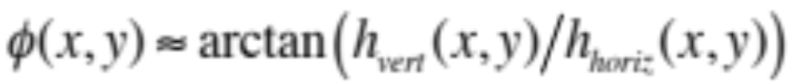
Edge Templates
Using just horizontal and vertical templates it is possible to estimate edge angles
  Horizontal cross-correlation is proportional to the horizontal component (cosine of the angle)
  Vertical cross-correlation is proportional to the vertical component (sine of the angle)
Orientation-independent edge templates
  Laplacian template
  Sobel templates
0 | -1 | 0
-1 | 4 | -1
0 | -1 | 0
© Manfred Huber 2019
Notes:
Angle estimation from horizontal and vertical templates can be performed.
Laplacian templates look for contrast in all directions and are thus orientation independent. However, they are more noise sensitive than Pewit or Sobel.

Slide 19



Edge Detection
Different edge detectors have different strengths
  Roberts:
  Sobel
© Manfred Huber 2019
Notes:
Shows that Roberts is more noisy than sobel.

Slide 20
Template Matching
Convolution is identifying image regions that look similar
  Can use this to find general patterns by making the template look like the pattern we are looking for
    Can use an image region directly as a template
  Computing cross-correlation between an image region and the template (target image piece) gives a measure of how similar it is
    Similarity is measured per pixel and thus it ahs to be the same size and orientation to be considered similar
© Manfred Huber 2019
Notes:
Template matching uses an image part as the template.

Slide 21
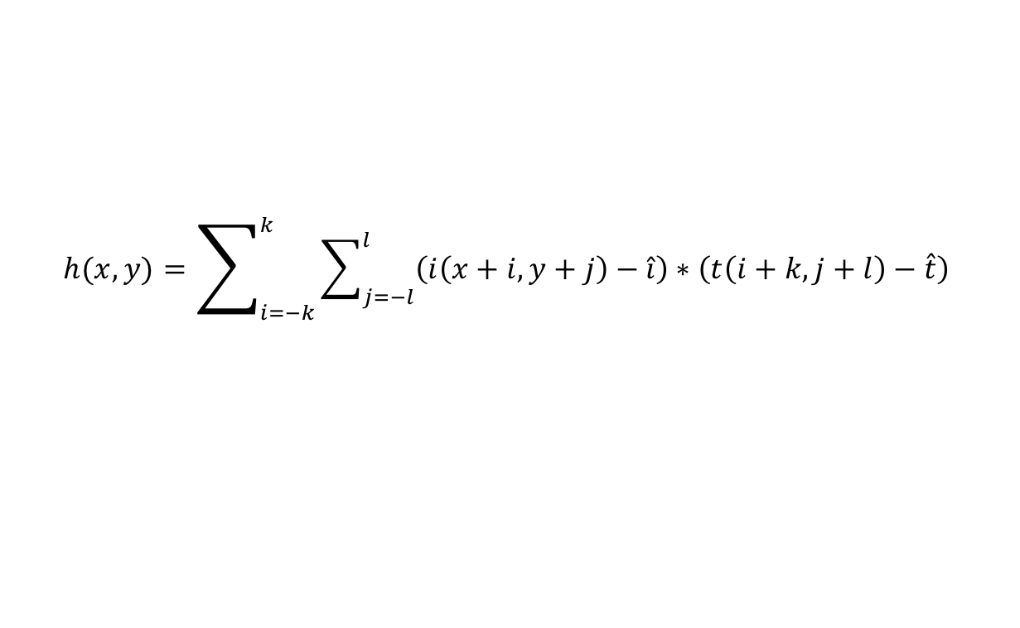
Normalized Template Matching
Intensity values of an image are all positive
  Thus templates are not natively normalized
What influence does the brightness of the image have on the result ?
  Increasing the values of the pixels increases the correlation value
    Brighter image regions look more “similar”
  Normalization can be used to compensate for this
© Manfred Huber 2019
Notes:
Increasing the brightness of the template or the image increases cross-correlation value (twice as bright means twice as high a value).
This makes it difficult to determine if a region looks similar to the template.
Normalization for brightness differences can reduce this effect. Subtracting the average of the image from the image and subtracting the average of the template from the template (thus making them average 0).

Slide 22
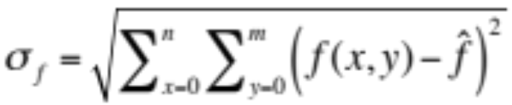
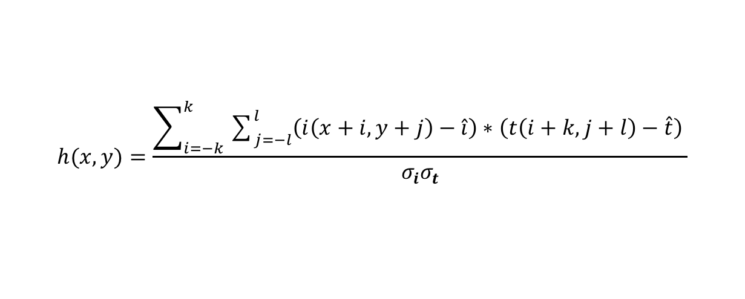
Normalized Template Matching
What influence does the contrast of the image have on the result ?
  Contrast is usually measured in terms of the standard deviation of the pixels in the image
  Increasing contrast scales correlation
    Higher contrast yields stronger positive and negative “matches”
  Normalization can be used to compensate for this
© Manfred Huber 2019
Notes:
Reduced contrast (e.g. resulting in bad lighting conditions or when over-exposing, or when being out of focus) reduces the size of the positive and negative matches.
Contrast (as standard deviation) is also used in most low-cost digital cameras to drive auto focus (that is why they always run a little bit too far and then back up – they search for the point where the contrast is maximum)

Slide 23
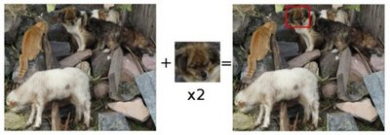
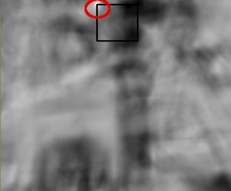
Global vs. Local Normalization
What if there are strong lighting differences across the image ?
  Normalization can be performed for each image region separately to address this
    Higher computational cost since mean and standard deviation have to be computed once per pixel
© Manfred Huber 2019
Notes:
Local normalization is usually better but much more expensive.

Slide 24
Grouping / Segmentation
Grouping / Segmentation is aimed at combining local features into objects
  Combine parts into the part of the image that corresponds to a single object
    Combining features can happen in different ways
      Edge chaining can be used to combine edgels into the contour of an object
      Blob coloring can be used to combine consistently colored / textured pixels into an object
      …
© Manfred Huber 2019

