Slide 1
Autonomous Guidance and Sensing
Manfred Huber
Spring 2020

Slide 2
Guidance & Sensing
Previous classes and projects provided the robot with waypoint navigation and obstacle avoidance
Way points provided a priori
Reactive trajectory between the waypoints
Reactive obstacle avoidance
We will now deal with making guidance more autonomous
Path planning and trajectory tracking
Sensing for goal detection and obstacle mapping

Slide 3
Tentative Timeline
 | 4/13 | 4/20 | 4/27 | 5/04 | 5/11?
Integration of Vision System
Camera mount and vision presentation
Autonomous mapping
Path planning
Path planning demonstration
Path planning report
Autonomous goal search and navigation demonstration
Final Report

Slide 4
“Hardware" Modifications
Guidance and Mapping will use both the sonar and a vision system
Sonar provides reliable obstacle presence
No good obstacle location information
Camera provides object identity and pose information
Goal identification and obstacle mapping
Mount details of camera are important
Visual range
Ambiguity

Slide 5
Camera Mounting
Height and viewing angle change location ambiguity
Distance largely influences size of objects
Distance also influences location in the image

Slide 6
Distance Estimation from Single Camera Vision
With an inclined mounting angle and flat terrain the location in the image of points touching the ground indicates distance
Objects move up in the image with distance
Need to determine calibration between image coordinates and locations in the world

Slide 7
Location Estimation from Single Camera Vision
With an inclined mounting angle and flat terrain the location in the image of points touching the ground indicates a location
Y- coordinate indicates a distance from the camera
X-coordinate indicates an angle from the center line of the Camera

Slide 8
Location Estimation from Single Camera Vision
In a pinhole camera model pixel locations represent a “beam” relative to the centerline of the camera
X and Y dimension of the image can be decoupled for two separate angles
Additional information (e.g. camera angle and flat floor) allows to compute a location along the “beam”
y
f
α

Slide 9
Camera Mounting
On flat ground the height of the bottom of an object in the image indicates its distance
Larger inclination results in larger effect
Inclination influences camera range
Stronger inclination reduces range
Precision of determination is effected by many factors
Camera height
Camera vibrations
Platform pitch and roll

Slide 10
Camera Mounting
Camera mount has to provide visual range
Objects should be detectable right in front of the platform as well as at large distances
Tradeoff between mount height, mount angle, and field of view of camera
Camera mount should be stable to not increase vibrations
Height increases vibration
Height reduces stability of the platform

Slide 11
Machine Vision
To determine the location in the image we have to apply machine vision
Parts that belong to an object have to be identified
Parts of the same object have to be combined
Objects have to be separated from the background

Slide 12
Machine Vision
By identifying and classifying groups of pixels as an obstacle, machine vision can be used to generate information that supports path planning, obstacle avoidance, goal finding, or opportunistic motion behaviors.

Slide 13
Machine Vision
Many ways to process images or video have been developed
A common processing sequence to identify an object (object recognition) involves
“Box”
Filtering
Segmentation
Recognition
Feature
Detection
Early Vision

Slide 14
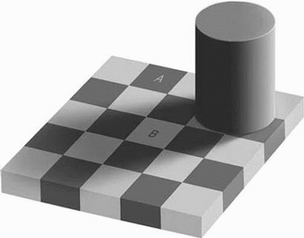
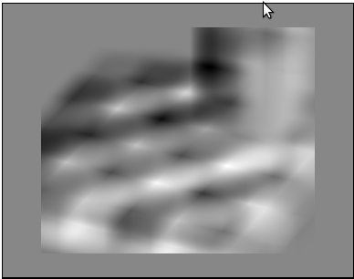
Machine Vision
Filtering:
Remove noise, normalize, and emphasize the image
Feature Detection:
Extract significant local structures
Edges, Color, Texture, Motion, …
Segmentation:
Group features into regions belonging to a common object
Recognition:
Determine identity of the object

Slide 15
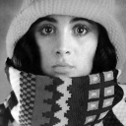

Machine Vision
Convolution is one of the most common filtering and feature detection methods
Cross-correlation computes the “similarity” between a local image region and a template
Convolution computes cross-correlation for each pixel
112
85
112
112
85
112
85
1/9 | 1/9 | 1/9
1/9 | 1/9 | 1/9
1/9 | 1/9 | 1/9
0 | 0 | 0 | 0 | 0 | 0 | 0
0 | 255 | 255 | 255 | 255 | 255 | 0
0 | 255 | 0 | 0 | 0 | 255 | 0
0 | 255 | 0 | 0 | 0 | 255 | 0
0 | 255 | 0 | 0 | 0 | 255 | 0
0 | 255 | 255 | 255 | 255 | 255 | 0
0 | 0 | 0 | 0 | 0 | 0 | 0
85 112 112
85 0 85 85
112 85 112 112
85 112 85 112 85

Slide 16



Machine Vision
Edge Detectors:
Roberts Templates:
Sobel Templates:
0 | 1
-1 | 0
1 | 0
0 | -1
1 | 0 | -1
2 | 0 | -2
1 | 0 | -1
1 | 2 | 1
0 | 0 | 0
-1 | -2 | -1
2 | 1 | 0
1 | 0 | -1
0 | -1 | -2
0 | 1 | 2
-1 | 0 | 1
-2 | -1 | 0

Slide 17
Machine Vision
Common example for simple color-based object extraction:
Filtering:
Blur image to reduce noise in individual pixels
Feature Detection:
Identify pixels that are within a given color range
Results in a black and white feature map
Segmentation:
Blob coloring to link neighboring pixels in the same color range

Slide 18
Machine Vision and Obstacle Avoidance
Once objects are extracted as color blobs, their distance and location can be computed:
Find parts that are in contact with the ground
Lowes pixels of an object are potentially on the ground
Represent the front of the object
Translate pixel location to location in space
Using the calibration of the camera pixel locations can be translated into floor locations
Starting from the bottom (closest objects) can help try to eliminate occluded obstacles
For avoidance, only obstacles with particular distances are of interest

Slide 19
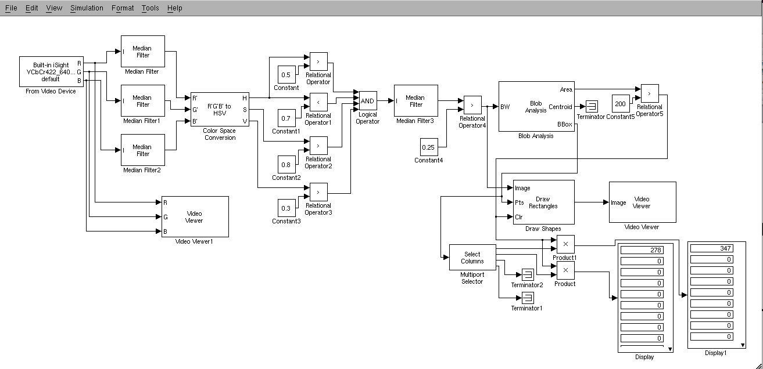
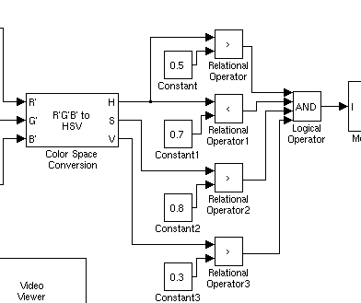
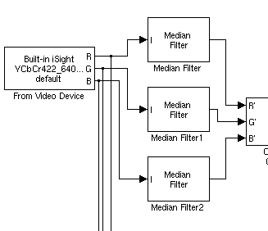
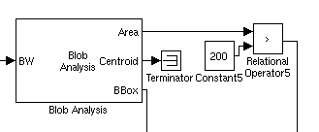
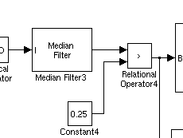
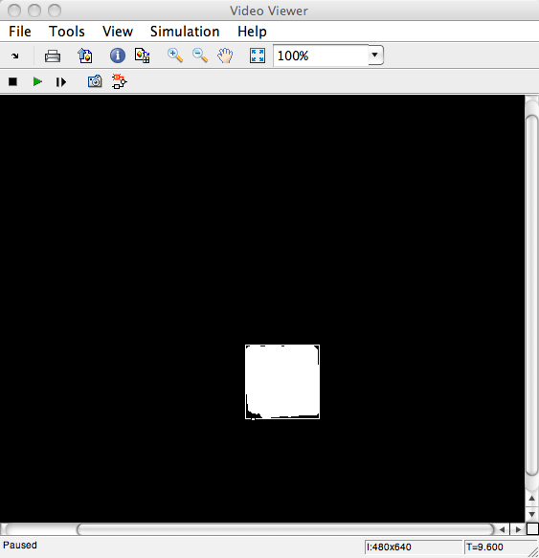
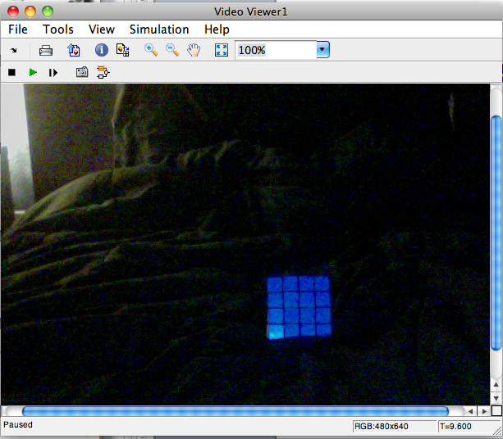
Machine Vision Example
Region Segmentation
Result Blurring
Image Blurring
Color Extraction

Slide 20
Next Tasks
Mount your camera
Determine height and camera inclination
A height around 10cm – 20cm off the chassis might be sufficient for a good distance range and still stable
Inclination has to be adjusted according to the camera field of view
Acquire camera images in simulink
Establish image to world mappings with the camera
We will provide a “horizon” during demonstrations

Slide 21
Autonomous Waypoint Generation
In autonomous applications waypoints are often not easily available
Vehicle should generate its own waypoints
Waypoints should be such that the generated trajectory through them does not collide with obstacles
Waypoints have to be dense enough
Waypoints need to be planned to consider obstacles in the environment
Path Planning provides a means for this

Slide 22
Recap - Path Planning
How to move from a configuration A to a configuration B without hitting arbitrarily shaped obstacles
Shape of robot makes this more complicated
Thumper is largely a rectangle
Movement constraints for robots lead to complications
Thumper is unicycle type

Slide 23
Recap – Configuration Space
The shape of the robot makes it more difficult to plan a path since no part of the robot can hit an obstacle
Robot takes up a volume in Cartesian space
Configuration space is the space spanned by the degrees of freedom of the robot
A point in configuration space describes the complete geometry of the robot
In Configuration space the robot can be reduced to a single point

Slide 24
Recap – Configuration Space
In Configuration space the robot can be reduced to a point by extending the obstacles appropriately
A round, holonomic mobile robot can be represented in a 2D configuration space
Other robot geometries can only be addressed accurately in a 3D (or higher dimensional)

Slide 25
Thumper Configuration Space
The Thumper is a unicycle-type robot
Can move forward and turn in place
Treating it as holonomic does not lead to non-executable trajectories
Only efficiency of execution can be influenced since it might have to stop and turn in place
The Thumper is largely rectangular
Treating it as cylindrical influences completeness by increasing the minimum clearance required
Treating Thumper as holonomic and cylindrical allows for path planning in 2D

Slide 26
Recap - Mapping
Multiple representations for map information have been used
Occupancy grid maps:
Map as array of obstacle/free cells
Landmark-based maps:
Map as a set of landmarks with poses
Topological maps:
Map encodes connectivity
Occupancy grids are often the simplest representation if the area to be mapped and the required precision are limited

Slide 27
Recap – Basic Motion Planning Problem
Basic Motion Planning Problem in Configuration Space is a simplified path planning problem
Solid robot reduced to a single point (by extending obstacles appropriately)
Only static obstacles
Holonomic robot
Only collision free paths are allowed

Slide 28
Recap - Path Planning Approaches
Roadmap approaches
Construct a set of “roads” that the robot can move on
Find a sequence of roads that lead from start to goal
Cell Decomposition approaches
Decompose the space into obstacle cells and free space cells
Find a sequence of connected free space cells such that the start is in the first and the goal in the last
Potential Field approaches
Design a numeric function over the configuration space with the goal at a minimum and obstacles at a maximum
Perform gradient descent to reach the goal

Slide 29
Roadmap Approaches
Voronoi Diagram
Road construction
Construct road segments that are equidistant to the two nearest obstacle features (including the workspace boundaries)
Connect start and goal to the nearest road
Path search
Find a sequence of road segments that leads from start to goal

Slide 30
Approximate Voronoi Diagrams
Approximate Voronoi diagram can be generated easier using distance propagation methods
Simultaneously starting wave fronts from all obstacles, record the points at which two wave fronts meet for the first time
In practice this requires a discretization of the configuration space.

Slide 31
Cell Decomposition Approaches
Approximate Regular Grid Cell Decomposition
Divide space into a regular grid and mark cells that contain any piece of an obstacle

Slide 32
Navigation Functions
Manhattan Distance
Discretize space into a regular grid
Propagate increasing distances to neighboring cells
Label goal cells with a potential of 0
21
20
19
18
17
16
15
14
13
12
11
10
9
8
7
6
7
22
21
20
13
12
11
10
9
8
7
6
5
6
23
22
21
22
13
12
11
4
5
22
21
20
14
13
3
4
21
20
19
13
12
2
3
20
19
18
17
16
15
12
11
1
2
19
18
17
16
15
14
13
12
11
10
9
2
1
0
1
18
17
16
15
14
13
12
11
10
9
8
4
3
2
1
2
17
16
15
14
13
12
11
10
9
8
7
6
5
4
3
2
3

Slide 33
Path Planning Approaches
Choice of path planning method changes the type of trajectories that are generated
Optimal distance methods like Visibility Graphs or Manhattan Distance generate shorter paths but move very close to obstacles and generate paths with corners
Distance/risk methods like Voronoi Diagrams of Harmonic Functions prefer paths with more clearance and generate smoother paths but result in longer overall paths
Path execution / trajectory tracking should take properties of paths into account

Slide 34
Trajectory Tracking
To track the path generated by the path planner the guidance system has to generate waypoints for the robot to move towards
A priori waypoint list generation
A complete list of waypoints along the trajectory can be generated form the path
Fixed path will be used, independent of errors in execution
Transition between waypoints can result in control discontinuities
Dynamic / “on the fly” waypoint generation
Waypoints can be generated using the path planner results and the current location of the robot at every point in time
Waypoints generated to have specific properties or distances
Can be used to influence trajectory tracking dynamics

Slide 35
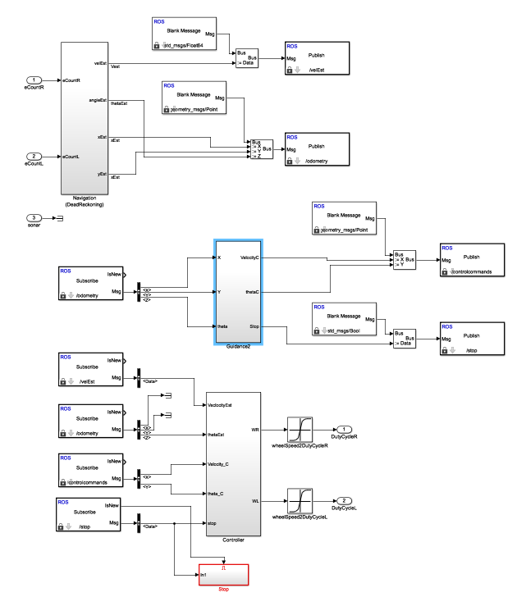
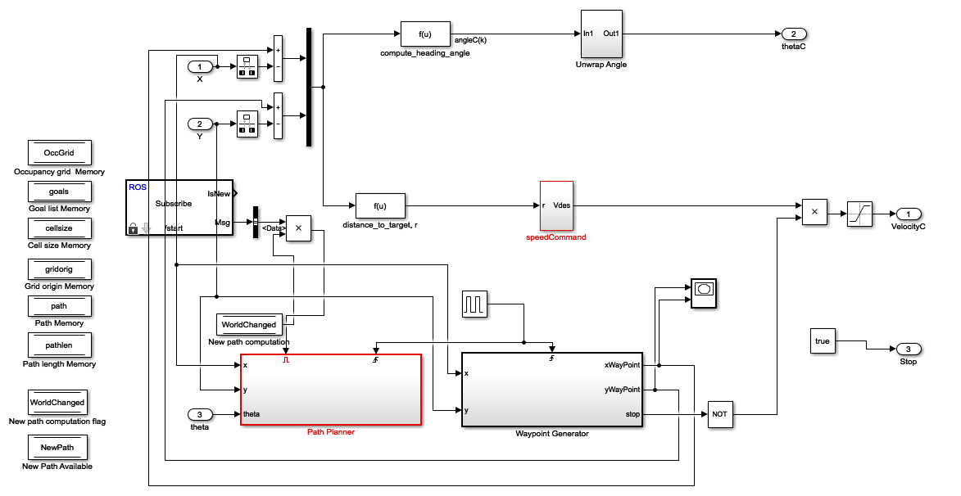
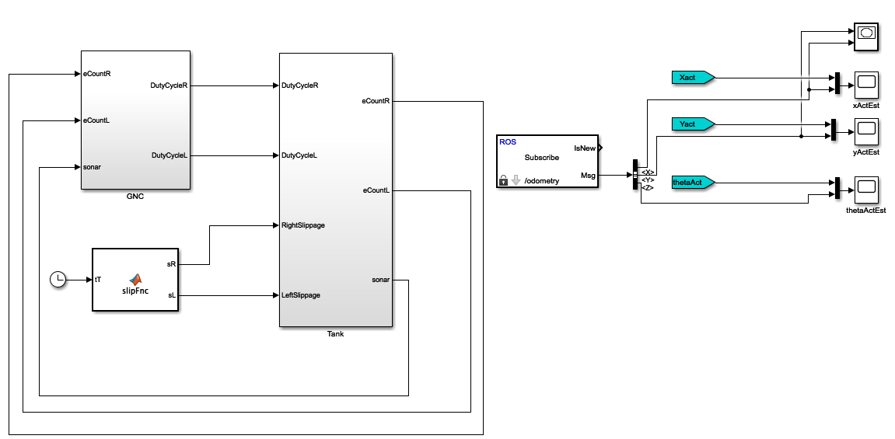
Simulink Path Planning Example

Slide 36
Next Tasks
Start building your path planner
Determine what path planner you want to use
Familiarize yourself with the provided Simulink model
Build initial Matlab function for the path planner in the provided Simulink simulation model
Move your path planner to the robot

