Slide 1
Parameter Identification of the UGV for Dead Reckoning
Based on Atilla Dogan
XX {4,5}379 – Unmanned Vehicle System Development
Spring 2019

Slide 2
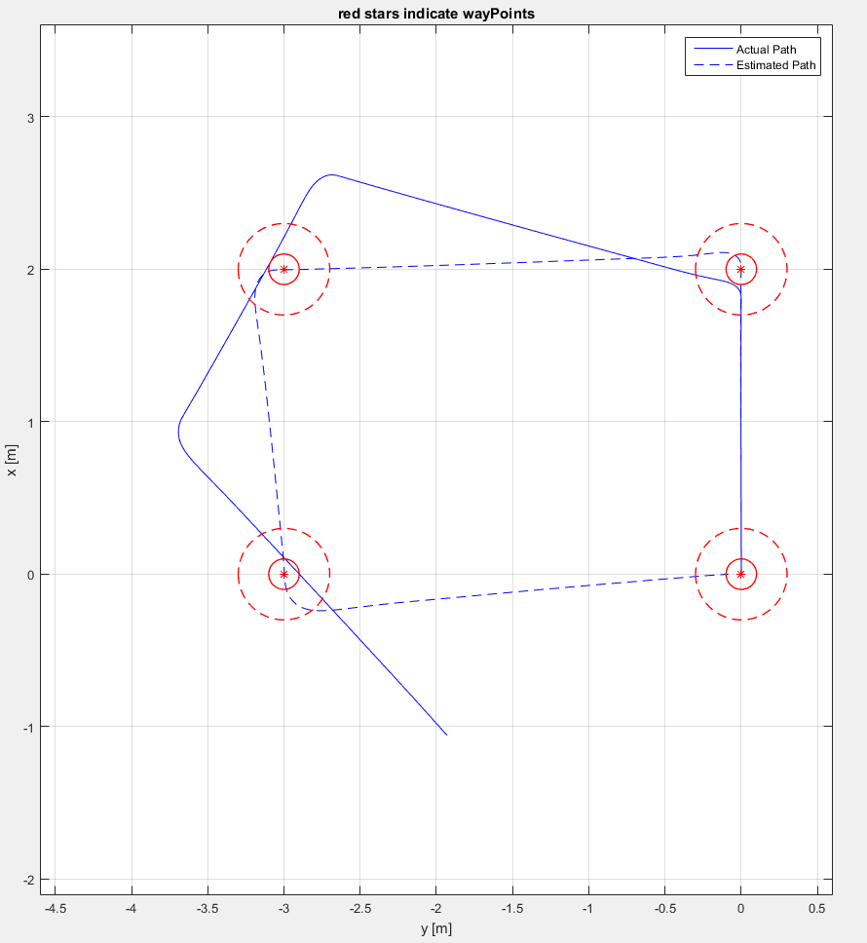
Estimated vs Actual Path
While the estimated path goes
through the wayPoints quite nicely,
The actual path does not!
There is no slippage!
This tells us that the estimation
by Dead Reckoning
should be looked into

Slide 3
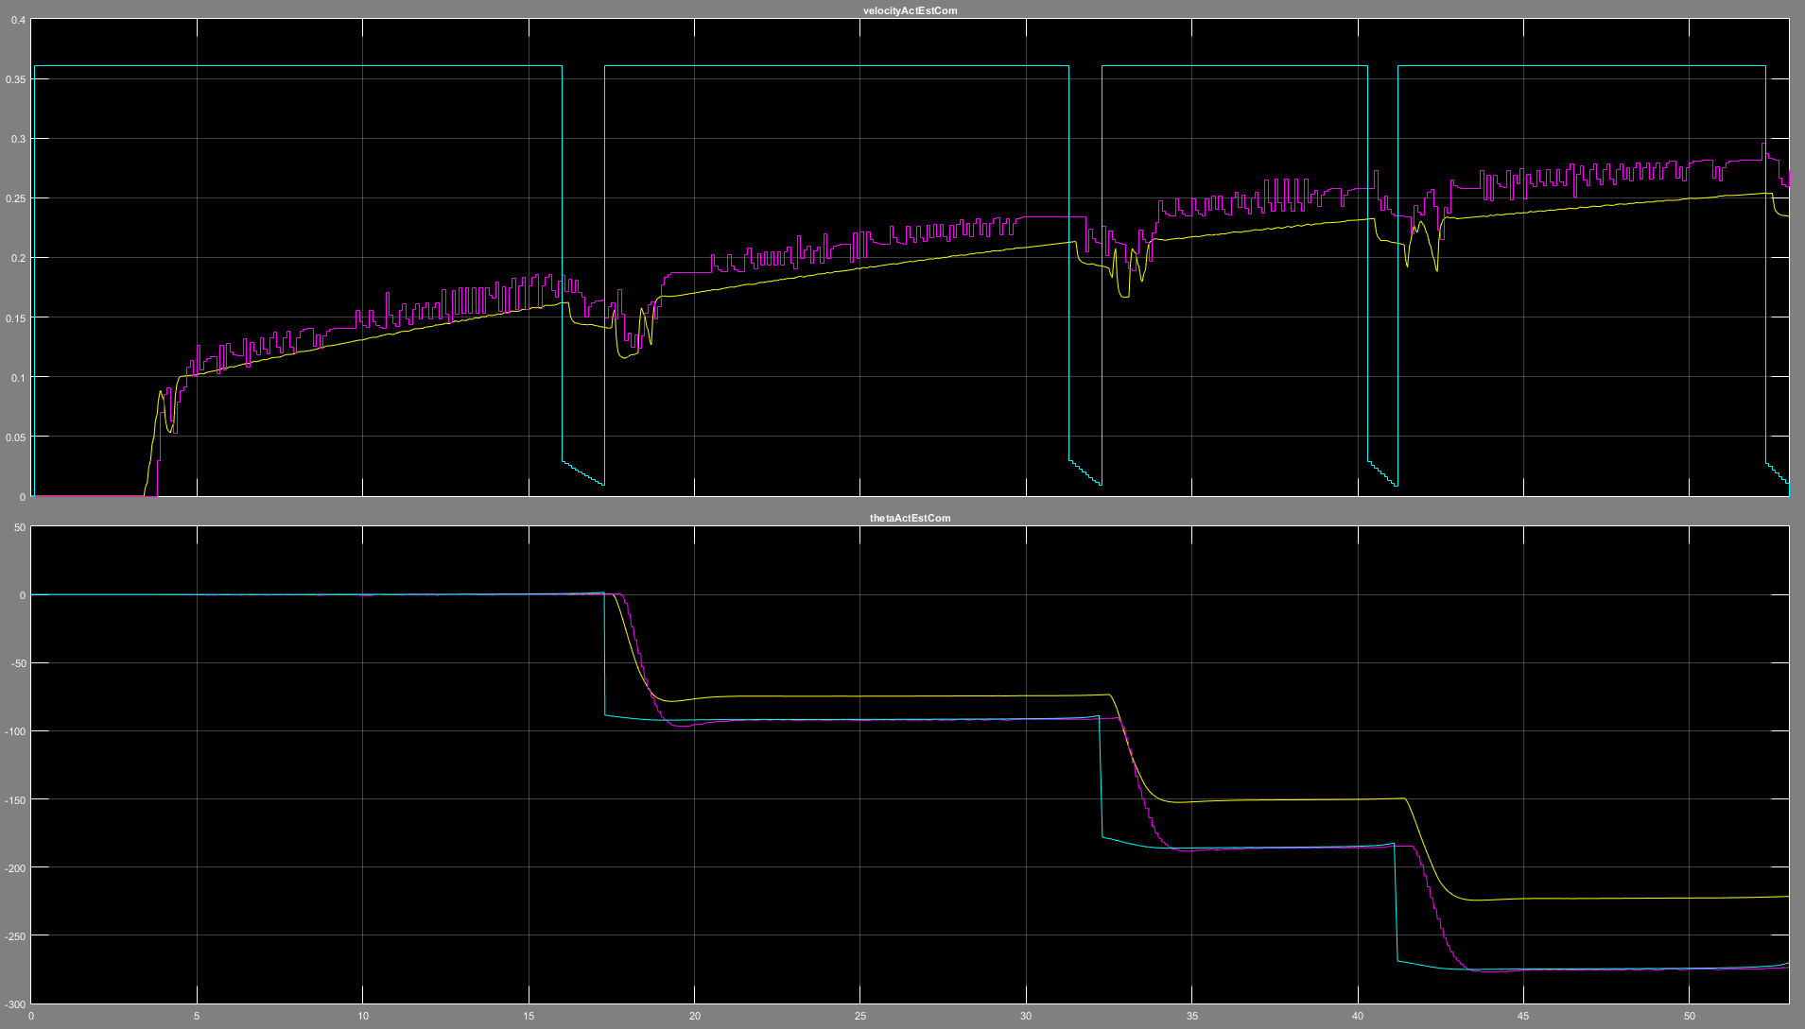
Speed and Angle (Actual vs Estimated)
Estimated speed
has an offset
Angle offset increases
after each turn

Slide 4
Model Parameters in Dead Reckoning
rNominalDR: [m] Nominal Wheel Radius
bDR: [m] Effective Platform Width
eTickDR: [ticks/m] number of ticks per 1 m
(dcArrayDR, wArrayDR):
Speed -> %Duty Cycle – Conversion
If these model parameters are not identified “correctly”, the dead reckoning will give wrong estimation

Slide 5
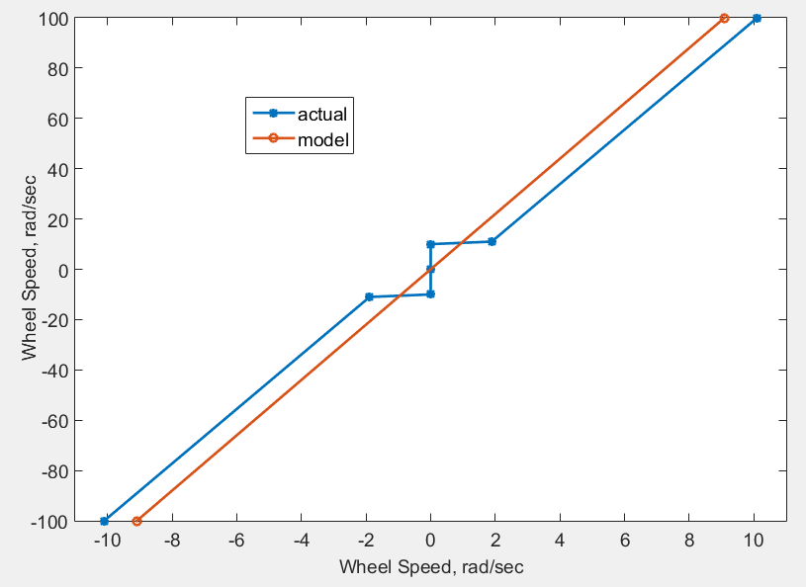
Error in Model Parameters
Parameter | Actual Value [Tank] | Model Value [GNC] | Percent Error
rNominal [m] | 0.0530 | 0.0530 | 0%
b [m] | 0.4074 | 0.3667 | -10%
eTick [ticks/m] | 237 | 213.3 | -10%
(dcArrayDR, wArrayDR)
Error in Path
Seemingly small differences in parameters
lead to large degradation in performance

Slide 6
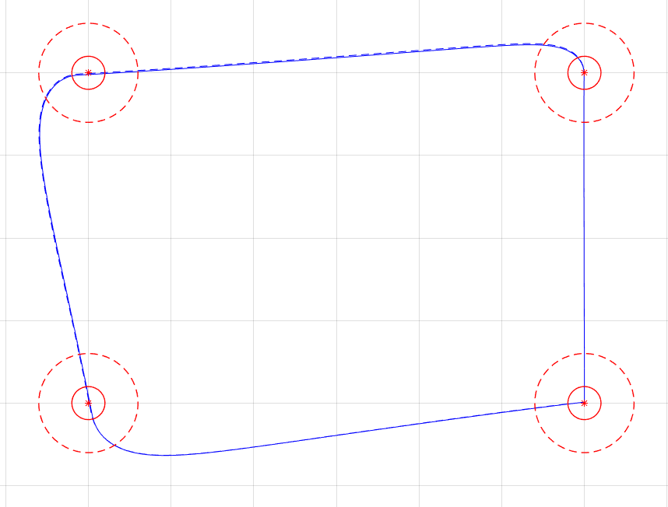
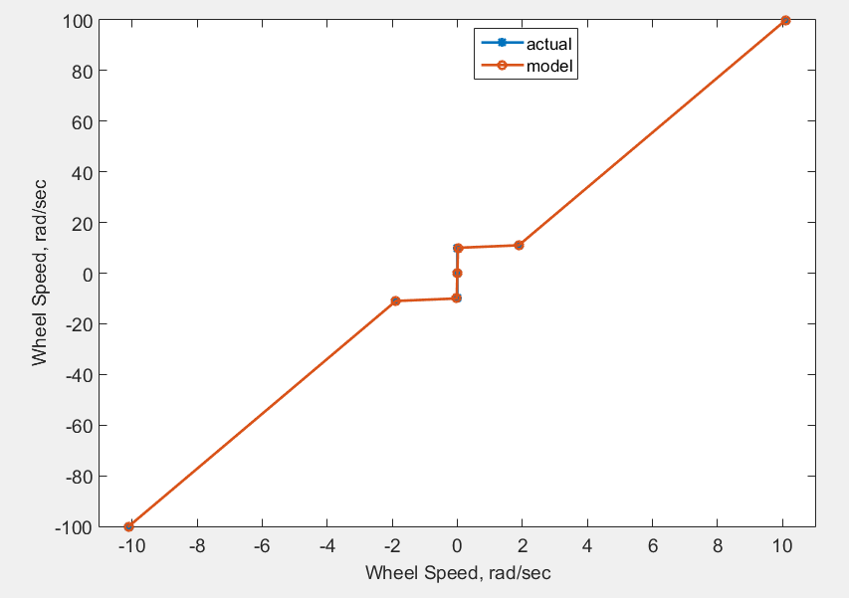
Good Parameter Identification => Good Performance
Parameter | Actual Value [Tank] | Model Value [GNC] | Percent Error
rNominal [m] | 0.0530 | 0.0530 | 0%
B [m] | 0.4074 | 0.4074 | 0%
eTick[ticks/m] | 237 | 237 | 0%
If parameters are identified correctly,
we will have a good performance
We should try to identify
these parameters

Slide 7
Imperfection in the UGV
We have seen that the vehicle (both Tank and Thumper) pulls slightly to the right or left, even when the same duty cycle is applied to both sides
This behavior is included in the tank (thumper) model as
rr = 1*rNominal; % Effective vehicle right wheel
rl = 0.99*rNominal; % Effective vehicle left wheel to represent inaccuracy in the vehicle
GNC still drives the vehicle on a straight line even with this problem,
**if ** this problem is observable in encoder counts

Slide 8
How to Identify the parameters
By experiment, since we have the vehicle
In this class, I will use tank model temp_vehicle.slx
Download “pp7_parameterEstimation4DR.zip” zip-file from blackboard
You will use the actual vehicle to carry out the experiments

Slide 9
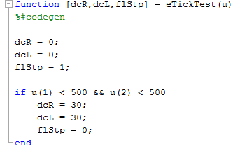
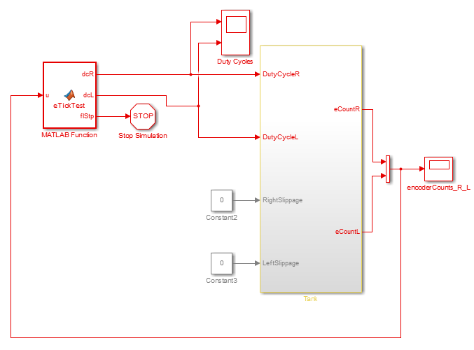
Determine eTick
Increments of encoder count per meter traveled
1) Apply constant %Duty Cycle
2) Stop the UGV when encoder
counts reaches a specified value

Slide 10
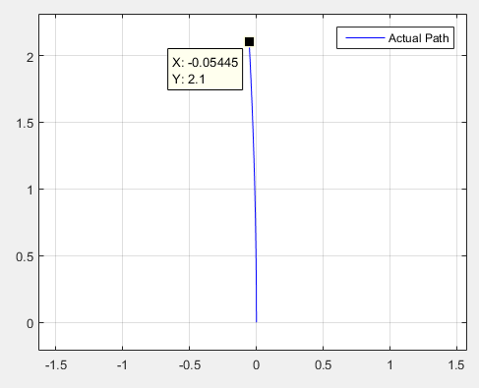
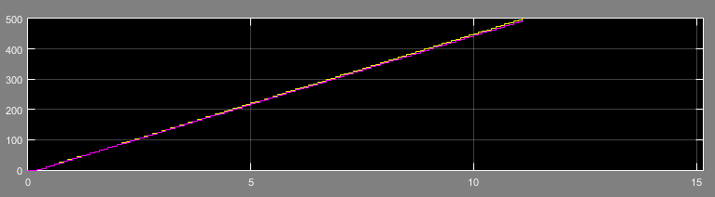
Determine eTick
Measure the distance
the UGV has travelled
Encoder counts
go to 500

Slide 11

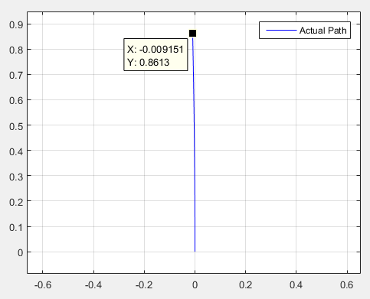
Determine eTick
Repeat the test with different %DC and different max value for encoder counts
Estimate is
Slightly different!

Slide 12
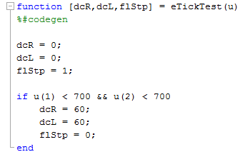
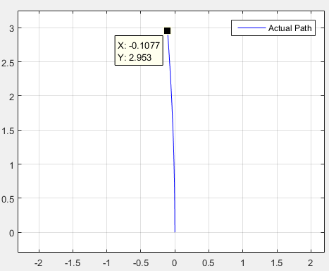
Determine eTick
Note
we ignore lateral move
Closer to the 1st estimate
Longer distance is better but you will need to deal with lateral offset

Slide 13
Determine b
If we can measure wheel speeds
and UGV angular speed,
then we can calculate b
Recall
Also recall
Increment in encoder
count in T seconds
Average wheel speed during
period of T seconds

Slide 14
Determine b
Change in UGV angle
in T seconds
Approximate as
Putting everything together
Given eTick, we can do
experiments to measure
eCount and theta

Slide 15
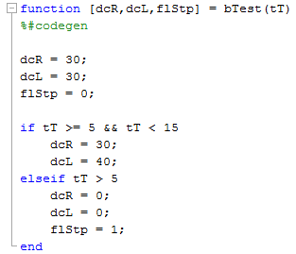
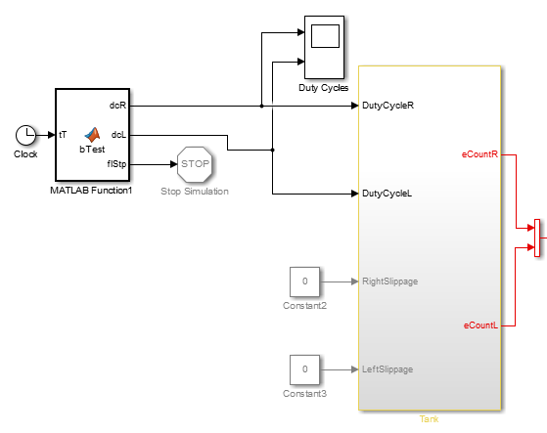
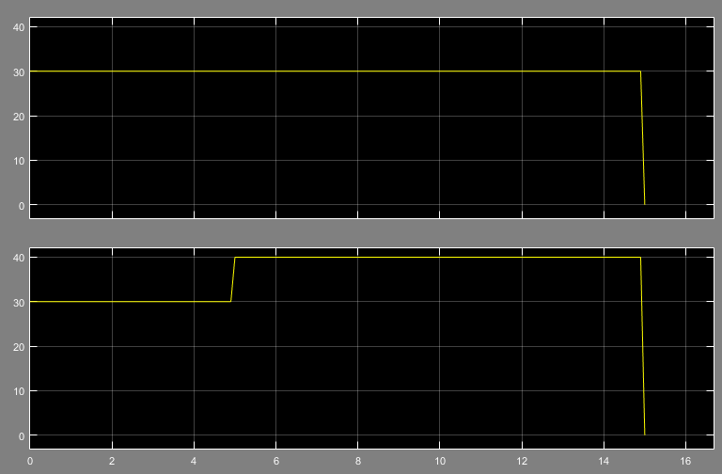
Determine b
Go straight for 5 sec &
make a turn for 10 sec

Slide 16
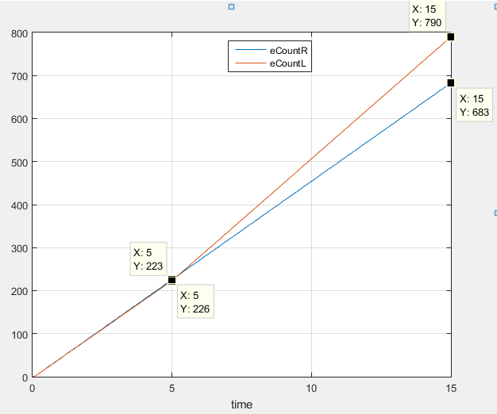
Determine b
Left Encoder Count changes 567 in 10 sec
Right Encoder Count changes 457 in 10 sec

Slide 17
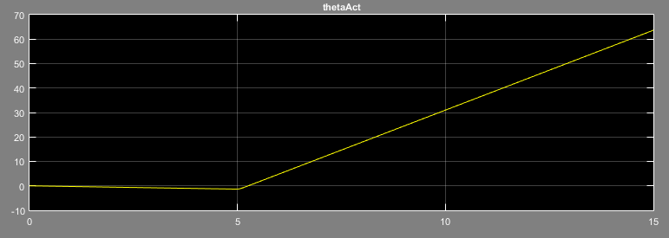
Determine b
63.65 deg at t = 15 sec
-1.34 deg at t = 5 sec
UGV has turned 65 deg in 10 sec
In your experiments,
you need to measure the angle of
the UGV at the end of the turn

Slide 18
Determine b
In the simulation, b is set to 0.4074 [m]
=> This method gives a close estimate
You should repeat the experiments with different %DC profiles
=> Every time, you should get similar (if not same) results

Slide 19
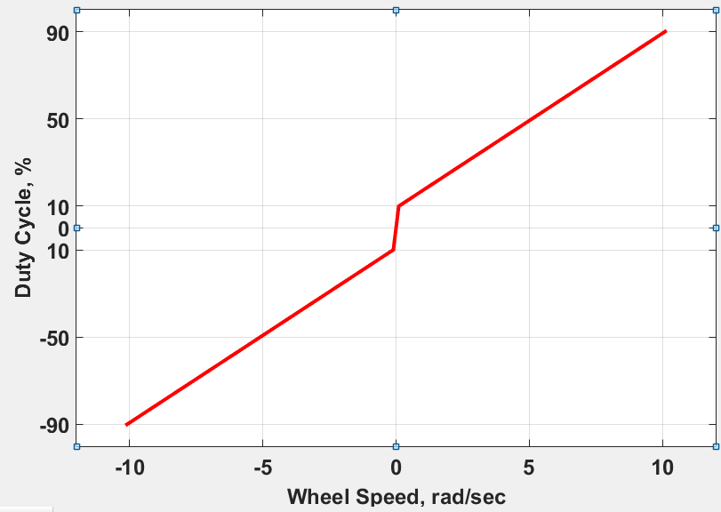
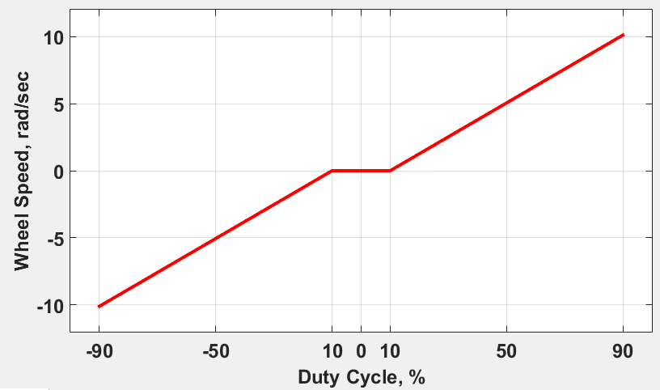
Determine (dcArrayDR, wArrayDR)
We need this:
controller computes wheel speed
=> lookUp table converts it to %DC
We will determine this:
Apply %DC and measure speed
=>
then take the inverse

Slide 20
Determine (dcArrayDR, wArrayDR)
%DC (percent Duty Cycle) dcArrayDR | Distance Travelled [m] | w (wheel speed) [rad/sec] wArrayDR
-100
…
0
…
80
90
100
We need
to fill
this table

Slide 21
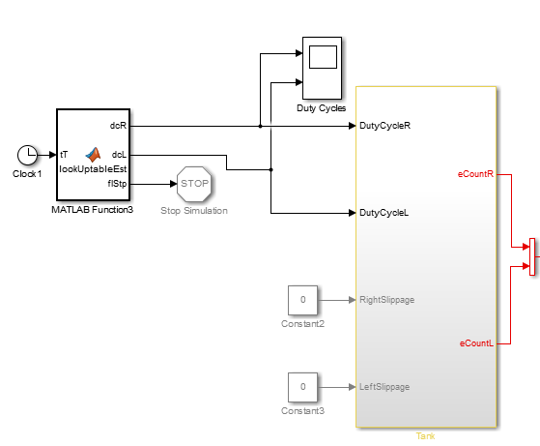
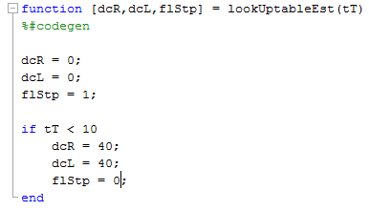
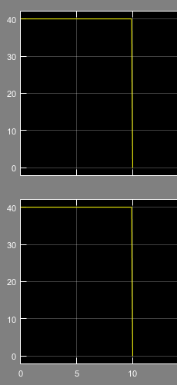
Determine (dcArrayDR, wArrayDR)
Apply constant %DC in a period of time
=> Measure distance travelled

Slide 22
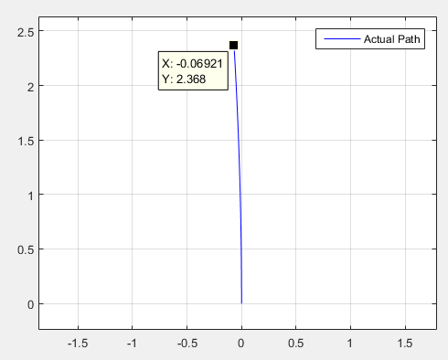
Determine (dcArrayDR, wArrayDR)
2.368 m travelled in 10 sec
when 40% DC is applied
%DC (percent Duty Cycle) dcArrayDR | Distance Travelled [m] | w (wheel speed) [rad/sec] wArrayDR
0
…
40 | 2.368 | 4.4714
…

Slide 23
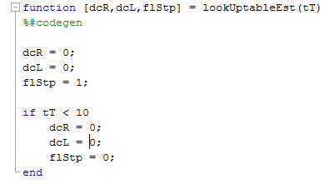
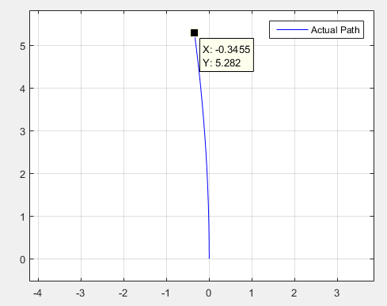
Determine (dcArrayDR, wArrayDR)
Change these numbers and repeat the experiment
%DC | period [s] | Distance Travelled [m] | angular speed [rad/s]
 | 10 |  | 0
 | 10 |  | 0
 | 10 |  | 0
-11 | 10 | -0.9899 | -1.86918
-10 | 10 | 0 | 0
0 | 10 | 0 | 0
5 | 10 | 0 | 0
10 | 10 | 0 | 0
11 | 10 | 0.9899 | 1.869182
15 | 10 | 1.1183 | 2.111634
25 | 10 | 1.667 | 3.147718
50 | 10 | 2.875 | 5.428728
70 | 10 | 3.839 | 7.249004
90 | 10 | 4.801 | 9.065504
100 | 10 | 5.282 | 9.973753
If you want to be
more accurate,
account for the
lateral offset

Slide 24
Determine (dcArrayDR, wArrayDR)
Assume we completed all the tests
%DC | period [s] | Distance Travelled [m] | angular speed [rad/s]
-100 | 10 | -5.282 | -9.97375
-90 | 10 | -4.801 | -9.0655
-70 | 10 | -3.839 | -7.249
-50 | 10 | -2.875 | -5.42873
-25 | 10 | -1.667 | -3.14772
-15 | 10 | -1.1183 | -2.11163
-11 | 10 | -0.9899 | -1.86918
-10 | 10 | 0 | 0
-5 | 10 | 0 | 0
0 | 10 | 0 | 0
5 | 10 | 0 | 0
10 | 10 | 0 | 0
11 | 10 | 0.9899 | 1.869182
15 | 10 | 1.1183 | 2.111634
25 | 10 | 1.667 | 3.147718
50 | 10 | 2.875 | 5.428728
70 | 10 | 3.839 | 7.249004
90 | 10 | 4.801 | 9.065504
100 | 10 | 5.282 | 9.973753
>> dcArrayDR =
[-100
-90
-70
-50
-25
-15
-11
-10
-5
0
5
10
11
15
25
50
70
90
100]
>> wArrayDR =
[ -9.9738
-9.0655
-7.2490
-5.4287
-3.1477
-2.1116
-1.8692
0
0
0
0
0
1.8692
2.1116
3.1477
5.4287
7.2490
9.0655
9.9738]
Define
lookUp
Variables
in Matlab

Slide 25
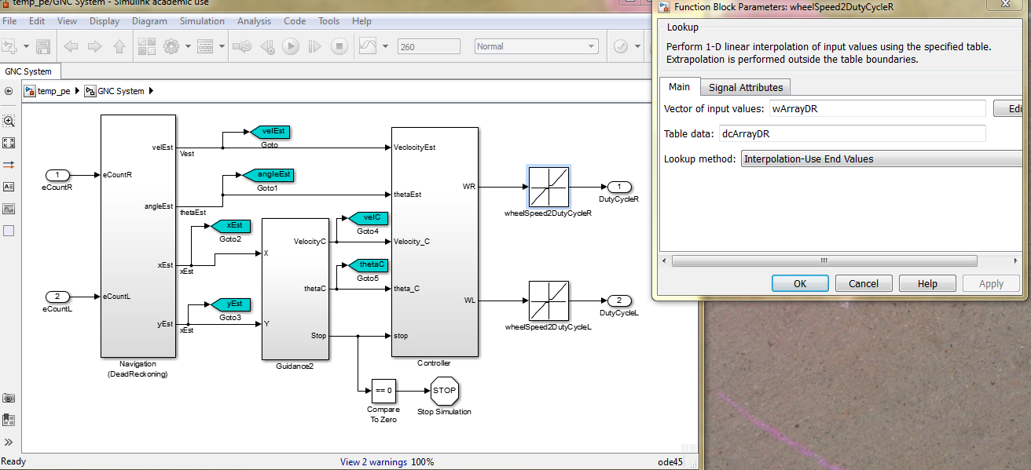
Determine (dcArrayDR, wArrayDR)
dcArrayDR, and wArrayDR
are used in lookUp table block
in GNC

Slide 26
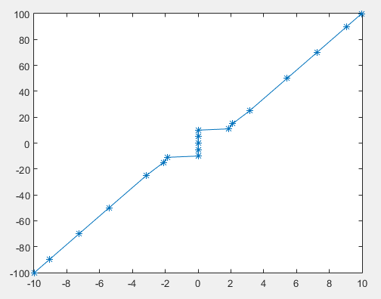
Determine (dcArrayDR, wArrayDR)
>> plot(wArrayDR,dcArrayDR,'-*')
Multiple values for
the same w (angular speed)
=>
LookUp table does not
accept such data
Need to approximate it
with a sharp slope

Slide 27
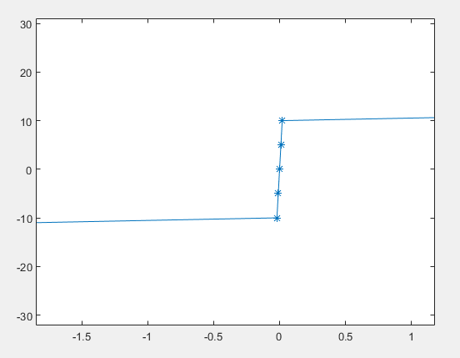
Determine (dcArrayDR, wArrayDR)
>> wArrayDR =
[ -9.9738
-9.0655
-7.2490
-5.4287
-3.1477
-2.1116
-1.8692
-0.02
-0.01
0
0.01
0.02
1.8692
2.1116
3.1477
5.4287
7.2490
9.0655
9.9738]
>> dcArrayDR =
[-100
-90
-70
-50
-25
-15
-11
-10
-5
0
5
10
11
15
25
50
70
90
100]

