Slide 1
Obstacle Mapping & Vision
Manfred Huber
Spring 2020

Slide 2
Guidance & Sensing
Previous classes and projects provided the robot with waypoint navigation, obstacle avoidance, and sensor fusion
Way points provided a priori
Reactive trajectory between the waypoints
Reactive obstacle avoidance
Path planning and trajectory tracking
We will now deal with making guidance more autonomous
Sensing for goal detection and obstacle mapping

Slide 3
Hardware Modifications
Guidance and Mapping will use both the sonar and a vision system
Sonar provides reliable obstacle presence
No good obstacle location information
Camera provides object identity and pose information
Goal identification and obstacle mapping
Mount details of camera are important
Visual range
Ambiguity

Slide 4
Obstacle Sensors
We have already used sonar sensors for obstacle avoidance
Sonars are good at
Determining the presence of an obstacle / object
Measuring the distance to this obstacle
They have problems with:
Identifying the object
Differentiating multiple objects
Sonars can be used for mapping
Limited by the size of the senor cone

Slide 5
Sonar-Based Mapping
We have to assume that everything visible by the sonar is an obstacle
Determining distance and shape of sonar cone potential obstacle bins can be identified

Slide 6
Sonar-Based Mapping
Sonars have disadvantages for mapping
Spatial resolution is limited by the width of the sonar cone
Sonar can be noisy due to environmental effects
Reflected signals are not received
Signals are only received after multiple reflections
We have to assume that everything visible by the sonar is an obstacle
Sonars are better for obstacle avoidance than for mapping
Vision or Laser rangers are preferred for mapping

Slide 7
Vision-Based Mapping
Single camera vision systems have different properties from sonar sensors
Vision sensors are good at
Identifying the identity of objects
Determining the shape, color, and other features of objects
Determining location in image coordinates
Single camera vision has in general problems with
Determining distance to objects
For mapping the mapping from image to space has to be addressed

Slide 8
Obstacle Location
To determine the location in the image we have to apply machine vision
Parts that belong to an object have to be identified
Parts of the same object have to be combined
Objects have to be separated from the background
Parts in contact with ground give location

Slide 9
Machine Vision and Obstacle Mapping
Once objects are extracted as color blobs, they can be mapped to obstacle locations:
Find parts that are in contact with the ground
Lowes pixels of an object are potentially on the ground
Represent the front of the object
For objects that are flat on ground, all of the blob gives size
Translate pixel location to location in space
Using the calibration of the camera pixel locations can be translated into floor locations
Map locations to obstacle cells
Starting from the bottom (closest objects) can help try to eliminate occluded obstacles

Slide 10
Single Camera Obstacle Mapping
Find obstacles locations in the image
Find obstacles
We are using color-based identification
Identify size and location of obstacle in image
Blob-coloring identifies bounding box an center
Translate image location to vehicle location
Camera calibration provides translation
Translation table is simples solution
Since all objects are on the ground, full size can be used
Translate vehicle location to obstacle grid location
Odometry is transform (rotation and translation)

Slide 11

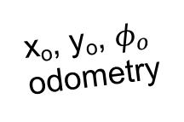
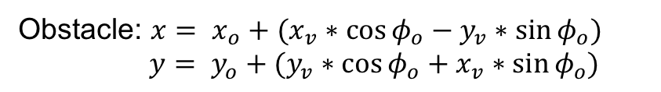
Mission Setup (Gazebo View)
x_{i}, y_{i}
Image
x_{v}, y_{v}
Vehicle
$$→$$
known obstacles
x_{o}, y_{o}, $φ_{o}$
odometry
x_{v}, y_{v}
Vehicle
*
Unknown (“dynamic”) obstacles
X
x, y
Obstacle
*
Start
Y
Obstacle: $x= x_{o}+(x_{v}∗\cos{φ_{o}−y_{v}∗\sin{φ_{o})}}$
$y= y_{o}+(y_{v}∗\cos{φ_{o}+x_{v}∗\sin{φ_{o})}}$

Slide 12
Next Tasks
Integrate Vision Component into Mapping
Use your vision system to determine locations of unknown obstacles
Add unknown obstacles to the map
Trigger recalculation of the path if needed
Use vision system to get you closer to the goal
Can improve path by localizing goals and obstacles
Known obstacles (blue), unknown obstacles (green), goal (yellow) have different color
Bonus: Include obstacle avoidance for cones
Use sonar but consider how to avoid without hitting other obstacles

Slide 13
Tentative Timeline
 | 4/13 | 4/20 | 4/27 | 5/04 | 5/15
Integration of Vision System
Camera mount and vision presentation
Autonomous mapping
Path planning
Path planning demonstration
Autonomous goal search and navigation demonstration
Final Report

