Slide 1
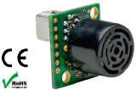
Obstacle Detection and Avoidance with Simulink using Sonar and LIDAR Sensor
Adapted from Atilla Dogan
XX {4,5}379 – Unmanned Vehicle System Development
Spring 2020

Slide 2
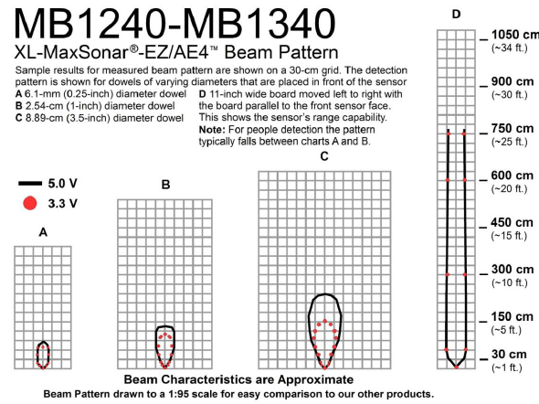
Sonar Range Sensor
Range
detection
varies with
factors
such as
size,
shape,
etc of
the obstacle

Slide 3
Sonar Sensor Model in Simulink
The first step for developing obstacle avoidance algorithm is to have a sensor model in simulation
A simple sonar sensor model is developed for Simulink
Sensor coverage is assumed to be rectangular and parameterized
Obstacles are assumed circular (or square)
Sensor model gives a range data when the obstacle is within sensor coverage

Slide 4
Sensing Model
a_{s}
r_{s} is the range
measurement
received from
the sensor
model
b_{s}
r_{s}
h_{s}

Slide 5
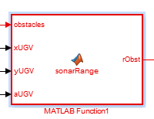
Simulink Block
A simulink block is developed representing sonar sensor
position in xy-frame
& radius of multiple
obstacles
Range to
the nearest
obstacle
UGV position
in xy-frame & angle

Slide 6
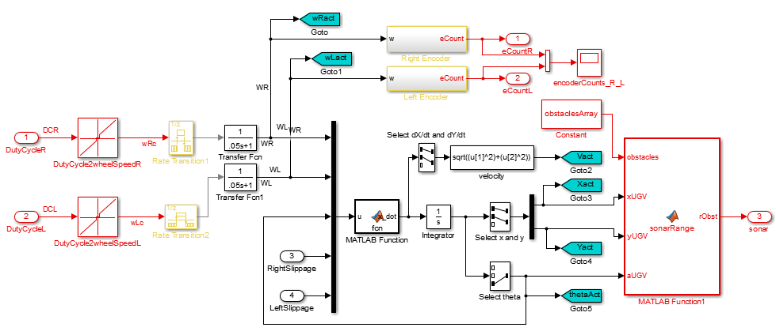
Sonar Block Implementation
Encoders in UGV
Sonar Sensor in UGV (tank) model

Slide 7
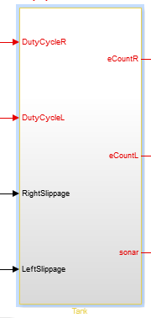
New Tank (Thumper) Model
Outputs:
Before:
Right & Left Encoder Counts
Now:
One more output =
range to closest obstacle
if within range

Slide 8
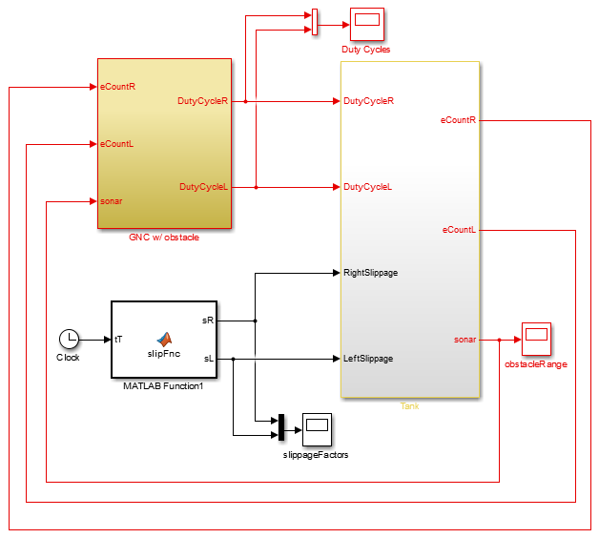
GNC takes SonarRange Measurement
Additional
input to
GNC:
to be used
for obstacle
avoidance

Slide 9
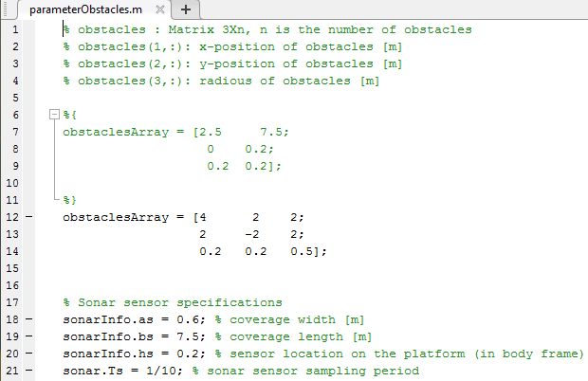
Parameter File for Obstacles & Sonar Sensor
3rd obstacle
You can add more
2nd obstacle
1st obstacle
x-coordinate
y-coordinate
radius
Sonar sensor parameters

Slide 10
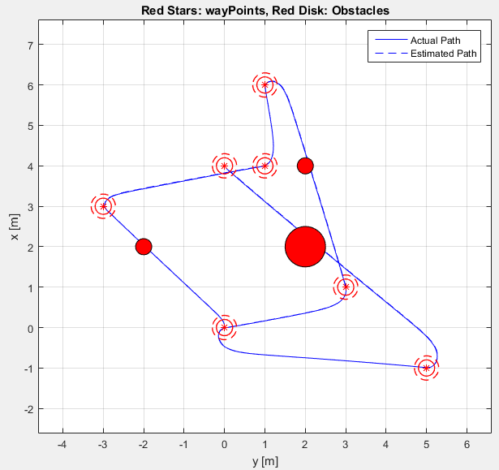
Three obstacles

Slide 11
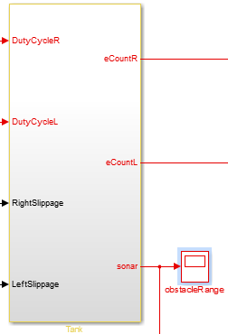
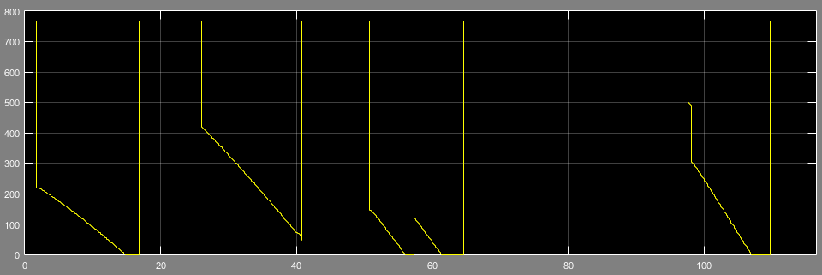
Example: Output of Sensor Model
767: no detection
Distance to
obstacle in cm

Slide 12
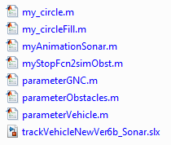
MATLAB/Simulink Files Provided
You will be given a folder
Animation runs after sim
plotting after sim
GNC parameter file
Obstacle/SonarSensor parameter file
Vehicle parameter file
Main Simulink Model
Tank subsystem w/ sonar model
GNC subsystem for
wayPoint navigation
(no obstacle avoidance capability)

Slide 13
Run Simulation
Download “pp11_simModelObst2students.zip” zip-file from blackboard
Run simulation in folder
To demonstrate the details of the simulink model, sonar sensor output and the animation

Slide 14
Your Assignment - Simulation
Add additional logic to GNC to avoid obstacles and still go through wayPoints
based on obstacle range measurements from sonar model

Slide 15
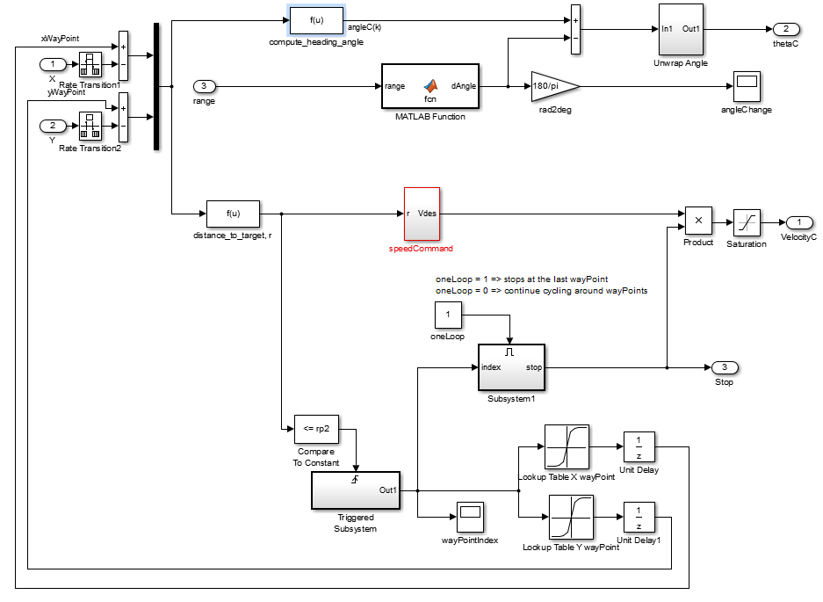
Modified GNC - Example
I have modified the current Guidance Subsystem to add obstacle avoidance capability
Commanded Angle is computed
based on SonarRange as well as
heading towards the wayPoint

Slide 16
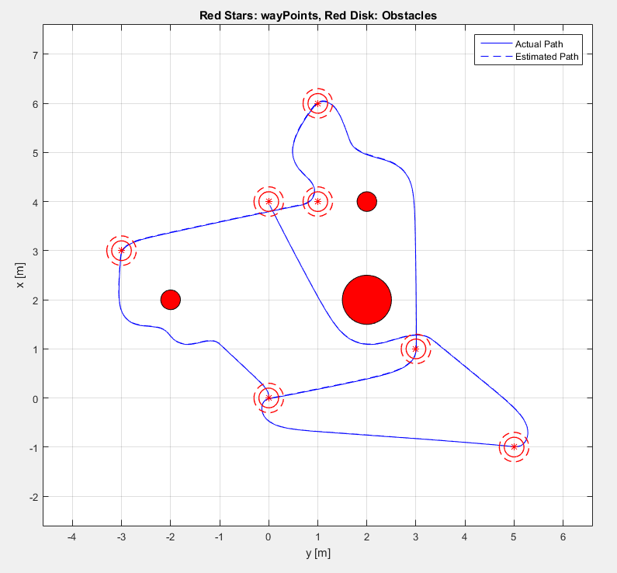
Modified GNC - Example
Three obstacles
are avoided nicely

Slide 17
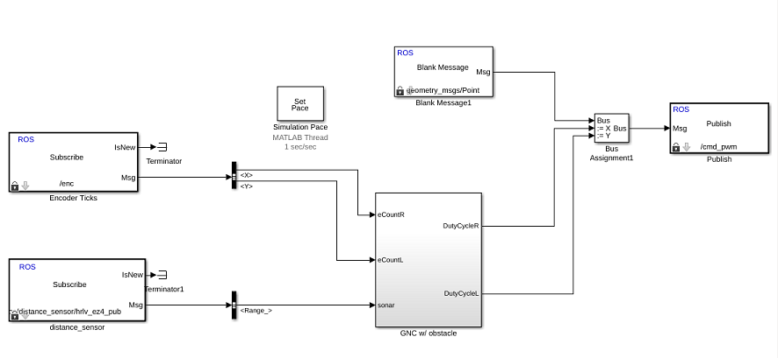
Steps for Assignment
Develop Simulink Block to read sonar range measurement into your Simulink model.
Connect GNC subsystem with teensy sensor and motor blocks

