Slide 1
GNC Implementation in NUC for wayPoint Navigation
Adapted fromAtilla Dogan
XX {4,5}379 – Unmanned Vehicle System Development
Spring 2020

Slide 2
Simulation Model
Download “simModelUGV_ClosedLoop.zip” from blackboard
Simulink Model: trackVehicleNewVer6b_Encoders_DR_GNC.slx

Slide 3
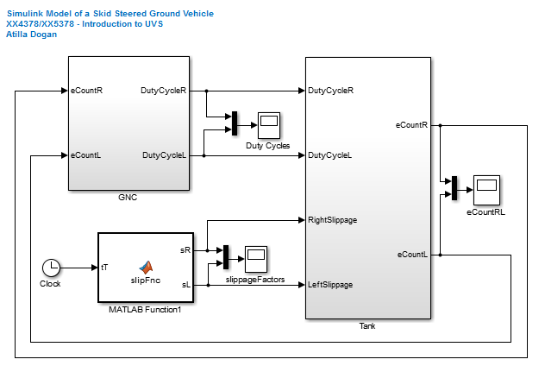
Simulation Model
For controlling the actual UGV,
we only need GNC
We will have the actual vehicle
instead of this block

Slide 4
Simulink Model for NUC
Need to build a new simulink model
“GNC” block
for Guidance, navigation, and Control
“Set Pace” block
to ensure simulink model runs at the speed of real time
ROS Encoder position Subscriber block
to read in encoder counts coming from the Teensyboard
ROS Motor Velocity Publisher block
to send out %duty cycle commands to the electric motors through the Teensyboard

Slide 5
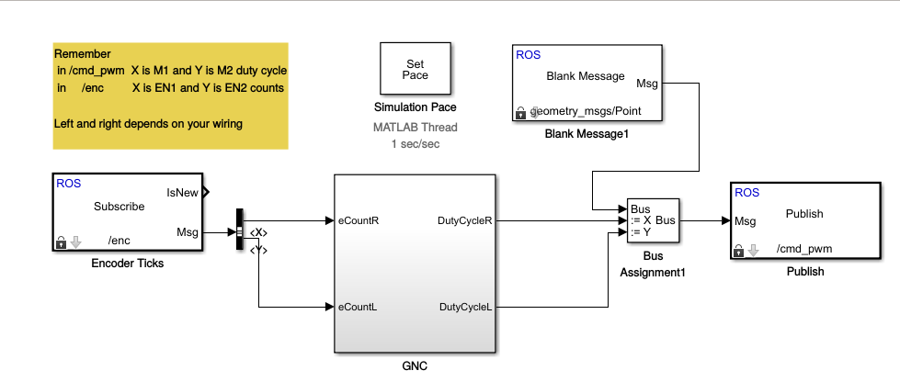
Simulink Model for NUC
When this simulink model is run in NUC,
which is connected to the teensy on the UGV,
UGV should be steered through the waypoints specified

