Slide 1
Autonomous Robots
Manipulator Kinematics
Inverse Kinematics

Slide 2
Inverse Kinematics of Manipulators
Forward kinematics is the function that determines the endpoint location given the joint parameters
The forward kinematics is usually computed one of two ways
Using Trigonometry
Using Linear Algebra
Inverse kinematics determines the joint parameters needed to have the endpoint in a particular location
Inverse kinematics is more complicated than forward kinematics
In general it is not a function since multiple sets of joint angles can yield the same endpoint location

Slide 3
Inverse Kinematics of Manipulators
To compute the inverse kinematics we are usually given either the location or the location and orientation of the toolframe in the world
If we are only provided a location there are an infinite number of solutions for any point in the dextrous workspace of the manipulator
Solving in this situation is difficult and usually a random orientation is chosen in order to make the solution simpler.
As with the forward kinematics there are two basic methods to solve the inverse kinematics
Using Algebra
Using Trigonometry

Slide 4

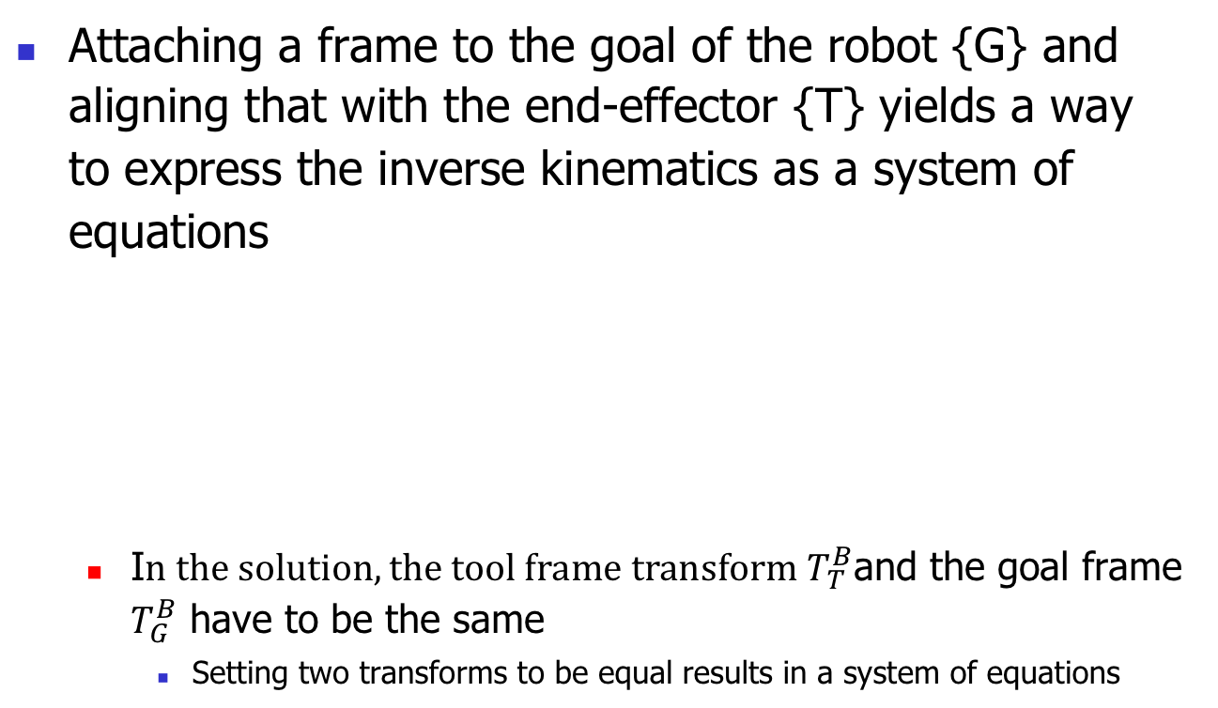




Algebraic Solution
Attaching a frame to the goal of the robot {G} and aligning that with the end-effector {T} yields a way to express the inverse kinematics as a system of equations
I$n the solution, the tool frame transform T_{T}^{B}$and the goal frame $T_{G}^{B}$ have to be the same
Setting two transforms to be equal results in a system of equations
$$θ_{2}$$
$$l_{1}$$
{G}
{B}
$$θ_{1}$$
$$l_{2}$$
{T}
$$\left(\begin{matrix}x \\ y\end{matrix}\right)$$

Slide 5




Algebraic Solution
$T_{G}^{B}=\left(\begin{matrix}\cos\left(φ\right) & −sin\left(φ\right) & x \\ \sin\left(φ\right) & \cos\left(φ\right) & y \\ 0 & 0 & 1\end{matrix}\right)$
$T_{T}^{B}=\left(\begin{matrix}\cos\left(θ_{1}+θ_{2}\right) & −sin\left(θ_{1}+θ_{2}\right) & l_{1}\cos{θ_{1}+l_{2}\cos\left(θ_{1}+θ_{2}\right)} \\ \sin\left(θ_{1}+θ_{2}\right) & \cos\left(θ_{1}+θ_{2}\right) & l_{1}\sin{θ_{1}+l_{2}\sin\left(θ_{1}+θ_{2}\right)} \\ 0 & 0 & 1\end{matrix}\right)$
$$θ_{2}$$
$$l_{1}$$
{G}
{B}
$$θ_{1}$$
$$l_{2}$$
{T}

Slide 6
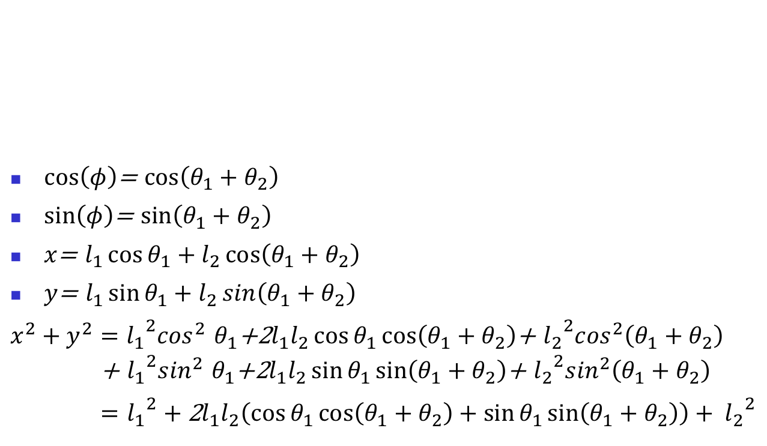
Algebraic Solution
$\cos\left(φ\right)$= $\cos\left(θ_{1}+θ_{2}\right)$
$\sin\left(φ\right)$= $\sin\left(θ_{1}+θ_{2}\right)$
$x$= $l_{1}\cos{θ_{1}+l_{2}\cos\left(θ_{1}+θ_{2}\right)}$
$y$= $l_{1}\sin{θ_{1}+l_{2}\sin\left(θ_{1}+θ_{2}\right)}$
$x^{2}+y^{2}={l_{1}}^{2}\cos^{2}$ $θ_{1}$+2$l_{1}l_{2}\cos{θ_{1}\cos\left(θ_{1}+θ_{2}\right)}$+ ${l_{2}}^{2}\cos^{2}\left(θ_{1}+θ_{2}\right)$ + ${l_{1}}^{2}\sin^{2}$ $θ_{1}$+2$l_{1}l_{2}\sin{θ_{1}\sin\left(θ_{1}+θ_{2}\right)}$+ ${l_{2}}^{2}\sin^{2}\left(θ_{1}+θ_{2}\right)$
$=$ ${l_{1}}^{2}+\text{2}l_{1}l_{2}\left(\cos{θ_{1}\cos\left(θ_{1}+θ_{2}\right)}+\sin{θ_{1}\sin\left(θ_{1}+θ_{2}\right)}\right)+ {l_{2}}^{2}$
$$θ_{2}$$
$$l_{1}$$
{G}
{B}
$$θ_{1}$$
$$l_{2}$$
{T}

Slide 7
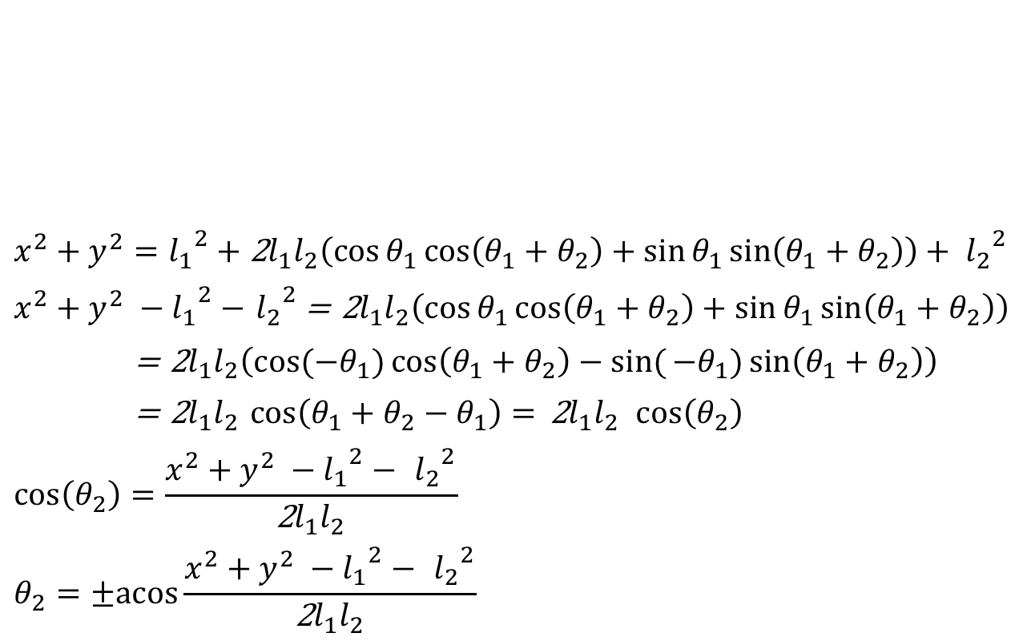
Algebraic Solution
$$x^{2}+y^{2}={l_{1}}^{2}+\text{2}l_{1}l_{2}\left(\cos{θ_{1}\cos\left(θ_{1}+θ_{2}\right)}+\sin{θ_{1}\sin\left(θ_{1}+θ_{2}\right)}\right)+ {l_{2}}^{2}$$
$x^{2}+y^{2} −{l_{1}}^{2}−$ ${l_{2}}^{2}$= $\text{2}l_{1}l_{2}\left(\cos{θ_{1}\cos\left(θ_{1}+θ_{2}\right)}+\sin{θ_{1}\sin\left(θ_{1}+θ_{2}\right)}\right)$
= $\text{2}l_{1}l_{2}\left(\cos{(−θ_{1})\cos\left(θ_{1}+θ_{2}\right)}−sin({{−θ}_{1})\sin\left(θ_{1}+θ_{2}\right)}\right)$
= $\text{2}l_{1}l_{2}$ $\cos\left(θ_{1}+θ_{2}−θ_{1}\right)= \text{2}l_{1}l_{2} \cos\left(θ_{2}\right)$
$$\cos\left(θ_{2}\right)=\frac{x^{2}+y^{2} −{l_{1}}^{2}− {l_{2}}^{2}}{\text{2}l_{1}l_{2}}$$
$$θ_{2}=±acos\frac{x^{2}+y^{2} −{l_{1}}^{2}− {l_{2}}^{2}}{\text{2}l_{1}l_{2}}⁡$$
$$θ_{2}$$
$$l_{1}$$
{G}
{B}
$$θ_{1}$$
$$l_{2}$$
{T}

Slide 8
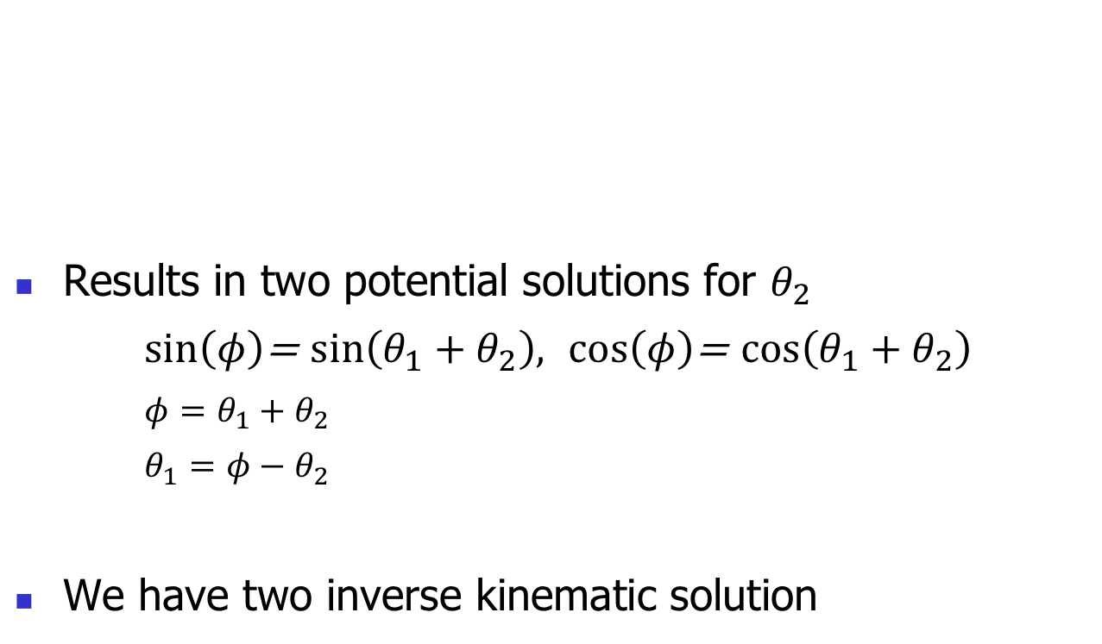
Algebraic Solution
Results in two potential solutions for $θ_{2}$
$\sin\left(φ\right)$= $\sin\left(θ_{1}+θ_{2}\right),$ $\cos\left(φ\right)$= $\cos\left(θ_{1}+θ_{2}\right)$
$φ=θ_{1}+θ_{2}$
$θ_{1}=φ−θ_{2}$
We have two inverse kinematic solution
$$θ_{2}$$
$$l_{1}$$
{G}
{B}
$$θ_{1}$$
$$l_{2}$$
{T}

Slide 9
Trigonometric Solution
For complex robot manipulators, the solution of the system of equations becomes very complex
If the robot is designed carefully the Trigonometric solution can be simpler
Often the manipulator can be reduced to a simpler version, solver for that, and then expanded again to give the full solution
$$θ_{2}$$
$$l_{1}$$
{G}
{B}
$$θ_{1}$$
$$l_{2}$$
{T}

Slide 10








Trigonometric Solution
To solve the end-effector inverse kinematics trigonometrically we need to find triangles in the robot structure
Law of cosine:
$$θ_{2}$$
$$l_{1}$$
$${θ′}_{}$$
$$θ^{′}=π+θ_{2}$$
$$θ_{1}$$
$$l_{2}$$
$$\left(\begin{matrix}x \\ y\end{matrix}\right)$$
$$\sqrt{x^{2}+y^{2}}$$
$x^{2}+y^{2}={l_{1}}^{2}+$ ${l_{2}}^{2}−2l_{1}$ $l_{2}\cos{θ^{′}}$
$={l_{1}}^{2}+$ ${l_{2}}^{2}−2l_{1}$ $l_{2}\cos{(π+θ_{2})}$
$={l_{1}}^{2}+$ ${l_{2}}^{2}+2l_{1}$ $l_{2}\cos{θ_{2}}$
$\cos{θ_{2}}=\frac{x^{2}+y^{2}−{l_{1}}^{2}−{l_{2}}^{2}}{2l_{1} l_{2}}$ →${ θ}_{2}=±acos\frac{x^{2}+y^{2}−{l_{1}}^{2}−{l_{2}}^{2}}{2l_{1} l_{2}}$

Slide 11


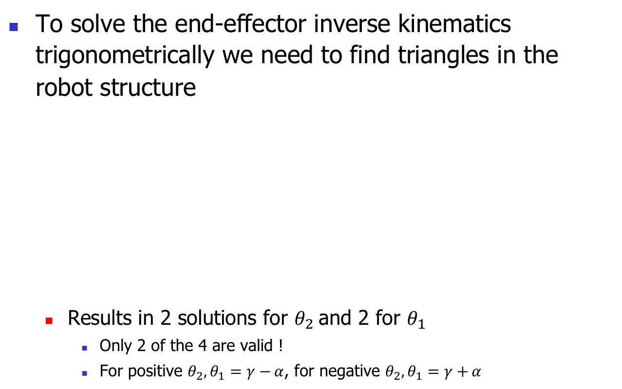






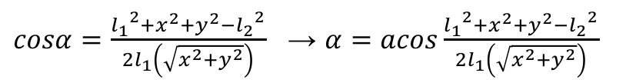
Trigonometric Solution
To solve the end-effector inverse kinematics trigonometrically we need to find triangles in the robot structure
Results in 2 solutions for $θ_{2}$and 2 for $θ_{1}$
Only 2 of the 4 are valid !
For positive $θ_{2},θ_{1}=γ−{α}$, for negative $θ_{2},θ_{1}=γ+{α}$
$$θ_{2}$$
$tanγ=\frac{y}{x}$ → $γ=atan\frac{y}{x}$
$$l_{1}$$
$$α$$
$$θ_{1}$$
$$l_{2}$$
$$γ$$
$$\left(\begin{matrix}x \\ y\end{matrix}\right)$$
$$\sqrt{x^{2}+y^{2}}$$
$$θ_{1}=γ±{α}$$
${l_{2}}^{2}={l_{1}}^{2}+x^{2}+y^{2}$ $−2l_{1}\left(\sqrt{x^{2}+y^{2}}\right)$ $\cos{α}$
$cosα=\frac{{l_{1}}^{2}+x^{2}+y^{2}−{l_{2}}^{2}}{2l_{1}\left(\sqrt{x^{2}+y^{2}}\right)}$ → $α=acos\frac{{l_{1}}^{2}+x^{2}+y^{2}−{l_{2}}^{2}}{2l_{1}\left(\sqrt{x^{2}+y^{2}}\right)}$

Slide 12


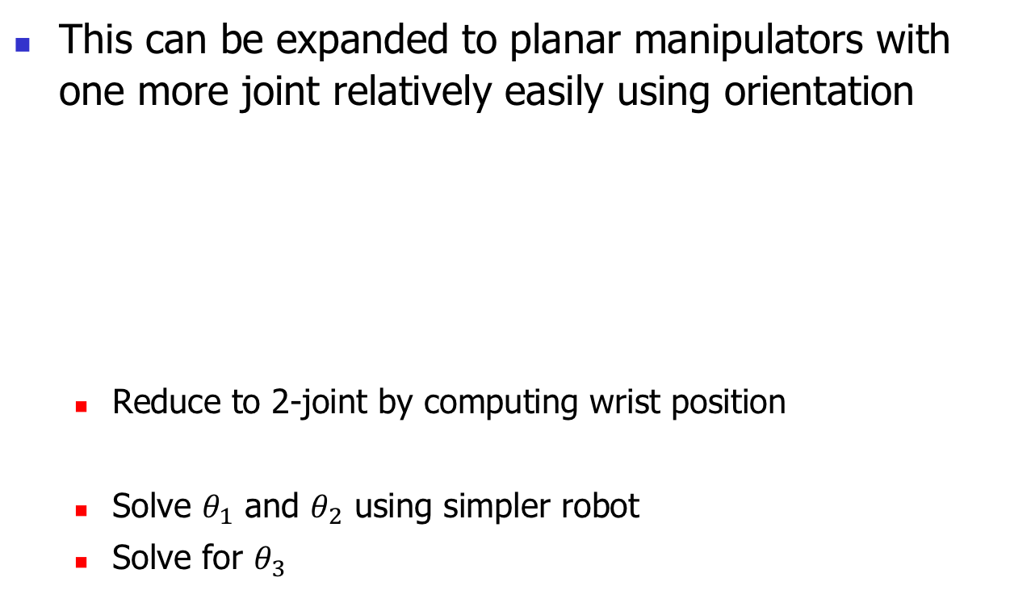






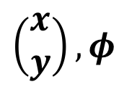

Trigonometric Solution
This can be expanded to planar manipulators with one more joint relatively easily using orientation
Reduce to 2-joint by computing wrist position
Solve $θ_{1}$ and $θ_{2}$ using simpler robot
Solve for $θ_{3}$
$$θ_{2}$$
$$\left(\begin{matrix}x \\ y\end{matrix}\right), φ$$
$$l_{1}$$
$$θ_{1}$$
$$l_{2}$$
$$l_{3}$$
$$\left(\begin{matrix}x′ \\ y′\end{matrix}\right)$$
$$θ_{3}$$
x’$=x−l_{3}\cos\left(φ\right) ,\text{y}\text{’}=y−l_{3}\sin\left(φ\right)$
$φ=θ_{1}+θ_{2}+θ_{3}$ → $θ_{3}=φ{−θ}_{1}−θ_{2}$

Slide 13


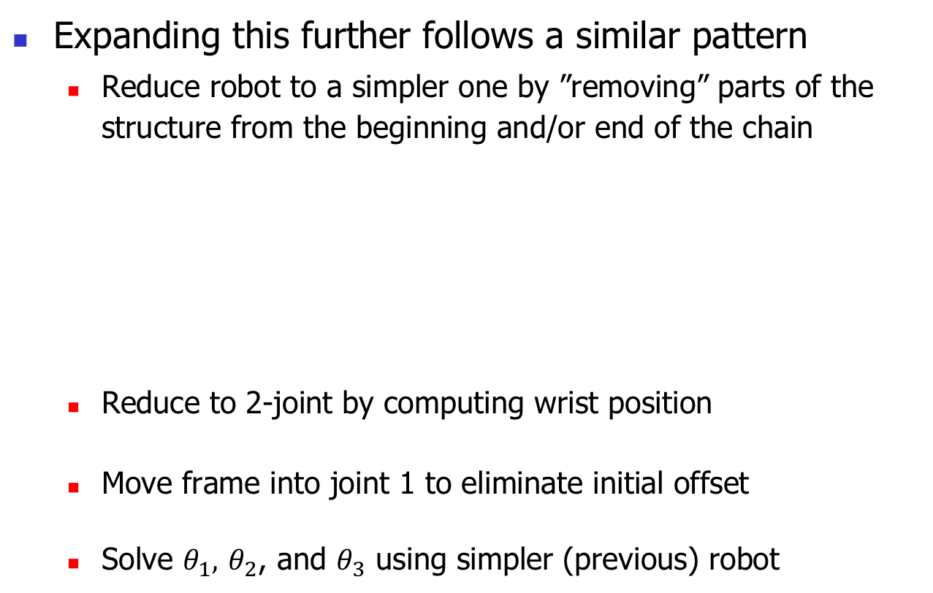






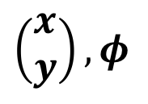

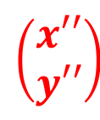
Trigonometric Solution
Expanding this further follows a similar pattern
Reduce robot to a simpler one by ”removing” parts of the structure from the beginning and/or end of the chain
Reduce to 2-joint by computing wrist position
Move frame into joint 1 to eliminate initial offset
Solve $θ_{1},$ $θ_{2}$, and $θ_{3}$ using simpler (previous) robot
$$θ_{2}$$
$$\left(\begin{matrix}x \\ y\end{matrix}\right), φ$$
$$l_{1}$$
$$θ_{1}$$
$$l_{2}$$
$$l_{3}$$
$$\left(\begin{matrix}x′′ \\ y′′\end{matrix}\right)$$
$$\left(\begin{matrix}x′ \\ y′\end{matrix}\right)$$
$$θ_{3}$$
$$l_{0}$$
x’$=x−l_{3}\cos\left(φ\right) ,\text{y}\text{’}=y−l_{3}\sin\left(φ\right)$
x’’$=x′ ,\text{y}’\text{’}=y′−l_{0}$

Slide 14

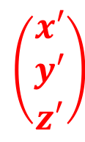











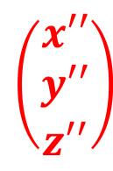



Trigonometric Solution
In 3 dimensions we have to look at multiple views
Reduce by computing wrist position
Solve for $θ_{0}$ in the top view
Move base frame to joint 1, with the x-axis aligned with link
$$θ_{2}$$
$$\left(\begin{matrix}x \\ y \\ z\end{matrix}\right), R$$
$$l_{1}$$
$$θ_{0}$$
$$\left(\begin{matrix}x′ \\ y′ \\ z′\end{matrix}\right)$$
$$\left(\begin{matrix}x′ \\ y′ \\ z′\end{matrix}\right)$$
$$l_{2}$$
$$l_{3}$$
$$θ_{1}$$
$$\left(\begin{matrix}x′′ \\ y′′ \\ z′′\end{matrix}\right)$$
$$θ_{3}$$
$$l_{0}$$
$$\left(\begin{matrix}x \\ y \\ z\end{matrix}\right), R$$
$$\left(\begin{matrix}x′′ \\ y′′ \\ z′′\end{matrix}\right)$$
$$\left(\begin{matrix}x′ \\ y′ \\ z′\end{matrix}\right)=\left(\begin{matrix}x \\ y \\ z\end{matrix}\right)−l_{3}\hat{X_{T}}$$
$tanθ_{0}=\frac{y′}{x′}$ → $θ_{0}=atan\frac{y′}{x′}$
$$\left(\begin{matrix}x′′ \\ y′′ \\ z′′\end{matrix}\right)=\left(\begin{matrix}\sqrt{{x′}^{2}+{y′}^{2}} \\ 0 \\ z^{′}−l_{0}\end{matrix}\right)$$

Slide 15
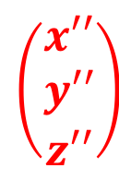


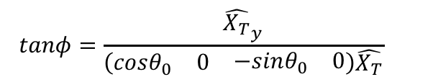
Trigonometric Solution
This reduces it to our previous, planar robot and we can solve for $θ_{1},$ $θ_{2}$as previously
To solve for $θ_{3}$we have to compute the orientation of the tool frame in the rotated frame
$$θ_{2}$$
$$\left(\begin{matrix}x \\ y \\ z\end{matrix}\right), R$$
$$l_{1}$$
$$θ_{0}$$
$$\left(\begin{matrix}x′ \\ y′ \\ z′\end{matrix}\right)$$
$$\left(\begin{matrix}x′ \\ y′ \\ z′\end{matrix}\right)$$
$$l_{2}$$
$$l_{3}$$
$$θ_{1}$$
$$\left(\begin{matrix}x′′ \\ y′′ \\ z′′\end{matrix}\right)$$
$$θ_{3}$$
$$l_{0}$$
$$\left(\begin{matrix}x′′ \\ y′′ \\ z′′\end{matrix}\right)$$
$$\left(\begin{matrix}x \\ y \\ z\end{matrix}\right), R$$
$$tanφ=\frac{{\hat{X_{T}}}_{y}}{\left(\begin{matrix}cosθ_{0} & 0 & \begin{matrix}−sinθ_{0} & 0\end{matrix}\end{matrix}\right)\hat{X_{T}}}$$
$$θ_{3}=φ{−θ}_{1}−θ_{2}$$

Slide 16
Trigonometric Solution
This can be further expanded to 6 Degrees of Freedom by adding two additional degrees of freedom with axes that intersect the wrist
This forms a 3-DOF wrist
Having all 3 axes intersect in the wrist means that after computing the wrist location, all 3 joints can be ignored as they do not move the wrist
The other 3 axes can be solved in exactly the same way presented previously
The 3 wrist joints achieve the final orientation of the wrist frame and can be computed using the toolframe orientation

Slide 17
Iterative Approximation
If the joints are arranged differently, the solution becomes harder
If the robot is redundant (i.e. has more than 6 Degrees of Freedom), there are an infinite number of solutions
We can select one to have a specific value and hope that for that configuration there is a solution
Iterative approximation of the Inverse Kinematics can be used to address this more generally,
Iteratively move the toolframe closer to the goal frame until it is close enough

Slide 18
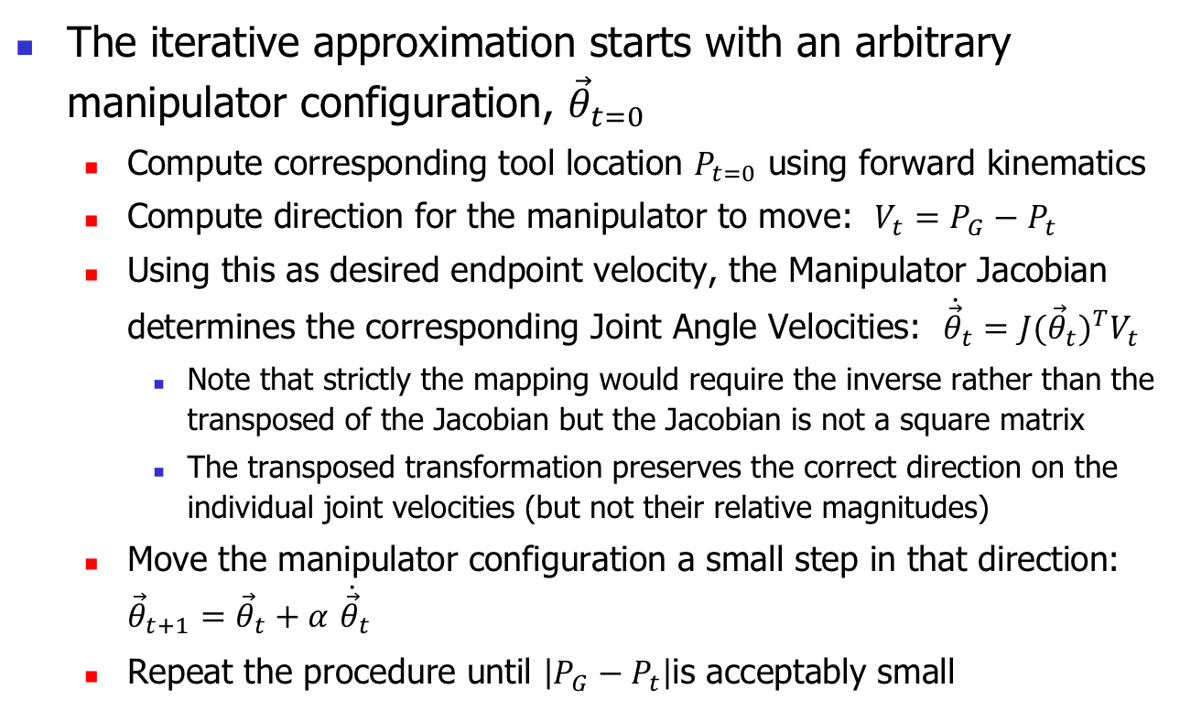
Iterative Approximation
The iterative approximation starts with an arbitrary manipulator configuration, ${\vec{θ}}_{t=0}$
Compute corresponding tool location $P_{t=0}$ using forward kinematics
Compute direction for the manipulator to move: $V_{t}=P_{G}−P_{t}$
Using this as desired endpoint velocity, the Manipulator Jacobian determines the corresponding Joint Angle Velocities: ${\dot{\vec{θ}}}_{t}={J({\vec{θ}}_{t})}^{T}V_{t}$
Note that strictly the mapping would require the inverse rather than the transposed of the Jacobian but the Jacobian is not a square matrix
The transposed transformation preserves the correct direction on the individual joint velocities (but not their relative magnitudes)
Move the manipulator configuration a small step in that direction: ${\vec{θ}}_{t+1}={\vec{θ}}_{t}+α$ ${\dot{\vec{θ}}}_{t}$
Repeat the procedure until $\left|P_{G}−P_{t}\right|$is acceptably small

Slide 19
Iterative Approximation
The iterative approximation is always applicable and only requires knowledge of the Forward Kinematics and the Jacobian
Can be used with manipulators with arbitrary numbers of Degrees of Freedom
The iterative approximation also has a few drawbacks
It does not yield a precise solution
It takes significant amounts of time and processing power
A closed-form solution is preferable when it can be computed

Slide 20
Inverse Kinematics
The inverse kinematics of a manipulator computes one or multiple configurations for the manipulator to successfully reach a specific goal location and orientation
The inverse kinematics is generally not a function and thus much harder to compute than the forward kinematics
Multiple ways exist to compute the inverse kinematics
Using Algebra
Solve a system of non-linear equations – can be come very difficult
Using Trigonometry
Depending on the manipulator design this allows to reduce the manipulator to a simpler one and build on its solution
Many real-world robots are built to facilitate this (e.g. using 3-DOF wrists)
Iterative approximation using the manipulator Jacobian
Can be applied to any kinematic chain and only requires forward kinematics and Jacobian. But does not provide exact solution and takes significant processing

