Slide 1
Connection between ROS & Simulink
Spring 2019
Dr. Ameya R. Godbole, MAE Dept.

Slide 2
Getting Started with ROS in Simulink Tutorial from Mathworks:
https://www.mathworks.com/help/robotics/examples/get-started-with-ros-in-simulink.html
Simulink Robotics System Toolbox provides ROS Simulink integration.
We are able to
create Publisher Block to send messages to ROS environment.
create Subscriber Block to get messages from specific ROS topics.
Important Notice: In order to establish communication between ROS and Simulink,
we need to use specific message types which is used by ROS.
There are a lot of different message types that are supported in ROS.

Slide 3
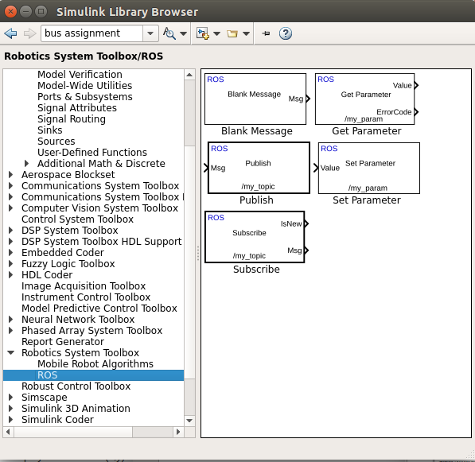
Connecting to ROS from Simulink
We will use Robotics System Toolbox - ROS blocks to read
encoder counts and control
motor speed through ROS.
Simulink ROS Toolbox

Slide 4
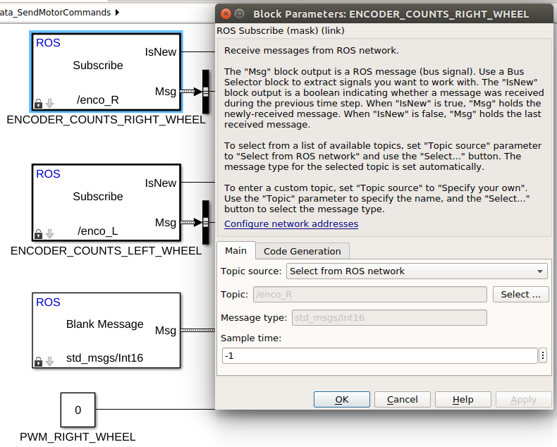
Connecting to ROS from Simulink
Creating Subscriber Block
We will use ROS Subscribe blocks to read encoder counts

Slide 5
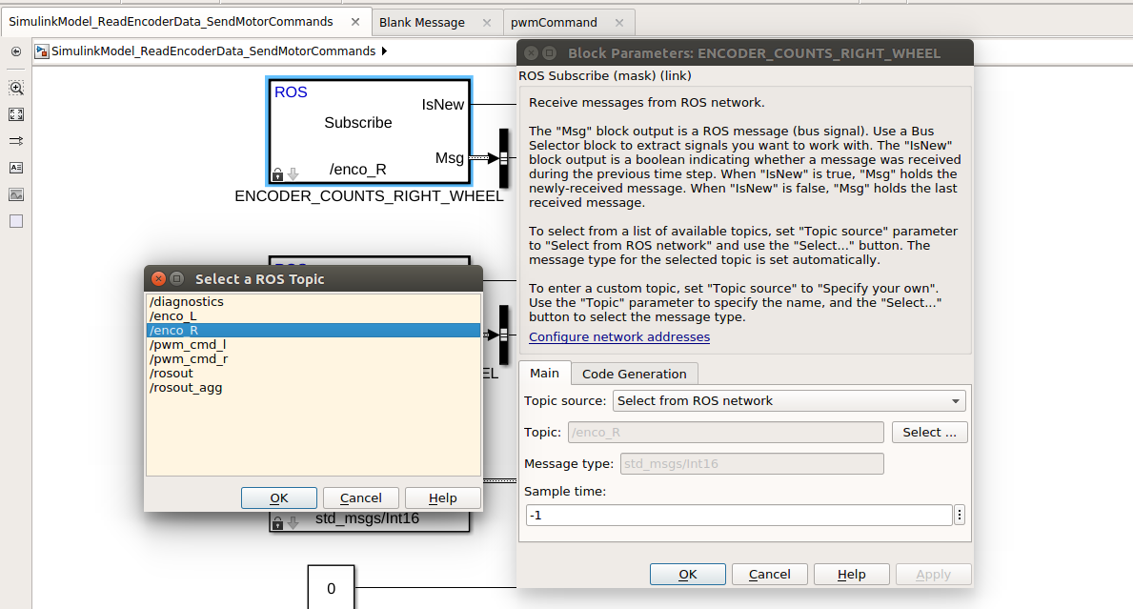
Connecting to ROS from Simulink
Creating Subscriber Block
If any topics are published,
you will see them here.
It will be /enco_R for the Right encoder ticks and /enco_L for the Left encoder ticks
Select topics from ROS Networks

Slide 6
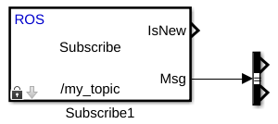
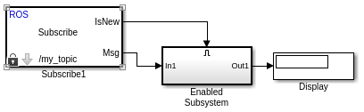
Connecting to ROS from Simulink
Creating Subscriber Block
To receive messages from ROS environment, make sure there are available topics
that is published in ROS.
IsNew output port of Subscriber block is used
to update information, according to whether
message is received from previous time step or
just now, indicating as a boolean value. (T - F)
Using Enabled Subsystem, we can update
system output only when there is a new coming data published from ROS.

Slide 7
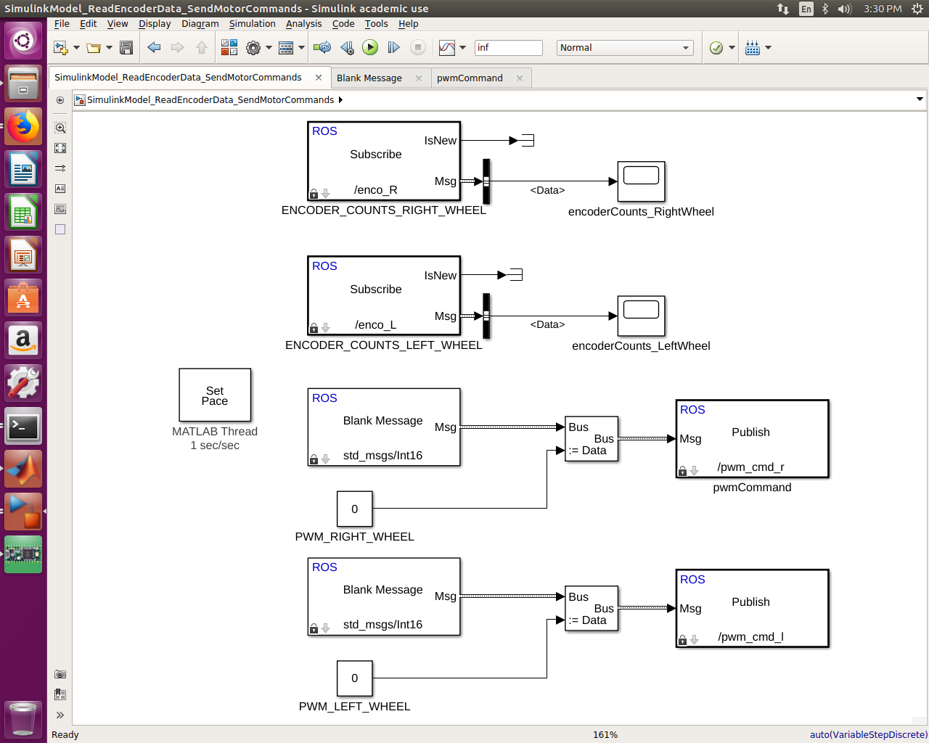
Connecting to ROS from Simulink
Creating Subscriber Block
Use Bus Selector block to reach messages published by previously selected topic.
Now, you can use the output as Encoder Count
in your model.

Slide 8
Connecting to ROS from Simulink
Creating Publisher Block
To publish data from Simulink to ROS, we need to create specific message types
according to ROS requirements. After creating Blank Message block, we can modify
message information by using Bus Assignment block. Finally, created message will
be published under specified Topic name in ROS.

Slide 9
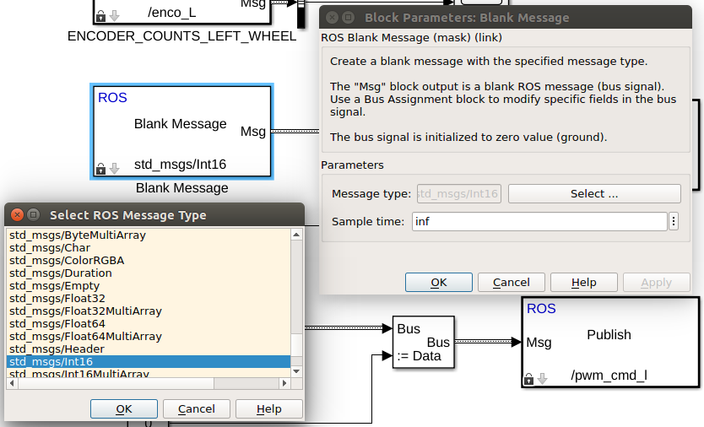
Connecting to ROS from Simulink
Creating Publisher Block
From wide range of standard ROS message types, you can select convenient one for your device or purpose. We are using std_msgs/Int16 message type to publish the PWM commands. Messages may carry more than multiple data sets. In order to publish data through them, we need to locate and relate them with Simulink blocks. For this reason, we will use Bus Assignment block.

Slide 10
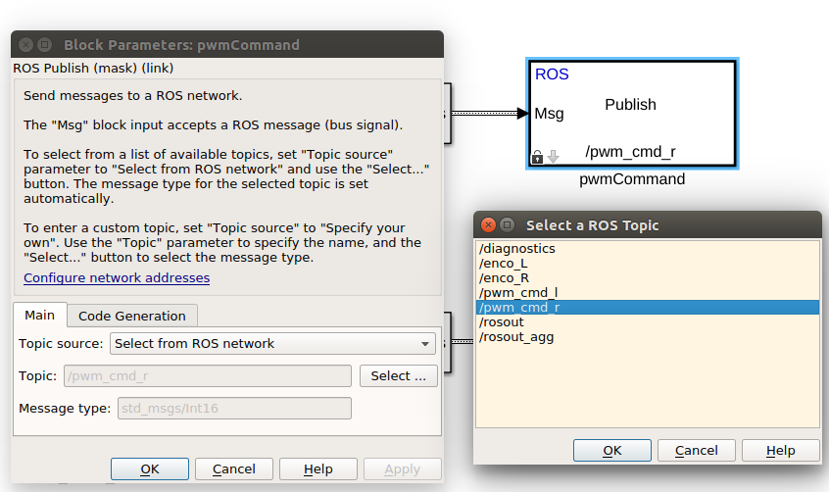
Connecting to ROS from Simulink
Creating Publisher Block
After assigning bus signals to created message, we will connect it to Publisher Block.
At this point, we can either publish this message under a user defined topic or publish it
under already existing topic name on ROS.

Slide 11
Example Simulink Model
Download the Simulink Model “SimulinkModel_ReadEncoderData_SendMotorCommands.slx” from the blackboard

Slide 12
Example Simulink Model
Encoder position:
To read left and right encoder
counts into Simulink model
You should be able to run your vehicle with this Simulink model and show encoder counts incrementing
This is your assignment this week
To Simulate Real-Time
Motor PWM for left and right motors

